Slide 1
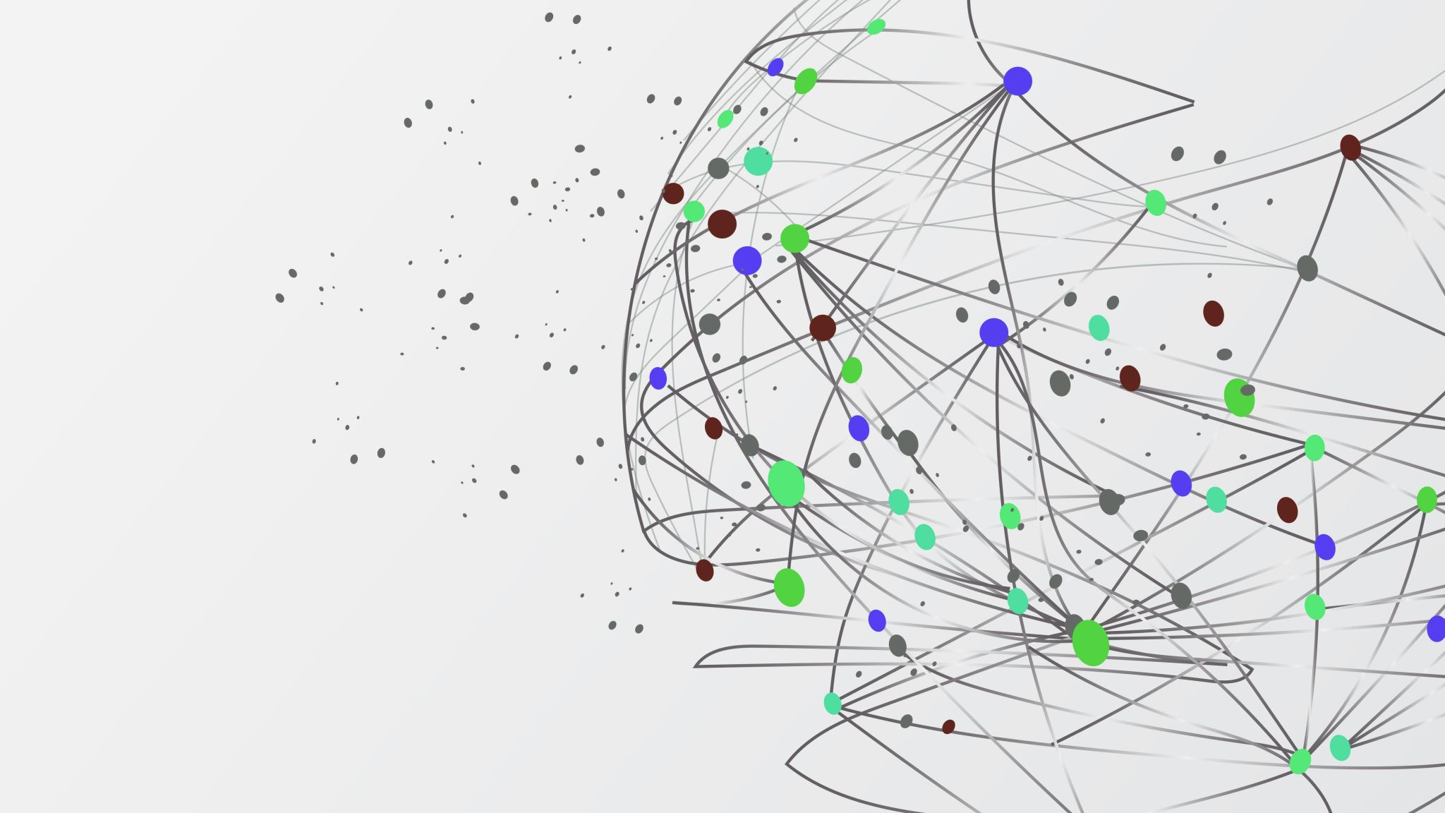
Programming for Artificial Intelligence
Instructor: Ms. Salma Asif
salma.asif@case.edu.pk

Slide 2
General Rules & Regulations
No Late Arrivals.
No disturbance in Class
No use of Mobile Phones(Keep them Silent and in your pockets)
No Retake of Quizzes/Assignments
No late submissions
Student is responsible for his/her short attendance.

Slide 3
Course Plagiarism Policy
Plagiarism in any kind of assessment including project or mid/ final exam, assignments quizzes, will result in F grade in the course.
So, what is it?
Plagiarism is presenting someone else's work or ideas as your
own, with or without their consent, by incorporating it into your
work without full acknowledgement. All published and unpublished material, whether in manuscript, printed or electronic form, is covered under this definition.

Slide 4

Google Classroom
Class: Programming for AI
Joining Code: jikjnvet
Email: salma.asif@case.edu.pk
Office: GF2C3

Slide 5
Days | 8:00 AM 09:30 AM | 9:30 AM 11:00 AM | 11:00 AM 12:30 PM | 12:30 PM 14:00 PM | 14:00 PM 15:30 PM
Monday
Tuesday |  | PAI |  |  | Office Hours
Wednesday | AI |  |  | Office Hours
Thursday
Friday | PAI |  | Office Hours

Slide 6
Reference Books
Textbook:
STARTING OUT WITH PYTHON 4th Edition by Tony Gaddis
Python for Everybody by Dr. Charles R. Severance
Python for Data Analysis: Data Wrangling with Pandas, NumPy, and Ipython
by Wes McKinney

Slide 7
Tentative Grading Policy
Quizzes 10%
Assignments 10%
Midterm 25%
Lab 20%
Final Exam 35%
Relative Grading

Slide 8
Outline
Introduction to AI and Programming
Variables, datatypes, expressions
Decision Structures
Repetition Structures
Functions and modules
Lists and Tuples
Strings
Dictionaries and sets

Slide 9
Outline
Classes and Object Oriented Programming (OOP)
Four Pillars of OOP
Recursion
NumPy
Pandas
Data Visualization
Data Preprocessing

Slide 10
Lecture # 1 Introduction to AI and Programming
Notes:
What

Slide 11
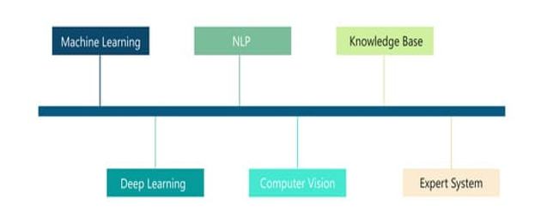
What is AI
Enable machines to mimic human intelligence
The Theory and development of computer systems able to perform task normally requiring human intelligence, such as visual perceptions, speech recognitions, decision-making, and translation between the languages.
Notes:
Visual perception → recognizing objects in images or videos (e.g., face detection in cameras).
Speech recognition → understanding spoken language (e.g., Siri, Alexa).
Decision-making → choosing the best action (e.g., self-driving cars avoiding accidents).
Language translation → converting one language to another (e.g., Google Translate).

Slide 12
Introduction to Artificial Intelligence
AI systems that improve their performance through experience and data analysis.
AI systems that can analyze and interpret visual information from the world.
AI that can understand, interpret, and generate human language.
AI-powered machines that can perform physical tasks and interact with the environment.

Slide 13
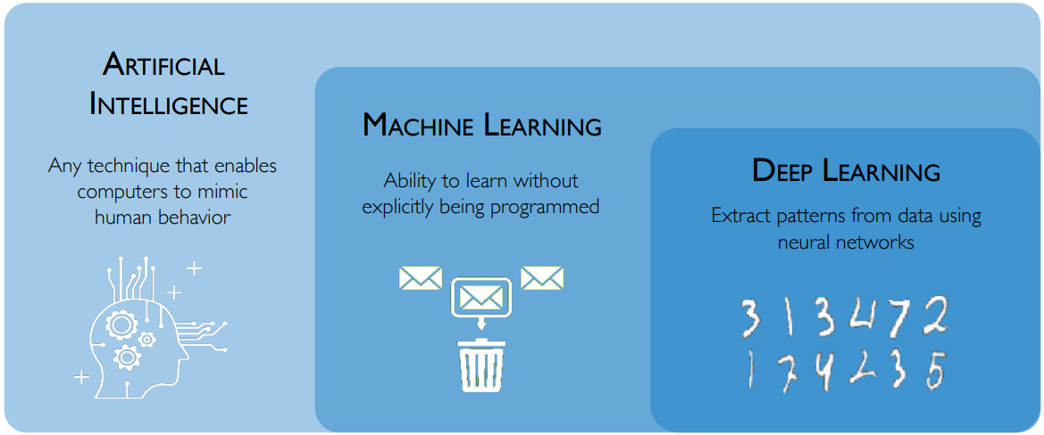
Artificial Intelligence subfields

Slide 14
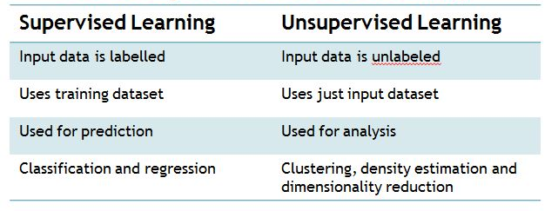
Supervised Vs Un-Supervised Learning
https://www.devopsschool.com/blog/what-is-the-difference-between-supervised-and-unsupervised-deep-learning/

Slide 15
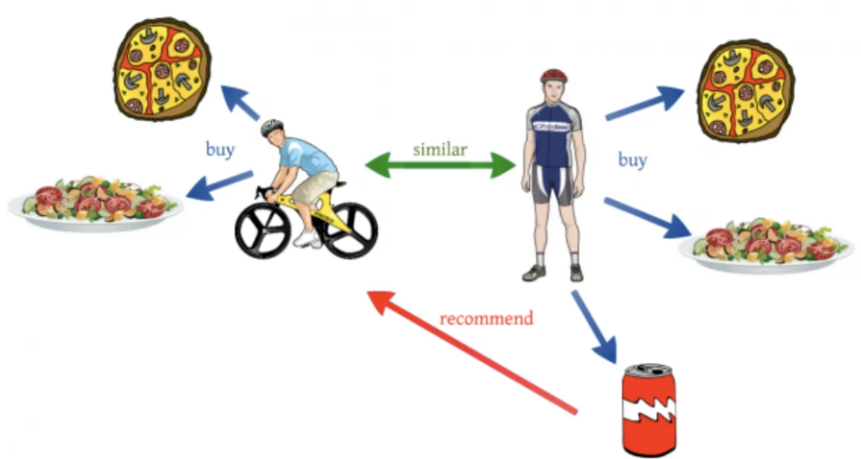
E-commerce Product Recommendation System
Build a recommendation system to suggest products to users based on their browsing and purchasing history.
https://towardsdatascience.com/recommendation-system-series-part-1-an-executive-guide-to-building-recommendation-system-608f83e2630a

Slide 16

Healthcare Diagnosis and Treatment Recommendation
Predict medical conditions based on patient symptoms and recommend appropriate treatment plans.
https://news.mit.edu/2022/deep-learning-technique-predicts-clinical-treatment-outcomes-0224

Slide 17
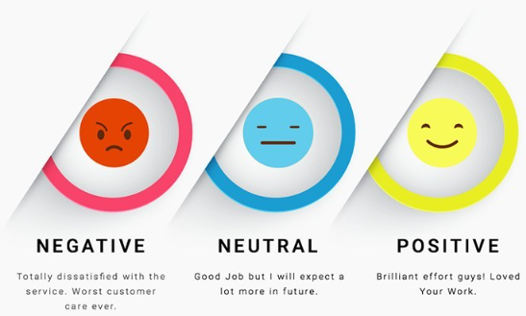
Sentiment Analysis and Customer Engagement
Analyze customer sentiment from product reviews and improve customer engagement strategies.
https://www.revechat.com/blog/customer-sentiment-analysis/

Slide 18
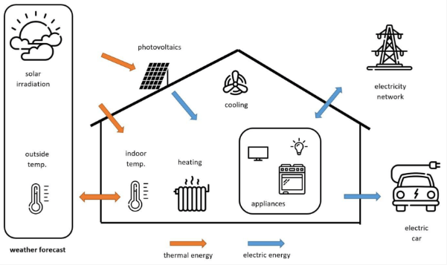
Energy Consumption Forecasting for Smart Grids
Predict electricity consumption for households or regions to optimize energy distribution and reduce costs.
https://www.mdpi.com/2076-3417/12/20/10212

Slide 19
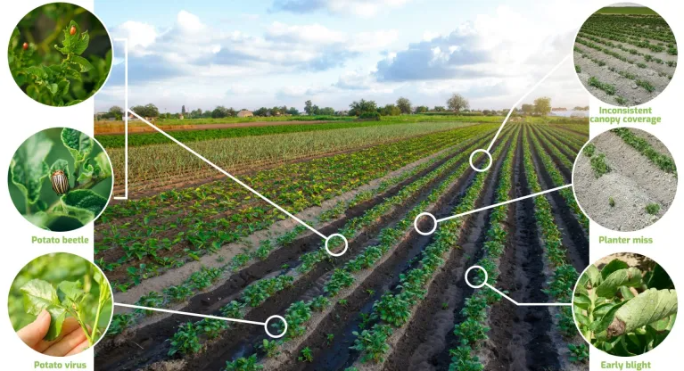
Crop Yield Prediction for Precision Agriculture
Predict crop yields based on weather conditions, soil characteristics, and agricultural practices to optimize farming strategies.
https://geopard.tech/blog/predicting-crop-yield-with-remote-sensing-data/

Slide 20

Credit Card Fraud Detection
Credit card fraud is the unauthorized use of a debit or credit card to make purchases or withdraw cash.
https://dataaspirant.com/credit-card-fraud-detection-classification-algorithms-python/

Slide 21
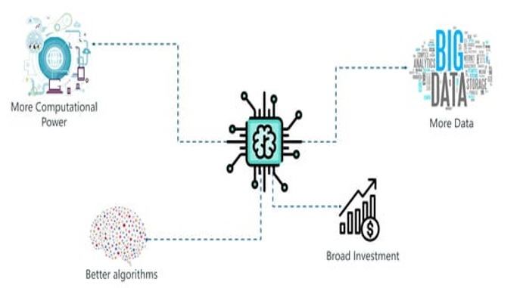
Demand of AI

Slide 22
Skill Sets for AI
Math & Stats → Linear Algebra, Calculus, Probability, Optimization.
Programming → Python + ML/DL libraries.
Data Handling → Cleaning, Visualization.
ML & DL Concepts → Algorithms, Neural Networks, Model Evaluation.
Tools → TensorFlow, PyTorch, SQL, Docker.
Domain Knowledge → Apply AI to real-world problems.
Soft Skills → Problem-solving, Communication, Ethics.

Slide 23
Data Science
Field that combines statistics, programming, and domain knowledge to extract insights from data.
Core tasks:
Data collection & cleaning
Data analysis & visualization
Predictive modeling
Communication of results
raw data → information → knowledge → decisions
Notes:
Raw Data → Unprocessed facts.
Information → Organized & summarized.
Knowledge → Understanding patterns.
Decision → Actionable step.

Slide 24
AI vs Data Science
Data Science: Focuses on understanding and extracting insights from data.
AI: Focuses on building systems that can act intelligently using data.
AI relies on Data Science for data preparation, while Data Science often uses AI techniques for advanced predictions.

Slide 25
How Can We Build an AI ?
Think About This:
What does it take to create an AI system that can learn and adapt?
Imagine the steps from an idea to a functioning AI – where does programming fit in?
Programming for AI:
How does a program work?
Which programming languages are best suited for developing an AI?

Slide 26
What is program ?
A program is a sequence of statements that have been crafted to do something

Slide 27
Building blocks of a program
Input: Get data from the “outside world”. This might be reading data from a file, or even some kind of sensor like a microphone or GPS. In our initial programs, our input will come from the user typing data on the keyboard.
Output: Display the results of the program on a screen or store them in a file or perhaps write them to a device like a speaker to play music or speak text.
Sequential execution: Perform statements one after another in the order they are encountered in the script.
Conditional execution: Check for certain conditions and then execute or skip a sequence of statements.
Repeated execution: Perform some set of statements repeatedly, usually with some variation.
Reuse: Write a set of instructions once and give them a name and then reuse those instructions as needed throughout your program.

Slide 28
How a Program Works
Concept:
A computer’s CPU can only understand instructions that are written in machine language. Because people find it very difficult to write entire programs in machine language, other programming languages have been invented.

Slide 29
How a Program Works
CPU is the most important component in a computer
CPU is not a brain
CPU is not smart
CPU is an electronic device that is designed to do specific things.

Slide 30
How a Program Works
CPU is designed to perform the following operations:
Read a piece of data from main memory
Adding two numbers
Subtracting one number from another number
Multiplying two numbers
Dividing one number by another number
Moving a piece of data from one memory location to another
Determining whether one value is equal to another value

Slide 31
How a Program Works
CPU only understands instructions written in machine language
Machine language instructions are written in 1s and 0s
The entire set of instructions that a CPU can execute is known as the CPU’s instruction set
Each brand of microprocessors (Intel, AMD, and Motorola) has a unique instruction set

Slide 32
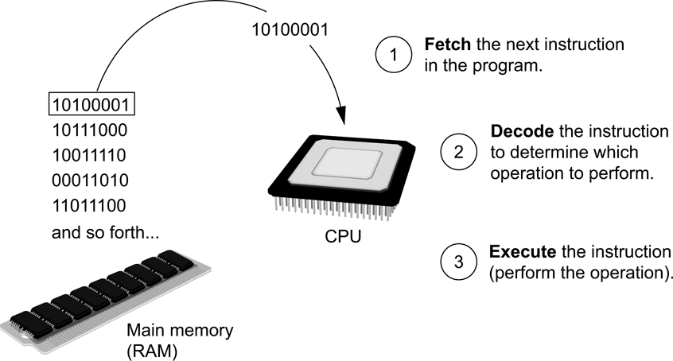
How a Program Works
Fetch-decode-execute cycle is the term used when the CPU executes the instructions in a program.
The cycle consist of three steps:
Fetch
Decode
Execute
Figure 1-17 The fetch-decode-execute cycle
1-32

Slide 33
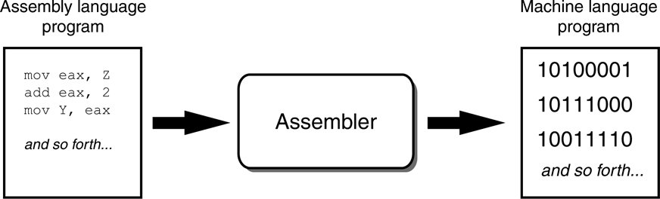
How a Program Works
From Machine Language to Assembly Language
Computers only understand machine language
Machine language is difficult to write
Assembly language uses short words that are known as mnemonics
Assembler is used to translate an assembly language program to machine language
Figure 1 An assembler translates an assembly language program to a machine language program
1-33

Slide 34
How a Program Works
High-Level Languages
Assembly language is referred to as a low-level language
High-level languages allow you to create powerful and complex programs without knowing how the CPU works, using words that are easy to understand.
For example:
Ada, BASIC, Python, C++, Ruby, Visual Basic
Do you know of any other high-level computer programming languages?
1-34

Slide 35
How a Program Works
Key Words, Operators, and Syntax: an Overview
Key words or reserved words have specific meaning and purpose in the programming language
Operators perform various operations on data
Syntax is a set of rules that must be strictly followed when writing a program
Statements are individual instructions written in a programming language
Notes:
The words that make up a high-level programming language are known as key words or reserved words. Each key word has a specific meaning, and cannot be used for any other purpose.
programming languages have operators that perform various operations on data.
The syntax rules dictate how key words, operators, and various punctuation characters must be used in a program.
The individual instructions that you use to write a program in a high-level programming language are called statements.

Slide 36
How a Program Works
Compilers and Interpreters
The statements written in a high-level language are called source code or simply code
Source code is translated to machine language using a compiler or an interpreter
Syntax error is a mistake such as a:
Misspelled word
Missing punctuation character
Incorrect use of an operator

Slide 37
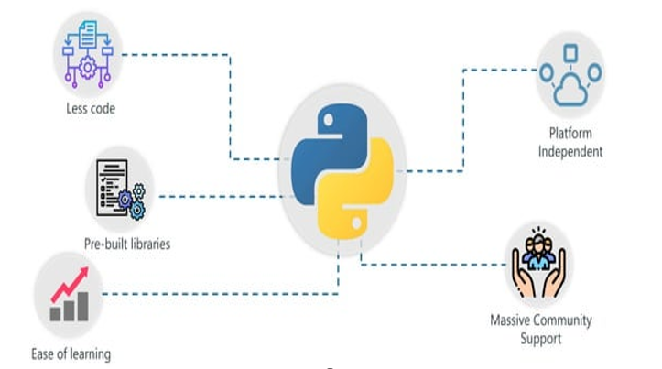
Why Python for AI

Slide 38
Using Python
Concept:
The Python interpreter can run Python programs that are saved in files, or can interactively execute Python statements that are typed at the keyboard. Python comes with a program named IDLE that simplifies the process of writing, executing, and testing programs.
Notes:
The Python interpreter is a program that can read Python programming statements and execute them.
You can use the interpreter in two modes: interactive mode and script mode.

Slide 39
Using Python
The Python Interpreter
A program that can read Python programming statements and execute them is the Python interpreter
Python interpreter has two modes:
Interactive mode waits for a statement from the keyboard and executes it
Script mode reads the contents of a file (Python program or Python script) and interprets each statement in the file

Slide 40
Using Python
Interpreter Mode
Invoke Python interpreter through Windows or command line
>>> is the prompt that indicates the interpreter is waiting for a Python statement
>>> print ‘Python programming is fun!’
Python programming is fun!
>>>
Statements typed in interactive mode are not saved as a program
[ENTER]
1-40

Slide 41
Using Python
Writing Python Programs and Running Them in Script Mode
Use a text editor to create a file containing the Python statements
Save the file with a .py extension
To run the program:
>>> python test.py
[ENTER]
1-41

Slide 42
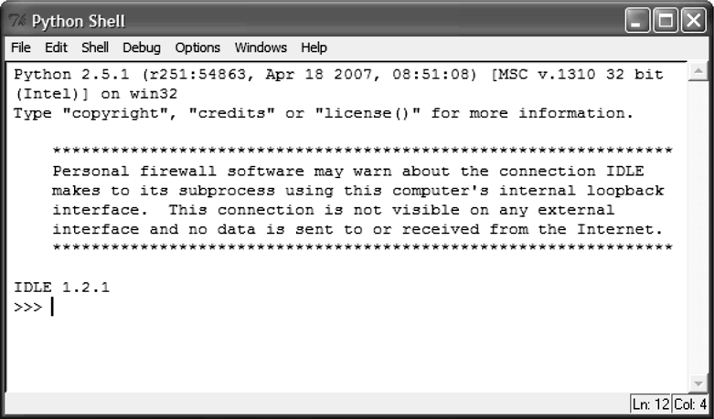
Using Python
The IDLE Programming Environment
Integrated DeveLopment Environment (IDLE)
Automatically installed when Python language is installed
It has a built-in text editor
IDLE editor colorizes code
Figure 1-21 IDLE
1-42

Slide 43
Welcome to Python Programming
Overview of Python: High-level, interpreted language
Why Python? Simple syntax, versatile, and widely used
Applications: Web development, data science, automation, AI

Slide 44
Setting Up the Environment
Installing Python: Using Anaconda, or directly from python.org
Installing an IDE: Visual Studio Code, PyCharm, or Jupyter Notebook

Slide 45
IDLE vs IDE
Feature | IDE | IDLE
Meaning | General tool for programming | A simple IDE made only for Python
Languages | Supports many (Java, C++, Python, etc.) | Only Python
Complexity | Advanced, feature-rich | Simple, beginner-friendly
Examples | PyCharm, VS Code | IDLE (comes with Python)

Slide 46
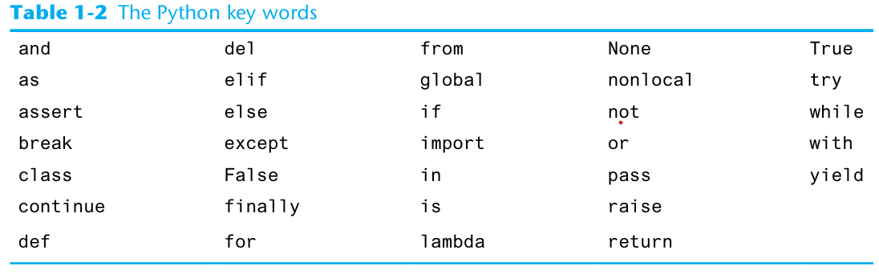
How a Program Works
Notes:
The words that make up a high-level programming language are known as key words or reserved words. Each key word has a specific meaning, and cannot be used for any other purpose.
The “reserved words” or “keywords”. These are words that have very special meaning to Python.

