Slide 1
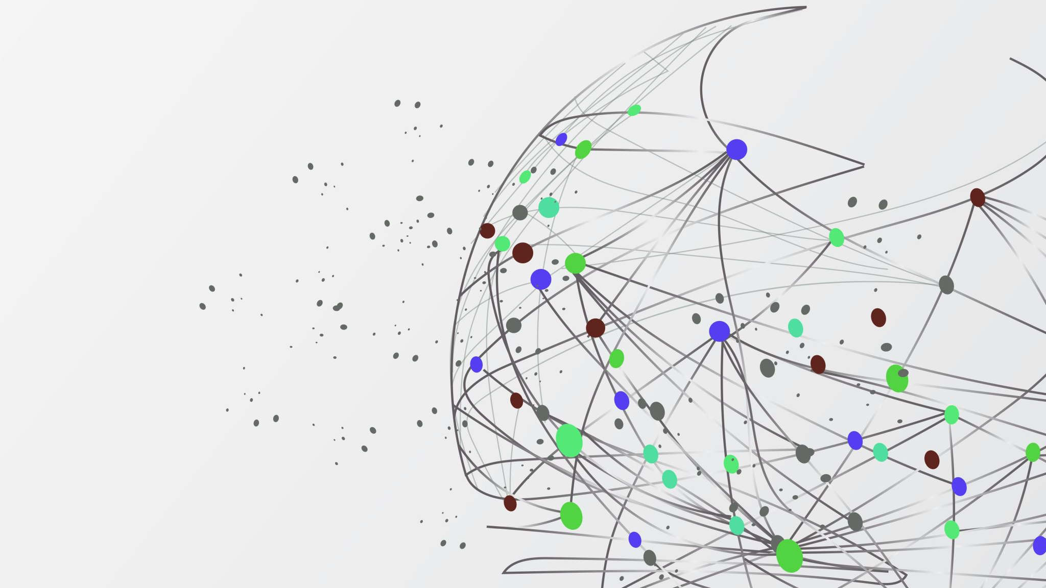
Programming for Artificial Intelligence Lecture# 2
By: Ms. Salma Asif

Slide 2
Outline
Designing a Program
Input, Processing, and Output
Displaying Output with the print Function
Comments
Variables
Reading Input from the Keyboard
Performing Calculations
More About Data Output
Typecasting

Slide 3
Designing a Program
Programs must be carefully designed before they are written. During the design process, programmers use tools such as pseudocode and flowcharts to create models of programs.

Slide 4
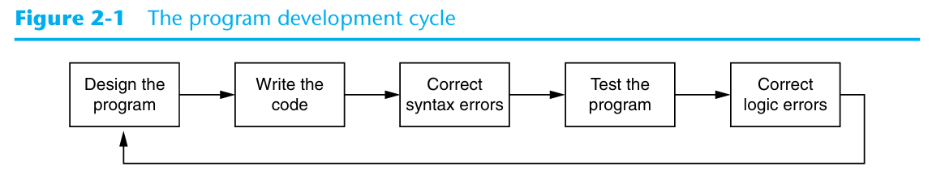
Program Development Cycle
Notes:
Design the Program. All professional programmers will tell you that a program should be carefully designed before the code is actually written. When programmers begin a new project, they should never jump right in and start writing code as the first step. They start by creating a design of the program. There are several ways to design a program, and later in this section, we will discuss some techniques that you can use to design your Python programs.
Write the Code. After designing the program, the programmer begins writing code in a high-level language such as Python. Recall from Chapter 1 that each language has its own rules, known as syntax, that must be followed when writing a program. A language’s syntax rules dictate things such as how key words, operators, and punc tuation characters can be used. A syntax error occurs if the programmer violates any of these rules.
Correct Syntax Errors. If the program contains a syntax error, or even a simple mis take such as a misspelled key word, the compiler or interpreter will display an error message indicating what the error is. Virtually all code contains syntax errors when it is first written, so the programmer will typically spend some time correcting these. Once all of the syntax errors and simple typing mistakes have been corrected, the pro gram can be compiled and translated into a machine language program (or executed by an interpreter, depending on the language being used).
Test the Program. Once the code is in an executable form, it is then tested to deter mine whether any logic errors exist. A logic error is a mistake that does not prevent the program from running, but causes it to produce incorrect results. (Mathematical mistakes are common causes of logic errors.)
Correct Logic Errors. If the program produces incorrect results, the programmer debugs the code. This means that the programmer finds and corrects logic errors in the program. Sometimes during this process, the programmer discovers that the program’s original design must be changed. In this event, the program development cycle starts over and continues until no errors can be found.

Slide 5
Designing a Program
Suppose you have been asked to write a program to calculate and display the gross pay for an hourly paid employee.
Get the number of hours worked.
Get the hourly pay rate.
Multiply the number of hours worked by the hourly pay rate.
Display the result of the calculation that was performed in step 3.
An algorithm, which is a set of well-defined logical steps that must be taken to perform a task.

Slide 6
Designing a Program
Programmers write a program in pseudocode before they write it in the actual code of a programming language such as Python.
The word “pseudo” means fake, so pseudocode is fake code.
It is an informal language that has no syntax rules and is not meant to be compiled or executed.
e.g;
Input the hours worked
Input the hourly pay rate
Calculate gross pay as hours worked multiplied by pay rate
Display the gross pay

Slide 7
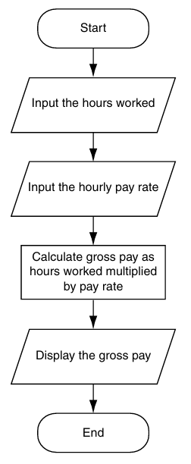
Designing a Program
A flowchart is a diagram that graphically depicts the steps that take place in a program.
There are three types of symbols in the flowchart: ovals, parallelograms, and a rectangle.
The ovals, which appear at the top and bottom of the flowchart, are called terminal symbols.
Parallelograms are used as input symbols and output symbols. They represent steps in which the program reads input or displays output.
Rectangles are used as processing symbols. They represent steps in which the program performs some process on data, such as a mathematical calculation.
The symbols are connected by arrows that represent the “flow” of the program.

Slide 8
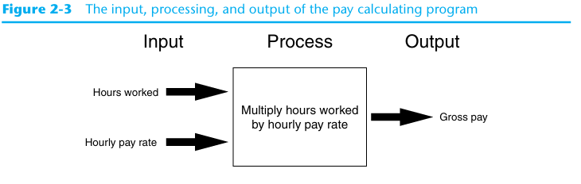
Input, Processing, and Output

Slide 9

Displaying Output with the print Function
Use the print function to display output in a Python program.
print("Hello, World!")

Slide 10
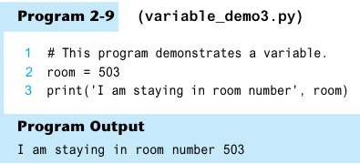
Displaying Multiple Items with the print Function

Slide 11
Strings and String Literals
'Kate Austen’
'123 Full Circle Drive ‘
'Asheville, NC 28899’
Sequences of characters
In programming terms, a sequence of characters that is used as data is called a string.
When a string appears in the actual code of a program, it is called a string literal
string literals in a set of single-quote marks (') or a set of double-quote marks (") or triple quotes (either """ or '‘’)
Triple quotes can also be used to surround multiline strings, something for which single and double quotes cannot be used
Notes:
In Python code, string literals must be enclosed in quote marks. As mentioned earlier, the quote marks simply mark where the string data begins and ends.

Slide 12
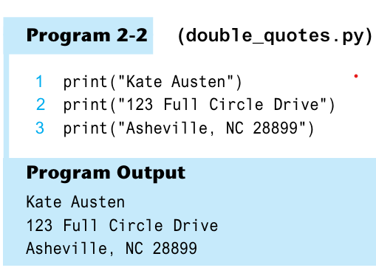
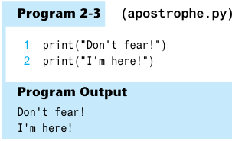
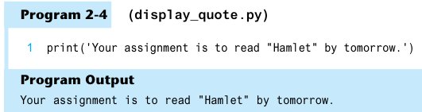
Strings and String Literals

Slide 13
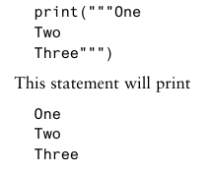

Strings and String Literals

Slide 14
Comments
Comments are notes that explain the lines or sections of a program.
Comments are part of the program, but the Python interpreter ignores them.
Comments: Single-line (#) and multi-line ("""...""") comments
Examples:
# This is a single-line comment print("Hello, World!") | """ This is a multi-line comment. It can span multiple lines. It's often used for documentation or longer comments. """ print("Hello, World!")
Notes:
Comments are notes of explanation that document lines or sections of a program. Comments are part of the program, but the Python interpreter ignores them. They are intended for people who may be reading the source code.

Slide 15
Variables
Variables: Name that represents a value stored in computer memory
Used to remember, access and manipulate data stored in memory
Variable references the value
Assignment statement - used to create a variable and make it reference the desired data
General format is:
variable_name = value or expression
Expression is the value, mathematical equation or function that results in a value

Slide 16
Variables
In assignment statement, variable receiving value must be on left side
You cannot use a variable UNTIL a value is assigned to it
A variable can be passed as an argument to a function, like print
Do not enclose variable name in quotes

Slide 17
Variables
age = 25
width = 10
length = 5
>>> print(width)
10
>>> print(length)
??

Slide 18
Variables
>>> print(“width”)
??
>>> print(width)
??

Slide 19
Variable Naming Rules
cannot use Python’s keywords as a variable name.
A variable name cannot contain spaces.
The first character must be one of the letters a through z, A through Z, or an under score character (_).
After the first character you may use the letters a through z or A through Z, the digits 0 through 9, or underscores.
Uppercase and lowercase characters are distinct. This means the variable name ItemsOrdered is not the same as itemsordered.

Slide 20
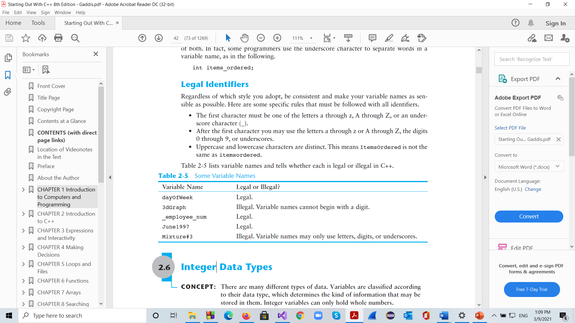
Legal and illegal variable names

Slide 21
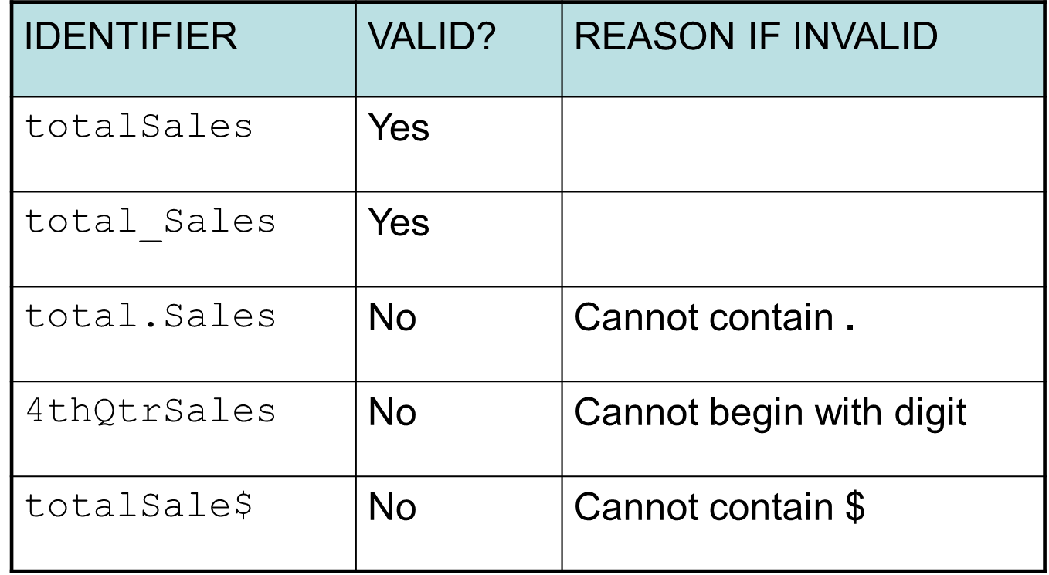
Valid and Invalid Identifiers

Slide 22
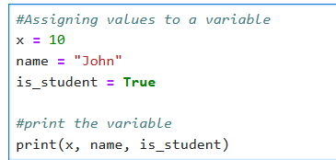
Assignment in Python
The assignment operator in Python is =.
Assigning a value to a new variable creates the variable:

Slide 23
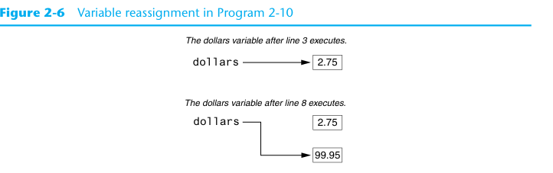
Variable reassignment in Python

Slide 24
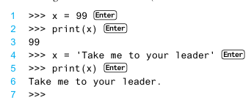
Different datatype Variable reassignment

Slide 25
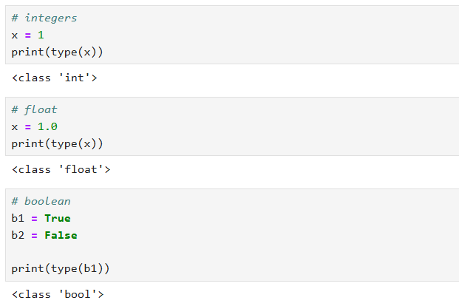
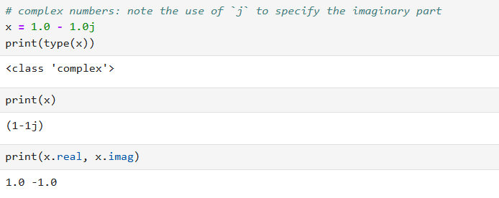
Data Types
Python is a dynamically typed language, so we do not need to specify the type of a variable when we create one.

Slide 26
Numeric Data Types and Literals
When an integer is stored in memory, it is classified as an int, and when a real number is stored in memory, it is classified as a float.
Python interpreter determines data type of numeric literal on the following rules:
A numeric literal that is written as a whole number with no decimal point is considered an int. Examples are 7, 124, and −9.
A numeric literal that is written with a decimal point is considered a float. Examples are 1.5, 3.14159, and 5.0
A number that is written into a program’s code is called a numeric literal.
e.g;
room = 503
dollars = 2.75

Slide 27
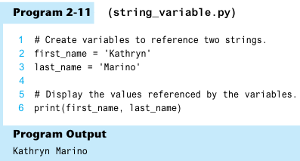
Strings Data Types
Python also has a data type named str, which is used for storing strings in memory.
e.g;

Slide 28
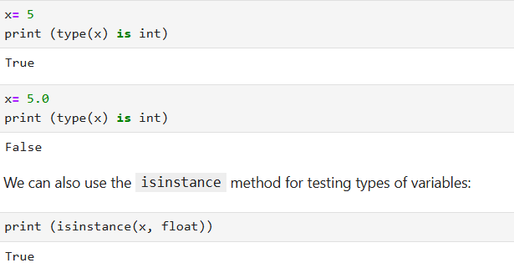
Data Types

Slide 29
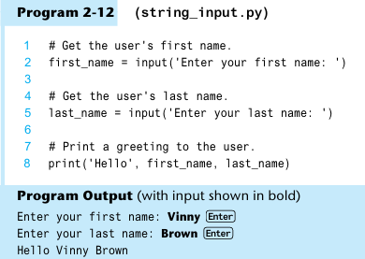
Reading Input from the Keyboard
Programs commonly need to read input typed by the user on the key board.
The Python function input used to take input from the keyboard.
variable = input(prompt)
Example:
name = input('What is your name? ‘)
The value entered by the user is stored in the variables name
The input function always returns the user’s input as a string,
even if the user enters numeric data.

Slide 30
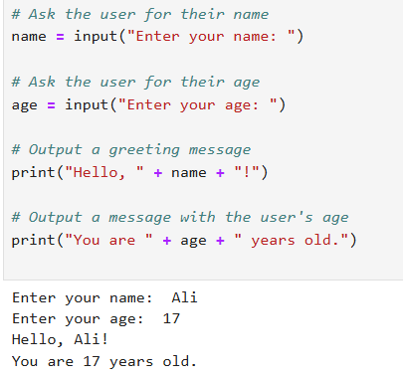
Reading Input from the Keyboard

Slide 31
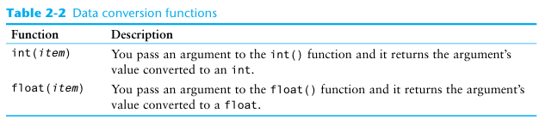
Reading Numbers with input Functions
Suppose you call the input function, type the number 72, and press the Enter key. The value that is returned from the input function is the string '72'.

Slide 32
Reading Numbers with input Functions
string_value = input('How many hours did you work? ‘)
hours = int(string_value)
OR
hours = int(input('How many hours did you work? ‘))
pay_rate = float(input('What is your hourly pay rate? '))

Slide 33
Simple Input and Output
input() function:The input() function is used to take input from the user.
The string inside the parentheses (e.g., "Enter your name: ") is displayed as a prompt to the user.
Storing Input:The value entered by the user is stored in the variables name

Slide 34
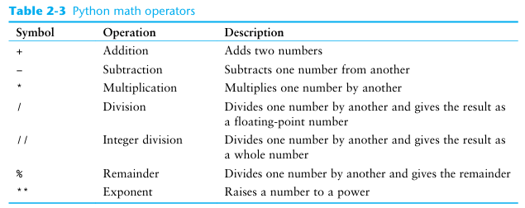
Performing Calculations in Python
operators are used to perform mathematical calculations

Slide 35
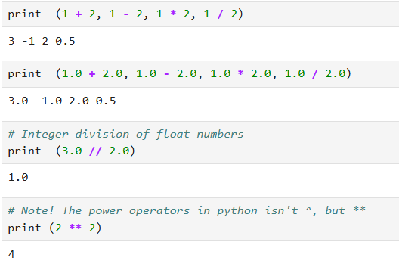
Operators and comparisons
Arithmetic operators +, -, *, /, // (integer division), '**' power

Slide 36
Arithmetic operators: + - * / %
a+b, a-b, a*b, a/b
Integer division: 11/4 gives 2
Floating point division:
11.0/4 gives 2.75
Modulo operator: % (only for integers)
11%4 gives 3
10%5 gives 0

Slide 37
Floating-Point (/) and Integer Division (//)
The / operator gives the result as a floating-point value, and the // operator gives the result as a whole number.
>>> 5 / 2 Enter
2.5
The // operator works like this:
When the result is positive, it is truncated, which means that its fractional part is thrown away.
When the result is negative, it is rounded away from zero to the nearest integer.
>>> 5 // 2 Enter and >>> −5 // 2 Enter
2 −3

Slide 38
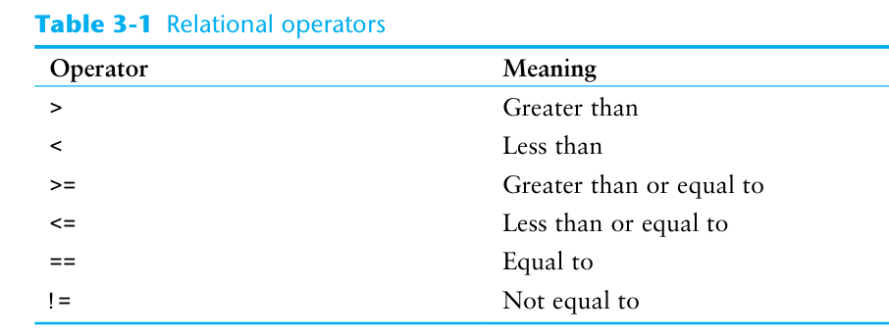
Relational Operators

Slide 39
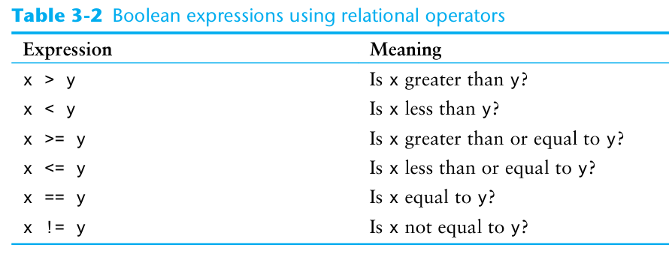
Relational Operators

Slide 40
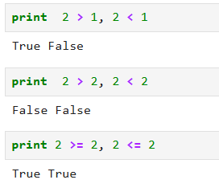
Relational Operators

Slide 41
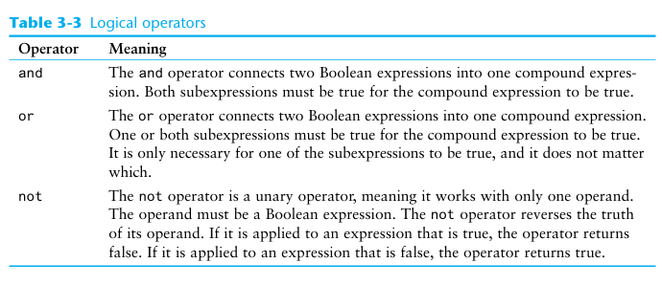
Logical Operators
The logical operators are spelled out as the words and, not, or.
Notes:
The logical and operator and the logical or operator allow you to connect multiple Boolean expressions to create a compound expression. The logical not operator reverses the truth of a Boolean expression.

Slide 42
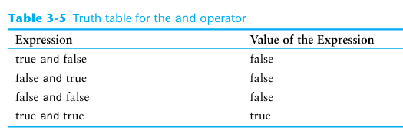
Logical Operator and
Notes:
The logical and operator and the logical or operator allow you to connect multiple Boolean expressions to create a compound expression. The logical not operator reverses the truth of a Boolean expression.

Slide 43
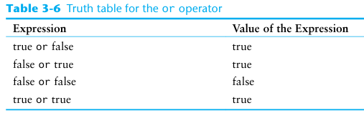
Logical Operator or
Notes:
The logical and operator and the logical or operator allow you to connect multiple Boolean expressions to create a compound expression. The logical not operator reverses the truth of a Boolean expression.

Slide 44
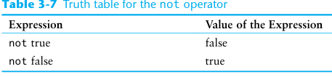
Logical Operator not
Notes:
The logical and operator and the logical or operator allow you to connect multiple Boolean expressions to create a compound expression. The logical not operator reverses the truth of a Boolean expression.

Slide 45
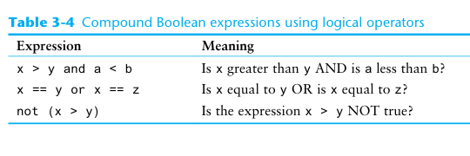
Logical Operators
The logical operators are spelled out as the words and, not, or.
Notes:
The logical and operator and the logical or operator allow you to connect multiple Boolean expressions to create a compound expression. The logical not operator reverses the truth of a Boolean expression.

Slide 46
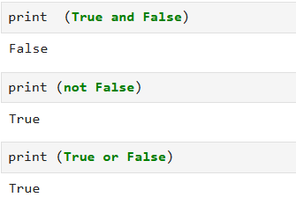
Logical Operators
The logical operators are spelled out as the words and, not, or.

Slide 47
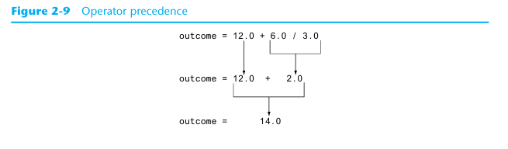
Precedence
First, operations that are enclosed in parentheses are performed first.
Then, when two operators share an operand, the operator with the higher precedence is applied first.
The precedence of the math operators, from highest to lowest, are:
Exponentiation: **
Multiplication, division, and remainder: * / // %
Addition and subtraction: + −
Notes:
Notice the multiplication (*), floating-point division (/), integer division (//), and remain der (%) operators have the same precedence. The addition (+) and subtraction (−) operators also have the same precedence. When two operators with the same precedence share an operand, the operators execute from left to right.

Slide 48
Mixed-Type Expressions and Data Type Conversion
An expression that uses operands of different data types is called a mixed-type expression.
Python follows these rules when evaluating mathematical expressions:
When an operation is performed on two int values, the result will be an int.
When an operation is performed on two float values, the result will be a float.
When an operation is performed on an int and a float, the int value will be temporarily converted to a float and the result of the operation will be a float.

Slide 49


Breaking Long Statements into Multiple Lines
Python allows you to break a statement into multiple lines by using the line continuation character, which is a backslash (\).
Python also allows you to break any part of a statement that is enclosed in parentheses into multiple lines without using the line continuation character.

Slide 50
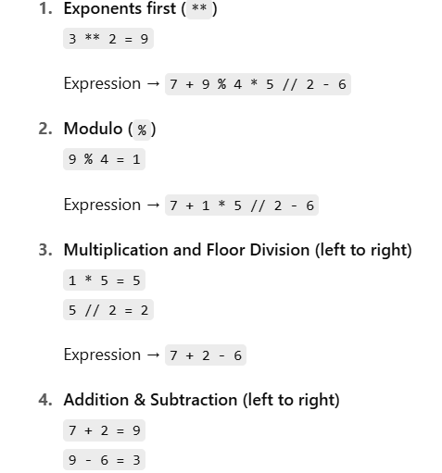
Solved Example
expr = 7 + 3 ** 2 % 4 * 5 // 2 - 6

Slide 51
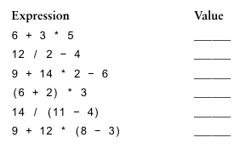

Slide 52
More about data output
The print Function’s Ending Newline
print('One’)
print('Two’)
print('Three’)
If you do not want the print function to start a new line of output when it finishes displaying its output, you can pass the special argument end=' ' to the function, as shown in the following code:
print('One', end=' ‘)
print('Two', end=' ‘)
print('Three’)
Output: One Two Three

Slide 53
Specifying an Item Separator
When multiple arguments are passed to the print function, they are automatically separated by a space when they are displayed on the screen.
>>> print('One', 'Two', 'Three') Enter
Output: One Two Three
If you do not want a space printed between the items, you can pass the argument sep=‘ ' to the print function, as shown here:
>>> print('One', 'Two', 'Three', sep='') Enter
Output: OneTwoThree

Slide 54
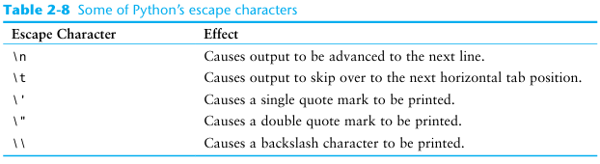
Escape Characters
An escape character is a special character that is preceded with a backslash (\), appearing inside a string literal.

Slide 55
Escape Characters Examples
print('One\nTwo\nThree’)
print('Mon\tTues\tWed’)
print('Thur\tFri\tSat’)
print("Your assignment is to read \"Hamlet\" by tomorrow.")
print('I\'m ready to begin.’)
print('The path is C:\\temp\\data.')

Slide 56
Displaying Multiple Items with the + Operator
+ operator performs string concatenation.
print('This is ' + 'one string.’)

Slide 57
Formatting Numbers
When a floating-point number is displayed by the print function, it can appear with up to 12 significant digits.
built-in format function.
The format specifier is a string that contains special characters specifying how the numeric value should be formatted
format(12345.6789, '.2f’)
print(format(12345.6789, '.1f'))

Slide 58
Formatting in Scientific Notation
display floating-point numbers in scientific notation
>>> print(format(12345.6789, 'e')) Enter
1.234568e+04
>>> print(format(12345.6789, '.2e')) Enter
1.23e+04

Slide 59
Inserting Comma Separators
If you want the number to be formatted with comma separators, you can insert a comma into the format specifier
>>> print(format(12345.6789, ',.2f')) Enter
12,345.68

Slide 60
Formatting a Floating-Point Number as a Percentage
you can use the % symbol to format a floating point number as a percentage.
>>> print(format(0.5, '%')) Enter
50.000000%
specifies 0 as the precision:
>>> print(format(0.5, '.0%')) Enter
50%

Slide 61
Formatting Integers
when writing a format specifier that will be used to format an integer:
You use d as the type designator.
You cannot specify precision.
>>> print(format(123456, 'd')) Enter
123456

Slide 62

Specifying a Minimum Field Width
The format specifier can also include a minimum field width, which is the minimum number of spaces that should be used to display the value.

Slide 63
Type casting
Type casting, or type conversion, refers to the process of converting a variable from one data type to another. In Python, this can be done using built-in functions.
int() → convert to integer
float() → convert to float
str() → convert to string
list() → convert to list
tuple() → convert to tuple
bool() → convert to boolean

Slide 64
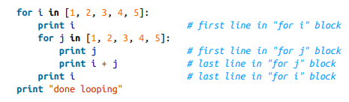
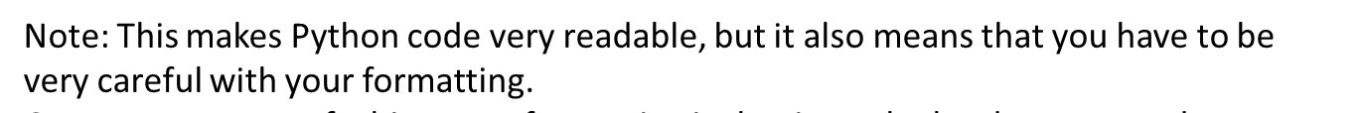
Python Syntax and Structure
Indentation: Python uses indentation to define code blocks

Slide 65
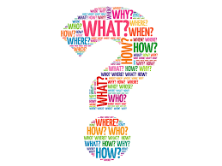
Questions?

