Slide 1
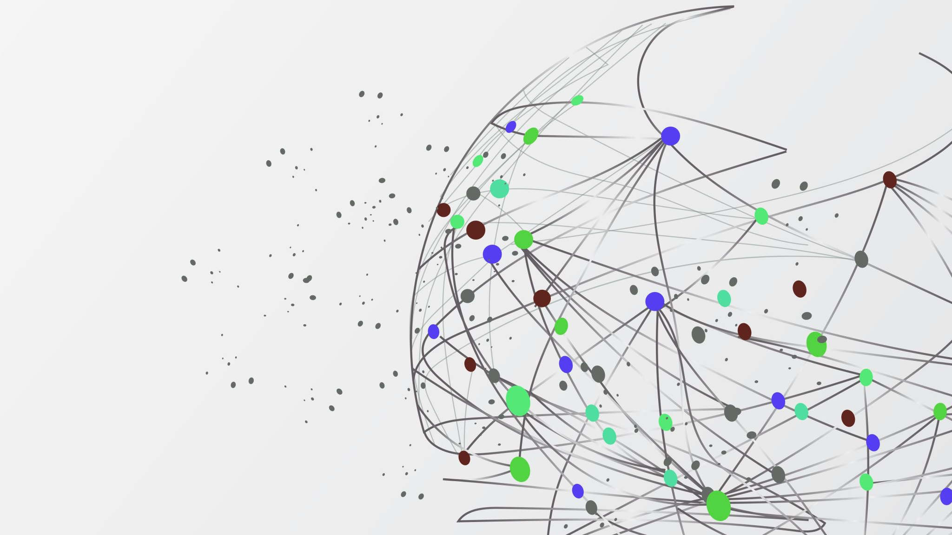
Programming for Artificial Intelligence
Decision Structure

Slide 2
Outline
The if statement
The if-else statement
Nested Decision Structures
if-elif-else statements
Boolean Variables

Slide 3
Decision Structures/ Conditional statements: if, elif, else
A decision structure allows a program to make decisions and execute different actions depending on whether a condition is True or False.
A control structure is a logical design that controls the order in which a set of statements execute.
A sequence structure is a set of statements that execute in the order in which they appear
Conditions are written using relational operators and logical operators, and decision-making is mainly handled using the if, elif, and else statements.

Slide 4
Types of Decision Structure
Simple if statement
If-else
If-elif-else
Nested if statements

Slide 5
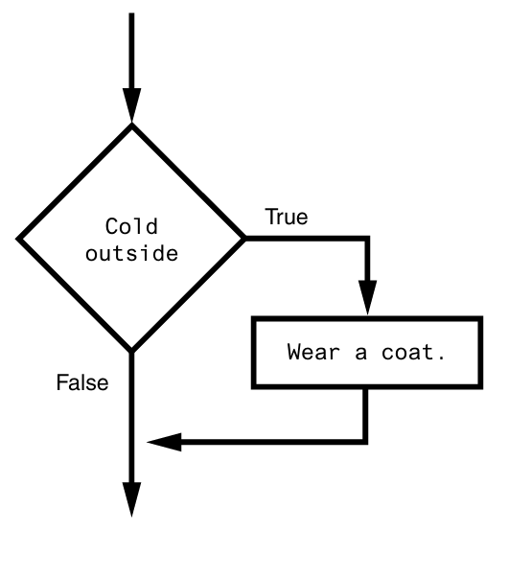
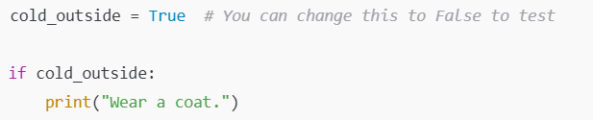
Simple if statement
Executes a block of code if condition is True.
Syntax
if condition:
statement
statement
etc.

Slide 6
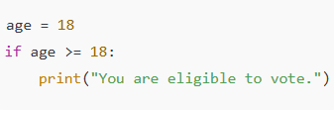
Simple if statement
Executes a block of code if condition is True.

Slide 7
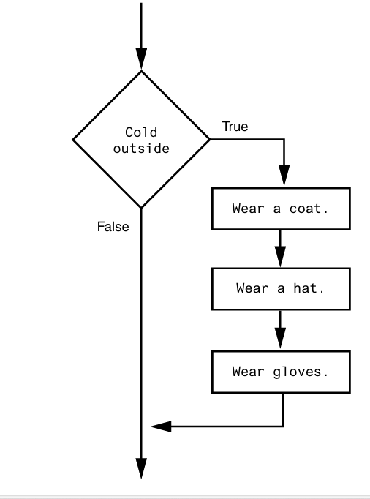
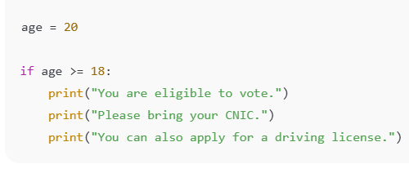
Simple if statement
Executes a block of code if condition is True.

Slide 8
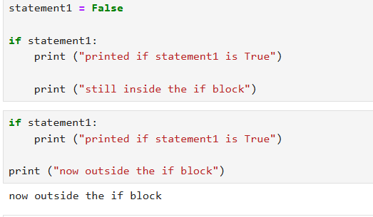
Simple if statement

Slide 9
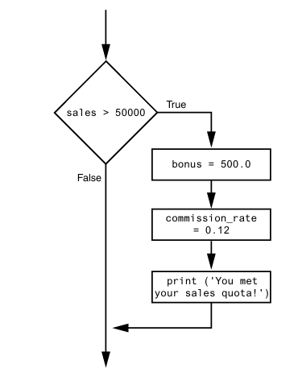
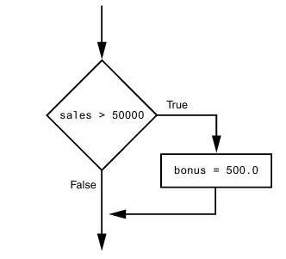
Simple if statement

Slide 10
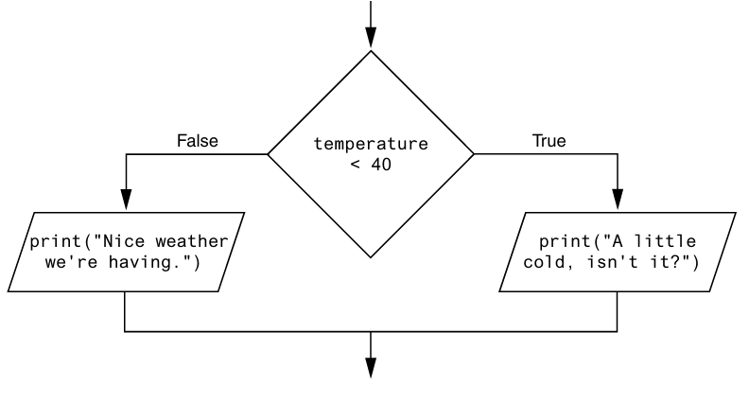
If-else
An if-else statement will execute one block of statements if its condition is true, or another block if its condition is false.

Slide 11
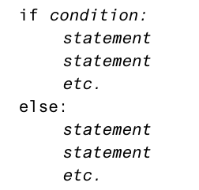
If-else

Slide 12
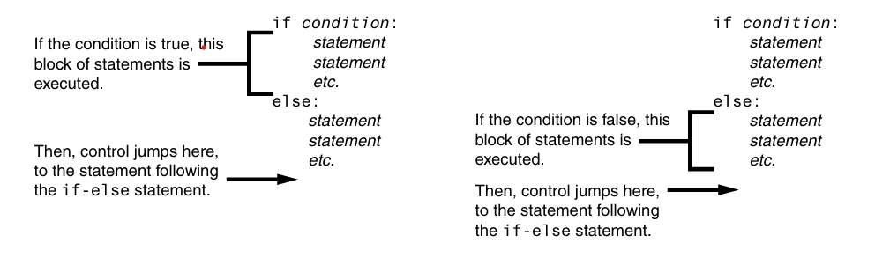
If-else

Slide 13
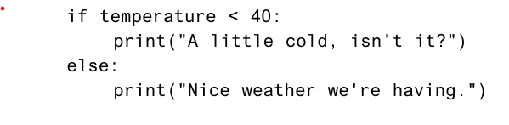
If-else

Slide 14
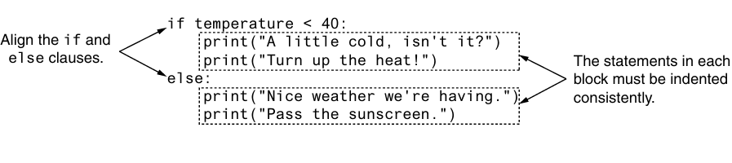
Indentation in the if-else Statement

Slide 15
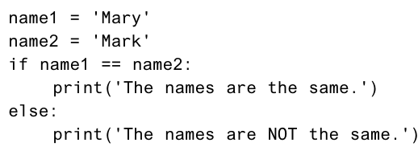
If-else examples

Slide 16
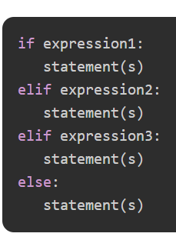
if-elif-else Statement
Checks multiple conditions in sequence.

Slide 17
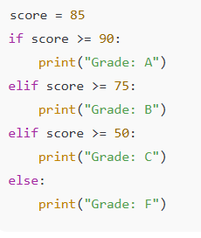
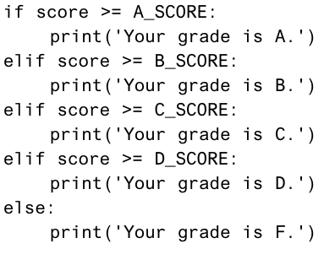
if-elif-else Statement

Slide 18
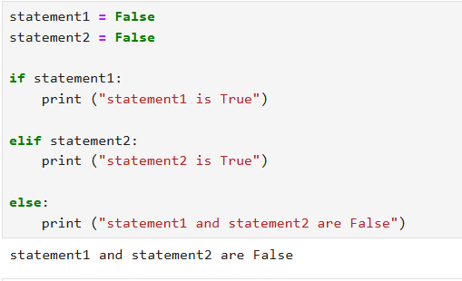
if-elif-else Statement

Slide 19
Nested if statements
An if inside another if.
To test more than one condition, a decision structure can be nested inside another decision structure.

Slide 20
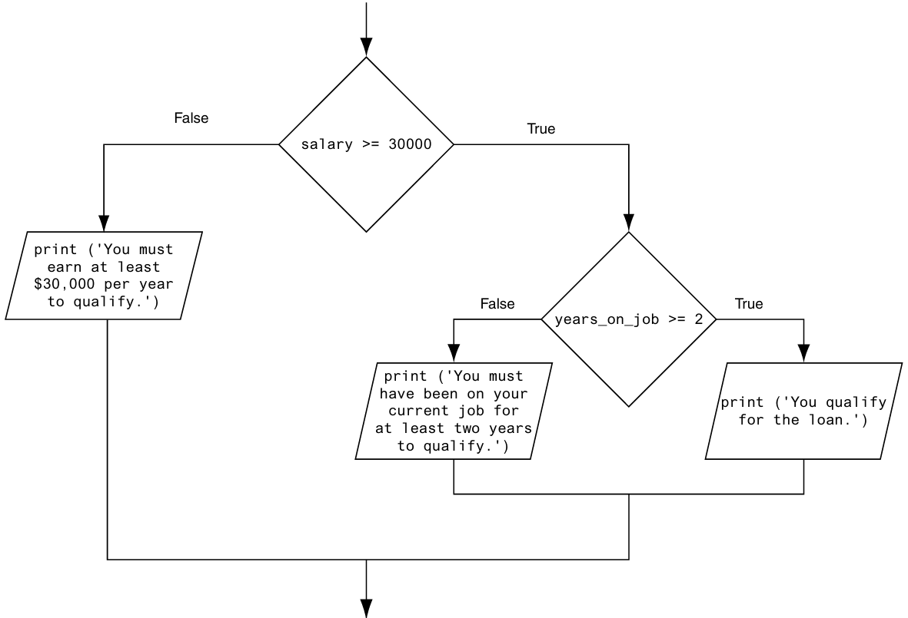
Nested if statements

Slide 21
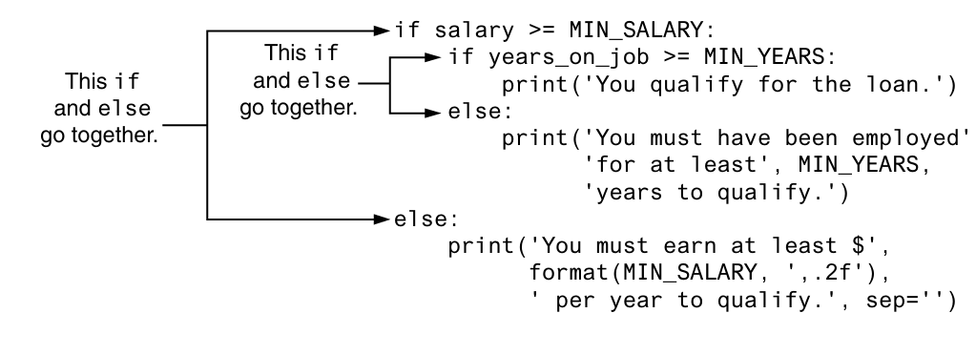
Nested if statements

Slide 22
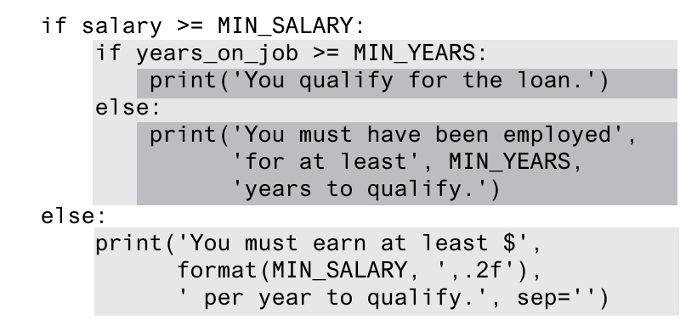
Nested if statements

Slide 23
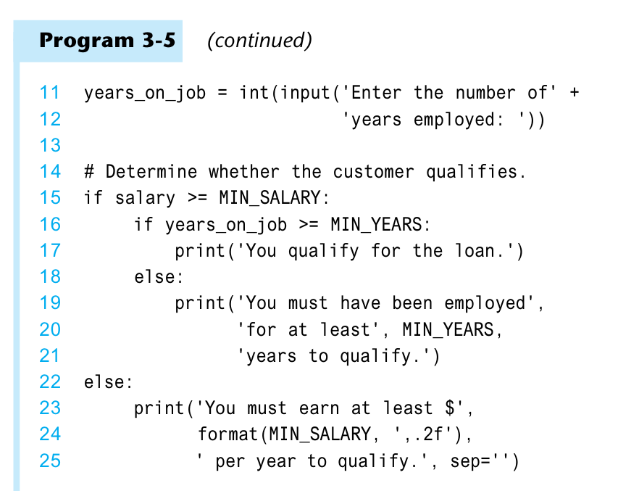
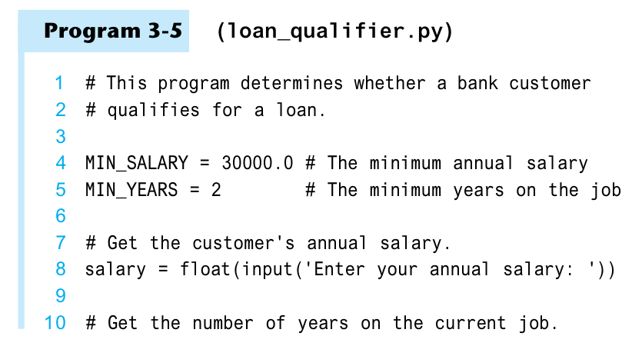
Nested if statements

Slide 24
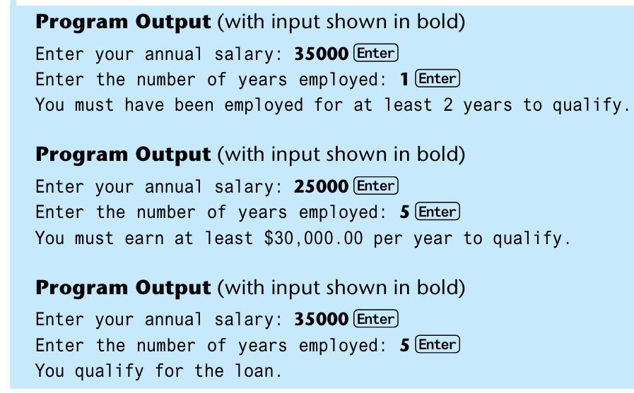
Nested if statements

Slide 25
Boolean Variables
A Boolean variable can reference one of two values: True or False.
Boolean variables are most commonly used as flags.
A flag is a variable that signals when some condition exists in the program.
When the flag variable is set to False, it indicates the condition does not exist
When the flag variable is set to True, it means the condition does exist.
hungry = True
sleepy = False

Slide 26
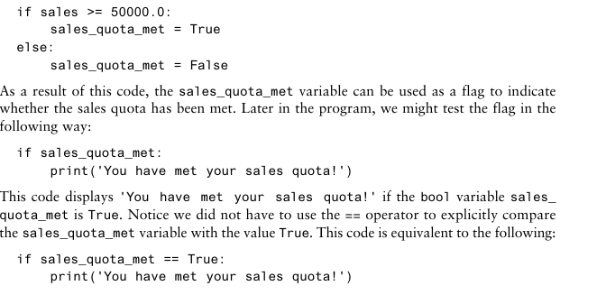
Boolean Variables

Slide 27
Tasks
Write a program to check if a number is positive, negative, or zero.
Check if a number is even or odd.
Find the largest of two numbers.
Check if a person is eligible to vote (age ≥ 18).
Check if a year is a leap year.
Check if a character is a vowel or consonant.
Check if a number is divisible by 5 and 11.
Check if a student passed or failed (pass marks = 40).
Check if a number is within range 1–100.
Check if a temperature is hot (>35), normal, or cold (<15).

Slide 28

Questions?

