Slide 1

CSC4311 SOFTWARE ENGINEERING
LECTURE THREE
LECTURER: DR. AMINU AMINU MU’AZU
Umaru Musa Yar’adua University Katsina
Faculty of Natural & Applied Science
Department of Computer Science

Slide 2
REQUIREMENTS ANALYSIS

Slide 3
Objectives
The objective of this section is to introduce software requirements and to discuss the processes involved in discovering and documenting these requirements.

Slide 4
Requirements
The requirements for a system are:
  The descriptions of what the system should do
  The services that the system provides and the constraints on its operation.
These requirements reflect the needs of customers for a system that serves a certain purpose.
  Example controlling a device, placing an order, or finding information.
The process of finding out, analyzing, documenting and checking these services and constraints is called requirements engineering.

Slide 5
Requirements
Definition:
  Capabilities and conditions to which the must conform.
Focusing on the WHAT not the HOW
Logically it is the first stage of software development is to establish precisely what the users of the system want.
Requirements specification is the process of writing down the user and system requirements in a requirements document.

Slide 6
Requirements Analysis Is Hard
Major causes of project failures
  Incomplete requirements
  Changing requirements
  Poor user input
Essential solutions, because it contains:
  Different classification of requirements
  Different Use Cases

Slide 7
Note that:
It is easy to write poor requirements specifications for software;
it is difficult to write good specifications.
In this section we will examine guidelines for writing specifications.
Remember that:
  Specifications are not usually written once and then frozen.
  Requirements change during the software development

Slide 8
Types of Requirements
Functional requirements
  Describe the interactions between the system and its environment independent from the implementation
  “A user must be able to start a new call “
Nonfunctional requirements
  Aspects not directly related to functional behavior.
  “The response time must be less than 1 second”
Constraints
  Accomplish by the client or the environment
  “The implementation language must be Java “

Slide 9
Functional:
  Features (GUI elements), capabilities, security,….
  “The system reads employee records and prints paychecks”
Non Functional:
  Usability: human factors (an easy-to-use GUI), help, documentation
    “Text on the display must be visible from 1 meter.”
  Reliability: frequency of failure, recoverability, predictability
    “When doing search, the radar should have 24 hours MTBF(mean time between failures)”

Slide 10
  Performance: response times, throughput, accuracy, availability
    “The server response time is <1 sec for 90% of the accesses”
  Supportability: adaptability, maintainability, internationalization, configurability
    “The system should allow frequent and easy changes in the network configuration”
  Implementation: resource limitations, languages, tools, hardware
    “Must use Linux and Java”

Slide 11
Unified Modeling Language (UML)
Definition:
  A visual language for specifying, constructing, and documenting the artifacts of systems.
  Standard diagramming notation for drawing pictures related to software.
  Includes 13 types of diagrams

Slide 12
Two Categories of UML Diagrams
Structural UML diagrams: is used to specify structure of the objects
  Class diagram
  Object diagram
… …
Dynamic UML diagrams: refers representing the object
  Use case diagram
  Sequence diagram
… …
Here, we will discuss
• Use case diagram (Requirement)

Slide 13
Use case diagram
Definition:
  A behavior diagrams which are used to define a set of actions that system should or can perform in collaboration with one or more external users of the system.
  A representation of interactions between actors and the system.
  It shows:
    Relationship between the users and the system
    The scope of the system.

Slide 14
The importance of Use Cases
The most widely used approach for capturing requirements of a system
Use cases can help manage the complexity of large projects by partitioning the problem into major user features (i.e., use cases)
Use cases are easy way to understand and provide an excellent way for communicating with customers.

Slide 15
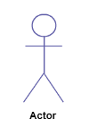
Element of Use Case
Use case diagrams are designed with 4 major elements
  Actors
  System
  Use Cases
  Relationships between actors and use cases
Actor:
  Actor in a use case diagram is any entity that performs a role in one given system. This could be a person, organization or an external system and usually drawn like skeleton shown below.

Slide 16
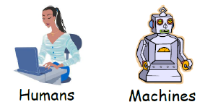
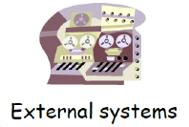
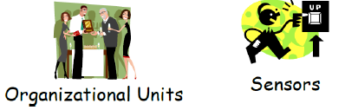
Three Kinds of Actors
Primary actor: uses the system to fulfill goals
  E.g., cashier
  Why? To find user goals and drive use cases
Supporting actor: provides a service to the system
  E.g., Tax agencies, credit card company, store
  Why? To clarify external interfaces and protocols
Offstage actor: has an interest in the behavior
  E.g., Customer
  Why? To ensure that all necessary interests are identified and satisfied

Slide 17
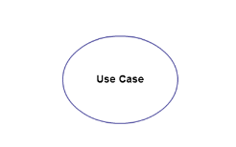
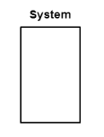
Use Case:
  A use case represents a function or an action within the system. It’s drawn as an oval and named with the function.
System:
  The system is used to define the scope of the use case and drawn as a rectangle.
  This an optional element but useful when you’re visualizing large systems.

Slide 18



Relationships between Actors and Use cases
  Use cases could be organized using following relationships:
    Association
    Extend
    Include
  Association: The relation between an actor and a use case.
  Includes dependency: A base use case includes a sub use case as component. (one UC must call another; e.g., Login UC includes User Authentication UC)
  Extends dependency: A use case extends the behavior of a base use case. (one UC calls Another under certain condition; think of if-then decision points; e.g., Display Error Message is an optional behavior that extends validate PIN, triggered only if the PIN in invalid)

Slide 19
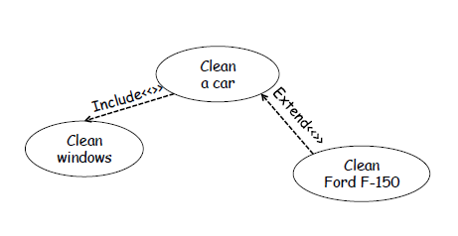
How to Draw a Use Case Diagram?
Identifying Actors
  Actors are external entities that interact with your system. It can be a person, another system or an organization.
Identifying Use Cases
  A good way to do this is to identify what the actors need from the system.
Draw the relationship between actors and the use cases
Look for Common Functionality to use <<Include>>
  Look for common functionality that can be reused across the system.
Optional Functions or Additional Functions
  There are some functions that are triggered optionally.
  In such cases, you can use the <<extend>>

Slide 20
Scenario in use case
Scenario (use case instance)
Definition:
  A specific sequence of actions and interactions between actors and the system.
  Scenarios are descriptions of how a system is use in practice

Slide 21
Running example: Scenario
A customer arrives at a checkout with items to purchase. The cashier uses the POS system to record each purchased item. The system presents a running total and line-item details. The customer enters payment information, which the system validates and records. The system updates inventory. The customer receives a receipt from the system.
Question: What are the use cases of the above scenario??

Slide 22
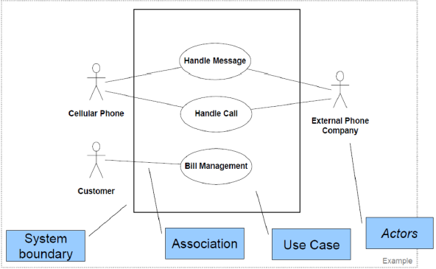
Running use case example

Slide 23
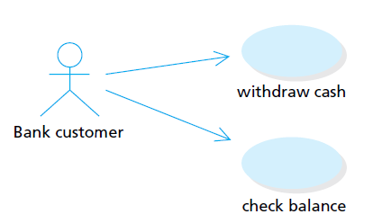
Running use case example
Use case diagram for the ATM

Slide 24
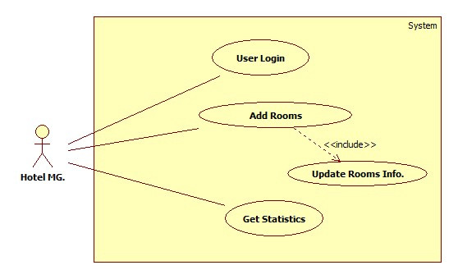
Running use case example
use case diagram of adding hotel room

Slide 25
Exercise: Withdraw Money from ATM
Customer inserts a card to ATM. The ATM prompts to enter password. Customer enters a password. ATM validates the customer and presents options “check balance”, “withdraw”, “transfer”. Customer indicates withdraw and enters the amount to withdraw. ATM validates the amount, debits the account, and charges process fee if necessary. ATM delivers money and receipt. Customer indicates log off. ATM pops up the card for customer to take away.

Slide 26
Questions to Answer
Who are the actors?
What are the use cases?
What is the relationship between the use cases?
What are the functional requirements to include?
What are the nonfunctional requirements?
What are the biggest challenges?
  Domain knowledge, new features
Plan to solve the challenges?
Finally, draw the use case diagram

Slide 27
SOFTWARE DESIGN

Slide 28
Objectives
The objective of this section is to introduce the concepts of software design

Slide 29
What is Design
Design is concerned with understanding how a system should be organized and designing the overall structure of that system.
Design is a creative process where you design a system organization that will satisfy the functional and non-functional requirements of a system.
The design process is making decisions about HOW to implement software solutions to meet requirements.

Slide 30
The design must be a readable, understandable guide for those who generate code and for those who test and subsequently support the software.
The design should provide a complete picture of the software, addressing the data, functional, and behavioral domains from an implementation perspective.
Encompasses the set of concepts, principles, and practices that lead to the development of high-quality systems.

Slide 31
Concepts in Software Design
Modularity
Concurrency
Cohesion & Coupling
Information Hiding

Slide 32
Modularity
Software is divided into separately named and addressable components, sometimes called modules, that are integrated to satisfy problem requirements.
Divide-and-conquer

Slide 33
Advantage of modularization
Smaller components are easier to maintain
Program can be divided based on functional aspects
Desired level of abstraction can be brought in the program
Concurrent execution can be made possible
Desired from security aspect

Slide 34
Concurrency
Back in time, all software were meant to be executed sequentially
Instruction will be executed one after another implying only one portion of program being activated at any given time.
Say, a software has multiple modules, then only one of all the modules can be found active at any time of execution
In software design, concurrency provides capability to the software to execute more than one part of code in parallel to each other.
It is necessary for the programmers and designers to recognize those modules, which can be made parallel execution.
Example
  The spell check feature in word processor is a module of software, which runs alongside the word processor itself.

Slide 35
Cohesion & Coupling
As we know, modules are set of instructions put together in order to achieve some tasks.
There are measures by which the quality of a design of modules and their interaction among them can be measured
These measures are called coupling and cohesion.

Slide 36
Cohesion
  Is a measure that defines the degree of intra-dependability within elements of a module.
  The greater the cohesion, the better is the program design.
Coupling
  Is a measure that defines the level of inter-dependability among modules of a program.
  It tells at what level the modules interfere and interact with each other.
  The lower the coupling, the better the program.

Slide 37
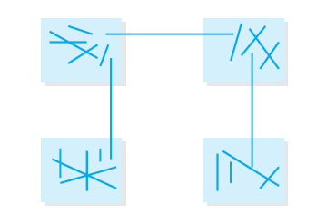
Coupling and cohesion in a software systems

Slide 38
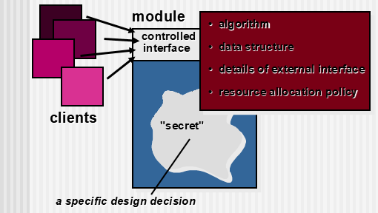
Information Hiding
Do not expose internal information of a module unless necessary
  E.g., private fields, getter & setter methods

Slide 39
Why Information Hiding?
Reduces the possibility of “side effects”
Emphasizes communication through controlled interfaces
Leads to encapsulation—an attribute of high quality design
Results in higher quality software

Slide 40
CODING

Slide 41
Coding techniques
The goal of the coding or programming phase is to translate the design into code.
  In a given programming language
  That can be executed by a computer
  That performs the computation specified by the design.
For implementing our design into a code, we require a good high level language

Slide 42
Programming concept
Some concepts related to coding are:
  Top-Down and Bottom-Up
In a top-down implementation,
  The implementation starts from the top of the hierarchy and proceeds to the lower levels.
  First the main module is implemented, then its subordinates are implemented, and their subordinates, and so on.
In implementing the modules at bottom of the hierarchy and proceeds through the higher levels until it reaches the top.

Slide 43
Programming Practice
Good programming is a skill that can only be acquired by practice.
However, much can be learned from the:
  Experience of others,
  Some general rules
  Guidelines can be laid for the programmer.
Good programming is a practice independent of the target programming language.
A programming language should have the following features:
  Coding standards and guidelines
  Code Review

Slide 44
Coding standards and guidelines
Good software development organizations usually develop their own coding standards and guidelines.
  Depending on what best suits their organization and the type of products they develop.
The following are some representative coding standards :
  Contents of the headers preceding codes for different modules
  Naming conventions for global variables, local variables, and constant identifiers
  The code should be well-documented
  The length of any function should not exceed 10 source lines

Slide 45
Code Review
Is carried out after the module is successfully compiled and all the syntax errors have been eliminated.
Are extremely cost-effective strategies for reduction in coding errors and to produce high quality code.
Normally, three types of reviews are carried out on the code of a module.
  Code walk through.
  Code inspection.
  Refactoring.

Slide 46
Code Walk Through
A few members of the development team are given the code to read and understand code.
They will trace execution through each statement and function execution.
The main objectives of the walk through are to discover the algorithmic and logical errors in the code.
The members note down their findings to discuss these in a walk through meeting.

Slide 47
Code Inspection
The aim of code inspection is to discover some common types of errors caused due to omission and improper programming.
Loyalty to coding standards is also checked during code inspection.
List of some classical programming errors which can be checked during code inspection:
  Use of uninitialized variables.
  Nonterminating loops.
  Incompatible assignments.
  Array indices out of bounds.
  Use of incorrect logical operators or incorrect precedence among operators.
  Improper modification of loop variables.
  Comparison of equally of floating point variables, etc

Slide 48
Refactoring
Definition:
  The process of changing a software system in such a way that it does not alter the external behavior of the code [design] yet improves its internal structure.
How would one find what to refactor? According to Fowler “places with a bad smell in the code”. E.g.:
  Duplicated code
    Same expression in two methods in the same class?
    Same code in two related classes?
    Same code in two unrelated classes?
  Long method
    Often a sign of trying to do too many things
Goal: to make software easier to integrate, test, and maintain

Slide 49
C.A TEST
DATE & TIME:
    MONDAY 12th MAY, 2025
    10:00AM T0 11:00AM
                BEST OF LUCK

