Slide 1
Informed Search

Slide 2
Informed Search
Definition:
  Use problem-specific knowledge beyond the definition of the problem itself
  Can find solutions more efficiently
Best-first search
  Greedy best-first search
  A*

Slide 3
Node expansion based on an estimate which
includes distance to the goal
General approach of informed search:
  Best-first search: node selected for expansion based on an evaluation function f(n)
—f(n) includes estimate of distance to goal (new idea!)
Implementation: Sort frontier queue by this new f(n).
  Special cases: greedy search, A* search

Slide 4
Best-First Search
Idea: use an evaluation function f(n) for each node
  estimate of "desirability"
  Expand most desirable unexpanded node
Implementation: use a data structure that maintains the frontier in a decreasing order of desirability
Is it really the best?
Special cases: uniform-cost (Dijkstra’s algorithm), greedy search, A* search
A key component is a heuristic function h(n):
  h(n) = estimated cost of the cheapest path from node n to a goal node
  h(n) = 0 if n is the goal
  h(n) could be general or problem-specific
  g(n) = known cost so far to reach n
  F(n) = g(n) + h(n)
  = estimated (optimal) total cost of path through n to goal

Slide 5
select node for expansion with minimal
evaluation function f(n)
  where f(n) is some function that includes estimate heuristic h(n) of the remaining distance to goal
Implement using priority queue
Expands the node that is estimated to be closest to goal
Completely ignores g(n): the cost to get to n
Here, h(n) = h_{SLD}(n) = straight-line distance from `
to Bucharest

Slide 6
Best First Search Algorithm
initialize the Q with the starting state (node)
while Q is not empty, do
  assign the first element of Q to N
  if N is the goal, return SUCCESS
  remove N from Q
  add the children of N to Q
  sort the entire Q by f (n)
return FAILURE

Slide 7
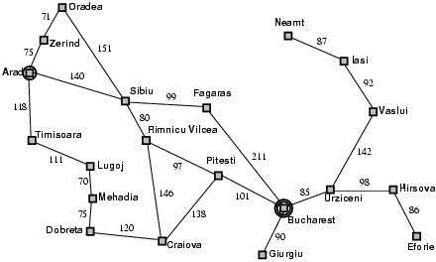
Romania Map Example with Costs

Slide 8
h(n) = estimate of cost from n to goal
  e.g., h(n) = straight-line distance from n to Bucharest
Greedy best-first search expands the node that appears to be closest to goal.
  Priority queue sort function = h(n)

Slide 9

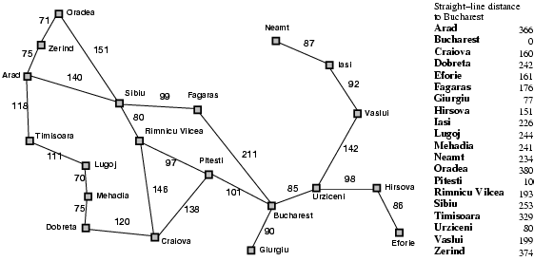
Greedy best-first search example

Slide 10
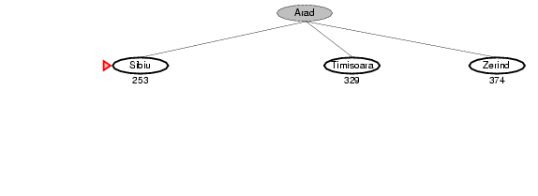
Greedy best-first search example

Slide 11
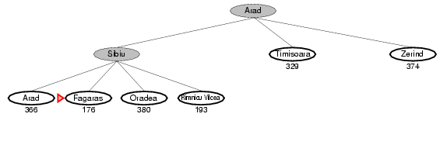
Greedy best-first search example

Slide 12
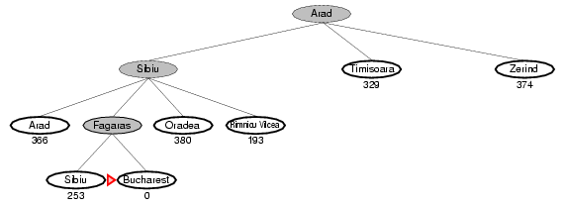
Greedy best-first search example

Slide 13

Optimal Path

Slide 14
Properties of greedy best-first search
Complete?
  Tree version can get stuck in loops.
  Graph version is complete in finite spaces.
Time? O(b^{m})
  A good heuristic can give dramatic improvement
Space? O(b^{m})
  Keeps all nodes in memory
Optimal? No
e.g., Arad → Sibiu → Rimnicu Vilcea → Pitesti → Bucharest is shorter!

Slide 15
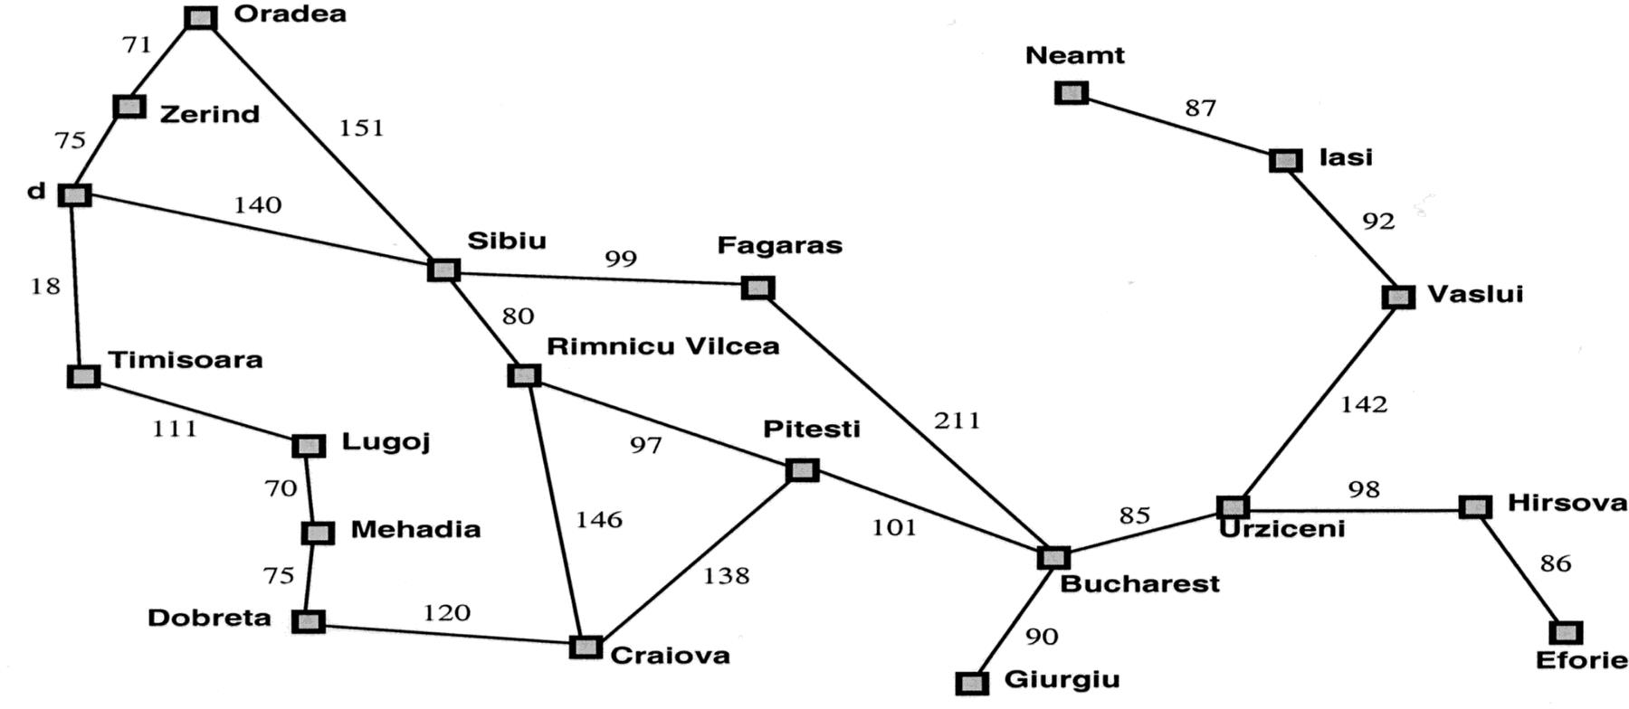
Properties of greedy best-first search
Optimal?
  No!
    Found: Arad → Sibiu → Fagaras → Bucharest (450km)
    Shorter: Arad → Sibiu → Rimnicu Vilcea → Pitesti→ Bucharest (418km)
Complete?
  No – can get stuck in loops,
  e.g., Iasi → Neamt → Iasi → Neamt →

Slide 16
A* search
Idea: avoid paths that are already expensive
  Generally the preferred simple heuristic search
  Optimal if heuristic is: admissible(tree)/consistent(graph)
Evaluation function f(n) = g(n) + h(n)
  g(n) = known path cost so far to node n.
  h(n) = estimate of (optimal) cost to goal from node n.
  f(n) = g(n)+h(n)
  = estimate of total cost to goal through node n.
Priority queue sort function = f(n)

Slide 17
A* search example
Frontier queue: Arad 366

Slide 18

A* search example
Frontier queue: Sibiu 393
Timisoara 447
Zerind 449
We add the three nodes we found to the Frontier queue. We sort them according to the g()+h() calculation.

Slide 19
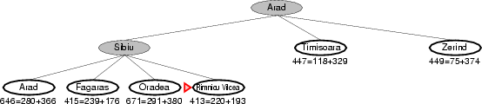
A* search example
Frontier queue: Rimricu Vicea 413
Fagaras 415
Timisoara 447
Zerind 449
Arad 646
Oradea 671
When we expand Sibiu, we run into Arad again. Note that we’ve already expanded this node once; but we still add it to the Frontier queue again.

Slide 20
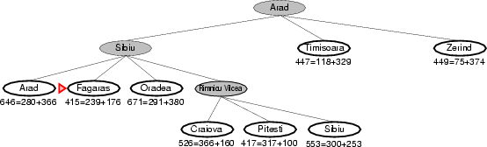
A* search example
Frontier queue: Fagaras 415
Pitesti 417
Timisoara 447
Zerind 449
Craiova 526
Sibiu 553
Arad 646
Oradea 671
We expand Rimricu Vicea.

Slide 21
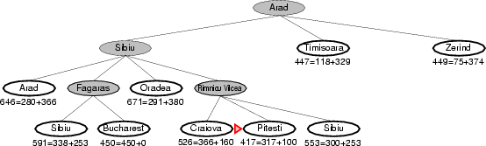
A* search example
Frontier queue:
Pitesti 417
Timisoara 447
Zerind 449
Bucharest 450
Craiova 526
Sibiu 553
Sibiu 591
Arad 646
Oradea 671
When we expand Fagaras, we find Bucharest, but we’re not done. The algorithm doesn’t end until we “expand” the goal node – it has to be at the top of the Frontier queue.

Slide 22
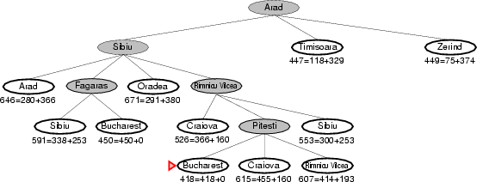
A* search example
Frontier queue: Bucharest 418
Timisoara 447
Zerind 449
Bucharest 450
Craiova 526
Sibiu 553
Sibiu 591
Rimricu Vicea 607
Craiova 615
Arad 646
Oradea 671
Note that we just found a better value for Bucharest!
Now we expand this better value for Bucharest since it’s at the top of the queue.
We’re done and we know the value found is optimal!

Slide 23

A* search example

Slide 24
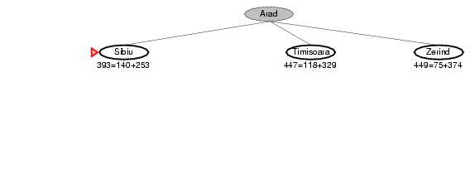
A* search example

Slide 25
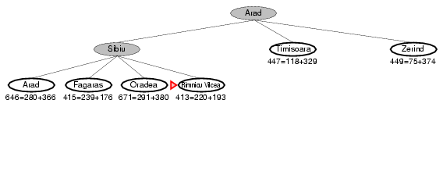
A* search example

Slide 26
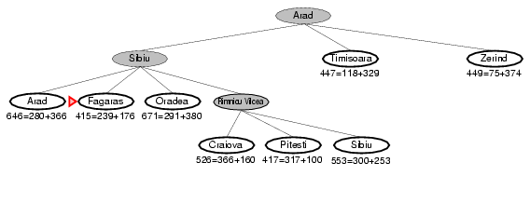
A* search example

Slide 27
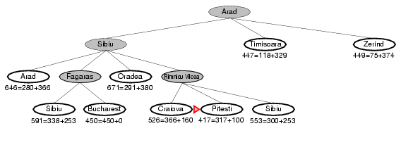
A* search example

Slide 28
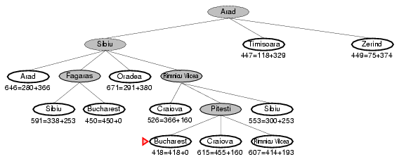
A* search example

Slide 29
A* search, evaluation
Completeness: YES
  Since bands of increasing f are added
  As long as b is finite
— (guaranteeing that there aren’t infinitely many nodes n with f (n) < f(G) )

Slide 30
A* search, evaluation
Completeness: YES
Time complexity:
  Number of nodes expanded is still exponential in the length of the solution.

Slide 31
A* search, evaluation
Completeness: YES
Time complexity: (exponential with path length)
Space complexity:
  It keeps all generated nodes in memory
  Hence space is the major problem not time

