Slide 1
Introduction to Machine Learning

Slide 2
Traditional Programming: You write explicit rules (e.g., "IF email contains 'free money' THEN mark as spam"). This works for simple problems but becomes unmanageable for complex ones with many variables.
A computer program is said to learn from experience E with respect to some task T and some performance measure P, if its performance on T, as measured by P, improves with experience E.

Slide 3
What is Machine Learning?
Machine Learning (ML) is a subset of Artificial Intelligence (AI) that gives computers the ability to learn and improve from experience without being explicitly programmed.
Machine Learning (ML) is a subfield of artificial intelligence (AI) that focuses on building systems that can learn from data rather than being explicitly programmed for a specific task. Instead of writing precise instructions for every possible scenario, we feed the machine large amounts of data, and it "learns" patterns and relationships from that data to make predictions or decisions on new, unseen data.

Slide 4
Why is ML important
Solves complex problems: Problems with too many factors for humans to explicitly program (e.g., image recognition, natural language processing).
Adaptability: ML systems can adapt to new data and changing environments.
Automation: Automates tasks that are repetitive or require significant human effort.
Personalization: Enables personalized experiences (e.g., recommendation systems).

Slide 5
Core Concepts of ML
Data: The fuel for machine learning. It can be structured (like tables in a database) or unstructured (like images, text, or videos).
  Features (or Attributes): The individual measurable properties or characteristics of the data being observed. For example, in predicting house prices, features might include square footage, number of bedrooms, and location.
  Instances (or Samples): A single data point or observation (e.g., a specific house with its features).
  Labels (or Targets): The output or the value we are trying to predict for a given instance (e.g., the price of a house). This is primarily used in supervised learning.

Slide 6
Core Concepts of ML
Model: A mathematical representation learned from the data. The model is what makes predictions or decisions. Think of it as the "knowledge" the machine has acquired.
Training: The process of feeding data to an algorithm to learn the model. The algorithm iteratively adjusts the model's parameters to minimize errors on the training data.
Testing (or Evaluation): The process of assessing the trained model's performance on new, unseen data (test data) to see how well it generalizes.
Prediction/Inference: Using the trained model to make predictions on new data for which we don't know the outcome.

Slide 7
Types of Machine Learning
Supervised Learning
Unsupervised Learning
Reinforcement Learning

Slide 8
Supervised Learning
The algorithm learns from labeled data. This means each data point in the training set has an input (features) and a corresponding correct output (label).
The goal is to learn a mapping function that can predict the output for new, unseen inputs.

Slide 9
Types of Supervised Learning
Classification (e.g., "spam" or "not spam," "cat" or "dog," "fraudulent" or "legitimate")
Regression (e.g., house price, temperature, stock price)

Slide 10
Key methods
Linear Regression: Predicts a continuous target variable, assuming a linear relationship with inputs. For example, predicting house prices based on square footage. The goal is to minimize the sum of squared errors, often using the least squares method.
Logistic Regression: Used for binary classification, modeling the probability of an input belonging to a class (e.g., 0 or 1) using the logistic (sigmoid) function. It maximizes the likelihood of observed data, making it suitable for tasks like email spam detection.
Decision Trees: A tree-like model where each node represents a decision based on a feature, leading to a class label or value at the leaves. It's intuitive, used for both classification and regression, and splits data to minimize impurity measures like Gini or entropy.

Slide 11
Support Vector Machines (SVMs): Finds the optimal hyperplane to separate classes, maximizing the margin between them. It can handle non-linear data using kernel tricks, making it versatile for complex classification tasks.
Neural Networks (Basics): Inspired by the human brain, these consist of layers of interconnected nodes (neurons) processing data. They're trained via backpropagation and gradient descent, excelling in tasks like image recognition,

Slide 12
Real-World Examples of Supervised Learning
| Application | Type | Description |
| ----------------------- | -------------- | ------------------------------------------ |
| Medical Diagnosis | Classification | Classify if a tumor is benign or malignant |
| Stock Market Prediction | Regression | Predict future stock prices |
| Email Spam Detection | Classification | Label emails as spam or not spam |

Slide 13
Spam Detection: Email services like Gmail train models on emails labeled as spam or not, helping filter unwanted messages.
Image Recognition: Platforms like Instagram use it to tag photos, identifying objects like dogs or faces.
House Price Prediction: Real estate tools like Zillow predict prices based on features like size and location.
Medical Diagnosis: Systems like IBM Watson Health predict diseases from patient data, aiding doctors.
Customer Churn Prediction: Companies like Netflix predict which users might leave, offering personalized offers to retain them.

Slide 14
Unsupervised Learning
The algorithm learns from unlabeled data. It tries to find hidden patterns, structures, or relationships within the data itself without explicit guidance on what to look for.
Analogy: Exploring a new dataset to discover interesting groupings or anomalies on your own.

Slide 15
Types of UnSupervised Learning
Clustering: Grouping similar data points together based on their features (e.g., customer segmentation, grouping similar documents, Anomaly Detection).
Dimensionality Reduction: Reducing the number of features while preserving important information (e.g., for data visualization or to improve performance of other ML algorithms).

Slide 16
Algorithms for Unsupervised Learning
K-Means Clustering
Hierarchical Clustering
DBSCAN
PCA
t-SNE

Slide 17
Unsupervised Learning Examples
Customer Segmentation: Amazon groups customers by buying habits for targeted marketing.
Anomaly Detection: PayPal identifies fraudulent transactions by spotting unusual patterns.
Recommendation Systems: Amazon’s “Frequently bought together” suggests products based on purchase history.
Dimensionality Reduction: Used in genomics to simplify data analysis, like in gene expression studies.
Topic Modeling: Google News groups articles into topics like sports or technology for better organization.
Social Network Analysis: LinkedIn finds professional networks to suggest connections.
Market Basket Analysis: Walmart places related items together, like diapers and beer, based on co-purchases.

Slide 18
| Application | Type | Description |
| --------------------- | ---------- | ------------------------------------ |
| Customer Segmentation | Clustering | Group customers by behavior |
| Topic Modeling | Clustering | Discover topics in documents |
| Anomaly Detection | Clustering | Identify unusual behavior in systems |

Slide 19
Reinforcement Learning
The algorithm learns by interacting with an environment. It performs actions and receives rewards or penalties based on those actions. The goal is to learn a policy (a strategy) that maximizes the cumulative reward over time.
Analogy: Learning to play a game by trial and error, where you get points for good moves and lose points for bad ones.

Slide 20
Key Components:
  Agent: The learner or decision-maker.
  Environment: The world the agent interacts with.
  State: The current situation of the agent in the environment.
  Action: A move the agent can make.
  Reward (or Penalty): Feedback from the environment based on the action taken.
  Example: Training a robot to navigate a maze by rewarding it for reaching the exit and penalizing it for hitting walls.

Slide 21
The Machine Learning Workflow
Problem Definition: Clearly understand the problem you want to solve and whether ML is the right approach.
Data Collection: Gather relevant data.
Data Preprocessing: Clean the data (handle missing values, outliers), transform it (feature scaling, encoding categorical variables), and split it into training and testing sets. This is often the most time-consuming part!
Model Selection: Choose an appropriate ML algorithm based on the problem type (classification, regression, clustering) and the nature of your data.
Model Training: Feed the training data to the selected algorithm to learn the model parameters.

Slide 22
Model Evaluation: Assess the model's performance on the test data using appropriate metrics (e.g., accuracy, precision, recall for classification; mean squared error for regression).
Parameter Tuning (Hyperparameter Optimization): Adjust the algorithm's settings (hyperparameters) to improve performance.
Deployment: Integrate the trained model into a real-world application to make predictions on new data.
Monitoring & Maintenance: Continuously monitor the model's performance in production and retrain it as needed with new data.

Slide 23
Applications of Machine Learning
Healthcare: Disease diagnosis, drug discovery, personalized medicine.
Finance: Fraud detection, algorithmic trading, credit scoring.
Retail: Recommendation systems, customer churn prediction, demand forecasting.
Transportation: Self-driving cars, traffic prediction, route optimization.
Entertainment: Content recommendation (Netflix, Spotify), game AI.

Slide 24
Manufacturing: Predictive maintenance, quality control.
Natural Language Processing (NLP): Machine translation, sentiment analysis, chatbots.
Computer Vision: Image recognition, object detection, facial recognition.

Slide 26
K-Means Clustering
K-Means is one of the simplest and most popular unsupervised learning algorithms.
K-Means is a clustering algorithm, which means its goal is to group similar data points together into a predefined number (K) of distinct, non-overlapping subgroups called clusters.

Slide 27
The algorithm tries to make the data points within each cluster as similar as possible (high intra-cluster similarity) while making the data points in different clusters as dissimilar as possible (low inter-cluster similarity).
It achieves this by iteratively assigning data points to the nearest cluster "center" (called a centroid) and then re-calculating the centroid based on the mean of the points assigned to it.

Slide 28
How K-Means Works (The Algorithm Steps):
Choose the Number of Clusters (K): This is a crucial first step. You, the user, must specify how many clusters you expect to find in the data. There are methods to help choose an optimal K (like the Elbow method, discussed later).
Initialize Centroids: Randomly select K data points from your dataset to serve as the initial centroids. Alternatively, centroids can be initialized using other strategies like K-Means++.

Slide 29
Assign Data Points to Clusters (Assignment Step):
For each data point in your dataset, calculate its distance to every centroid. Common distance metrics include:
Euclidean Distance: The most common, representing the straight-line distance between two points.
For two points P=(p 1,p2,...,pn ) and Q=(q1,q2,...,qn),
the Euclidean distance is (p1 −q 1 ) 2+(p2−q2 )2 +...+(pn −qn)2
Assign the data point to the cluster whose centroid is closest (i.e., has the minimum distance).

Slide 30
Update Centroids (Update Step):
  Once all data points have been assigned to a cluster, recalculate the centroid for each of the K clusters.
  The new centroid of a cluster is the mean (average) of all the data points currently assigned to that cluster. This is why it's called "K-Means."

Slide 31
Repeat and Converge: Repeat steps 3 and 4 iteratively. The algorithm has converged when:
  The cluster assignments of the data points no longer change between iterations.
  The centroids no longer move significantly.
  A predefined maximum number of iterations is reached

Slide 32

K-Means Clustering Algorithm
K-Means Clustering Algorithm involves the following steps:
Step 1: Calculate the number of K (Clusters).
Step 2: Randomly select K data points as cluster center.
Step 3: Using the Euclidean distance formula measure the distance between each data point and each cluster center.

Slide 33
Step 4: Assign each data point to that cluster whose center is nearest to that data point.
Step 5: Re-compute the center of newly formed clusters. The center of a cluster is computed by taking the mean of all the data points contained in that cluster.
Step 6: Keep repeating the procedure from Step 3 to Step 5 until any of the following stopping criteria is met
  If data points fall in the same cluster
  Reached maximum of iteration
  The newly formed cluster does not change in center points

Slide 34
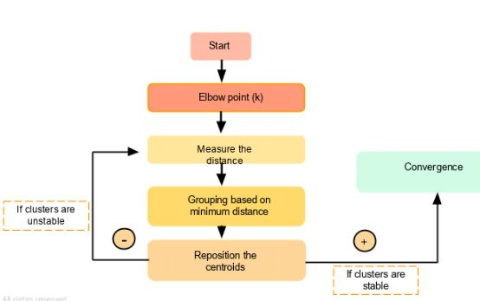

Slide 35
Example
Lets consider we have cluster points P1(1,3) , P2(2,2) , P3(5,8) , P4(8,5) , P5(3,9) , P6(10,7) , P7(3,3) , P8(9,4) , P9(3,7).
First, we take our K value as 3 and we assume that our Initial cluster centers are P7(3,3), P9(3,7), P8(9,4) as C1, C2, C3. We will find out the new centroids after 2 iterations for the above data points.

Slide 36
Step 1
Find the distance between data points and Centroids. which data points have a minimum distance that points moved to the nearest cluster centroid.

Slide 37
Iteration 1
Calcualte the distance between data points and K (C1,C2,C3)
C1P1 =>(3,3)(1,3) => sqrt[(1–3)²+(3–3)²] => sqrt[4] =>2
C2P1 =>(3,7)(1,3)=> sqrt[(1–3)²+(3–7)²] => sqrt[20] =>4.5
C3P1 =>(9,4)(1,3) => sqrt[(1–9)²+(3–4)²]=> sqrt[65] =>8.1
For P2,
C1P2 =>(3,3)(2,2) => sqrt[(2–3)²+(2–3)²] => sqrt[2] =>1.4
C2P2 =>(3,7)(2,2)=> sqrt[(2–3)²+(2–7)²] => sqrt[26] =>5.1
C3P2 =>(9,4)(2,2) => sqrt[(2–9)²+(2–4)²]=> sqrt[53] =>7.3
For P3,
C1P2 =>(3,3)(5,8) => sqrt[(5–3)²+(8–3)²] => sqrt[29] =>5.3
C2P2 =>(3,7)(5,8)=> sqrt[(5–3)²+(8–7)²] => sqrt[5] =>2.2
C3P2 =>(9,4)(5,8) => sqrt[(5–9)²+(8–4)²]=> sqrt[32] =>5.7

Slide 38
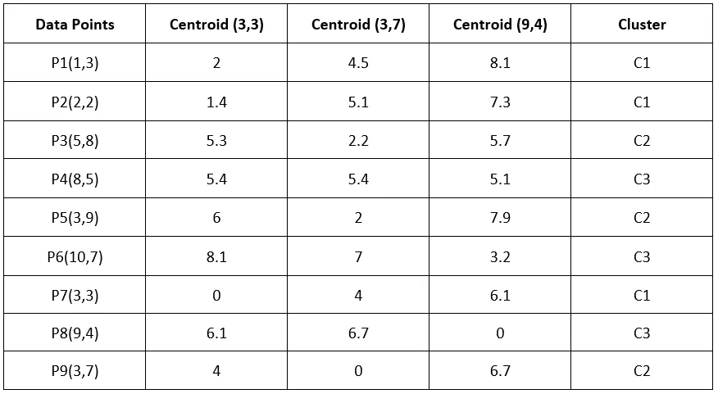
Similarly for other distances..

Slide 39
Cluster 1 => P1(1,3) , P2(2,2) , P7(3,3)
Cluster 2 => P3(5,8) , P5(3,9) , P9(3,7)
Cluster 3 => P4(8,5) , P6(10,7) , P8(9,4)
Now, We re-compute the new clusters and the new cluster center is computed by taking the mean of all the points contained in that particular cluster.
New center of Cluster 1 => (1+2+3)/3 , (3+2+3)/3 => 2,2.7
New center of Cluster 2 => (5+3+3)/3 , (8+9+7)/3 => 3.7,8
New center of Cluster 3 => (8+10+9)/3 , (5+7+4)/3 => 9,5.3

Slide 40
Iteration 1 is over. Now, let us take our new center points and repeat the same steps which are to calculate the distance between data points and new center points with the Euclidean formula and find cluster groups.
Iteration 2
Calcualte the distance between data points and K (C1,C2,C3)
C1(2,2.7) , C2(3.7,8) , C3(9,5.3)
C1P1 =>(2,2.7)(1,3) => sqrt[(1–2)²+(3–2.7)²] => sqrt[1.1] =>1.0
C2P1 =>(3.7,8)(1,3)=> sqrt[(1–3.7)²+(3–8)²] => sqrt[32.29] =>4.5
C3P1 =>(9,5.3)(1,3) => sqrt[(1–9)²+(3–5.3)²]=> sqrt[69.29] =>8.3

Slide 41
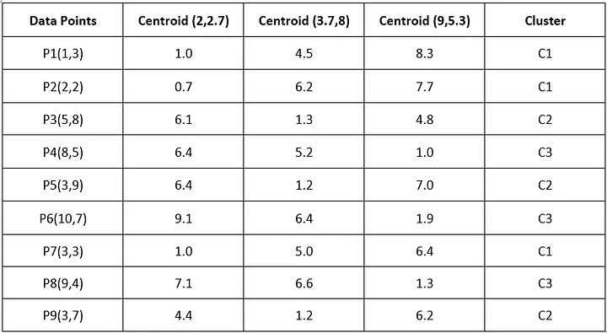
Similarly for other distances

Slide 42
Cluster 1 => P1(1,3) , P2(2,2) , P7(3,3)
Cluster 2 => P3(5,8) , P5(3,9) , P9(3,7)
Cluster 3 => P4(8,5) , P6(10,7) , P8(9,4)
Center of Cluster 1 => (1+2+3)/3 , (3+2+3)/3 => 2,2.7
Center of Cluster 2 => (5+3+3)/3 , (8+9+7)/3 => 3.7,8
Center of Cluster 3 => (8+10+9)/3 , (5+7+4)/3 => 9,5.3
We got the same centroid and cluster groups which indicates that this dataset has only 2 groups. K-Means clustering stops iteration because of the same cluster repeating so no need to continue iteration and display the last iteration as the best cluster groups for this dataset.

Slide 43
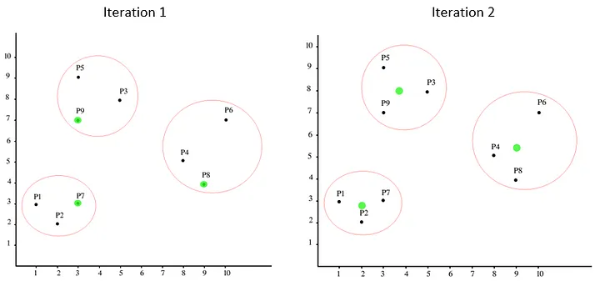
The Below graph explained the difference between iterations 1 and 2. We can see centroids (green dot) changed in the 2nd Iteration.

Slide 44
Example: Segmenting Online Shoppers Based on Purchase Behavior
An e-commerce company wants to group its customers into distinct segments to tailor marketing strategies.
They use K-means clustering to categorize customers based on two key features:
Annual Spending (in $)
Number of Purchases per Year

Slide 45
Step 1: Data Collection
The company collects data from 500 customers:
Customer ID Annual Spending ($) Number of Purchases
1 1200 15
2 800 10
... ... ...
500 3000 25

Slide 46
Step 2: Choosing K (Number of Clusters)
Using the Elbow Method, they determine that K=3 (Low, Medium, High-value customers) is optimal.

Slide 47
Step 3: Applying K-means Clustering
The algorithm groups customers into 3 clusters:
Cluster 1 (Low-Value Customers):
  Low annual spending (~$500)
  Few purchases (~5/year)
  Marketing strategy: Discounts to encourage more purchases.
Cluster 2 (Medium-Value Customers):
  Moderate spending (~$1500)
  Moderate purchases (~12/year)
  Strategy: Loyalty programs to increase retention.
Cluster 3 (High-Value Customers):
  High spending (~$3000+)
  Frequent purchases (~20+/year)
  Strategy: Exclusive offers & premium support.

Slide 48
Step 4: Business Impact
By targeting each group differently, the company improves:
Customer retention (by personalizing offers)
Revenue (upselling high-value customers)
Marketing efficiency (reducing ad spend on low-value customers)

Slide 49
Output Explanation
Initial State (Before 1st Iteration)
  Gray points: Raw data.
  Red X: Randomly initialized centroids.
After Each Iteration
  Colored points: Cluster assignments.
  Black X: Centroids from the previous iteration.
  Yellow *: Updated centroids.
  Arrows (optional): Show centroid movement direction.
Final State
  Centroids stabilize (no more changes).
  Clear separation into 3 clusters.

Slide 50
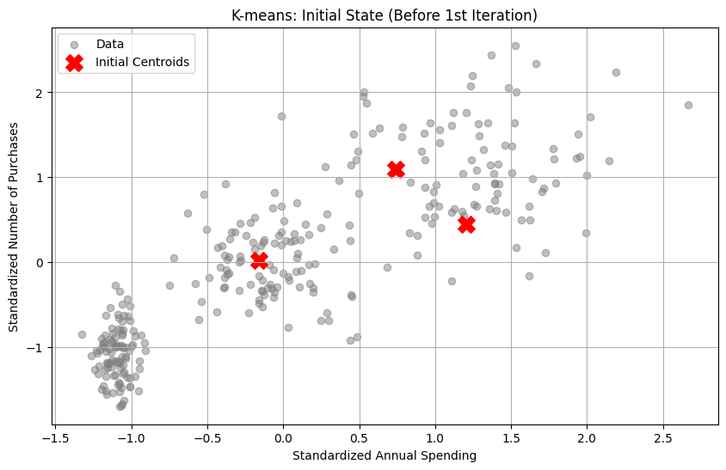
Example Output

Slide 51
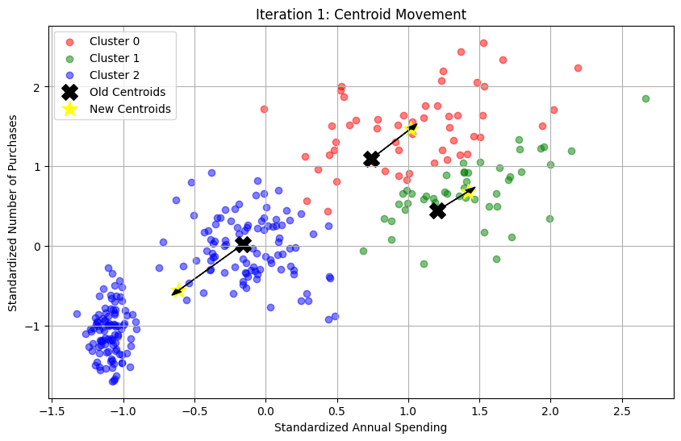
Example Output

Slide 52
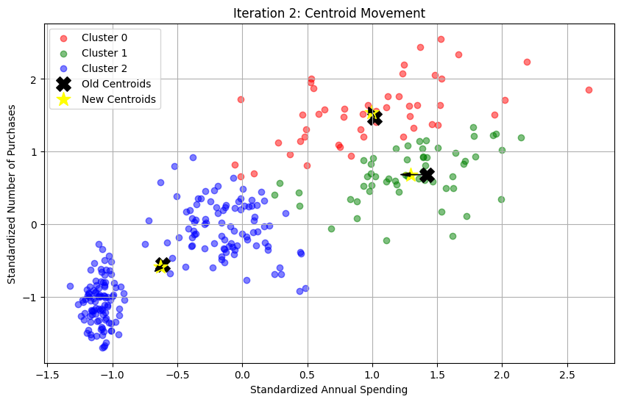
Example Output

Slide 53
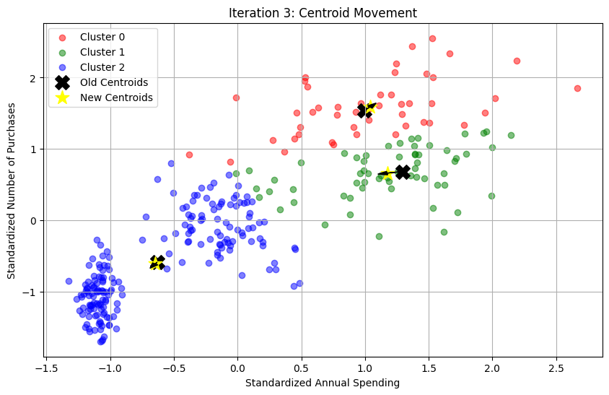

Slide 54


Slide 55
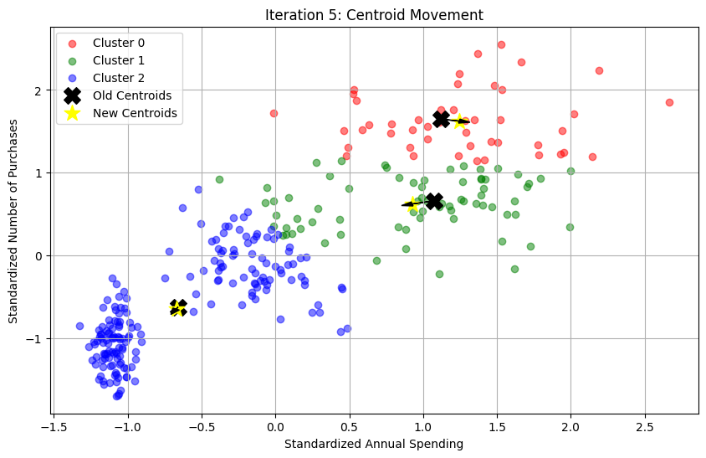

Slide 56


Slide 57
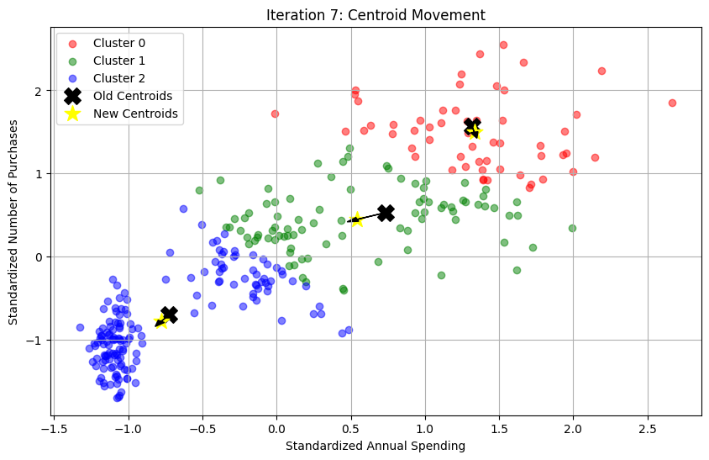

Slide 58
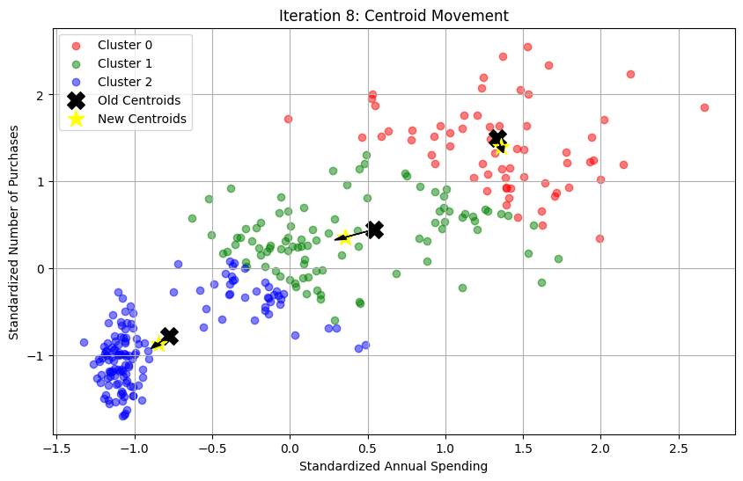

Slide 59
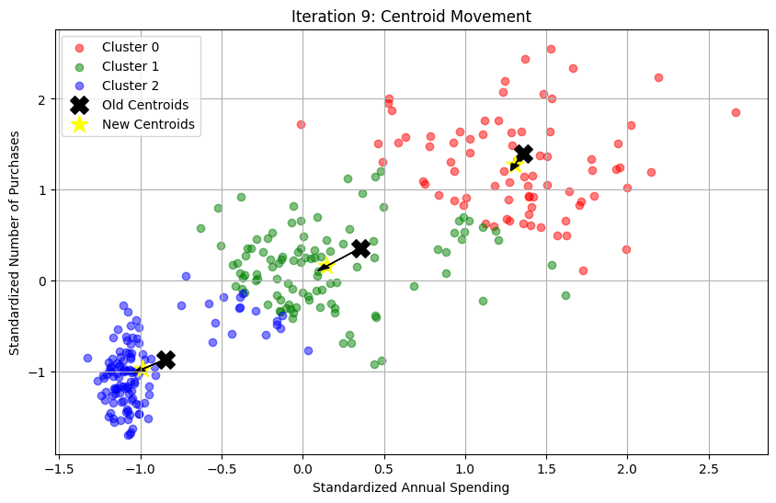

Slide 60
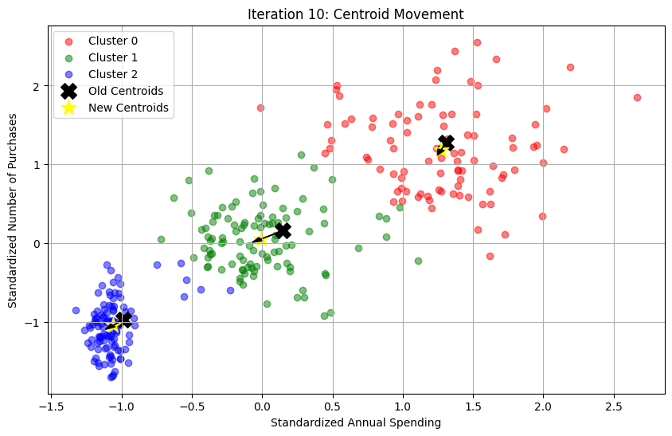

Slide 61
Neural Networks (NN)
A neural network is a computational model inspired by the structure and functioning of the human brain.
It consists of interconnected nodes (called neurons or units) that work together to process information and solve complex problems.
Neural networks are widely used in machine learning and deep learning for tasks such as image recognition, natural language processing, speech recognition, and more.

Slide 62
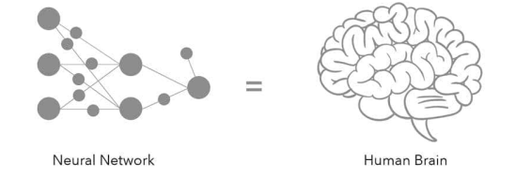
Neural networks are designed to mimic the way biological neurons communicate with each other through synapses.
They learn patterns from data and generalize to make predictions or decisions.

Slide 63
Biological Inspiration
The Human Neuron
  Cell body (soma): Processes incoming signals
  Dendrites: Receive signals from other neurons
  Axon: Transmits signals to other neurons
  Synapses: Connection points between neurons
How it translates to artificial networks:
  Biological neurons → Artificial nodes/neurons
  Synaptic strength → Connection weights
  Neural firing → Activation functions
  Learning → Weight adjustment

Slide 64
Structure of Artificial Neural Networks
Basic Components:
Neurons (Nodes)
  Basic processing units that receive inputs, process them, and produce outputs
  Each neuron applies a mathematical function to its inputs
Connections (Weights)
  Links between neurons that carry signals
  Each connection has a weight that determines the strength of the signal
  Positive weights = excitatory, Negative weights = inhibitory

Slide 65
Layers
  Input Layer: Receives raw data
  Hidden Layer(s): Process data through weighted connections and activation functions
  Output Layer: Produces final results
Activation Functions
Mathematical functions that determine if a neuron should be activated:
  Sigmoid: σ(x) = 1/(1 + e^(-x)) - Output between 0 and 1
  ReLU: f(x) = max(0, x) - Most popular in modern networks
  Tanh: f(x) = (e^x - e^(-x))/(e^x + e^(-x)) - Output between -1 and 1

Slide 66
Basic Architecture
A typical neural network is organized into layers:
Input Layer: This layer receives the raw input data.
  Each neuron in the input layer represents a feature of the input.
  For example, if you're trying to predict house prices, input features might include square footage, number of bedrooms, and location.
Hidden Layer(s): These layers are located between the input and output layers. This is where most of the "computation" happens.
Neurons in hidden layers transform the input data through a series of weighted sums and activation functions.
A network can have zero or many hidden layers.
Networks with multiple hidden layers are often called deep neural networks.

Slide 67
Output Layer:
  This layer produces the final result of the network.
  The structure of the output layer depends on the task:
  For classification tasks (e.g., identifying if an image is a cat or a dog), it might have one neuron for each class.
  For regression tasks (e.g., predicting a house price), it might have a single neuron outputting a numerical value.

Slide 68
Components of a Neuron
Weights:
  Each connection between neurons has an associated weight.
  These weights determine the strength of the connection and are the primary parameters the network learns during training.
Bias:
  Each neuron (except input neurons, typically) has a bias term.
  The bias allows the neuron to be activated even when all its inputs are zero, providing more flexibility to the model.

Slide 69
Activation Function:
  After a neuron calculates a weighted sum of its inputs and adds the bias, an activation function is applied.
  This function introduces non-linearity into the model, allowing it to learn more complex patterns.
  Common activation functions include Sigmoid, ReLU (Rectified Linear Unit), and Tanh.

Slide 70
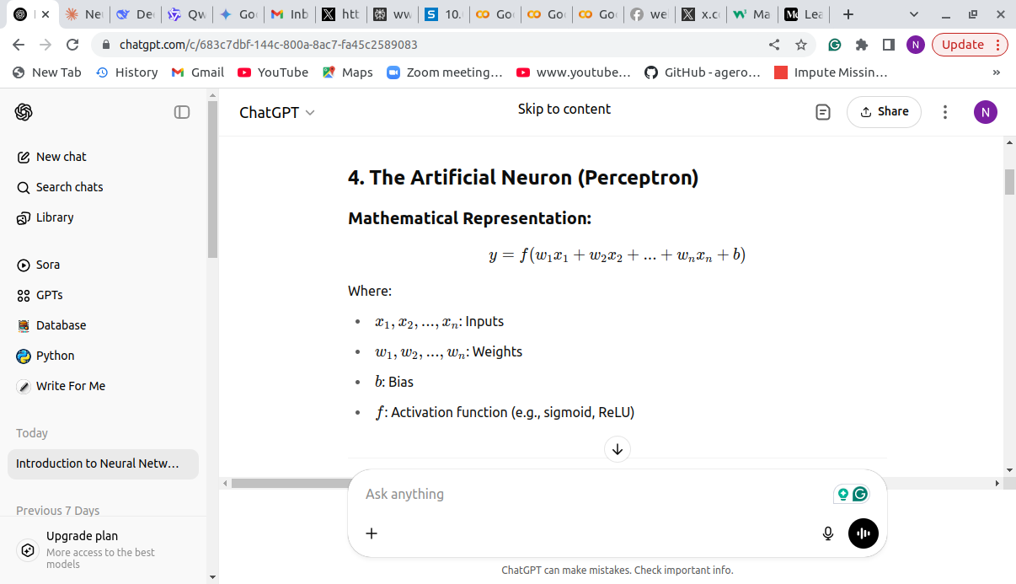
Mathematically, the output y of a single neuron can be represented as:

Slide 71
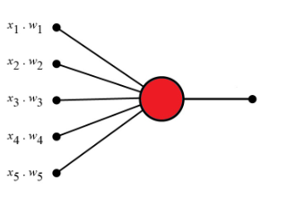
Perceptrons
The Perceptron defines the first step into Neural Networks.
It represents a single neuron with only one input layer, and no hidden layers.

Slide 72
How Neural Networks Work
Neural networks operate in two phases:
Forward Propagation:
  Input data passes through the layers.
  Each neuron computes a weighted sum of inputs, adds a bias, and applies an activation function.
  The output layer produces the final prediction.
Backpropagation:
  The network compares the predicted output to the actual output using a loss function (e.g., Mean Squared Error for regression, Cross-Entropy for classification).
  The error is propagated backward to update weights and biases using an optimization algorithm like Gradient Descent.

Slide 73
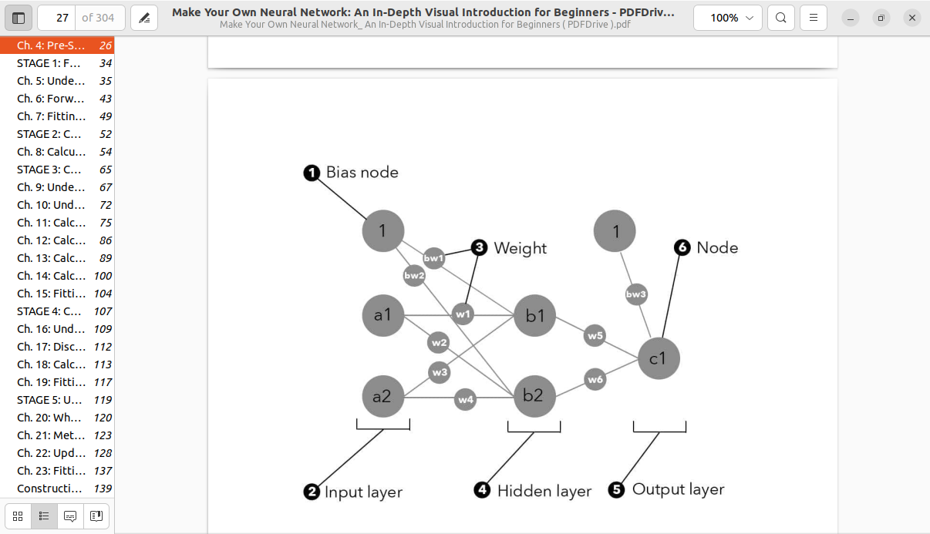
Simple Neural Network Architecture

Slide 74
Input Layer: 2 neurons (x₁, x₂)
Hidden Layer: 2 neurons (h₁, h₂)
Output Layer: 1 neuron (y)
Activation Function: Sigmoid σ(z) = 1/(1 + e^(-z))
Loss Function: Mean Squared Error L = ½(target - predicted)²

Slide 75
Initial Weights and Biases:
Input to Hidden weights: W₁ = [[0.5, -0.3], [0.2, 0.8]]
Hidden to Output weights: W₂ = [[0.4], [0.6]]
Hidden biases: b₁ = [0.1, -0.2]
Output bias: b₂ = [0.3]
Training Example:
Input: x = [1.0, 0.5]
Target: t = 0.8

Slide 76
Part 1: Forward Propagation
Step 1: Input to Hidden Layer
Calculate Hidden Layer Input (z₁):
z₁₁ = (x₁ × w₁₁) + (x₂ × w₂₁) + b₁₁
z₁₁ = (1.0 × 0.5) + (0.5 × 0.2) + 0.1
z₁₁ = 0.5 + 0.1 + 0.1 = 0.7
z₁₂ = (x₁ × w₁₂) + (x₂ × w₂₂) + b₁₂
z₁₂ = (1.0 × -0.3) + (0.5 × 0.8) + (-0.2)
z₁₂ = -0.3 + 0.4 - 0.2 = -0.1

Slide 77
Apply Activation Function (Sigmoid)
h₁ = σ(z₁₁) = σ(0.7) = 1/(1 + e^(-0.7)) = 1/(1 + 0.497) = 0.668
h₂ = σ(z₁₂) = σ(-0.1) = 1/(1 + e^(0.1)) = 1/(1 + 1.105) = 0.475

Slide 78
Step 2: Hidden to Output Layer
Calculate Output Layer Input (z₂):
z₂ = (h₁ × w₂₁) + (h₂ × w₂₂) + b₂
z₂ = (0.668 × 0.4) + (0.475 × 0.6) + 0.3
z₂ = 0.267 + 0.285 + 0.3 = 0.852

Slide 79
Apply Activation Function:
y = σ(z₂) = σ(0.852) = 1/(1 + e^(-0.852)) = 1/(1 + 0.427) = 0.701.
Step 3: Calculate Loss
Loss = ½(target - predicted)²
Loss = ½(0.8 - 0.701)²
Loss = ½(0.099)²
Loss = ½(0.0098) = 0.0049

Slide 80
Forward Propagation Summary
Input: [1.0, 0.5]
Hidden activations: [0.668, 0.475]
Output: 0.701
Target: 0.8
Loss: 0.0049

Slide 81
Part 2: Backward Propagation
Step 1: Output Layer Gradients
Calculate Output Error (δ₃):
δ₃ = (predicted - target) × σ'(z₂)

Slide 82

First, calculate sigmoid derivative:
σ'(z₂) = σ(z₂) × (1 - σ(z₂)) = 0.701 × (1 - 0.701) = 0.701 × 0.299 = 0.210
Then:
δ₃ = (0.701 - 0.8) × 0.210 = (-0.099) × 0.210 = -0.021

Slide 83
Calculate Weight Gradients (Hidden to Output):
∂L/∂w₂₁ = δ₃ × h₁ = -0.021 × 0.668 = -0.014
∂L/∂w₂₂ = δ₃ × h₂ = -0.021 × 0.475 = -0.010
Calculate Bias Gradient (Output):
∂L/∂b₂ = δ₃ = -0.021

Slide 84
Step 2: Hidden Layer Gradients
Calculate Hidden Layer Errors (δ₂):
For h₁:
σ'(z₁₁) = h₁ × (1 - h₁) = 0.668 × (1 - 0.668) = 0.668 × 0.332 = 0.222
δ₂₁ = (δ₃ × w₂₁) × σ'(z₁₁) = (-0.021 × 0.4) × 0.222 = -0.0084 × 0.222 = -0.0019
For h₂:
σ'(z₁₂) = h₂ × (1 - h₂) = 0.475 × (1 - 0.475) = 0.475 × 0.525 = 0.249
δ₂₂ = (δ₃ × w₂₂) × σ'(z₁₂) = (-0.021 × 0.6) × 0.249 = -0.0126 × 0.249 = -0.0031

Slide 85
Calculate Weight Gradients (Input to Hidden):
∂L/∂w₁₁ = δ₂₁ × x₁ = -0.0019 × 1.0 = -0.0019
∂L/∂w₁₂ = δ₂₁ × x₂ = -0.0019 × 0.5 = -0.00095
∂L/∂w₂₁ = δ₂₂ × x₁ = -0.0031 × 1.0 = -0.0031
∂L/∂w₂₂ = δ₂₂ × x₂ = -0.0031 × 0.5 = -0.00155
Calculate Bias Gradients (Hidden):
∂L/∂b₁₁ = δ₂₁ = -0.0019
∂L/∂b₁₂ = δ₂₂ = -0.0031

Slide 86
Part 3: Weight Updates
Using learning rate α = 0.5:
Update Hidden to Output Weights:
w₂₁_new = w₂₁_old - α × ∂L/∂w₂₁ = 0.4 - 0.5 × (-0.014) = 0.4 + 0.007 = 0.407
w₂₂_new = w₂₂_old - α × ∂L/∂w₂₂ = 0.6 - 0.5 × (-0.010) = 0.6 + 0.005 = 0.605

Slide 87
Update Output Bias:
b₂_new = b₂_old - α × ∂L/∂b₂ = 0.3 - 0.5 × (-0.021) = 0.3 + 0.0105 = 0.3105
Update Input to Hidden Weights:
w₁₁_new = 0.5 - 0.5 × (-0.0019) = 0.5 + 0.00095 = 0.50095
w₁₂_new = -0.3 - 0.5 × (-0.00095) = -0.3 + 0.000475 = -0.299525
w₂₁_new = 0.2 - 0.5 × (-0.0031) = 0.2 + 0.00155 = 0.20155
w₂₂_new = 0.8 - 0.5 × (-0.00155) = 0.8 + 0.000775 = 0.800775

Slide 88
Update Hidden Biases:
b₁₁_new = 0.1 - 0.5 × (-0.0019) = 0.1 + 0.00095 = 0.10095
b₁₂_new = -0.2 - 0.5 × (-0.0031) = -0.2 + 0.00155 = -0.19845

Slide 89
Before Training:
Weights W₁: [[0.5, -0.3], [0.2, 0.8]]
Weights W₂: [[0.4], [0.6]]
Biases b₁: [0.1, -0.2]
Bias b₂: [0.3]
Prediction: 0.701
Loss: 0.0049
After Training:
Weights W₁: [[0.50095, -0.299525], [0.20155, 0.800775]]
Weights W₂: [[0.407], [0.605]]
Biases b₁: [0.10095, -0.19845]
Bias b₂: [0.3105]

