Slide 1
Knowledge Representation

Slide 2
What is Knowledge?
Knowledge is awareness or familiarity gained by experiences of facts, Data and situations.
familiarity with the way to do something to perform a task;
an accumulation of facts, procedural rules or heuristics.

Slide 3
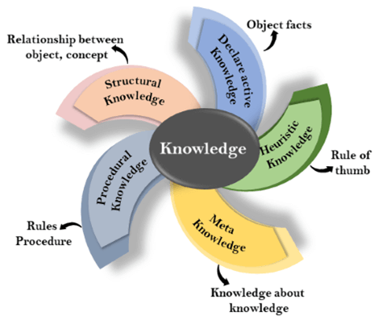
Types of knowledge

Slide 4
Declarative Knowledge:
Declarative knowledge is to know about something.
It includes concepts, facts, and objects.
It is also called descriptive knowledge and expressed in declarative sentences.

Slide 5
Procedural Knowledge
It is also known as imperative knowledge.
Procedural knowledge is a type of knowledge which is responsible for knowing how to do something.
It can be directly applied to any task.
It includes rules, strategies, procedures, agendas, etc.
Procedural knowledge depends on the task on which it can be applied.

Slide 6
Heuristic knowledge
Heuristic knowledge is representing knowledge of some experts in a filed or subject.
Heuristic knowledge is rules of thumb based on previous experiences, awareness of approaches, and which are good to work but not guaranteed.
  Example:
    If a person drives no more
    than 5 miles above the
    speed limit, then that
    person is not likely to be
    stopped for speeding

Slide 7
Structural knowledge
Structural knowledge is basic knowledge to problem-solving.
It describes relationships between various concepts such as kind of, part of, and grouping of something.
It describes the relationship that exists between concepts or objects.

Slide 8
Meta-knowledge:
Knowledge about the other types of knowledge is called Meta-knowledge.
Knowledge on knowing which knowledge to use to solve a problem
Always used by experts to enhance the efficiency of problem solving
Example:
  if you want to know about heart attack, please read this book

Slide 9
Knowledge Representation
Knowledge representation is
“a science of translating actual knowledge into a format that can be used by the computer”.

Slide 10
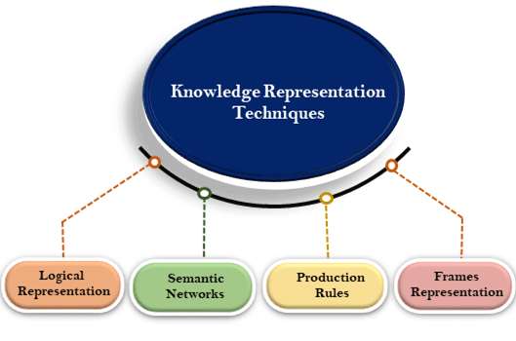
Techniques of knowledge representation

Slide 11
Logical Representation
Logical representation means drawing a conclusion based on various conditions.
It consists of precisely defined syntax and semantics which supports the sound inference.
Syntax:
Syntaxes are the rules which decide how we can construct legal sentences in the logic.
It determines which symbol we can use in knowledge representation.
How to write those symbols.

Slide 12
Logical Representation
Semantics:
Semantics are the rules by which we can interpret the sentence in the logic.
Semantic also involves assigning a meaning to each sentence.

Slide 13
Logical Representation
Different logics exist, which allow you to represent different kinds of things.
Logical representation can be categorised into mainly two logics:
Propositional Logics
Predicate logics

Slide 14
Propositional logic
Propositional logic consists of:
The logical values true and false (T and F)
Propositions: “Sentences,” which
Are atomic (that is, they must be treated as indivisible units, with no internal structure), and
Often represented using symbols, e.g. P, Q, A etc.
Have a single logical value, either true or false

Slide 15
Propositional logic
Manipulate basic Boolean logic operations (AND, OR, NOT, IMPLIES, EQUIVALENCE.)
E.g.:
Normal :“Today is raining, therefore I will miss the class”
Logic : today_raining ⇒ i_will_miss_class
• propositional variables (A,B, . . . , P,Q, . . .)
• logical constants (True,False)
• logical connectives (∧,∨,⇒, . . .)
Every propositional variable stands for a basic fact
Examples: I’m hungry, Apples are red, Joe and Jill are friends
Combining two or more PL forms compound propositions (CP) or formulae.
CP consists of propositions and logical operators.

Slide 16
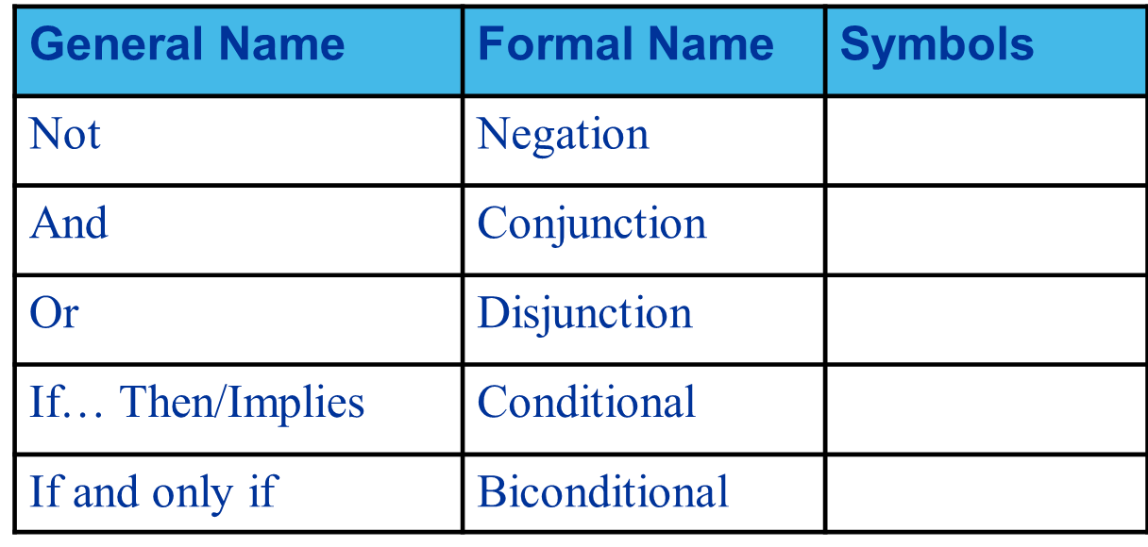
Propositional logic
Logical operators:

Slide 17
Propositional logic
Nested formulae – important to express the actual meaning of a wff.
E.g:
it_is_raining ⇒ kitty_is_outside ⇒ kitty_gets_wet
(1) (it_is_raining ⇒ kitty_is_outside) ⇒ kitty_gets_wet
(2) it_is_raining (kitty_is_outside ⇒ kitty_gets_wet)

Slide 18
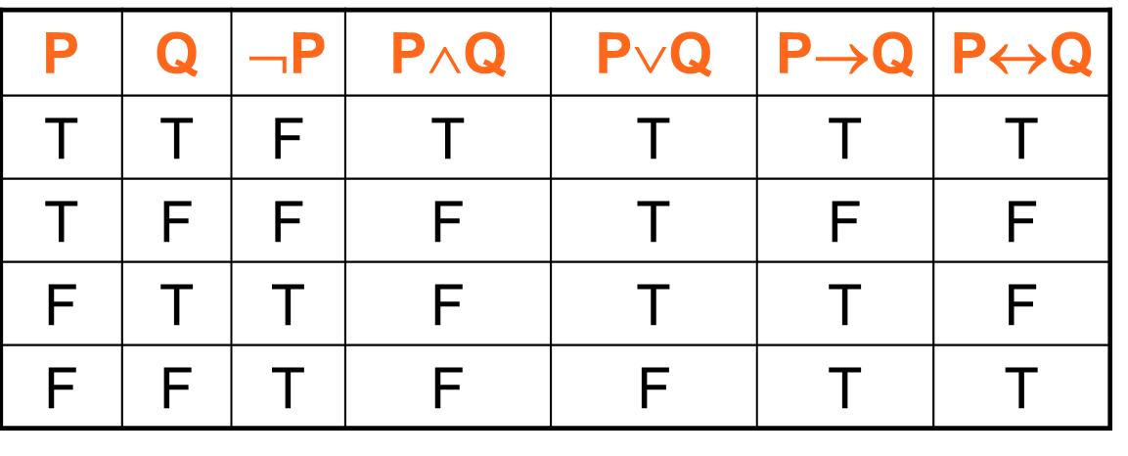
Propositional logic
Truth table – a common method to prove the truth value of any statement written in PL.

Slide 19
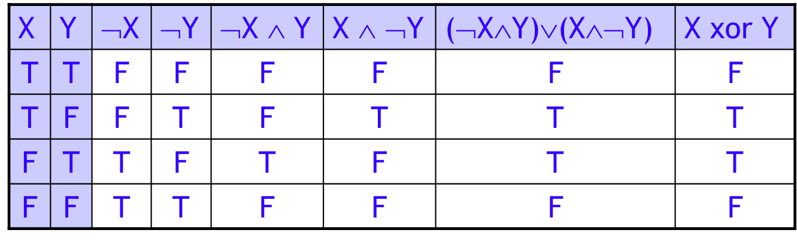
Propositional logic
Exclusive or (xor) is true if exactly one of its operands is true

Slide 20
Propositional logic
Truth table – determines the category of formula
  Tautology – formula is always T regardless of the truth values of its propositions.
    E.g. (P∧(P→Q))→Q
  Contingent – formula is sometimes T and sometimes F, depending on the truth values of its propositions
    E.g. (A∧B)→C
  Inconsistent – formula is always F regardless of the truth values of its propositions
    E.g. P∧(¬P)

Slide 21
Propositional logic
Limitation
  Cannot express universality of objects
    E.g.
      “all computers have processor”; “all birds fly”.
  Cannot express existence / inexistence / partial quantity of objects
    E.g.
      “there are some birds which cannot fly”
      “none of us is immortal”

Slide 22
Predicate Calculus
Also known as First Order Predicate Logic (FOPL).
This method overcomes the limitations of propositional logic through use of quantifiers and variables.
Main structure
  → argument (i.e. variables and/or constants) is linked by operator (i.e. functor).

Slide 23
Predicate Calculus
A predicate
    functor(argument1, argument2)
A predicate consists of functor and zero or more arguments
  Functor (or predicate name) relates the arguments
  Argument can be variables or constant
    Variables
      A symbol in capital letter or a word begins with upper case letter
      Represent general classes of objects or properties

Slide 24
Predicate Calculus
      E.g.:
      teach(X,Y)
      X and Y can be substituted with any value/constant such as:
      ‘dave’ and ‘comp5346’,
      resulting in:
      teach(dave,comp5346)

Slide 25
Predicate Calculus
    Constant
      A symbol or string of letters begins with lower case letter
      Represent specific classes of objects or properties
      E.g.:
        ‘dave’ and ‘comp5436’ are constants
        ‘dAVe’ and ‘coMP5436’ are also valid constants
        What about ‘Dave’ and ‘COMP5436’? Are they the valid constants? Why?

Slide 26
Predicate Calculus
Basic idea
  functor(variable_1, variable_2, ….)
    E.g.
      “she likes chocolate”
            likes(she, chocolate)
      “tweety is a bird”
      isa(tweety,bird) OR
      bird(tweety)

Slide 27
Quantifier ‘∀’ and ‘∃’
Universal quantifier (∀X)
  ∀ means ‘for all’
  Indicates the expression is T (i.e. true) for ALL values of designated variables
  E.g.: ∀X likes(X,icecream)
    For all values of X, the statement ‘X likes ice cream’ is true
  E.g.:
    “all birds fly” is represented as ∀X (bird(X) ∧ flies(X))
    This also means “no birds do not fly”, thus it can also be represented as ¬∃X ¬flies(X).

Slide 28
Quantifier ‘∀’ and ‘∃’
Existential quantifier (∃X)
  ∃ means ‘there exist’.
  Indicates the expression is T (i.e. true) for SOME values of designated variables (at least one value exists that makes the statement T)
  E.g.: “some children like ice cream”
    Is represented as:
      ∃X likes(X,icecream) OR ∃Children likes(Children,icecream)
      Can also be represented as ¬∀X likes(X,icecream) …. As the statement also means ‘not all children like ice cream’.
  E.g.: “some birds do not fly”
    is represented as ∃X (bird(X) ∧ ¬flies(X))

Slide 29
Some examples
E.g. 1:
  Normal: If it doesn’t rain today, Ahmad will go to the beach
  FOPL: “¬rain(today)→ go(Ahmad, beach)”
E.g. 2:
  Normal: All volleyball players are tall
  FOPL: “∀X (volleyball_player (X) → tall (X))”
E.g. 3:
  Normal: Some people like durian.
  FOPL: “∃X (person(X) ∧ likes(X, apple))”
E.g. 4:
  Normal: Nobody likes war
  FOPL: “∀ X ¬ likes (X, war)” OR “¬∃X likes(X,war)”

Slide 30
Some examples
Everyone likes McDonalds
  ∀x, likes(x, McDonalds)
Someone likes McDonalds
  ∃x, likes(x, McDonalds)
All children like McDonalds
  ∀x, child(x) ⇒ likes(x, McDonalds)
Everyone likes McDonalds unless they are allergic to it
  ∀x, likes(x, McDonalds) ∨ allergic(x, McDonalds)
  ∀x, ¬allergic (x, McDonalds) ⇒ likes(x, McDonalds)

Slide 31
Nesting Quantifiers
Everyone likes some kind of food
  ∀y ∃x, food(x) ∧ likes(y, x)
There is a kind of food that everyone likes
  ∃x ∀y, food(x) ∧ likes(y, x)
Someone likes all kinds of food
  ∃y ∀x, food(x) ∧ likes(y, x)
Every food has someone who likes it
  ∀x ∃y, food(x) ∧ likes(y, x)

Slide 32
Nesting Quantifiers
Quantifier Duality
  Not everyone like McDonalds
  ¬(∀x, likes(x, McDonalds))
  ∃x, ¬likes(x, McDonalds)
  No one likes McDonalds
  ¬(∃x, likes(x, McDonalds))
  ∀x, ¬likes(x, McDonalds)

Slide 34
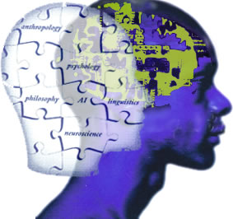
KNOWLEDGE
REASONING & INFERENCE
action
object
interpretation
perceive

Slide 35
Definition
Reasoning is
  A process of applying knowledge to arrive at solution
  Requires the ability to infer conclusions from the available facts
  To reason is to think clearly and logically, to draw reasonable inference or conclusion from known or assumed facts
  It works through interaction of rules and data

Slide 36
Definition
Process of working with knowledge, facts and problem solving strategies to draw conclusions

Slide 37
Definition
Inference is
  A reasoning mechanism that is used to relate between facts and rules to derive a new conclusion or fact

Slide 38
Reasoning Types
5 types of reasoning:
  Deductive
  Inductive
  Abductive
  Analogical
  Commonsense

Slide 39
Reasoning Types
Deductive reasoning
  A process in which general premises are used to obtain specific inference.
  E.g. 1:
  P1: rainy_day → wet_grass
  P2: wet_grass
  rainy_day
  E.g. 2:
  P1: mother(X) → female(X)
  P2: mother(lily)
  female(lily)

Slide 40
Reasoning Types
Inductive Reasoning
  Human sometimes make new conclusion by generalizing from a limited set of facts.
  E.g:
P1: Monkeys in the National Zoo eats bananas
P2: Monkeys in Taiping Zoo eats bananas
All monkeys eat bananas
Generalized to all monkeys

Slide 41
Reasoning Types
Abductive reasoning
  A form of deduction that allows for plausible inference, meaning that, the conclusion might follow from available information, but it might be wrong.
  If A → B is true, given B is true, then the conclusion A is true might be deduced, but it can be false.
  E.g.:
  P1: rainy_day → wet_grass
  P2: wet_grass
    rainy_day? … or maybe someone watered the grass last night.

Slide 42
Reasoning Types
Analogical Reasoning
  Mapping of a mental model (developed from experience) to situation or objects.
  E.g.:
  Q: “What are the working hours of engineers in the company”
    Mental model (of white-collar employees) : ‘white collar employees work from 8am to 5pm’
          Engineers are white-collar employees
            Engineers work from 8am to 5pm.
Mapping the white collar employees → engineers

Slide 43
Reasoning Types
Commonsense Reasoning
  Based on heuristic (knowledge that is gained through experience).
  Relies more on good judgment than on exact logic.
  E.g.:
    “A loose fan usually causes strange noises”.
                OR
              strange_noise → loose_fan
  Valuable for quick solutions.

Slide 44
Important Concepts in Reasoning & Inference
Concept 1 : Pattern matching
  A process of matching between symbols, and between predicates, to determine whether they are identical and therefore, match to each other.
Concept 2 : Instantiation
  A process of substituting or replacing a variable with another variable or a constant.
  Only applicable when dealing with FOPL statements.

Slide 45
Important Concepts in Reasoning & Inference
Concept 3 : Unification
  A process of matching identical predicates and instantiating the variables (if any) with another variables or constants.
  Combine pattern matching with instantiation.
  Only applicable when dealing with FOPL statements.

Slide 46
Concept 1: Pattern Matching
Two symbols/predicates are matched if they are identical
E.g.
  tweety = tweety ... match
  tweety ≠ tweaty ... not match
  fly ≠ flies ... not match
  man ≠ men ... not match
  teach(X, math) = teach(she, math) ... match
Pattern 2
Mismatch because
unequal with Pattern 1
Pattern 3
Pattern 1
Pattern 4

Slide 47
Concept 1: Pattern Matching
Reasons
tweety = tweety | Exactly the same string of symbols
tweety ≠ tweaty | ‘e’ ≠ ‘a’
fly ≠ flies | ‘y’ ≠ ‘ies’
man ≠ men | ‘a’ ≠ ‘e’
teach(X, math) = teach(she, math) | identical predicate name/functor identical # of arguments

Slide 48
Concept 2: Instantiation
A variable can be instantiated with
  Another variable, e.g: X/Y; X/Z
  Constant, e.g.: X/math; Y/adam
E.g.:
man(X), man(Y) ..... X/Y or Y/X
man(X), man(adam) ..... X/adam
teach(X, math), teach(joe,Y) ... .. X/joe; Y/math

Slide 49
Concept 2: Instantiation
Instantiation involving rules
  The same variable in the same rule must be instantiated with the same value (can be either another variable or constant).
  E.g.:
    Rule1: have(X, wings) ∧ flies(X) → isa(X, Y)
    Axiom1: flies(tweety)
      Predicate flies(X) in Rule1 match with axiom flies(tweety), and X is instantiated with tweety, i.e. X/tweety
Rule1 : have(tweety,wings) ∧ flies(tweety) → isa(tweety,Y)

Slide 50
Concept 3: Unification
Two predicates unify when they pass pattern matching and instantiation test.
E.g.:
      isa(X,mammal) and isa(whale,mammal ) ..... X/whale; mammal=mammal
      isa(X,mammal) and isa(Y,Z) ..... X/Y or Y/X; Z/mammal
      isa(X,Y) and isa(whale,mammal) ..... X/whale; Y/mammal
      isa(X,Y) and isa(whale,fish) ..... X/whale; Y/fish
      isa(X,Y) and isa(P,Q) ..... X/P or P/X; Y/Q or Q/Y
      isa(X,Mammal) and isa(Whale,mammal) ..... X/Whale or Whale/X; Mammal/mammal
      isa(X,Y) and isa(whale,X) ..... X/whale; Y/whale

Slide 51
Concept 3: Unification
Two predicates cannot unify if they failed pattern matching and/or instantiation test.
E.g.:
      isa(X,mammal) and isa(whale,fish ) ..... mammal ≠ fish
      isa(X,mammal) and is(Y,Z) ..... isa ≠ is
      isa(X,Y) and isa(whale,mammal,animal) ..... different # of arguments
      isa(X,X) and isa(whale,mammal) ..... whale ≠ mammal
      isa(X,mammal) and isa(whale,X) ..... X/whale; X/mammal
      What about ‘teach(X, math) and ‘teach(she, math)’? Are they unifying?

Slide 52
Entailment
Entailment means that “one thing follows from
another”
- KB |= α
Knowledge base (KB) entails sentence α if and
only if α is true in all possible worlds where KB is
true
Example:
- KB: I finished the AI assignment. I am happy
- α: I finished the AI assignment and I am happy.

Slide 53
Logical inference problem
Logical inference problem:
• Given:
– a knowledge base KB (a set of sentences) and
– a sentence α (called a theorem),
• Does a KB semantically entail α? KB |=α ?
In other words: In all interpretations in which sentences in the
KB are true, is also true α?
Question: Is there a procedure (program) that can decide this
problem in a finite number of steps?
Answer: Yes. Logical inference problem for the propositional
logic is decidable.

Slide 54
Solving logical inference problem
In the following:
How to design the procedure that answers:
Three approaches:
• Truth-table approach
• Inference rules
– Resolution-refutation
    KB |=α ?

Slide 55
Truth-table approach
A two steps procedure:
1. Generate table for all possible interpretations
2. Check whether the sentence α evaluates to true whenever KB evaluates to true

Slide 56
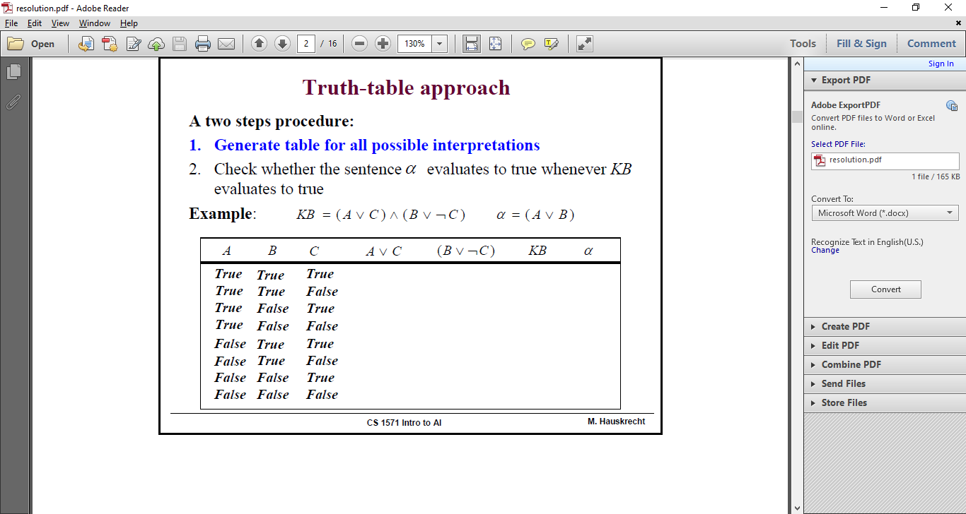

Slide 57
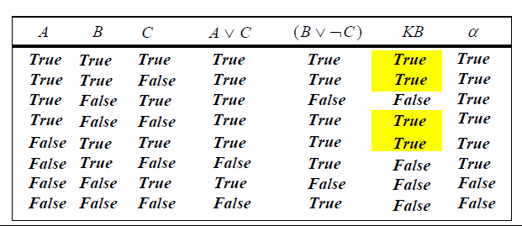
A two steps procedure:
1. Generate table for all possible interpretations
2. Check whether the sentence α evaluates to true whenever KB evaluates to true

Slide 58
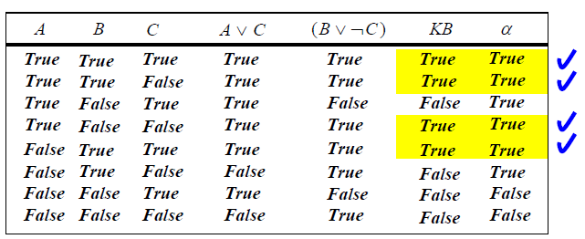
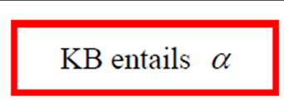
Example
KB = ( A ∨ C ) ∧ (B ∨ ¬C ) α = ( A ∨ B )
The truth-table approach is sound and complete for the propositional logic!!

Slide 59


Inference Technique
4 techniques:
Besides, there are also 2 control strategies:
  Forward chaining
  Backward chaining
Modus Ponens
Resolution
Modus Tollens
Hypothetical Syllogism

Slide 60
Technique 1: Modus Ponens
Definition: Rule of logic that asserts IF A and (A → B) are known to be true, then one can infer that B is true.
E.g.
        It is sunny day (A)
        If it is sunny (A), then we will go to the beach (B)
        We will go to the beach (B)
or (in PL)
1. A
2. A → B
3. B

Slide 61
Modus Ponens
Basic form:
A → B
A
B
((A → B) ∧ A) → B
..... a tautology

Slide 62
Modus Ponens
Example with rules with >1 propositions:
A ∧ B → C
A
B
C
((((A ∧ B) → C) ∧ A) ∧ B) → C

Slide 63
Technique 2: Modus Tollens
Definition: Rule of logic that asserts IF (a → b), and b is known to be not true , then one can infer that a is not true.
Basic form:
A → B
¬B
¬A
((A → B) ∧ ¬B) → ¬A

Slide 64
Technique 3: Hypothetical Syllogism
Definition: Rule of logic that asserts IF (a → b) and (b → c) are true, (a → c) is also true.
Antecedent of the 1st rule (b) is a premise of the 2nd rule. The 3rd rule concluded consists of:
  the antecedent of the first rule (a) and
  the consequent of the second rule (c) .

Slide 65
Hypothetical Syllogism
Basic form:
A → B
B → C
A → C
((A → B) ∧ (B → C)) → (A → C)

Slide 66
Technique 4: Resolution
Definition
  An inference strategy that is used to determine the truth of an insertion (new fact)
Structure:
  (A v B) ∧ (¬B v C) = (A v C) * since B ∧ ¬B can be resolved.

Slide 67
Resolution
  New insertion should contradict with original insertion.
  A contradiction is simply two axioms that are logically contradictory (Eg: B and ¬B).
    If B is true, saying that B is false is definitely contradict.
  Known as “proof by refutation”
  Resolvent is a new expression from the resolution of existing axioms.

Slide 68
Resolution
Algorithm
  Assume ¬P is TRUE
  Show that the axioms and ¬P lead to a
  contradiction
  Conclude that ¬P is FALSE since it leads to a
  contradiction.
  Conclude that P is TRUE since ¬P is FALSE
  The processes continue until a contradiction is produced.

Slide 69
Normal forms
Sentences in the propositional logic can be transformed into one of the normal forms. This can simplify the inferences.
Normal forms used:
Conjunctive normal form (CNF)
• conjunction of clauses (clauses include disjunctions of literals)
( A ∨ B) ∧ (←A ∨ ←C ∨ D)
Disjunctive normal form (DNF)
• Disjunction of terms (terms include conjunction of literals)
( A ∧ ←B) ∨ (←A ∧ C) ∨ (C ∧ ←D)

Slide 70
Conversion to a CNF
Assume: ¬( A ⇒ B) ∨ (C ⇒ A)
1. Eliminate ⇒,⇔
¬(¬A ∨ B) ∨ (¬C ∨ A)
2. Reduce the scope of signs through DeMorgan Laws and double negation.
( A ∧ ¬B) ∨ (¬C ∨ A)
3. Convert to CNF using the associative and distributive laws
( A ∨ ¬C ∨ A) ∧ (¬B ∨ ¬C ∨ A)
and
( A ∨ ¬C) ∧ (¬B ∨ ¬C ∨ A)

Slide 71
Resolution
Steps:
    Negate the goal (proof by refutation)
    Transform rules into clausal forms
    Produce a resolvent from contradict axioms
P
¬P
A → B
¬A ∨ B
¬A ∨ B
¬B ∨ C
¬A ∨ C
resolvent

Slide 72
Resolution
Steps (continued):
    Repeat Step 3 until P is obtained
    Cancel both P and ¬P to procude [] to establish the goal.
:
:
P
¬P
[]

Slide 73
Resolution
Equivalence rules
  P ∨ (Q ∨ R) ⇔ (P ∨ Q) ∨ R
  P ∧ Q ⇔ Q ∧ P
  P ∨ Q ⇔ Q ∨ P
  ¬(P ∧ Q) ⇔ ¬P ∨ ¬Q De Morgan
  ¬(P ∨ Q) ⇔ ¬P ∧ ¬Q De Morgan
  P → Q ⇔ ¬Q → ¬P
  ¬¬P ⇔ P Double negation elimination
  P → Q ⇔ ¬P ∨ Q Implication elimination
  P ←→ Q ⇔ (P → Q) ∧ (Q → P)
  P ←→ Q ⇔ (P ∧ Q) ∨ (¬P ∧ ¬Q)
  P ∧ ¬P ⇔ False

Slide 74
Resolution with PL example
  IF temperature > 100 (A) THEN patient has high temperature (B).
  IF patient has high temperature (B) THEN advise two aspirin (C).
  temperature > 100 (A) .
                STATE 1
                A → B
                B → C
                A

Slide 75
Resolution Process
  STATE 2
    A → B
    B → C
    A
    B
  STATE 3
    A → B
    B → C
    A
    B
    C
  Perform a resolution to prove C.
  Step 1: Proof by refutation ... obtain ¬C (by negating the goal C)

Slide 76
Resolution Process
  Step 2: Convert rules into clausal forms
    ¬A ∨ B
    ¬B ∨ C
    A .......... The existing axiom
    ¬C ......... The new insertion, contradict with the goal
  Step 3: Produce resolvents
  ¬A ∨ B
  ¬B ∨ C
  ¬A ∨ C
Rules 1 and 2 are converted using equivalence rules P → Q ≡ ¬P ∨ Q
    ¬A ∨ B
    ¬B ∨ C
    A
    ¬C
    ¬A ∨ C ..... new resolvent produced after the cancellation of B and ¬B

Slide 77
Resolution Process
  Step 4: Repeat Step 3 to produce another resolvents
    A
    ¬A ∨ C
    C
C is obtained.
    ¬A ∨ B
    ¬B ∨ C
    A
    ¬C
    ¬A ∨ C
    C ..... newly added resolvent

Slide 78
Resolution Process
Step 5: Cancel C and ¬ C to establish [].
    C
    ¬C
    []
[] is established.
    ¬A ∨ B
    ¬B ∨ C
    A
    ¬C
    ¬A ∨ C
    C
    []

Slide 79
Resolution Process
A complete resolution process is shown as below:
¬A ∨ B
¬B ∨ C
¬A ∨ C
A
C
¬C
[]

Slide 80
Resolution with FOPL example
E.g.:
All cats are animal. By nature, animal will die. Chico is a cat and therefore, is also an animal. Using resolution, prove that Chico will die.
∀X cat(X) → animal(X).
∀Y animal(Y) → will_die(Y).
cat(chico).
animal(chico).

Slide 81
Resolution with FOPL example
Step 1 – negate the goal and add into the list
∴ will_die(chico) becomes ¬will_die(chico)
∀X cat(X) → animal(X).
∀Y animal(Y) → will_die(Y).
cat(chico).
animal(chico).
¬will_die(chico).

Slide 82
Resolution with FOPL example
Step 2 – convert all rules into clausal form
∀X cat(X) → animal(X).
∀Y animal(Y) → will_die(Y).
cat(chico).
animal(chico).
¬will_die(chico).
Applying
P → Q ≡ ¬P ∨ Q
¬cat(X) ∨ animal(X).
¬animal(Y) ∨ will_die(Y).
cat(chico).
animal(chico).
¬will_die(chico).

Slide 83
Resolution with FOPL example
Step 3-5 – Produce resolvents, cancel all contradictions until [ ] is obtained.
¬cat(X) ∨ animal(X)
¬animal(Y) ∨ will_die(Y)
X/Y (note: Y/X is also true)
¬cat(Y) ∨ will_die(Y)
cat(chico)
Y/chico
will_die(chico)
¬will_die(chico)

Slide 84






Semantic Network
Animals

Slide 85
Semantic Network
Definition
  method of knowledge representation using a graph made up of nodes and arcs”
Graphical view of problem’s important objects, properties and relationships.
Nodes represent objects & arcs represent the relationship.
Arcs are commonly labeled with terms “IS-A” or “HAS”

Slide 86
Semantic Network
FACT : Parrot is a bird. Typically bird has wings and travel by flying. Bird category falls under animal kingdom. All animal requires air to breathe. Ostrich is a bird but travels by walking.
Wings
has
Parrot
is-a
Bird
is-a
Animal
Air
breathe
travel
Fly
Ostrich
travel
Walk

Slide 87
Semantic Network
Mammals
Walk
is-a
travel-by
Human
Two legs
has
Female
is-a
is-a
Male
Mariam
is-a
System
Analyst
mother-of
Ahmad
is-a
travel-by
has
Degree
BIT(Hons)
Wheel
chair

Slide 88

Frame
Frame
  Definition :: →”a data structure for representing stereotypical knowledge of some concept or object”

Slide 89
Frame
An extension version of semantic network – called “schema” (proposed by Barlett, 1932).
Basic concept of object oriented programming (proposed by Minsky, 1975).
Class frame → general characteristics of some common objects (Eg: class frame bird refer to common properties of bird).
Instance frame → to describe unique characteristic from class frame (Eg: class “ostrich” from class frame “bird”)

Slide 90
Frame
Example
Frame Name: BIRD
Properties:
Color = <unknown>
Wings = 2
Flies = True
Frame Name: OSTRICH
Class Name: BIRD
Properties:
Color = brown/dark
Wings = 2
Flies = False

Slide 91
Frame
Two elements
of frame
Slot
Is the characteristic that describe an object
Exp: color, food, no. of wings, …
Facet
Value for slot
Exp: yellow, 1, worm,…

Slide 92
Frame
Example
Frame Name: BIRD
Properties:
Color = <unknown>
Wings = 2
Flies = True
Slot
Facet

Slide 93

Rules
Rule
  Definition :: Rules →”a knowledge structure that relates some known information to other information and that can be concluded or inferred to be known”

Slide 94
Rules
Is a form of procedural knowledge → associates given information to some action.
Structure → connects antecedents (premises) and consequents (conclusions).

Slide 95
Rules
Statement “IF” → antecedent and “THEN” → consequent
IF <antecedent> THEN <consequent>
IF thirsty THEN drink_a_water

Slide 96
Rules
Example:
  Diagnosing strep throat (knowledge base)
  Rule 1:
  IF x has a sore throat
  AND suspect bacterial infection
  THEN patient has strep throat
  Rule 2:
  IF x temperature is > 37 c
  THEN x has a fever
  Rule 3:
  IF x has been sick > a month
  AND x has a fever
  THEN suspect bacterial infection

