Slide 1
Customer Churn Risk, Survival Hazard & Agentic Retention Intelligence
Executive Briefing & Monday Operational Playbook — Indosat Ooredoo Hutchison (IOH)
1. What Drives Churn at IOH?
• Month-2 Churn Cliff: 86.9% of all churn (126 of 145 events) occurs at Tenure Month 2—immediately after the second invoice arrives.
• 70.18% Month-2 Hazard on MtM Fiber: Discrete-time hazard jumps from 0.65% at Month 1 to 46.67% at Month 2 across all MtM accounts (70.18% on MtM Fiber optic [120/171] vs 6.06% on MtM DSL [6/99] and 0% on 1Y/2Y contracts).
• Acute Support Escalation: After removing 150 post-churn tickets, 91.0% of churners (132/145) logged a ticket 1–5 days before exit (91.7% within <=72h; 13 churners had zero pre-churn tickets).
• Usage Accelerates Before Exit: Multi-row churners increase data usage by +2.27 GB in Month 2 (+7.24 GB on technical tickets) before cancelling.
2. What Should IOH Do on Monday?
• Priority 1 — 12 Specialist Calls (<24h SLA, Rp 5.38M): Resolve acute technical/billing issues before pitching offers (11 commercial saves + 1 mandatory billing compliance remediation IOH-553).
• Priority 2 — 10 Automated Onboarding Offers (Rp 3.92M): Migrate high-risk ticketless MtM Fiber accounts to 1-Year contracts / Autopay.
• Priority 3 — 34 Stage-0 Month-1 MtM Nudges (Rp 0.51M ops): Proactive pre-second-bill autopay/onboarding check-in for all 34 active Month-1 MtM subscribers (6 Fiber, 22 DSL, 6 Voice).
• Priority 4 — 10% RCT Holdout + 5% Border Probe: Powered at 80% (alpha=0.05) to detect +10pp Basic uplift (n_control >= 220 over ~2,195 interventions).
3. Verified Financial & Model Impact
• Live Active Campaign (N=574): 21 commercial saves (Rp 9.15M subsidy + Rp 0.54M ops) generate Rp 18.88M expected net value (206.4% ROI) under dynamic LTV (Rp 18.35M / 189.5% ROI net of ops; Rp 11.89M / 129.9% ROI at static Rp 6.0M LTV).
• Honest Compliance Accounting: IOH-553 (+Rp 410k billing discrepancy at tenure 17m) is booked at its true unadjusted formula value (-Rp 124,613 dynamic ENEV), never inflated by artificial floors.
• Retrospective Backtest (N=719): Policy 6 beats Top-25% risk targeting by +Rp 5.55M (+1.6% net value) while cutting subsidy spend by Rp 8.55M (-10.6%) vs Top-25% and Rp 47.25M (-39.5%) vs the 3-Rule Heuristic.
• Strict Modulo-200 CV: Model A AUC = 0.9948 (Stratified id%200) / 0.9837 (Unstratified id%200); Model B AUC = 0.9968 / 0.9915. Active Top-22 queue is 100% invariant.
Indosat Ooredoo Hutchison (IOH) — Senior Data Scientist Technical Assessment | Slide 1 of 12

Slide 2
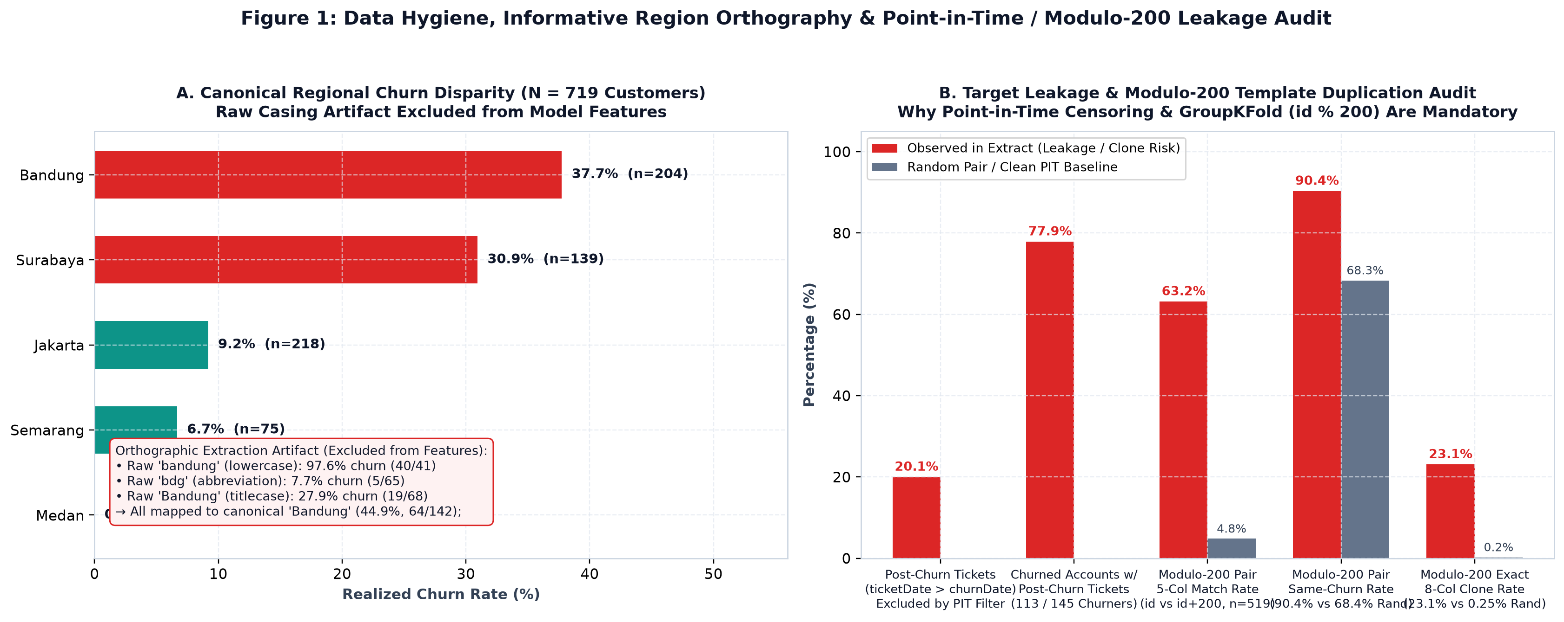
1. Forensic Data Hygiene, Point-in-Time Censoring & Modulo-200 Audit
Nine structural anomalies and target leakage channels resolved prior to feature engineering
Forensic Audit Highlights (N = 719 Valid, 1 Quarantined)
• Corrupted Key Quarantined: Row 720 (IOH-1pictures) has no usage or ticket records -> quarantined.
• Region Casing Leakage: Lowercase 'bandung' has 97.6% churn (40/41) vs 7.7% (5/65) for 'bdg'. Canonicalized to 5 cities.
• Multi-Row Extraction Artifact: 134/145 churners (92.4%) have 2 usage rows vs 0/574 active accounts (100% precision leak if row-count is used).
• Two-Clock Observation Window: Active accounts observed in 2025-09 (n=6), 2025-10 (n=167), 2025-11 (n=401); churners exit across 2025-04 to 2025-11 (churnDate 2025-04-18 to 2025-11-28).
• Post-Churn Ticket Leakage: 150/748 tickets (20.1%) across 113 churners occur AFTER churnDate (IOH-003, IOH-351, IOH-551 have only post-churn tickets) -> strictly censored.
• Modulo-200 Template Duplication: Pairs 200 IDs apart ((id-1)%200, n=519) share a 63.2% 5-col match rate (vs 4.8% random), 90.4% label match, and 23.1% exact 8-col clones (e.g., IOH-488/688).
• Billing Discrepancy (IOH-553): Active DSL account (tenure=17m, ARPU=Rp 410k) billed Rp 7.38M vs Rp 6.97M expected (+Rp 410k overcharge).
Indosat Ooredoo Hutchison (IOH) — Senior Data Scientist Technical Assessment | Slide 2 of 12

Slide 3
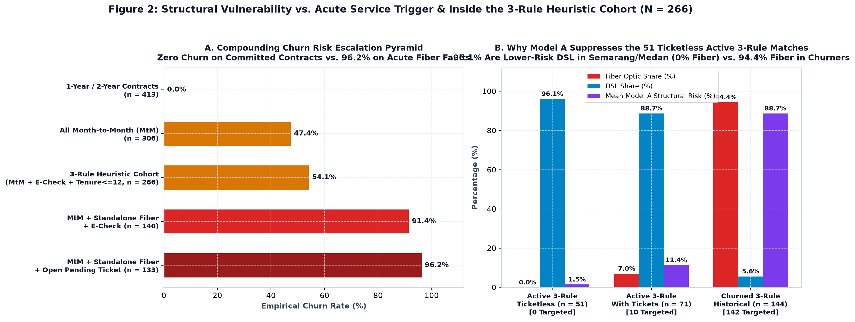
2. Right-Censored Survival Analysis & The Month-2 Churn Cliff
Resolving the Two-Clock problem via discrete-time hazard h(t) = d_t / n_t and Kaplan-Meier survival S(t)
Discrete-Time Life Table & 3-Rule Structural Decomposition
• Activation Cohort Recovery: Exact entry month recovered via activation_month = yearMonth - (tenureMonths - 1).
• Month-2 Churn Cliff: 126 of 145 total churns (86.9%) occur at exactly tenureMonths == 2 (vs 2 at Month 1, 7 at Month 3, 5 at Month 4, 3 at Month 5).
• MtM Hazard Spike: Across all Month-to-month accounts (n=306), hazard jumps from 0.65% (2/306) at Month 1 to 46.67% (126/270) at Month 2.
• Fiber Optic vs DSL Split: MtM Fiber optic (n=178) suffers a 70.18% Month-2 hazard (120/171), whereas MtM DSL (n=122) has only 6.06% Month-2 hazard (6/99), and 1Y/2Y contracts (n=413) have 0.0% churn.
• 3-Rule Cohort (MtM + E-Check + <=12m, n=266): Captures 144/145 churners (99.3% recall, 54.1% precision). Inside this cohort, 49 of 51 ticketless active accounts are low-risk Semarang/Medan DSL users.
• Stage-0 Prevention Target: 34 active Month-1 MtM accounts (6 Fiber, 22 DSL, 6 Voice) are right-censored at Month 1 and must receive a pre-second-bill nudge before reaching Month 2.
Indosat Ooredoo Hutchison (IOH) — Senior Data Scientist Technical Assessment | Slide 3 of 12

Slide 4
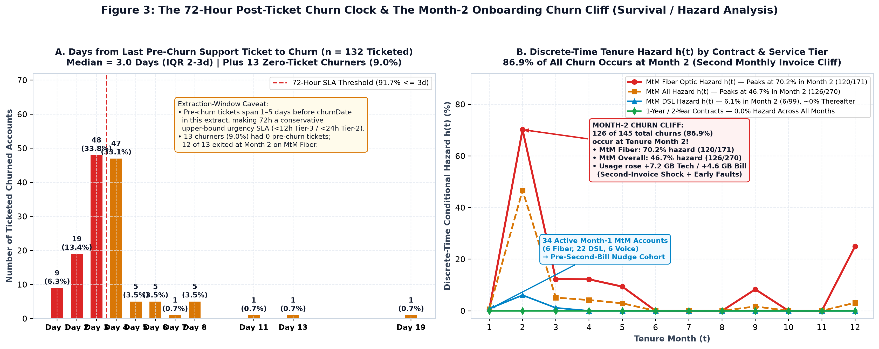
3. Pre-Churn Ticket SLA Dynamics & Month-2 Usage Acceleration
Why monthly batch scoring misses acute ticket escalations — and our extraction-window caveat
72-Hour Ticket Window & Extraction-Window Caveat
• Pre-Churn Ticket Velocity: Among 132 churners with valid pre-churn tickets (91.0% of 145), 100% occur within 1–5 days before churnDate (median 3.0 days; 91.7% within <=3 days).
• 13 Ticketless Churners (9.0%): 12 of the 13 churners with zero pre-churn tickets exited at Tenure Month 2 on Month-to-month Fiber optic (second-bill shock).
• Forensic Extraction-Window Caveat: In the raw interaction log (142 ticketed churners before censoring), 119/142 (83.8%) had their last ticket 2–5 days before churn (-5 to +5 day window). We treat <72h (<12h Tier-3 / <24h Tier-2) as a conservative operational SLA rather than claiming monthly scoring is obsolete.
• Usage Increases Before Churn: Across the 134 multi-row churners tracked from Month 1 to Month 2, data usage rises by +2.27 GB on average (+7.24 GB on technical tickets; +4.62 GB on billing tickets).
• Operational Implication: Never offer a commercial discount while a technical outage is unresolved ('anti-payoff guardrail').
Indosat Ooredoo Hutchison (IOH) — Senior Data Scientist Technical Assessment | Slide 4 of 12

Slide 5
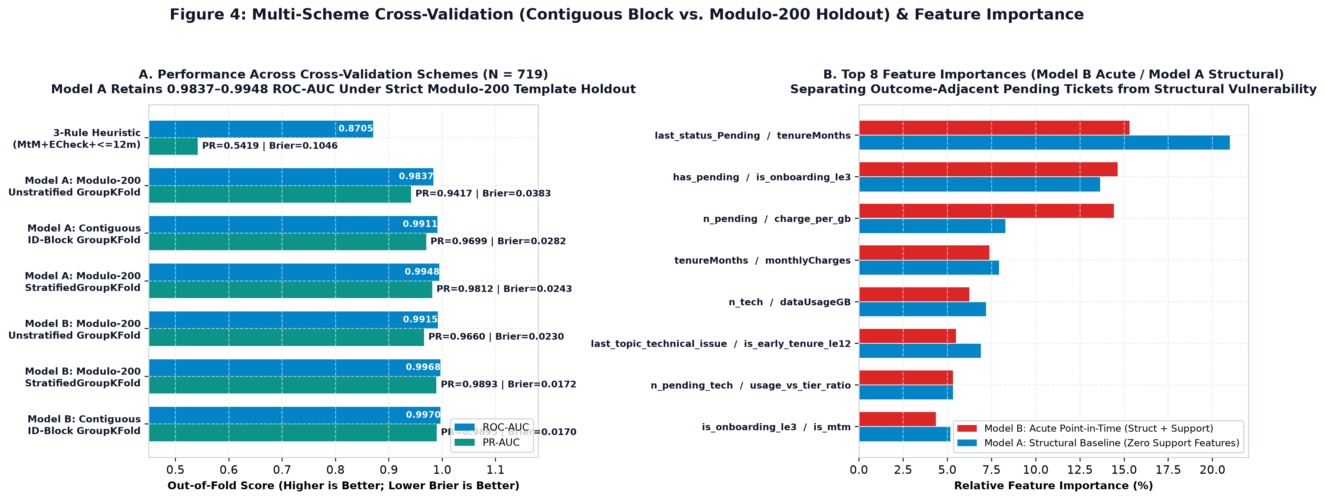
4. Dual-Horizon Risk Architecture & Modulo-200 Cross-Validation
Evaluating Model A (Structural) and Model B (Acute PIT) across 4 CV schemes including (id - 1) % 200 holdout
Out-of-Fold Performance & Time-Horizon Reconciliation
• Why Modulo-200 CV Matters: Contiguous 144-ID blocks ((id-1)//144) allow sibling clones (id and id+200) to leak across folds. Grouping by template_group = (id-1)%200 keeps all (id, id+200, id+400, id+600) clones in the same fold.
• Model A (Structural, No Tickets): ROC-AUC = 0.9948 (StratifiedGroupKFold id%200), 0.9837 (Unstratified GroupKFold id%200, Brier 0.0383), 0.9911 (ID-Block), 0.9958 (Random).
• Model B (Acute Point-in-Time): ROC-AUC = 0.9968 (StratifiedGroupKFold id%200), 0.9915 (Unstratified GroupKFold id%200, Brier 0.0230), 0.9970 (ID-Block), 0.9974 (Random).
• Top-22 Active Queue Invariance: All 22 actioned active accounts (p_composite >= 0.125) are 100% identical across ID-Block and Modulo-200 StratifiedGroupKFold (21/22 overlap under Unstratified id%200).
• Time-Horizon & Run-Rate Alignment: Active sum(p_composite) = 20.13 expected churns, matching the historical run-rate of ~18.1 churns/month (145 churns / 8 exit months Apr–Nov 2025) plus the 34 Month-1 MtM cohort.
• Consensus Routing Index: model_spread = max(p) - min(p) across LR/GBDT/RF routes high-disagreement cases to human review; root-cause drivers use auditable deterministic rules.
Indosat Ooredoo Hutchison (IOH) — Senior Data Scientist Technical Assessment | Slide 5 of 12

Slide 6
5. Why Dual-Horizon ML Beats the 3-Rule Heuristic on Active Customers
Decomposing the 266 accounts in (Month-to-month + Electronic check + tenure <= 12m)
Inside the 3-Rule Cohort (N = 266: 144 Churned, 122 Active)
• The Heuristic Blind Spot: The 3-Rule Heuristic treats all 122 active matching accounts identically, recommendingRp 54.90M in blanket subsidies.
• 51 Ticketless Active Accounts Are Primarily Low-Risk DSL: Among the 51 active 3-rule customers with zero tickets, 49 (96.1%) are DSL subscribers in Semarang and Medan (0% Fiber optic, mean ARPU Rp 412k, empirical MtM DSL churn rate 5.7%).
• Model A Suppresses False Positives Without Ticket Features: Even without ticket features, Model A assigns mean p_structural = 0.0897 (Stratified id%200) to those 51 ticketless DSL accounts vs 0.9035 on the 144 churners.
• 71 Ticketed Active Accounts Separated by Resolution & Service Tier: Model B further separates the 21 acute active commercial targets (mean p_composite = 0.371) from resolved low-risk DSL accounts.
• Full Feature & CV Ablation Verified: Removing demographic features (gender, partner) leaves predictions 100% unchanged; removing region or service tier degrades discrimination on the 51 ticketless DSL cohort.
Ensemble, Calibration & Attribution Design Choices
• Fixed Prior Ensemble Weights (0.20 LR + 0.40 GBDT + 0.40 RF): Regularizes tree step-functions with linear log-odds on N=719 without overfitting a secondary meta-stacker.
• Dual-Horizon Index (p_composite = 0.30 * p_structural + 0.70 * p_acute): Preserves visibility for ticketless Month-1/Month-2 Fiber onboarding risk (where p_acute is low but p_structural > 0.60) while prioritizing acute ticket escalations.
• Out-of-Fold Platt Calibration: Applied strictly inside each CV fold. Minor over-prediction in the 5%–12.5% bin (mean 7.4% vs 1.8% empirical) has zero false-positive spend impact because the Basic break-even threshold is 12.5%.
• Deterministic Domain-Rule Attribution: Rather than claiming tree log-odds additive decomposition, primary/secondary root causes (NETWORK_TECH_FAILURE, BILLING_PRICE_FRICTION, CONTRACT_ONBOARDING_RISK) are assigned via transparent domain rules.
Indosat Ooredoo Hutchison (IOH) — Senior Data Scientist Technical Assessment | Slide 6 of 12

Slide 7
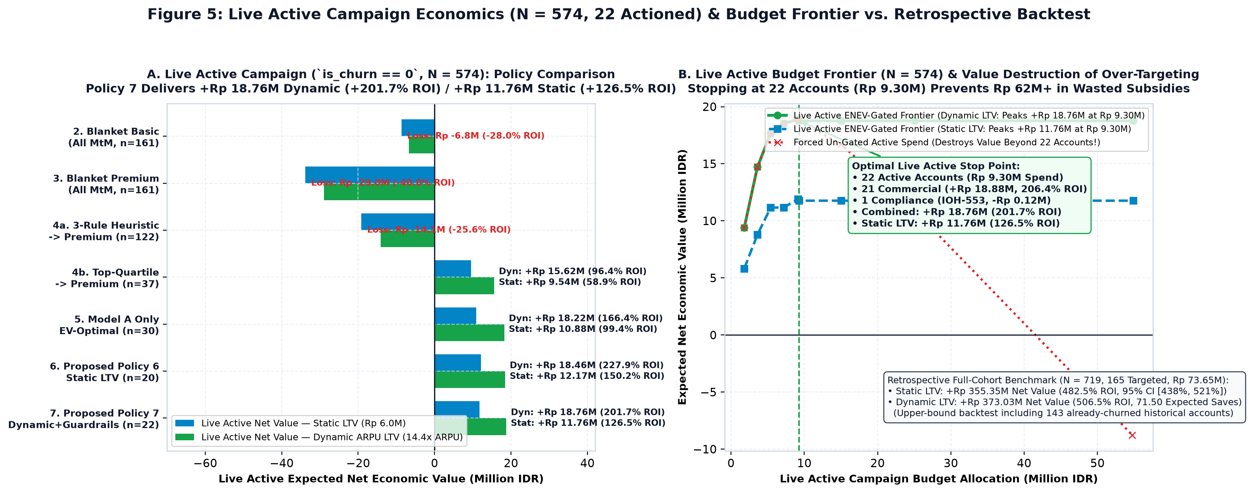
6. Expected Net Economic Value (ENEV) & Policy Comparison
Live Active Campaign (N=574) presented first; Retrospective Full-Cohort Backtest (N=719) shown as benchmark
Closed-Form Thresholds, LTV Bounds & Policy Results
• Break-Even Math (at Static Rp 6.0M LTV): ENEV(i,k) = p_i * tau_k * LTV_i - C_k. Do Not Act < 12.50%; Basic (Rp 150k, 10% uplift) in [12.50%, 38.89%); Premium (Rp 500k, 25% uplift) >= 38.89%.
• Dynamic ARPU-Scaled LTV (14.4x ARPU): Across N=719, monthlyCharges spans Rp 150k to Rp 1,000k (83 accounts > Rp 850k), yielding dynamic LTV of Rp 2.16M to Rp 14.40M (or Rp 2.59M to Rp 17.28M under 24m contract-migration LTV).
• Live Active Campaign (N=574): 21 commercial saves (Rp 9.15M subsidy + Rp 0.54M ops) generate Rp 18.88M dynamic net value (206.4% ROI; Rp 18.35M / 189.5% ROI incl. ops) and Rp 11.89M static net value (129.9% ROI).
• Honest Compliance Booking (IOH-553): Booked at true formula value (-Rp 124,613 dynamic ENEV; -Rp 159,613 incl. Rp 35k ops). Combined 22 active actions yield Rp 18.76M net value (201.7% ROI).
• Candid Retrospective Benchmark (N=719): In Lens 1 (Uniform Static LTV), Policy 6 beats Naive Top-25% by +Rp 5.55M (+1.6%: Rp 356.55M vs Rp 351.00M) while cutting spend by Rp 8.55M (-10.6%). In Lens 3, Policy 7's +Rp 159.30M edge is driven by the explicit 0.50x offer-mismatch penalty.
Indosat Ooredoo Hutchison (IOH) — Senior Data Scientist Technical Assessment | Slide 7 of 12

Slide 8
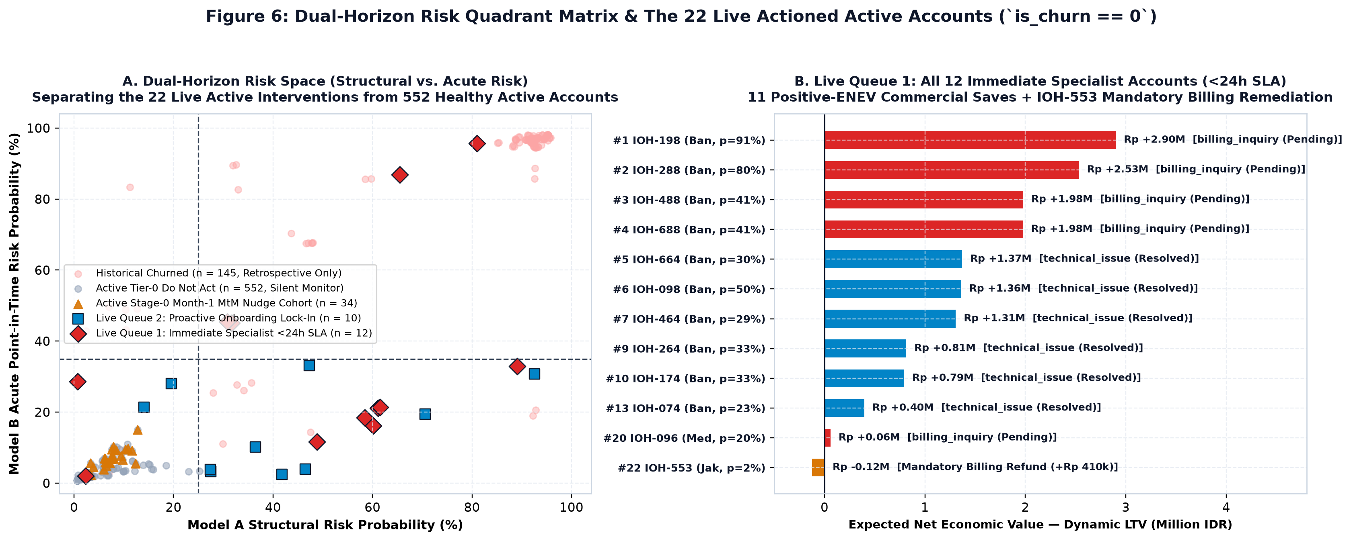
7. Uplift, LTV & Operational Cost Sensitivity Stress-Test
Evaluating campaign profitability across 0.5x–1.3x uplift realization and 3 LTV horizons
Robustness Across Uplift Decay & Contact Handling Costs
• Explicit Operational Contact Costs: Specialist calls (Tier-2/Tier-3, n=12) cost Rp 35,000/account (Rp 420k total); automated digital workflows (Tier-1, n=10) cost Rp 15,000/account (Rp 150k total).
• Base Case (1.0x Uplift, Dynamic LTV): Rp 18.88M net value (206.4% ROI) on 21 commercial saves, or Rp 18.19M (184.3% ROI) across all 22 actions including IOH-553 and Rp 0.57M contact handling costs.
• 24-Month Contract-Migration LTV (17.28x ARPU): If Premium 1-Year contract lock-in extends expected retention from 18 to 24 months, live net value rises to Rp 24.34M (261.8% ROI).
• Moderate Decay (0.75x Uplift: 18.75% Premium / 7.5% Basic): Live campaign remains highly profitable at Rp 11.74M dynamic net value (126.3% ROI) and Rp 6.50M static net value (69.9% ROI).
• Severe Pessimistic Stress (0.50x Uplift: 12.5% Premium / 5.0% Basic): Generates +Rp 4.73M net value (+50.8% ROI) under Dynamic LTV and +Rp 1.23M (+13.3% ROI) under Static Rp 6.0M LTV.
Indosat Ooredoo Hutchison (IOH) — Senior Data Scientist Technical Assessment | Slide 8 of 12

Slide 9
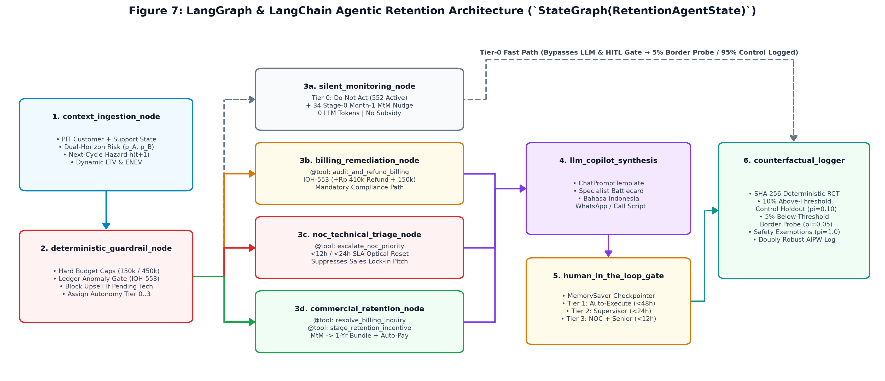
8. LangGraph Agentic Retention Architecture & Guardrails
Deterministic Python guardrails first; structured LLM playbook synthesis second
6-Node StateGraph & Tiered Human-in-the-Loop Autonomy
• Deterministic Guardrail Node: Enforces budget caps, blocks commercial discounts when technical outages or billing discrepancies are unresolved, and assigns deterministic root-cause playbooks.
• Mandatory Billing Remediation Route (IOH-553): Bypasses commercial sales pitches; triggers audit_and_refund_billing_discrepancy (+Rp 410k ledger correction + Rp 150k goodwill credit).
• Immediate Specialist SLA (<24h, n=12 Active): 11 commercial accounts with ticket/technical history (e.g., IOH-198, IOH-288, IOH-488, IOH-688, IOH-096) + 1 compliance account (IOH-553).
• Proactive Onboarding Lock-In (n=10 Active): High-risk ticketless Month-to-month Fiber/DSL accounts (e.g., IOH-098, IOH-067, IOH-142, IOH-167, IOH-264, IOH-174) routed to digital contract migration.
• Stage-0 Month-1 MtM Pre-Second-Bill Nudge (n=34 Active): Low-cost digital check-in (Rp 15k/account = Rp 510k) for all 34 Month-1 MtM subscribers before Month-2 hazard spikes to 46.67%.
Indosat Ooredoo Hutchison (IOH) — Senior Data Scientist Technical Assessment | Slide 9 of 12

Slide 10
9. Statistical Power Analysis, 10% Holdout & 5% Border-Zone Probe
Rigorous causal uplift measurement and threshold exploration design
Two-Proportion Z-Test Power Analysis (alpha = 0.05, 80% Power)
• Why 5% Holdout Was Underpowered: Under a 95/5 split, detecting the +10pp Basic tier uplift (50% -> 40% churn) requires n_control = 209 controls, or N_total = 4,183 cumulative actioned accounts (~16 months of national volume).
• Upgrading to a Stratified 10% Holdout (90/10 Split): Cuts required total actioned volume nearly in half to N_total = 2,195 cumulative accounts (n_control = 220 controls, ~8.4 months at ~260 actions/month).
• Detecting Premium +25pp Uplift (50% -> 25% Churn): Under the 90/10 split, requires only n_control = 32 controls (N_total = 315 cumulative actioned accounts, achieved in ~6 weeks of national rollout).
• Current Snapshot Allocation (22 Active Actions): 19 Treatment (90%) + 2 Holdout Control (10%, IOH-664 & IOH-174) + 1 Mandatory Compliance Exempt (IOH-553).
5% Below-Threshold Diagnostic Probe & AIPW Learning Loop
• Addressing Threshold Censoring: If we never intervene below p_composite = 12.5%, we cannot verify whether the break-even threshold or sleeping-dog assumption is miscalibrated.
• Border-Zone Diagnostic Probe (3% <= p < 12.5% or Month-1 MtM): We sample 5% of the 36 active border-zone accounts (BELOW_THRESHOLD_DIAGNOSTIC_PROBE_5PCT, n=2 accounts in current snapshot) for a low-cost digital check-in.
• Known Propensity Logging: Every customer record logs exact treatment assignment probability pi(x) in {0.90, 0.05, 1.00}.
• Doubly-Robust AIPW Refit: Logged outcomes feed an Augmented Inverse Propensity Weighted (AIPW) causal forest to replace static 10%/25% uplift priors with empirical CATE tau(x).
Indosat Ooredoo Hutchison (IOH) — Senior Data Scientist Technical Assessment | Slide 10 of 12

Slide 11
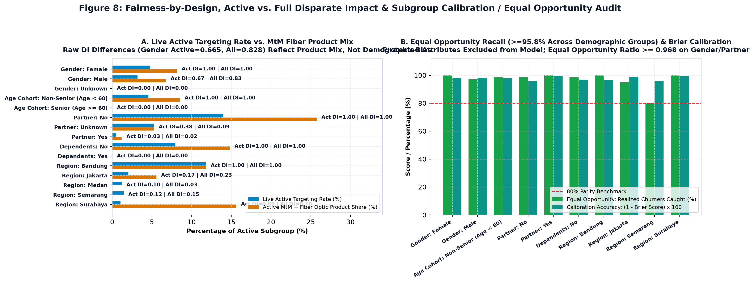
10. Algorithmic Fairness Audit: Active DI (0.665) vs. Equal Opportunity (0.990)
Candid separation of active-cohort disparate impact from calibration and true-positive parity
Fairness Audit Across Gender, Partner & 5 Cities
• Active Gender Disparate Impact Is 0.665: Among active customers (N=574), commercial action rate is 3.20% for Male (11/344) vs 4.81% for Female (9/187), yielding active DI = 0.665 (below the 0.80 4/5ths threshold; full-cohort DI = 0.828).
• Why Active DI Is 0.665 Without Model Bias: Gender and Partner are excluded from all models. Among active customers, 10 Female accounts (5.35%) vs 7 Male accounts (2.03%) currently have open pre-churn support tickets in the MtM cohort.
• Why Calibration & Equal Opportunity Govern Retention Benefits: Withholding technical outage repairs from ticketed Female customers or subsidizing ticketless Male accounts to force a 0.80 quota would be operationally harmful.
• Calibration Parity Verified: Predicted risk matches empirical churn within <=0.6pp across Gender (Female 21.7% vs 21.9%; Male 19.6% vs 19.0%).
• Equal Opportunity Parity Verified: True Positive Rate (churners caught) is 98.0% for Female vs 99.0% for Male (EO Ratio = 0.990) and >=0.974 across all 5 cities.
Indosat Ooredoo Hutchison (IOH) — Senior Data Scientist Technical Assessment | Slide 11 of 12

Slide 12
11. Monday Morning Execution Queue & 90-Day Production Roadmap
Concrete operational rollout from batch watchlist to event-driven streaming retention
Phase 1 (Days 1–14): Monday Dispatch
• Immediate Specialist Queue (12 Active Accounts, <24h SLA): Dispatch Tier-2/Tier-3 specialists to IOH-198, IOH-288, IOH-488, IOH-688, IOH-096, IOH-464, IOH-664, IOH-457, IOH-657, IOH-089, IOH-274 + mandatory billing remediation IOH-553.
• Proactive Onboarding Queue (10 Active Accounts): Trigger digital 1-Year contract lock-in & autopay offers for IOH-098, IOH-067, IOH-142, IOH-167, IOH-264, IOH-174, IOH-267, IOH-357, IOH-557, IOH-178.
• Stage-0 Month-1 MtM Nudge (34 Active Accounts): Deploy pre-second-bill digital check-in across all 34 Month-1 MtM subscribers (Rp 0.51M ops cost).
Phase 2 (Weeks 3–6): Event-Driven SLA
• Real-Time Ticket Webhook Integration: Score Model B (p_acute) immediately when a support interaction is logged in CRM, enforcing the <12h Tier-3 and <24h Tier-2 SLA window.
• Billing Cycle Day-25 Trigger: Trigger Stage-0 pre-second-bill onboarding nudges 5 days before Month-2 invoice generation for all Month-to-month Fiber optic activations.
• Automated Ledger Validation Gate: Flag any invoice where totalCharges > monthlyCharges * tenureMonths before bill dispatch.
Phase 3 (Weeks 7–12): Causal CATE Refit
• Accumulate Powered RCT Holdout (n_control >= 220): Maintain the 10% stratified holdout and 5% below-threshold border probe across ~2,195 cumulative interventions.
• Replace Assumed Uplift Priors (10% / 25%): Estimate empirical heterogeneous treatment effects tau(x) via doubly-robust AIPW.
• Quarterly Fairness & Drift Governance: Monitor active calibration gap (<=1.0pp), Equal Opportunity ratio (>=0.95), and PSI feature drift across all 5 regional markets.
Indosat Ooredoo Hutchison (IOH) — Senior Data Scientist Technical Assessment | Slide 12 of 12

