Slide 1


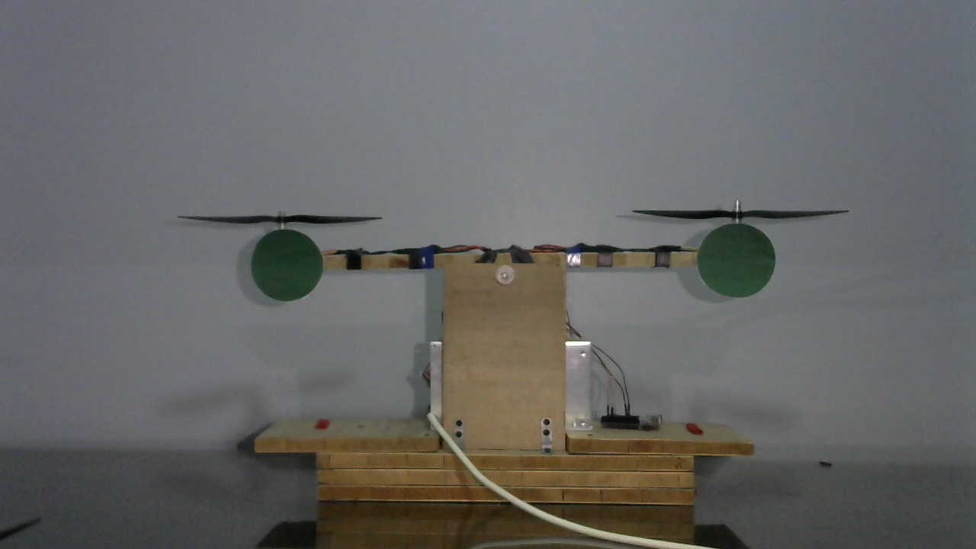
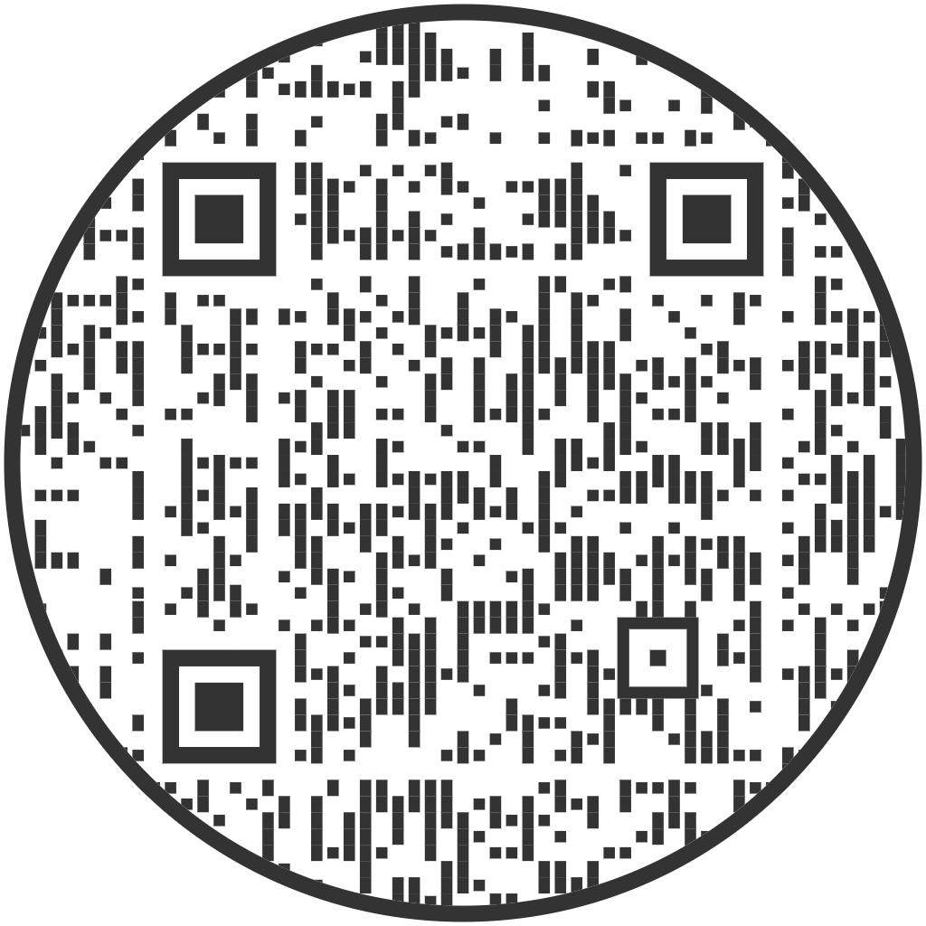
Image Processing for Mechatronics MCTR1010
Balancing a Brushless Bicopter using a Visual Sensor
Dr. Eng. Omar M. Shehata , Eng. Dalia M. Mahfouz, Eng. Mai Mira, MSc
Team Members:
Ahmed Mady 46-0798 ahmed.alimady@student.guc.edu.eg || Ahmed Yasser 46-12951 ahmed.yasser@student.guc.edu.eg ||Omar Mohsen 46-5023 omar.mohsen@student.guc.edu.eg Mostafa Kashaf 46-5456 mostafa.kashaf@student.guc.edu.eg || Mohamed Magdy 46-3493 mohamed.magdy@student.guc.edu.eg
Spring 2023
Abstract
The bicopter is a two-rotor aerial vehicle, characterized by its ability to maintain stable flight by actively adjusting the angle of its central bar horizontally. By leveraging the powerful computational capabilities and the versatility of the Raspberry Pi, the system achieves enhanced responsiveness and adaptability. The webcam captures images of the surrounding environment and processes them using image processing algorithms techniques such as edge detection is employed to identify the bicopter's central bar and determine its orientation relative to the horizontal plane. The integration of the Raspberry Pi and the webcam result in a robust and cost-effective solution for achieving self-balancing flight.
Methodology
To control the bicopter, a desired angle is inputted, and according to this angle, the speed of both motors is adjusted as they rotate in directions opposite to each other. Below each propeller, a colored circle is attached to track the error between the pitch and the desired angle using a visual sensor, the camera. The circles are of the color green and a threshold is applied to grab only the color needed. Then segmentation and edge detection were applied to track the circle and draw a line connecting both circles and measuring the angle. This measured error angle is then fed from the camera into the control loop as feedback and the correct speed is sent to the ESC of the two brush-less motors by the computer to achieve the desired angle.
Results
Execution Time: On a Raspberry Pi 4B+, the average execution time of the code you provided is about 100 milliseconds. This means that the code can process one frame of video every 100 milliseconds. Accuracy: The accuracy of the code in detecting the angle of the bicopter is very high as the 2 motors never turn off but are always on and at varying speeds. Stability: The stability of the bi-copter was taken into consideration when designing the control law. Responsiveness: The responsiveness of the code to changes in the angle of the bicopter.
Conclusion
The camera’s input is processed by the Raspberry Pi, which analyzes the images and extracts relevant features to estimate the bicopter’s position and orientation. This data is then fed into the PID control algorithm, which calculates the necessary adjustments to the bicopter’s motor speeds or control surfaces. The integration of these technologies enables autonomous or semi-autonomous flight of the bicopter. Overall, the combination of a camera, Raspberry Pi 4B+, and PID control offers a reliable and adaptable system for controlling a bicopter.

