Slide 1
AUTOSAR
Mohamed Saied

Slide 2
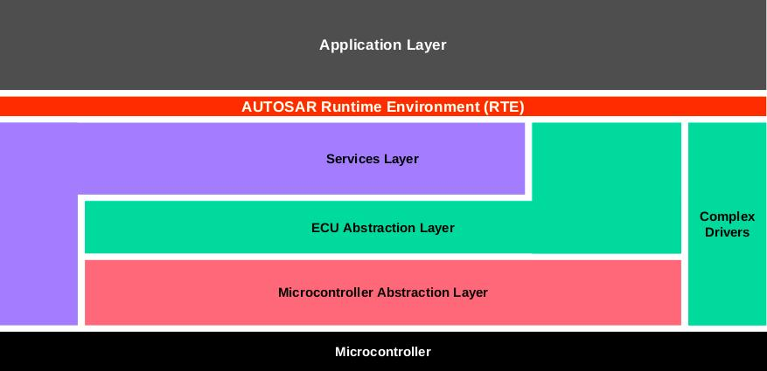
AUTOSAR Architecture

Slide 3
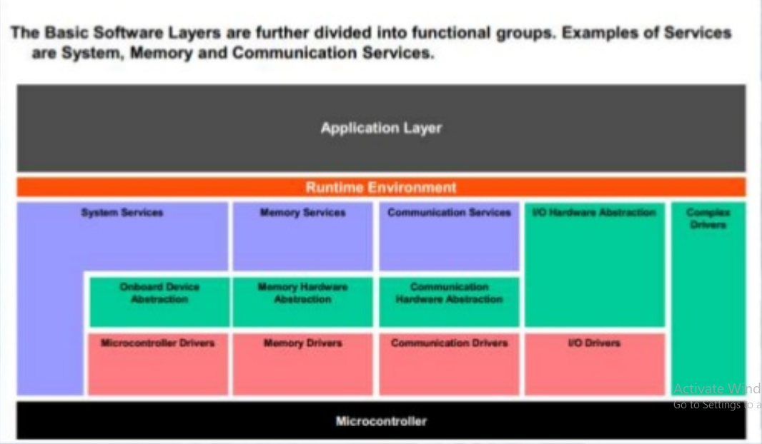
AUTOSAR Stacks

Slide 4
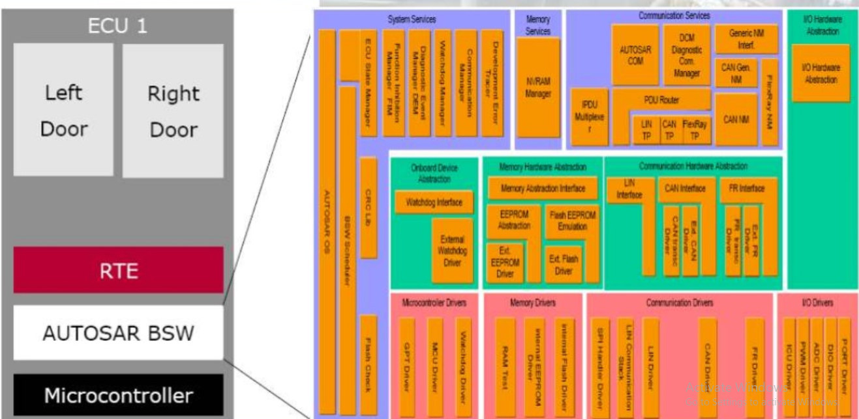
BSW

Slide 5
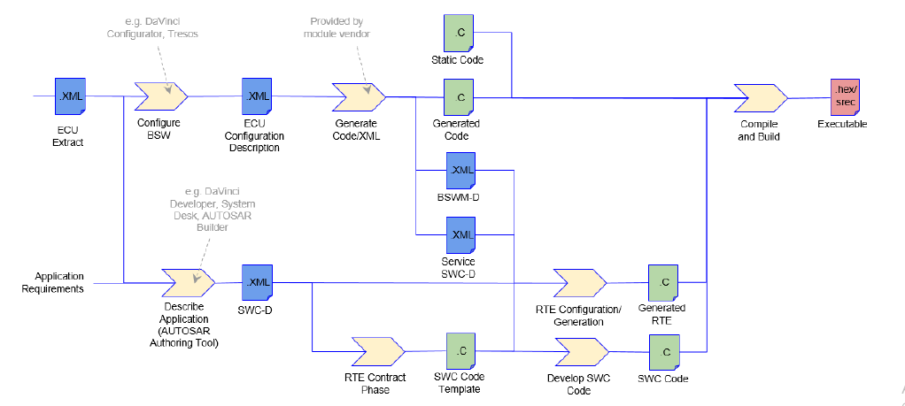
AUTOSAR Methodology

Slide 6
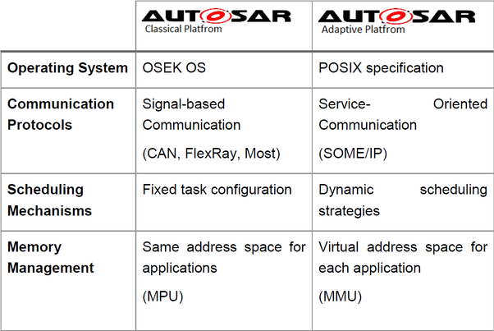
AUTOSAR Classic vs Adaptive platform

Slide 7

AUTOSAR Documents

Slide 8
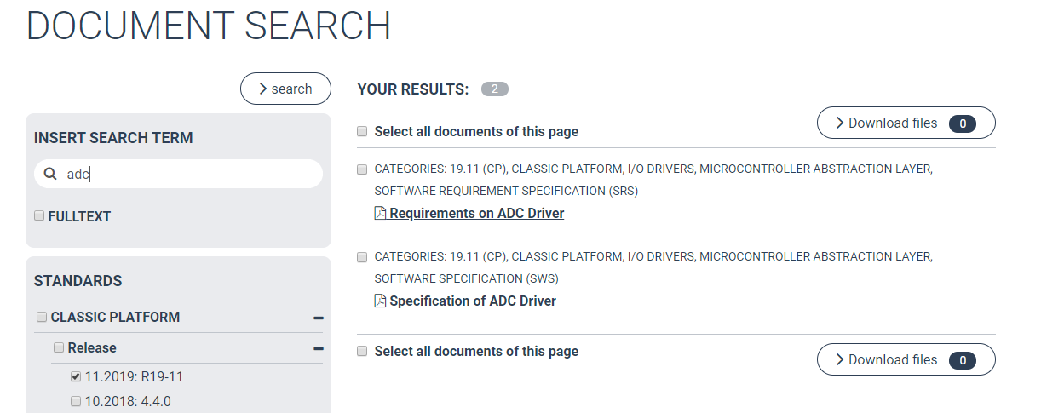
ADC Docs

Slide 9
Requirements
Requirements
Functional Requirements
Non-functional Requirements

Slide 10
Configuration Types
Adc_cfg.c
Adc_Lcfg.c
Adc_Pbcfg.c
Difference?

Slide 11
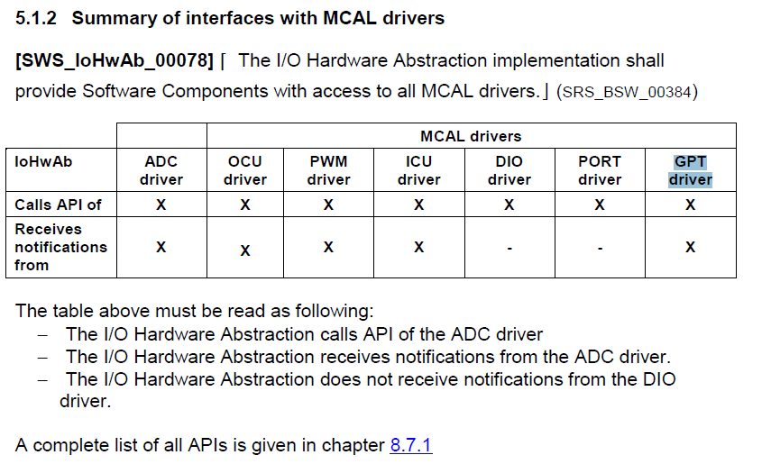
IoHwAb SWS

Slide 12
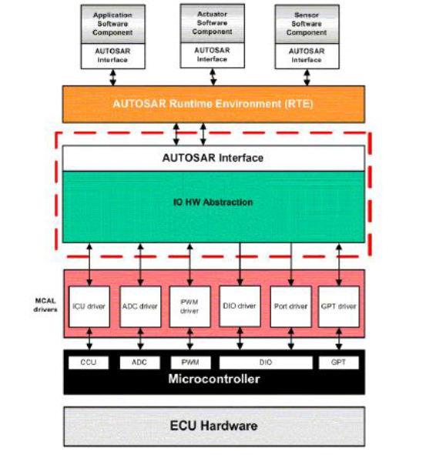
I/O Hardware Abstraction
All ECU signals shall have an Age Attribute.
ECU Input signals: the specific functionality
of this attribute is to limit the signals lifetime
The value defines the maximum allowed age
for data of this signal.
If the lifetime is 0, the signal has to be
retrieved from the physical register, immediately. If the lifetime is greater than 0, the signal is valid for the specified time.

Slide 13
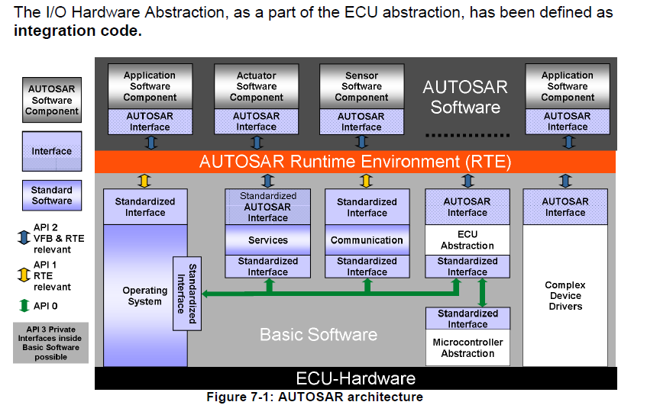
ECU Abstraction

Slide 14
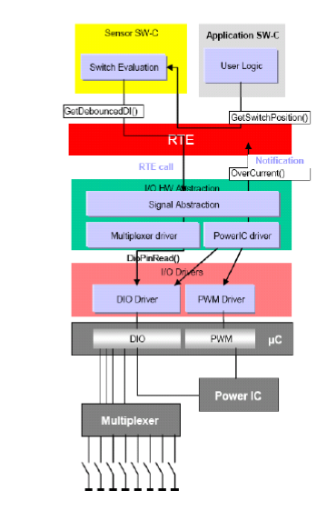
Use case of on-board hardware

Slide 15
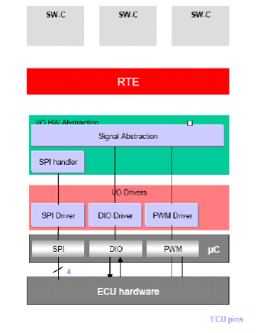
Signal Abstraction

Slide 16
Power stage driver
Some outputs are controlled via the SPI driver/handler.
Some inputs are directly controlled via the DIO driver.
Some voltages, frequencies are set via the PWM driver.
A power stage driver provides the view of all outputs. It calls services of PWM, DIO drivers and SPI handler. The signal abstraction makes all these outputs “visible” from the point of view of Software Component (signals are mapped on Ports).
The “Power stage driver” can be configurable

Slide 17
References
AUTOSAR_SWS_IOHWAB
AUTOSAR_SWS_ADCDriver

