Slide 1
Memory Stack Services
Mohamed Saied

Slide 2
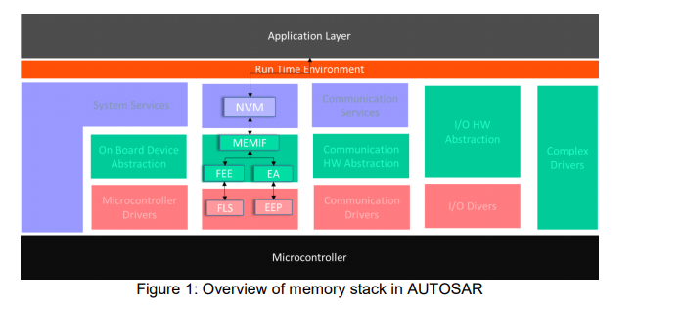
Overview memory stack

Slide 3
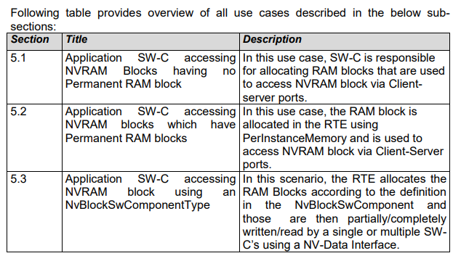

Slide 4
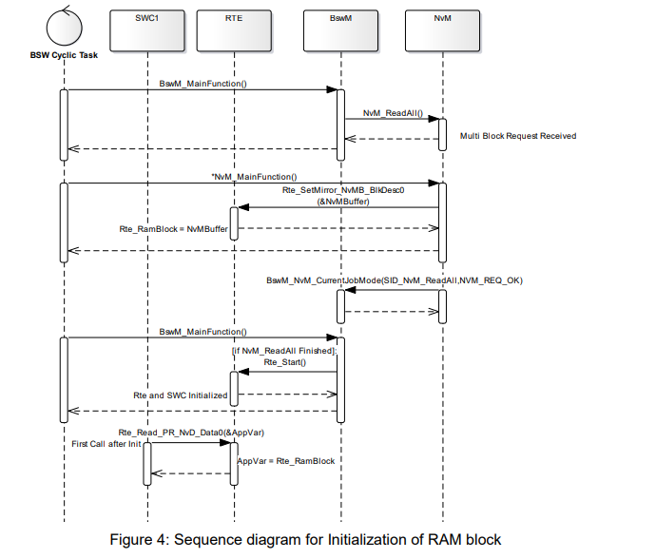

Slide 5
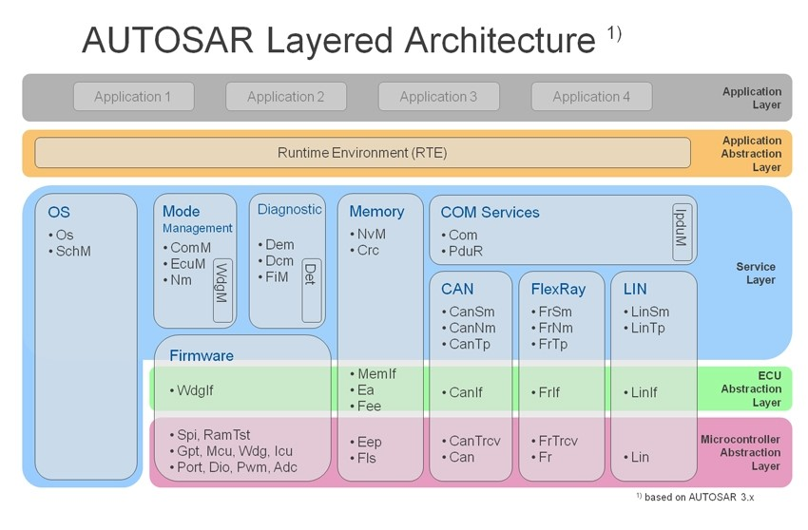

Slide 6
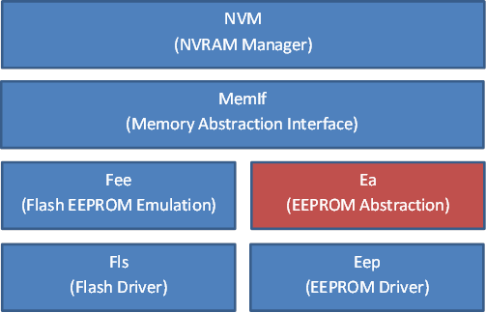
MemStack

Slide 7
Memory Stack Modules
Memory Stack in AUTOSAR layered architecture is a collection of software modules and device drivers.
Following is the list of modules in different layers of AUTOSAR:
Non-Volatile Memory Manager (NvM) – it is part of the AUTOSAR Services Layer
Memory Interface (MemIf) – it is part of the AUTOSAR ECU Abstraction Layer
Flash EEPROM Emulation (Fee) – it is part of the AUTOSAR ECU Abstraction Layer
EEPROM Abstraction (Ea) – it is part of the AUTOSAR ECU Abstraction Layer
Flash Driver (Fls) – it is part of the AUTOSAR MCAL Layer
EEPROM Driver (Eep) – it is part of the AUTOSAR MCAL Layer

Slide 8
NvM Manager
The NvM module ensures data storage and maintenance of NV (non volatile) data according to the individual requirements in an automotive environment.
The NvM module manages the NV data of an EEPROM and/or a FLASH EEPROM emulation device.

Slide 9
MemIf
The Memory Abstraction Interface (MemIf) module facilitates abstraction from the underlying FEE and EA modules. Hence MemIf module provides upper layer (NvM) with a virtual segmentation on a uniform linear address space.
This ensures that the Non-Volatile Memory Manager (NvM) is independent of the driver interface layers of EEPROM (Eep) and Flash interface (Fls)

Slide 10
EEPROM Abstraction
EEPROM driver provides services for reading, writing, erasing data to/from an EEPROM. It also provides a service for comparing a data block in the EEPROM with a data block in the memory (e.g. RAM).
Ea module facilitates abstraction from the addressing scheme of underlying EEPROM driver and hence provides a uniform addressing scheme.
This ensures that the upper layer (NvM) need not be changed if the underlying EEPROM driver and device is replaced.

Slide 11
FEE Module
The Flash EEPROM Emulation (FEE) abstracts from the device, a specific addressing scheme and segmentation.
This provides the upper layers (NvM) with a virtual addressing scheme, segmentation as well as a “virtually” unlimited number of erase cycles.

Slide 12
Flash Driver
Fls Driver Initializes Flash and reads/writes to Flash memory.

Slide 13
EEPROM Driver
EEPROM driver provides services for reading, writing, erasing to/from an EEPROM.
It also provides a service for comparing a data block in the EEPROM with a data block in the memory (e.g. RAM).

Slide 14
NvM Configuration
There are two major parts of the configuration; NvMCommon and NvMBlockDescriptors. The NvMCommon contains parameters that are common to the whole module. The NvMBlockDescriptors contains configuration of individual memory blocks.

Slide 15
NvM Common
There are three variants (config classes) of the NVM in order to adapt the module to limited hardware resources.
NVM_API_CONFIG_CLASS_1 Especially for matching systems with very limited hardware resources this API configuration class offers only a minimum set of API calls which are required in any case.
NVM_API_CONFIG_CLASS_2 An intermediate set of API calls is available.
NVM_API_CONFIG_CLASS_3 All specified API calls are available. A maximum of functionality is supported.

Slide 16
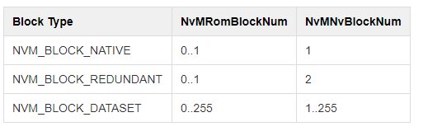
NvMBlockDescriptor
The NvMBlockManagementType defines the block type for the NVRAM block and may assume the folloiwng values: NVM_BLOCK_DATASET, NVM_BLOCK_NATIVE, and NVM_BLOCK_REDUNDANT.
The NvMRomBlockNum and NvMNvBlockNum valid values are, depending on the type, according to the table below:

Slide 17
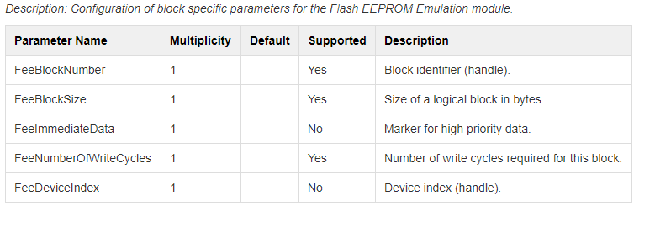
Flash Configuration

Slide 18
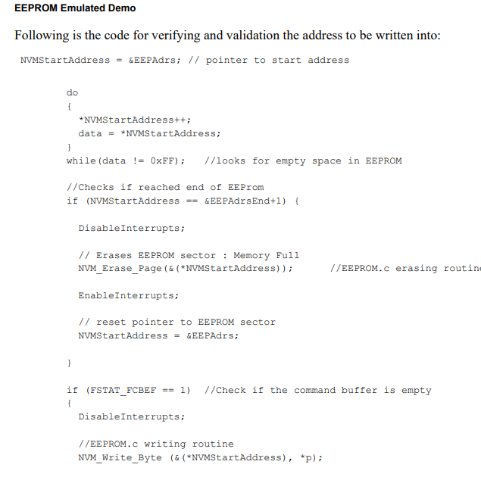
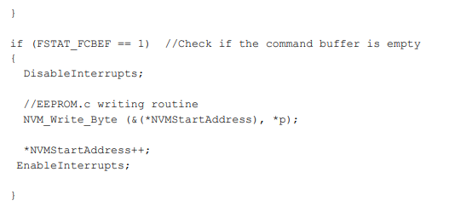
Emulator demo

