Slide 1
Runtime Environment (RTE)
Mohamed Saied

Slide 2
Agenda
AUTOSAR Methodology
Virtual Function Bus (VFB)
RTE between SWCs on the same Partition (core)
RTE between SWCs on two different Partitions (core)
RTE between SWCs on Two different ECUs
Port Interface
Relation Between OS and RTE

Slide 3
Introduction to RTE
RTE is responsible to establish link between AUTOSAR software components.
Software components communicate via this link provided by RTE.
RTE acts as means by which AUTOSAR software components access basic software modules including the OS and Communication service.
RTE implements the VFB for each ECU.
RTE abstracts the software component layer from implementation of the Basic software and from the hardware.
RTE enables software components to be reused in different ECUs.

Slide 4
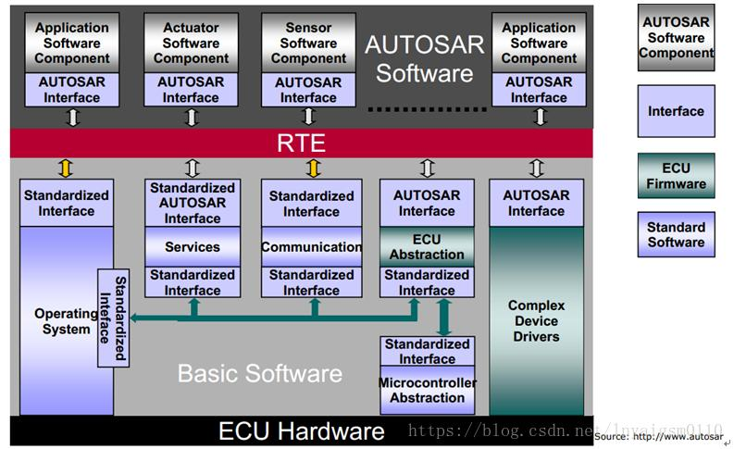

Slide 5
AUTOSAR Interface
An “AUTOSAR Interface” defines the information exchanged between software components and/or BSW modules. This description is independent of a specific programming language, ECU or network technology. AUTOSAR Interfaces are used in defining the ports of software-components and/or BSW modules. Through these ports software-components and/or BSW modules can communicate with each other (send or receive information or invoke services). AUTOSAR makes it possible to implement this communication between Software- Components and/or BSW modules either locally or via a network.

Slide 6
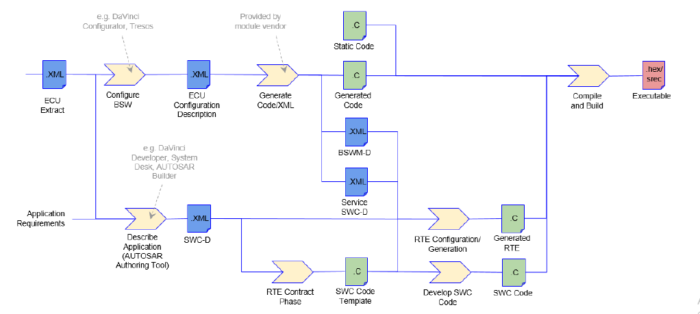
AUTOSAR Methodology

Slide 7
Types of SWC components
Application Software Component
Sensor Actuator Component
Calibration Parameter Component
Service Component
ECU Abstraction Component
Complex Device Driver Component

Slide 8
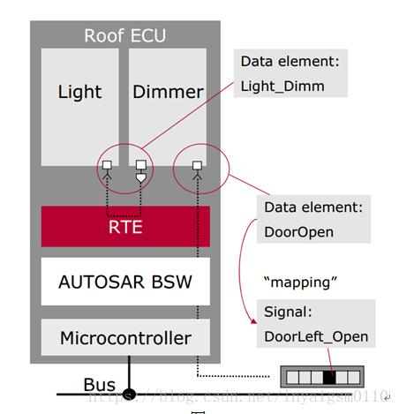
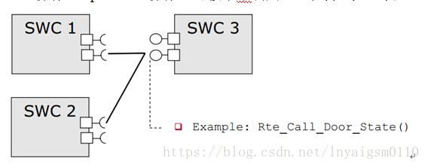
Mapping SWC [Sender Receiver Port]

Slide 9
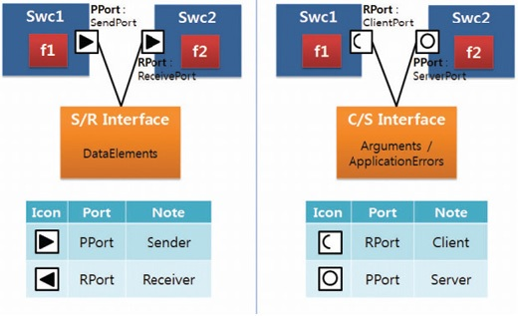
COMPOSITION

Slide 10
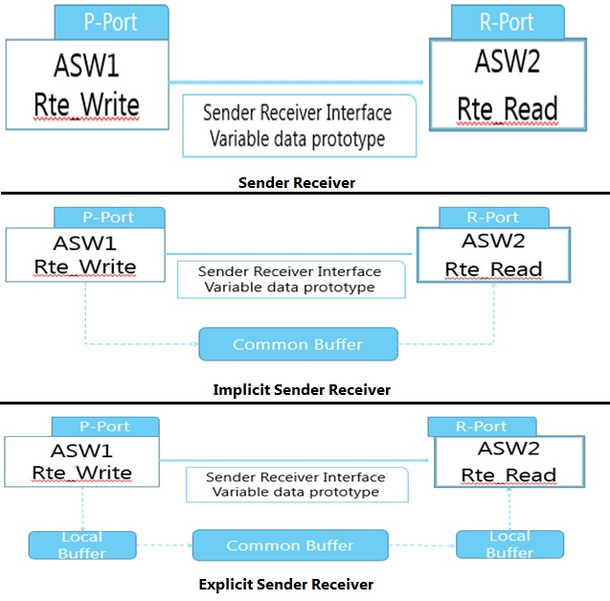

Slide 11
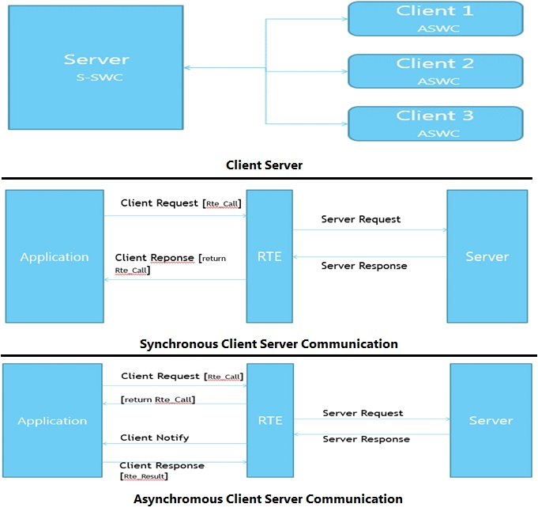

Slide 12
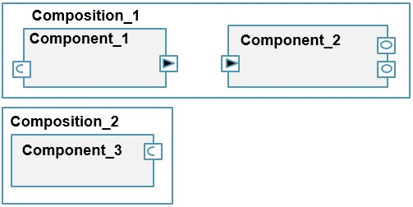
Composition cont’

Slide 13
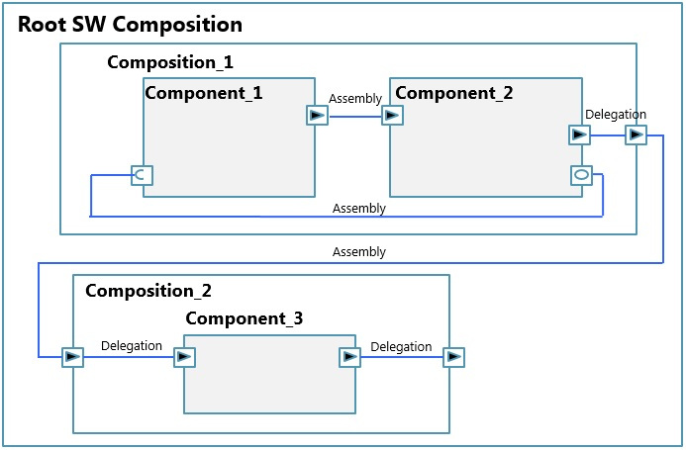
Connector
Types of Connectors
Assembly
Delegation

Slide 14
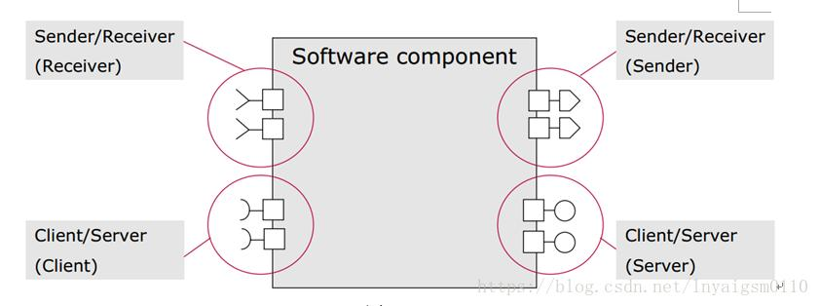
Port Types

Slide 15
PORT INTERFACE:
Different types of interfaces:
Sender Receiver Interface
NV Data Interface
Mode Switch Interface
Client Server Interface
Parameter Interface
Trigger Interface

Slide 16
SWC Described in AUTOSAR
Structure/Composition
Port Interface
Internal Behavior (Runnables,events “timing port access”,waitpoint)
Implementation (Exclusive area critical section memory map)

Slide 17
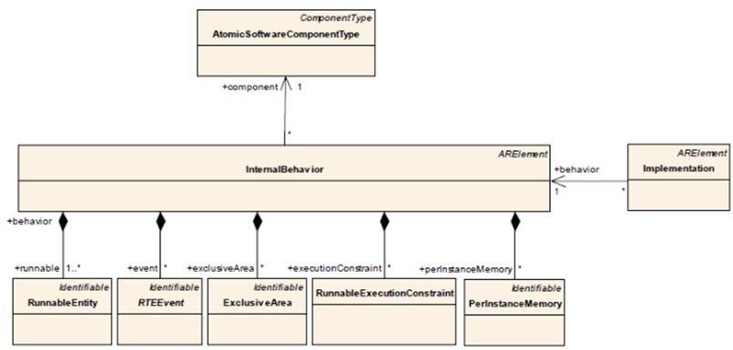
RTE Entities
Runnable Entity
RTE Events
Exclusive Areas
Runnable Execution Constraints
Per Instance Memory

Slide 18
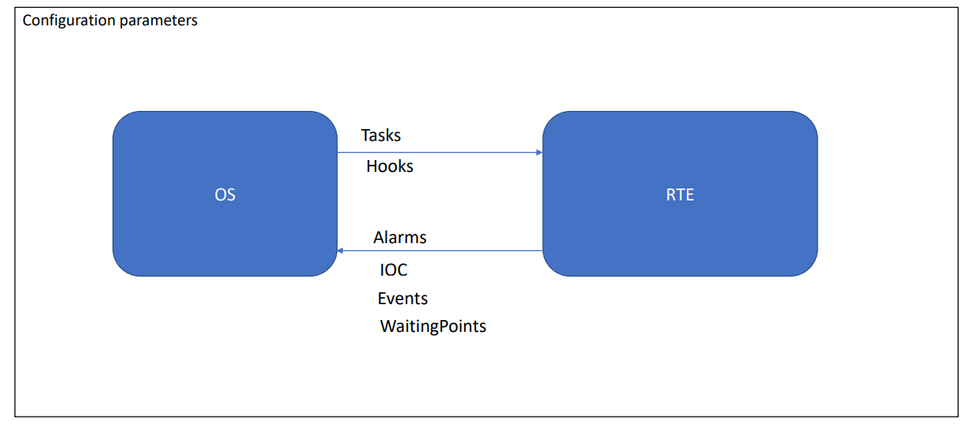
RTE OS Relation

Slide 19
RTE OS Relation
1- Tasks :
The RTE generator has to create the task bodies, which contain the calls of the RunnableEntitys and BswSchedulableEntitys. Note that
the term task body is used here to describe a piece of code, while the term task describes a configuration object of the OS. • The RTE
and Basic Software Scheduler controls the task activation/resumption either directly by calling OS services like SetEvent() or
ActivateTask() or indirectly by initializing OS alarms or starting Schedule-Tables for time-based activation of RunnableEntitys. If the task
terminates, the generated taskbody also contains the calls of TerminateTask() or ChainTask(). • The RTE generator does not create
tasks. The mapping of RunnableEntitys and BswSchedulableEntitys to tasks is the input to the RTE generator and is therefore part of the
RTE Configuration. • The RTE configurator has to allocate the necessary tasks in the OS configuration.

Slide 20
RTE OS Relation
2- OS applications
AUTOSAR OS has in R4.0 a new feature called Inter-OS-Application Communication (IOC). IOC is generated by the OS based on the
configuration partially generated by the RTE. The appropriate objects (OS-Applications) are generated by the OS, and are used by RTE
to for task/runnable mapping.
3- Events:
• The RTE and Basic Software Scheduler may use OS Events for the implementation of the abstract RTEEvents and BswEvents.
• TheRTE and Basic Software Scheduler therefore may call the OS service functions SetEvent(), WaitEvent(), GetEvent() and ClearEvent().
The used OS Events are part of the input information of the RTE generator • The RTE configurator has to allocate the necessary events
in the OS configuration

Slide 21
RTE OS Relation
Resources: The RTE and Basic Software Scheduler may use OS Resources (standard or internal) e.g. to implement data consistency mechanisms.
• The RTE and Basic Software Scheduler may call the OS services GetResource() and ReleaseResource().
• The used Resources are part of the input information of the RTE generator.
• The RTE configurator has to allocate the necessary resources (all types of resources) in the OS configuration.

Slide 22
RTE OS Relation
Interrupt Processing An alternative mechanism to get consistent data access is disabling/enabling of interrupts. The AUTOSAR OS provides different service functions to handle interrupt enabling/disabling. The RTE may use these functions and must not use compiler/processor dependent functions for the same purpose.

Slide 23
RTE OS Relation
The RTE may use Alarms for timeout monitoring of asynchronous client/server calls. The RTE is responsible for Timeout handling.
• The RTE and Basic Software Scheduler may setup cyclic alarms for periodic triggering of RunnableEntitys and BswSchedulableEntitys (RunnableEntity activation via RTEEvent TimingEvent respectively BswSchedulableEntity activation via BswEvent BswTimingEvent )
• The RTE and Basic Software Scheduler therefore may call the OS service functions GetAlarmBase(), GetAlarm(), SetRelAlarm(), SetAbsAlarm() and CancelAlarm().
• The used Alarms are part of the input information of the RTE generator.
• The RTE configurator has to allocate the necessary alarms in the OS configuration

Slide 24
RTE OS Relation
Schedule Tables The RTE and Basic Software Scheduler may setup schedule tables for cyclic task activation (e.g. RunnableEntity activation via RTEEvent TimingEvent)
• The used schedule tables are part of the input information of the RTE generator.
• The RTE configurator has to allocate the necessary schedule tables in the OS configuration

Slide 25
RTE OS Relation
Hook functions The AUTOSAR OS Specification defines hook functions as follows: A Hook function is implemented by the user and invoked by the operating system in the case of certain incidents. In order to react to these on system or application level, there are two kinds of hook functions.
• application-specific: Hook functions within the scope of an individual OS Application.
• system specific: Hook functions within the scope of the complete ECU (in general provided by the integrator)

Slide 26
References
http://www.programmersought.com/article/8830111360/
https://automotiveembeddedsite.wordpress.com/runtime-enviroment/ (read it)

