Slide 1
Communication Stack
Mohamed Saied

Slide 2
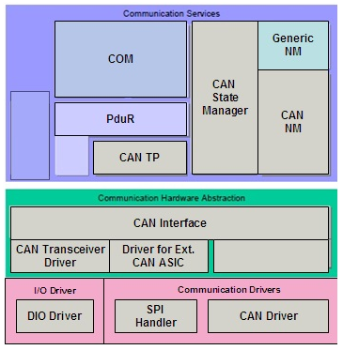
Communication Stack
AUTOSAR COM (Services Layer)
PDU Router (Services layer)
CAN State Manager (Services Layer)
CAN Network Manager (Services Layer)
CAN Transport Protocol (Services Layer)
CAN Interface (ECU Abstraction Layer)
CAN Transceiver Driver (ECU Abstraction
Layer)
CAN Driver (MCAL Layer)

Slide 3
AUTOSAR COM
AUTOSAR COM is a module between the RTE and the PDU Router. It is based on OSEK COM specification and provides a uniform interface to the CAN Network. It is responsible for providing Signal level access to the application layer and PDU level access to the lower layers, independent of the protocol.
It packs the signals to a PDU at the transmitter and unpacks the received PDU to provide signal level access to the application at the receiver. At the PDU level, COM is responsible for grouping of the PDUs, and starting/stopping of the PDU groups.

Slide 4
PDU Router
PDU Router is a module responsible for routing the PDU to the respective Bus Specific Interface modules.Above the PDU Router module, all the PDUs are protocol independent. Below the PDUR, all the PDUs are routed to the protocol specific modules.
PDUR is also the PDU level gateway for transmitting the received PDU from one Bus Specific Interface module to another Bus Specific Interface module.
The PDU Router also accomplishes the gateway functionality when the PDU is routed from one controller to another over the same protocol.

Slide 5
CAN TP and CANIf
CAN TP: The basic services offered by the CAN TP module are segmentation of messages which have a payload of more than 8 bytes, transmission of the messages with flow control and reassembling the segmented messages at the receiver.
CAN Interface: CAN Interface (CANIF) is a module in the ECU Abstraction Layer, which is responsible for services like Transmit Request, Transmit Confirmation, Reception Indication, Controller mode control and PDU mode control.

Slide 6
CAN State Manager
CAN State Manager (CANSM): This module implements the control flow for the respective Bus. The CAN State Manager is a member of the Communication Services group of modules.CAN State Manager handles the start-up and shutdown features that depend on the communication system. It also regulates the various options of COM for sending PDUs and monitoring signal timeouts.

Slide 7
CAN NM –CAN Network Management
The AUTOSAR CAN Network Management is a hardware independent protocol tool that can only be used on CAN network. It coordinates the transition between normal operation and bus-sleep mode of the network. The CAN Network Management (CANNM) function provides an adaptation between Network Management Interface (NMIF) and CAN Interface (CANIF) modules.

Slide 8
MCAL and HAL drivers
CAN Transceiver Driver – The primary functionality of the CAN Transceiver Driver includes controlling the external CAN transceiver hardware. The wake-up and sleep processes of the CAN Bus are regulated by the CAN Transceiver Driver. This driver also observes the BUS line and transmits physical network layer diagnostic information to the upper layers.
CAN Driver (CANDrv): This module is a part of the MCAL layer and provides hardware access to the upper layer services and a hardware-independent interface to the upper layers. CANIF is the only module that can access the CAN Driver.

Slide 9
Conclusion
AUTOSAR software components are designed as plug and play components and standardized communication is the key here. In the future automotive architecture, we can witness a reduced number of control units, thanks to advancements in communication within AUTOSAR architecture (Virtual Function Bus and RTE).

Slide 10
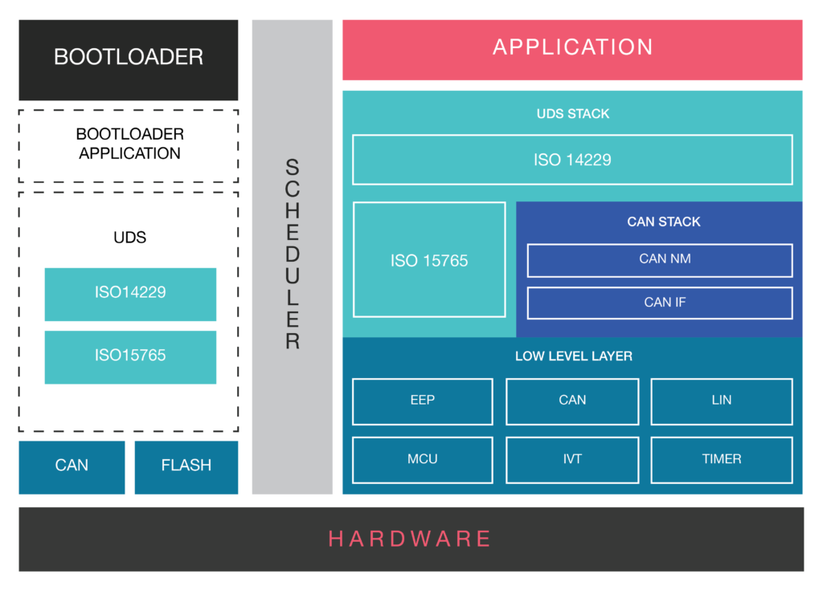
A Software Stack for CAN BUS Protocol (ISO 11898): Details of the Software Architecture

Slide 11
Com Stack Cont’
A Software Stack/Package compliant with ISO 11898: Our CAN BUS Stack consists of CAN Network Management (NM) Layer and CAN Interface (IF) Layer.
NM layer manages sleep/wake up functionality.
CAN Bus Interface Layer carries out all hardware independent tasks, related to the flow of data to the upper layer modules of the CAN software stack.
UDS Software Stack compliant with ISO 14229: UDS is the off-board diagnostics application. It is based on ISO 14229 Standard. This layer manages the diagnostics aspect of CAN bus software.
Flash Bootloader Application: Flash Bootloader is tasked with ECU Reprogramming. In our CAN software stack, we provide a UDS based flash bootloader for ECU Flashing purposes.
ISO Transport Layer (ISO 15765): Responsible for segmenting the data, if the size of the data frame is more than 8 Bytes.
Low-Level Driver: The CAN BUS Device Driver enables the access to hardware resources, for the upper software layers. It also offers access to the hardware independent API, to the application layer.

