Slide 1
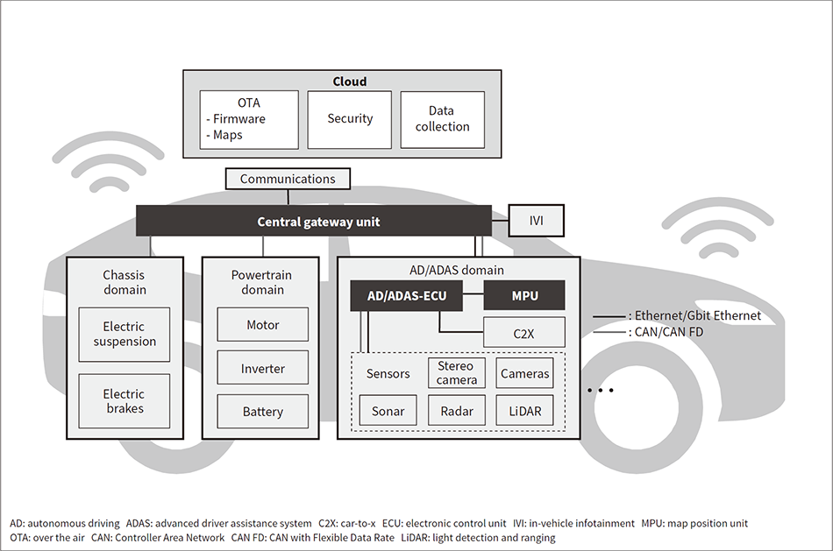
CAN

Slide 2
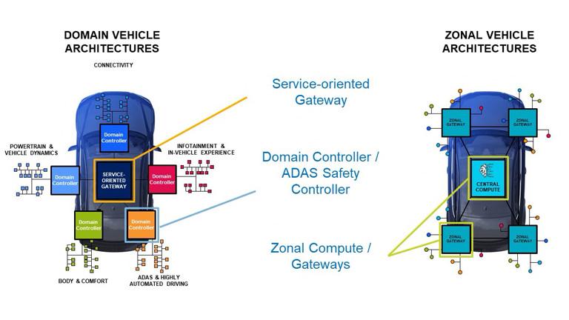
Evolution in vehicle network

Slide 3
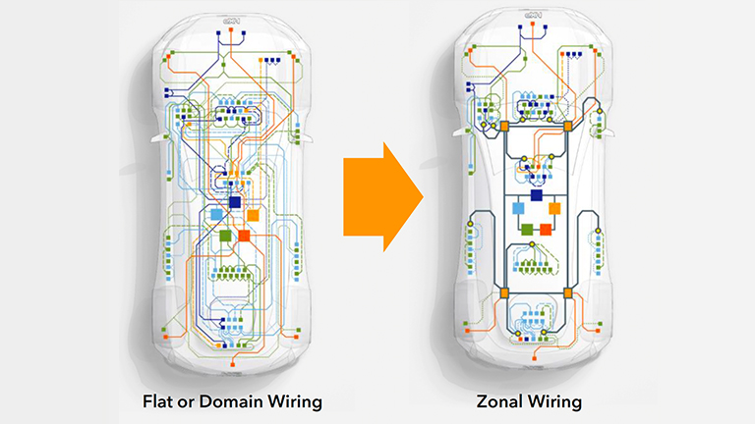
Wiring problem

Slide 4
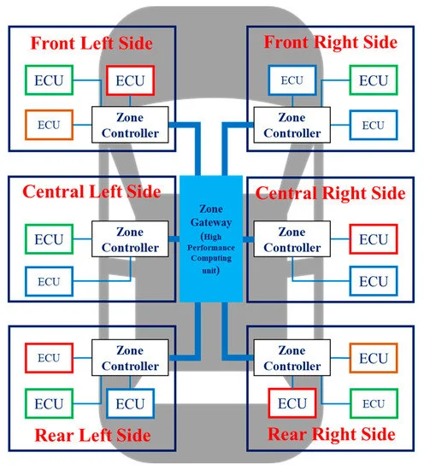
Zone vehicle Arch

Slide 5
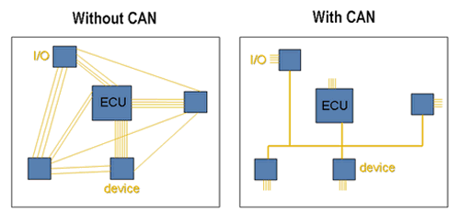
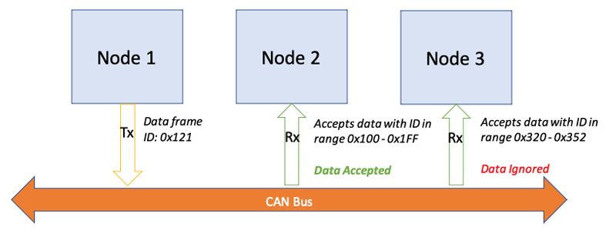
Controller Area Network bus
An automotive serial bus system developed to satisfy the following requirements:
➢ Network multiple microcontrollers with 1 pair of wires.
➢ Allow microcontrollers communicate with each other.
➢ High speed, real-time communication. (BaudRate up to 1 MbPS)
➢ Provide noise immunity in an electrically noisy environment.
➢ Low cost
➢ prioritization of messages

Slide 6
CAN Features
Multi-master protocol
Broadcasting
Event-Driven: Medium used only when necessary, Time of message arrival is unknown, Medium might be overloaded
Asynchronous communication (Event Triggered)
Serial communication technology
Priority-based bit-wise arbitration
Variable message priority based on 11-bit (or extended 29 bit) packet identifier
Differential, two wire with speed 1 Mbps

Slide 7
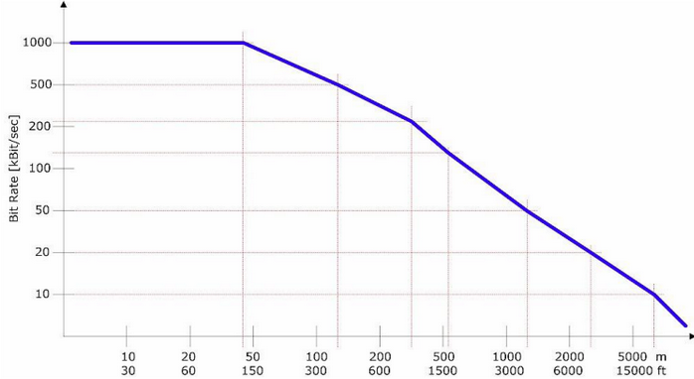
Transmission Characteristics

Slide 8
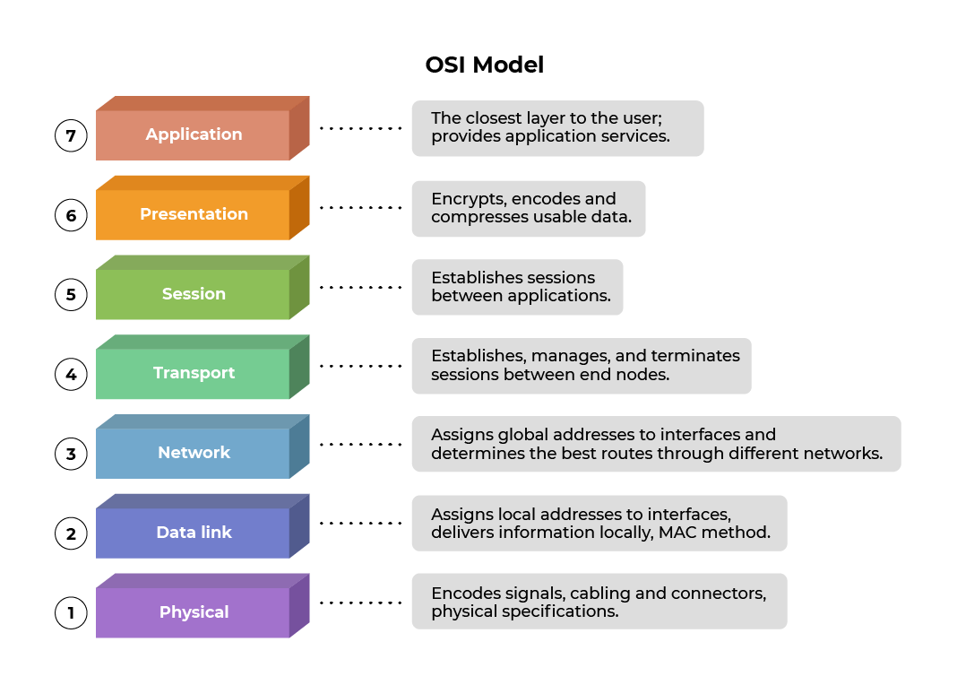
OSI Model

Slide 9
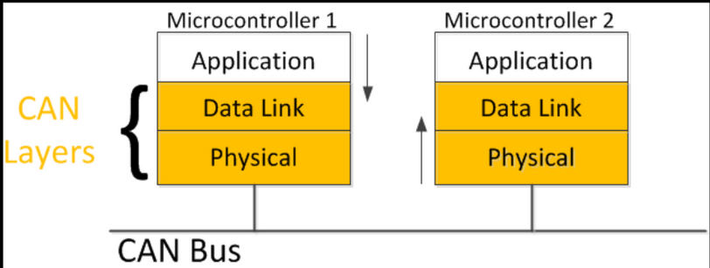
CAN Layers

Slide 10
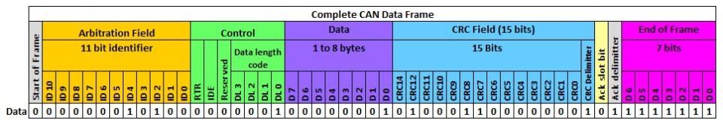
CAN Frame
Data frame: a frame containing node data for transmission
Remote frame: a frame requesting the transmission of a specific identifier
Error frame: a frame transmitted by any node detecting an error
Overload frame: a frame to inject a delay between data or remote frame

Slide 11
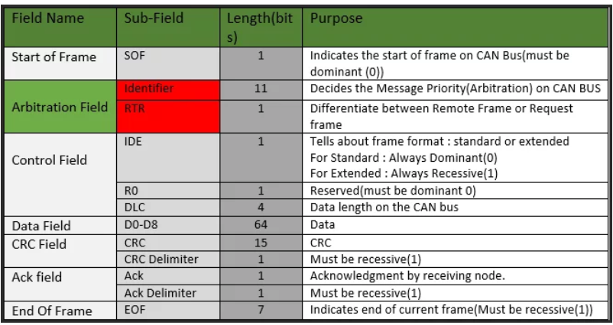
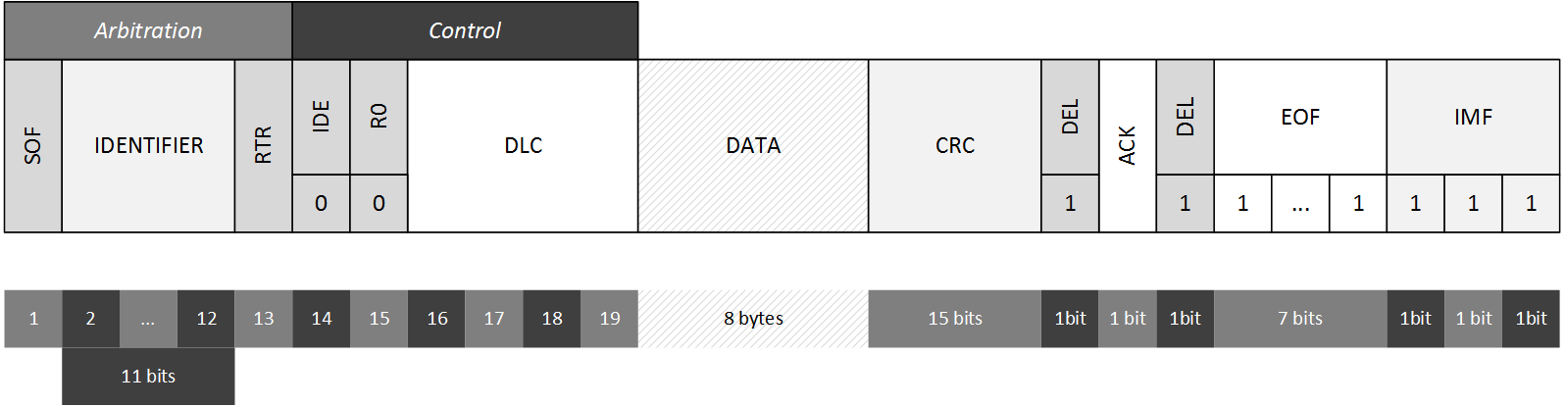

Slide 12
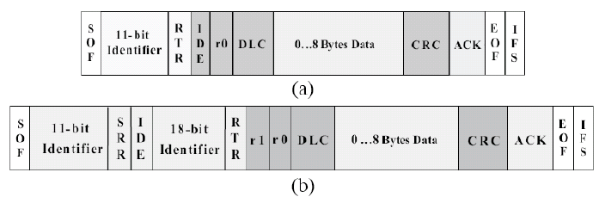
Standard vs Extended
The SRR bit is the substitute remote request and is recessive

Slide 13
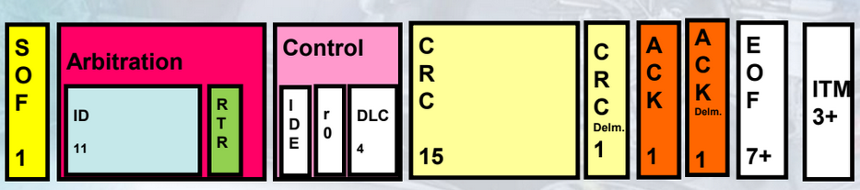
Remote frame
A Remote Frame requests the transmission of a message by another node. The requested data frame, identified by a unique message ID, may be accepted by any number of nodes in the network according to the individual application needs but can only be sent by one node associated with the requested message.

Slide 14
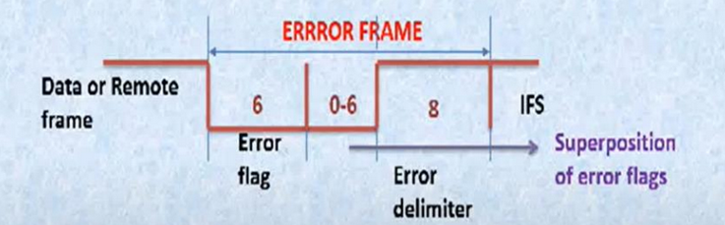
Error Frame
This frame consists of two fields:
◆ The first field is given by the superposition of error flags contributed from
different nodes.
◆ The second field is the error delimiter. (Recessive)
Error flag can be either active-error flag or passive-error flag.
◆ Active error flag consists of six consecutive dominant bits.
◆ Passive error flag consists of six consecutive recessive bits.
The error delimiter consists of eight recessive bits.

Slide 15
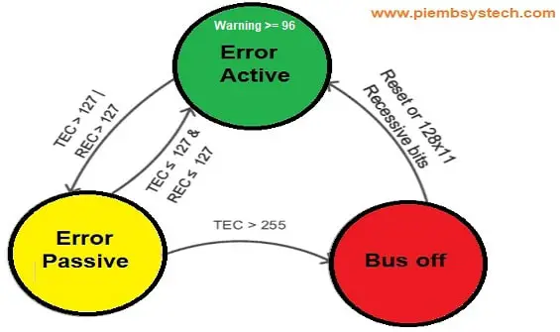
Error Frame
In every CAN node, there are 2 error counters
◆ Transmit Error Counter (TEC)
◆ Receive Error Counter (REC).
◆ When the transmitter detects an error in the transmitted frame, it
increments the TEC by 8.
◆ A receiver detecting an error will increment its REC by 1.
◆ On successful transmission/reception the error counters are reduced by 1.

Slide 16
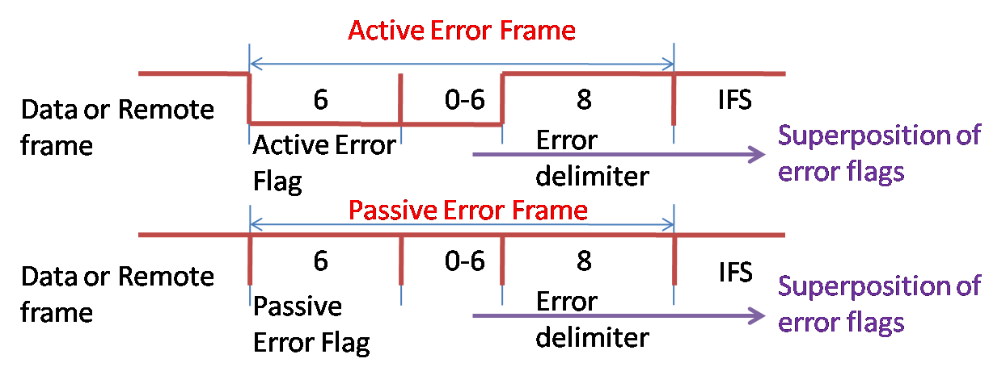
Error frames

Slide 17
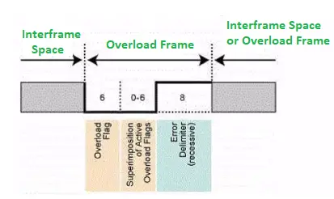
Overload Frame
Consists of two bit fields: overload flag and overload delimiter
◆ The over load frame will be generated, when the receiving node is
overloaded – i.e. it is not able to detect and receive the incoming messages
◆ The format is very similar to Error Frame but without the error counters incrementing.
◆ An Overload frame indicates that its transmitter require delay before receiving next data or remote frame The overload flag consists of six dominant bits.
◆ The overload delimiter consists of eight recessive bits.

