Slide 1
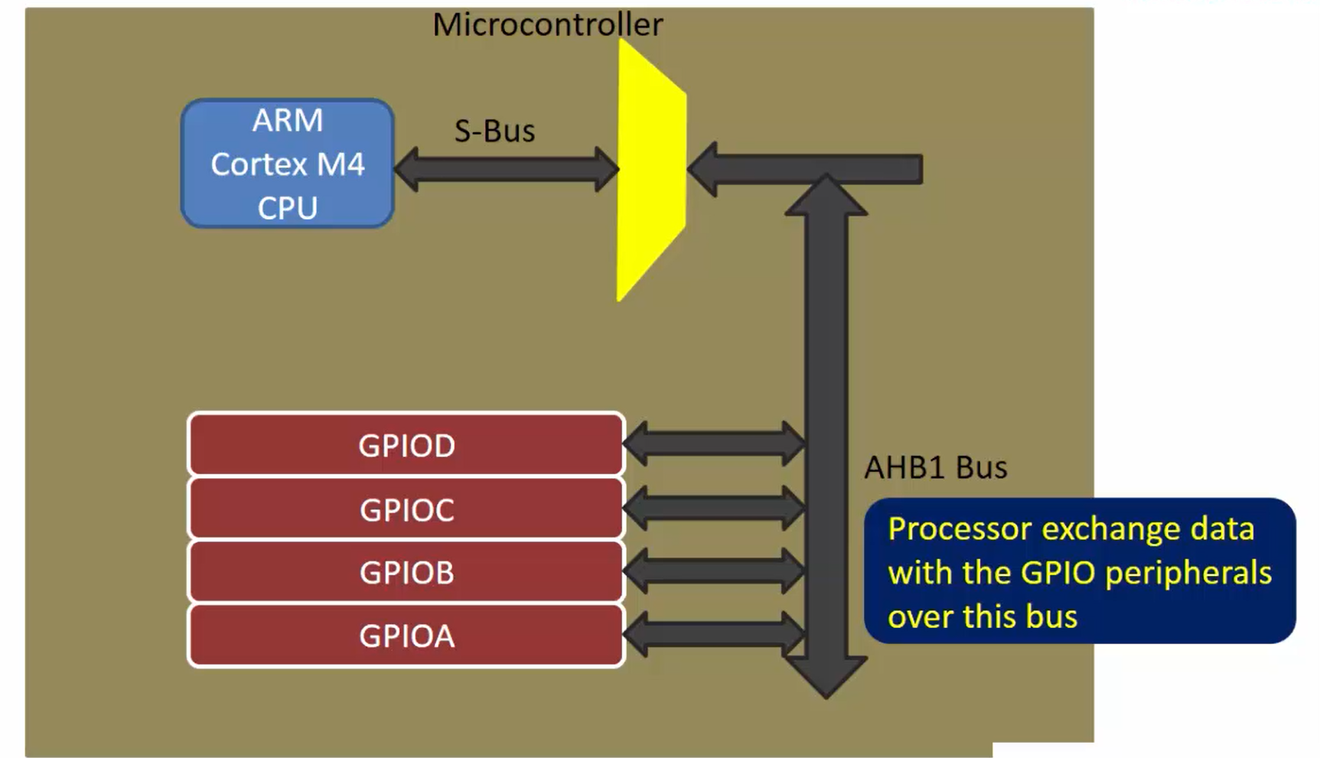
GPIO
FOR STM32F103C8T6

Slide 2
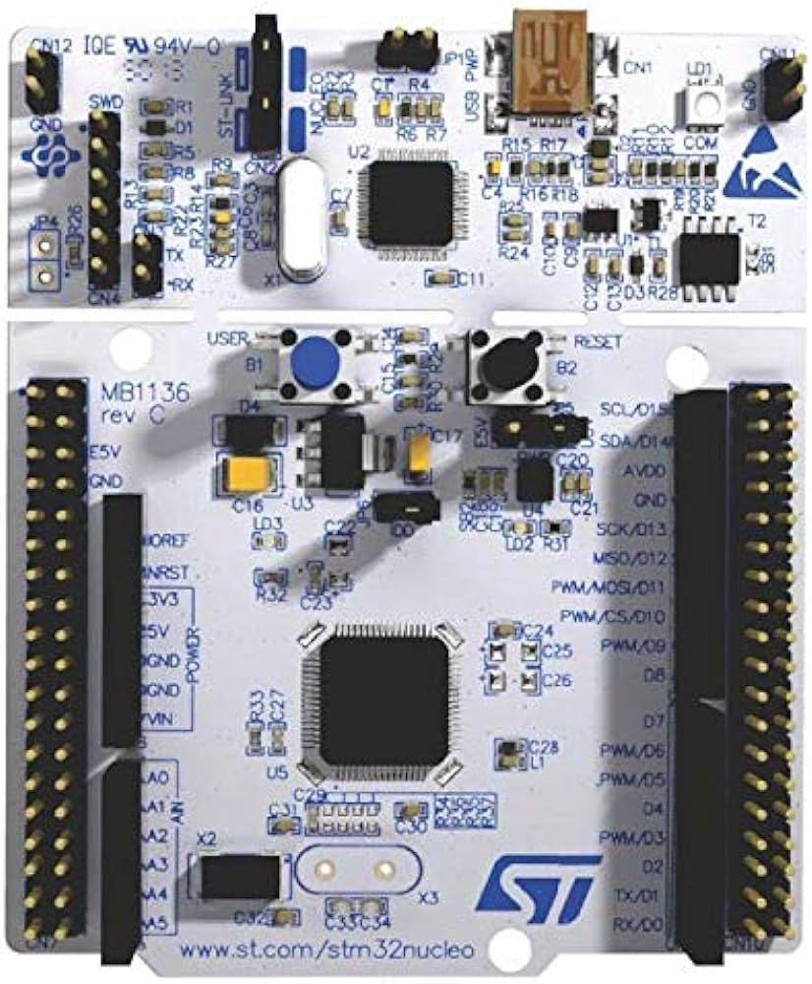
GPIO Introduction

Slide 3
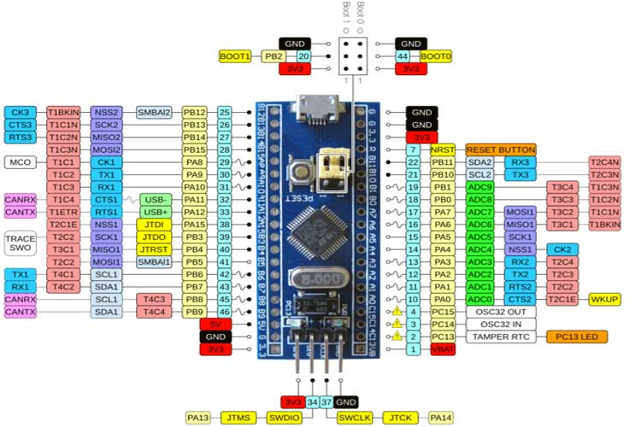

Slide 4
Enable any GPIO port
1- GPIO clock From RCC
2- configure GPIO Pin to be input(digital or analog) or output (digital(low 2MHZ, medium 10MHZ, high 50MHZ), AF)
3- use data register of GPIO

Slide 5
Registers
we have 16 Pins for every port, and every pin needs 4bit configuration
1- control register (low,high)
2- data register
3- BSRR (Bit set reset register)
4- BRR (Bit reset register)
5- lock register

Slide 6
