Slide 1
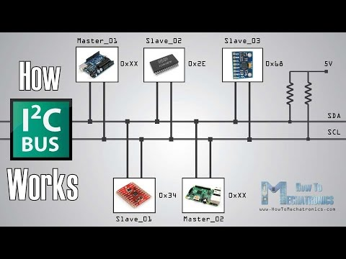
I2C
Inter-Integrated circuit
(Two wire bus)

Slide 2
What is I2C
I2C is communication protocol that is ideal for low-speed devices over short distance.
Devices Ex: MCU, EEPROM, Real Timers, LCD, ADC,.. etc.
Multi-master Multi-slave
Synchronous
Half duplex
Speed between 100KHz to 4MHZ
I2C use 2 bidirectional open-drain pins for data communication.

Slide 3
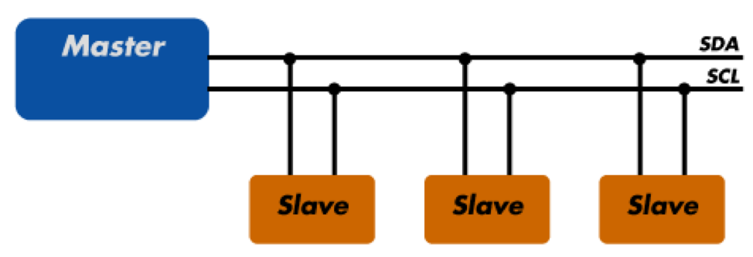
I2C Bus
SDA (Serial Data) – The line for the master and slave to send and receive data (bidirectional).
SCL (Serial Clock) – The line that carries the clock signal.

Slide 4
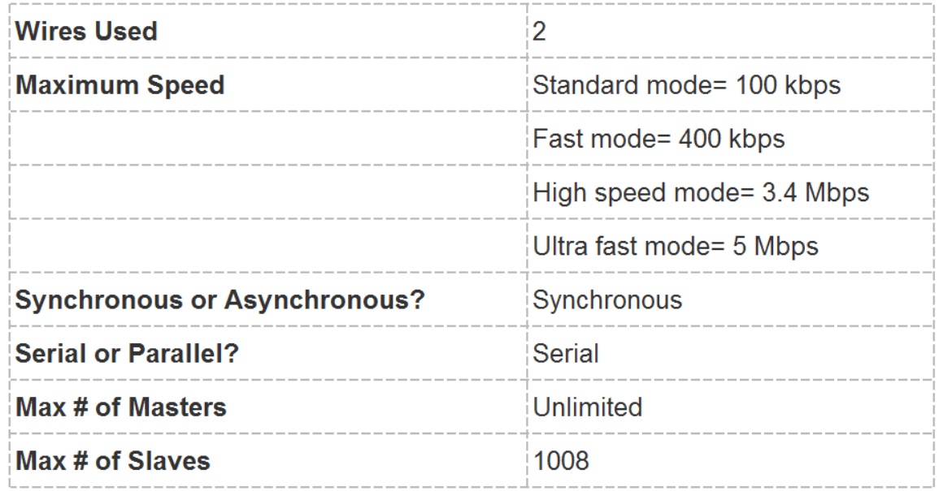
I2C
I2C is a serial communication protocol, so data is transferred bit by bit along a single wire (the SDA line).
Like SPI, I2C is synchronous, so the output of bits is synchronized to the sampling of bits by a clock signal shared between the master and the slave. The clock signal is always controlled by the master.
I2C is usually used for slave devices which are fine with I2C speed constrains or which are kind of slow like sensors which can take longer time to get the measure e.g. popular temperature and humidity sensor HTU21-D

Slide 5
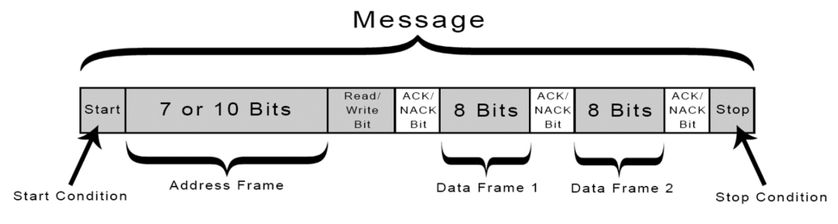
I2C Frame
Start Condition: The SDA line switches from a high voltage level to a low voltage level before the SCL line switches from high to low.
Stop Condition: The SDA line switches from a low voltage level to a high voltage level after the SCL line switches from low to high.
Address Frame: A 7 or 10 bit sequence unique to each slave that identifies the slave when the master wants to talk to it.
Read/Write Bit: A single bit specifying whether the master is sending data to the slave (low voltage level) or requesting data from it (high voltage level).

Slide 6
I2C Frame
ACK/NACK Bit: Each frame in a message is followed by an acknowledge/no-acknowledge bit. If an address frame or data frame was successfully received, an ACK bit is returned to the sender from the receiving device.

Slide 7
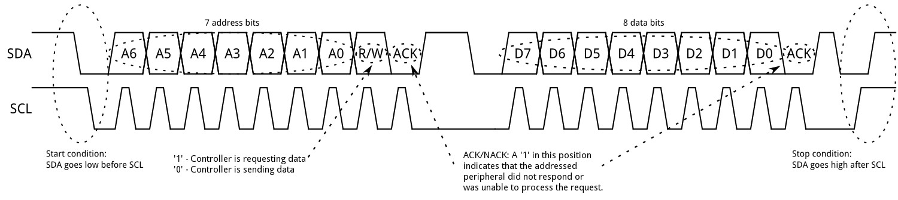
I2C Frame

Slide 8
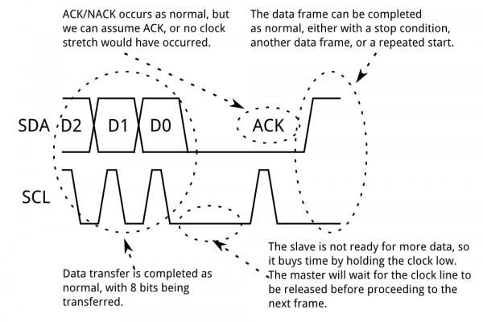
Clock Stretching
there can be some situations when I2C slave device is not able to cooperate with clock signals given by master. Clock stretching is the mechanism used to slow down master device for slave device to complete it’s operation.
I2C slave device is allowed to hold down the clock signal when it needs master to slow down on the 9th clock of every data transfer before the ACK stage
This can be because the data isn't ready yet (for instance, the slave hasn't completed an analog-to-digital conversion yet) or because a previous operation hasn't yet completed (say, an EEPROM which hasn't completed writing to non-volatile memory yet and needs to finish that before it can service other requests).

Slide 9
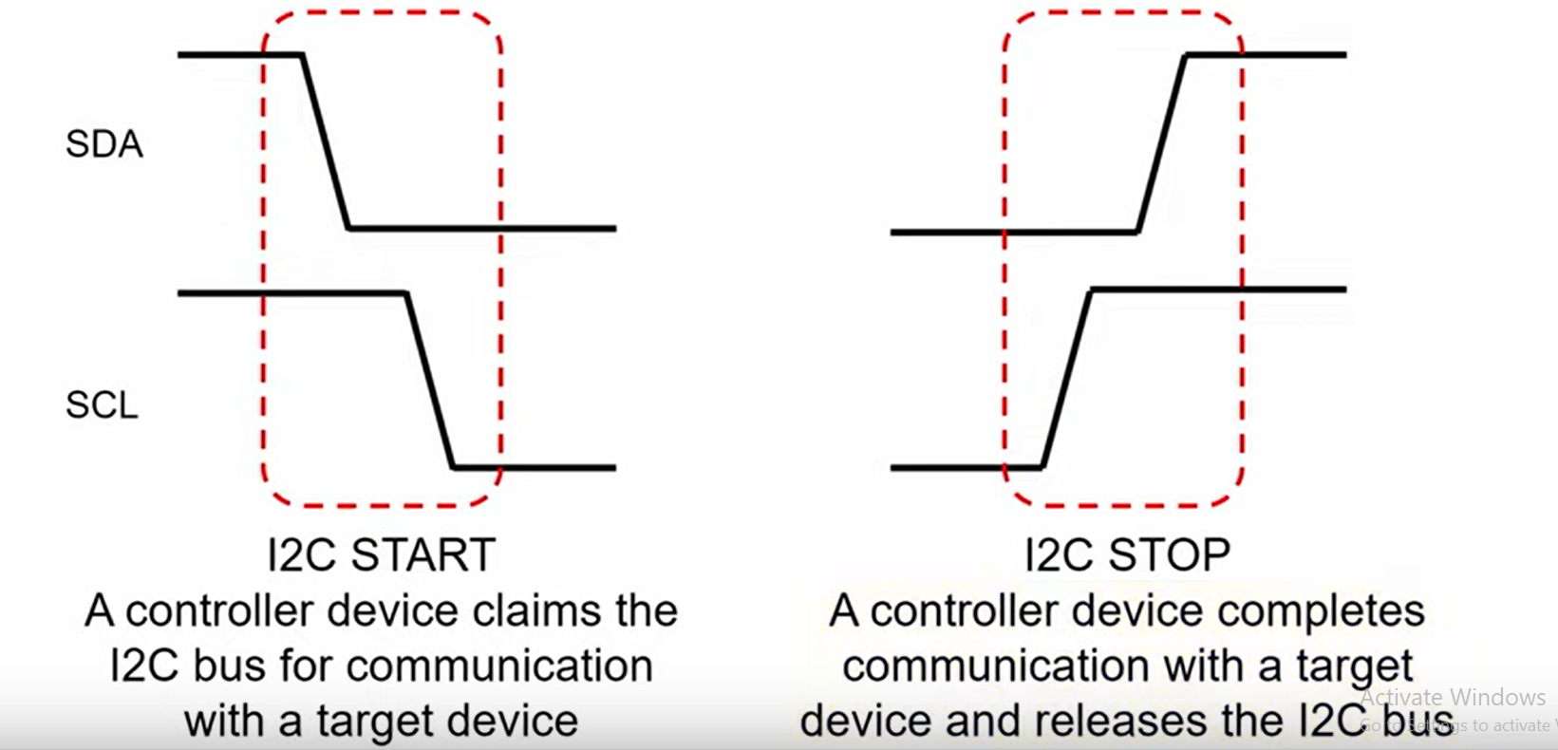
Start & Stop Conditions

Slide 10
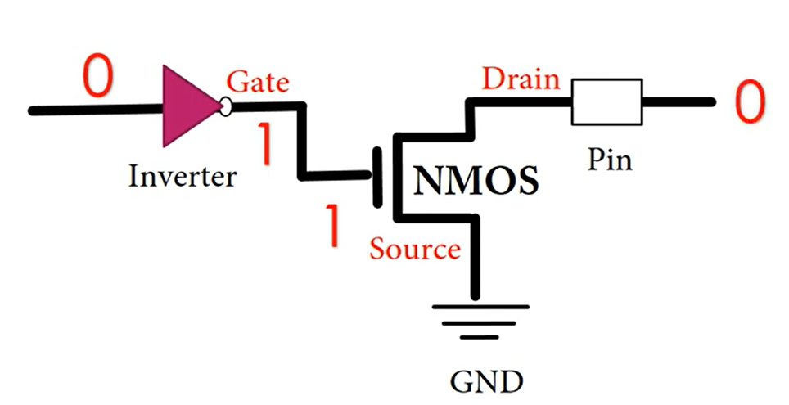
Open Drain

Slide 11
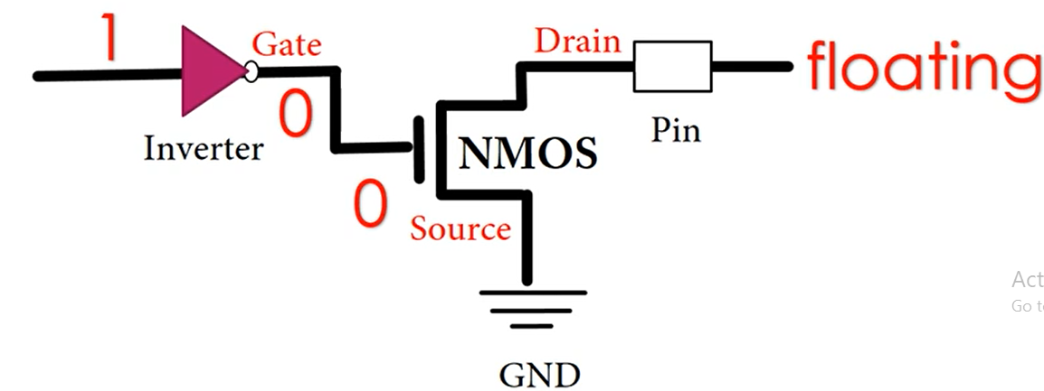
Open Drain

Slide 12
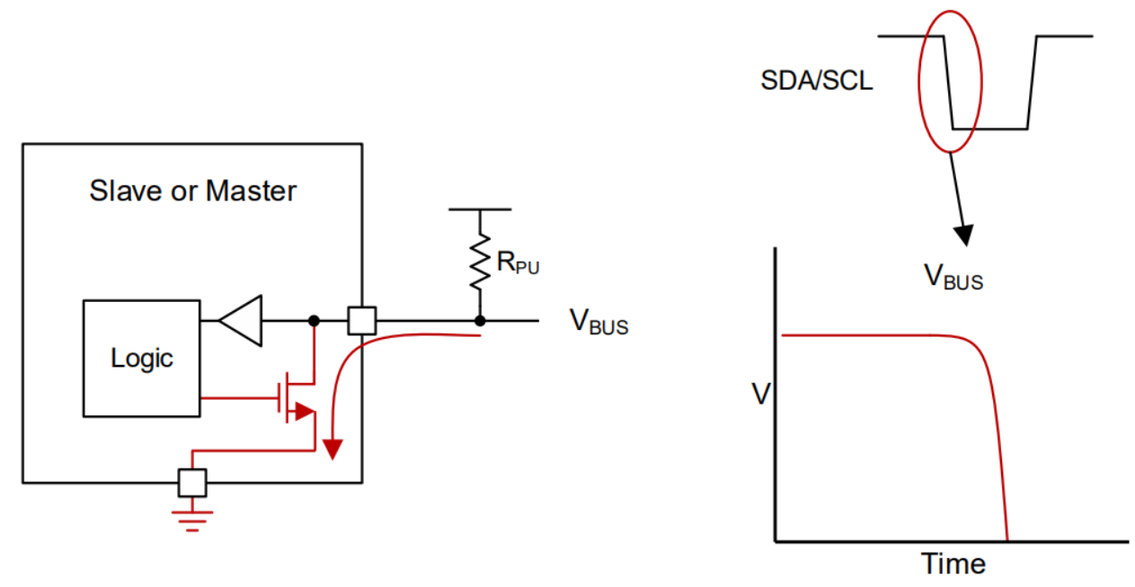
Open Drain – Pulling Low
When the device needs to transmit LOW, it can switch ON the MOSFET, the bus will be pulled down (shorted to ground).

Slide 13
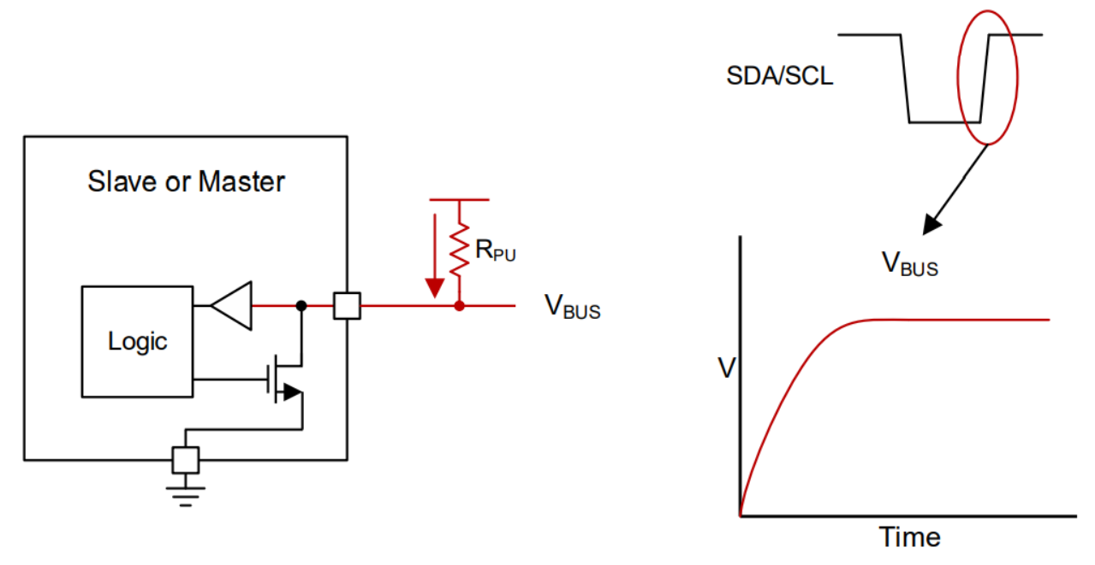
Open Drain – Releasing Bus
When a device needs to transmit HIGH, it can simply release the bus (MOSFET OFF). This leaves the bus floating and it will be pulled HIGH by the pull up resistors.

