Slide 1
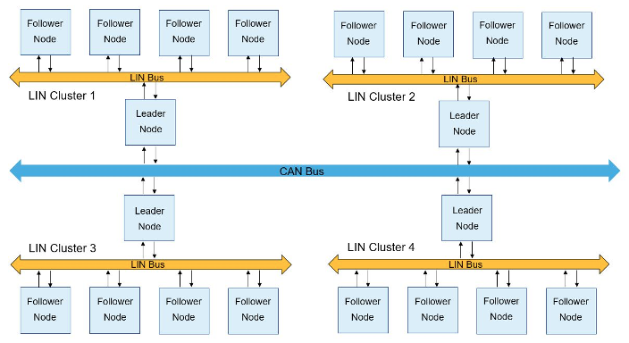
LIN
Local Interconnect Network

Slide 2
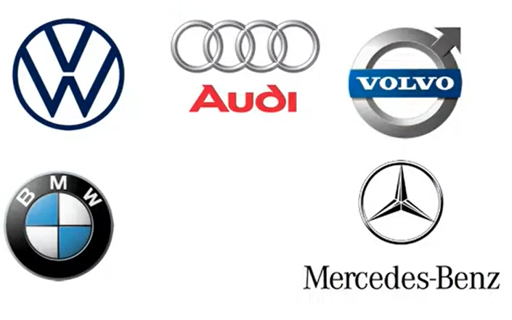
Why LIN?
LIN came into existence when CAN was the most common protocol used, because manufactures needed protocol which was cheaper compared to CAN, with trade off to be slower than CAN.
Some systems in car need lower speed protocol, less time critical, without any extreme fault tolerance.
1-20 kbit/s
Max 40 m wire length

Slide 3
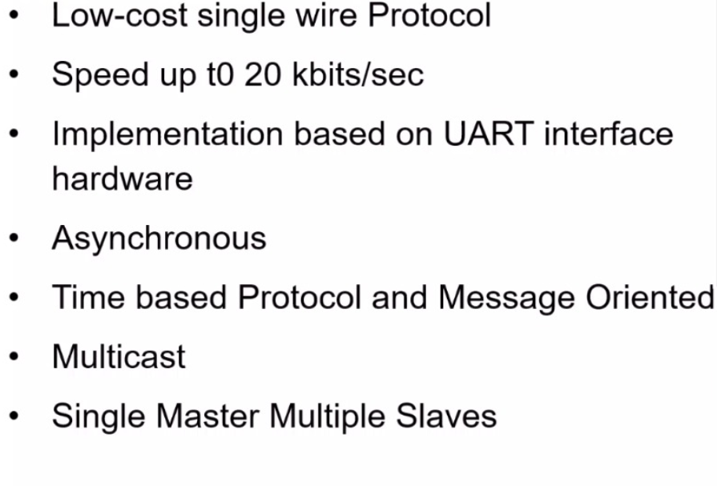
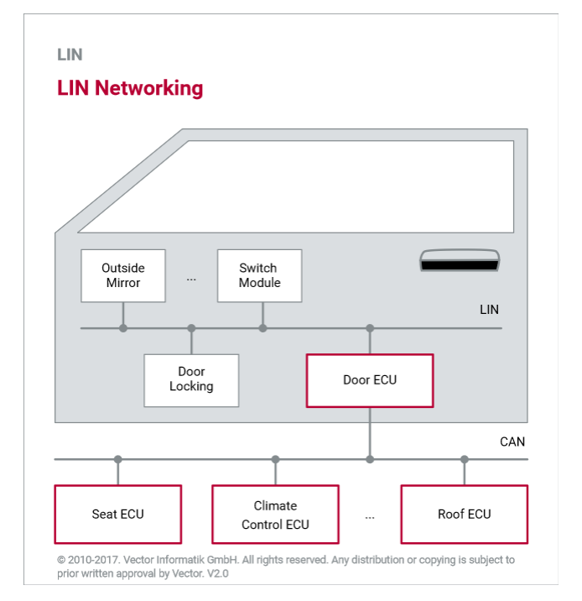
LIN Features

Slide 4
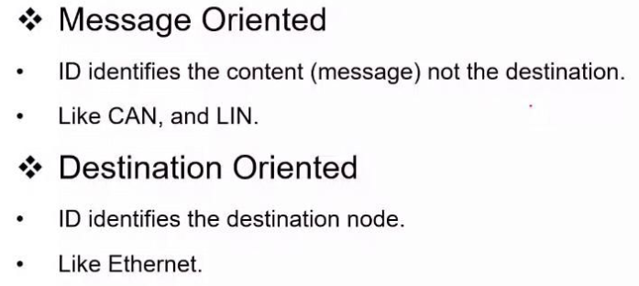
Message Orientation

Slide 5
LIN Features
Network for sensors and actuators.
Physical Layer is single wire.
LIN Cluster is subsystem always.
Use Cases: Seat, Mirror, Wiper, Car locking, Air conditioning systems.

Slide 6
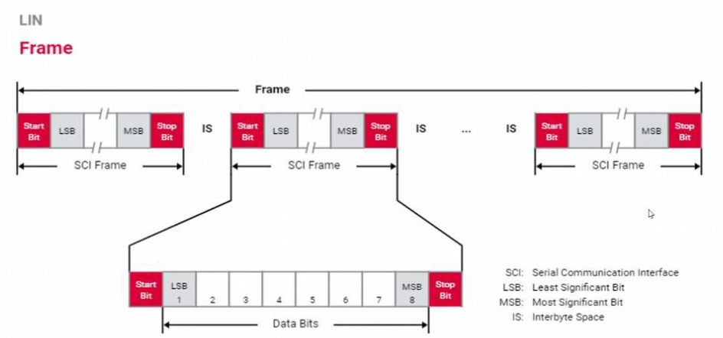
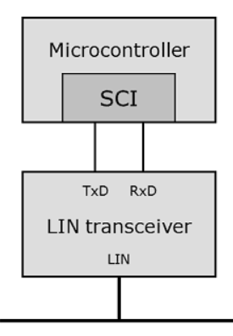
LIN Frame

Slide 7
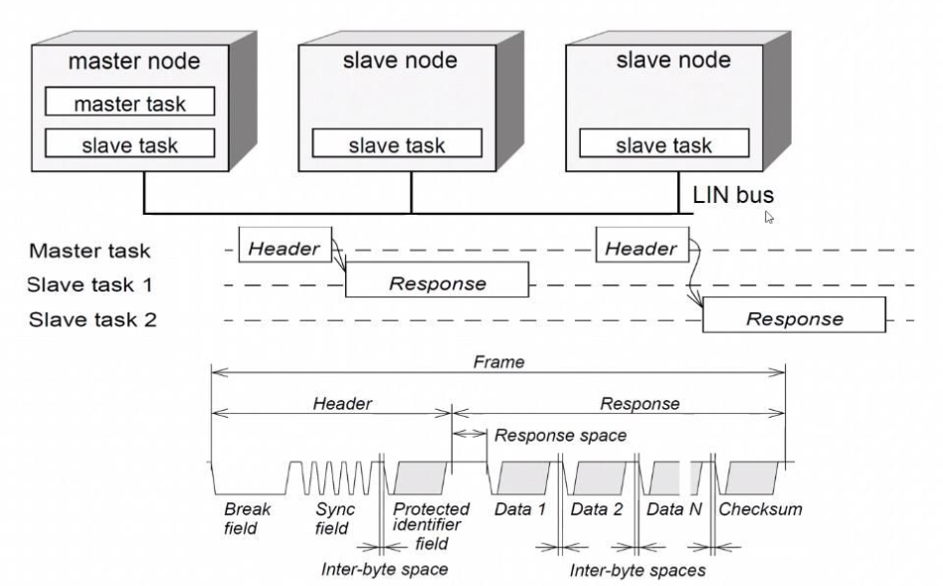
LIN Frame

Slide 8
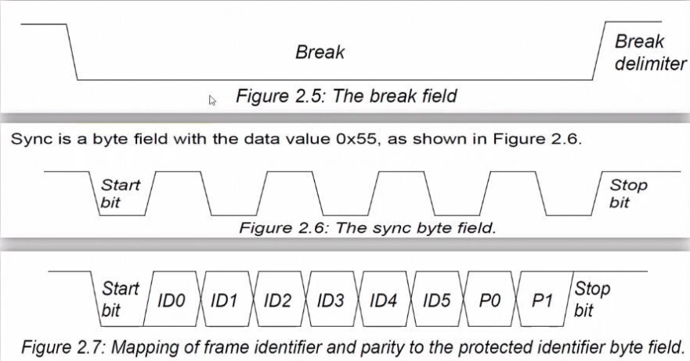
Header Frame
P0 = ID0 ⊕ ID1 ⊕ ID2 ⊕ ID4
P1 = ! (ID1 ⊕ ID3 ⊕ ID4 ⊕ ID5)

Slide 9
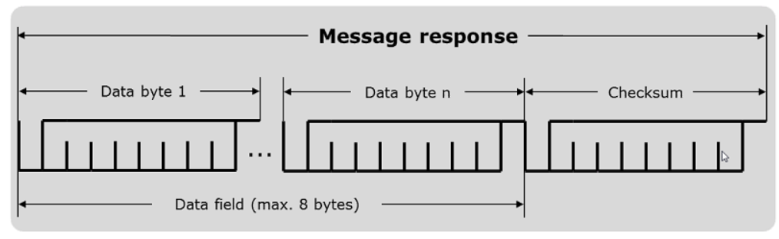
Response Frame
Payload: 1 to 8 bytes.
Checksum dependent on LIN Version.

Slide 10
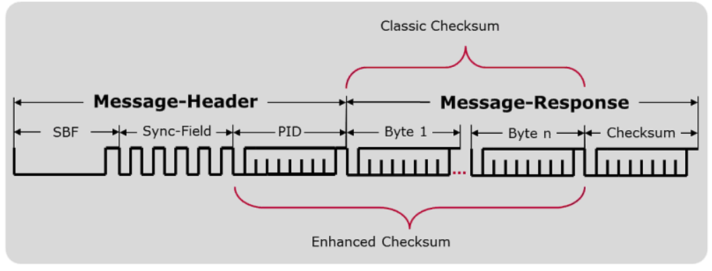
Response Frame
Classic Checksum: LIN version 1.
Enhanced Checksum: LIN version 2.
Diagnostic Frames use Classic Checksum.

Slide 11
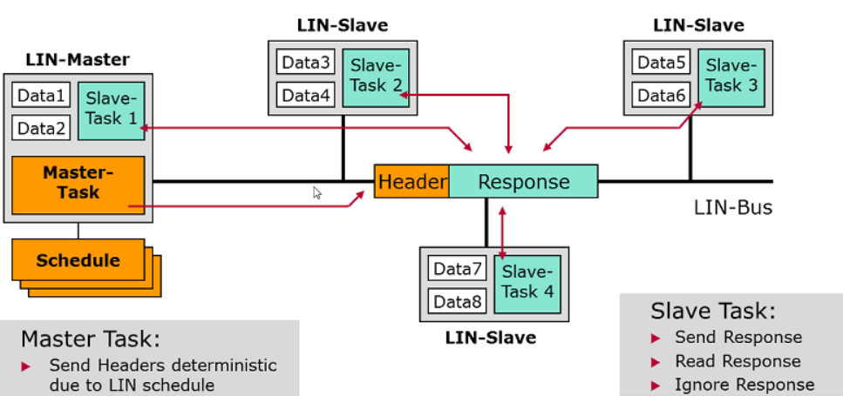
LIN Communication

Slide 12
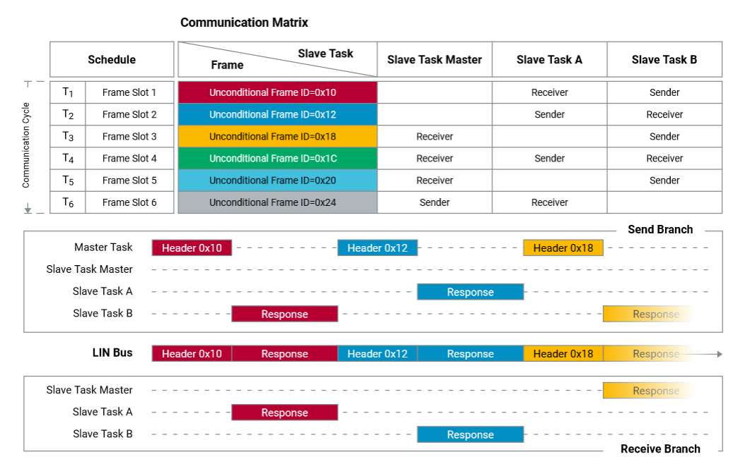
LIN Schedule

Slide 13
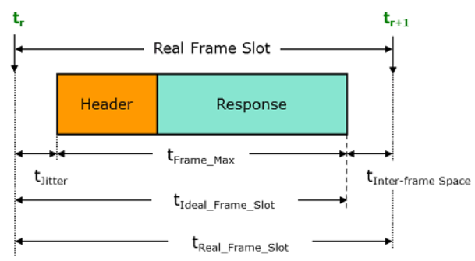
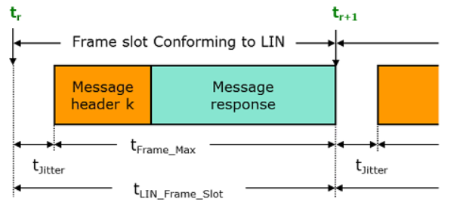
LIN Schedule
In computing the size of a slot, a jitter value is added. This is the potential time difference between the nominal beginning of a slot and the actually starting point. If a frame does not completely fill out the slot, the rest of the time period must be waited until the next slot is available. This time period is known as the IFS.

Slide 14
Message Types
Unconditional Frames
This is the “normal” type of LIN communication.
The Master sends a frame header in a scheduled frame slot and the designated Slave node fills the frame with data.
Unconditional frames carry signals and their frame identifiers are in the range 0 (zero) to 59 (0x3B).

Slide 15
Message Types
Event-Triggered Frames
The purpose of an event-triggered frame is to increase the responsivity of the LIN cluster without assigning too much of the bus bandwidth to the polling of multiple Slave nodes with seldom occurring events.
Master asks Slaves if a certain event has occurred.
Only those who have seen the event publish a response.
Identifiers 0x00 to 0x3b (0-59).
Collisions are possible - if more than one Slave has detected the specified event, all respond simultaneously, resulting in a collision.
When detected, Master reverts to unconditional frames.
Can result in better utilization of bandwidth.

Slide 16
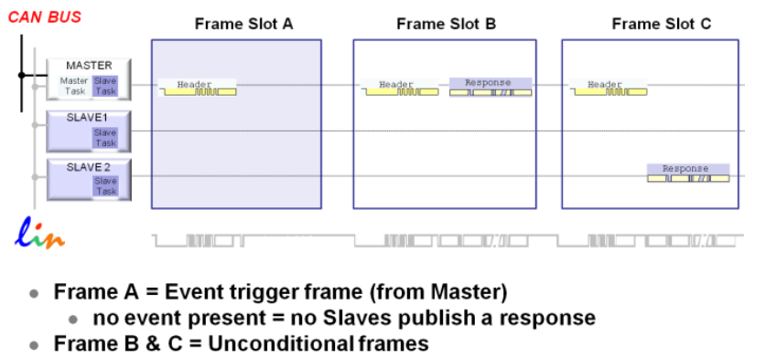
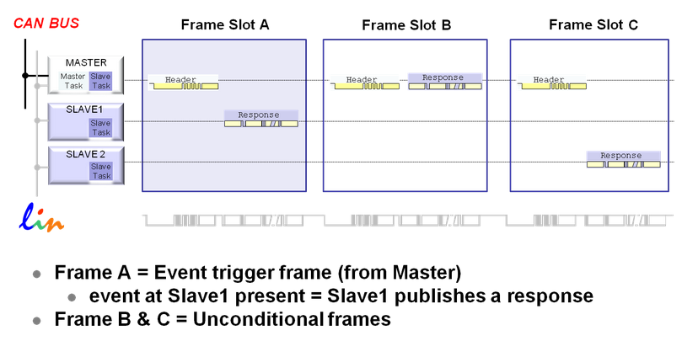
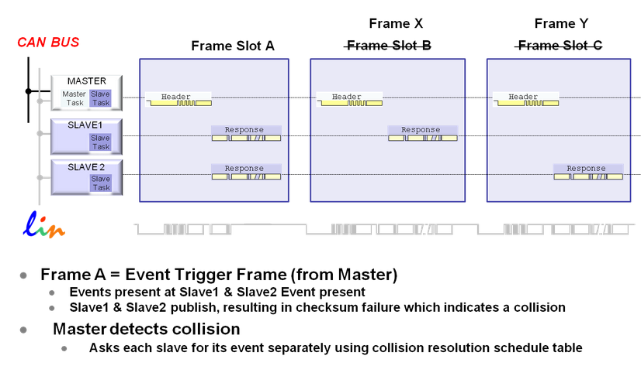

Slide 17
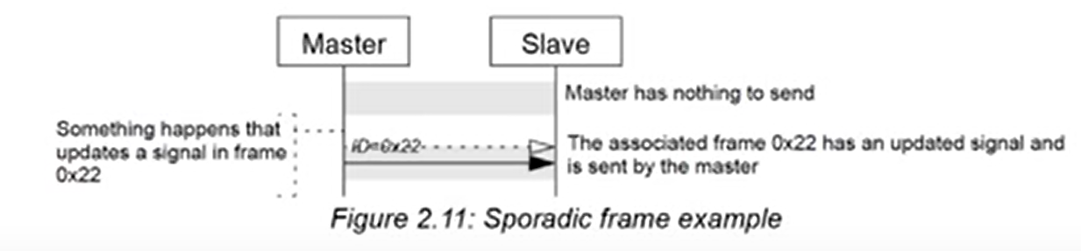
Sporadic Frame
The sporadic frame is basically an Event Triggered Frame for the master.
This method provides some dynamic behavior to the otherwise static LIN protocol. The header of a sporadic frame is only sent from the master when it knows that a signal has been updated in a slave node. Usually the master fills the data bytes of the frame itself and the slave nodes will be the receivers of the information.

Slide 18
