Slide 1

Build Tools
Mohamed Saied

Slide 2
Motivation
Small programs all in a single C/C++ file
“Not so small” programs :
  Many lines of code
  Multiple components
  More than one programmer
  Require coordination of files to build

Slide 3
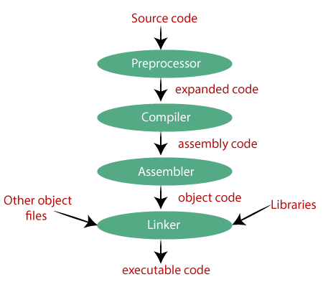
Build Process

Slide 4
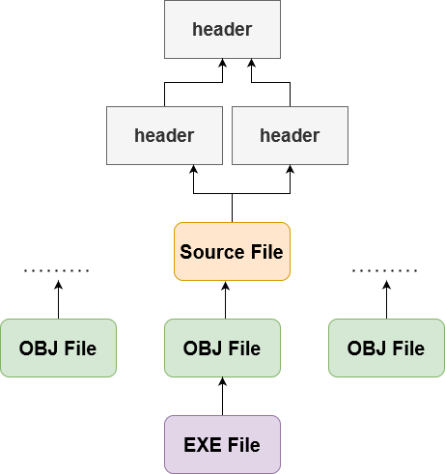
Build Dependency Tree

Slide 5
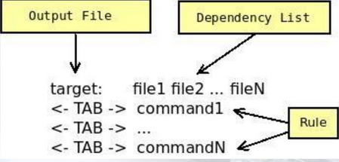
Project maintenance
Performed in Unix by the make utility
A makefile is a file (script) containing:
  Project structure (files, dependencies)
  Instructions for creation of object code, executables, other tasks

Slide 6
Project structure
Project structure and dependencies can be represented as a DAG (= Directed Acyclic Graph)
Example :
  Date class:
    contains 3 files
  Date.h, Date.cpp, TestDate.cpp
  Date.h included in both .cpp files
  Executable should be named testdate

Slide 7
testdate (exe)
TestDate.o
Date.o
TestDate.c
Date.h
Date.c
Date.h

Slide 8
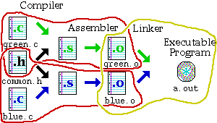
Makefiles
Provide a way for separate compilation.
Describe the dependencies among the project files.
The make utility.
Notes:
Makefiles provide a way for separate compilation. When a file from a project is changed, only the files that depend on the changed file are compiled.

Slide 9
Makefile Rules:
Targets, Dependencies, and Associated Commands
testdate: Date.o TestDate.o
gcc -o testdate TestDate.o Date.o
TestDate.o: TestDate.c Date.h
gcc -c TestDate.c
Date.o: Date.c Date.h
gcc -c Date.c

Slide 10
Rule syntax
TestDate.o: TestDate.c Date.h
gcc -c TestDate.c
This rule compiles TestDate.cpp, but does NOT create any executable, just TestDate.o
Target
Rule
tab
action
dependencies

Slide 11
Macros
Macros are used to simplify and automate
  Often used like constants in programs
We can compress identical dependencies and use built-in macros to get another (shorter) equivalent makefile :
testdate: TestDate.o Date.o
gcc –o $@ TestDate.o Date.o
TestDate.o Date.o: Date.h
gcc –c $*.c
Macro $@ represents rule target:
$@ = testdate
Macro $* represents prefixes shared by target and dependant files:
$* = TestDate, if target is TestDate.o
Date, if target is Date.o

Slide 12
make operation
Project’s dependency tree is constructed
Target of first rule is to be created
Go down the dependency tree to see if there is a target that should be recreated:
  target file is older than one of its dependencies
  recreate the target file according to the action specified, on our way up the tree. Consequently, more files may need to be recreated
If something is changed, linking is usually necessary
  Top target in dependency tree

Slide 13
make operation - continued
make operation ensures minimum compilation, when the project structure is written properly
Do not write something like:
testdate: TestDate.c Date.c Date.h
gcc -o testdate TestDate.c Date.c
which requires compilation of all files when something is changed
  Example: If Date.cpp changes, why compile TestDate.cpp?

Slide 14
Passing parameters to makefile
Parameters can be passed to a makefile by specifying them along with their values in the command line.
For example:
make PAR1=1 PAR2=soft1
will call the makefile with 2 parameters: PAR1 is assigned the value “1” and PAR2 is assigned the value “soft1”. The same names should be used within the makefile to access these variables (using the usual “$(VAR_NAME)” syntax)

Slide 15
Passing parameters - continued
Note that assigning a value to a variable within the makefile overrides any value passed from the command line.
For example:
command line : make PAR=1
in the makefile:
PAR = 2
PAR value within the makefile will be 2, overriding the value sent from the command line

Slide 16
Conditional statements
Simple conditional statements can be included in a makefile.
Usual syntax is:
ifeq (value1, value2)
body of if
else
body of else
endif

Slide 17
Conditional statements - example
sum: main.o sum.o
gcc –o sum main.o sum.o
main.o: main.c sum.h
gcc –c main.c
#deciding which file to compile to create sum.o
ifeq ($(USE_SUM), 1)
sum.o: sum1.c sum.h
gcc –c sum1.c –o $@
else
sum.o: sum2.c sum.h
gcc –c sum2.c –o $@
endif

Slide 18
Example
For example, if you have the following source files in some project of yours:
  ccountln.h
  ccountln.c
  fileops.h
  fileops.c
  process.h
  process.c
  parser.h
  parser.c
You could compile every C file and then link the objet files generated, or use a single command for the entire thing.
  This becomes unfriendly when the number of files increases; hence, use Makefiles!
NOTE: you don’t NEED to compile .h files explicitly.

Slide 19
Example (2)
One by one:
  gcc -g -Wall -ansi -pedantic -c ccountln.c
  gcc -g -Wall -ansi -pedantic -c parser.c
  gcc -g -Wall -ansi -pedantic -c fileops.c
  gcc -g -Wall -ansi -pedantic -c process.c
This will give you four object files that you need to link and produce an executable:
  gcc ccountln.o parser.o fileops.o process.o -o ccountln

Slide 20
Example (3)
You can do this as well:
  gcc -g -Wall -ansi -pedantic ccountln.c parser.c fileops.c process.c -o ccountln
Instead of typing this all on a command line, again: use a Makefile.
Notes:
-ansi
In C mode, this is equivalent to -std=c89. In C++ mode, it is equivalent to -std=c++98

Slide 21
Example (4)
# Simple Makefile with use of gcc could look like this
CC=gcc
CFLAGS=-g -Wall -ansi -pedantic
OBJ:=ccountln.o parser.o process.o fileops.o
EXE=ccountln
all: $(EXE)
$(EXE): $(OBJ)
$(CC) $(OBJ) -o $(EXE)
ccountln.o: ccountln.h ccountln.c
$(CC) $(CFLAGS) -c ccountln.c
...

Slide 22
Using makefiles
Naming:
  makefile or Makefile are standard
  other name can be also used
Running make
make
make –f filename – if the name of your file is not “makefile” or “Makefile”
make target_name – if you want to make a target that is not the first one

Slide 23
makefiles content
Makefiles content
rules : implicit, explicit
variables (macros)
directives (conditionals)
# sign – comments everything till the end of the line
\ sign - to separate one command line on two rows

Slide 24
Sample makefile
Makefiles main element is called a rule:
Example:
my_prog : eval.o main.o
g++ -o my_prog eval.o main.o
eval.o : eval.c eval.h
g++ -c eval.c
main.o : main.c eval.h
g++ -c main.c
_________________________
# -o to specify executable file name
# -c to compile only (no linking)
target : dependencies
TAB commands #shell commands

Slide 25
Variables
The old way (no variables) A new way (using variables)
Defining variables on the command line:
Take precedence over variables defined in the makefile.
make C=cc
C = g++
OBJS = eval.o main.o
HDRS = eval.h
my_prog : eval.o main.o
$(C) -o my_prog $(OBJS)
eval.o : eval.c
$(C) –c –g eval.c
main.o : main.c
$(C) –c –g main.c
$(OBJS) : $(HDRS)
my_prog : eval.o main.o
g++ -o my_prog eval.o main.o
eval.o : eval.c eval.h
g++ -c –g eval.c
main.o : main.c eval.h
g++ -c –g main.c

Slide 26
Implicit rules
Implicit rules are standard ways for making one type of file from another type.
There are numerous rules for making an .o file – from a .c file, a .p file, etc. make applies the first rule it meets.
If you have not defined a rule for a given object file, make will apply an implicit rule for it.
Example:
Our makefile The way make understands it
my_prog : eval.o main.o
$(C) -o my_prog $(OBJS)
$(OBJS) : $(HEADERS)
my_prog : eval.o main.o
$(C) -o my_prog $(OBJS)
$(OBJS) : $(HEADERS)
eval.o : eval.c
$(C) -c eval.c
main.o : main.c
$(C) -c main.c

Slide 27
Defining implicit rules
%.o : %.c
$(C) -c –g $<
C = g++
OBJS = eval.o main.o
HDRS = eval.h
my_prog : eval.o main.o
$(C) -o my_prog $(OBJS)
$(OBJS) : $(HDRS)
Avoiding implicit rules - empty commands
target: ; #Implicit rules will not apply for this target.
Notes:
The target is considered a pattern for matching file names;

Slide 28
Automatic variables
Automatic variables are used to refer to specific part of rule components.
eval.o : eval.c eval.h
g++ -c eval.c
$@ - The name of the target of the rule (eval.o).
$< - The name of the first dependency (eval.c).
$^ - The names of all the dependencies (eval.c eval.h).
$? - The names of all dependencies that are newer than the target
target : dependencies
TAB commands #shell commands

Slide 29
make options
make options:
-f filename - when the makefile name is not standard
-t - (touch) mark the targets as up to date
-q - (question) are the targets up to date, exits with 0 if true
-n - print the commands to execute but do not execute them
/ -t, -q, and -n, cannot be used together /
-s - silent mode
-k - keep going – compile all the prerequisites even if not able to link them !!

Slide 30
Phony targets
Phony targets:
Targets that have no dependencies. Used only as names for commands that you want to execute.
clean :
rm $(OBJS)
__________________
To invoke it: make clean
Typical phony targets:
all – make all the top level targets
  .PHONY : all
  all: my_prog1 my_prog2
clean – delete all files that are normally created by make
print – print listing of the source files that have changed
.PHONY : clean
clean:
rm $(OBJS)
or

Slide 31
VPATH
VPATH variable – defines directories to be searched if a file is not found in the current directory.
VPATH = dir : dir …
/ VPATH = src:../headers /
vpath directive (lower case!) – more selective directory search:
vpath pattern directory
/ vpath %.h headers /
GPATH:
GPATH – if you want targets to be stored in the same directory as their dependencies.

Slide 32
Variable modifiers
C = g++
OBJS = eval.o main.o
SRCS = $(OBJS, .o=.c) #!!!
my_prog : $(OBJS)
$(C) -g -c $^
%.o : %.c
$(C) -g -c S<
$(SRCS) : eval.h

Slide 33
Conditionals (directives)
Possible conditionals are:
if ifeq ifneq ifdef ifndef
All of them should be closed with endif.
Complex conditionals may use elif and else.
Example:
libs_for_gcc = -lgnu
normal_libs =
ifeq ($(CC),gcc)
libs=$(libs_for_gcc) #no tabs at the beginning
else
libs=$(normal_libs) #no tabs at the beginning
endif

Slide 34
The Patsubst Function
The patsubst function inside Make is a useful one, giving you the ability to modify strings based on a pattern.
The functionality in itself is very basic; it finds some text and replaces it. The syntax is as follows:
$(patsubst pattern,replacement,text)
$(patsubst world,everyone,hello world)
which would produce the text to “hello everyone”
REF: https://earthly.dev/blog/using-makefile-wildcards/

