Slide 1
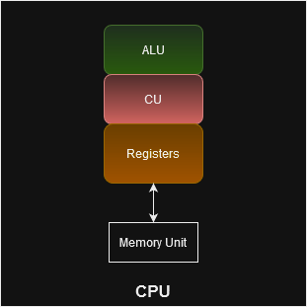
Microprocessors
Microprocessor is IC that can perform Arithmetic and logical operations.
It consists of CPU only.

Slide 2
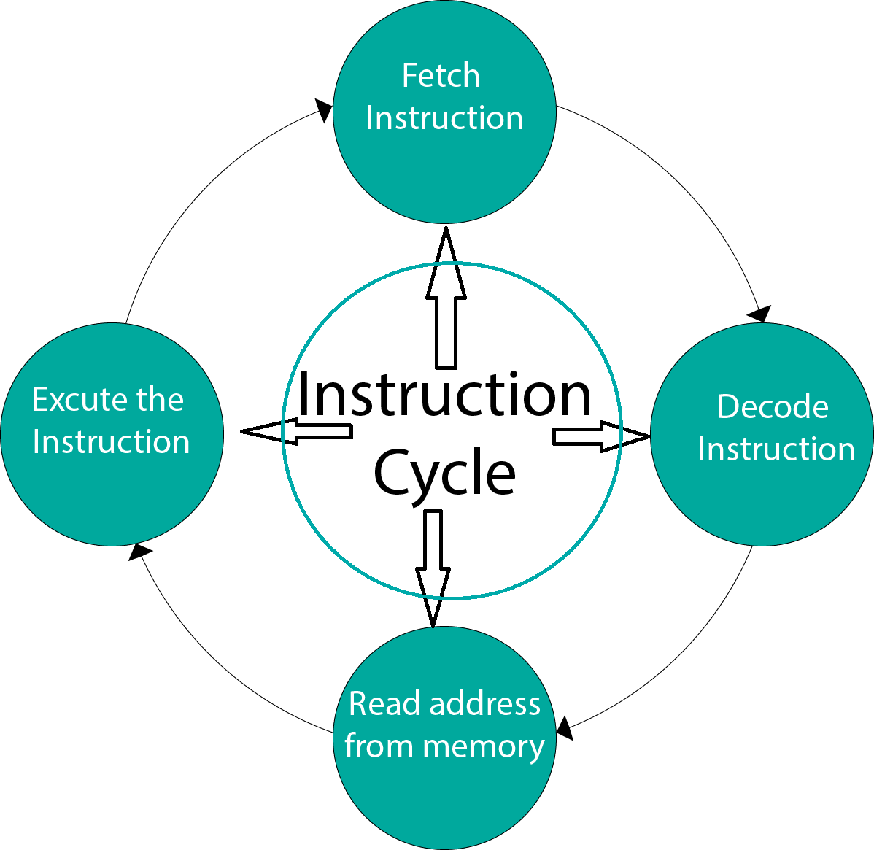

Slide 3
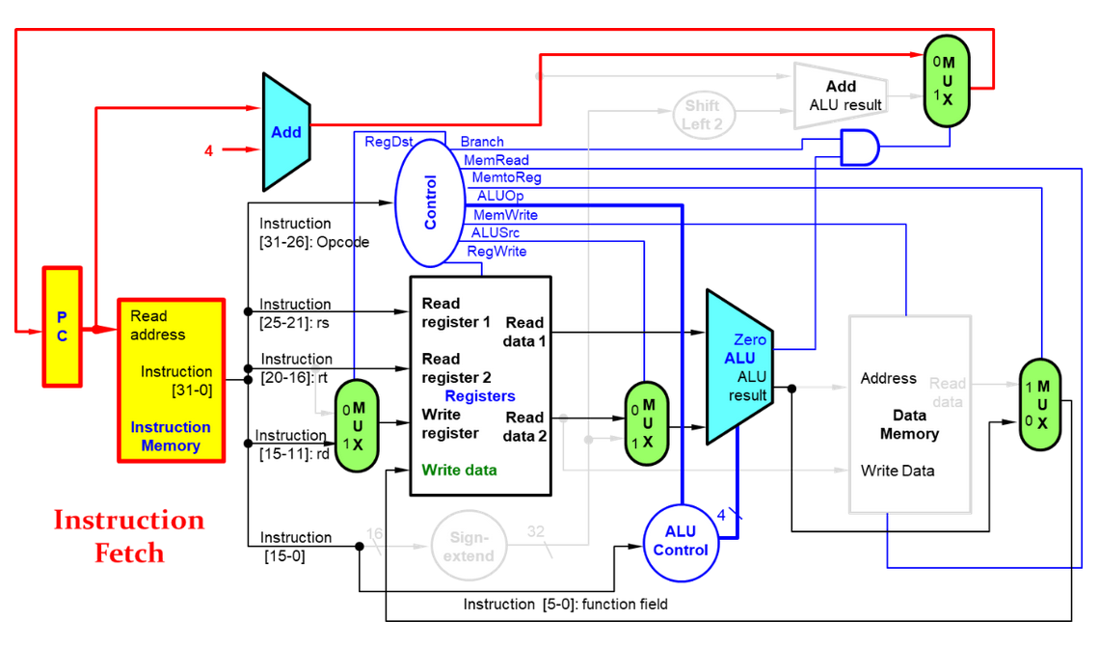

Slide 4
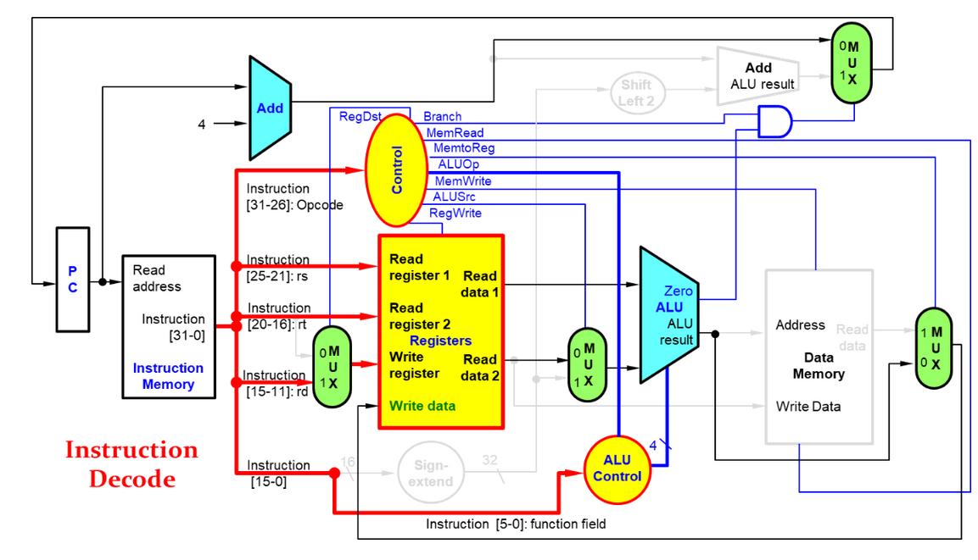

Slide 5
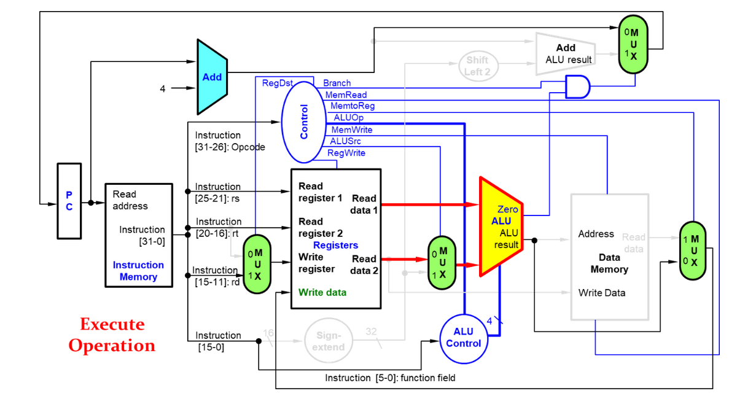

Slide 6
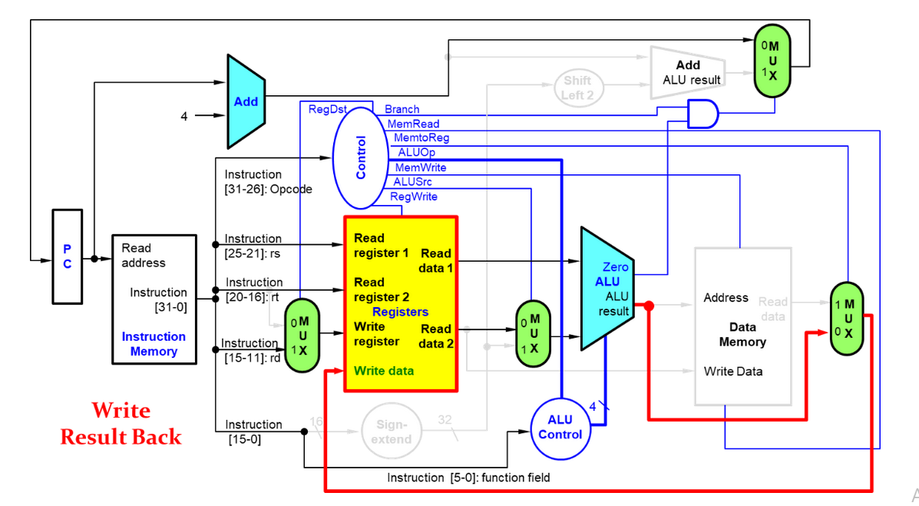

Slide 7
CISC VS RISC
A RISC architecture is simple and straightforward, and thus microprocessors of this type will execute instructions in much faster times than those based on CISC.
In reduced set of instructions computer, the machine code will be longer than that necessary for a CISC processor, since the instructions are not present (but present in CISC) in the ‘together they will need to be implemented and will require multiple instructions to execute them. This will therefore lead to a greater demand for memory and a greater number of instructions to execute. However, the execution speed of each instruction will be equivalent to a single machine cycle.
In CISC there are individual instructions that allow you to perform multiple operations together, such as reading data in memory, modifying it and then saving it. We therefore have shorter and simplified machine code programs. However, the instructions in this case will be heavier, requiring even more machine cycles.

Slide 8
CISC VS RISC
Example
In CISC:
clear 0x1000; %clear memory location 0x1000
In RISC:
xor r1,r2; %clear reg1
store r1, 0x1000; %clear memory location 0x1000

Slide 9
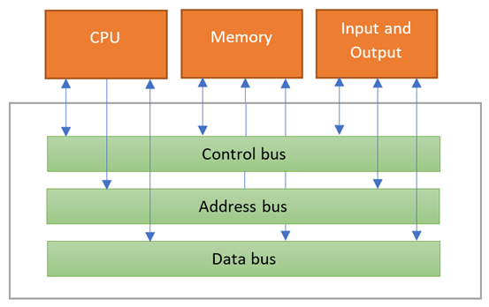
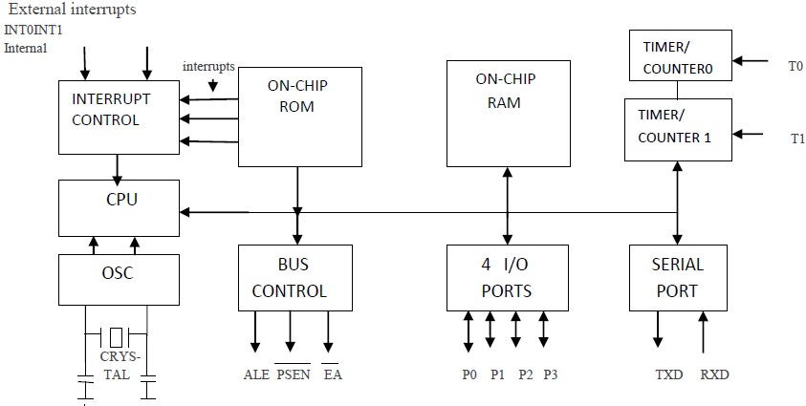
Microcontroller

Slide 10
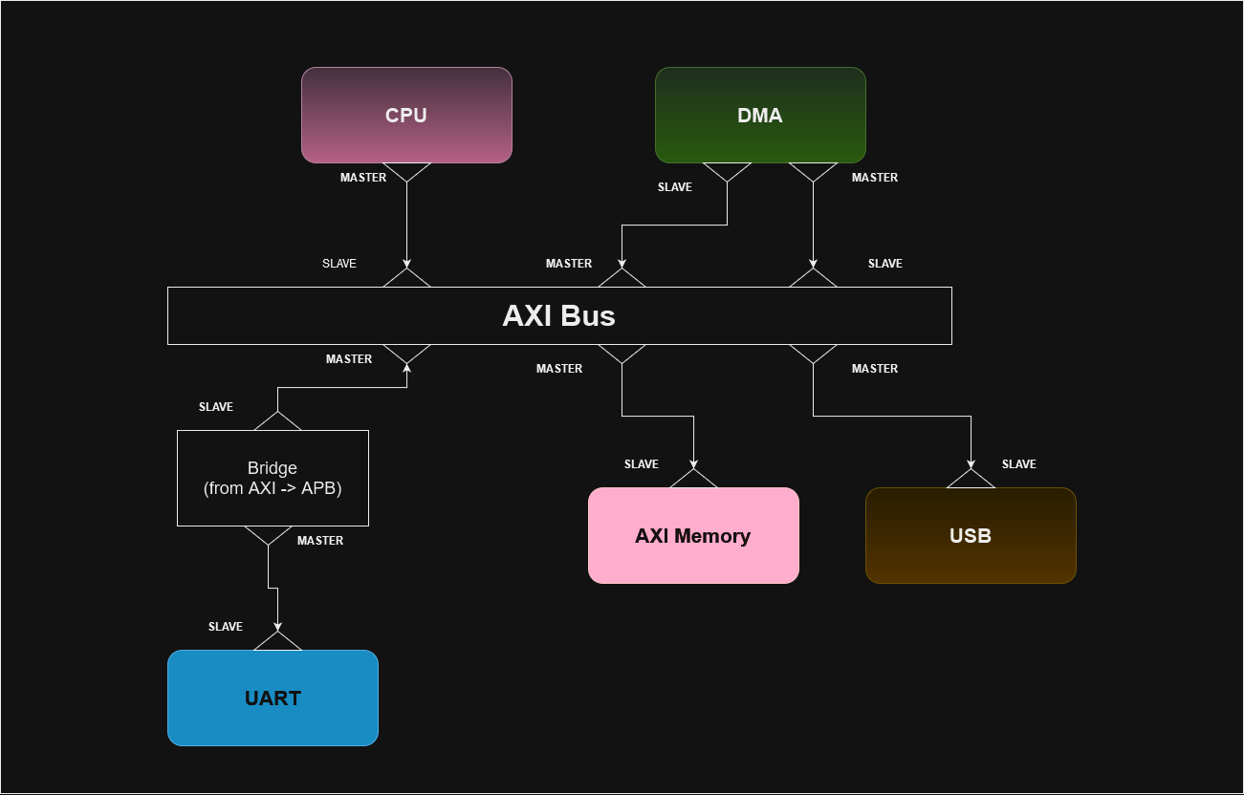
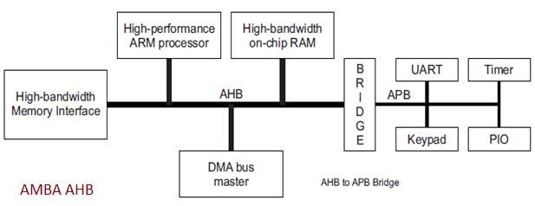
Bus

Slide 11
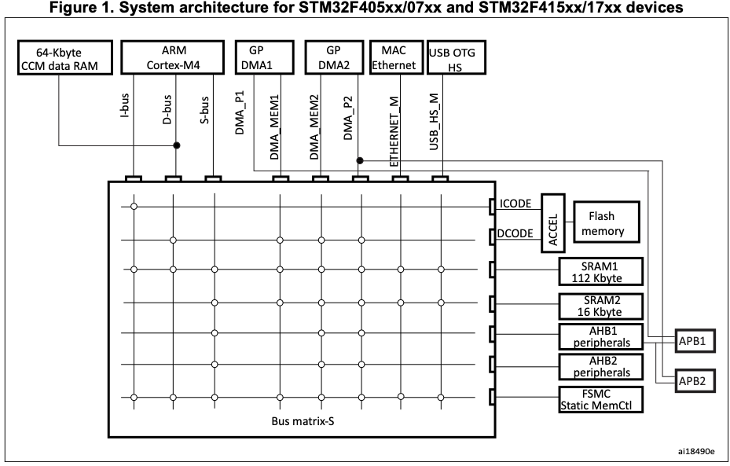

Slide 12
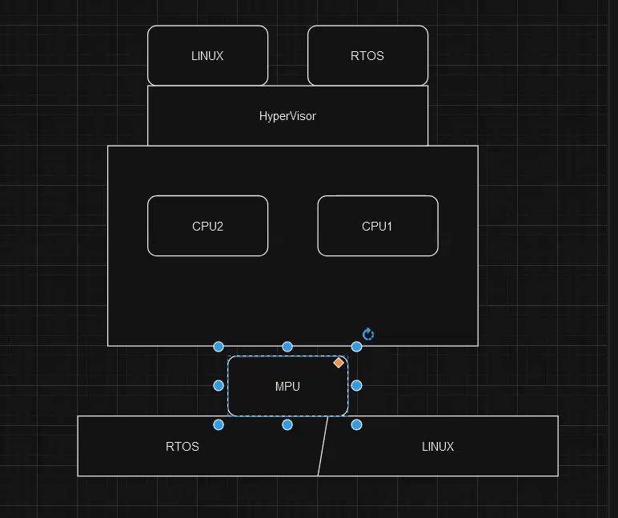
MPU
What does memory protection unit do?
MPU monitors transactions, including instruction fetches and data accesses from the processor, which can trigger a fault exception when an access violation is detected. The main purpose of memory protection is to prevent a process from accessing memory that has not been allocated to it.

Slide 13
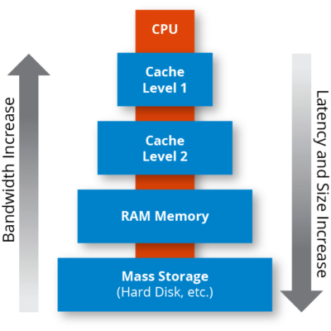

Slide 14
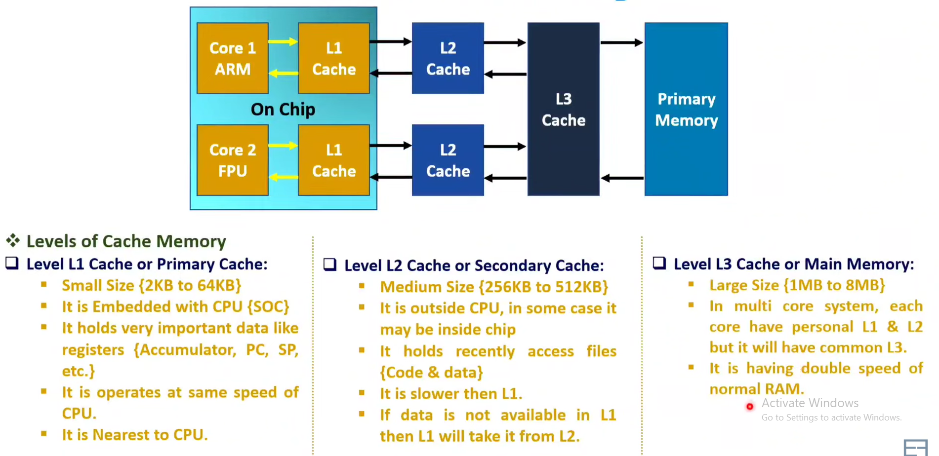
Cache levels

Slide 15
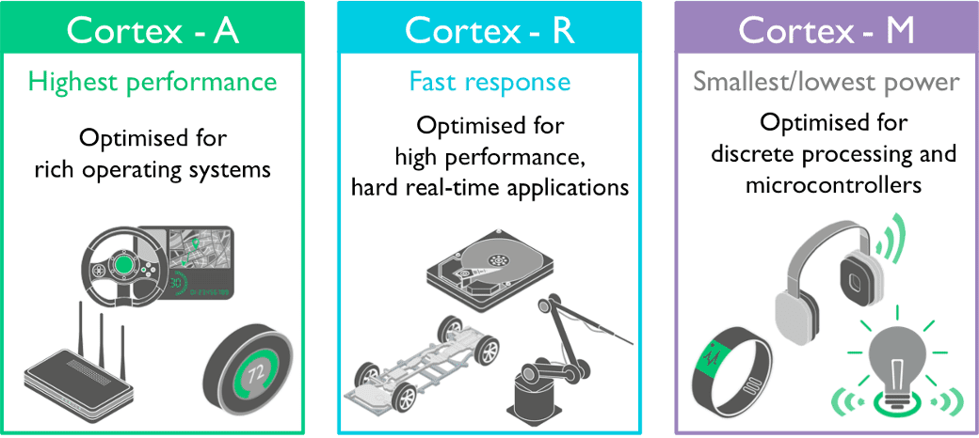
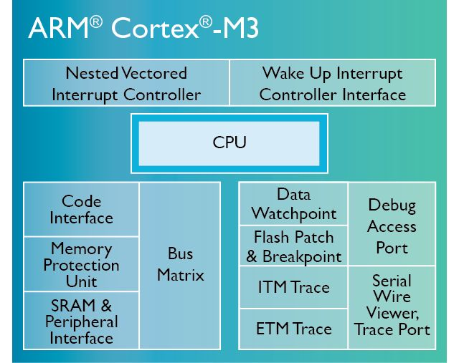
ARM Introduction

Slide 16
ARM Introduction
ARM processor is 32-bit architecture.
Most ARM’S implement 2 instruction sets:
32-bit Arm Instruction set
16-bit Thumb Instruction set

Slide 17
ARM Introduction
Modes of operation
OPERATION STATE
OPERATION MODE
Privileged
Access
And (NPA)User Access
Thread mode & Handler mode
Thumb state & Debug state

Slide 18
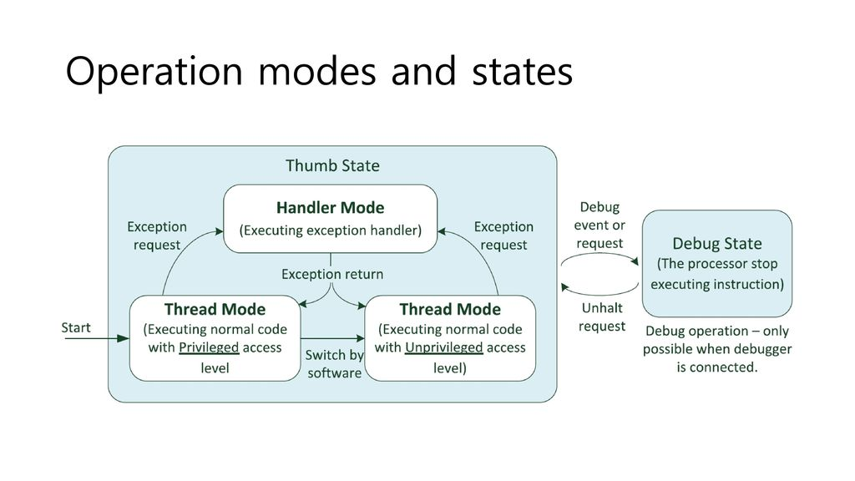

Slide 19
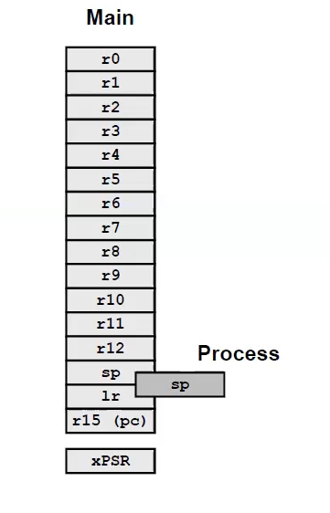
Registers-Set

Slide 20
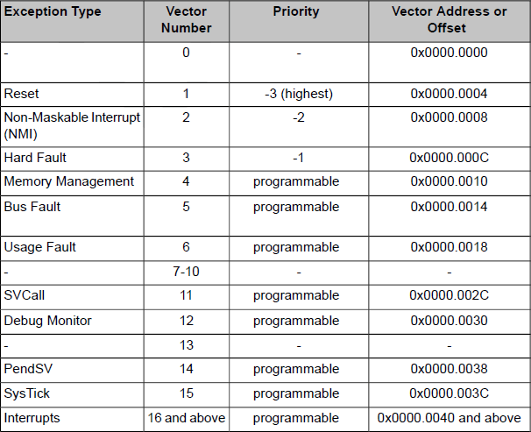
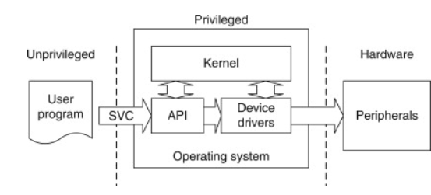
Interrupts in ARM processor
Hard fault: bus error when reading from vector table
Memory management: any conflict between MPU and memory mapped.
Bus fault: fault when fetching instruction
Usage fault: if there is undefined instruction, or dividing by zero

Slide 21
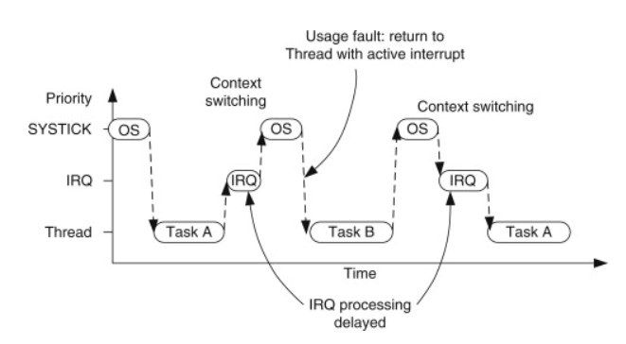
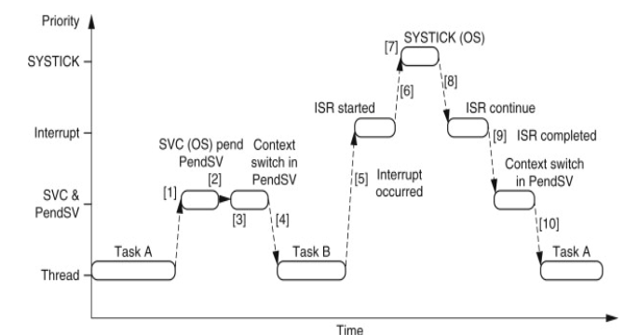
Pending Service
If an interrupt request takes place before the SYSTICK exception, the SYSTICK exception will preempt the IRQ Handler.
In this case, the OS should not carry out the context switching. Otherwise the IRQ handler process will be delayed
The PendSV exception solves the problem by delaying the context-switching request until all other IRQ handlers have completed their processing.
If the OS detects that an IRQ is currently active (IRQ handler running and preempted by SYSTICK), it defers the context switching by pending the PendSV exception.

Slide 22
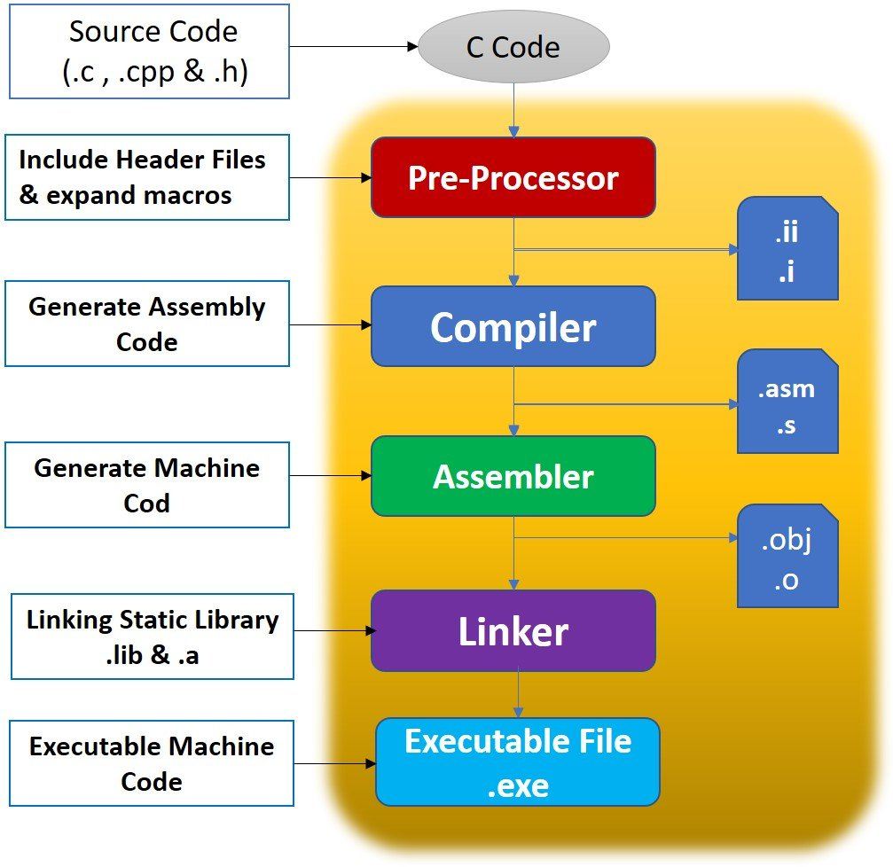
Toolchain
Bundle of Apps needed to create executable for specific MCU.

Slide 23
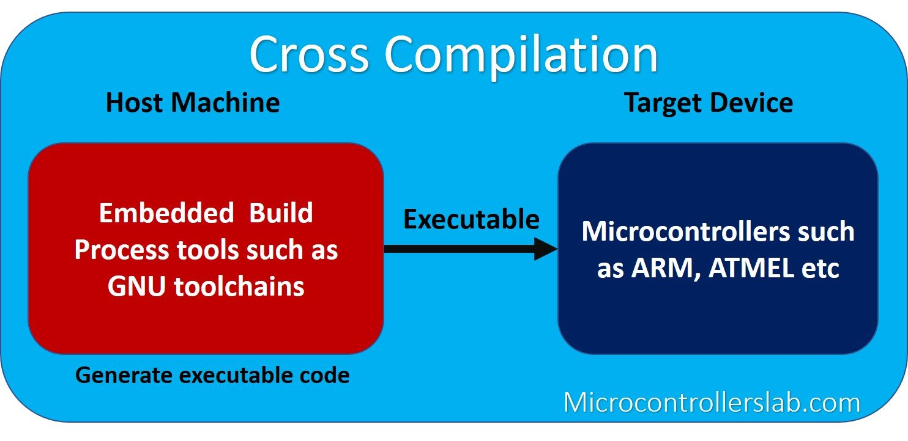
Build machines
Host system: where the toolchain will be executed.
Target System: where the binaries created by the toolchain are executed.

Slide 24
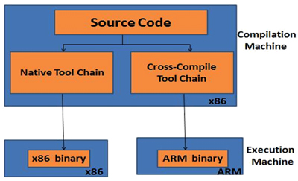
Native Vs Cross Toolchains
Native Toolchain is when host system is the target system.
Cross Toolchain System is when host system is NOT the target system.

Slide 25
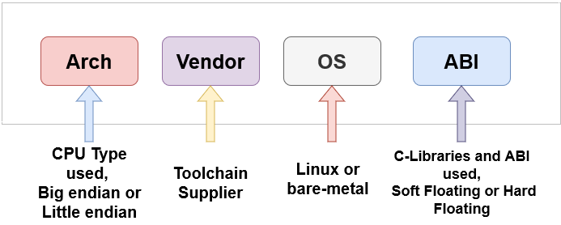
Toolchain Naming Convention

Slide 26
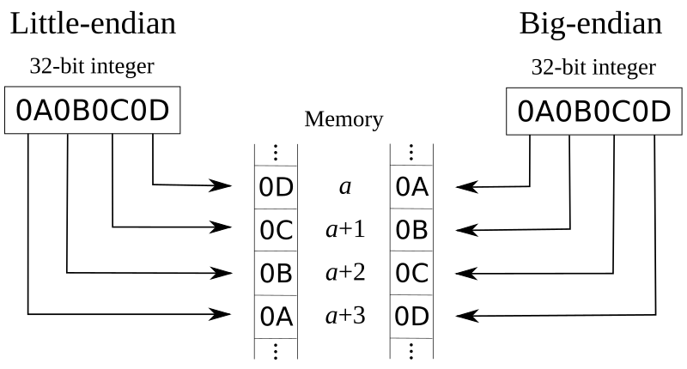
Big-endian vs Little-endian

