Slide 1
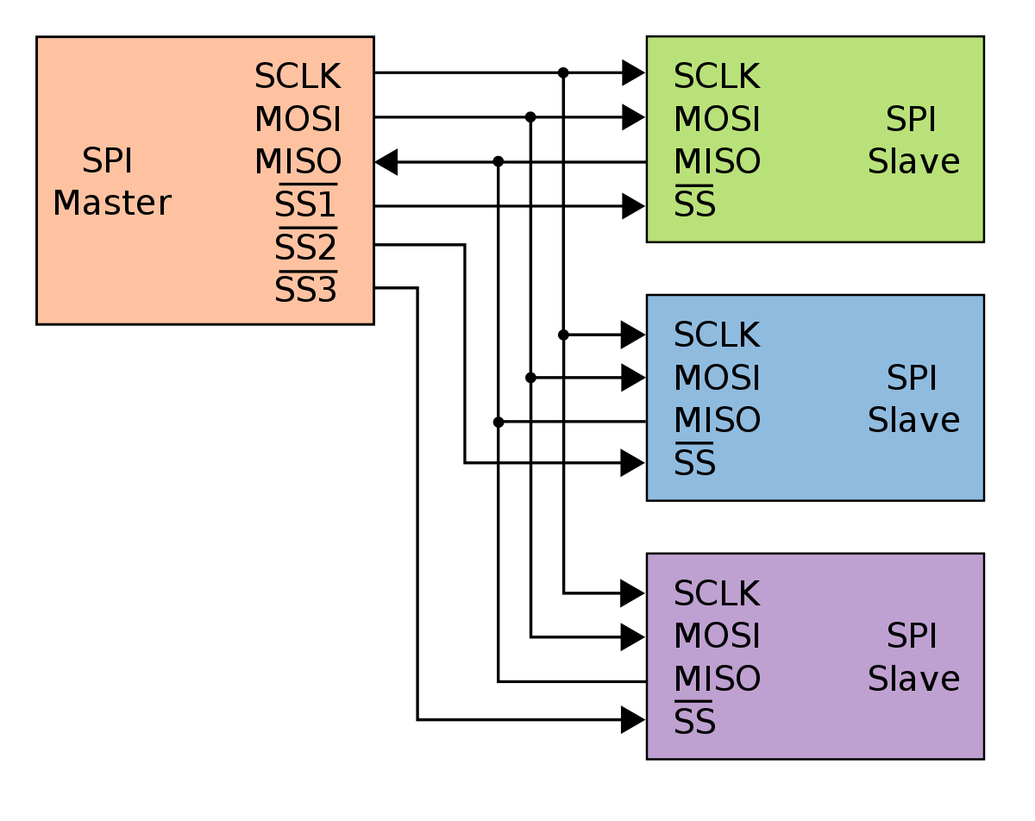
SPI
(Serial Peripheral Interface)

Slide 2
SPI Features
synchronous data transfer
Full-duplex
Single Master / multi slave
Serial interface
Multiple slave devices are supported through selection with individual slave select (SS) lines.
It can be used to communicate with a serial peripheral device like external EEPROM or with another microcontroller with an SPI interface

Slide 3
Advantages of SPI
Higher throughput (Faster)
SPI: 10Mbs – 20Mbs
Simple Receiver Hardware >>> Simple Shift Register
Support Multiple Slaves
Lower power Requirements than I2C.

Slide 4
Disadvantages of SPI
Requires more Pins
Master must control all communications (Slave doesn’t issue the
transaction).
Separate SS Lines.
No Flow Control (must know slave speed)

Slide 5
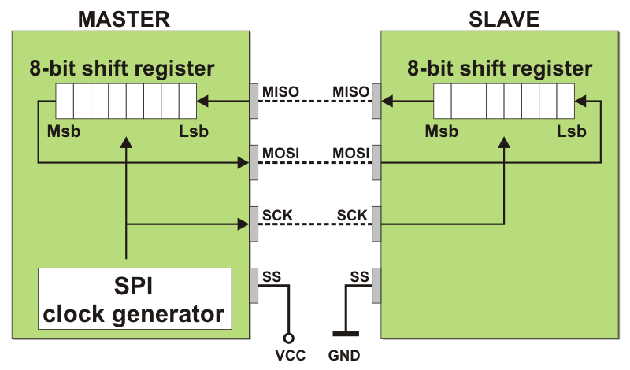
SPI
The SPI bus specifies four logic signals:
SCLK(SCK,CLK) : Serial Clock (output from master).
MOSI(SIMO,SDI,DI) : Master Output, Slave Input (output from master).
MISO(SIMO,SDO,DO) : Master Input, Slave Output (output from slave).
SS (CS,CE,CEN): Slave Select (active low, output from master).

Slide 6
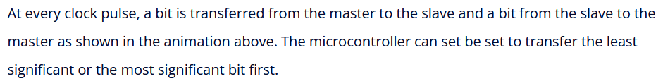
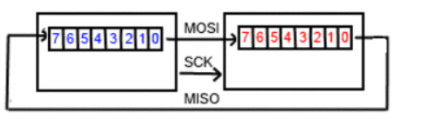
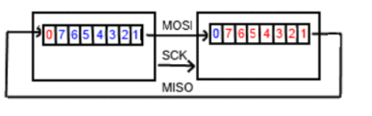
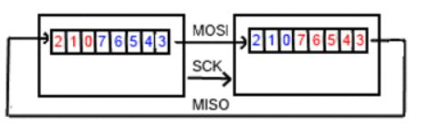
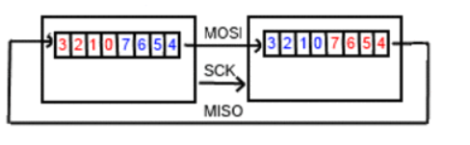
How SPI works ?

