Slide 1

Structure in C Programming

Slide 2
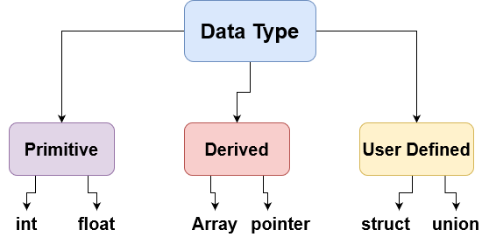
Introduction
Structures are user-defined data types.
Using structure, objects can be created ex: Vehicles
Struct useful to create array of different types

Slide 3
Defining a Structure
struct struct_Name
{
float member 1;
int member 2;
int * member 3;
double member 4;
};

Slide 4
Defining a Structure
#include<stdio.h>
/* Defining Person structure */
struct Person
{
int age;
};
int main(){
/* Declaring variables of Person structure */
struct Person person;
/* Assigning value to age of Person */
person.age = 25;
return 0;
}

Slide 5
What is output ?
Struct Vehicle
{
unsigned char id;
};
void main()
{
struct Vehicle v ={50};
printf(“vehicle size in bytes: %d”, sizeof(struct vehicle));
}

Slide 6
What is output ?
Struct Vehicle
{
unsigned char id;
unsigned int price;
};
void main()
{
struct Vehicle v ={50, 1000};
printf(“vehicle size in bytes: %d”, sizeof(struct vehicle));
}

Slide 7
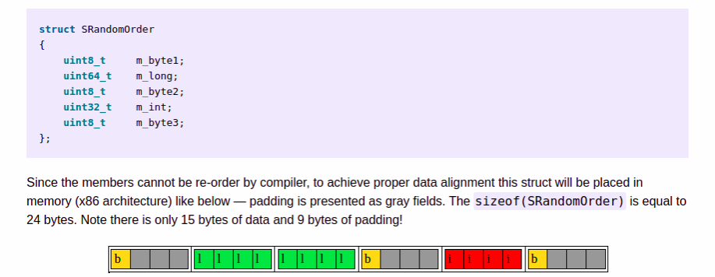
Structure Alignment

