Slide 1
Flowcharts & Pseudo code

Slide 2
When faced with a problem:
1. We first clearly define the problem
2. Think of possible solutions
3. Select the one that we think is the best under the prevailing circumstances
4. Think how to apply that solution
The process that can be used to solve a problem is termed as the “algorithm

Slide 3
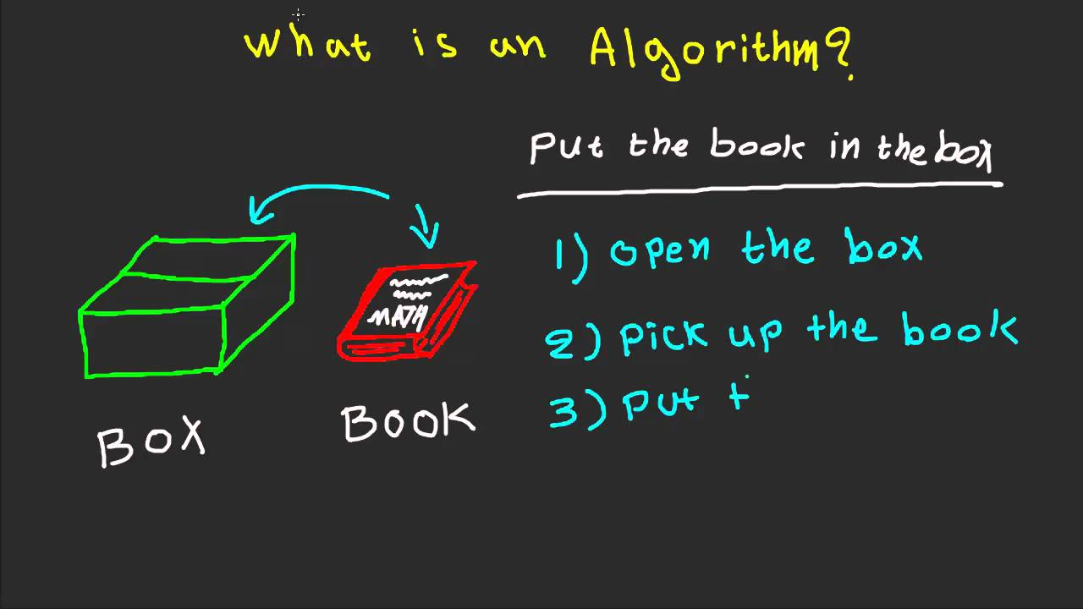
What’s an Algorithm ?
Algorithm is a sequence of steps to solve a particular problem

Slide 4
Qualities of a good algorithm
Input and output should be defined precisely.
Each step in the algorithm should be clear and unambiguous.
Algorithms should be most effective among many different ways to solve a problem.
An algorithm shouldn't include computer code. Instead, the algorithm should be written in such a way that it can be used in different programming languages.

Slide 5
Why Learning Algorithm
Time
Memory
Scalability

Slide 6
Types of Control Structures
Sequence: In the sequence structure, statements are placed one after the other and the execution takes place starting from up to down.
Branching (Selection): In branch control, there is a condition and according to a condition, a decision of either TRUE or FALSE is achieved
Loop (Repetition): The Loop or Repetition allows a statement(s) to be executed repeatedly based on certain loop condition

Slide 7
HOW TO WRITE ALGORITHMS
Step 1 Define your algorithms input
Step 2 Define the variables
Step 3 Outline the algorithm's operations
Step 4 Output the results of your algorithm's operations
Notes:
Step 1 Define your algorithms input: Many algorithms take in data to be processed, e.g. to calculate the area of rectangle input may be the rectangle height and rectangle width.
Step 2 Define the variables: Algorithm's variables allow you to use it for more than one place. We can define two variables for rectangle height and rectangle width as HEIGHT and WIDTH (or H & W). We should use meaningful variable name e.g. instead of using H & W use HEIGHT and WIDTH as variable name.
Step 3 Outline the algorithm's operations: Use input variable for computation purpose, e.g. to find area of rectangle multiply the HEIGHT and WIDTH variable and store the value in new variable (say) AREA. An algorithm's operations can take the form of multiple steps and even branch, depending on the value of the input variables.
Step 4 Output the results of your algorithm's operations: In case of area of rectangle output will be the value stored in variable AREA. if the input variables described a rectangle with a HEIGHT of 2 and a WIDTH of 3, the algorithm would output the value of 6.

Slide 8
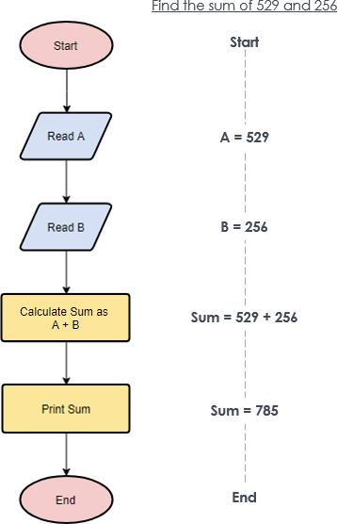
Flowcharts
A graphical representation of a process (e.g. an algorithm),

Slide 9
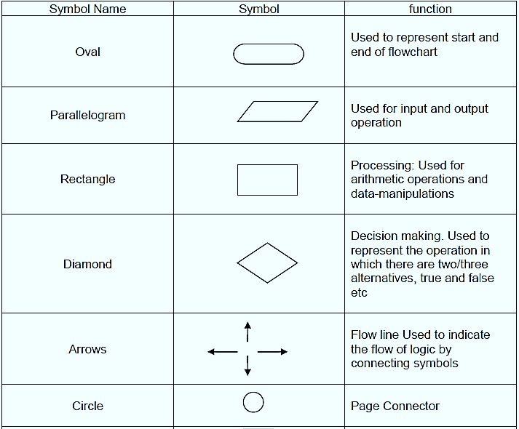

Slide 10
Pseudocode ?
Pseudocode is an informal way of writing a program.
It is not exactly a computer program.
It represents the algorithm of the program in natural language and mathematical notations (Print , While , IF then , Else )

Slide 11
Let’s Try

Slide 12
Thank you

