Slide 1
Evaluation of the impact of Air pollution policies on road traffic injuries in England and Scotland
Matched Staggered Difference-in-Differences Design
Ahmad Alkhatib
DD/MM/YYYY

Slide 2
Overview
1 | Background & Objectives
2 | Data
3 | Proposed methods
4 | Matching strategy
5 | Donor pool construction
6 | Analytical sample
7 | Staggered Difference-in-Differences framework
8 | Comments and questions

Slide 3
Background
Clean Air Zones (CAZs) in England and Low Emission Zones (LEZs) in Scotland are geographically defined areas where older, more polluting vehicles face charges or restrictions. Introduced from 2021 onwards to improve urban air quality in busy city centres.
Why might they affect road safety? By diverting or reducing traffic, changing speed patterns, and shifting mode share, these policies may reduce — or displace — road traffic injuries (RTIs). The direction and magnitude is not a priori clear.
Evidence gap: The causal road safety impact of English CAZs and Scottish LEZ is largely unstudied. The staggered adoption of schemes across cities provides a natural quasi-experimental setting to fill this gap.

Slide 4
Objectives
Evaluate the causal impact of CAZ-LEZ on road traffic injuries.
Quantify changes in injury counts and severity (KSI vs slight) following implementation, disaggregated by travel mode (car, pedestrian, cyclist, other).
Estimate average treatment effects over time after policy introduction.
Explore heterogeneity in effects across cities, treatment cohorts, road types, and injury severity.

Slide 5
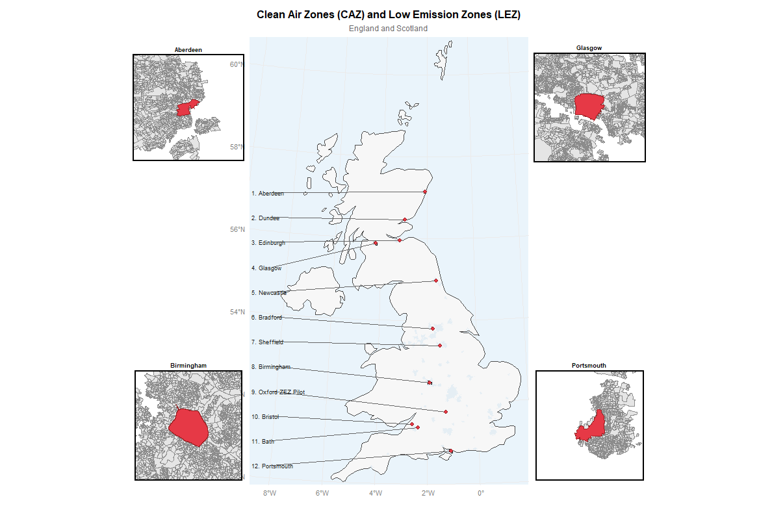
Excluding London, there are 12 schemes with staggered adoption dates ranging from 2021 to 2024.

Slide 6
Data Architecture
Datasets
CAZ/LEZ maps with implementation dates
Local Authorities map
Police reported Road Traffic Injuries (RTI) from STATS19 data 2015-2025
Severity (KSI, slight) and Mode (car, pedestrian, cyclist, other)
Road segments network information data from the OS Open Roads dataset
Census (population, socio-demographic and socioeconomic characteristics)
Amenities and points of interest from OS POI data
Road speed from OS from the Multi-modal Routing Network)
Traffic volume from Agilysis data

Slide 7
Data Linkage
Road segments were spatially intersected with LADs
Filter LADs with population >100,000 (big cities)
Census, traffic characteristics and amenities were linked via OAs
Roads linked to OAs and CAZ/LEZ boundaries (road link is assigned to a CAZ if=>50% within zone)
RTIs linked to roads
first classified by road type (Motorway, A, B, minor)
matched to the nearest road segment of the same class within 50 m; if none was found, a fallback match to any road within 100 m was allowed.
This two-stage rule reduced misclassification while retaining high match coverage

Slide 8
Research Design / Estimation framework
Difference-in-Differences with Multiple Time Periods
Modern doubly robust staggered DiD estimator
avoids negative weighting problems in traditional Two-Way FE DiD
allows treatment timing heterogeneity
Estimation combines outcome regression modelling and propensity score weighting, providing consistent estimates if either model is correctly specified.
Estimates group–time average treatment effects (ATT(g,t)), comparing treated units with appropriate comparison groups not-yet-treated or never-treated controls.

Slide 9
Control group
We can’t estimate causal effects directly without a credible counterfactual!
CAZ/LEZ policies are not randomly assigned; they are typically implemented in large urban city centres that differ systematically from other areas.
These areas have higher traffic volumes, different road networks, dense urban environments, and higher baseline injury risk.
Using all untreated areas as controls could violate the parallel trends assumption, as many areas follow different pre-treatment injury trajectories.
Therefore, matching is used to restrict the donor pool to OAs comparable to treated areas, improving balance and the credibility of the causal estimates.

Slide 10
Matching Strategy
(design stage)
the Objective: improve comparability between treated and control areas ie design quality before estimation
Match treated OAs to similar non-treated OAs based on:
pre-treatment information:
injury levels and trends, broken down by injury type and travel mode
Contextual and structural confounders
Road network: link density, road type mix (A-road %, minor road %), speed limit distribution, junction density
Traffic exposure
Sociodemographic and Socioeconomic characteristics
Stratified by country (England Vs Scotland)

Slide 11
Matching method
Mahalanobis distance matching with Caliper at the OA level
It identifies the control OA, minimising the weighted multivariate distance across all matching variables simultaneously. This deals with multiple pre-treatment trends across outcome types and casualty modes that are, by construction, highly intercorrelated.
We impose a caliper (maximum allowable distance) of 0.25 SD, such that any treated OA for which no sufficiently similar control exists within this distance is excluded rather than matched badly, preventing poor matches from biasing the estimated treatment effects.
Matching is performed separately within each treatment timing cohort, consistent with the grouped treatment structure of the Callaway & Sant'Anna (2021) estimator,
Exact matching is enforced on the country to account for differences in recording, contexts, etc.
Calipers prevent bad matches when treated OAs are unusual, so that if no sufficiently similar control exists, the treated OA is dropped rather.

Slide 12
“Proposed” Methods
OA level (matching dataset) Road-link level (analysis dataset)
───────────────────────── ────────────────────────────────
Census variables KSI_adj / Slight_adj
Network characteristics ──► × casualty type
Pre-treatment RTI trends × road × quarter
IMD, urban/rural, etc.
C&S staggered DiD
Donor pool on restricted road links
restriction
Match OAs to define comparable control OAs, then carry all road links within those matched control OAs into C&S estimation.
The matching happens at the OA level, and the causal estimation happens at the road-link level.
Design logic

Slide 13
Final Analysis Dataset
Panel structure: Road link x Quarter x Severity (KSI/Slight) x Travel Mode — a four-dimensional panel spanning 2015–2025 (~40 quarters).
Treated units: Road links falling within matched treated OAs, within CAZ/LEZ boundaries.
Control units: Road links in matched control OAs (1:4 ratio), selected via Mahalanobis matching. Balance confirmed before estimation (SMD < 0.1).
Dataset scale: Approximately 11 treated city schemes x multiple road links per OA x 10 outcome models (5 injury types x 2 severity levels) — yielding a large, rich panel for causal estimation.
Final merge: Treatment indicators, RTI outcomes, and all covariates joined to produce the analysis-ready dataset.

Slide 14
Estimation Approaches
The Callaway & Sant'Anna (2021) framework offers three estimation strategies:
Outcome Regression (OR): Models the outcome evolution of comparison units over time using regression.
Inverse Probability Weighting (IPW): Weights observations by estimated propensity scores to balance treated and control groups.
Doubly Robust (DR): Combines OR and IPW. Consistent if either model is correctly specified. This is the primary estimator reported.
All three are reported for sensitivity. OR and IPW serve as robustness checks against the main DR estimates.

Slide 15
Identification: Parallel Trends Assumption
Core assumption: The parallel trends assumption: in the absence of treatment, injured counts in treated and control OAs would have followed the same trend. This is untestable but made credible by matching and supported empirically.
Pre-trend test: Event-study plots show ATT(g,t) estimates for periods before treatment. Coefficients close to zero in pre-treatment periods are the primary evidence of parallel trends.
Matching reinforces assumption: Mahalanobis matching on pre-treatment RTI trends (by mode and severity) directly targets the key confounder. If matched units share similar pre-trends, parallel trends is more plausible.
Anticipation effects: We assume no anticipatory behaviour (e.g. drivers avoiding a zone before its launch date). CAZ launch dates were not always widely publicised in advance, making this reasonable.
Sensitivity checks: Results are replicated using never-treated-only controls, alternative caliper widths (0.15 and 0.35 SD), and placebo zones to test robustness.

Slide 16
Sensitivity Analysis & Robustness Checks
Alternative caliper widths: Matching repeated at 0.15 SD (stricter) and 0.35 SD (looser) to test sensitivity of results to matching tightness.
Alternative control groups: Results replicated using (a) never-treated controls only, and (b) not-yet-treated controls only, to assess robustness of comparison group choice.
Placebo zones: CAZ boundaries shifted or randomly assigned to confirm no spurious treatment effects in control areas.
Alternative RTI linkage rules: RTI-to-road matching repeated using 75 m (primary) and 150 m (fallback) distances to test sensitivity of spatial linkage decisions.
Outcome model specification: Estimation run under negative binomial and Poisson outcome models (in addition to the primary OLS-based DR estimator) given count outcome nature.
Exclusion of small schemes: Analysis repeated dropping the two smallest CAZ areas to check for undue influence of outlier zones on pooled estimates.

Slide 17
Causal pipeline
Linked road-level injury data (road × quarter)
↓
OA covariates + pre-treatment RTI trends
(Census, network characteristics, KSI/Slight
trends × casualty mode, seasonality)
↓
Pre-matching exclusions
(LADs <100,000 population and 500m buffer)
↓
Mahalanobis distance matching with caliper
(cohort-stratified, 1:4, 0.25 SD caliper,
exact match on country)
↓
Balance diagnostics ← DECISION POINT
(SMD < 0.1, love.plot, pre-trend overlay)
↓
↓
Restricted donor pool
(road links in matched control OAs only)
↓
Callaway & Sant'Anna staggered DiD
(doubly robust, clustered at OA level,
never-treated controls, 10 outcome models)
↓
ATT(g,t) — cohort × time estimates
↓
Aggregation
(overall ATT | event-study | by-cohort)

Slide 18

All data and code are available open access on GitHub
Thank you

