Slide 1

Predicting Urban OD Matrices from Synthetic Traffic Data
Using an MLP: Application to Manhattan
CE 6800: Data Science and Artificial Intelligence in Civil & Environmental Engineering
Emad Rashidi
Ahmad Mansour
The George Washington University · April 23, 2026

Slide 2
Table of Content
Introduction
Literature review
Methodology and Model Design
Hyperparameter Optimization
Results
Conclusion and discussion
Bibliography

Slide 3
1. Introduction
OD matrices describe how trips are distributed between city zones and are essential for traffic modeling, demand forecasting, and transport planning.
They support congestion analysis, infrastructure design, and network operations.
In practice, OD matrices are often built from household travel surveys and direct observations, which are costly and infrequently updated.
This motivates a data-driven approach that estimates OD demand from routinely collected traffic counts.
Estimate OD demand
Traffic
counts
MLP
OD
matrix
Observed link counts are used
to infer hidden trips between
all origins and destinations.

Slide 4
1. Introduction
Definition of the problem:
We want to estimate how many trips occur between every origin and destination in the city. What we observe are mainly traffic counts on network links, not the full trip patterns themselves.
Challenge of the problem:
OD estimation is an underdetermined inverse problem: many different OD matrices can produce similar observed traffic counts. Therefore, recovering OD demand from counts is non-unique and difficult, especially under limited data.

Slide 5
2. Literature review
Early & Classical OD Estimation Methods (1970s–1980s)
Focus: deterministic, information-theoretic, and early probabilistic methods
1. First-generation OD estimation
  Robillard (1975) [1] – Formulated OD estimation as a linear regression problem under proportional assignment; proposed gravity-type allocation using travel costs.
2. Information-theoretic approaches
  Van Zuylen & Willumsen (1980) [2] – Introduced information-minimization and entropy-maximization methods; can use prior OD matrices or operate without one.
3. Probabilistic refinements of entropy models
  Bell (1983) [3] – Improved entropy-based estimation using probabilistic iterative fitting to adjust priors based on observed link counts.
4. Bayesian & maximum-likelihood foundations
  Maher (1983) [4] – Proposed Bayesian OD estimation, treating priors and counts as random variables, updating posteriors with uncertainty.
  Spiess (1987) [5] – Formulated maximum-likelihood Poisson-based OD models; iteratively matched OD samples and link flows.

Slide 6
2. Literature review
Statistical Optimization & Dynamic OD Estimation (1980s–2000s)
Focus: GLS, bilevel optimization, sensor location, and dynamic methods
1. Generalized Least Squares (GLS)
  Cascetta (1984) [6] – Developed GLS combining survey priors with traffic counts; weighted errors based on reliability.
  Bell (1991) – Extended GLS with constraints (non-negativity, inequalities) and provided variance formulas for large networks.
2. Observability, convexity & sensor placement
  Yang (1994) [8] – Converted earlier bilevel OD-estimation problems into single convex programs; showed equivalence with an underspecified linear system.
  Yang & Zhou (1998) [9] – Studied impact of count locations; proposed integer programming formulations for optimal sensor placement.
3. Dynamic OD estimation
  Cascetta et al. (1993) [10] – Introduced dynamic sequential & simultaneous estimators (GLS-based), updating OD through time slices.
  Ashok & Ben-Akiva (2000) [11]– State-space OD estimation using Kalman filtering for real-time prediction.
  Zhou & Mahmassani (2006) [12] – Combined AVI, link counts, and history in a nonlinear bilevel algorithm for online OD updating.
4. Statistical refinements
  Hazelton (2000) [13]– Poisson likelihood models with multivariate normal approximations; optional Bayesian priors.
  Bell et al. (1997) [14] – Stochastic user-equilibrium path-flow estimator for intelligent transport systems (ATT).
  Castillo et al. (2008) [15] – Bayesian-network OD estimator + Wardrop-minimum variance assignment; correlation-based sensor placement rules.

Slide 7
2. Literature review
Neural OD Estimation and Hyperparameter Optimization (2008–today)
Focus: neural networks, deep learning, and tuning strategies
1. Neural OD estimation
  Kim & Chang (2008) [13] – Early MLP-based OD estimator from link counts.
  Mussone & Matteucci (2013) [14] – Added PCA-based preprocessing to improve NN training stability.
  Pamula & Zochowska (2023) [15] – Applied deep learning to OD estimation in uncongested networks.
  Min et al. (2025) [16] – Used deep neural networks for real-time OD learning in digital-twin settings.
2. Hyperparameter optimization for neural models
  Bergstra & Bengio (2012) [17] – Showed that random search outperforms grid search in high-dimensional spaces.
  Snoek et al. (2012) [18] – Proposed Bayesian optimization for machine learning algorithms.
  Bergstra et al. (2011) [19] – Introduced the Tree-structured Parzen Estimator (TPE).
  Li et al. (2018) [20] – Proposed Hyperband for efficient multi-fidelity tuning.
  Falkner et al. (2018) [21] – Combined Bayesian optimization and Hyperband in BOHB.

Slide 8
3. Methodology
Input Data:
Synthetic traffic dataset generated by Chen et al.
Four one-hour simulations representing different congestion levels (7846, 11756, 21430 and 31217 veh/hr) in Manhattan
Created using CityFlow, a multi-agent reinforcement learning traffic environment
Dataset includes the full Manhattan network configuration
Data refinment:
Zoning the network:
  Using the Manhattan network configuration, Manhattan was divided into 20 zones using a K-means clustering algorithm
  Each link in the network was assigned to one of these zones.
2) Temporal segmentation:
  Each of the four one-hour simulations was split into 5-minute intervals, producing 48 time slices in total.

Slide 9
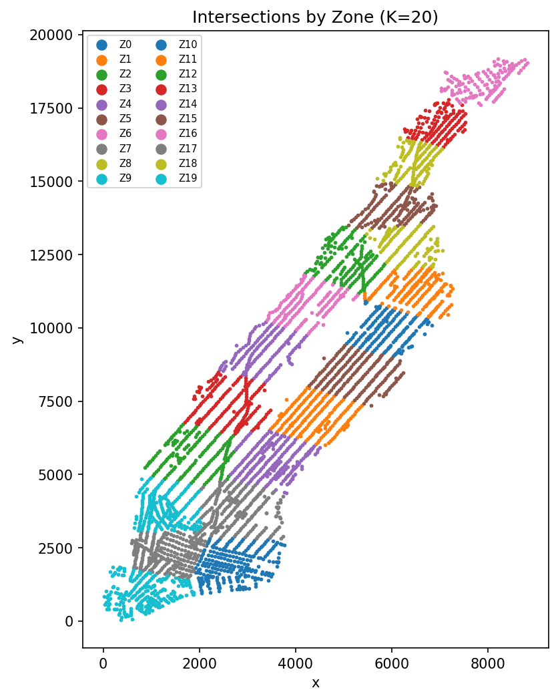
3. Methodology
Data refinment:
3) Zonal traffic data construction:
For every 5-minute interval, zonal traffic counts were created by aggregating:
  Traffic within each zone, and
  Traffic flows between adjacent zones.
4) OD matrix construction:
  An OD matrix was generated for each 5-minute interval.
  If a trip lasted longer than 5 minutes, it was assigned to the interval in which the trip started.
Figure 1: Network zoning using the K-means clustering algorithm

Slide 10
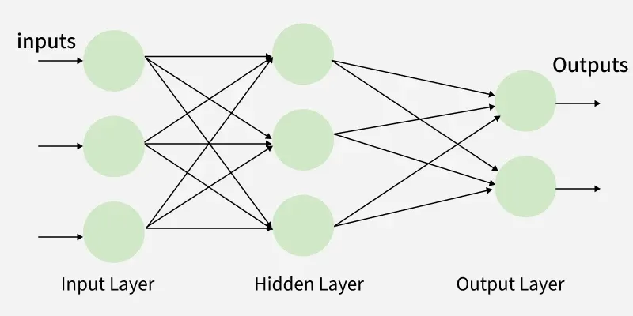
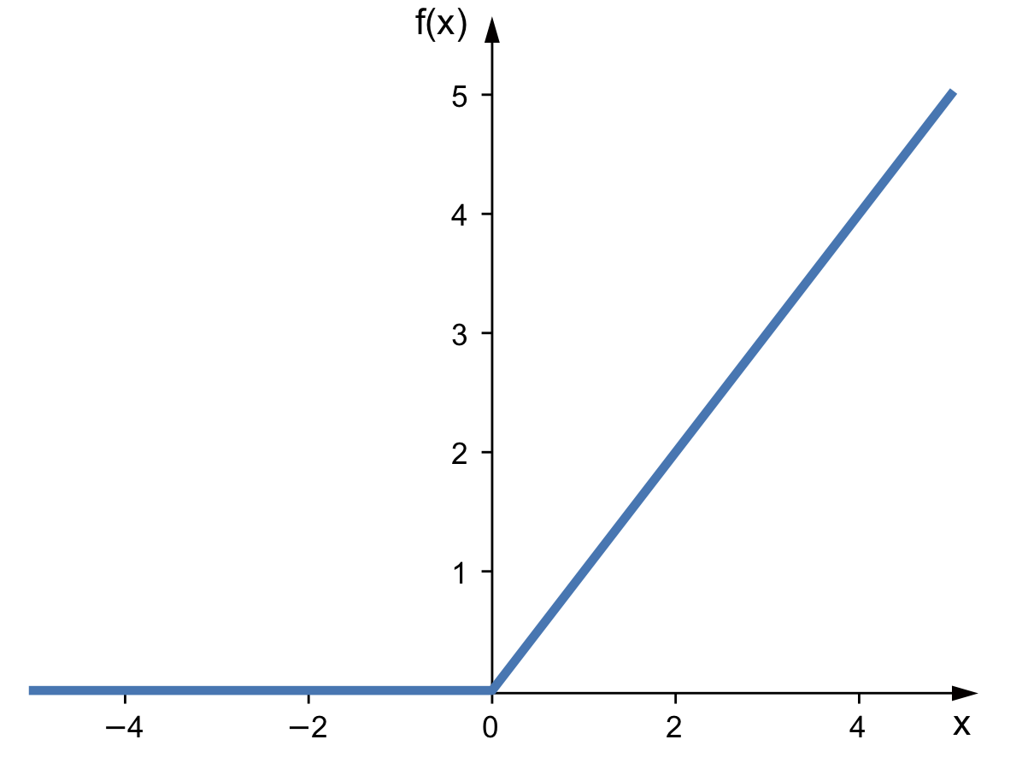
3. Methodology - Model Architecture
  Goal: Learn the direct mapping from zonal traffic counts → OD matrix.
  Input: Zonal features per 5-min interval (internal flows, departures, arrivals, adjacent-zone flows), normalized with log(1+x) and standardization.
  Neural Network:
    Multi-Layer Perceptron (MLP) with 3 hidden layers (512, 256, 128)
    Each layer includes BatchNorm + ReLU + Dropout
  Output: Flattened 20 × 20 OD matrix
Figure 2: Multi Layer Perceptron schema
Figure 3: ReLU (Rectified linear unit) function

Slide 11



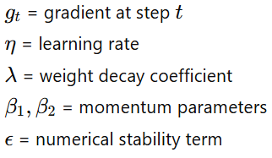





3. Methodology – Loss function
  : Cell-wise OD pattern loss
    Makes the global OD shape close to the true one.
  : Marginal consistency
    MSE on row and column sums (departures / arrivals per zone).
  : Total demand loss
    MSE between predicted and true log total trips per window.
  : internal trips (diagonal)
    MSE on diagonal entries, i.e. within-zone flows.
  : percentage error
    Symmetric percentage loss on OD cells to control relative error.
  : log-space loss
    MSE on log(1+Y), preserving dynamic range for small & large flows.
Optimization function – AdamW:
Gradient moments :
Bias correction:
AdamW parameter update (decoupled weight decay):

Slide 12
3. Methodology – Training & Inference Pipeline
1. Data splitting
Use first 12 windows for each congestion level (1 hour/level).
Split: 8 train / 2 val / 2 test windows per level.
Optionally aggregate windows into larger samples (e.g., 10 min).
2. Pre-processing
Build input features X and targets Y per window.
Apply log(1+x) and standardization (fit on train only).
3. Training
Mini-batch training with PyTorch.
Forward pass → compute weighted loss → backprop → optimizer step.
Track validation metrics: MAE, RMSE, sMAPE per congestion level.
4. Inference & post-processing
Optional corrections:
  Total-flow scaling (match global trip count).
  IPF (match row/column marginals).
  Gamma sharpening (adjust variance).
5. Evaluation
Compute level-wise errors: MAE, RMSE, sMAPE, marginal errors.
Export true vs predicted OD and difference matrices (Excel).

Slide 13
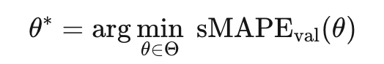
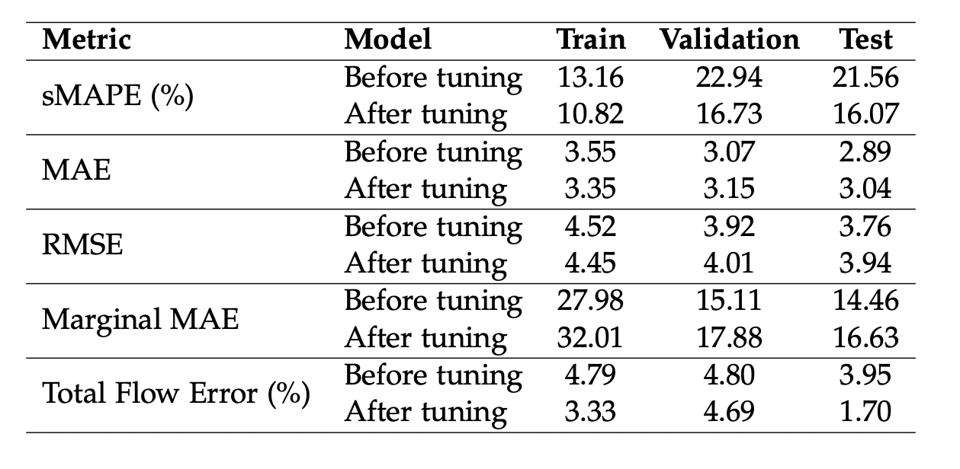
3. Hyperparameter Optimization
Systematic hyperparameter optimization rather than manual trial-and-error
Implemented in Optuna using a Tree-structured Parzen Estimator (TPE) sampler
Hyperband pruning used to terminate weak trials early
Objective: minimize the best validation sMAPE achieved during training
Search space included hidden-layer configuration, dropout rate, learning rate, weight decay, batch size, epochs, early-stopping patience, and loss weights
Optional components also tuned: Huber loss, total-flow head, IPF, and global rescaling
Final model selected as the configuration with the lowest validation sMAPE

Slide 14
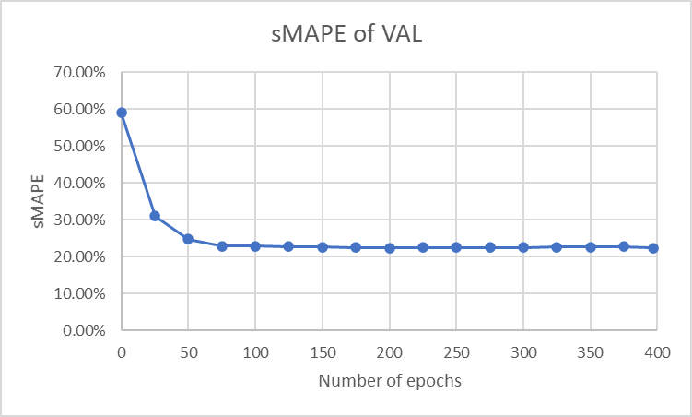
5. Results
Validation sMAPE drops quickly in the first ~50 epochs, then stabilizes → model converges well.
Train vs. Validation gap is small, indicating no strong overfitting.
Test performance (sMAPE 21.5%) is close to validation, showing good generalization.
MAE and RMSE are low, meaning OD predictions are numerically close to ground truth.
Total traffic error < 5% for all splits → model preserves overall trip volume accurately.

Slide 15
5. Results – Resilience of the model
Performance is stable when using 40–100% of the training data: sMAPE stays around 23–24%, showing the model is robust.
Below 20% data, performance begins to degrade gradually: sMAPE rises to 25–26% for 10–5%.
With extremely small datasets (≤ 3%), accuracy drops sharply: sMAPE reaches 28–30% and RMSE increases noticeably.
Total flow difference grows as data decreases: from ~3% at 100% data; up to ~30% at 0.5% data; meaning the model struggles to preserve global trip volume with limited training samples.
Overall trend: Model performs well with moderate data (≥ 40%), but becomes unstable and biased when data becomes very limited.

Slide 16
6. Conclusion and discussion
Zonal MLP maps sparse intra-/inter-zonal counts to full OD matrices.
Recovers main OD structure and total demand (sMAPE ≈ 21–22%, total-flow error < 5%).
Errors concentrate on low-flow OD pairs; major corridors are well captured.
Conservation-aware loss (shape, marginals, diagonal, total) improves coherence.
Robust up to ~60% link-data loss; extreme sparsity still problematic and motivates future work on real data and graph-based models.

Slide 17
7. Biblioghraphy
Robillard, P. (1975). Estimating the o–d matrix from observed link volumes. Transportation Research, 9, 123–128.
Van Zuylen, H. J., and Willumsen, L. G. (1980). The most likely trip matrix estimated from traffic counts. Transportation Research Part B: Methodological, 14(3), 281–293.
Bell, M. G. H. (1983). The estimation of an origin–destination matrix from traffic counts. Transportation Science, 17(2), 198–217.
Maher, M. J. (1983). Inferences on trip matrices from observations on link volumes: A bayesian statistical approach. Transportation Research Part B: Methodological, 17(6), 435–447.
Spiess, H. (1987). A maximum likelihood model for estimating origin–destination matrices. Transportation Research Part B: Methodological, 21(5), 395–412.
Cascetta, E. (1984). Estimation of trip matrices from traffic counts and survey data: A generalized least squares estimator. Transportation Research Part B: Methodological, 18(4/5), 289–299.
Cascetta, E., Inaudi, D., and Marquis, G. (1993). Dynamic estimators of origin–destination matrices using traffic counts. Transportation Science, 27(4), 363–373.
Yang, H., Iida, Y., and Sasaki, T. (1994). The equilibrium-based origin–destination matrix estimation problem. Transportation Research Part B: Methodological, 28(1), 23–33.
Bell, M. G. H. (1991). The estimation of origin–destination matrices by constrained generalised least squares. Transportation Research Part B: Methodological, 25(1), 13–22.
Yang, H. and Zhou, J. (1998). Optimal traffic counting locations for origin–destination matrix estimation. Transportation Research Part B: Methodological, 32(2), 109–126.
Ashok, K. and Ben-Akiva, M. E. (2000). Alternative approaches for real-time estimation and prediction of time-dependent origin–destination flows. Transportation Science, 34(1), 21–36.
Hazelton, M. L. (2000). Estimation of origin–destination matrices from link flows on uncongested networks. Transportation Research Part B: Methodological, 34(7), 549–566.
Zhou, X. and Mahmassani, H. S. (2006). Dynamic origin–destination demand estimation using automatic vehicle identification data. IEEE Transactions on Intelligent Transportation Systems, 7(1), 105–114.
Castillo, E., Menendez, J. M., and Jiménez, P. (2008). Traffic estimation and optimal counting location without path enumeration. Computer-Aided Civil and Infrastructure Engineering, 23(3), 163–185.

Slide 18
7. Biblioghraphy
Kim, D. and Chang, Y. (2008). Neural network-based o-d matrix estimation from link traffic counts. International Journal of Urban Sciences, 12(2), 146–157.
Mussone, L. and Matteucci, M. (2013). Od matrices network estimation from link counts by neural networks. Journal of Transportation Systems Engineering and Information Technology, 13(4), 84–93.
Pamuła, T. and Zochowska, R. (2023). Estimation and prediction of the od matrix in uncongested urban road network based on traffic flows using deep learning. Engineering Applications of Artificial Intelligence, 117, 105550.
Min, D., Yun, H., Ham, S. W., and Kim, D.-K. (2025). Real-time estimation of origin–destination matrices using a deep neural network for digital twins. Transportation Research Record, 2679(2), 1309–1328.
Bergstra, J., Bardenet, R., Bengio, Y., and Kegl, B. (2011). Algorithms for hyper-parameter optimization. In Advances in Neural Information Processing Systems, volume 24.
Bergstra, J. and Bengio, Y. (2012). Random search for hyper-parameter optimization. Journal of Machine Learning Research, 13(10), 281–305.
Snoek, J., Larochelle, H., and Adams, R. P. (2012). Practical bayesian optimization of machine learning algorithms. In Advances in Neural Information Processing Systems, volume 25.
Probst, P., Boulesteix, A.-L., and Bischl, B. (2019). Tunability: Importance of hyperparameters of machine learning algorithms. Journal of Machine Learning Research, 20(53), 1–32.
Li, L., Jamieson, K., DeSalvo, G., Rostamizadeh, A., and Talwalkar, A. (2018a). Hyperband: A novel bandit-based approach to hyperparameter optimization. Journal of Machine Learning Research, 18(185), 1–52.
Li, L., Jamieson, K., et al. (2018b). A system for massively parallel hyperparameter tuning. arXiv preprint arXiv:1810.05934.
Falkner, S., Klein, A., and Hutter, F. (2018). Bohb: Robust and efficient hyperparameter optimization at scale. In Proceedings of the 35th International Conference on Machine Learning, volume 80, pages 1437–1446.
Jaderberg, M., Dalibard, V., Osindero, S., et al. (2017). Population based training of neural networks. arXiv preprint arXiv:1711.09846.
Holzmuller, D., Grinsztajn, L., and Steinwart, I. (2024). Better by default: Strong pre-tuned mlps and boosted trees on tabular data. In Advances in Neural Information Processing Systems.
Schmucker, R., Donini, M., Perrone, V., Zafar, M. B., and Archambeau, C. (2020). Multi-objective multi-fidelity hyperparameter optimization with application to fairness. In NeurIPS Meta-Learning Workshop.

Slide 19
Thank you

Slide 20
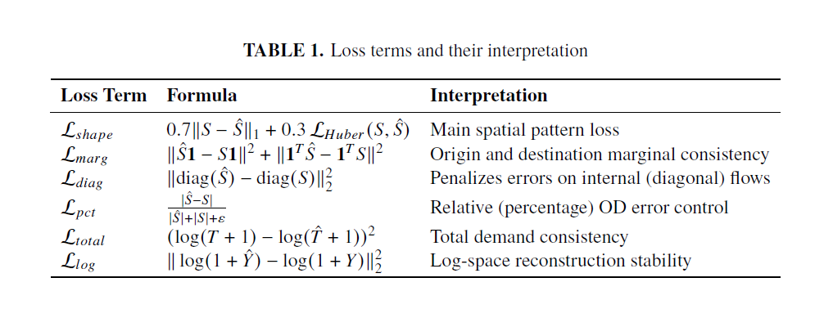

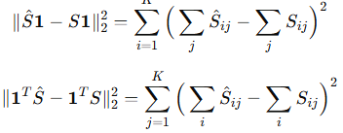
Annex

