Slide 1
Maze Solver
CSE115.4 – Group 5
A program that generates random mazes and then solves them using search algorithms.

Slide 2
Introduction
Taqy Bin Masud (2522963042)
Nasiha Rida Amin (2523282642)
Farhan (2521439642)

Slide 3
Project Objective
To design and implement a program that generates a random maze using C programming and displays it in a matrix format.
Key Goals:
Create a grid-based maze.
Use randomness to vary structure

Slide 4
What is a Maze?
A maze is a 2D structure of paths and walls.
Represented using a grid (7x7)
1 = path, 0 = wall

Slide 5
Algorithm of the Maze Generation
Maze Generation Logic:
Use rand() function for randomness
70% chance to create a path
Ensure (0, 0) and (n-1, n-1) are always 1
Key Points:
No solving included
No guarantee of a valid path

Slide 6
Code Overview
The Generate Maze function:
if (rand() % 100 < 70)
maze[i][j] = 1;
else
maze[i][j] = 0;
Initialize start and end as 1

Slide 7
Maze Solving Logic
Use DFS (Depth-First Search)
Explore in order: right → down → left → up
Backtrack if dead-end found
Record visited path in separate array

Slide 8
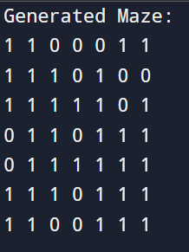
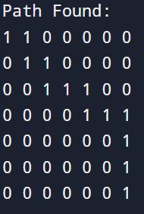
Example Outputs

Slide 9
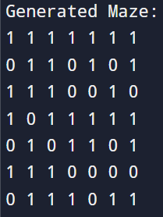

Limitations
May generate unsolvable mazes

Slide 10
Conclusion
Usage of header file <time.h>
Learned 2D arrays, random number generation, and recursion
Explored randomness and grid generation
Implemented DFS with backtracking
Combined generation and solving into one program

Slide 11
Thank You!

