Slide 1
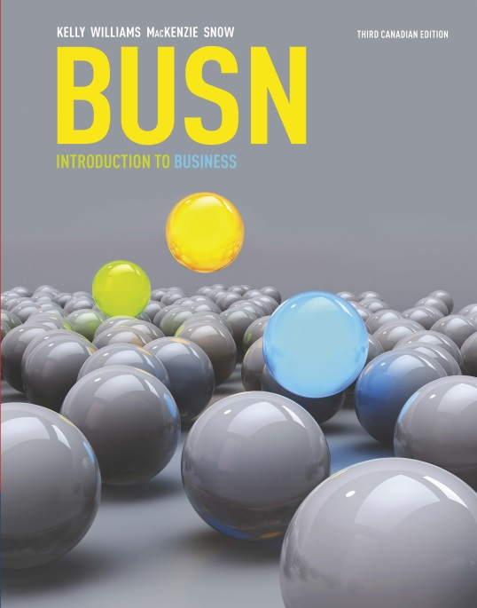
Chapter 4: The World Marketplace
Business Without Borders

Slide 2
Looking Ahead
4-1 Discuss business opportunities in the world economy.
4-2 Explain the key reasons for and against international trade.
4-3 Describe the tools for measuring international trade.

Slide 3
Looking Ahead
4-4 Analyze strategies for reaching global markets.
4-5 Discuss barriers to international trade and strategies to surmount them.
4-6 Describe the free trade movement and discuss key benefits and criticisms.

Slide 4
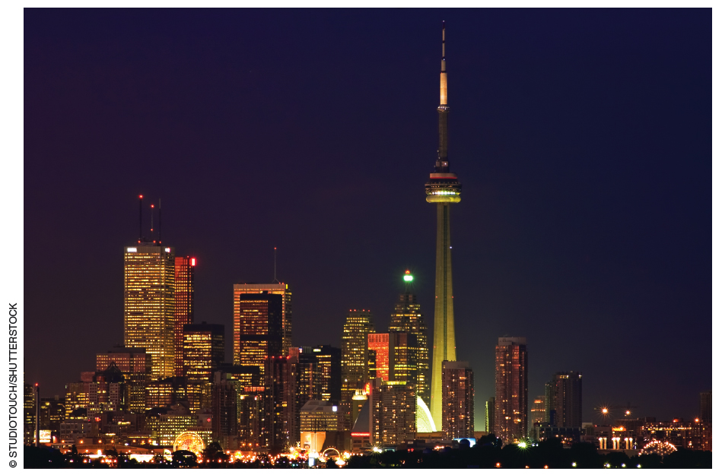
4-1 An Unprecedented Opportunity
With technology and telecommunications booming, and trade barriers falling, the economic boundaries between nations have begun to blur.

Slide 5
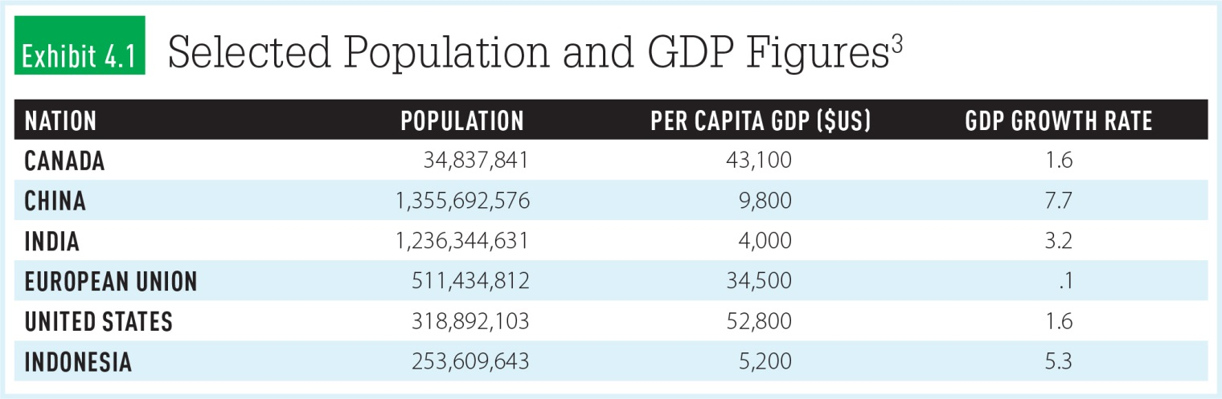
Worldwide Economic Growth

Slide 6
4-2 Key Reasons For International Trade
Access to factors of production
Reduced risk
Inflow of innovation
Copyright © 2017 by Nelson Education Limited
6

Slide 7
Key Reasons Against International Trade
Loss of jobs
Loss of industries
Increase in foreign ownership
Copyright © 2017 by Nelson Education Limited
7

Slide 8
Competitive Advantage
Opportunity cost – the opportunity of giving up the second-best choice when making a decision
Absolute advantage – when a country can produce more of a good than other nations, using the same amount of resources
Comparative advantage – the benefit a country has in a given industry if it can make products at a lower opportunity cost

Slide 9
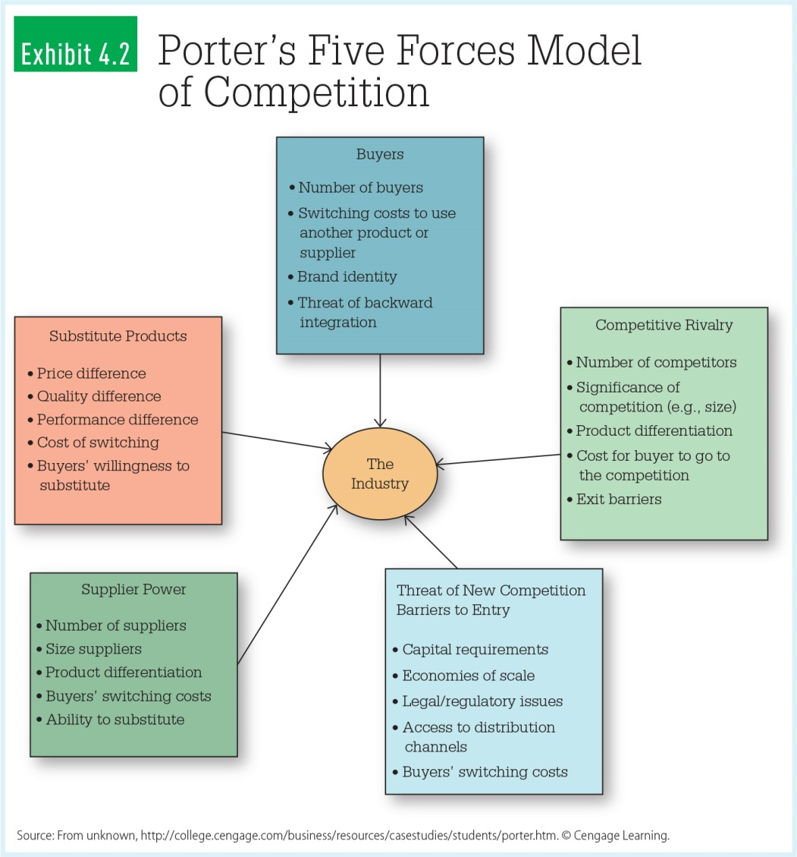
Porter’s Five Forces Model of Competition

Slide 10
4-3 Global Trade: Taking Measure
Balance of trade
Balance of payments
Exchange rates
Countertrade

Slide 11
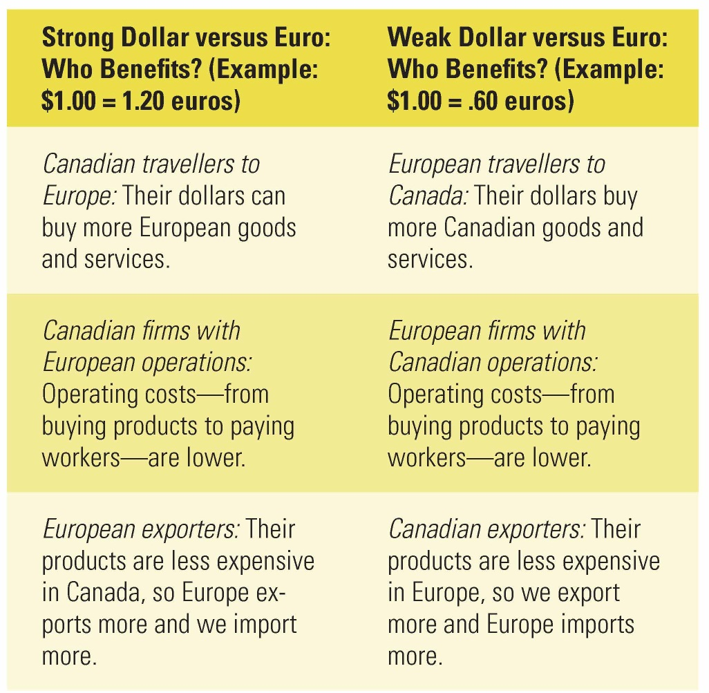
Exchange Rates: Who Benefits?

Slide 12
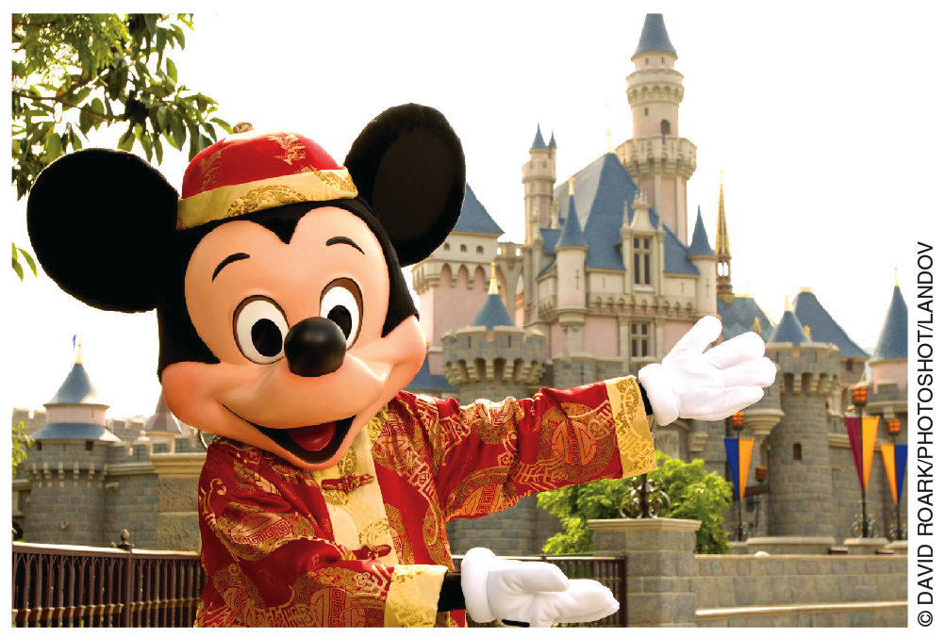
4-4 Seizing the Opportunity: Strategies for Reaching Global Markets
Foreign outsourcing
Importing

Slide 13
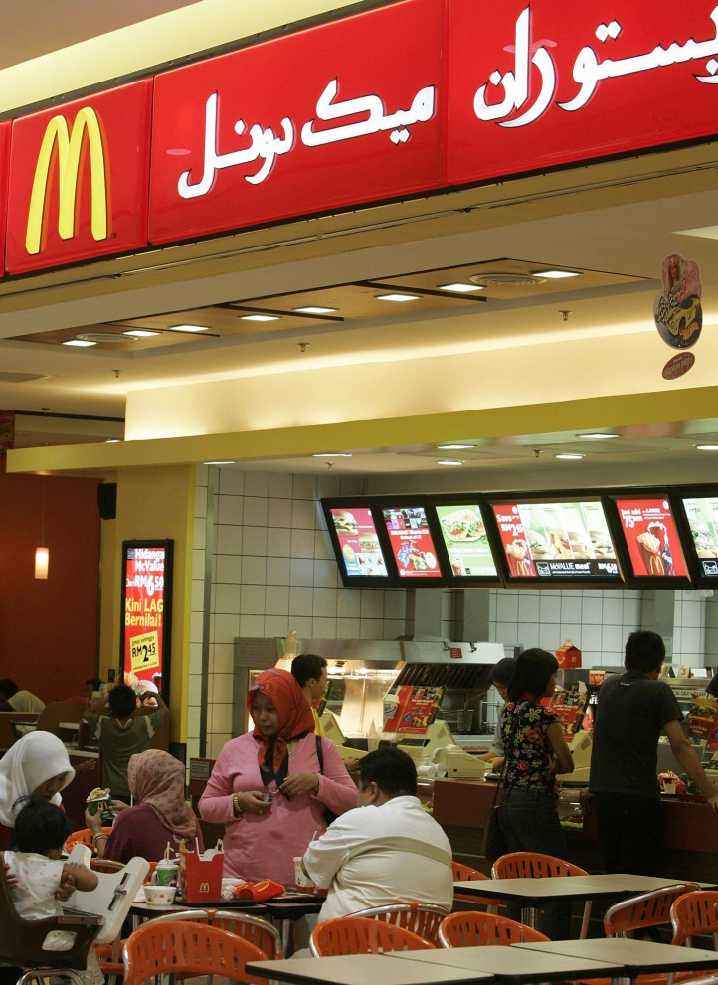
Strategies for Reaching Global Markets
Licensing
Franchising
Direct investment

Slide 14
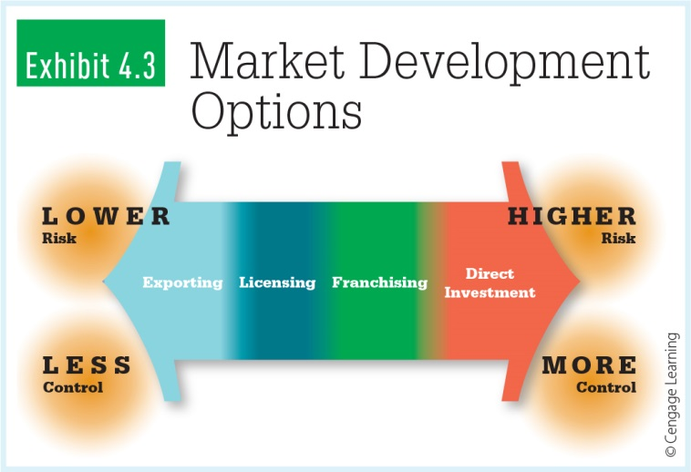
Market Development Options: Foreign Investment Risk

Slide 15
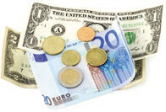
4-5 Barriers to International Trade
Sociocultural differences
Economic differences
Political and legal differences

Slide 16
Social/Cultural Differences
Think beyond the obvious differences
Social/cultural differences can rapidly undermine business relationships
Nonverbal communication
Forms of address
Attitudes toward punctuality
Religious celebrations
Business practice/gifts

Slide 17
Economic Differences
Population
Per capita income
Economic growth rate
Currency exchange rates
Stage of economic development
Infrastructure
Can you profitably provide your product or service to meet the needs of the market?

Slide 18
Political and Legal Differences
Political regimes differ around the world
Laws and regulations
Political climate
International trade restrictions

Slide 19
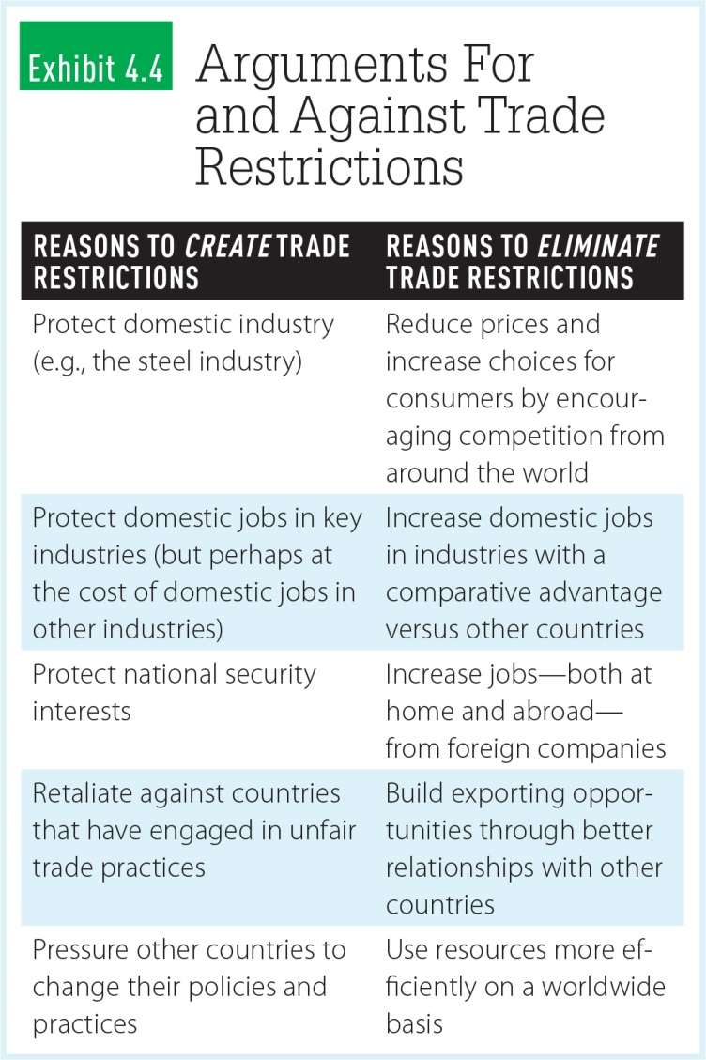
Pros and Cons of Trade Restrictions

Slide 20
Trade Restrictions
Tariffs
Quotas
Voluntary export restraints
(VER)
Embargos

Slide 21
4-6 Free Trade: The Movement Gains Momentum
There has been a global move toward free trade – the unrestricted movement of good and services across borders.
There has been a
global move toward
free trade – the
unrestricted
movement of goods
and services across borders.

Slide 22
GATT and the World Trade Organization (WTO)
General Agreement on Tariffs and Trade (GATT) – now encompasses 125 nations and has slashed tariffs by about 30%
World Trade Organization (WTO) – promotes international trade and settles trade disputes

Slide 23
World Bank and International Monetary Fund
World Bank – made up of 188 member countries; provides financial assistance and low-interest loans
International Monetary Fund (IMF) – supports stable exchange rates and facilitates international payments

Slide 24
Trading Blocs/Common Markets
Groups of countries promoting the free flow of goods and services
The North American Free Trade Agreement (NAFTA)
European Union (EU)

Slide 25
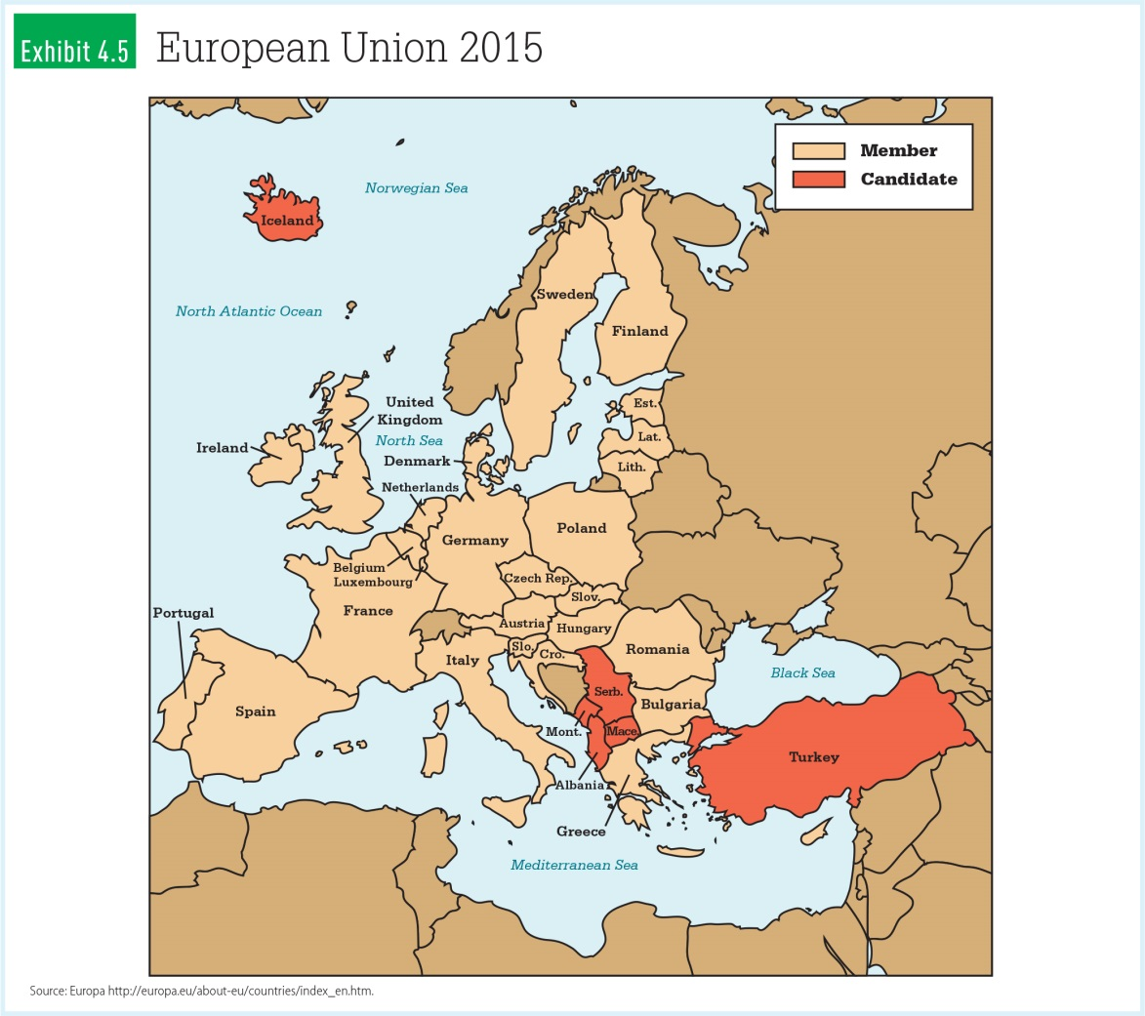
European Union 2015

Slide 26
Looking Back
Why should today’s managers think globally?
What are the reasons for and against international trade?
How do we measure trade?

Slide 27
Looking Back
How do companies reach global markets?
What are the barriers to international trade?
What are the benefits and criticisms of the free trade movement?

