Slide 1
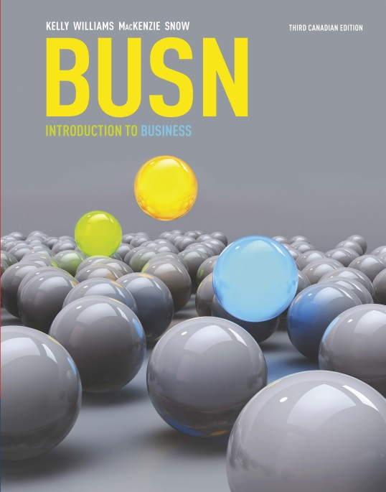
Chapter 7: Accounting
[[CATCH: New BUSN 3CE Front Cover]]
Decision Making by the Numbers

Slide 2
Looking Ahead
7-1 Define accounting and explain how accounting information is used by a variety of stakeholders.
7-2 Identify the purposes and goals of accounting standards.
7-3 Describe the key elements of the major financial statements.

Slide 3
Looking Ahead
7-4 Describe several methods stakeholders can use to obtain useful insights from a company’s financial statements.
7-5 Explain the role of managerial accounting and describe the various cost concepts identified by managerial accountants.
7-6 Describe how financial managers use key ratios to evaluate their firm.

Slide 4
7-1 Accounting: Who Needs It?
Managers
Shareholders
Employees
Creditors
Suppliers
Government Agencies
What other groups would be interested
in accounting information?

Slide 5
7-2 Financial Accounting: Intended for Those on the Outside Looking In
Financial accounting – the branch of accounting that addresses the needs of external stakeholders; includes financial statements to provide broad information

Slide 6
Playing by the Rules of Financial Accounting
International Financial Reporting Standards (IFRS) –
accounting standards that are used in the preparation of financial statements
Through IFRS,
accountants aim to
ensure that financial
statements are:
Relevant
Reliable
Consistent
Comparable

Slide 7
Ethics in Accounting
Accounting scandals have shocked business since the late 1990s.
The scandals have served as a wake-up call.

Slide 8
7-3 Financial Statements: Read All about Us
Financial accounting includes three basic financial statements:
Balance sheet
Income statement
Statement of cash flows
Corporations with publicly held stock must publish annual reports with all three statements.

Slide 9
Balance Sheet: What We Own and How We Got It
Balance sheet – summarizes a firm’s financial position at a specific point in time
Assets
Liabilities
Owner’s equity
Assets = Liabilities + Owner’s equity

Slide 10
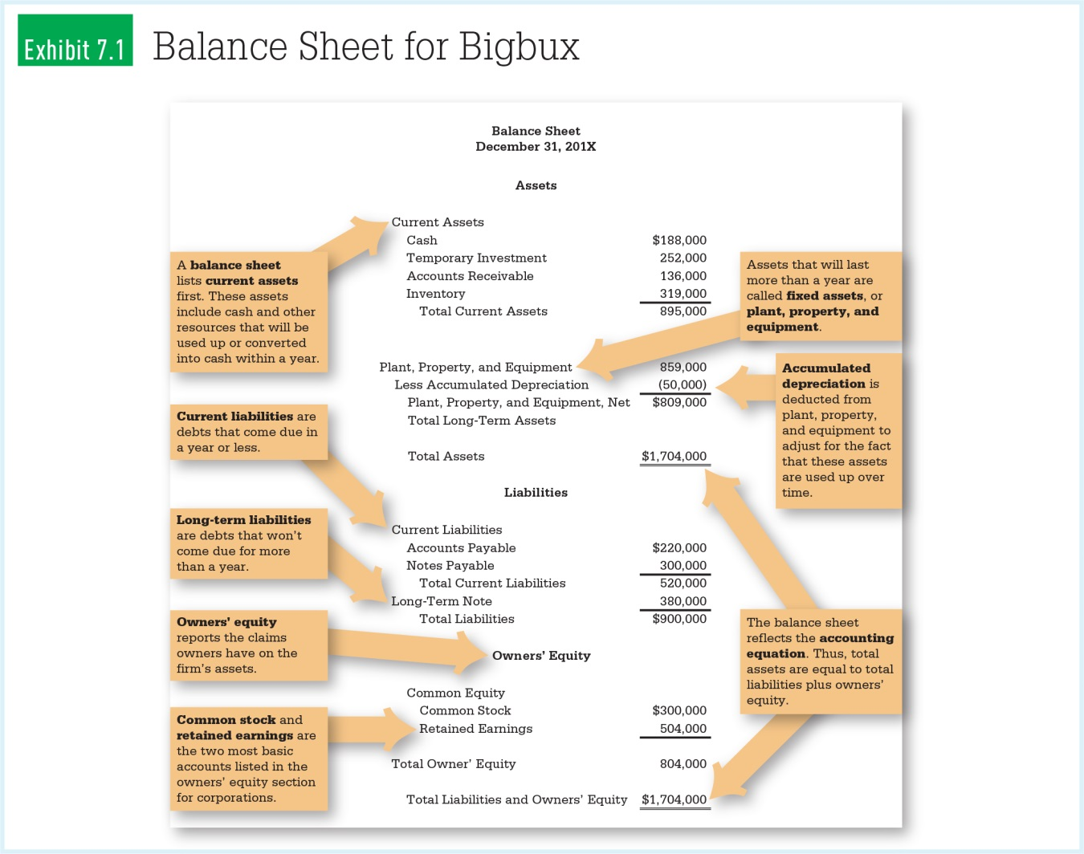
Sample Balance Sheet
[[CATCH: Exhibit 7.1 (Balance Sheet for Bigbux) from p. 103 in the textbook]]

Slide 11
The Income Statement: How Did We Do?
Income statement – summarizes a firm’s operations over a given period of time in terms of profit and loss
Revenue
Expenses
Net Income
Revenue – Expenses = Net income

Slide 12
Accrual-Basis Accounting
Revenue is not the same as cash received during the same time period.
Accrual-basis accounting records revenues as they are earned.
Expenses are matched to the revenues they generated.

Slide 13
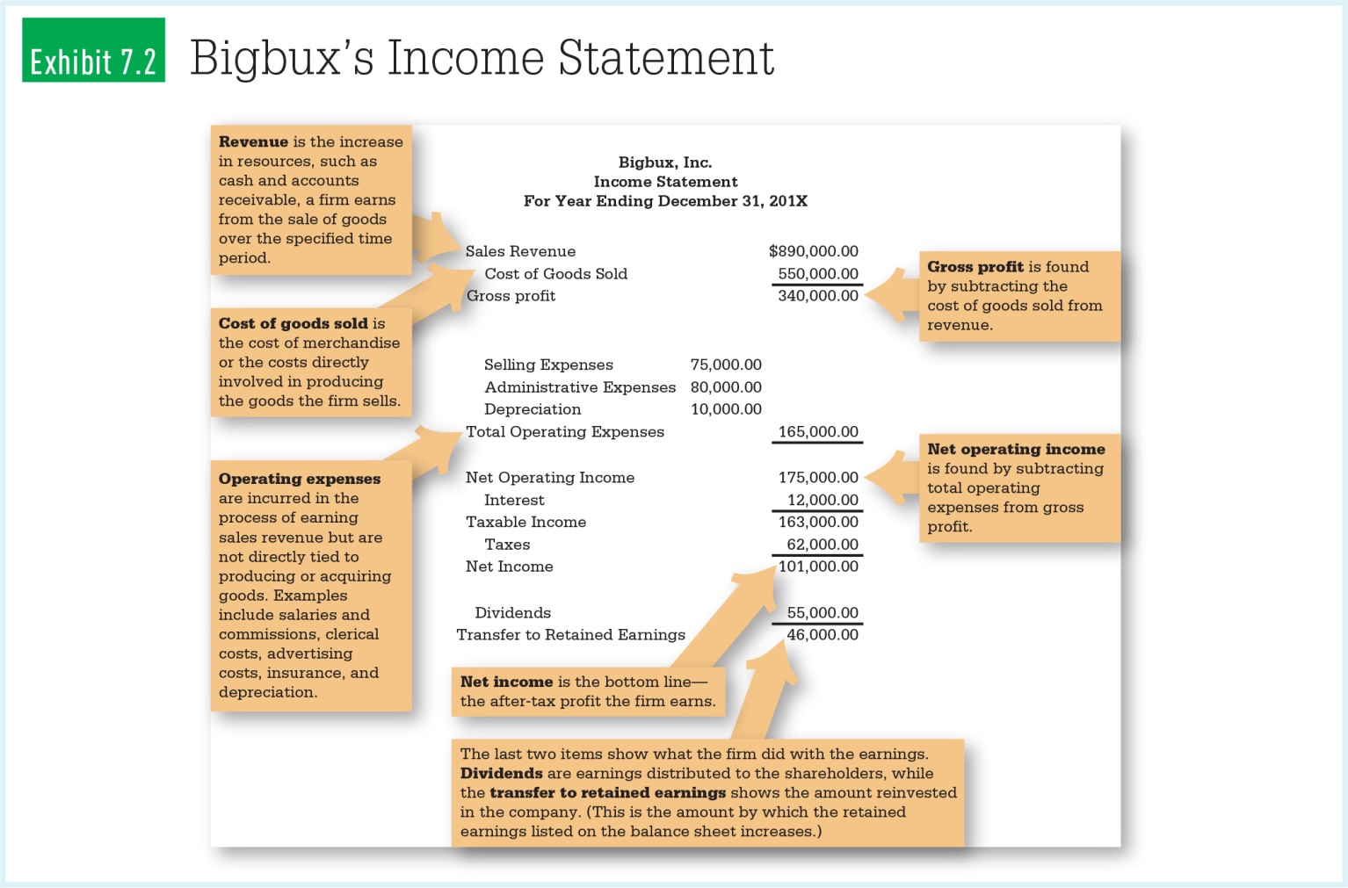
Sample Income Statement
[[CATCH: Exhibit 7.2 (Bigbux’s Income Statement) from p. 106 in the textbook]]

Slide 14
Statement of Cash Flows: Show Me the Money
Cash flowing into and out of the firm
Operations
Investing
Financing
Increases and decreases the
total amount of cash on hand
Operations
Investing
Financing

Slide 15
Statement of Cash Flows: Show Me the Money
Stakeholders want to know if there is adequate cash to pay workers, creditors, suppliers, and the Canada Revenue Agency.

Slide 16
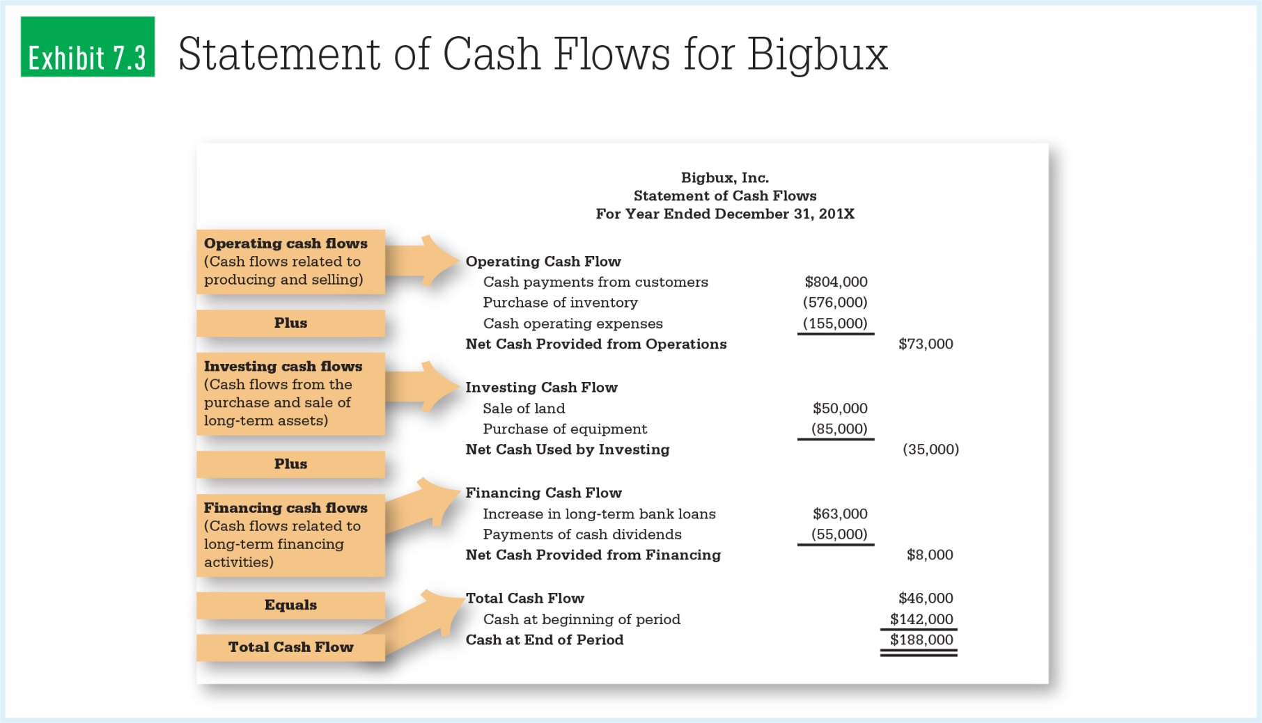
Sample Statement of Cash Flows
[[CATCH: Exhibit 7.3 (Statement of Cash Flows for Bigbux) from p. 107 in the textbook]]

Slide 17
Other Statements
Statement of retained earnings – reports how retained earnings have changed
Shareholders’ equity statement – reports how net income and dividends affect retained earnings

Slide 18

7-4 Interpreting Financial Statements: Digging Beneath the Surface
It’s important to view financial statements and the:
Auditor’s report
Notes to financial statements
Comparative statements

Slide 19

Independent Auditor’s Report: A Necessary Stamp of Approval
Publicly traded corporations are required to have an accounting firm perform an external audit.
The auditor will issue an unqualified, qualified, or adverse opinion.
Auditors must be independent.

Slide 20
Notes to Financial Statements: Reading the Fine Print
Additional information may be required to explain the numbers; notes can:
Provide additional information about operations
Clarify and supplement the numbers
Explain accounting methods or changes
Detail status of lawsuits

Slide 21
Looking for Trends in Comparative Statements
The IFRS requires publicly traded companies to provide information about previous years.
Horizontal analysis uses comparative statements to identify changes in key accounts’ values over time.

Slide 22
7-5 Inside Intelligence: The Role of Managerial Accounting
Managerial accounting – provides reports and analysis to managers to help them make informed business decisions

Slide 23
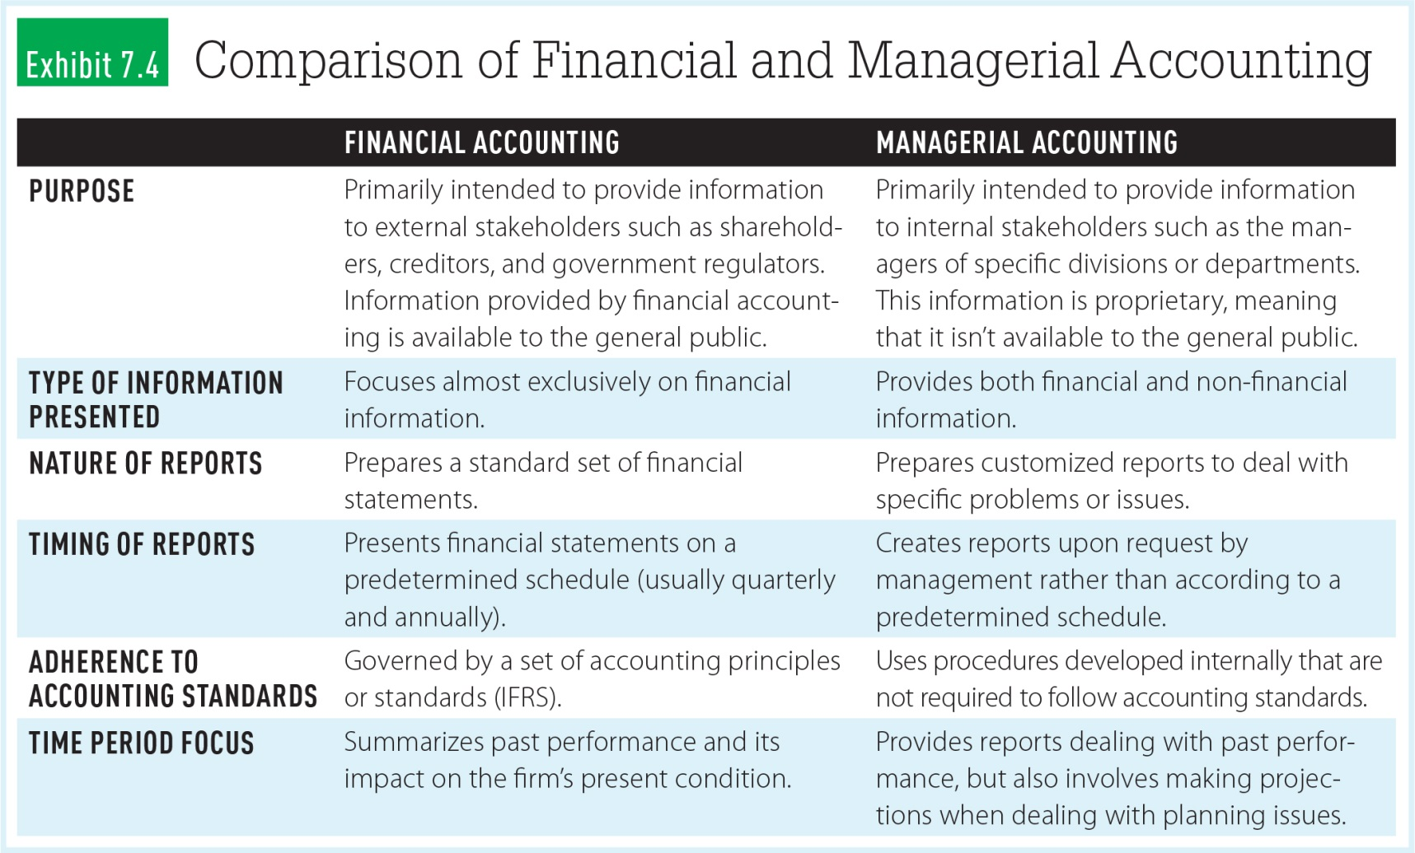
Comparison of Financial and Managerial Accounting
[[CATCH: Exhibit 7.4 (Comparison of Financial and Managerial Accounting) from p. 110 in the textbook]]

Slide 24
Managerial (or Management) Accounting
Examples of managerial accountants’ responsibilities:
Determining product costs
Performing incremental analysis
Developing budgets

Slide 25
Product Costing
Managers assign costs to the products and services:
Direct costs can be directly traced to production.
Indirect costs are the result of general operations.

Slide 26

Activity-Based Costing (ABC)
Activity-based costing – a technique used to assign product costs based on links between activities that drive costs and the production of specific goods

Slide 27
7-6 Evaluating Performance: Where Do We Stand?
Financial ratios provide insight into financial strengths and weaknesses.
Use financial data from balance sheet and income statement.
Companies can compare their ratios with other businesses.
%

Slide 28
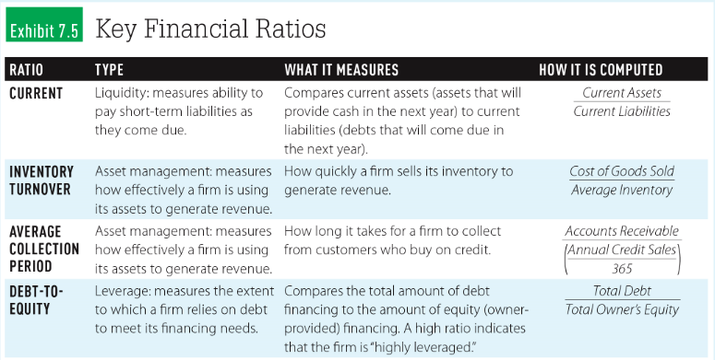
Key Financial Ratios

Slide 29
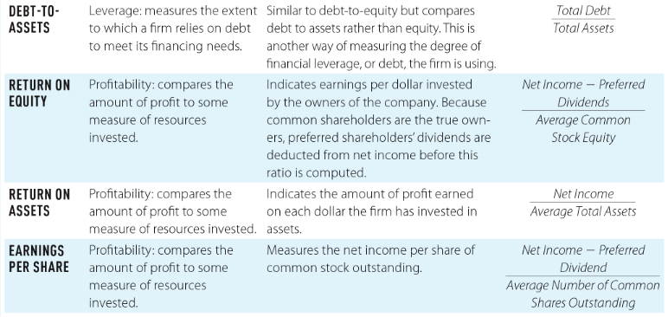
Key Financial Ratios

Slide 30
Looking Back
What is accounting? How is accounting information used by stakeholders?
What are the goals of accounting standards?
What are the key elements of major financial statements?

Slide 31
Looking Back
What information is provided in the independent auditor’s report and notes to the financial statements?
How can managerial accounting help managers with product costing?
How do financial managers use key ratios to evaluate the firm?

