Slide 1

Chapter 8: Finance
[[CATCH: New BUSN 3ce Front Cover]]
Acquiring and Using Funds To Maximize Value

Slide 2
Looking Ahead
8-1 Identify the goal of financial management and explain the issues financial managers confront as they seek to achieve this goal.
8-2 Explain how the budget process can help managers plan, motivate, and evaluate their organization’s performance.

Slide 3
Looking Ahead
8-3 Evaluate the major sources of funds available to meet a firm’s short-term and long-term financial needs.
8-4 Identify the key issues involved in determining a firm’s capital structure.

Slide 4
Looking Ahead
8-5 Describe how financial managers acquire and manage current assets.
8-6 Explain how financial managers evaluate capital budgeting proposals to identify the best long-term investment options for their company.

Slide 5
8-1 What Motivates Financial Decisions?
What types of assets do we need to achieve goals?
How do we get the funds we need?
Evaluate financial performance
Plan financial resources
Manage working capital
Evaluate investment opportunities
Determine appropriate strategies

Slide 6
Shareholder Value and Social Responsibility: Does Good Behaviour Pay Off?
Historically, the goal of the firm has been to
but a commitment to meeting social responsibilities can contribute to profit.
maximize the value of the firm to its shareholders

Slide 7
8-2 Budgeting: Planning for Accountability
Budgeting:
Outlines how resources will be used to meet goals
Translates goals into measurable quantities and identifies resources
Communication and coordination among managers and employees
Motivates achievement of goals
Monitors progress

Slide 8
Preparing the Budget: Top-Down or Bottom-Up?
Top-down budgeting – top management prepares the budget with little or no input from middle and supervisory managers
Bottom-up or participatory budgeting – allows middle and supervisory managers to actively participate in the creation of the budget

Slide 9
Developing the Key Budget Components: One Step at a Time
Operating budgets – identify sales and production goals
Sales budget
Production budget
Direct labour budget
Financial budgets – focus on the firm’s financial objectives
Cash budget
Capital budget

Slide 10
Developing the Key Budget Components: One Step at a Time
Master budget –
brings together all
of the budgets to
represent the
overall plan

Slide 11
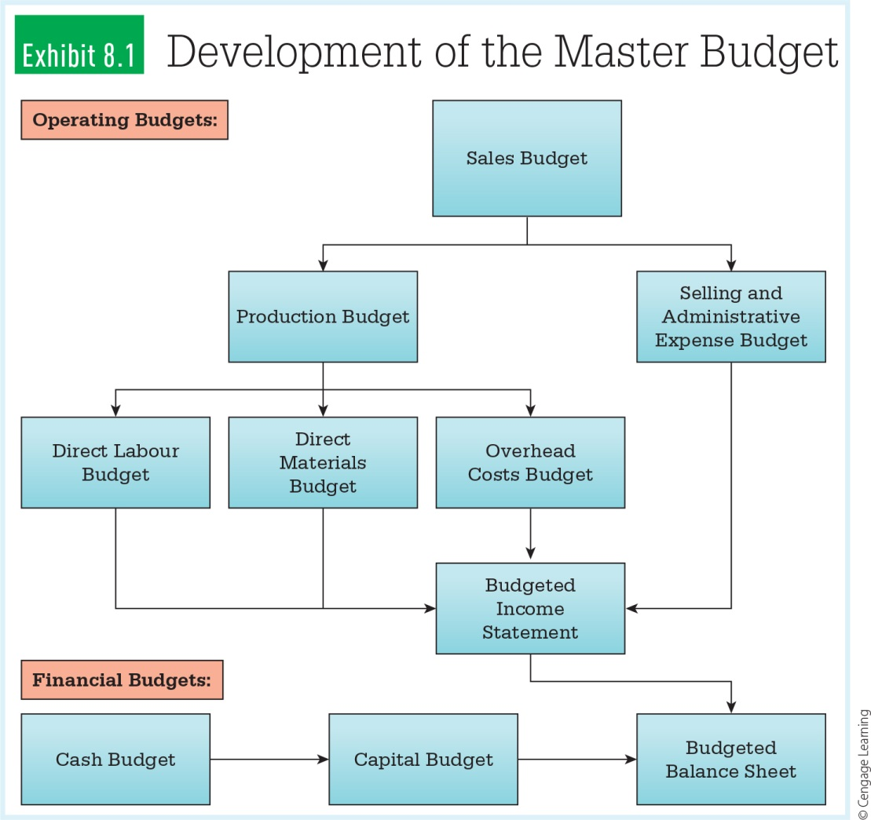
Development of the Master Budget
[[CATCH: Exhibit 8.1 (Development of the Master Budget) from p. 119 in the textbook]]

Slide 12

Planning Tools: Creating a Road Map for the Future
What assets must be obtained?
How much additional financing is needed?
How much can the firm generate internally? Externally?
When will external financing be required?

Slide 13
Basic Planning Tools
Budgeted income statement – forecasts sales, expenses, and net income
Balance sheet – forecasts the types and amounts of assets a firm will need to carry out plans

Slide 14
Basic Planning Tools
Cash budget –
detailed projection of cash flows to determine when cash shortages and surpluses will occur

Slide 15
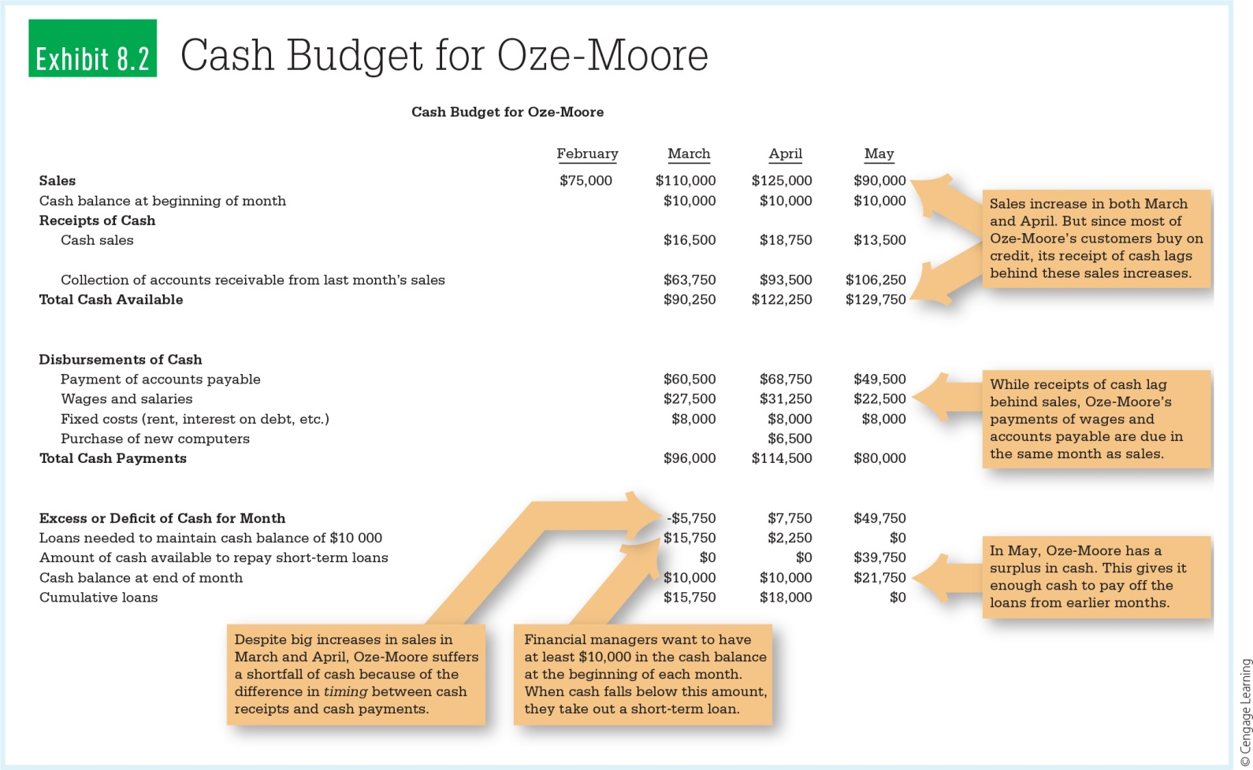
Sample Cash Budget
[[CATCH: Exhibit 8.2 (Cash Budget for Oze-Moore) from p. 122 in the textbook]]

Slide 16
8-3 Finding Funds: What Are the Options?
Short-term needs include meeting payroll, paying suppliers and paying taxes
Long-term needs include major investments in plant, property and equipment
Which sources of funds to tap?
Short or long-term financing?

Slide 17

Short vs Long-Term Financing
Short-Term
Long-Term
Trade Credit
Factoring
Short-term Bank Loans
Commercial Paper
Direct Investment from Owners
Long-Term Debt Credit
Term Loans
Corporate Bonds

Slide 18
Borrowing Money
“
If you want to know the value of money, go and try to borrow some.
— Benjamin Franklin
“

Slide 19
8-4 Leverage and Capital Structure
Capital structure – the mix of equity and debt
financing a firm uses for financing needs
Debt financing – creditors
Equity financing – owners

Slide 20

Debt Financing
Pros
Cons
Interest payments are tax deductible
Owners don’t have to invest more of their own money
Fixed payments required
Creditors may impose conditions

Slide 21
Sources of Equity Financing
Direct contributions by owners
Retained earnings
Equity financing provides more flexibility than debt financing

Slide 22
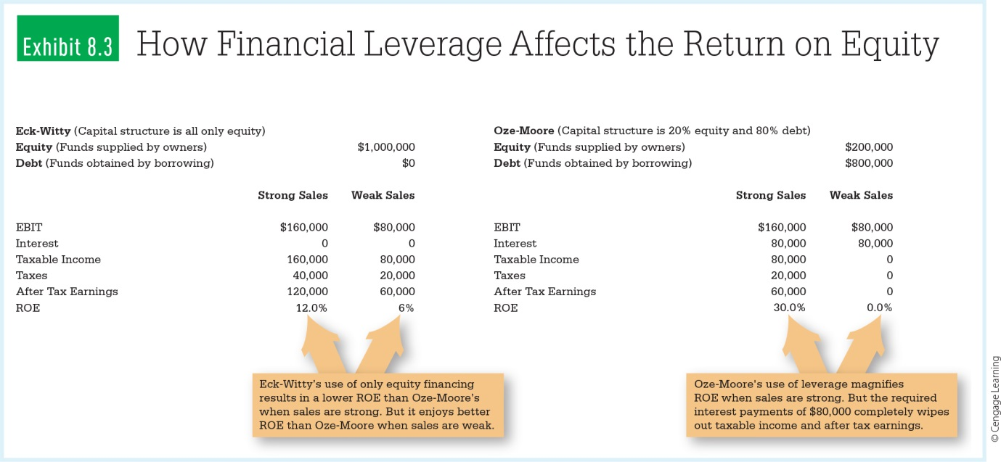
Financial Leverage: Using Debt to Magnify Gains
Heavy debt in capital structure
Potential high returns to owners
Increased risk

Slide 23
8-5 Acquiring and Managing Current Assets
A firm determines the amount and type of current assets to hold.

Slide 24
Managing Cash
Need cash to pay bills
Cash does not earn returns
Report cash equivalents as cash

Slide 25
Cash Equivalents
T-bills
Money market funds

Slide 26
Managing Accounts Receivable
Accounts receivable – represent what credit customers owe the firm
Set credit terms
Establish credit standards
Design an appropriate collection policy

Slide 27
Managing Inventories
Inventories are the stocks of finished products and partly finished products.
Inventories represent a major investment.

Slide 28

8-6 Capital Budgeting: In It for the Long Haul
Capital budgeting – a systematic evaluation of a firm’s major long-run capital investment opportunities

Slide 29
Capital Budgeting: Used for Making Decisions
When to replace machines and equipment
When to purchase new machines and equipment
When to build a new factory, warehouse, or office
When to introduce a new product line

Slide 30
Comparing Cash Flows that Occur at Different Times
Managers must evaluate costs and benefits of investment that occur over a period of many years.
Time Value of Money
Compounding

Slide 31
Using Net Present Value to Evaluate Capital Budgeting Proposals
Managers use the process of discounting to calculate the present value.
Present value depends on the interest rate the invested money will earn.
Present value – how much a given amount of cash received in a future period is worth today, given the time value of money

Slide 32
Using Net Present Value to Evaluate Capital Budgeting Proposals
Net present value (NPV) – the present value of all cash flows associated with an investment, including the initial (negative) cash flow of the investment

Slide 33
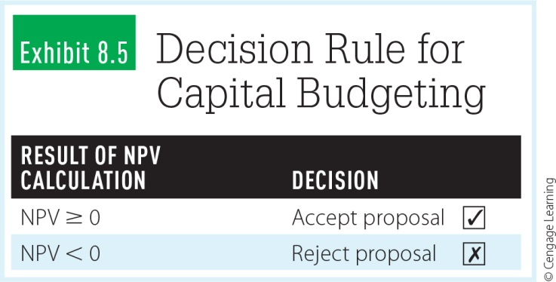
NPV Calculation
[[CATCH: Exhibit 8.5 (Decision Rule for Capital Budgeting) from p. 132 in the textbook]]

Slide 34
Looking Back
How does maximizing financial value relate to social responsibility?
How do financial managers use budgeted financial statements and cash budgets?
What are the options for financing in the short and long-term?

Slide 35
Looking Back
How do managers determine the amount and type of current assets to hold?
How do financial managers determine the firm’s capital structure?
How do financial managers evaluate capital budgeting proposals?

