Slide 1
RESTAURANT MANAGEMENT SYSTEM

Slide 2
Presented By:
Ahmad Mujtaba Fa22 bscs 205 Abubakar Ajmal Fa22 bscs 208 Abdullah Ali Fa22 bscs 213

Slide 3


Introduction
Restaurant Management System
Streamlining Restaurant Operations with a Comprehensive Database Solution

Slide 4
Purpose of the System
To efficiently manage restaurant operations
To centralize and organize data for easy access and analysis
To improve customer service and satisfaction

Slide 5
Benefits
Enhanced efficiency in managing daily operations
Improved accuracy in data handling
Streamlined employee and customer management
Better inventory and supplier management
Increased customer satisfaction through better service and feedback handling

Slide 6
Key Functionalities
Employee Management
Customer Management
Reservation Handling
Order Processing
Payment Handling
Menu Item Management
Feedback Collection
Supplier and Inventory Management

Slide 7
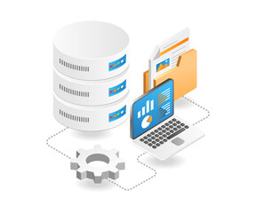
Database Overview
Comprehensive database schema
Relationship between tables
Data integrity

Slide 8
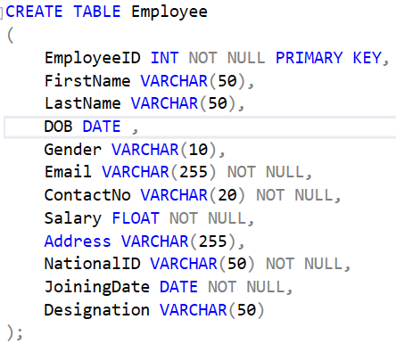
Employee Management
Tracking employee details and salaries
Storing contact information and addresses
Managing designations and joining dates

Slide 9
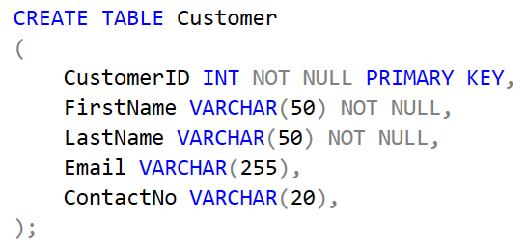
Customer Management
Recording customer information
Tracking customer interactions and orders
Handling customer feedback

Slide 10
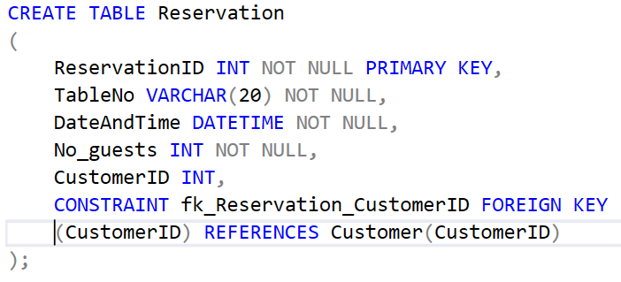

Reservation Management
Managing table reservations
Tracking reservation dates and guest numbers
Associating reservations with customers

Slide 11
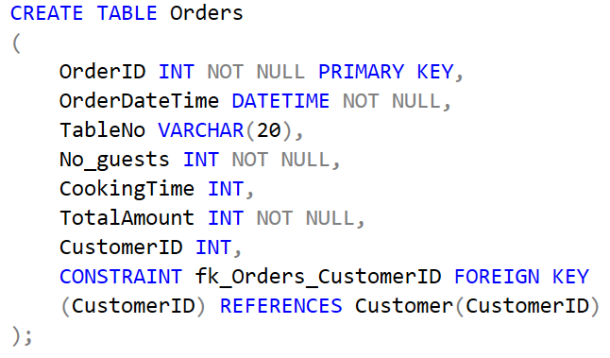
Order Processing
Recording order details and timestamps
Tracking cooking times and table numbers
Associating orders with customers and menu items

Slide 12
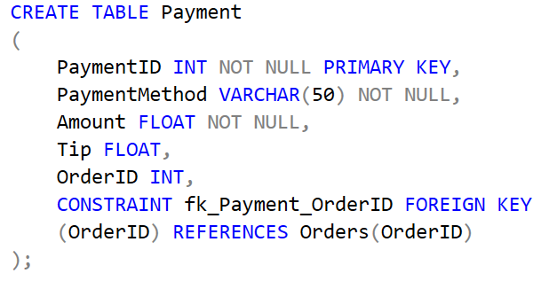
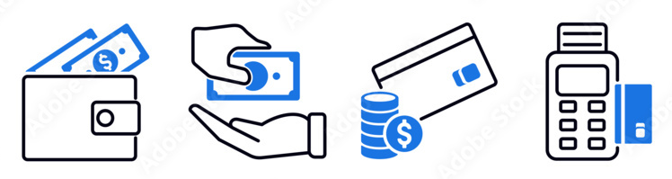
Payment Handling
Processing different payment methods
Recording payment amounts and tips
Associating payments with orders

Slide 13
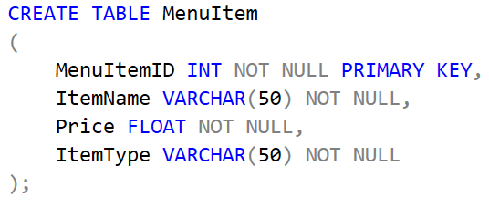

Menu Item Management
Storing menu item details
Tracking item prices and types
Associating menu items with orders

Slide 14
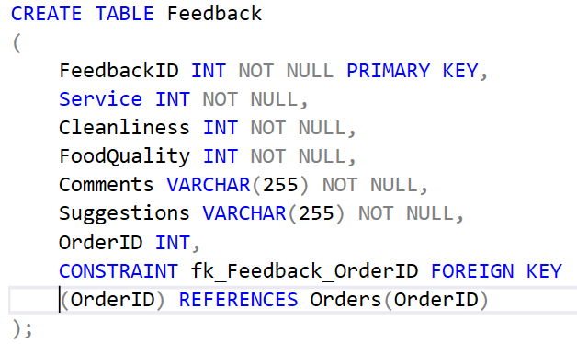

Feedback Collection
Collecting feedback on service, cleanliness, and food quality
Storing customer comments and suggestions
Associating feedback with specific orders

Slide 15
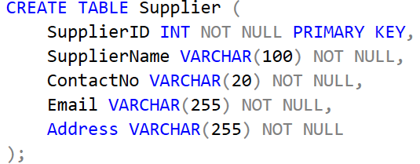
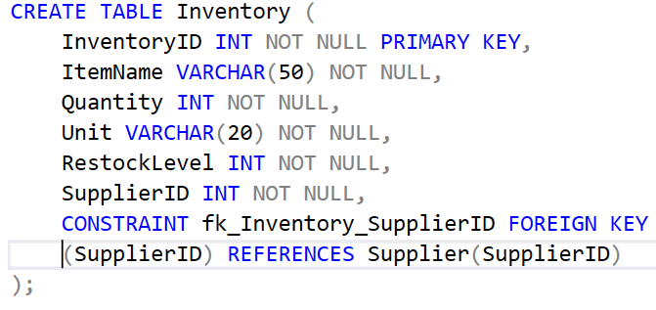
Supplier and Inventory Management
Managing supplier information and contacts
Tracking inventory levels and restock needs
Associating inventory items with suppliers

Slide 16
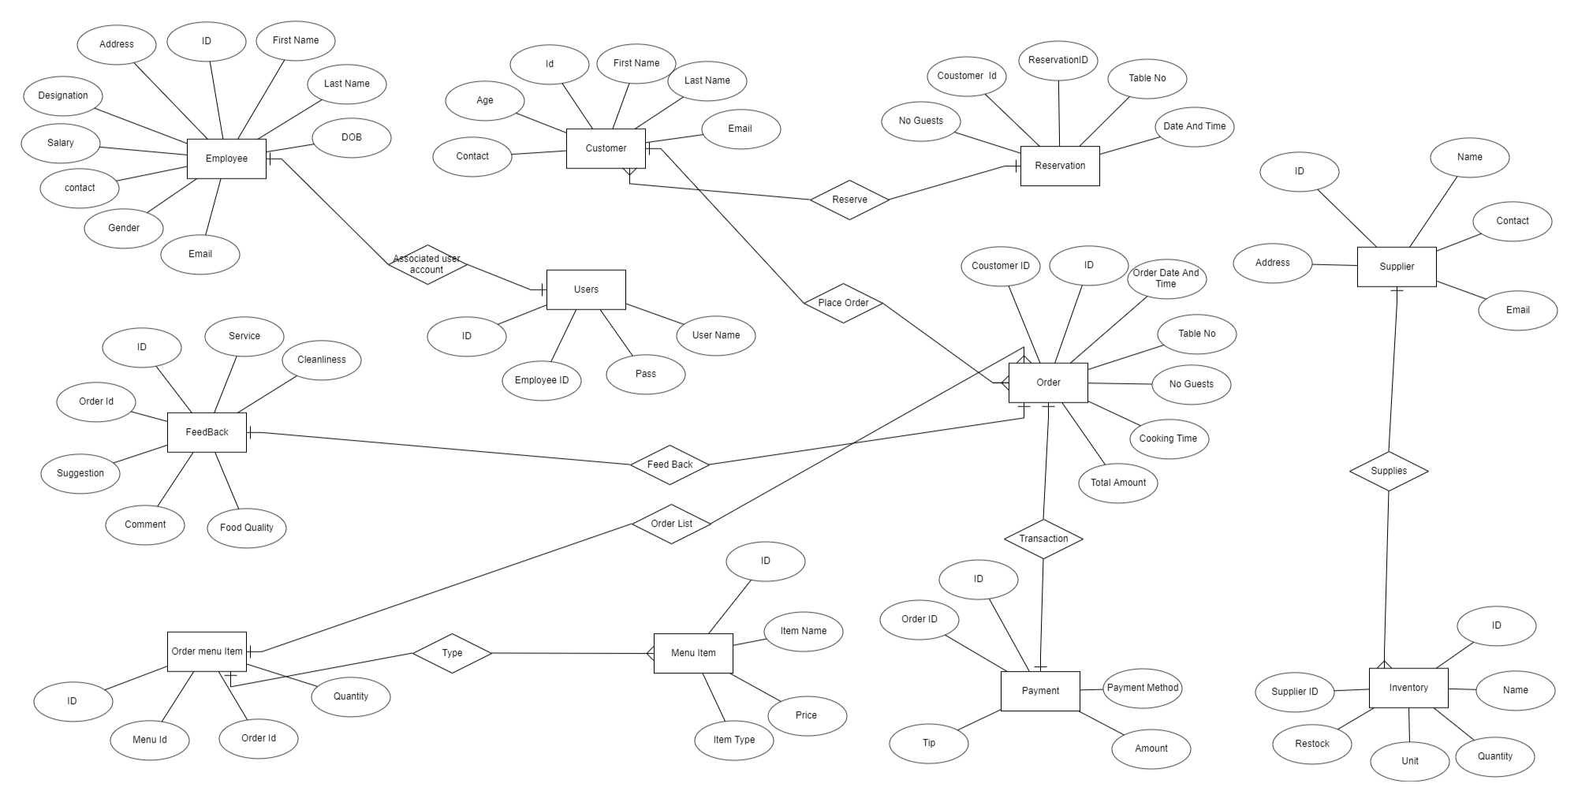
ERD

Slide 17
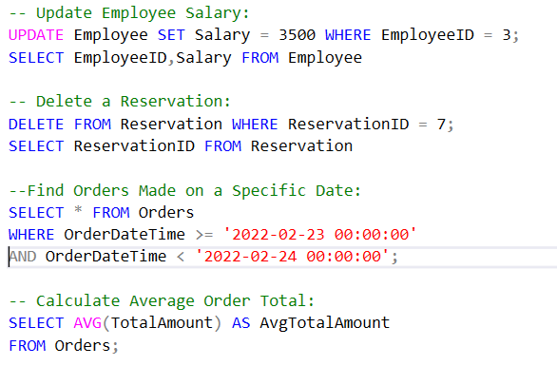
Task Examples
Updating employee salaries
Deleting reservations
Finding orders made on specific dates
Calculating average order totals

Slide 18
Reporting and Queries
Performing specific queries for data analysis
Example queries: orders above a certain amount, items to restock, feedback and order details

Slide 19
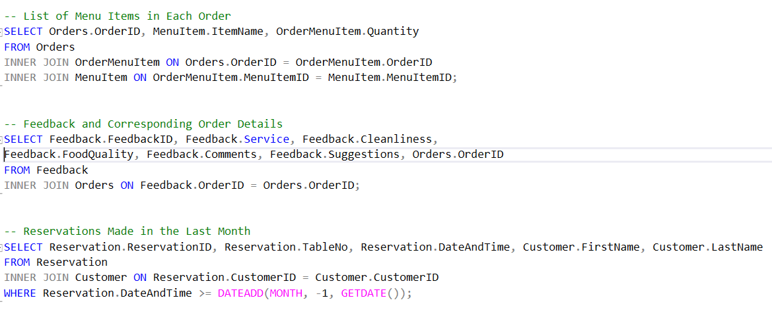
JOIns

Slide 20
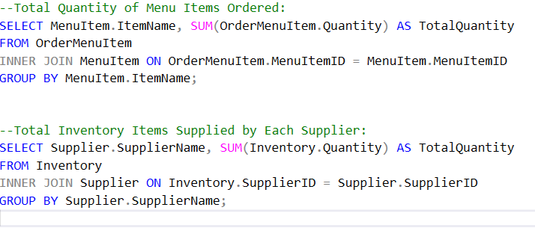
Group By

Slide 21
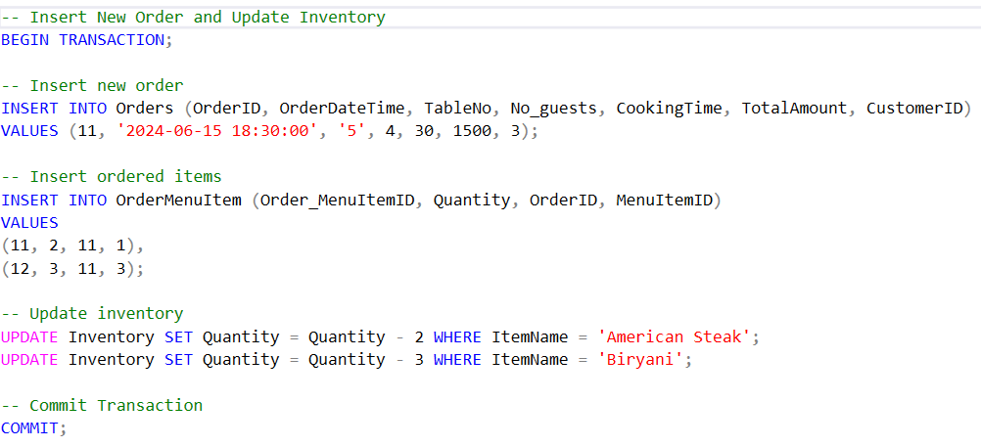
Transaction

Slide 22
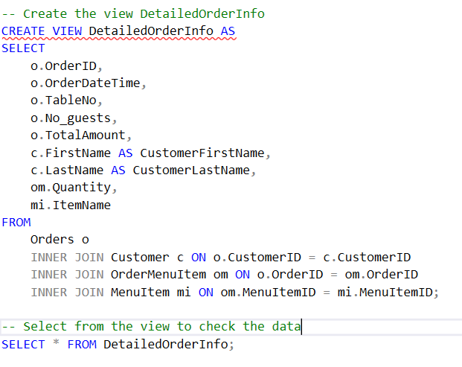
Views

Slide 23
THE END

