Slide 1


Self-Service Reporting

Slide 2



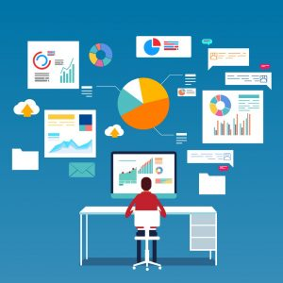
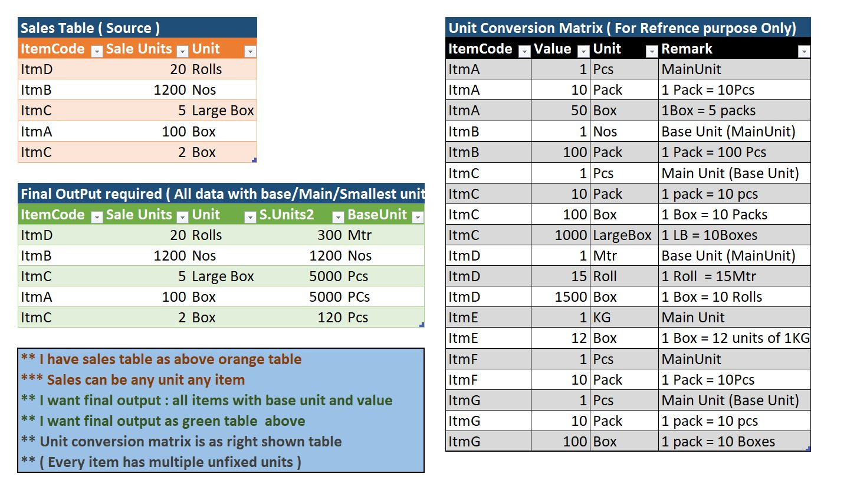
ABOUT ME
02
Definition
Platform with engine to generate adhoc reports, with advance tuning query techniques.

Slide 3

ABOUT ME
02
Targeted Audience
Technicians who handle the end-customer daily requests.

Slide 4

ABOUT ME
02
Scenario
Urgent report request from the manager

Slide 5


ABOUT ME
02
Scenario
Urgent report request from the manager
How manager see employees
The Truth

Slide 6

ABOUT ME
02
Targeted Audience
CEO, Department managers

Slide 7

How it works
08

Slide 8
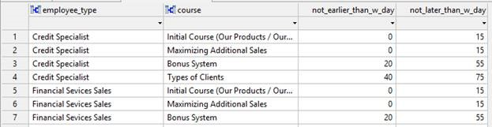
How it works
08
Attributes
Filters

Slide 9
Added Values
06
Optimization
Naming Convention
Scalability
Authentication

Slide 10
Demo!

