Slide 1
1
CHAPTER
Basic
Concepts of
Thermodynamics

Slide 2
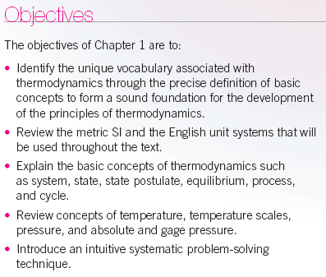

Slide 3
Nomenclature
A area (m²)
C_{P} specific heat at constant pressure (kJ/(kg⋅K))
C_{V} specific heat at constant volume (kJ/(kg⋅K))
COP coefficient of performance
d exact differential
E stored energy (kJ)
e stored energy per unit mass (kJ/kg)
F force (N)
g acceleration of gravity ( 9.807 m/s²)
H enthalpy (H= U + PV) (kJ)
h specific enthalpy (h= u + Pv) (kJ/kg)
h convective heat transfer coefficient (W/(m²⋅K)
K Kelvin degrees
k specific heat ratio, C_{P}/C_{V}
k 10³
k_{t} thermal conductivity (W/(m-°C))
M molecular weight or molar mass (kg/kmol)
M 10⁶
m mass (kg)
N moles (kmol)
n polytropic exponent (isentropic process, ideal gas n = k)
η isentropic efficiency for turbines, compressors, nozzles
η_{th} thermal efficiency (net work done/heat added)
P pressure (kPa, MPa, psia, psig)
Pa Pascal (N/m²)

Slide 4



Nomenclature con’t
Q_{net} net heat transfer (∑Q_{in} - ∑Q_{out}) (kJ)
q_{net} Q_{net} /m, net heat transfer per unit mass (kJ/kg)
R particular gas constant (kJ/(kg⋅K))
R_{u} universal gas constant (= 8.314 kJ/(kmol⋅K) )
S entropy (kJ/K)
s specific entropy (kJ/(kg⋅K))
T temperature ( °C, K, °F, R)
U internal energy (kJ)
u specific internal energy (kJ/(kg ⋅K))
V volume (m³ )
volume flow rate (m³/s)
velocity (m/s)
v specific volume (m³/kg)
molar specific volume (m³/kmol)
X distance (m)
X exergy (kJ)
x quality
Z elevation (m)
W_{net} net work done [(∑W_{out} - ∑W_{in})_{other} + W_{b}] (kJ) where W_{b} = for closed systems and 0 for control volumes
w_{net} W_{net} /m, net work done per unit mass (kJ/kg)
W_{t} weight (N)
δ inexact differential
ε regenerator effectiveness
ϕ relative humidity
ρ density (kg/m³)
ω humidity ratio

Slide 5
Subscripts, superscripts
A actual
B boundary
F saturated liquid state
G saturated vapor state
fg saturated vapor value minus saturated liquid value
gen generation
H high temperature
HP heat pump
L low temperature
net net heat added to system or net work done by system
other work done by shaft and electrical means
P constant pressure
REF refrigerator
rev reversible
s isentropic or constant entropy or reversible, adiabatic
sat saturation value
v constant volume
1 initial state
2 finial state
i inlet state
e exit state
⋅ per unit time

Slide 6
INTRODUCTION
The study of thermodynamics is concerned with the ways energy is stored within a body and how energy transformations, which involve heat and work, may take place. One of the most fundamental laws of nature is the conservation of energy principle. It simply states that during an energy interaction, energy can change from one form to another but the total amount of energy remains constant. That is, energy cannot be created or destroyed.
This review of thermodynamics is based on the macroscopic approach where a large number of particles, called molecules, make up the substance in question. The macroscopic approach to thermodynamics does not require knowledge of the behavior of individual particles and is called classical thermodynamics. It provides a direct and easy way to obtain the solution of engineering problems without being overly cumbersome. A more elaborate approach, based on the average behavior of large groups of individual particles, is called statistical thermodynamics. This microscopic approach is rather involved and is not reviewed here and leads to the definition of the second law of thermodynamics. We will approach the second law of thermodynamics from the classical point of view and will learn that the second law of thermodynamics asserts that energy has quality as well as quantity, and actual processes occur in the direction of decreasing quality of energy.

Slide 7
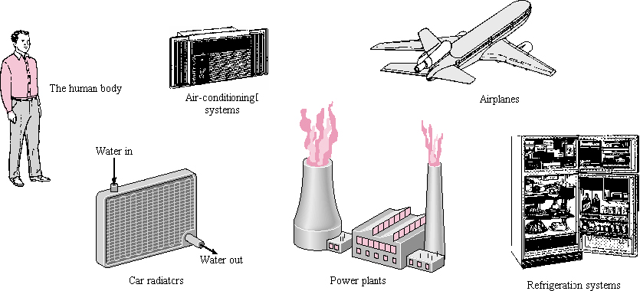
Applications of Thermodynamics
1-1
The human body
Air-conditioning
systems
Airplanes
Car radiators
Power plants
Refrigeration systems

Slide 8
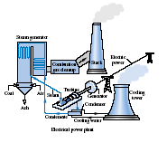
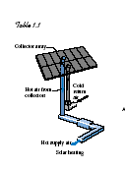



Slide 9
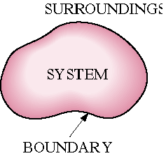
Closed, Open, and Isolated Systems
A thermodynamic system, or simply system, is defined as a quantity of matter or a region in space chosen for study. The region outside the system is called the surroundings. The real or imaginary surface that separates the system from its surroundings is called the boundary. The boundary of a system may be fixed or movable.
Surroundings are physical space outside the system boundary.
Systems may be considered to be closed or open, depending on whether a fixed mass or a fixed volume in space is chosen for study.

Slide 10
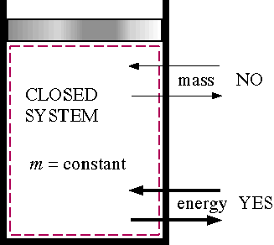
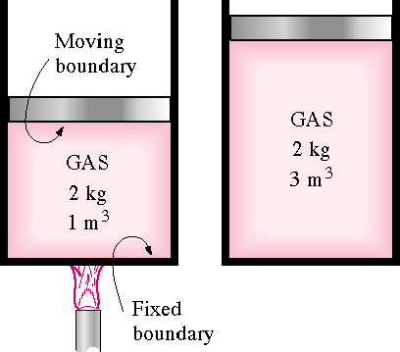
A closed system consists of a fixed amount of mass and no mass may cross the system boundary. The closed system boundary may move.
Examples of closed systems are sealed tanks and piston cylinder devices (note the volume does not have to be fixed). However, energy in the form of heat and work may cross the boundaries of a closed system.

Slide 11
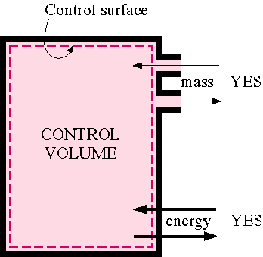
An open system, or control volume, has mass as well as energy crossing the boundary, called a control surface. Examples of open systems are pumps, compressors, turbines, valves, and heat exchangers.
An isolated system is a general system of fixed mass where no heat or work may cross the boundaries. An isolated system is a closed system with no energy crossing the boundaries and is normally a collection of a main system and its surroundings that are exchanging mass and energy among themselves and no other system.
Isolated System Boundary
Heat = 0
Work = 0
Mass = 0
Across
Isolated
Boundary
Work
Surr 4
Mass
System
Surr 3
Surr 1
Heat
Mass
Surr 2

Slide 12
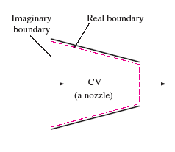
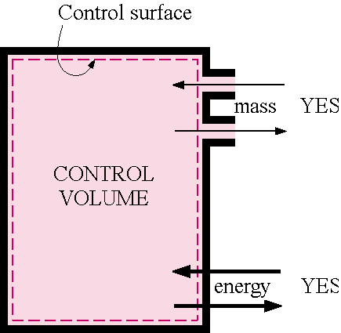
Since some of the thermodynamic relations that are applicable to closed and open systems are different, it is extremely important that we recognize the type of system we have before we start analyzing it.

Slide 13
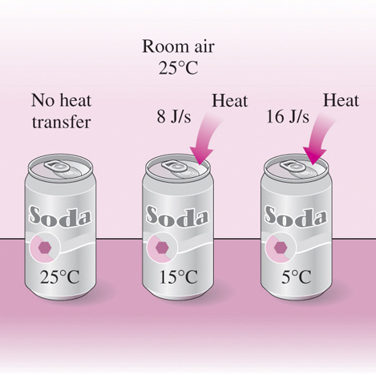

Slide 14
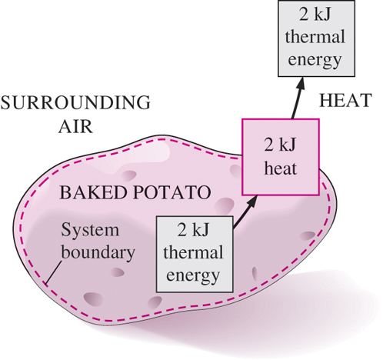

Slide 15
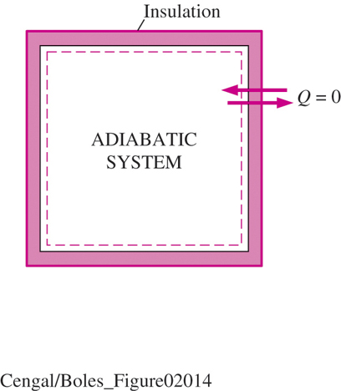

Slide 16
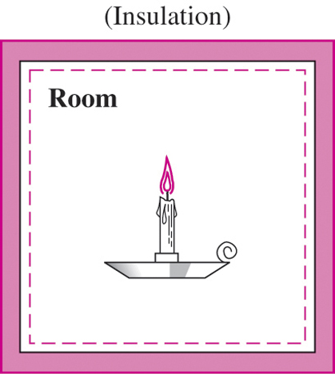

Slide 17
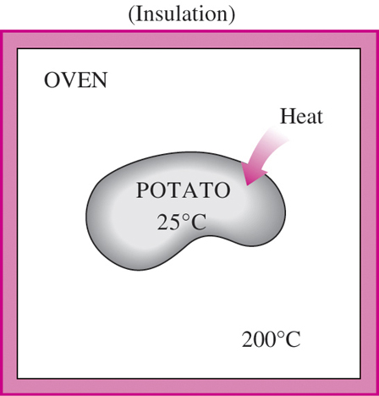

Slide 18
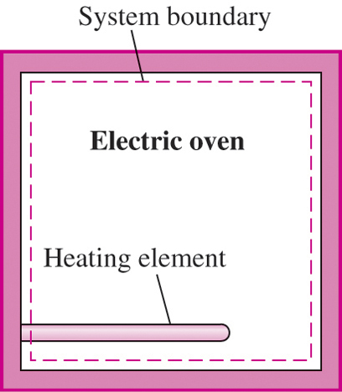

Slide 19
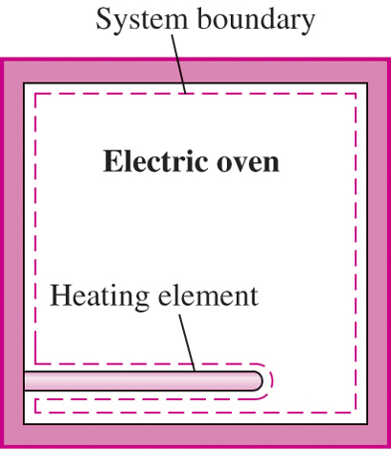

Slide 20
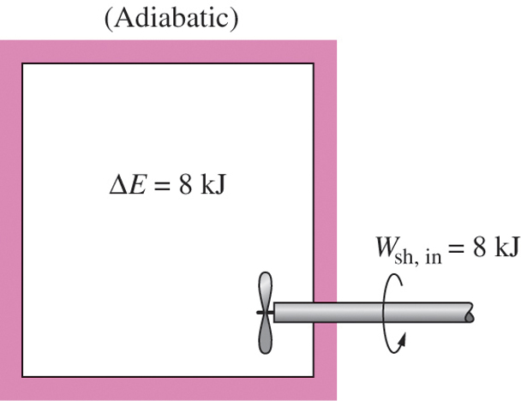

Slide 21
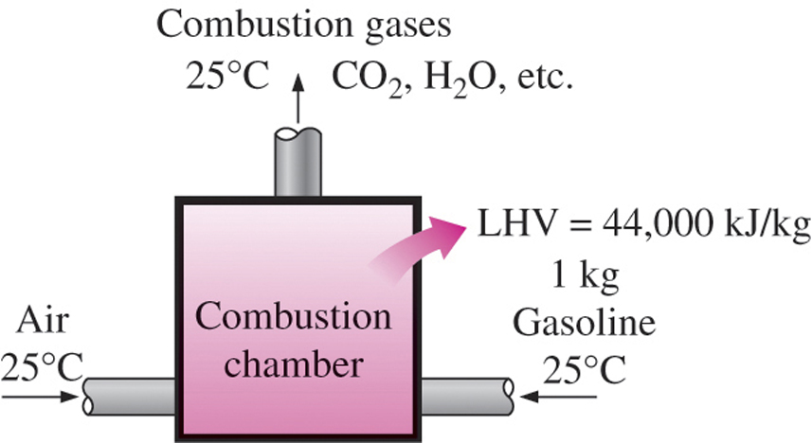
C.V.

Slide 22
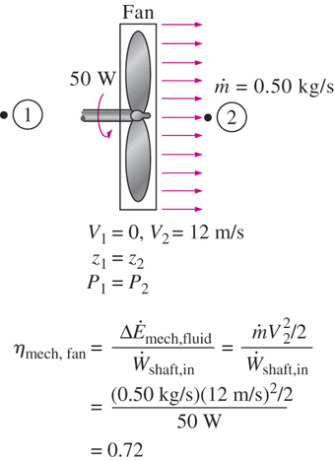
C.V.

Slide 23
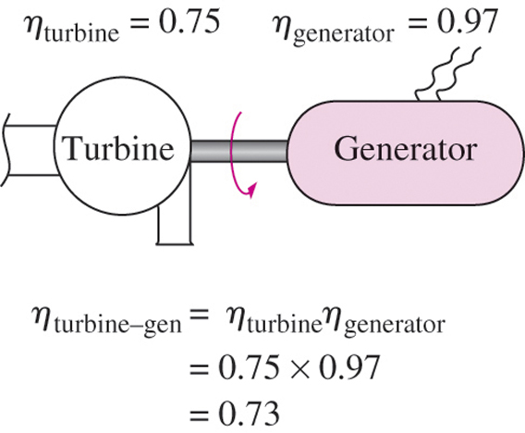
C.V.

Slide 24
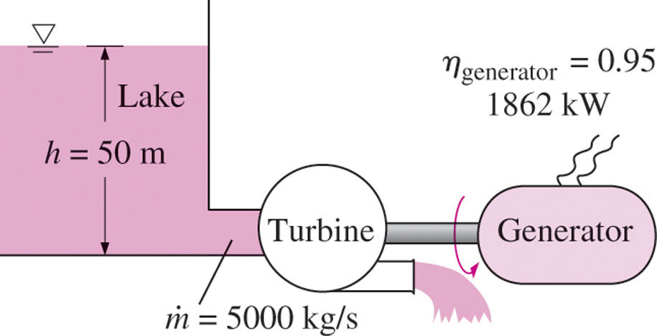
C.V.

Slide 25
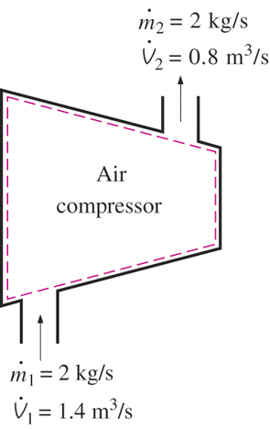

Slide 26
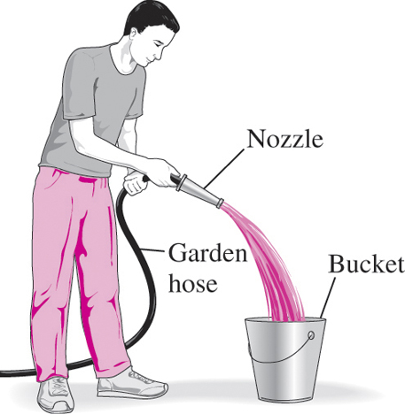

Slide 27
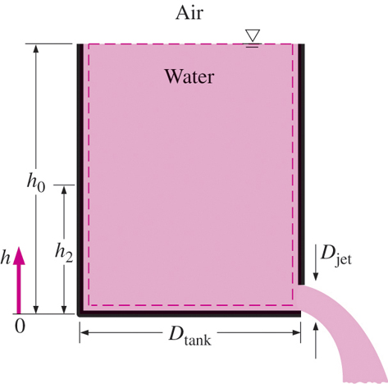

Slide 28
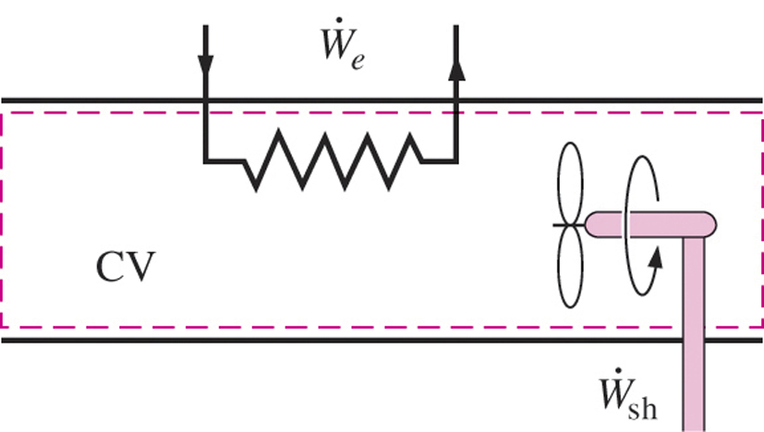

Slide 29
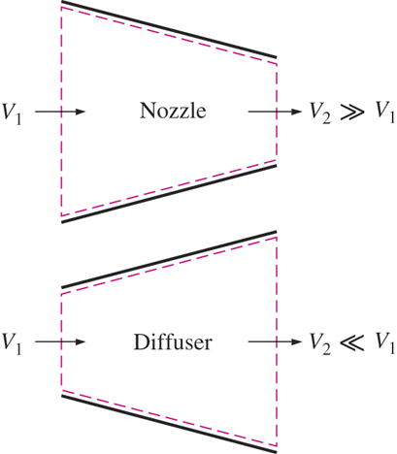

Slide 30
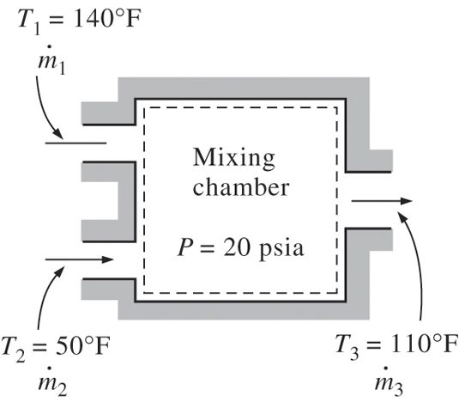

Slide 31
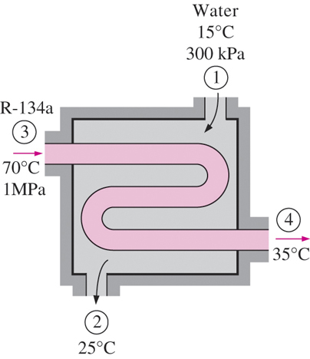

Slide 32
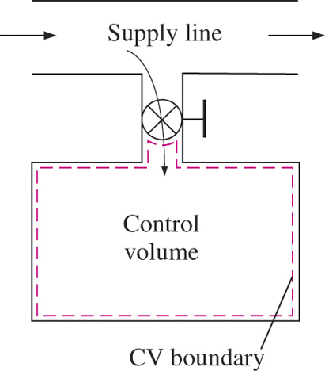

Slide 33
Properties of a System
Any characteristic of a system in equilibrium is called a property. The property is independent of the path used to arrive at the system condition.
Some thermodynamic properties are pressure P, temperature T, volume V, and mass m.
Properties may be intensive or extensive.
Extensive properties are those that vary directly with size--or extent--of the system.
Some Extensive Properties
a. mass
b. volume
c. total energy
d. mass dependent property

Slide 34
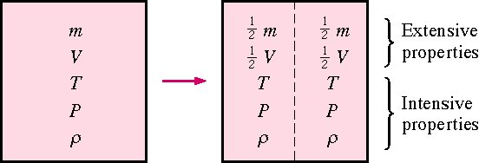
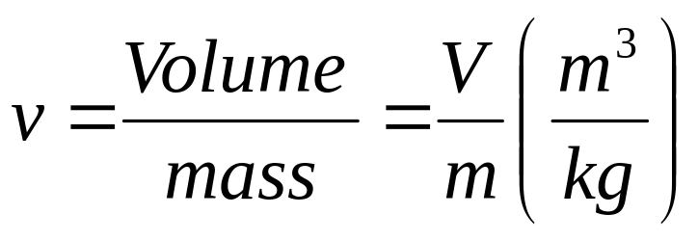
Intensive properties are those that are independent of size.
Some Intensive Properties
a. temperature
b. pressure
c. age
d. color
e. any mass independent property
Extensive properties per unit mass are intensive properties. For example, the specific volume v, defined as

Slide 35
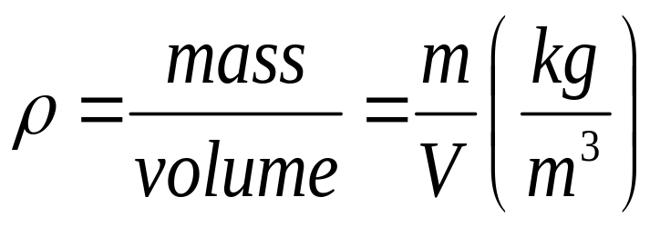
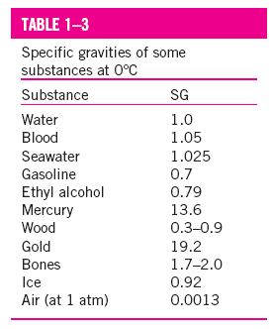

and density ρ, defined as
are intensive properties.

Slide 36
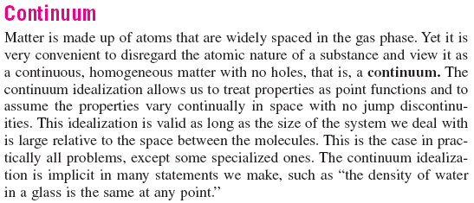
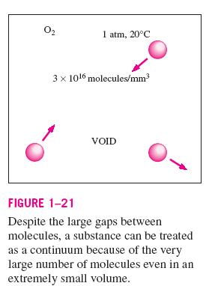

Slide 37
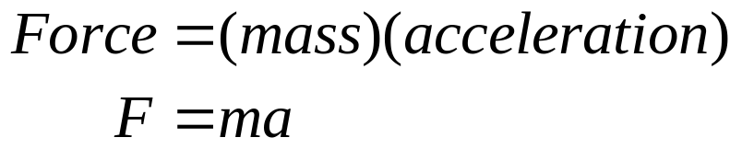
Units
An important component to the solution of any engineering thermodynamic problem requires the proper use of units. The unit check is the simplest of all engineering checks that can be made for a given solution. Since units present a major hindrance to the correct solution of thermodynamic problems, we must learn to use units carefully and properly. The system of units selected for this course is the SI System, also known as the International System (sometimes called the metric system). In SI, the units of mass, length, and time are the kilogram (kg), meter (m), and second (s), respectively. We consider force to be a derived unit from Newton's second law, i.e.,

Slide 38
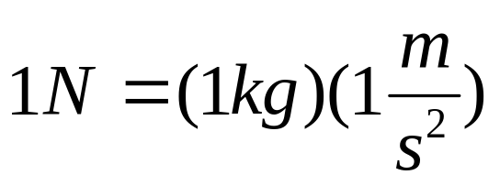
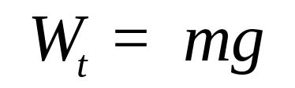
In SI, the force unit is the newton (N), and it is defined as the force required to accelerate a mass of 1 kg at a rate of 1 m/s². That is,
This definition of the newton is used as the basis of the conversion factor to convert mass-acceleration units to force units.
The term weight is often misused to express mass. Unlike mass, weight W_{t} is a force. Weight is the gravitational force applied to a body, and its magnitude is determined from Newton's second law,
where m is the mass of the body and g is the local gravitational acceleration (g is 9.807 m/s² at sea level and 45°latitude). The weight of a unit volume of a substance is called the specific weight w and is determined from w = ρ g, where ρ is density.
Oftentimes, the engineer must work in other systems of units. Comparison of the United States Customary System (USCS), or English System, and the slug system of units with the SI system is shown below.

Slide 39
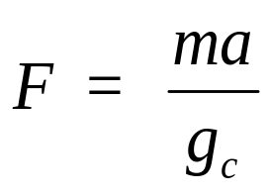
 | SI | USCS | Slug
Mass | Kilogram (kg) | Pound-mass (lbm) | Slug-mass (slug)
Time | Second (s) | Second (s) | Second (s)
Length | Meter (m) | Foot (ft) | Foot (ft)
Force | Newton (N) | Pound-force (lbf) | Pound-force (lbf)
Sometimes we use the mole number in place of the mass. In SI units the mole number is in kilogram-moles, or kmol.
Newton’s second law is often written as
where gc is called the gravitational constant and is obtained from the force definition. In the SI System 1 newton is that force required to accelerate 1 kg mass 1 m/s². The gravitational constant in the SI System is

Slide 40
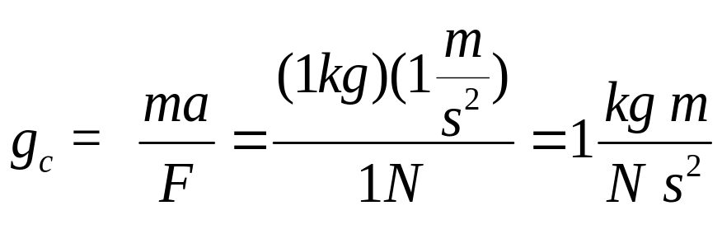
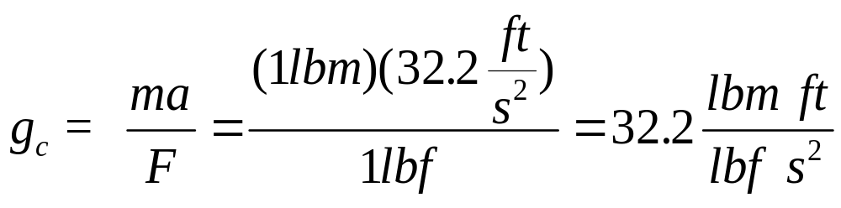
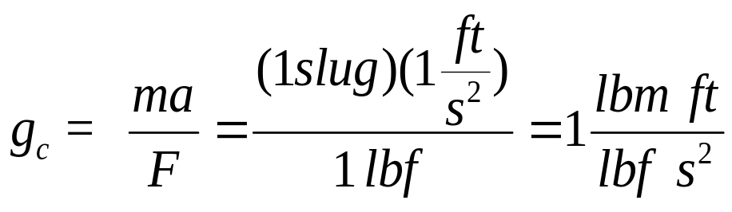
In the USCS 1 pound-force is that force required to accelerate 1 pound-mass 32.176 ft/s². The gravitational constant in the USCS is
In the slug system, the gravitational constant is

Slide 41
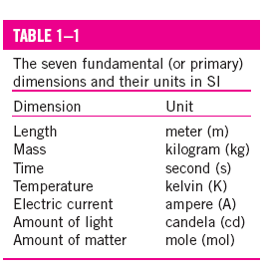
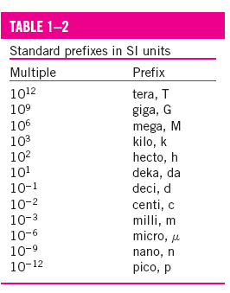

Slide 42
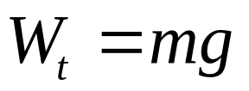
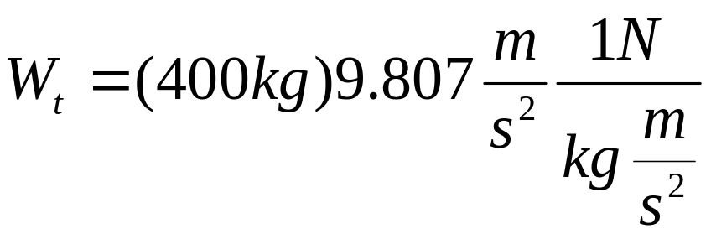

Example 1-1
An object at sea level has a mass of 400 kg.
a) Find the weight of this object on earth.
b) Find the weight of this object on the moon where the local gravitational acceleration is one-sixth that of earth.
(a)
Note the use of the conversion factor to convert mass-acceleration units into force units.

Slide 43
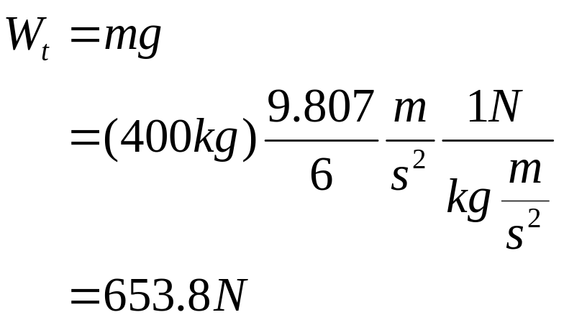
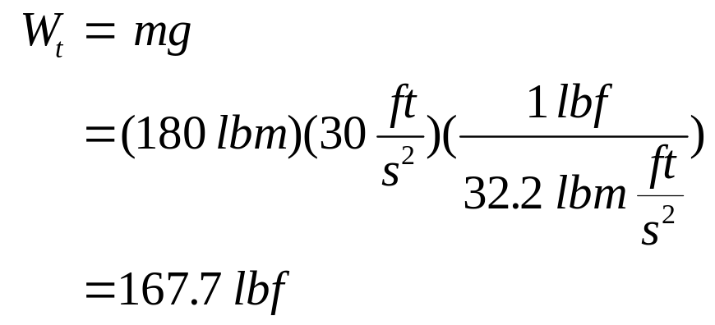
(b)
Example 1-2E
An object has a mass of 180 lbm. Find the weight of this object at a location where the local gravitational acceleration is 30 ft/s².

Slide 44
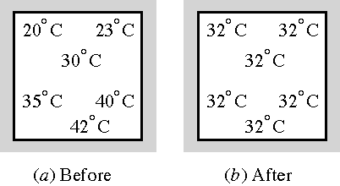
State, Equilibrium, Process, and Properties State
Consider a system that is not undergoing any change. The properties can be measured or calculated throughout the entire system. This gives us a set of properties that completely describe the condition or state of the system. At a given state all of the properties are known; changing one property changes the state.
Equilibrium
A system is said to be in thermodynamic equilibrium if it maintains thermal (uniform temperature), mechanical (uniform pressure), phase (the mass of two phases, e.g., ice and liquid water, in equilibrium) and chemical equilibrium.

Slide 45

Process
Any change from one state to another is called a process. During a quasi-equilibrium or quasi-static process the system remains practically in equilibrium at all times. We study quasi-equilibrium processes because they are easy to analyze (equations of state apply) and work-producing devices deliver the most work when they operate on the quasi-equilibrium process.
In most of the processes that we will study, one thermodynamic property is held constant. Some of these processes are
Process | Property held constant
isobaric | pressure
isothermal | temperature
isochoric | volume
isentropic | entropy (see Chapter 7)

Slide 46

We can understand the concept of a constant pressure process by considering the above figure. The force exerted by the water on the face of the piston has to equal the force due to the combined weight of the piston and the bricks. If the combined weight of the piston and bricks is constant, then F is constant and the pressure is constant even when the water is heated.
System
Boundary
F
Water
Constant Pressure Process
We often show the process on a P-V diagram as shown below.

Slide 48

Steady-Flow Process
Consider a fluid flowing through an open system or control volume such as a water heater. The flow is often defined by the terms steady and uniform. The term steady implies that there are no changes with time. The term uniform implies no change with location over a specified region. Engineering flow devices that operate for long periods of time under the same conditions are classified as steady-flow devices. The processes for these devices is called the steady-flow process. The fluid properties can change from point to point with in the control volume, but at any fixed point the properties remain the same during the entire process.

Slide 49
State Postulate
As noted earlier, the state of a system is described by its properties. But by experience not all properties must be known before the state is specified. Once a sufficient number of properties are known, the state is specified and all other properties are known. The number of properties required to fix the state of a simple, homogeneous system is given by the state postulate:
The thermodynamic state of a simple compressible system is completely specified by two independent, intensive properties.

Slide 50
Cycle
A process (or a series of connected processes) with identical end states is called a cycle. Below is a cycle composed of two processes, A and B. Along process A, the pressure and volume change from state 1 to state 2. Then to complete the cycle, the pressure and volume change from state 2 back to the initial state 1 along process B. Keep in mind that all other thermodynamic properties must also change so that the pressure is a function of volume as described by these two processes.
2
P
Process
B
1
Process
A
V

Slide 51


Pressure
Force per unit area is called pressure, and its unit is the pascal, N/m², in the SI system and psia, lbf/in² absolute, in the English system.

Slide 52

The pressure used in all calculations of state is the absolute pressure measured relative to absolute zero pressure. However, pressures are often measured relative to atmospheric pressure, called gage or vacuum pressures. In the English system the absolute pressure and gage pressures are distinguished by their units, psia (pounds force per square inch absolute) and psig (pounds force per square inch gage), respectively; however, the SI system makes no distinction between absolute and gage pressures.

Slide 53


Slide 54




These pressures are related by
Or these last two results may be written as
Where the +P_{gage} is used when P_{abs} > P_{atm} and –P_{gage} is used for a vacuum gage.
The relation among atmospheric, gage, and vacuum pressures is shown below.

Slide 55


Some values of 1 atm of pressure are 101.325 kPa, 0.101325 MPa, 14.696 psia, 760 mmHg, and 29.92 inches H₂O.
Small to moderate pressure differences are measured by a manometer and a differential fluid column of height h corresponds to a pressure difference between the system and the surroundings of the manometer.
This pressure difference is determined from the manometer fluid displaced height as
The text gives an extensive review of the manometer pressure relations. For further study of the manometer pressure relations, see the text.
Other devices for measuring pressure differences are shown below.

Slide 56


Example 1-3
A vacuum gage connected to a tank reads 30 kPa at a location where the atmospheric pressure is 98 kPa. What is the absolute pressure in the tank?

Slide 57



Example 1-4
A pressure gage connected to a valve stem of a truck tire reads 240 kPa at a location where the atmospheric pressure is 100 kPa. What is the absolute pressure in the tire, in kPa and in psia?
The pressure in psia is
What is the gage pressure of the air in the tire, in psig?

Slide 58


Check the side walls of the tires on your car or truck. What is the maximum allowed pressure? Is this pressure in gage or absolute values?
Example 1-5
Both a gage and a manometer are attached to a gas tank to measure its pressure. If the pressure gage reads 80 kPa, determine the distance between the two fluid levels of the manometer if the fluid is mercury, whose density is 13,600 kg/m³.

Slide 59


Slide 60


Slide 61

Temperature
Although we are familiar with temperature as a measure of “hotness” or “coldness,” it is not easy to give an exact definition of it. However, temperature is considered as a thermodynamic property that is the measure of the energy content of a mass. When heat energy is transferred to a body, the body's energy content increases and so does its temperature. In fact it is the difference in temperature that causes energy, called heat transfer, to flow from a hot body to a cold body. Two bodies are in thermal equilibrium when they have reached the same temperature. If two bodies are in thermal equilibrium with a third body, they are also in thermal equilibrium with each other. This simple fact is known as the zeroth law of thermodynamics.
The temperature scales used in the SI and the English systems today are the Celsius scale and Fahrenheit scale, respectively. These two scales are based on a specified number of degrees between the freezing point of water ( 0°C or 32°F) and the boiling point of water (100°C or 212°F) and are related by

Slide 62

Below is a comparison of the temperature scales.
°C
K
°F
R
99.975
373.125
211.955
671.625
Boiling
point
of water
at 1 atm
0.01
273.16
32.02
491.69
Triple
point of
water
Absolute
zero
-273.15
0
-459.67
0
This figure shows that that according to the International Temperature Scale of 1990 (ITS-90) the reference state for the thermodynamic temperature scale is the triple point of water, 0.01 °C. The ice point is 0°C, but the steam point is 99.975°C at 1 atm and not 100°C as was previously established. The magnitude of the kelvin, K, is 1/273.16 of the thermodynamic temperature of the triple point of water.

Slide 63


Slide 64


Slide 65




Example 1-6
Water boils at 212 °F at one atmosphere pressure. At what temperature does water boil in °C.
Like pressure, the temperature used in thermodynamic calculations must be in absolute units. The absolute scale in the SI system is the Kelvin scale, which is related to the Celsius scale by
In the English system, the absolute temperature scale is the Rankine scale, which is related to the Fahrenheit scale by
Also, note that

Slide 66


The magnitudes of each division of 1 K and 1°C are identical, and so are the magnitudes of each division of 1 R and 1°F. That is,

Slide 67
Chapter Summary
1-13
Thermodynamics is the science that primarily deals with energy.

Slide 68
Chapter Summary
1-14
The first law of thermodynamics is simply an expression of the conservation of energy principle, and it asserts that energy is a thermodynamic property.
The second law of thermodynamics asserts that energy has quality as well as quantity, and actual processes occur in the direction of decreasing quality of energy.

Slide 69
Chapter Summary
1-15
A system of fixed mass is called a closed system, or control mass, and a system that involves mass transfer across its boundaries is called an open system, or control volume.

Slide 70
Chapter Summary
1-16
The mass-dependent properties of a system are called extensive properties and the others, intensive properties. Density is mass per unit volume, and specific volume is volume per unit mass.

Slide 71
Chapter Summary
1-17
The sum of all forms of energy of a system is called total energy, which is considered to consist of internal, kinetic, and potential energies. Internal energy represents the molecular energy of a system and may exist in sensible, latent, chemical, and nuclear forms.

Slide 72
Chapter Summary
1-18
A system is said to be in thermodynamic equilibrium if it maintains thermal, mechanical, phase, and chemical equilibrium.

Slide 73
Chapter Summary
1-19
Any change from one state to another is called a process.
A process with identical end states is called a cycle.

Slide 74
Chapter Summary
1-20
During a quasi-static or quasi-equilibrium process, the system remains practically in equilibrium at all times.

Slide 75
Chapter Summary
1-21
The state of a simple, compressible system is completely specified by two independent, intensive properties.

Slide 76

Chapter Summary
1-22
Force per unit area is called pressure, and its unit is the pascal. The absolute, gage, and vacuum pressures are related by

Slide 77

Chapter Summary
1-23
Small to moderate pressure differences are measured by a manometer, and a differential fluid column of height h corresponds to a pressure difference of
where ρ is the fluid density and g is the local gravitational acceleration.

Slide 78

Chapter Summary
1-24
The atmospheric pressure is measured by a barometer and is determined from
where h is the height of the liquid column above the free surface.

Slide 79
Chapter Summary
1-25
The zeroth law of thermodynamics states that two bodies are in thermal equilibrium if both have the same temperature reading even if they are not in contact.

Slide 80
Chapter Summary
1-26
The temperature scales used in the SI and the English system today are the Celsius scale and the Fahrenheit scale, respectively.

Slide 81

Chapter Summary
1-27
The absolute temperature scale in the SI is the Kelvin scale, which is related to the Celsius scale by

Slide 82

Chapter Summary
1-28
In the English system, the absolute temperature scale is the Rankine scale, which is related to the Fahrenheit scale by

Slide 83

Chapter Summary
1-29
The magnitudes of each division of 1 K and
1 ⁰C are identical, and so are the magnitude of each division of 1 R and 1⁰F. Therefore,
and

Slide 84
Chapter Summary
1-30
An important application area of thermodynamics is the biological system. Most diets are based on the simple energy balance: the net energy gained by a person in the form of fat is equal to the difference between the energy intake from food and the energy expended by exercise.

Slide 85


Slide 86


Slide 87


Slide 88



Slide 89


Slide 90


