Slide 1
Chapter 2
Energy, Energy Transfer, and General Energy Analysis

Slide 2
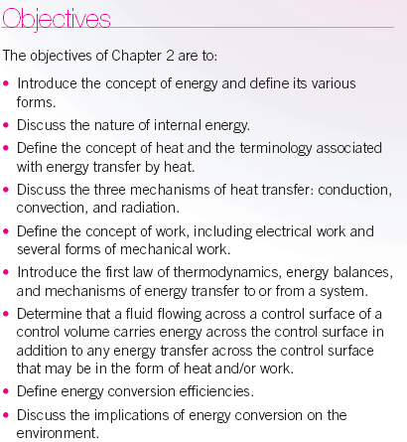

Slide 3

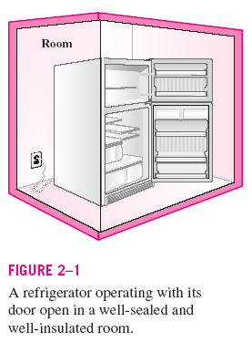

Slide 4

We will soon learn how to apply the first law of thermodynamics as the expression of the conservation of energy principle. But, first we study the ways in which energy may be transported across the boundary of a general thermodynamic system. For closed systems (fixed mass systems) energy can cross the boundaries of a closed system only in the form of heat or work. For open systems or control volumes energy can cross the control surface in the form of heat, work, and energy transported by the mass streams crossing the control surface. We now consider each of these modes of energy transport across the boundaries of the general thermodynamic system.
Energy
Consider the system shown below moving with a velocity, at an elevation Z relative to the reference plane.
Energy of system:
Kinetic energy
Potential energy
Internal energy
General
System
CM
Z
Reference Plane, Z=0

Slide 5
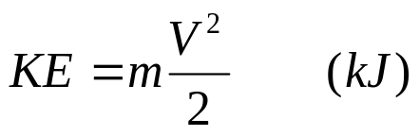


The total energy E of a system is the sum of all forms of energy that can exist within the system such as thermal, mechanical, kinetic, potential, electric, magnetic, chemical, and nuclear. The total energy of the system is normally thought of as the sum of the internal energy, kinetic energy, and potential energy. The internal energy U is that energy associated with the molecular structure of a system and the degree of the molecular activity (see Section 2-1 of text for more detail). The kinetic energy KE exists as a result of the system's motion relative to an external reference frame. When the system moves with velocity the kinetic energy is expressed as
The energy that a system possesses as a result of its elevation in a gravitational field relative to the external reference frame is called potential energy PE and is expressed as
where g is the gravitational acceleration and z is the elevation of the center of gravity of a system relative to the reference frame. The total energy of the system is expressed as
or, on a unit mass basis,

Slide 6
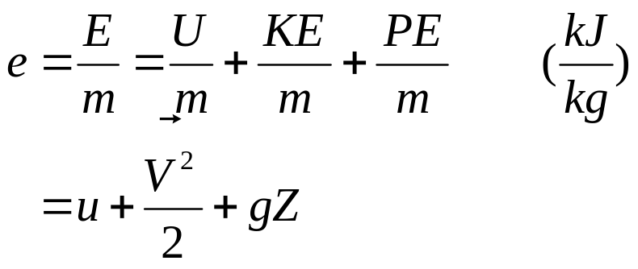

where e = E/m is the specific stored energy, and u = U/m is the specific internal energy. The change in stored energy of a system is given by
Most closed systems remain stationary during a process and, thus, experience no change in their kinetic and potential energies. The change in the stored energy is identical to the change in internal energy for stationary systems.
If ΔKE = ΔPE = 0,

Slide 7
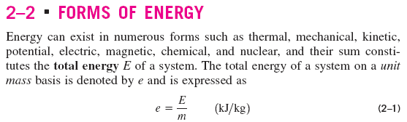
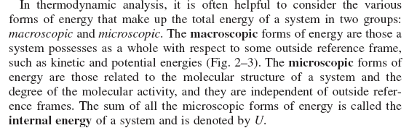

Slide 8
Energy
Transient:
-Heat
- Work
Related to mass:
K.E -P.E
F.E -I.E

Slide 9
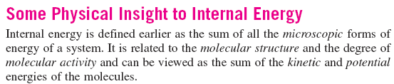
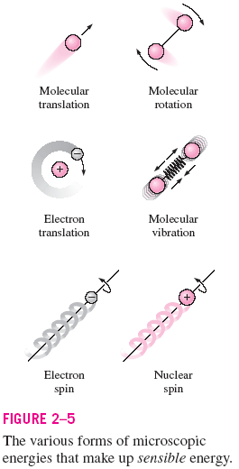
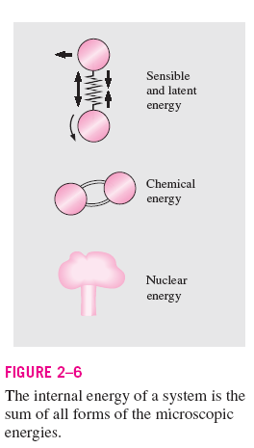

Slide 10
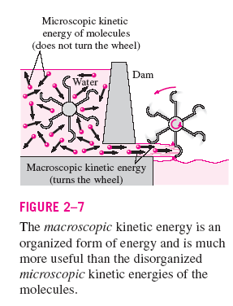

Slide 11

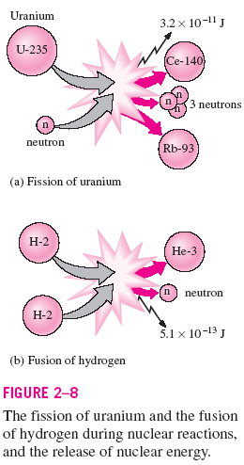

Slide 12
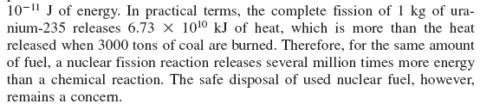

Slide 13
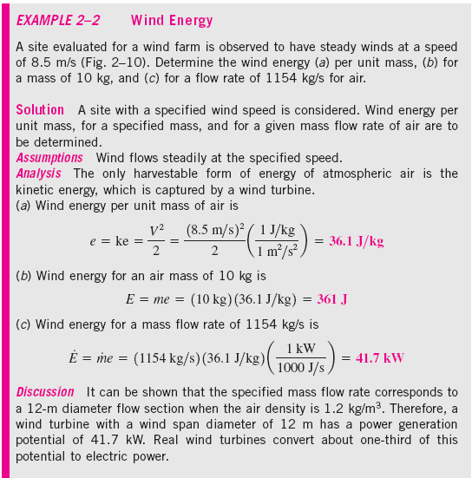

Slide 14
Energy Transport by Heat and Work and the Classical Sign Convention
Energy may cross the boundary of a closed system only by heat or work.
Energy transfer across a system boundary due solely to the temperature difference between a system and its surroundings is called heat.
Energy transferred across a system boundary that can be thought of as the energy expended to lift a weight is called work.
Heat and work are energy transport mechanisms between a system and its surroundings. The similarities between heat and work are as follows:
1.Both are recognized at the boundaries of a system as they cross the boundaries. They are both boundary phenomena.
2.Systems possess energy, but not heat or work.
3.Both are associated with a process, not a state. Unlike properties, heat or work has no meaning at a state.
4.Both are path functions (i.e., their magnitudes depends on the path followed during a process as well as the end states.

Slide 15
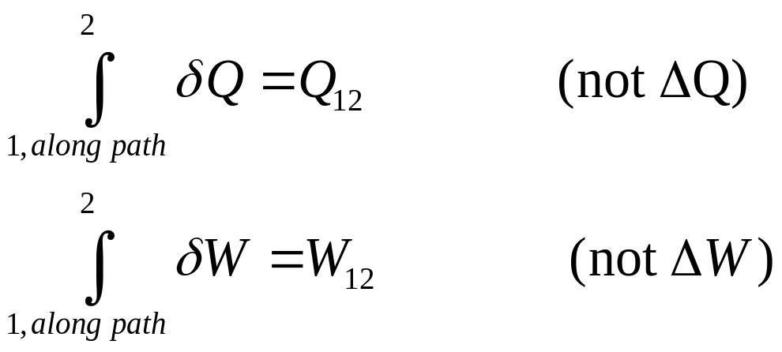
Since heat and work are path dependent functions, they have inexact differentials designated by the symbol δ. The differentials of heat and work are expressed as δQ and δW. The integral of the differentials of heat and work over the process path gives the amount of heat or work transfer that occurred at the system boundary during a process.
That is, the total heat transfer or work is obtained by following the process path and adding the differential amounts of heat (δQ) or work (δW) along the way. The integrals of δQ and δW are not Q₂ – Q₁ and W₂ – W₁, respectively, which are meaningless since both heat and work are not properties and systems do not possess heat or work at a state.
The following figure illustrates that properties (P, T, v, u, etc.) are point functions, that is, they depend only on the states. However, heat and work are path functions, that is, their magnitudes depend on the path followed.

Slide 16
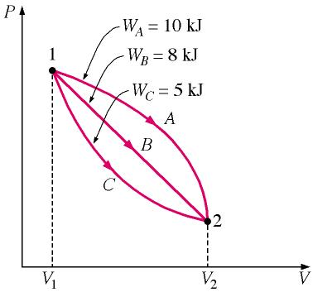
700 kPa
100 kPa
0.01 m³ 0.03 m³
A sign convention is required for heat and work energy transfers, and the classical thermodynamic sign convention is selected for these notes. According to the classical sign convention, heat transfer to a system and work done by a system are positive; heat transfer from a system and work a system are negative. The system shown below has heat supplied to it and work done by it.
In this study guide we will use the concept of net heat and net work.

Slide 17
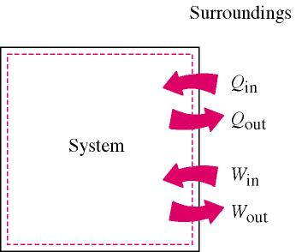
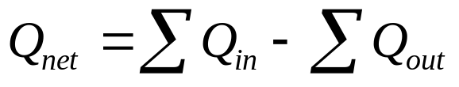
System
Boundary
Energy Transport by Heat
Recall that heat is energy in transition across the system boundary solely due to the temperature difference between the system and its surroundings. The net heat transferred to a system is defined as
Here, Q_{in} and Q_{out} are the magnitudes of the heat transfer values. In most thermodynamics texts, the quantity Q is meant to be the net heat transferred to the system, Q_{net}. Since heat transfer is process dependent, the differential of heat transfer δQ is called inexact. We often think about the heat transfer per unit mass of the system, Q.

Slide 18
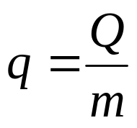
Heat transfer has the units of energy measured in joules (we will use kilojoules, kJ) or the units of energy per unit mass, kJ/kg.
Since heat transfer is energy in transition across the system boundary due to a temperature difference, there are three modes of heat transfer at the boundary that depend on the temperature difference between the boundary surface and the surroundings. These are conduction, convection, and radiation. However, when solving problems in thermodynamics involving heat transfer to a system, the heat transfer is usually given or is calculated by applying the first law, or the conservation of energy, to the system.
An adiabatic process is one in which the system is perfectly insulated and the heat transfer is zero.

Slide 19
Introduction to the Basic Heat Transfer Mechanisms
For those of us who do not have the opportunity to have a complete course in heat transfer theory and applications, the following is a short introduction to the basic mechanisms of heat transfer. Those of us who have a complete course in heat transfer theory may elect to omit this material at this time.
Heat transfer is energy in transition due to a temperature difference. The three modes of heat transfer are conduction, convection, and radiation.

Slide 20
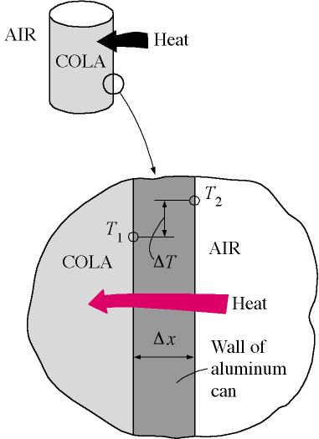
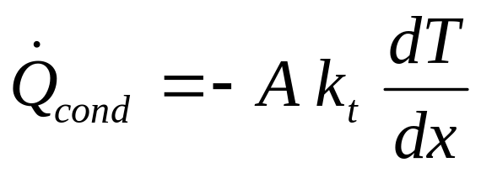


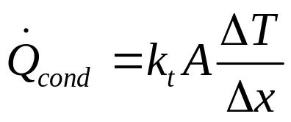
Conduction through Plane Walls
Conduction heat transfer is a progressive exchange of energy between the molecules of a substance.
Fourier's law of heat conduction is
here
= heat flow per unit time (W)
k_{t} = thermal conductivity (W/m⋅K)
A = area normal to heat flow (m²)
= temperature gradient in the direction of heat flow (°C/m)
Integrating Fourier's law
Since T₂>T₁, the heat flows from right to left in the above figure.

Slide 21
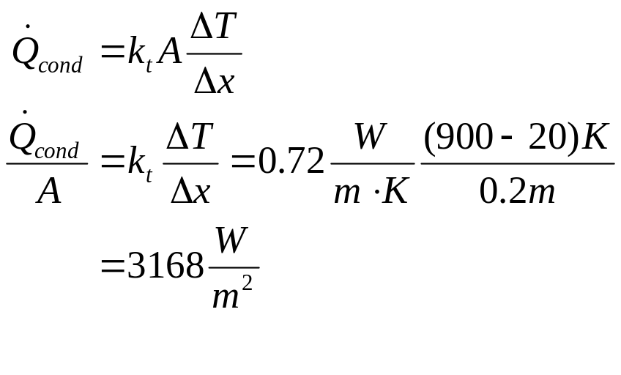
Example 2-1
A flat wall is composed of 20 cm of brick having a thermal conductivity k_{t} = 0.72 W/m⋅K. The right face temperature of the brick is 900°C, and the left face temperature of the brick is 20°C. Determine the rate of heat conduction through the wall per unit area of wall.
T_{right} = 900°C
T_{left} = 20°C
20 cm

Slide 22
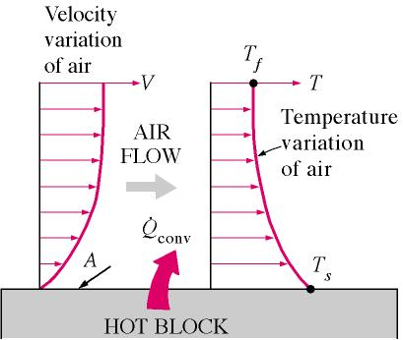
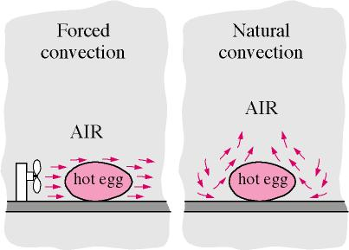

Convection Heat Transfer
Convection heat transfer is the mode of energy transfer between a solid surface and the adjacent liquid or gas that is in motion, and it involves the combined effects of conduction and fluid motion.
The rate of heat transfer by convection is determined from Newton's law of cooling, expressed as

Slide 23
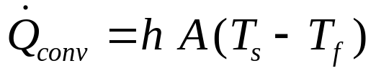
here
= heat transfer rate (W)
A = heat transfer area (m²)
h = convective heat transfer coefficient (W/m²⋅K)
T_{s} = surface temperature (K)
T_{f} = bulk fluid temperature away from the surface (K)
The convective heat transfer coefficient is an experimentally determined parameter that depends upon the surface geometry, the nature of the fluid motion, the properties of the fluid, and the bulk fluid velocity. Ranges of the convective heat transfer coefficient are given below.
h W/m²⋅K
free convection of gases 2-25
free convection of liquids 50-100
forced convection of gases 25-250
forced convection of liquids 50-20,000
convection in boiling and condensation 2500-100,000

Slide 24
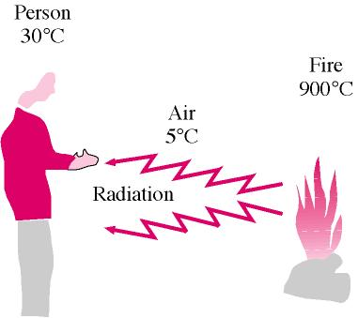
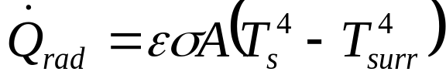
Radiative Heat Transfer
Radiative heat transfer is energy in transition from the surface of one body to the surface of another due to electromagnetic radiation. The radiative energy transferred is proportional to the difference in the fourth power of the absolute temperatures of the bodies exchanging energy.

Slide 25

here
= heat transfer per unit time (W)
A = surface area for heat transfer (m²)
σ = Stefan-Boltzmann constant, 5.67x10⁻⁸ W/m²K⁴ and 0.1713x10⁻⁸ BTU/h ft² R⁴
ε = emissivity
T_{s} = absolute temperature of surface (K)
T_{surr} = absolute temperature of surroundings (K)
Example 2-2
A vehicle is to be parked overnight in the open away from large surrounding objects. It is desired to know if dew or frost may form on the vehicle top. Assume the following:
  Convection coefficient h from ambient air to vehicle top is 6.0 W/m²⋅°C.
  Equivalent sky temperature is -18°C.
  Emissivity of vehicle top is 0.84.
  Negligible conduction from inside vehicle to top of vehicle.
Determine the temperature of the vehicle top when the air temperature is 5ºF. State which formation (dew or frost) occurs.

Slide 26
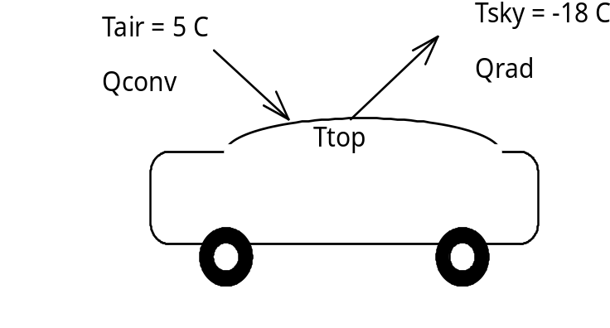

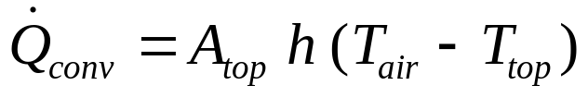
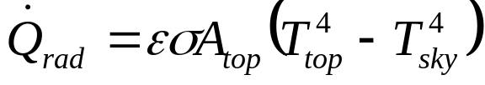
Under steady-state conditions, the energy convected to the vehicle top is equal to the energy radiated to the sky.
The energy convected from the ambient air to the vehicle top is
The energy radiated from the top to the night sky is
Setting these two heat transfers equal gives

Slide 27
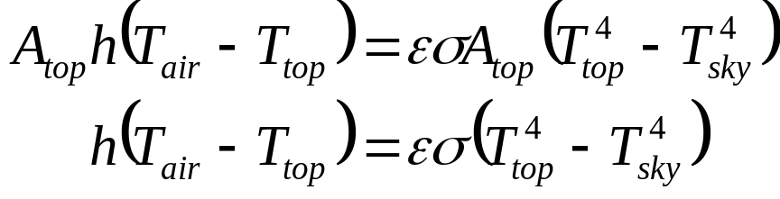
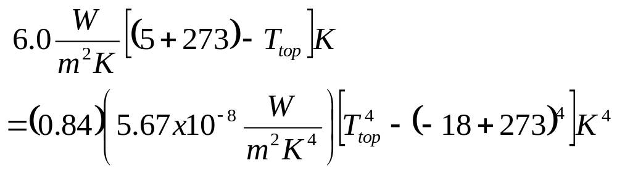
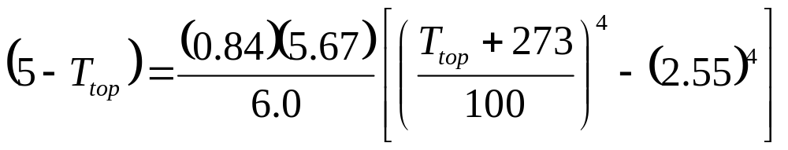

Write the equation for T_{top} in C (T K = TC + 273)
Using the EES software package
Since T_{top} is below the triple point of water, 0.01°C, the water vapor in the air will form frost on the car top (see Chapter 14).

Slide 28
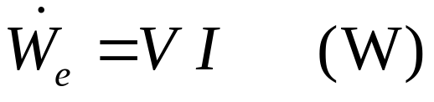
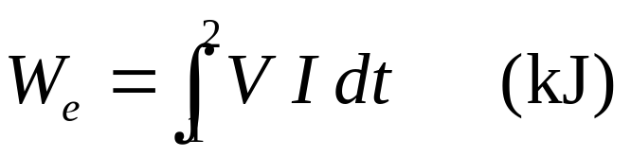
Extra Problem
Explore what happens to T_{top} as you vary the convective heat transfer coefficient. On a night when the atmosphere is particularly still and cold and has a clear sky, why do fruit growers use fans to increase the air velocity in their fruit groves?
Energy Transfer by Work
Electrical Work
The rate of electrical work done by electrons crossing a system boundary is called electrical power and is given by the product of the voltage drop in volts and the current in amps.
The amount of electrical work done in a time period is found by integrating the rate of electrical work over the time period.

Slide 29
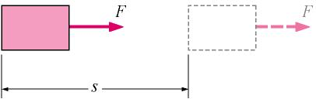
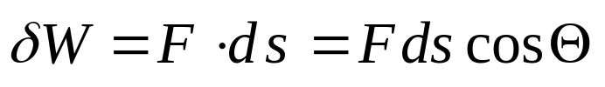
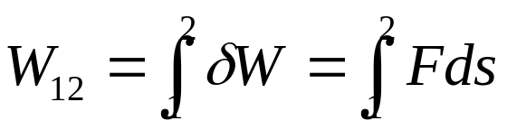
Mechanical Forms of Work
Work is energy expended by a force acting through a distance. Thermodynamic work is defined as energy in transition across the system boundary and is done by a system if the sole effect external to the boundaries could have been the raising of a weight.
Mathematically, the differential of work is expressed as
here Θ is the angle between the force vector and the displacement vector.
As with the heat transfer, the Greek symbol δ means that work is a path-dependent function and has an inexact differential. If the angle between the force and the displacement is zero, the work done between two states is

Slide 30
Work has the units of energy and is defined as force times displacement or newton times meter or joule (we will use kilojoules). Work per unit mass of a system is measured in kJ/kg.
Common Types of Mechanical Work Energy (See text for discussion of these topics)
  Shaft Work
  Spring Work
  Work done of Elastic Solid Bars
  Work Associated with the Stretching of a Liquid Film
  Work Done to Raise or to Accelerate a Body
Net Work Done By A System
The net work done by a system may be in two forms other work and boundary work. First, work may cross a system boundary in the form of a rotating shaft work, electrical work or other the work forms listed above. We will call these work forms “other” work, that is, work not associated with a moving boundary. In thermodynamics electrical energy is normally considered to be work energy rather than heat energy; however, the placement of the system boundary dictates whether

Slide 31
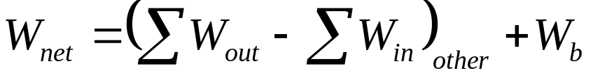
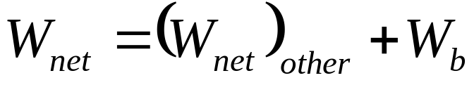
to include electrical energy as work or heat. Second, the system may do work on its surroundings because of moving boundaries due to expansion or compression processes that a fluid may experience in a piston-cylinder device.
The net work done by a closed system is defined by
Here, W_{out} and Win are the magnitudes of the other work forms crossing the boundary. W_{b} is the work due to the moving boundary as would occur when a gas contained in a piston cylinder device expands and does work to move the piston. The boundary work will be positive or negative depending upon the process. Boundary work is discussed in detail in Chapter 4.
Several types of “other” work (shaft work, electrical work, etc.) are discussed in the text.

Slide 32
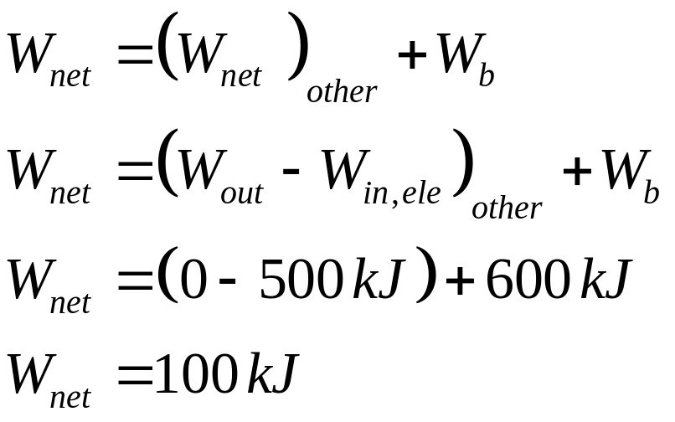
Example 2-3
A fluid contained in a piston-cylinder device receives 500 kJ of electrical work as the gas expands against the piston and does 600 kJ of boundary work on the piston. What is the net work done by the fluid?
W_{ele} =500 kJ
W_{b}=600 kJ

Slide 33
The First Law of Thermodynamics
The first law of thermodynamics is known as the conservation of energy principle. It states that energy can be neither created nor destroyed; it can only change forms. Joule’s experiments lead to the conclusion: For all adiabatic processes between two specified states of a closed system, the net work done is the same regardless of the nature of the closed system and the details of the process. A major consequence of the first law is the existence and definition of the property total energy E introduced earlier.

Slide 34
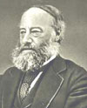
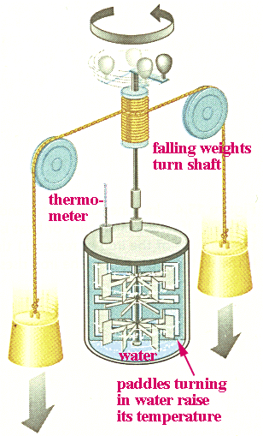
Mechanical Equivalent of Heat
Joule demonstrated that water can be heated by doing (mechanical) work, and showed that for every 4186 J of work done, the temperature of water rose by 1C⁰ per kg.

Slide 35
Mechanical Equivalent of Heat
Conversion between different units of heat:
1 cal = 10⁻³ kcal = 3.969 x 10⁻³ Btu = 4.186 J
1 Cal = 1 kcal=4186 J

Slide 36

The First Law and the Conservation of Energy
The first law of thermodynamics is an expression of the conservation of energy principle.
Energy can cross the boundaries of a closed system in the form of heat or work. Energy may cross a system boundary (control surface) of an open system by heat, work and mass transfer.
A system moving relative to a reference plane is shown below where z is the elevation of the center of mass above the reference plane and is the velocity of the center of mass.
System
CM
Energy_{in}
Energy_{out}
z
Reference Plane, z = 0

Slide 37
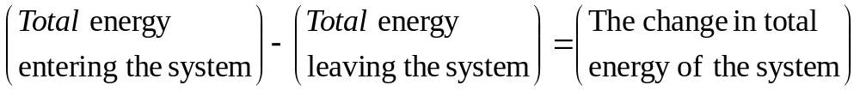

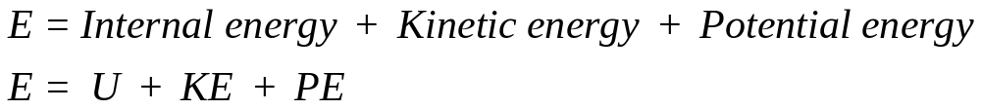
For the system shown above, the conservation of energy principle or the first law of thermodynamics is expressed as
or
Normally the stored energy, or total energy, of a system is expressed as the
sum of three separate energies. The total energy of the system, E_{system}, is given as
Recall that U is the sum of the energy contained within the molecules of the system other than the kinetic and potential energies of the system as a whole and is called the internal energy. The internal energy U is dependent on the state of the system and the mass of the system.
For a system moving relative to a reference plane, the kinetic energy KE and the potential energy PE are given by

Slide 38
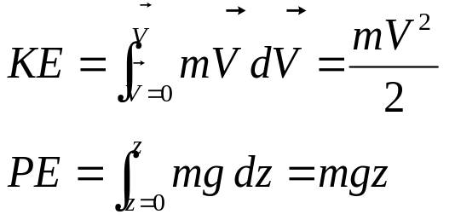



The change in stored energy for the system is
Now the conservation of energy principle, or the first law of thermodynamics for closed systems, is written as
If the system does not move with a velocity and has no change in elevation, it is called a stationary system, and the conservation of energy equation reduces to
Mechanisms of Energy Transfer, E_{in} and E_{out}
The mechanisms of energy transfer at a system boundary are: Heat, Work, mass flow. Only heat and work energy transfers occur at the boundary of a closed (fixed mass) system. Open systems or control volumes have energy transfer across the control surfaces by mass flow as well as heat and work.

Slide 39
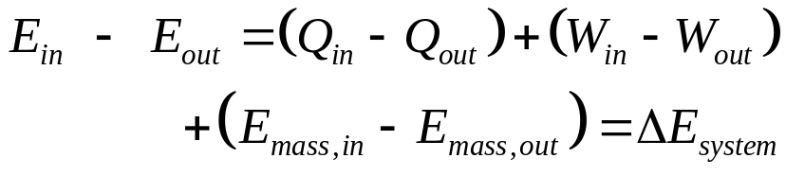
Heat Transfer, Q: Heat is energy transfer caused by a temperature difference between the system and its surroundings. When added to a system heat transfer causes the energy of a system to increase and heat transfer from a system causes the energy to decrease. Q is zero for adiabatic systems.
Work, W: Work is energy transfer at a system boundary could have caused a weight to be raised. When added to a system, the energy of the system increase; and when done by a system, the energy of the system decreases. W is zero for systems having no work interactions at its boundaries.
Mass flow, m: As mass flows into a system, the energy of the system increases by the amount of energy carried with the mass into the system. Mass leaving the system carries energy with it, and the energy of the system decreases. Since no mass transfer occurs at the boundary of a closed system, energy transfer by mass is zero for closed systems.
The energy balance for a general system is

Slide 40
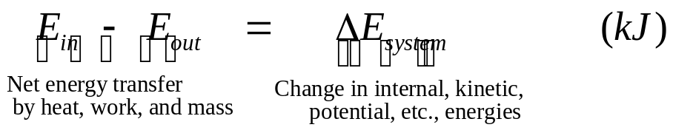
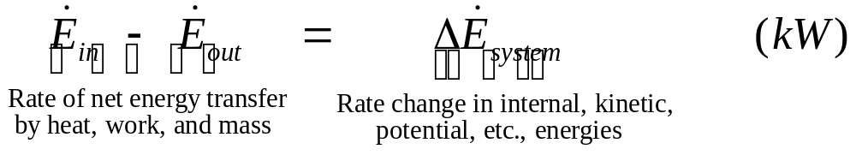

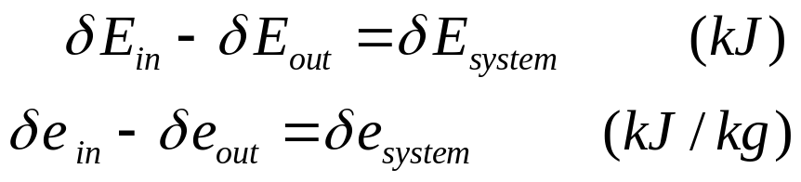
Expressed more compactly, the energy balance is
or on a rate form, as
For constant rates, the total quantities during the time interval Δt are related to the quantities per unit time as
The energy balance may be expressed on a per unit mass basis as
and in the differential forms as

Slide 41


First Law for a Cycle
A thermodynamic cycle is composed of processes that cause the working fluid to undergo a series of state changes through a process or a series of processes. These processes occur such that the final and initial states are identical and the change in internal energy of the working fluid is zero for whole numbers of cycles. Since thermodynamic cycles can be viewed as having heat and work (but not mass) crossing the cycle system boundary, the first law for a closed system operating in a thermodynamic cycle becomes

Slide 42

Example 2-4
A system receives 5 kJ of heat transfer and experiences a decrease in energy in the amount of 5 kJ. Determine the amount of work done by the system.
Q_{in} =5 kJ
ΔE= -5 kJ
W_{out}=?
We apply the first law as
System Boundary
The work done by the system equals the energy input by heat plus the decrease in the energy of the working fluid.

Slide 43

Example 2-5
A steam power plant operates on a thermodynamic cycle in which water circulates through a boiler, turbine, condenser, pump, and back to the boiler. For each kilogram of steam (water) flowing through the cycle, the cycle receives 2000 kJ of heat in the boiler, rejects 1500 kJ of heat to the environment in the condenser, and receives 5 kJ of work in the cycle pump. Determine the work done by the steam in the turbine, in kJ/kg.
The first law requires for a thermodynamic cycle

Slide 44





Example 2-6
Air flows into an open system and carries energy at the rate of 300 kW. As the air flows through the system it receives 600 kW of work and loses 100 kW of energy by heat transfer to the surroundings. If the system experiences no energy change as the air flows through it, how much energy does the air carry as it leaves the system, in kW?
System sketch:
Open System
Conservation of Energy:

Slide 45


Energy Conversion Efficiencies
A measure of performance for a device is its efficiency and is often given the symbol η. Efficiencies are expressed as follows:
How will you measure your efficiency in this thermodynamics course?
Efficiency as the Measure of Performance of a Thermodynamic cycle
A system has completed a thermodynamic cycle when the working fluid undergoes a series of processes and then returns to its original state, so that the properties of the system at the end of the cycle are the same as at its beginning.
Thus, for whole numbers of cycles
Heat Engine
A heat engine is a thermodynamic system operating in a thermodynamic cycle to which net heat is transferred and from which net work is delivered.

Slide 46

The system, or working fluid, undergoes a series of processes that constitute the heat engine cycle.
The following figure illustrates a steam power plant as a heat engine operating in a thermodynamic cycle.
Thermal Efficiency, ηth
The thermal efficiency is the index of performance of a work-producing device or a heat engine and is defined by the ratio of the net work output (the desired result) to the heat input (the cost or required input to obtain the desired result).

Slide 47



For a heat engine the desired result is the net work done (W_{out} – W_{in}) and the input is the heat supplied to make the cycle operate Q_{in}. The thermal efficiency is always less than 1 or less than 100 percent.
where
Here, the use of the in and out subscripts means to use the magnitude (take the positive value) of either the work or heat transfer and let the minus sign in the net expression take care of the direction.

Slide 48

Example 2-7
In example 2-5 the steam power plant received 2000 kJ/kg of heat, 5 kJ/kg of pump work, and produced 505 kJ/kg of turbine work. Determine the thermal efficiency for this cycle.
We can write the thermal efficiency on a per unit mass basis as:

Slide 49

Fuel
C_{n}H_{m}
Combustion
Chamber
CO₂
H₂O
N₂
Combustion Efficiency
Consider the combustion of a fuel-air mixture as shown below.
Air
Products
P_{P}, T_{P}
Reactants
T_{R}, P_{R}
Q_{out} = HV
Fuels are usually composed of a compound or mixture containing carbon, C, and hydrogen, H₂. During a complete combustion process all of the carbon is converted to carbon dioxide and all of the hydrogen is converted to water. For stoichiometric combustion (theoretically correct amount of air is supplied for complete combustion) where both the reactants (fuel plus air) and the products (compounds formed during the combustion process) have the same temperatures, the heat transfer from the combustion process is called the heating value of the fuel.
The lower heating value, LHV, is the heating value when water appears as a gas in the products.
The lower heating value is often used as the measure of energy per kg of fuel supplied to the gas turbine engine because the exhaust gases have such a high temperature that the water formed is a vapor as it leaves the engine with other products of combustion.

Slide 50

The higher heating value, HHV, is the heating value when water appears as a liquid in the products.
The higher heating value is often used as the measure of energy per kg of fuel supplied to the steam power cycle because there are heat transfer processes within the cycle that absorb enough energy from the products of combustion that some of the water vapor formed during combustion will condense.
Combustion efficiency is the ratio of the actual heat transfer from the combustion process to the heating value of the fuel.
Example 2-8
A steam power plant receives 2000 kJ of heat per unit mass of steam flowing through the steam generator when the steam flow rate is 100 kg/s. If the fuel supplied to the combustion chamber of the steam generator has a higher heating value of 40,000 kJ/kg of fuel and the combustion efficiency is 85%, determine the required fuel flow rate, in kg/s.

Slide 51


Generator Efficiency:

Slide 52


Power Plant Overall Efficiency:
Motor Efficiency:

Slide 53


Lighting Efficacy:
Type of lighting | Efficacy, lumens/W
Ordinary Incandescent | 6 - 20
Ordinary Fluorescent | 40 - 60
Effectiveness of Conversion of Electrical or chemical Energy to Heat for Cooking, Called Efficacy of a Cooking Appliance:

Slide 54




Slide 55



Slide 56



Slide 57



Slide 58




Slide 59



