Slide 1
Chapter 4
Energy Analysis of Closed Systems
Study Guide in PowerPoint
to accompany
Thermodynamics: An Engineering Approach, 5th edition
by Yunus A. Çengel and Michael A. Boles

Slide 2


The first law of thermodynamics is an expression of the conservation of energy principle. Energy can cross the boundaries of a closed system in the form of heat or work. Energy transfer across a system boundary due solely to the temperature difference between a system and its surroundings is called heat.
Work energy can be thought of as the energy expended to lift a weight.
Closed System First Law
A closed system moving relative to a reference plane is shown below where z is the elevation of the center of mass above the reference plane and is the velocity of the center of mass.
Closed
System
Heat
Work
z
Reference Plane, z = 0
For the closed system shown above, the conservation of energy principle or the first law of thermodynamics is expressed as

Slide 3
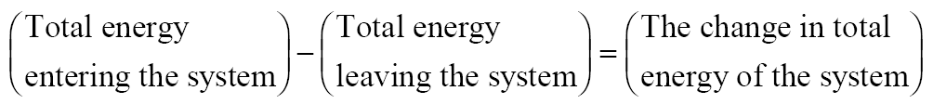


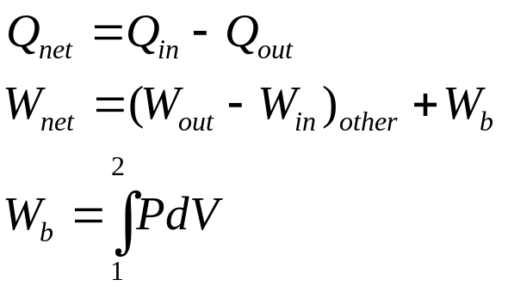
or
According to classical thermodynamics, we consider the energy added to be net heat transfer to the closed system and the energy leaving the closed system to be net work done by the closed system. So
Where
Normally the stored energy, or total energy, of a system is expressed as the sum of three separate energies. The total energy of the system, E_{system}, is given as

Slide 4
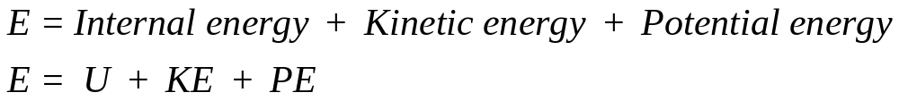
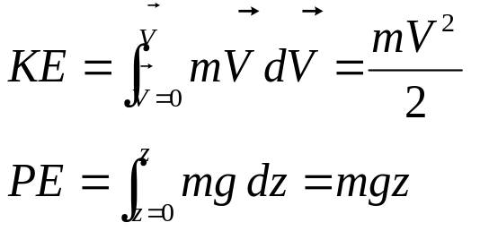


Recall that U is the sum of the energy contained within the molecules of the system other than the kinetic and potential energies of the system as a whole and is called the internal energy. The internal energy U is dependent on the state of the system and the mass of the system.
For a system moving relative to a reference plane, the kinetic energy KE and the potential energy PE are given by
The change in stored energy for the system is
Now the conservation of energy principle, or the first law of thermodynamics for closed systems, is written as

Slide 5

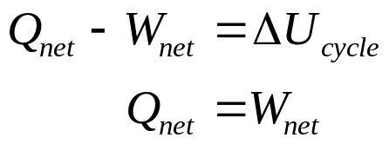
If the system does not move with a velocity and has no change in elevation, the conservation of energy equation reduces to
We will find that this is the most commonly used form of the first law.
Closed System First Law for a Cycle
Since a thermodynamic cycle is composed of processes that cause the working fluid to undergo a series of state changes through a series of processes such that the final and initial states are identical, the change in internal energy of the working fluid is zero for whole numbers of cycles. The first law for a closed system operating in a thermodynamic cycle becomes

Slide 6
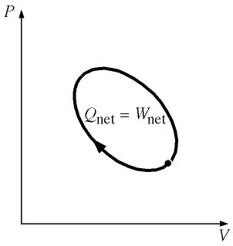
Example 4-1
Complete the table given below for a closed system under going a cycle.
Process Q_{net} kJ W_{net} kJ U₂ – U₁ kJ
1-2 +5 -5
2-3 +20 +10
3-1 -5
Cycle

Slide 7
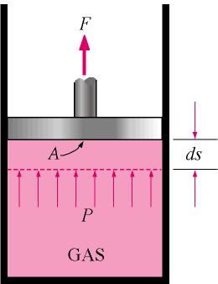
(Answer to above problem) Row 1: +10, Row 2: +10, Row 3: -10, -5
Row 4: +15, +15, 0
In the next section we will look at boundary work in detail. Review the text material on other types of work such as shaft work, spring work, electrical work.
Boundary Work
Work is energy expended when a force acts through a displacement. Boundary work occurs because the mass of the substance contained within the system boundary causes a force, the pressure times the surface area, to act on the boundary surface and make it move. This is what happens when steam, the “gas” in the figure below, contained in a piston-cylinder device expands against the piston and forces the piston to move; thus, boundary work is done by the steam on the piston. Boundary work is then calculated from

Slide 8
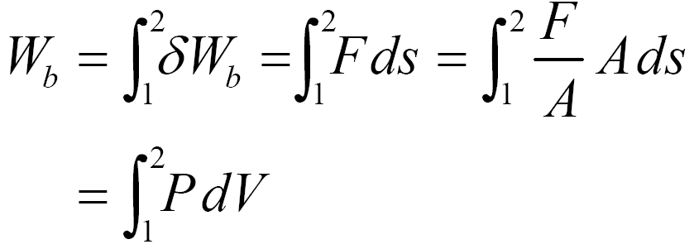

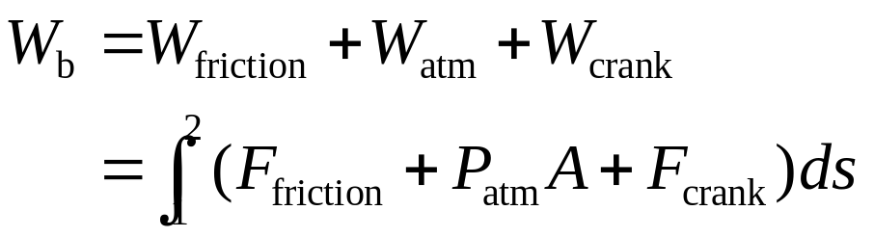
Since the work is process dependent, the differential of boundary work δW_{b}
is called inexact. The above equation for W_{b} is valid for a quasi-equilibrium process and gives the maximum work done during expansion and the minimum work input during compression. In an expansion process the boundary work must overcome friction, push the atmospheric air out of the way, and rotate a crankshaft.
To calculate the boundary work, the process by which the system changed states must be known. Once the process is determined, the pressure-volume relationship for the process can be obtained and the integral in the boundary work equation can be performed. For each process we need to determine

Slide 9

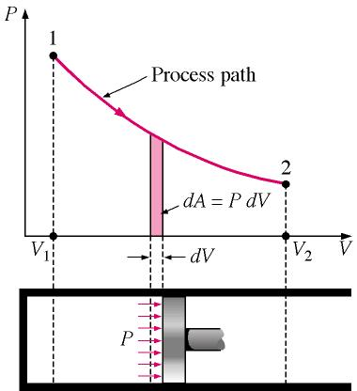
So as we work problems, we will be asking, “What is the pressure-volume relationship for the process?” Remember that this relation is really the force-displacement function for the process.
The boundary work is equal to the area under the process curve plotted on the pressure-volume diagram.

Slide 10
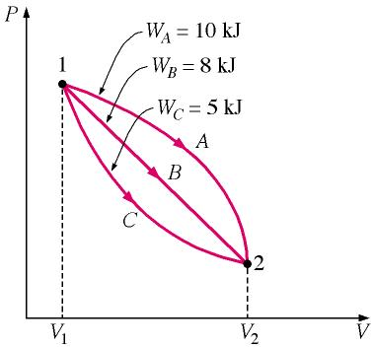
Note from the above figure:
P is the absolute pressure and is always positive.
When dV is positive, W_{b} is positive.
When dV is negative, W_{b} is negative.
Since the areas under different process curves on a P-V diagram are different, the boundary work for each process will be different. The next figure shows that each process gives a different value for the boundary work.

Slide 11
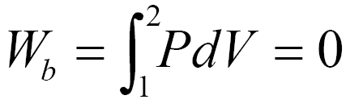
Some Typical Processes
Constant volume
If the volume is held constant, dV = 0, and the boundary work equation becomes
P
1
2
V
P-V diagram for V = constant
If the working fluid is an ideal gas, what will happen to the temperature of the gas during this constant volume process?

Slide 12
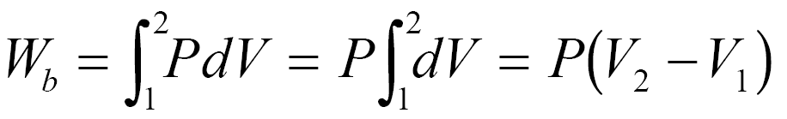
Constant pressure
P
2
1
V
P-V DIAGRAM for P = CONSTANT
If the pressure is held constant, the boundary work equation becomes
For the constant pressure process shown above, is the boundary work positive or negative and why?
Constant temperature, ideal gas
If the temperature of an ideal gas system is held constant, then the equation of state provides the pressure-volume relation

Slide 13
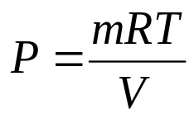
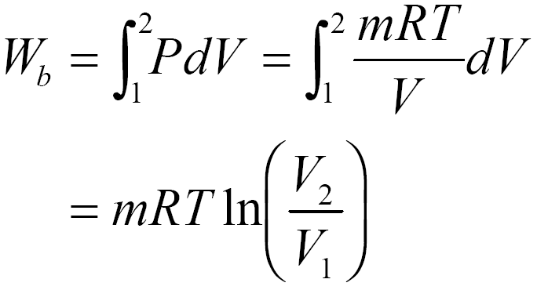

Then, the boundary work is
Note: The above equation is the result of applying the ideal gas assumption for the equation of state. For real gases undergoing an isothermal (constant temperature) process, the integral in the boundary work equation would be done numerically.
The polytropic process
The polytropic process is one in which the pressure-volume relation is given as
The exponent n may have any value from minus infinity to plus infinity depending on the process. Some of the more common values are given below.

Slide 14
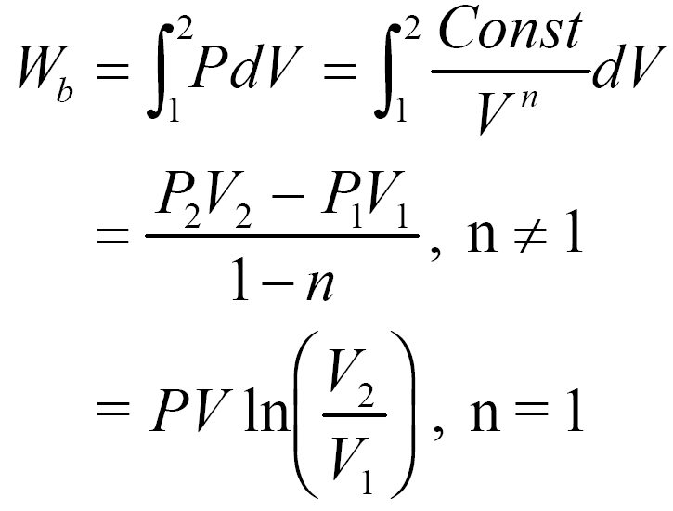
Process Exponent n
Constant pressure 0
Constant volume ∞
Isothermal & ideal gas 1
Adiabatic & ideal gas k = C_{P}/C_{V}
Here, k is the ratio of the specific heat at constant pressure C_{P} to specific heat at constant volume C_{V}. The specific heats will be discussed later.
The boundary work done during the polytropic process is found by substituting the pressure-volume relation into the boundary work equation. The result is

Slide 15
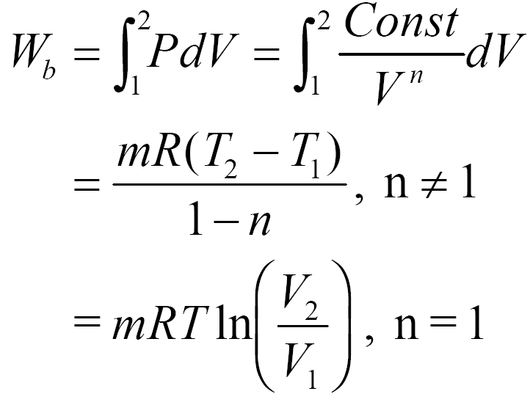
For an ideal gas under going a polytropic process, the boundary work is
Notice that the results we obtained for an ideal gas undergoing a polytropic process when n = 1 are identical to those for an ideal gas undergoing the isothermal process.
Example 4-2
Three kilograms of nitrogen gas at 27°C and 0.15 MPa are compressed isothermally to 0.3 MPa in a piston-cylinder device. Determine the minimum work of compression, in kJ.
System: Nitrogen contained in a piston-cylinder device.
Process: Constant temperature

Slide 16
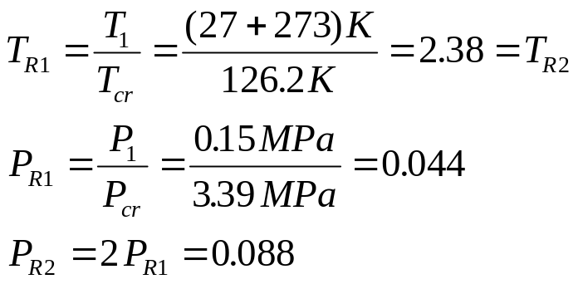

2
System Boundary
P
1
Nitrogen
gas
W_{b}
V
P-V DIAGRAM for T = CONSTANT
Property Relation: Check the reduced temperature and pressure for nitrogen. The critical state properties are found in Table A-1.
Since P_{R}<<1 and T>2T_{cr}, nitrogen is an ideal gas, and we use the ideal gas equation of state as the property relation.

Slide 17
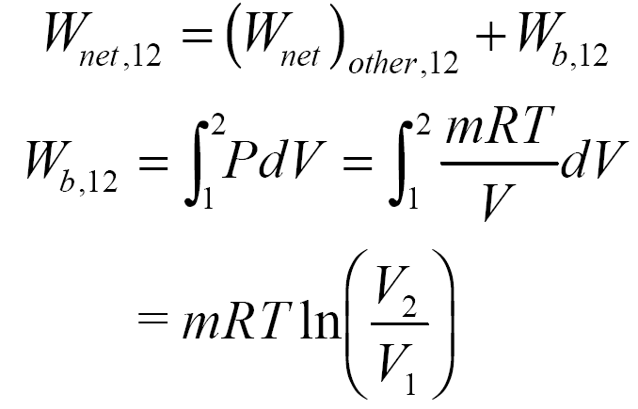
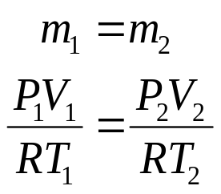
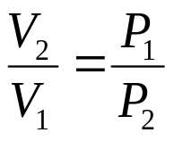
Work Calculation:
For an ideal gas in a closed system (mass = constant), we have
Since the R's cancel, we obtain the combined ideal gas equation. Since T₂ = T₁,

Slide 18
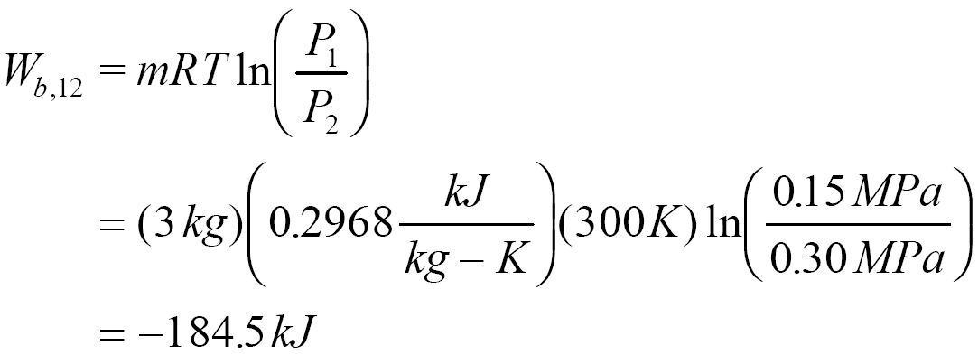

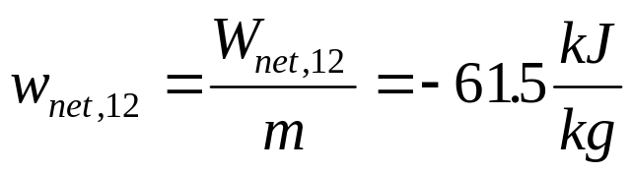
The net work is
On a per unit mass basis
The net work is negative because work is done on the system during the compression process. Thus, the work done on the system is 184.5 kJ, or 184.5 kJ of work energy is required to compress the nitrogen.

Slide 19
Example 4-3
Water is placed in a piston-cylinder device at 20 °C, 0.1 MPa. Weights are placed on the piston to maintain a constant force on the water as it is heated to 400 °C. How much work does the water do on the piston?
System: The water contained in the piston-cylinder device
System
Boundary
for water
W_{b}
Heat
Property Relation: Steam tables
Process: Constant pressure

Slide 20
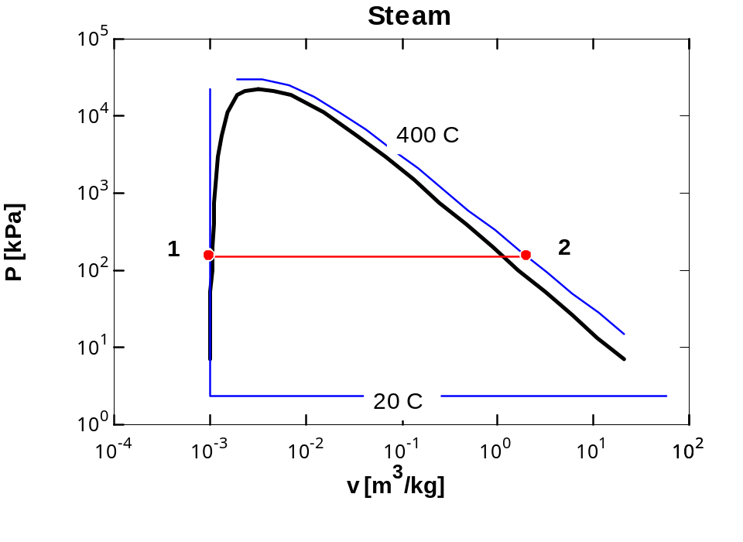
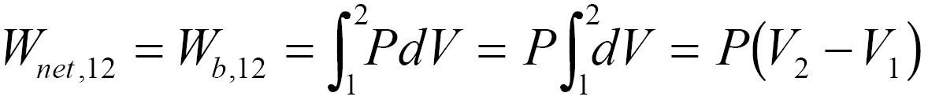
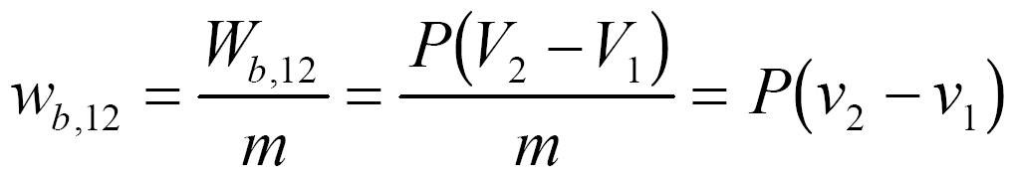
Work Calculation:
Since there is no W_{other} mentioned in the problem, the net work is
Since the mass of the water is unknown, we calculate the work per unit mass.

Slide 21
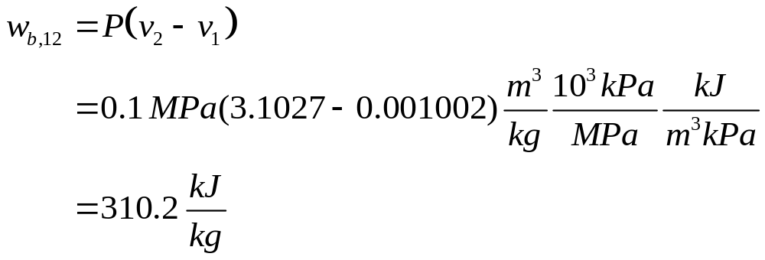
At T₁ = 20°C, P_{sat} = 2.339 kPa. Since P₁ > 2.339 kPa, state 1 is compressed liquid. Thus,
v₁ ≅ v_{f} at 20 °C = 0.001002 m³/ kg
At P₂ = P₁ = 0.1 MPa, T₂ > T_{sat} at 0.1 MPa = 99.61°C.
So, state 2 is superheated. Using the superheated tables at 0.1 MPa, 400°C
v₂ = 3.1027 m³/kg
The water does work on the piston in the amount of 310.2 kJ/kg.

Slide 22
Example 4-4
One kilogram of water is contained in a piston-cylinder device at 100 °C. The piston rests on lower stops such that the volume occupied by the water is 0.835 m³. The cylinder is fitted with an upper set of stops. When the piston rests against the upper stops, the volume enclosed by the piston-cylinder device is 0.841 m³. A pressure of 200 kPa is required to support the piston. Heat is added to the water until the water exists as a saturated vapor. How much work does the water do on the piston?
System: The water contained in the piston-cylinder device
Stops
P
System
Boundary
Stops
W_{b}
W_{b}
Water
v

Slide 23
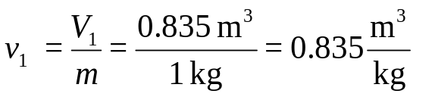
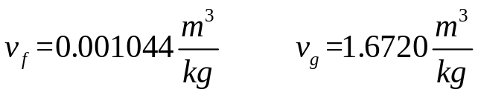
Property Relation: Steam tables
Process: Combination of constant volume and constant pressure processes to be shown on the P-v diagram as the problem is solved.
Work Calculation:
The specific volume at state 1 is
At T₁ = 100°C,
Therefore, v_{f} < v₁ < v_{g} and state 1 is in the saturation region; so
P₁ = 101.35 kPa. Show this state on the P-v diagram.
Now let’s consider the processes for the water to reach the final state.
Process 1-2: The volume stays constant until the pressure increases to 200 kPa. Then the piston will move.

Slide 24
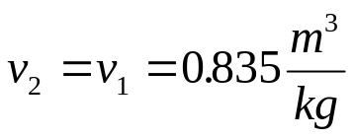
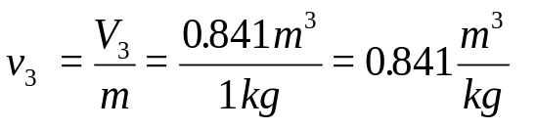
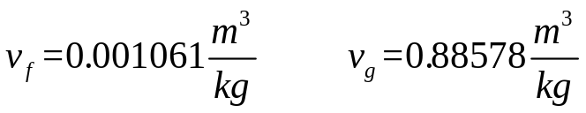
Process 2-3: Piston lifts off the bottom stops while the pressure stays constant. Does the piston hit the upper stops before or after reaching the saturated vapor state?
Let's set
At P₃ = P₂ = 200 kPa
Thus, v_{f} < v₃ < v_{g}. So, the piston hits the upper stops before the water reaches the saturated vapor state. Now we have to consider a third process.
Process 3-4: With the piston against the upper stops, the volume remains constant during the final heating to the saturated vapor state and the pressure increases.
Because the volume is constant in process 3-to-4, v₄ = v₃ = 0.841 m³/kg and v₄ is a saturated vapor state. Interpolating in either the saturation pressure table or saturation temperature table at v₄ = v_{g} gives

Slide 25
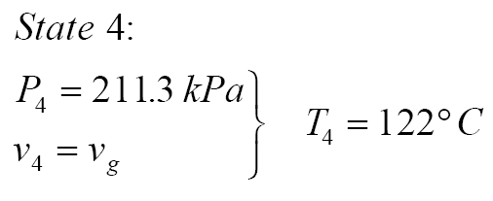
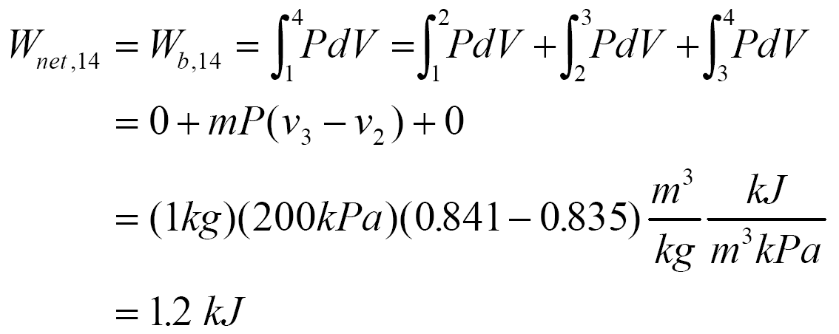
The net work for the heating process is (the “other” work is zero)
Later in Chapter 4, we will apply the conservation of energy, or the first law of thermodynamics, to this process to determine the amount of heat transfer required.
Example 4-5
Air undergoes a constant pressure cooling process in which the temperature decreases by 100°C. What is the magnitude and direction of the work for this process?

Slide 26
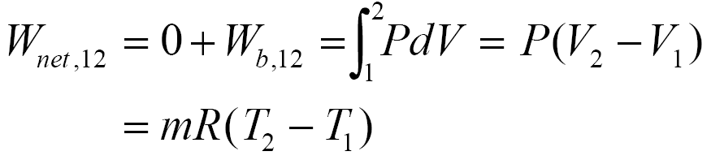
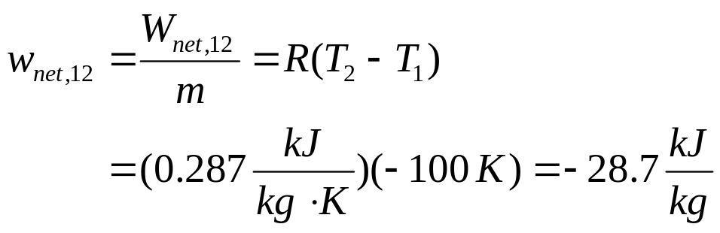
System:
P
System
Boundary
2
1
W_{b}
Air
V
Property Relation: Ideal gas law, Pv = RT
Process: Constant pressure
Work Calculation: Neglecting the “other” work
The work per unit mass is

Slide 27
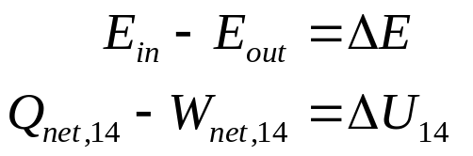



The work done on the air is 28.7 kJ/kg.
Example 4-6
Find the required heat transfer to the water in Example 4-4.
Review the solution procedure of Example 4-4 and then apply the first law to the process.
Conservation of Energy:
In Example 4-4 we found that
The heat transfer is obtained from the first law as
where

Slide 28
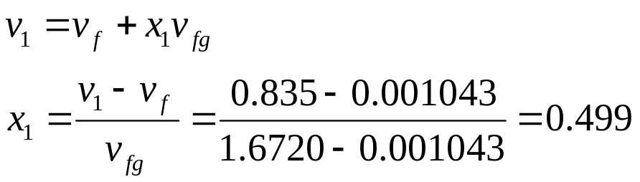
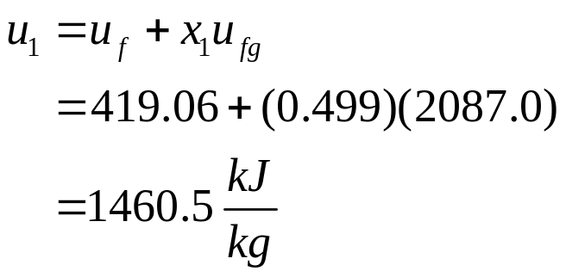
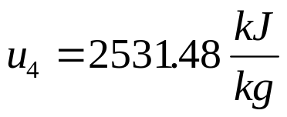
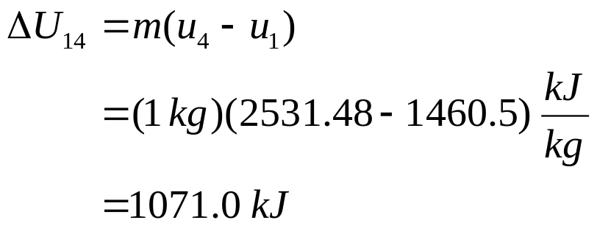
At state 1, T₁ = 100°C, v₁ = 0.835 m³/kg and v_{f} < v₁ < v_{g} at T₁. The quality at state 1 is
Because state 4 is a saturated vapor state and v₄ = 0.841 m³/kg, interpolating in either the saturation pressure table or saturation temperature table at v₄ = v_{g} gives
So

Slide 29
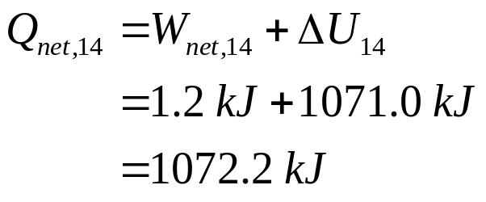

The heat transfer is
Heat in the amount of 1072.42 kJ is added to the water.
Specific Heats and Changes in Internal Energy and Enthalpy for Ideal Gases
Before the first law of thermodynamics can be applied to systems, ways to calculate the change in internal energy of the substance enclosed by the system boundary must be determined. For real substances like water, the property tables are used to find the internal energy change. For ideal gases the internal energy is found by knowing the specific heats. Physics defines the amount of energy needed to raise the temperature of a unit of mass of a substance one degree as the specific heat at constant volume C_{V} for a constant-volume process, and the specific heat at constant pressure C_{P} for a constant-pressure process. Recall that enthalpy h is the sum of the internal energy u and the pressure-volume product Pv.
In thermodynamics, the specific heats are defined as

Slide 30
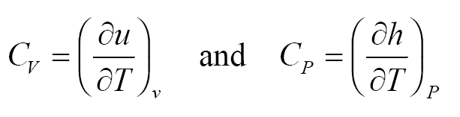

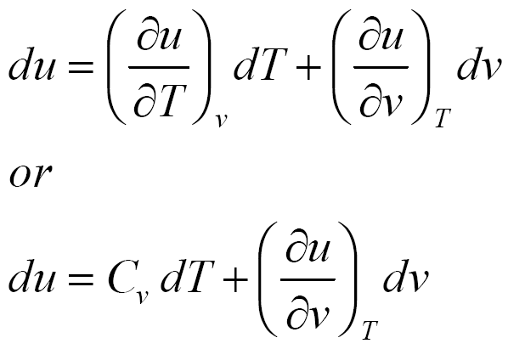
Simple Substance
The thermodynamic state of a simple, homogeneous substance is specified by giving any two independent, intensive properties. Let's consider the internal energy to be a function of T and v and the enthalpy to be a function of T and P as follows:
The total differential of u is

Slide 31
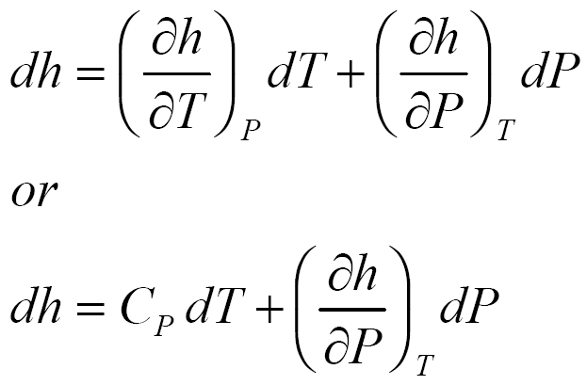
The total differential of h is
Using thermodynamic relation theory, we could evaluate the remaining partial derivatives of u and h in terms of functions of P,v, and T. These functions depend upon the equation of state for the substance. Given the specific heat data and the equation of state for the substance, we can develop the property tables such as the steam tables.
Ideal Gases
For ideal gases, we use the thermodynamic function theory of Chapter 12 and the equation of state (Pv = RT) to show that u, h, C_{V}, and C_{P} are functions of temperature alone.
For example when total differential for u = u(T,v) is written as above, the function theory of Chapter 12 shows that

Slide 32
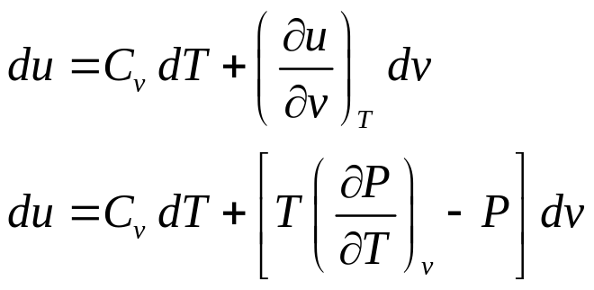
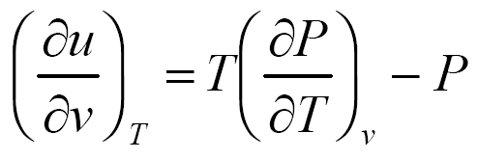
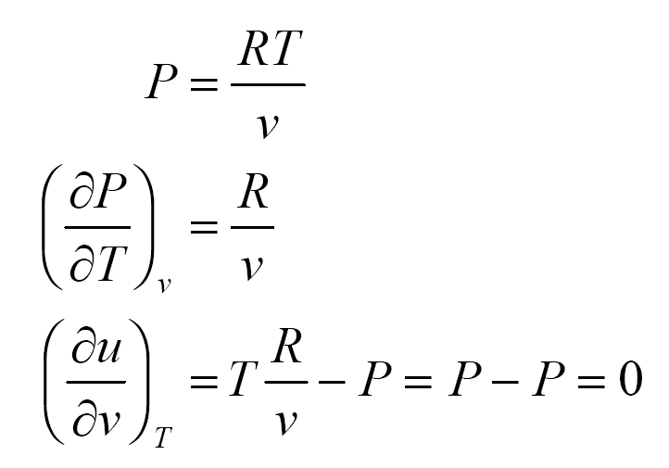
Let’s evaluate the following partial derivative for an ideal gas.
For ideal gases

Slide 33
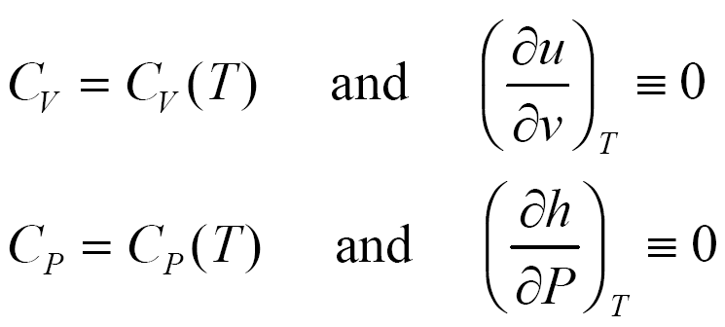
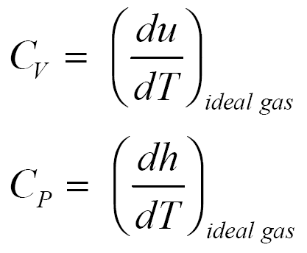
This result helps to show that the internal energy of an ideal gas does not depend upon specific volume. To completely show that internal energy of an ideal gas is independent of specific volume, we need to show that the specific heats of ideal gases are functions of temperature only. We will do this later in Chapter 12. A similar result that applies to the enthalpy function for ideal gases can be reviewed in Chapter 12.
Then for ideal gases,
The ideal gas specific heats are written in terms of ordinary differentials as

Slide 34




Using the simple “dumbbell model” for diatomic ideal gases, statistical thermodynamics predicts the molar specific heat at constant pressure as a function of temperature to look like the following
Vibration mode
Rotation mode
“Dumbbell model”
Translation mode
T
The following figure shows how the molar specific heats vary with temperature for selected ideal gases.

Slide 35


The differential changes in internal energy and enthalpy for ideal gases become
The change in internal energy and enthalpy of ideal gases can be expressed as

Slide 36

where C_{V},_{ave} and C_{P},_{ave} are average or constant values of the specific heats over the temperature range. We will drop the ave subscript shortly.
2a
P
2b
1
2c
T₂
T₁
V
P-V diagram for several processes for an ideal gas.
In the above figure an ideal gas undergoes three different process between the same two temperatures.
Process 1-2a: Constant volume
Process 1-2b: P = a + bV, a linear relationship
Process 1-2c: Constant pressure
These ideal gas processes have the same change in internal energy and enthalpy because the processes occur between the same temperature limits.

Slide 37




To find Δu and Δh we often use average, or constant, values of the specific heats. Some ways to determine these values are as follows:
1.The best average value (the one that gives the exact results)
See Table A-2(c) for variable specific data.
2.Good average values are
and

Slide 38


3.Sometimes adequate (and most often used) values are the ones evaluated at 300 K and are given in Table A-2(a).
Let's take a second look at the definition of Δu and Δh for ideal gases. Just consider the enthalpy for now.
Let's perform the integral relative to a reference state where
h = h_{ref} at T = T_{ref}.
At any temperature, we can calculate the enthalpy relative to the reference state as

Slide 39



A similar result is found for the change in internal energy.
These last two relations form the basis of the air tables (Table A-17 on a mass basis) and the other ideal gas tables (Tables A-18 through A-25 on a mole basis). When you review Table A-17, you will find h and u as functions of T in K. Since the parameters P_{r}, v_{r}, and so, also found in Table A=17, apply to air only in a particular process, call isentropic, you should ignore these parameters until we study Chapter 7. The reference state for these tables is defined as
A partial listing of data similar to that found in Table A.17 is shown in the following figure.

Slide 40



In the analysis to follow, the “ave” notation is dropped. In most applications for ideal gases, the values of the specific heats at 300 K given in Table A-2 are adequate constants.
Exercise
Determine the average specific heat for air at 305 K.
(Answer: 1.005 kJ/kg⋅K, approximate the derivative of h with respect to T as differences)

Slide 41



Relation between C_{P} and C_{V} for Ideal Gases
Using the definition of enthalpy (h = u + Pv) and writing the differential of enthalpy, the relationship between the specific heats for ideal gases is
where R is the particular gas constant. The specific heat ratio k (fluids texts often use γ instead of k) is defined as
Extra Problem
Show that

Slide 42
Example 2-9
Two kilograms of air are heated from 300 to 500 K. Find the change in enthalpy by assuming
a. Empirical specific heat data from Table A-2(c).
b. Air tables from Table A-17.
c. Specific heat at the average temperature from Table A-2(c).
d. Use the 300 K value for the specific heat from Table A-2(a).
a.Table A-2(c) gives the molar specific heat at constant pressure for air as
The enthalpy change per unit mole is

Slide 43




Slide 44


b.Using the air tables, Table A-17, at T₁ = 300 K, _{h1} = 300.19 kJ/kg and at T₂ = 500 K, h₂ = 503.02 kJ/kg
The results of parts a and b would be identical if Table A-17 had been based on the same specific heat function listed in Table A-2(c).
c.Let’s use a constant specific heat at the average temperature.
T_{ave} = (300 + 500)K/2 = 400 K. At T_{ave} , T_{able} A-2 gives
C_{P} = 1.013 kJ/(kg⋅K).
For C_{P} = constant,

Slide 45



d.Using the 300 K value from Table A-2(a), C_{P} = 1.005 kJ/kg- K.
For C_{P} = constant,
Extra Problem
Find the change in internal energy for air between 300 K and 500 K, in kJ/kg.

Slide 46
The Systematic Thermodynamics Solution Procedure
When we apply a methodical solution procedure, thermodynamics problems are relatively easy to solve. Each thermodynamics problem is approached the same way as shown in the following, which is a modification of the procedure given in the text:
Thermodynamics Solution Method
Sketch the system and show energy interactions across the boundaries.
Determine the property relation. Is the working substance an ideal gas or a real substance? Begin to set up and fill in a property table.
Determine the process and sketch the process diagram. Continue to fill in the property table.
Apply conservation of mass and conservation of energy principles.
Bring in other information from the problem statement, called physical constraints, such as the volume doubles or the pressure is halved during the process.
Develop enough equations for the unknowns and solve.

Slide 47

Example 4-7
A tank contains nitrogen at 27°C. The temperature rises to 127°C by heat transfer to the system. Find the heat transfer and the ratio of the final pressure to the initial pressure.
System: Nitrogen in the tank.
2
System boundary
P
T₁=
27°C
T₂=127°C
Nitrogen gas
1
V
P-V diagram for a constant volume process
Property Relation: Nitrogen is an ideal gas. The ideal gas property relations apply. Let’s assume constant specific heats. (You are encouraged to rework this problem using variable specific heat data.)
Process: Tanks are rigid vessels; therefore, the process is constant volume.
Conservation of Mass:

Slide 48




Using the combined ideal gas equation of state,
Since R is the particular gas constant, and the process is constant volume,
Conservation of Energy:
The first law closed system is
For nitrogen undergoing a constant volume process (dV = 0), the net work is (W_{other} = 0)

Slide 49


Using the ideal gas relations with W_{net} = 0, the first law becomes (constant specific heats)
The heat transfer per unit mass is
Example 4-8
Air is expanded isothermally at 100°C from 0.4 MPa to 0.1 MPa. Find the ratio of the final to the initial volume, the heat transfer, and work.
System: Air contained in a piston-cylinder device, a closed system

Slide 50


Process: Constant temperature
1
System
boundary
P
2
Air W_{b}
T = const.
V
P-V diagram for T= constant
Property Relation: Assume air is an ideal gas and use the ideal gas property relations with constant specific heats.
Conservation of Energy:
The system mass is constant but is not given and cannot be calculated; therefore, let’s find the work and heat transfer per unit mass.

Slide 51


Work Calculation:
Conservation of Mass: For an ideal gas in a closed system (mass = constant), we have
Since the R's cancel and T₂ = T₁

Slide 52


Then the work expression per unit mass becomes
The net work per unit mass is
Now to continue with the conservation of energy to find the heat transfer. Since T₂ = T₁ = constant,
So the heat transfer per unit mass is

Slide 53

The heat transferred to the air during an isothermal expansion process equals the work done.
Examples Using Variable Specific Heats
Review the solutions in Chapter 4 to the ideal gas examples where the variable specific heat data are used to determine the changes in internal energy and enthalpy.

Slide 54


Extra Problem for You to Try:
An ideal gas, contained in a piston-cylinder device, undergoes a polytropic process in which the polytropic exponent n is equal to k, the ratio of specific heats. Show that this process is adiabatic. When we get to Chapter 7 you will find that this is an important ideal gas process.
Internal Energy and Enthalpy Changes of Solids and Liquids
We treat solids and liquids as incompressible substances. That is, we assume that the density or specific volume of the substance is essentially constant during a process. We can show that the specific heats of incompressible substances (see Chapter 12) are identical.
The specific heats of incompressible substances depend only on temperature; therefore, we write the differential change in internal energy as

Slide 55





and assuming constant specific heats, the change in internal energy is
Recall that enthalpy is defined as
The differential of enthalpy is
For incompressible substances, the differential enthalpy becomes
Integrating, assuming constant specific heats
For solids the specific volume is approximately zero; therefore,

Slide 56


For liquids, two special cases are encountered:
1.Constant-pressure processes, as in heaters (ΔP = 0)
2.Constant-temperature processes, as in pumps (ΔT = 0)
We will derive this last expression for Δh again once we have discussed the first law for the open system in Chapter 5 and the second law of thermodynamics in Chapter 7.
The specific heats of selected liquids and solids are given in Table A-3.

Slide 57
Example 4-8 Incompressible Liquid
A two-liter bottle of your favorite beverage has just been removed from the trunk of your car. The temperature of the beverage is 35°C, and you always drink your beverage at 10°C.
  How much heat energy must be removed from your two liters of beverage?
  You are having a party and need to cool 10 of these two-liter bottles in one-half hour. What rate of heat removal, in kW, is required? Assuming that your refrigerator can accomplish this and that electricity costs 8.5 cents per kW-hr, how much will it cost to cool these 10 bottles?
System: The liquid in the constant volume, closed system container
System
boundary
My
beverage
Q_{out}
The heat
removed

Slide 58



Property Relation: Incompressible liquid relations, let’s assume that the beverage is mostly water and takes on the properties of liquid water. The specific volume is 0.001 m³/kg, C = 4.18 kJ/kg⋅K.
Process: Constant volume
Conservation of Mass:
Conservation of Energy:
The first law closed system is

Slide 59



Since the container is constant volume and there is no “other” work done on the container during the cooling process, we have
The only energy crossing the boundary is the heat transfer leaving the container. Assuming the container to be stationary, the conservation of energy becomes
The heat transfer rate to cool the 10 bottles in one-half hour is

Slide 60



Slide 61



Slide 62



Slide 63


Slide 64



Slide 65



Slide 66



Slide 67


Slide 68


Slide 69



Slide 70


Slide 71


Slide 72


Slide 73


Slide 74



Slide 75


Slide 76



Slide 77


