Slide 1

Emoji Prediction from
Social Media Text
NLP
AI 445: Natural Language Processing
Text alone misses tone.
Emojis restore the feeling.
Goal: read a short social-media text and predict the emoji that best matches its emotion or context.
😂 ❤ 📷 😎 😉 💯 🔥 ✨ 😊 😜 😁
Team:
Notes:
Opening script: Hello everyone. Our project is Emoji Prediction from Social Media Text. The main idea is simple: given a short text like a tweet, the system predicts the emoji that best represents the emotion or meaning. This is useful because emojis add context that plain text often misses.

Slide 2
1. Problem and motivation
Why this NLP task matters in real social media text
People write short, messy text online:
• Text alone lacks emotional depth and contextual tone.
• Emojis act as "digital body language" to provide instant intent.
“Best birthday ever with my friends tonight”
Possible prediction:
😂 / ❤ / ✨
Project objective
Build and compare models, then deploy the best one as a usable web application.
AI 445 NLP • Emoji Prediction Project • 2
Notes:
Say: We defined this as a supervised multi-class classification problem. The input is a sentence, and the output is one emoji class. The challenge is that tweets are very informal and sometimes one word changes the meaning. This is why a deep learning model is useful.

Slide 3
2. Dataset overview
11 target emoji classes
❤ 😂 📷 😎😉 💯 🔥 ✨😊 😜 😁
Prepared files
58,498
4,922
2,520
training samples
validation samples
test samples
Class-balance idea
Cleaning and balancing pipeline
Frequent classes like 😂 and ❤ were balanced against rarer emojis such as 💯 and 😜 so the final model would not simply predict the most common class.
• Removed emojis from the input text to prevent label leakage.
• Replaced user mentions with @user and links with http.
• Decoded HTML/unicode symbols and removed duplicate sentences.
• Grouped similar emojis and oversampled minority classes.
Total prepared examples: 65,940
AI 445 NLP • Emoji Prediction Project • 3
Notes:
Say: For the data, we used TweetEval emoji data and added extra clean Twitter emoji examples from Kaggle. We selected eleven high-impact emoji classes. The final processed dataset has 58,498 training samples, 4,922 validation samples, and 2,520 test samples. The preprocessing was important because if emojis remain inside the input text, the model can cheat.

Slide 4
3. Modeling strategy
We compared simple, pre-trained, and fine-tuned deep learning approaches
Model 1
TF‑IDF + Logistic Regression
Fast baseline using word/character n-grams and 15k features.
Model 2
Pre-trained RoBERTa
Off-the-shelf twitter-roberta-base-emoji-latest, without extra training.
Model 3
FGM Fine‑Tuned RoBERTa
Custom fine-tuned transformer with robustness and class weighting.
Why compare three models?
Selection logic
• The baseline shows what a traditional model can do.
• The pre-trained model shows whether transfer learning works directly.
• The fine-tuned model tests whether training on our classes improves performance.
Final model chosen by test Accuracy + Macro F1, with Macro F1 emphasized because classes are not perfectly balanced.
AI 445 NLP • Emoji Prediction Project • 4
Notes:
Say: We did not only build one model. We started with TF-IDF plus logistic regression as a simple baseline. Then we tested a pre-trained emoji RoBERTa model without fine-tuning. Finally, we trained our own FGM fine-tuned RoBERTa model. This gives a fair comparison from simple to advanced.

Slide 5
4. Best model: FGM fine-tuned RoBERTa
Fine-tuning improved both contextual understanding and robustness
Clean text
@user, http, no emojis
Tokenizer
RoBERTa subwords
FGM training
small embedding perturbations
Emoji class
11-way prediction
Training decisions
Why FGM helped
• Class-weighted loss: gives more attention to minority classes.
• Hyperparameter search: learning rates and batch sizes.
• Early stopping: patience of 4 epochs using Validation Macro F1.
FGM acts like a stress test during training. The model learns to stay stable even when the text representation changes slightly, which matches noisy social media writing.
AI 445 NLP • Emoji Prediction Project • 5
Notes:
Say: Our best model is a fine-tuned RoBERTa model with Fast Gradient Method adversarial training. In simple words, FGM slightly perturbs the embeddings during training so the model becomes more robust to small wording variations, spelling mistakes, and slang. We also used class-weighted loss and early stopping.

Slide 6
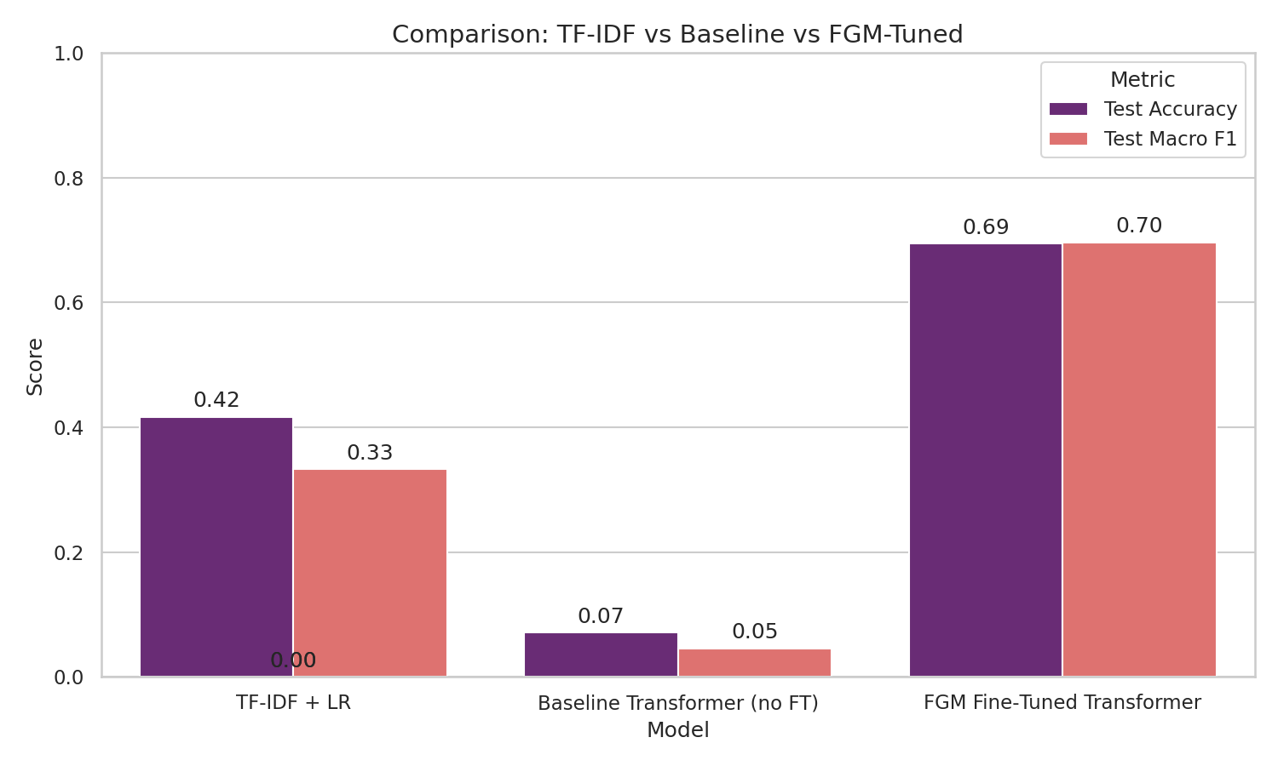
5. Results: fine-tuning made the difference
0.694
Test accuracy and Macro F1 on the final held-out test set
FGM test accuracy
0.696
FGM Macro F1
Key finding
The off‑the‑shelf transformer performed poorly because it did not match our exact 11-class setup. Custom fine‑tuning adapted the model to our data.
AI 445 NLP • Emoji Prediction Project • 6
Notes:
Say: The results show the main lesson of the project. The traditional TF-IDF model reached around 0.42 accuracy and 0.33 Macro F1. The pre-trained transformer without fine-tuning was not suitable for our exact classes. The FGM fine-tuned model was clearly the best with about 0.694 accuracy and 0.696 Macro F1.

Slide 7
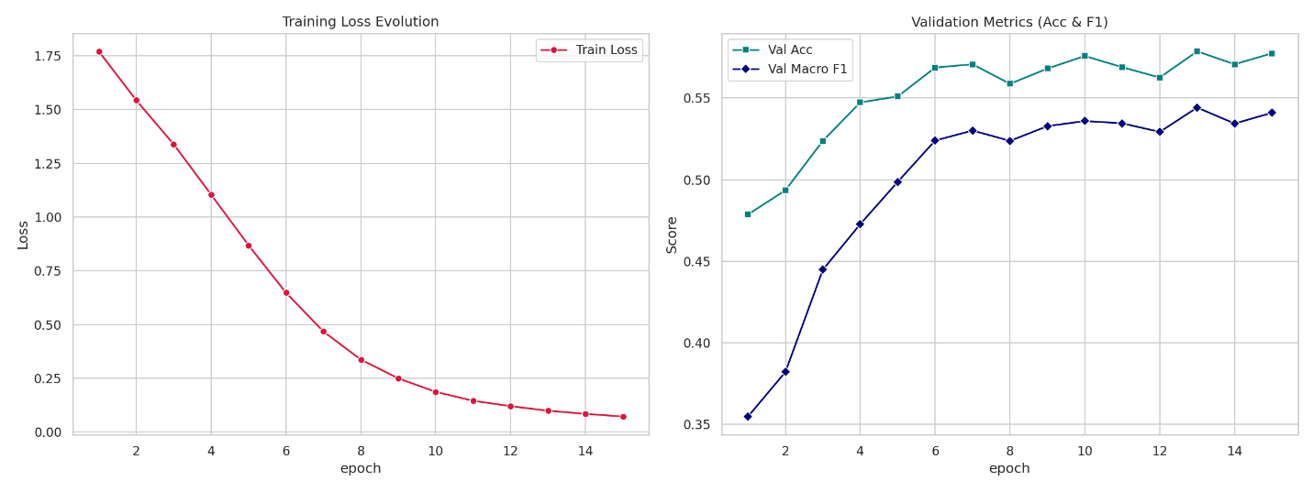
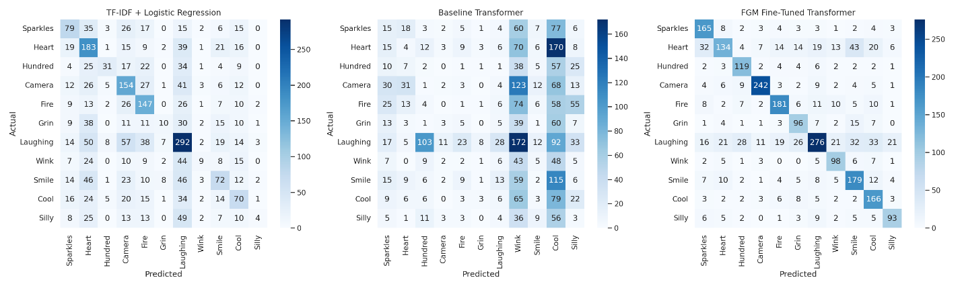
6. Learning curves and error analysis
The model converged well and most mistakes were between similar emotions
What the visuals show
• Training loss decreased smoothly across epochs.
• Validation accuracy and Macro F1 stabilized instead of collapsing.
• The FGM confusion matrix has a strong diagonal, meaning many correct predictions.
Interpretation
Remaining errors are understandable: emojis like 😊, 😁, and 😂 can appear in very similar contexts, so even humans may disagree sometimes.
AI 445 NLP • Emoji Prediction Project • 7
Notes:
Say: The learning curves suggest stable training. The loss goes down, and validation metrics improve and then stabilize. In the confusion matrices, the FGM model shows a strong diagonal, which means many samples are classified correctly. Most remaining mistakes happen between close emotions like smile, grin, and laughing.

Slide 8
7. Deployment architecture
User input
Arabic or English text
Translation
MyMemory API
Rule engine
sad / angry / coffee / sleep
ML backend
Hugging Face Space + Gradio
Prediction
emoji + confidence
Frontend
Backend
• React + TypeScript + Vite + TailwindCSS
• Firebase Hosting
• Responsive dark/light UI
• PyTorch RoBERTa model
• best_fgm_model.pt served through Gradio
• Returns predicted emoji and confidence
AI 445 NLP • Emoji Prediction Project • 8
Notes:
Say: We also deployed the project. The frontend is a React TypeScript app hosted on Firebase. Since the model understands English, Arabic input is translated first. The rule-based engine handles out-of-distribution cases like sadness or anger. If no rule matches, the app sends the text to the Hugging Face backend and returns the predicted emoji.

Slide 9
8. Challenges and future work
Challenges faced
Future improvements
• Social media text is noisy: typos, slang, short phrases, and mixed languages.
• Some emoji classes are naturally ambiguous or visually similar in meaning.
• The deployed model depends on translation for Arabic input.
• Train a native multilingual model, such as AraBERT or XLM-R.
• Add more emoji classes, especially negative emotions such as 😢 and 😠.
• Collect more balanced Arabic-English social media examples.
• Improve deployment with automated model updates.
Final conclusion: the FGM fine‑tuned transformer gave the strongest and most practical solution for emoji prediction from noisy social media text.
AI 445 NLP • Emoji Prediction Project • 9
Notes:
Say: The main challenges were noisy social media text, class imbalance, and ambiguity between emoji meanings. In the future, the strongest improvement would be training a native multilingual model so Arabic input does not need translation. We can also expand the emoji set and collect more balanced examples.

Slide 10

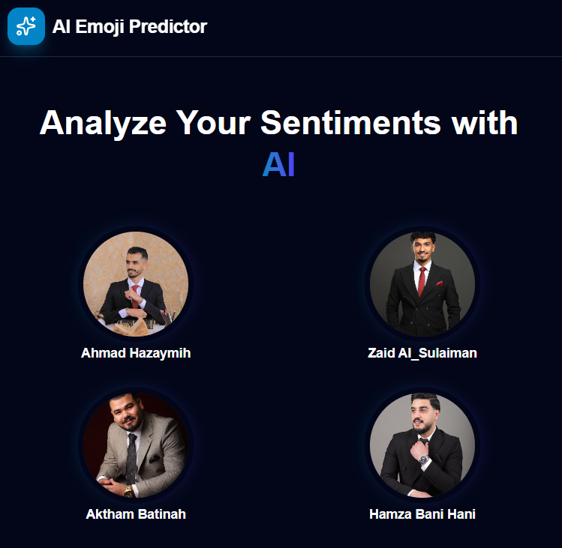
Demo QR
Thank you
Questions?
Live demo: https://emoji-predictor-app.web.app/
GitHub: Ahmad12Rased/Emoji-Prediction-from-Text
Web
Notes:
Closing script: Thank you for listening. We are ready for questions. If time allows, open the live demo and enter one English sentence and one Arabic sentence to show the full workflow.

