Slide 1
Secure Web Scraper Course: Secure Programming
PRESENTED BY : AHMAD RASOOL

Slide 2
Aim & Program Overview
Goal: Build a secure web scraper allowing:
User registration & login Secure URL submission
Scraping HTML content
Downloading scraped data in a password-protected .zip file

Slide 3
Technologies Used
Backend: Node.js, Express.js
Frontend: React.js
Database: SQLite with Sequelize ORM
Security: JWT, bcryptjs, express-validator
Scraping: Axios, Cheerio
Testing: Mocha, Chai, Supertest, Sinon

Slide 4
How the Program Works
User registers/logs in → gets JWT token in cookie
Submits URL → server fetches & extracts text
Text saved to .txt, compressed with 7-zip using password
Password shown to the user, .zip file been downloaded.

Slide 5
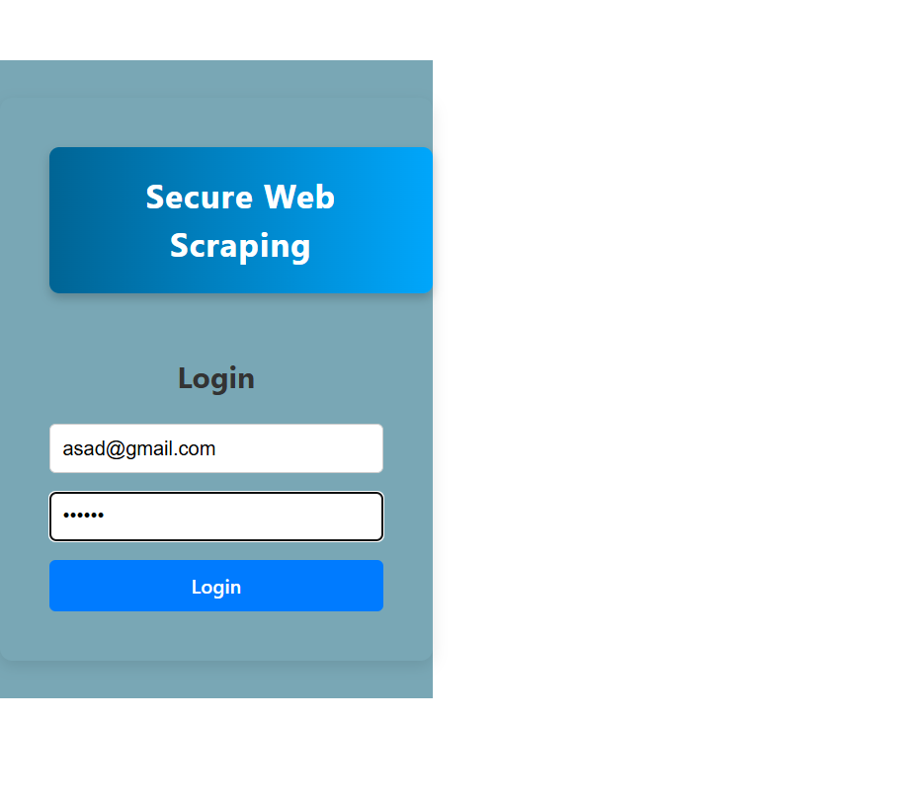
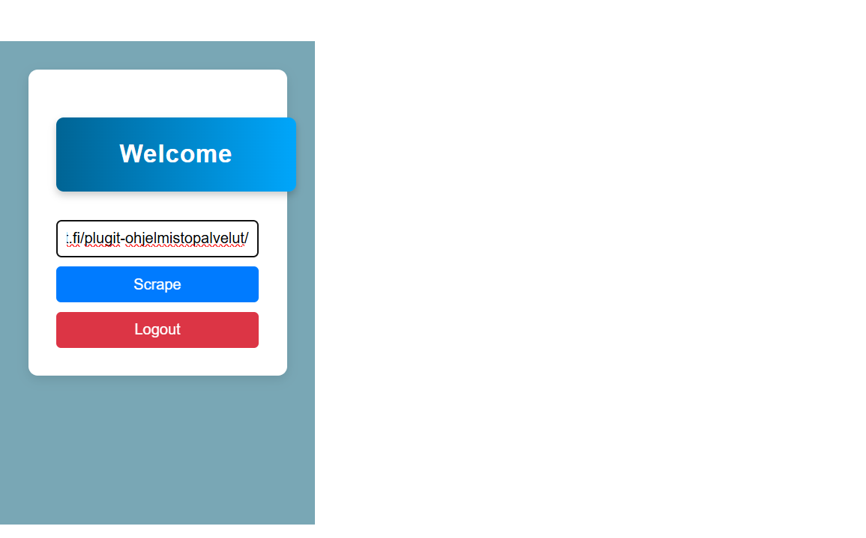
LOGIN SCREEN
HOME SCREEN FOR URL INSERTION

Slide 6
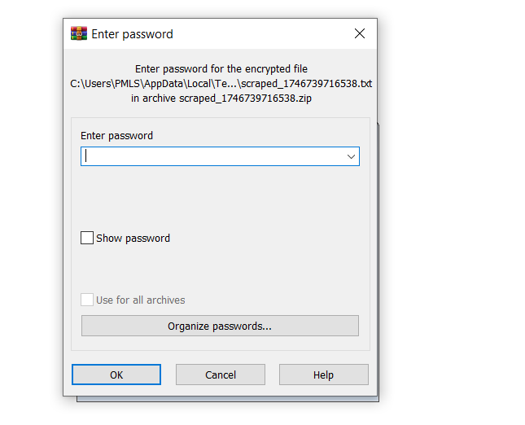
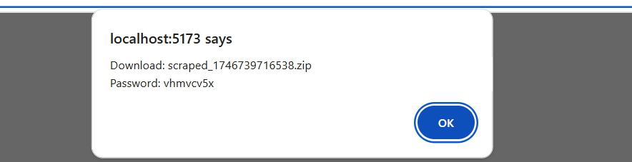
Password for file
PASSWORD FOR OPENING FILE

Slide 7
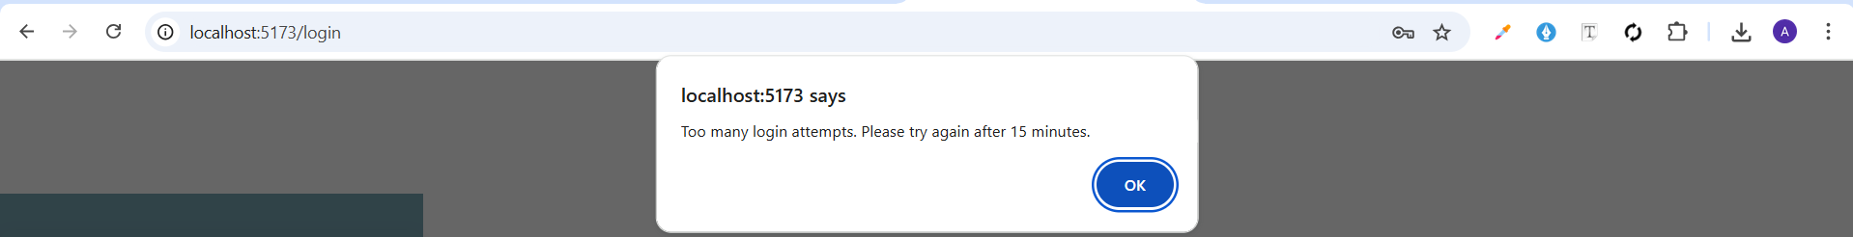
Rate Limiting

Slide 8
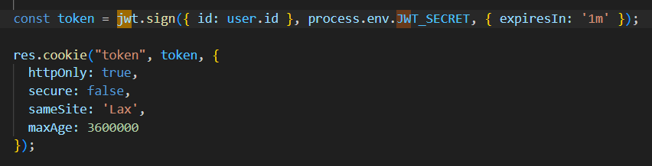
Hashing Password
JWT TOKEN CREATTION AND SAVE IN COOKIE

Slide 9
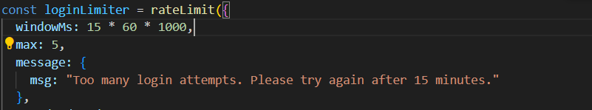
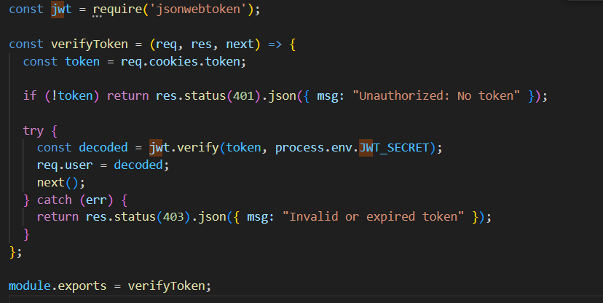
Token verification
Rate limiting

Slide 10
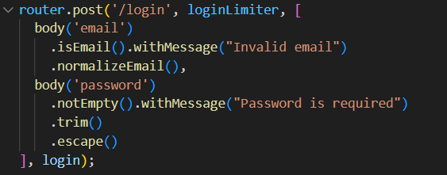
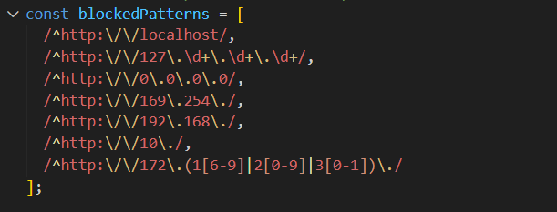
input validation
SSRF PROTECTION

Slide 11
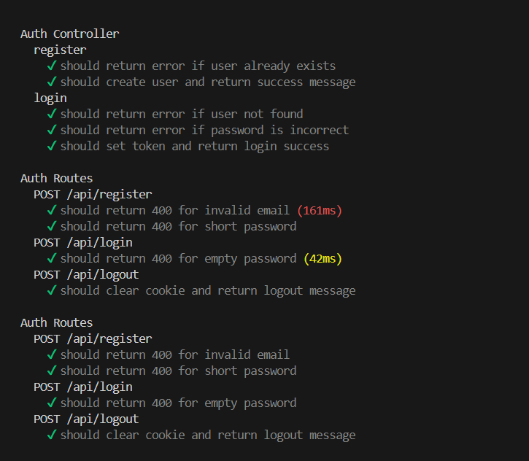
Testing implementation

Slide 12
Conclusion
Secure by design: protected endpoints, validated input, session handling
Real-world security practices (rate limiting, SSRF protection)

Slide 13
THANK YOU

