Slide 1
اللغة العربية لغير الناطقين بها
البرومو: فيديو #8
Notes:
https://vimeo.com/reviews/090b4e08-f081-41b5-8784-8cb5463c3686/videos/1112671790

Slide 2

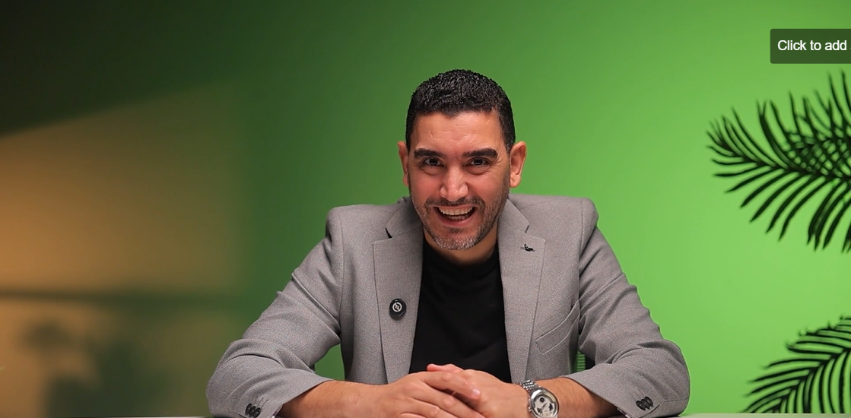
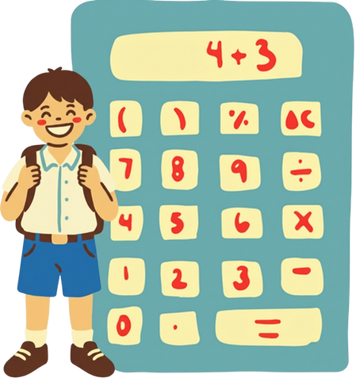
Notes:
Assets:
Instructions to graphic designer:
اظهر ايقونة ولد والة حاسبة
Instructions to video editor:
Sound effects :
مؤثر صوت
On screen text: -------------
Narration:
Hello, my little mathematician!

Slide 3
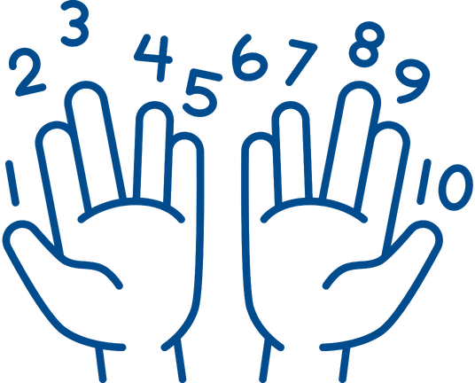
Notes:
Assets:
Instructions to graphic designer:
Instructions to video editor:
اظهر صورة يد تعد من 1 ل 10
Sound effects :
مؤثر صوت ظهور
On screen text:
Arabic adventure
Narration:
Today, we’re going to learn how to **count in Arabic**!

Slide 4
Notes:
Assets:
Instructions to graphic designer:
Instructions to video editor:
Sound effects :
مؤثر صوت ظهور
On screen text:
Narration:
Are you ready to count from 1 to 10 with me?
Let’s go!

Slide 5

Notes:
Assets:
Instructions to graphic designer:
Instructions to video editor:
اظهر شكل مثل المرفق
Sound effects :
مؤثر صوت ظهور
On screen text:
Narration:
**1** = **Wāḥid** (واحِد)

Slide 6
Notes:
Assets:
Instructions to graphic designer:
Instructions to video editor:
اظهر شكل مثل المرفق
Sound effects :
مؤثر صوت ظهور
On screen text:
Arabic Speaker
Narration:
Say it: **Waa-hid**

Slide 7

Notes:
Assets:
Instructions to graphic designer:
Instructions to video editor:
اظهر شكل مثل المرفق
Sound effects :
مؤثر صوت ظهور
On screen text: -------------
Narration:
**2** = **Ithnān** (اِثْنَان)
Say it: **Ith-naan**

Slide 8

Notes:
Assets:
Instructions to graphic designer:
Instructions to video editor:
اظهر شكل مثل المرفق
Sound effects :
On screen text: -------------
Narration:
**3** = **Thalātha** (ثَلَاثَة)
Try this: **Tha-laa-tha**

Slide 9
Notes:
Assets:
Instructions to graphic designer:
Instructions to video editor:
Sound effects :
مؤثر صوت ظهور
On screen text:
Narration:
Great!

Slide 10
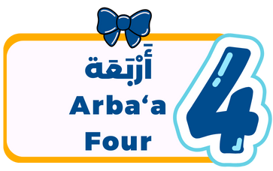
Notes:
Assets:
Instructions to graphic designer:
Instructions to video editor:
اظهر شكل مثل المرفق
Sound effects :
مؤثر صوت ظهور
On screen text:
Narration:
**4** = **Arba‘a** (أَرْبَعَة)
Say: **Ar-ba-a**

Slide 11

Notes:
Assets:
Instructions to graphic designer:
Instructions to video editor:
اظهر شكل مثل المرفق
Sound effects :
مؤثر صوت ظهور
On screen text: -------------
Narration:
**5** = **Khamsa** (خَمْسَة)
Repeat after me: **Kham-sa**
Perfect!

Slide 12

Notes:
Assets:
Instructions to graphic designer:
Instructions to video editor:
اظهر شكل مثل المرفق
Sound effects :
مؤثر صوت ظهور
On screen text: -------------
Narration:
**6** = **Sitta** (سِتَّة)
Say: **Sit-ta**
You’re doing awesome!

Slide 13
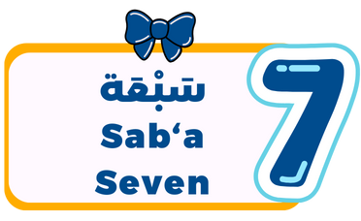
Notes:
Assets:
Instructions to graphic designer:
Instructions to video editor:
اظهر شكل مثل المرفق
Sound effects :
مؤثر صوت ظهور
On screen text: -------------
Narration:
**7** = **Sab‘a** (سَبْعَة)
Repeat: **Sab-a**

Slide 14
Notes:
Assets:
Instructions to graphic designer:
Instructions to video editor:
Sound effects :
On screen text:
Good morning
Goodbye
Narration:
Getting easier, right?

Slide 15

Notes:
Assets:
Instructions to graphic designer:
Instructions to video editor:
اظهر شكل مثل المرفق
Sound effects :
مؤثر صوت ظهور
On screen text:
Narration:
**8** = **Thamāniya** (ثَمَانِيَة)
Say it slow: **Tha-maa-ni-ya**
Amazing!

Slide 16
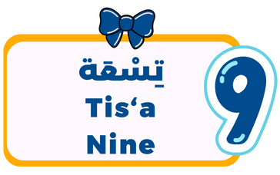
Notes:
Assets:
Instructions to graphic designer:
Instructions to video editor:
اظهر شكل مثل المرفق
Sound effects :
مؤثر صوت ظهور
On screen text:
Narration:
**9** = **Tis‘a** (تِسْعَة)
Repeat: **Tis-a**
You rock!

Slide 17
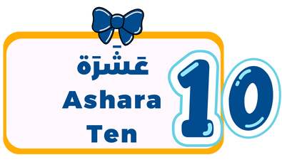
Notes:
Assets:
Instructions to graphic designer:
Instructions to video editor:
اظهر شكل مثل المرفق
Sound effects :
مؤثر صوت ظهور
On screen text:
Narration:
**10** = **‘Ashara** (عَشَرَة)
Last one! Say: **A-sha-ra**

Slide 18
Notes:
Assets:
Instructions to graphic designer:
Instructions to video editor:
Sound effects :
مؤثر صوت ظهور
On screen text:
Narration:
YOU DID IT!
Let’s count them all together now, fast! Ready?

Slide 19
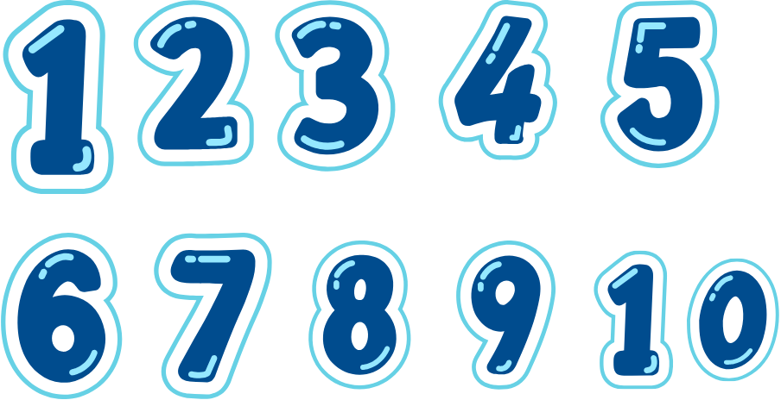
Notes:
Assets:
Instructions to graphic designer:
Instructions to video editor:
اظهر شكل مثل المرفق
Sound effects :
مؤثر صوت ظهور
On screen text:
Narration:
**Wāḥid – Ithnān – Thalātha – Arba‘a – Khamsa – Sitta – Sab‘a – Thamāniya – Tis‘a – ‘Ashara!**

Slide 20
Notes:
Assets:
Instructions to graphic designer:
Instructions to video editor:
Sound effects :
مؤثر صوت ظهور
On screen text:
Narration:
Woohoo! You just counted from 1 to 10 in Arabic!
Next time, we’ll learn the **colors** around us in Arabic — it’s going to be fun and colorful!

Slide 21

Notes:
Assets:
Instructions to graphic designer:
Instructions to video editor:
بالتزامن مع "Ma’a as-salama" اظهر كلمة مع السلامة
Sound effects :
مؤثر صوت ظهور
On screen text: مع السلامة
Narration:
See you there!
Or as we say in Arabic: “Ma’a as-salama

