Slide 1
IN THE NAME OF GOD
Project: Python language roadmap
Student’s name: Ahmadreza Kordi
Teacher's name: Mr. Hashemi
University’s name: Science and Technology of Mazandaran
1/15

Slide 2
Introduction
Python is an object-oriented, interpreted, high-level, open-source, general-purpose programming language.
This language was first published in 1991 by Guido van Rossum in the Netherlands.
This language is one of the interpreted programming languages and is completely an object-oriented language, but this language supports different programming models, including object-oriented and command-oriented and function-oriented programming.
The language structure and object-oriented perspective in Python is designed in such a way that it allows the programmer to write code for small and large projects.
Because of its grammatical structure, this language is easier to learn and use than other languages.
Due to having many libraries, the Python language has made the work simple for users and has made it a useful language in most fields In general, the Python language is very suitable for beginners in the field of programming or people who intend to work in various fields of programming.
2/15

Slide 3
Python job market
Most people who think about making money from Python programming go into data science and data analysis fields. Today's world is surrounded by valuable data, and businesses tend to identify hidden patterns in this data and use them to improve themselves. There is some of most important jobs:
Senior software engineer
DevOps Engineer
data scientist
Senior Data Scientist
Machine learning engineer
Analytical researcher
3/15

Slide 4
In Iran:
In world:
Python income
Junior
Intermediate
Senior
9 million
13 million
21 million
Canada
USA
Germany
121,530 $
122,272 $
90,673 €
4/15

Slide 5
Python Or JAVA
Language:
Python: Python is an interpreted language that can quickly convert programmer code into machine-readable code.
Java: The source code of this language is compiled into a binary byte code, so we can consider Java as a compiled and interpreted language.
Popularity:
According to information published by GitHub, Stack Overflow, Octoverse and Google Trends, the difference between Python and Java is that Python is relatively more popular.
5/15

Slide 6
Python Or JAVA
Speed:
Python: Due to its convenience and simplicity, development in Python is faster.
Java: Java projects usually take longer and require a larger development team.
Conclusion:
Considering these and other topics, we can say that Python is a better language for programming in many ways.
6/15

Slide 7
PYTHON IS EASIEST
Learning Python for beginners is a quick and easy way to enter a programming career. Due to the simplicity of code development and the existence of open source libraries, learning this language is ideal for beginners and provides a suitable platform for choosing expertise in one of the fields of web, artificial intelligence, network and data mining.
The amount of time it takes to learn Python is highly variable and depends on factors such as your programming experience, the time you can devote to the process, and your commitment. But on average, it takes about 3 to 6 months to reach an intermediate and practical level in Python.
7/15

Slide 8
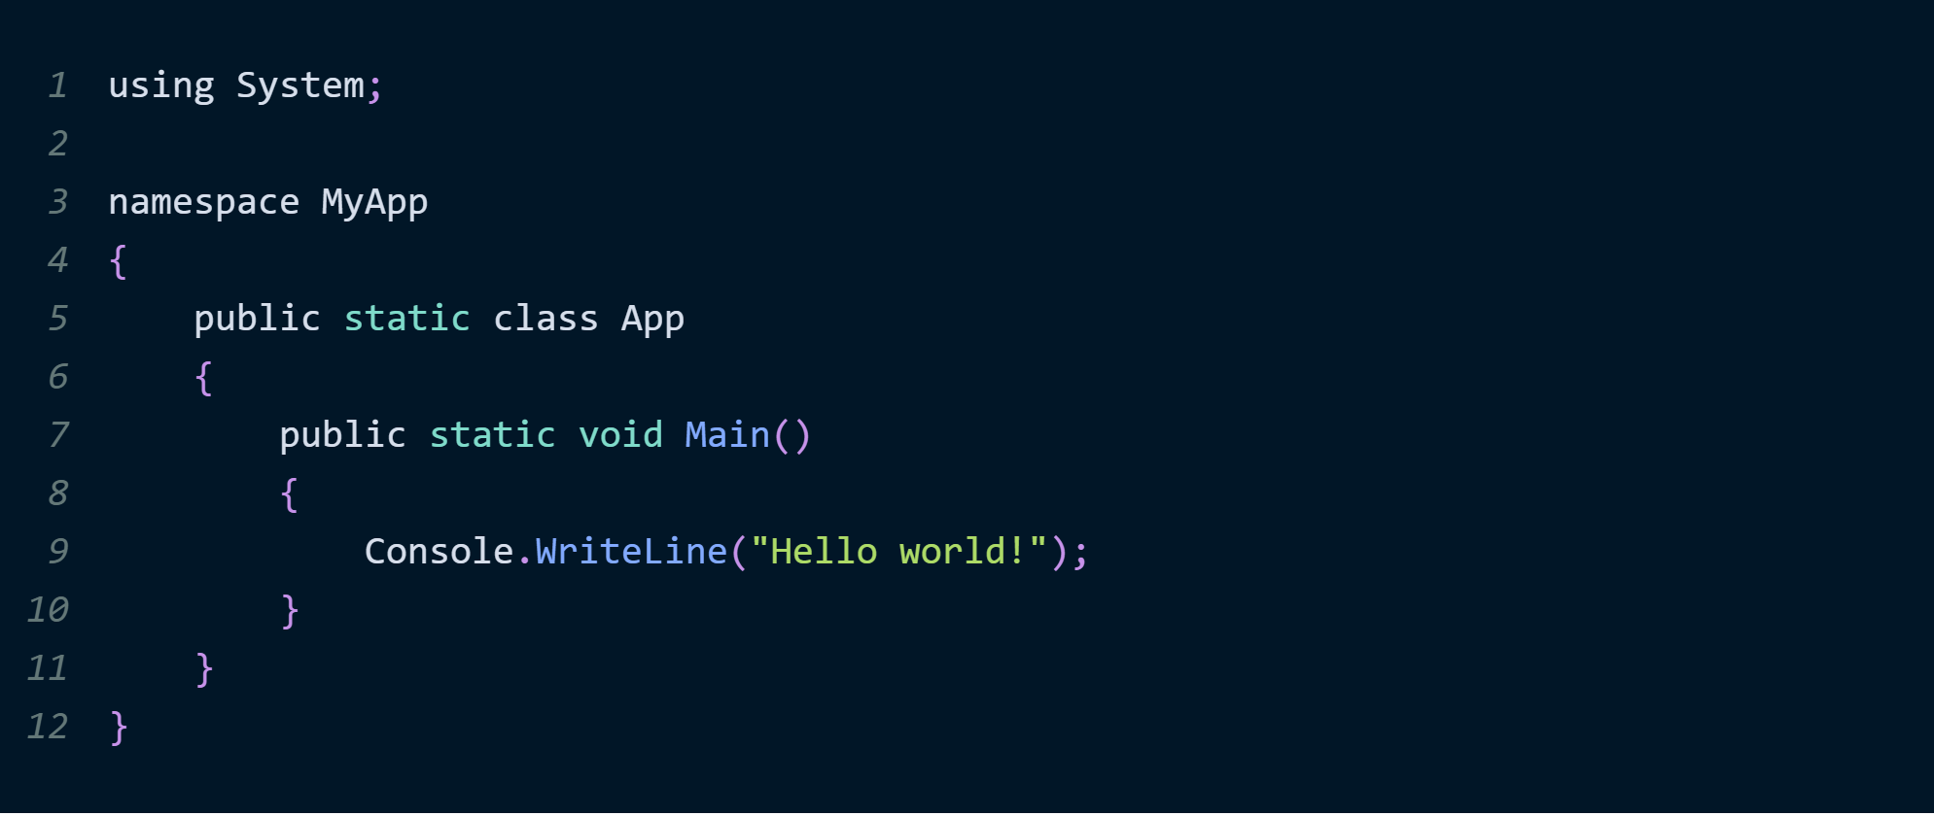
PYTHON IS EASIEST
Now we wanna compare python with other languages in coding simplity:
C#:
8/15

Slide 9
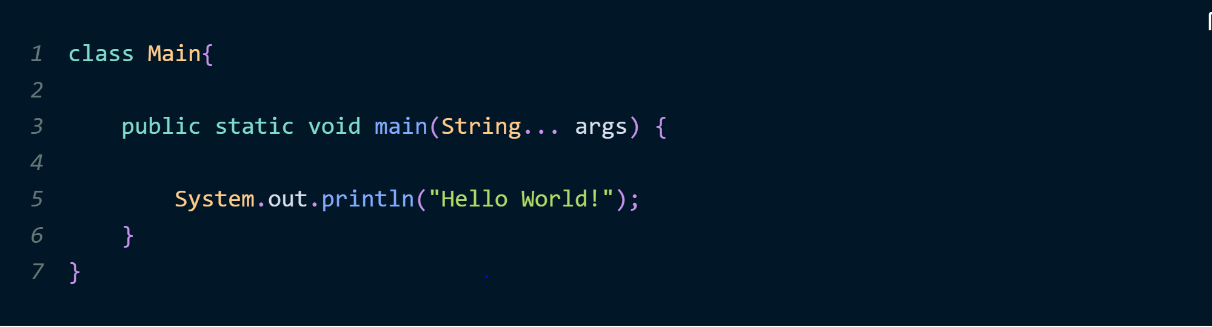
PYTHON IS EASIEST
Java:
Python:
9/15

Slide 10
Python Usages
01
02
03
Data Science
Machine Learning
Data Analyze
04
05
06
07
Web Development
Web Scraping
Game Development
Hack & Security
10/15

Slide 11
Python IN AI
Python AI refers to the use of the Python programming language in the field of artificial intelligence (AI).
Python is widely used in AI development due to its simplicity, ease of use, and rich ecosystem of libraries and frameworks that support various AI tasks.
These applications of Python in the field of artificial intelligence include natural language processing, machine learning, deep learning, computer vision, etc.
Python's popularity in the AI community stems from its flexibility, which allows researchers and developers to efficiently test and implement AI solutions.
Advantages of learning artificial intelligence with Python:
Easy to learn and syntax
Artificial intelligence libraries
Acceptance in the field of AI
11/15

Slide 12
Python Roadmap
Basic
Advance
Data Types
Variables
Conditions
Loops
Basic Modules
File
Basic OOP
Advanced OOP
Functional Programing
Error Handlig
Multi threading
Regex
Testing
Decorator
Generator
Iterator
Python Libraries
Numpy, Pandas, Matplotlib, Seaborn, Scipy, Tensorflow, Keras
12/15

Slide 13
Learning rESOURCES
Udemy
Coursera
Downloadly
W3Schools
Ramin Saljoughinejad
Darsman Academy
13/15

Slide 14
rESOURCES
Python.org
Wikipedia.org
Darsman.com
14/15

Slide 15
The End …
15/15

