Slide 1


Slide 2
Recommended Books
Principles of Information Security, 2015 4th Edition by Michael E. Whitman and Herbert J. Mattord.
Computer Security: Art and Science, Matthew Bishop, 2018, 2nd Edition, ISBN-10: 0321712331, ISBN-13: 978-0321712332
Cryptography and Network Security by William Stalling 7th Edition, 2015
Principles of Information Security, 2nd Edition

Slide 3
Course Evaluation Criteria
Mid Exam: 30%
Final Exam: 50%
Quiz: 10%
Assignments: 5%
Attendance 5%
Principles of Information Security, 2nd Edition

Slide 4
Week Wise Distribution of the Contents
Lecture Number | Topic
W1 | Introduction and Overview of Information Security Understanding the Threats: Malicious software, Viruses, trojans, rootkits, worms, botnets.
W2 | Memory exploits (buffer overflow, heap overflow, integer overflow, format string)
W3 | Formalisms: Access control theory, access control matrix, Information flow), Policies: Security policies, Confidentiality policies (BLP model),
W4 | Integrity policies (Biba, and Clark-Wilson model), Hybrid policies (Chinese Wall model, role-based access control)
W5 | Cryptography Block and stream ciphers, Cryptographic hash functions., Message Authentication Codes (MAC), Public and private key systems, Message digests. Approximate strength of ciphers, Authentication, Password system.
W6 | Systems Secure design principles (Least-privilege, fail safe defaults, complete mediation, separation of privilege.
W7 | TCB and security kernel construction, System defense against memory exploits
W8 | UNIX security and Security-Enhanced Linux (SELinux),Windows security.
W9 | Network Security: TCP/IP security issues, DNS security issues and defenses, TLS/SSL. Network Intrusion detection and prevention systems ,Firewalls.
W10 | Software Security: Vulnerability auditing, penetration testing, Sandboxing, Control flow integrity.
W11 | Web Security: User authentication, authentication-via-secret and session management.
W12 | Cross Site Scripting, Cross Site Request Forgery, SQL Injection.
W13 | database security
W14 | host- based and network-based security issues, operational security issues, physical security issues; personnel security electronic voting
W15 | classification and trust modeling; risk assessment, IDS
W16 | Legal and Ethical Issues: Cybercrime and computer crime, Intellectual property, copyright, patent, trade secret, Hacking and intrusion, Privacy, identity theft.
Principles of Information Security, 2nd Edition

Slide 5
What is Security?
“The quality or state of being secure—to be free from danger”
Protection against adversaries
For example,
National security is a multilayered system that protects the independence of a state, its assets, its resources, and its people
Principles of Information Security, 2nd Edition
Notes:
What Is Security?
In general, security is “the quality or state of being secure--to be free from danger.”
It means to be protected from adversaries--from those who would do harm, intentionally or otherwise.
What Is Security?
A successful organization should have the following multiple layers of security in place for the protection of its operations:
Physical security - to protect the physical items, objects, or areas of an organization from unauthorized access and misuse.
Personal security – to protect the individual or group of individuals who are authorized to access the organization and its operations.
Operations security – to protect the details of a particular operation or series of activities.
Communications security – to protect an organization’s communications media, technology, and content.
Network security – to protect networking components, connections, and contents.

Slide 6
Security Types
Physical security
  To Protect physical items, objects and areas from unauthorized access
Personal security
    To protect individual or group of individuals who are authorized to access the organization and its operations
Operations security
    To protect the detail of particular operation or activity
Communications security
    To protect communication media, technology and content
Network security
    To protect networking components, connections and contents
Information security
    To protect information assets
Principles of Information Security, 2nd Edition
Notes:
What Is Security?
In general, security is “the quality or state of being secure--to be free from danger.”
It means to be protected from adversaries--from those who would do harm, intentionally or otherwise.
What Is Security?
A successful organization should have the following multiple layers of security in place for the protection of its operations:
Physical security - to protect the physical items, objects, or areas of an organization from unauthorized access and misuse.
Personal security – to protect the individual or group of individuals who are authorized to access the organization and its operations.
Operations security – to protect the details of a particular operation or series of activities.
Communications security – to protect an organization’s communications media, technology, and content.
Network security – to protect networking components, connections, and contents.

Slide 7
What is Information Security?
The protection of information and its critical elements, including systems and hardware that use, store, and transmit that information
Necessary tools:
  Policy
  Awareness
  Training
  Education
  Technology
Principles of Information Security, 2nd Edition
Notes:
What Is Information Security?
Information security, therefore, is the protection of information and its critical elements, including the systems and hardware that use, store, and transmit that information.
But to protect the information and its related systems from danger, tools, such as policy, awareness, training, education, and technology are necessary.
The C.I.A. triangle has been considered the industry standard for computer security since the development of the mainframe. It was solely based on three characteristics that described the utility of information: confidentiality, integrity, and availability.
The C.I.A. triangle has expanded into a list of critical characteristics of information.

Slide 8
Critical Characteristics of Information
The value of information comes from the characteristics it possesses:
  Timeliness
    No value if it is too late
  Utility
    Quality or state of having value for some purpose
    Information has value when it can serve a purpose.
    If information is available, but is not in a format meaningful to the end user, it is not useful.
  Authenticity
    Quality or state of being genuine rather than a reproduction.
    Information is authentic when it is in the same state in which it was created, placed, stored, or transferred. i.e., sender of an email
Principles of Information Security, 2nd Edition
Notes:
Critical Characteristics Of Information
The value of information comes from the characteristics it possesses.
Availability - enables users who need to access information to do so without interference or obstruction and in the required format. The information is said to be available to an authorized user when and where needed and in the correct format.
Accuracy- free from mistake or error and having the value that the end-user expects. If information contains a value different from the user’s expectations due to the intentional or unintentional modification of its content, it is no longer accurate.
Authenticity - the quality or state of being genuine or original, rather than a reproduction or fabrication. Information is authentic when it is the information that was originally created, placed, stored, or transferred.
Confidentiality - the quality or state of preventing disclosure or exposure to unauthorized individuals or systems.
Integrity - the quality or state of being whole, complete, and uncorrupted. The integrity of information is threatened when the information is exposed to corruption, damage, destruction, or other disruption of its authentic state.
Utility - the quality or state of having value for some purpose or end. Information has value when it serves a particular purpose. This means that if information is available, but not in a format meaningful to the end-user, it is not useful.
Possession - the quality or state of having ownership or control of some object or item. Information is said to be in possession if one obtains it, independent of format or other characteristic. While a breach of confidentiality always results in a breach of possession, a breach of possession does not always result in a breach of confidentiality.

Slide 9
Critical Characteristics of Information
  Confidentiality
    Disclosure or exposure of information to unauthorized individuals or system is prevented
  Integrity
    Information has integrity when it is Whole, completed and uncorrupted
    Size of the file, hash values, error-correcting codes, retransmission
  Availability
    Authorized access information without interference or obstruction and to receive it in the required format.
  Accuracy
    Free from mistakes
Principles of Information Security, 2nd Edition

Slide 10
Components of an Information System
Information System (IS) is entire set of software, hardware, data, people, procedures, and networks necessary to use information as a resource in the organization
Software
  Perhaps most difficult component to secure
  Easy target of accidental or intentional attacks
  Exploitation of errors in software programming accounts for a substantial portion of attacks on information
Hardware
  Physical security policies
  Securing physical location important
  Thefts of smartphones, Laptops and Flash memory are common now a days
Principles of Information Security, 2nd Edition
Notes:
Components Of An Information System
Software is perhaps the most difficult IS component to secure. The exploitation of errors in software programming accounts for a substantial portion of the attacks on
information.

Slide 11
Components of an Information System
Data
  Often most valuable asset
  Main target of intentional attacks
People
  Can be Weakest link organization’s information security program
  Social engineering
  Must be well trained and informed
Procedures
  Threat to integrity of data
Networks
  Locks and keys won’t work
  Implementation of alarm and intrusion detection systems
Principles of Information Security, 2nd Edition

Slide 12
Approaches to Information Security Implementation: Bottom-Up Approach
Grassroots effort: systems administrators attempt to improve security of their systems
Key advantage: Technical expertise of individual administrators are used.
Seldom works, as it lacks a number of critical features like
  Participant support
  Organizational staying power
Principles of Information Security, 2nd Edition
Notes:
Bottom Up Approach To Security Implementation
Security can begin as a grass-roots effort when systems administrators attempt to improve the security of their systems. This is referred to as the bottom-up approach.
The key advantage of the bottom-up approach is the technical expertise of the individual administrators.
Unfortunately, this approach seldom works, as it lacks a number of critical features, such as participant support and organizational staying power.

Slide 13
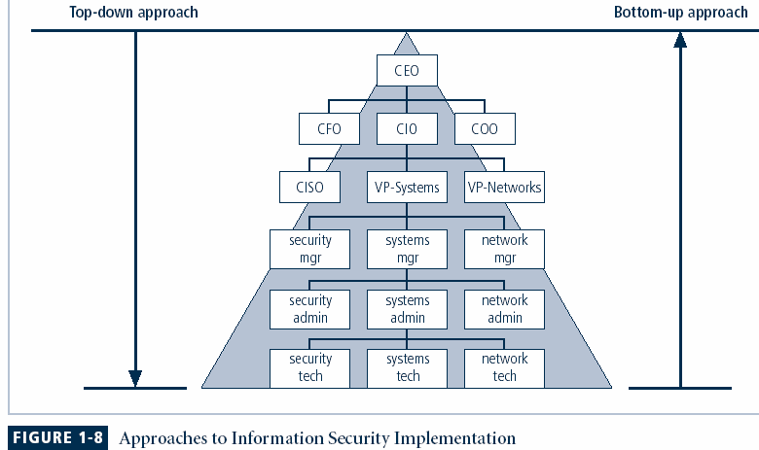
Principles of Information Security, 2nd Edition
Notes:
Key concept here is the direction of the left and right side arrows to show where planning is sourced and from which direction the pressure for success if driven.

Slide 14
Approaches to Information Security Implementation: Top-Down Approach
Initiated by upper management
  Issue policy, procedures and processes
  Dictate goals and expected outcomes of project
  Determine accountability for each required action
The most successful also involve formal development strategy referred to as systems development life cycle
Principles of Information Security, 2nd Edition
Notes:
Top-down Approach to Security Implementation
An alternative approach, which has a higher probability of success, is called the top-down approach. The project is initiated by upper management who issue policy, procedures and processes, dictate the goals and expected outcomes of the project, and determine who is accountable for each of the required actions.
The top-down approach has strong upper management support, a dedicated champion, dedicated funding, clear planning and the opportunity to influence organizational culture.
The most successful top-down approach also involves a formal development strategy referred to as a systems development life cycle.

Slide 15
Balancing Information Security and Access
Impossible to obtain perfect security—it is a process, not an absolute
Security should be considered balance between protection and availability
To achieve balance, level of security must allow reasonable access, yet protect against threats
Principles of Information Security, 2nd Edition
Notes:
Security And Access Balancing
When considering information security, it is important to realize that it is impossible to obtain perfect security. Security is not an absolute; it is a process not a goal.
Security should be considered a balance between protection and availability.
To achieve balance the level of security must allow reasonable access, yet protect against threats.

Slide 16
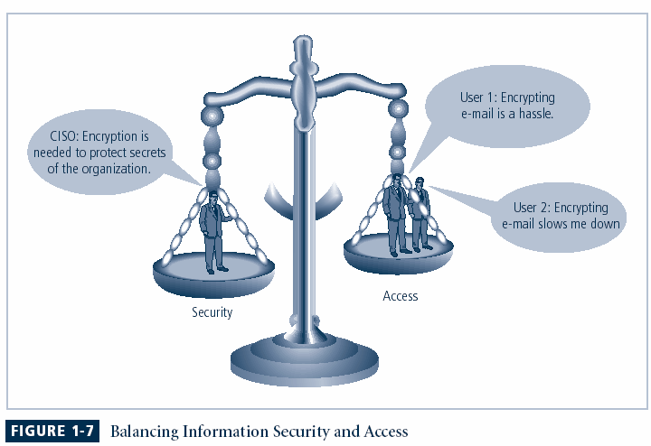
Figure 1-6 – Balancing Security and Access
Principles of Information Security, 2nd Edition
Notes:
This graphic intends to show that tradeoffs between security and access.

Slide 17
Terminologies of IS
Subject/ Object
  When the subject of an attack, computer is used as an active tool to conduct attack
  When the object of an attack, computer is the entity being attacked
Access
  A subject or object’s ability to use, manipulate, modify, or affect another subject or object
Asset
  The organizational resource that is being protected.
  Asset may be logical or physical
Principles of Information Security, 2nd Edition
Notes:
Key Terms
Access: A subject or object’s ability to use, manipulate, modify, or affect another subject or object. Authorized users have legal access to a system, whereas hackers have illegal access to a system. Access controls regulate this ability.
Asset: The organizational resource that is being protected. An asset can be logical, such as a Web site, information, or data; or an asset can be physical, such as a person, computer system, or other tangible object. Assets, and particularly information assets, are the focus of security efforts; they are what those efforts are attempting to protect.

Slide 18
Terminologies of IS
Attack
  An intentional or unintentional act that can cause damage to or otherwise compromise information and/or the systems that support it.
  Attacks can be
    Active or Passive
    Direct or Indirect
Control, Safeguard or Countermeasure
  Security mechanisms, policies, or procedures that can successfully counter attacks, reduce risk, resolve vulnerabilities, and otherwise improve the security within an organization.
Principles of Information Security, 2nd Edition
Notes:
Key Terms
Access - a subject or object’s ability to use, manipulate, modify, or affect another subject or object.
Asset - the organizational resource that is being protected.
Attack - an act that is an intentional or unintentional attempt to cause damage or compromise to the information and/or the systems that support it.
Control, Safeguard or Countermeasure - security mechanisms, policies or procedures that can successfully counter attacks, reduce risk, resolve vulnerabilities, and otherwise improve the security within an organization.
Exploit – to take advantage of weaknesses or vulnerability in a system.
Exposure - a single instance of being open to damage.
Hack - Good: to use computers or systems for enjoyment; Bad: to illegally gain access to a computer or system.
Object - a passive entity in the information system that receives or contains information.
Risk - the probability that something can happen.
Security Blueprint - the plan for the implementation of new security measures in the organization.
Security Model - a collection of specific security rules that represents the implementation of a security policy.
Security Posture or Security Profile - a general label for the combination of all policy, procedures, technology, and programs that make up the total security effort currently in place.
Subject - an active entity that interacts with an information system and causes information to move through the system for a specific end purpose
Threats - a category of objects, persons, or other entities that represents a potential danger to an asset.
Threat Agent - a specific instance or component of a more general threat.
Vulnerability - weaknesses or faults in a system or protection mechanism that expose information to attack or damage.

Slide 19
Terminologies of IS
Exploit
  A technique used to compromise a system
Exposure
  A condition or state of being exposed.
  In IS, exposure exists when a vulnerability known to an attacker is present.
Loss
  A single instance of an information asset is damaged, modified or disclosed by unauthorized personx
Principles of Information Security, 2nd Edition
Notes:
Key Terms
Exploit: A technique used to compromise a system. This term can be a verb or a noun. Threat agents may attempt to exploit a system or other information asset by using it illegally for their personal gain. Or, an exploit can be a documented process to take advantage of a vulnerability or exposure, usually in software, that is either inherent in the software or is created by the attacker. Exploits make use of existing software tools or custom-made software components.
Loss:
A single instance of an information asset suffering damage or unintended or unauthorized modification or disclosure. When an organization’s information is stolen, it has suffered a loss.

Slide 20
Terminologies of IS
Protection profile or security posture:
  The entire set of controls and safeguards, that the organization implements to protect the asset
Risk
  The probability that something unwanted will happen
Threat
  A category of objects, persons, or other entities that presents a danger to an asset.
Threat agent
  The specific instance or a component of a threat.
Principles of Information Security, 2nd Edition
Notes:
Protection profile or security posture: The entire set of controls and safeguards, including policy, education, training and awareness, and technology, that the organization implements (or fails to implement) to protect the asset. The terms are sometimes used interchangeably with the term security program.
Threat: A category of objects, persons, or other entities that presents a danger to an asset. Threats are always present and can be purposeful or undirected. For example, hackers purposefully threaten unprotected information systems, while severe storms incidentally threaten buildings and their contents.
Threat agent: The specific instance or a component of a threat. For example, all hackers in the world present a collective threat, while Kevin Mitnick, who was convicted for hacking into phone systems, is a specific threat agent. Likewise, a lightning strike, hailstorm, or tornado is a threat agent that is part of the threat of severe storms.

Slide 21
Terminologies of IS
Vulnerability
  A weaknesses or fault in a system or protection mechanism that opens it to attack or damage.
    Flaw in a software package,
    An unprotected system port,
    An unlocked door.
Principles of Information Security, 2nd Edition
Notes:
Key Terms
Vulnerability: A weaknesses or fault in a system or protection mechanism that opens it to attack or damage. Some examples of vulnerabilities are a flaw in a software package, an unprotected system port, and an unlocked door. Some well-known vulnerabilities have been examined, documented, and published; others remain latent (or undiscovered).

Slide 22
Malware
Malware (short for "malicious software") refers to any software designed to harm or exploit a device, network, or service. Here are some common types of malware along with everyday examples:
1. Virus
What it does: Attaches itself to files and spreads from one device to another when those files are shared.
Daily Life Example: You receive a file from a friend through email or USB drive. If the file has a virus, it can infect your computer and spread to other files or devices you connect.
2. Worm
What it does: Self-replicates and spreads through networks without needing to attach to files.
Daily Life Example: A worm could spread across a company's network, slowing down all computers and potentially stealing data without anyone opening a file. For example, the "ILOVEYOU" worm spread through email and infected millions of computers.
Principles of Information Security, 2nd Edition
Notes:
The ILOVEYOU worm was a destructive malware attack from May 2000 that spread globally through email. Disguised as a love letter attachment named "LOVE-LETTER-FOR-YOU.txt.vbs," it tricked users into opening it. Once opened, the worm replicated itself by sending copies to all contacts in the victim’s email address book, causing severe data loss and network disruptions. The attack led to billions of dollars in damage and highlighted the dangers of social engineering, sparking advancements in email security practices and awareness about suspicious attachments.

Slide 23
3. Trojan (Trojan Horse)
What it does: Disguises itself as a legitimate application to trick users into downloading it, then performs malicious activities.
Daily Life Example: You download what appears to be a free game or app, but once installed, it secretly steals your data or opens a backdoor for hackers.
4. Ransomware
What it does: Encrypts your files and demands a ransom to unlock them.
Daily Life Example: You open a seemingly harmless attachment in an email, only to find your files are locked, and a message demands payment to get them back. A well-known ransomware attack is "WannaCry," which affected many users worldwide.
5. Spyware
What it does: Secretly monitors your activities and collects sensitive information, such as passwords or credit card numbers.
Daily Life Example: You download free software from an untrusted source, and it starts tracking your web activity and keylogging (recording your keystrokes) to capture passwords.

Slide 24
6. Adware
What it does: Displays unwanted ads, often in pop-up windows, and may collect data to target you with specific ads.
Daily Life Example: After installing free software, your browser is suddenly filled with annoying ads that redirect you to unknown sites. Sometimes, it installs toolbars or changes your browser settings.
7. Keylogger
What it does: Records keystrokes to capture sensitive information, like passwords and personal messages.
Daily Life Example: You unknowingly install a keylogger by downloading a suspicious file, and it starts recording everything you type, including your banking information.
8. Rootkit
What it does: Hides deep in a system to give hackers remote control over it, often staying undetected.
Daily Life Example: After clicking a suspicious link, a rootkit installs itself on your system and allows an attacker to control your device without you knowing.

Slide 25
9. Botnet
What it does: Turns your device into a "bot" or "zombie" controlled by an attacker to carry out large-scale attacks.
Daily Life Example: Your computer unknowingly joins a botnet and participates in a Distributed Denial of Service (DDoS) attack against a website, slowing down your internet and consuming resources.
Principles of Information Security, 2nd Edition

