Slide 1
CSE-861-Software System Design and Architecture
Introduction

Slide 2
My Introduction
Research Interests
UML (current ver 2.4.1)
Model Driven Architecture
Software Architecture
Web Engineering
Software Requirements Engineering

Slide 3
SDA Course Objectives
To teach the issues, techniques and methods that are at the heart of sound architectural practices.
To expose the description and analysis of the general purpose component and middleware technologies that support many of the fundamental architectural styles.
To give ideas about changes in technologies and practices, and how these may affect the next generation of business information systems, like banking, e-commerce and government information systems.
To provide pointers and references to existing work on software architecture.
Dr Farooque Azam, CEME, NUST

Slide 4
Evaluation Components
Evaluation
  Quizzes - 04%
  Assignments - 08%
  Research Paper - 08%
  Sessionals - 30%
  Final - 50%
  -------------------------------------------------
  Total =100%

Slide 5
Content Outline
Broad Introduction to the area of SA
UML / SysML / OCL Review
Model Driven Architecture / QVT
Software Design Patterns
Architectural Styles and Views
Selected Software Architectures
Middleware Architectures and Technologies

Slide 6
Text Books
Essential Software Architecture, Second Edition by Ian Gorton, Published by Springer, 2011
Reference Books
UML Tool Kit (OMG Press- 2004)
The Unified Modeling Language User Guide SECOND EDITION By Grady Booch, James Rumbaugh, Ivar Jacobson - 2005
Documenting Software Architectures, Views and Beyond Second Edition - 2011
Pattern-Oriented Software Architecture For Dummies, Robert Hanmer, 2013
Other references will be provided as needed

Slide 7
Writing of Research Paper
Two students to contribute a paper

Slide 8
Research Paper
You have 2 Options
Improve and submit the previous paper
  Before submission you need to upload to LMS for plagiarism check and my final approval. Do it by 4th week.
  If are able to get confirmation of publishing before 16th week of the semester. You will get 80% mks for conference and 100% mks for journal.
  No publication. No marks.
Write the new paper with same plan / criteria as in the previous semester.
You can avail both options. Best of 2 will be considered.

Slide 9
Research Paper
Instructions
1. Ideas of the research paper must be intuitive
2. If it is a survey paper it must be a Systematic Literature Review (a sample paper is attached)
3. If you are proposing a new Idea, then properly explain the idea through some case study etc
4. All References must be of original conference and journal Research papers, No blog entry or white papers, Wikipedia topic will be counted as reference, 20% refrences from internet can be used
5. Referred papers must be of IEEE, ACM, ELSEVIER, SPRINGERLINK or some well known items of digital library
6. At least 40 % references must be from journals and rest may be from conferences.

Slide 10
Research Paper
Marking Criteria
5% Mks - No of pages (at least 15 pages) of single column, font size 11 - times roman, line spacing single. Margin 1” all sides. As per given format. No need of acknowledgment
5% - References at least 12 (from year 2006 onwards)
10% - Figures + flow charts + graphs + tables >= 12 - All should be of readable size. Don’t copy-paste (make your own). Each item to be give the number and Caption (Table1-ASD, Figure 2-SPM etc)
20% - Timely submission
  5% - 1st Draft (5th week) >=5 pages – 5% 2nd Draft (10th week) >= 12 pages – 10% Full paper >= 15 pages (13^{h} week)
60% - Structure & Content Quality, For : -
  SI=<10%, no deduction,
  10<SI<20%= 20%
  25<SI<20%= 30%,
  30<SI<25%= 40%,
  SI > 30% = 60%

Slide 11
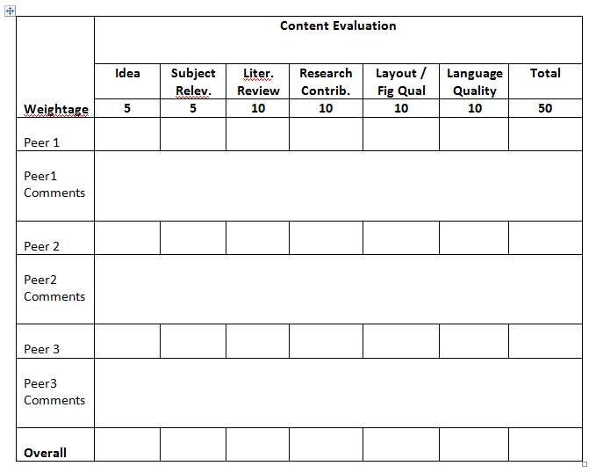

Content will be Peer Reviewed
Marking Criteria
20
60

Slide 12
Project
As a first step learn Papyrus UML/SysML/Marte Tool
Here is the starting point https://www.eclipse.org/papyrus/usersTutorials/usersTutorialsIndex.php
There is procedure to install papyrus on eclipse
If you face any problem in installation, you may use this link to download preinstalled eclipse.zip file
https://drive.google.com/open?id=0BxsKXoetunzVdEd4WU84aUxvUkU&authuser=0
Just unzip and double click eclipse exe to run the application
Further details on the project will be provided later.

Slide 13
Software Architecture Basics
Pattern-Oriented Software Architecture For Dummies, Robert Hanmer, 2013

Slide 14
Introduction
The term software architecture means different things to different people.
To the developer, it means the structure of the system being built.
To the framework developer, it’s the shape of the system that is created with the framework.
To the tester, it’s the shape of what needs to be tested.
For all concerned, it’s the high-level structure of the solution to a problem that the customer or client wants solved.

Slide 15
Components of software architecture
The software architecture provides the high-level view of the system you’re building and must cover the following aspects: -
  Goals and philosophy of the system
  Architectural assumptions and dependencies
  Architecturally significant requirements
  Packaging instructions for subsystems and components
  Critical subsystems and layers
  References to architecturally significant design elements
  Critical system interfaces
  Key scenarios that describe critical behavior of the system
Notes:
Goals and philosophy of the system: The architecture explains the
goals and describes the purpose of the system, as well as who uses it
and what problem it solves.
✓ Architectural assumptions and dependencies: The architecture explains
the assumption made about the environment and about the system
itself. The architecture also explains any dependencies on other systems
or on the builders of the system.
✓ Architecturally significant requirements: The architecture points to the
most significant requirements that shaped it.
✓ Packaging instructions for subsystems and components: The architecture
explains how the parts of the system are deployed on computing
platforms and how the parts must be combined for proper functioning. The
subsystems and components are the building blocks of the architecture.
✓ Critical subsystems and layers: The architecture explains the different
views and parts of the system and how they relate. It also explains the
most critical subsystems in detail.
✓ References to architecturally significant design elements: The architecture
describes the most prominent and significant parts of the design.
✓ Critical system interfaces: The architecture describes the interfaces of
the system, with special attention to the interfaces that are critical to
meet the system’s requirements.
✓ Key scenarios that describe critical behavior of the system: The architecture
explains the most important scenarios that illustrate and explain
how the system will be used.

Slide 16
Architecture models (views)
The software architecture has several audiences, including fellow architects, programmers, configuration managers, testers, and customers.
All are interested in different information, and all look for different things within the architecture.
4+ 1 View architecture is popular choice for documenting the architecture.
The term “architecture views” got popularity from Philippe Krutchen’s 1995 paper “Architectural Blueprints–The ‘4+1’ View Model of Software Architecture”, IEEE Software, 12(6) Nov. 1995

Slide 17
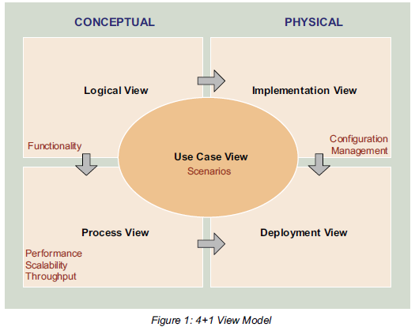
Architecture Views
Reference: Applying 4+1 View Architecture with UML 2 http://www.sparxsystems.com/downloads/whitepapers/FCGSS_US_WP_Applying_4+1_w_UML2.pdf

Slide 18
Architecture Views
Logical View - Describes the systems behaviour in terms of structural components (elements, abstractions, separation of concerns, and responsibilities)

Slide 19
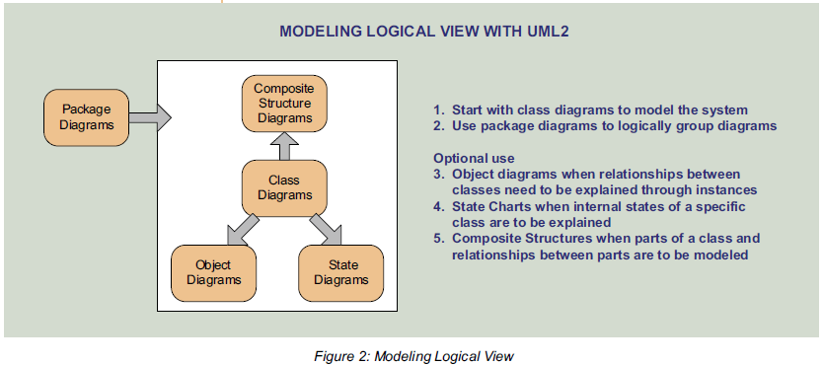
Modeling Logical View
Reference: Applying 4+1 View Architecture with UML 2 http://www.sparxsystems.com/downloads/whitepapers/FCGSS_US_WP_Applying_4+1_w_UML2.pdf

Slide 20
Architecture Views
Process View
  Addresses non-functional requirements such as performance, scalability, throughput, concurrency, and fault tolerance
  Decomposes system processes into tasks
  Maps structural components from the Logical View to processes and threads that represent tasks

Slide 21
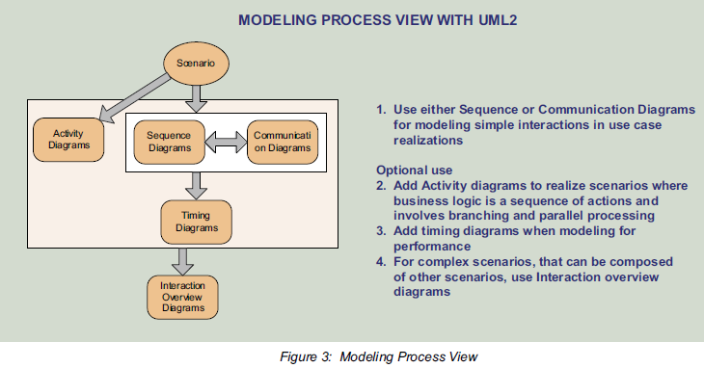
Modeling Process View
Reference: http://www.sparxsystems.com/downloads/whitepapers/FCGSS_US_WP_Applying_4+1_w_UML2.pdf

Slide 22
Architecture Views
Implementation (Development) View
  Addresses configuration management
  Maps structural components from the Logical View to physical software packages
  Describes dependencies needed to assemble the physical system

Slide 23
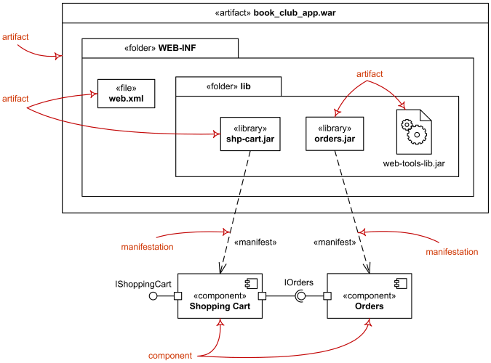
Implementation View

Slide 24
Architecture Views
Deployment View
  Maps processes and software components to hardware nodes
  Describes communication paths between nodes

Slide 25
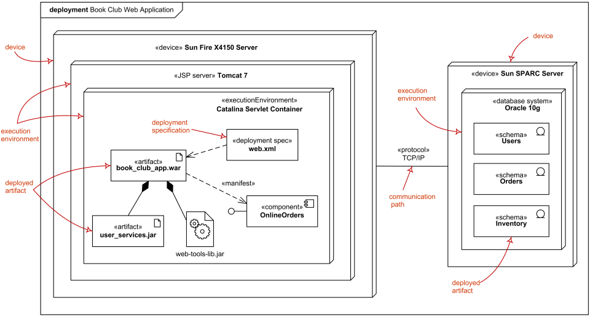
Deployment View

Slide 26
Architecture Views
These views are tied together by the architecturally significant use cases (+1) - often called [scenarios].

Slide 27
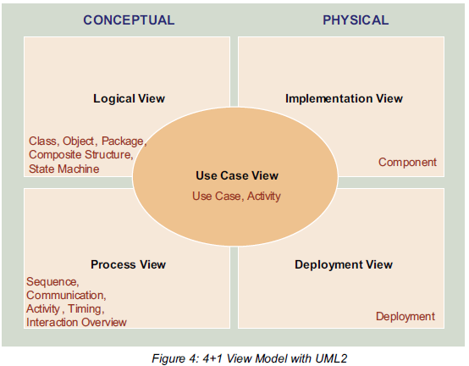
Summary of Applying 4+1 View Architecture with UML 2

Slide 28
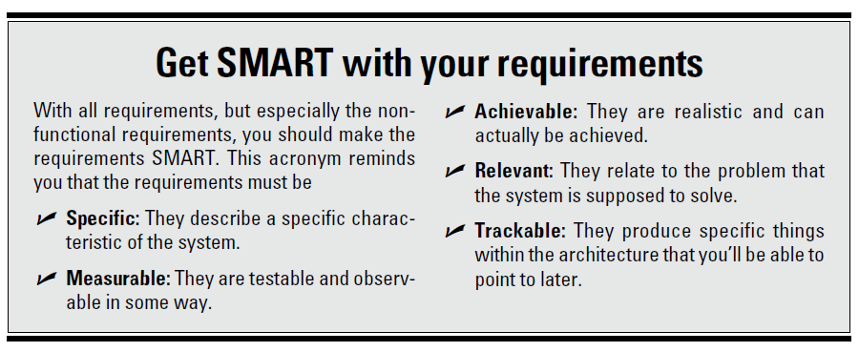
Starting to develop S. Architecture…

Slide 29
Choosing a Software System Style
Now you need to start thinking about what kind of style and shape the system should have?
There are two aspects of system styles: -
  Architectural style (Model-View-Controller and Pipes and Filters, etc.)
  Programming style (object-based style, procedural style, or functional style, etc)
Not every problem fits into every style, so being familiar with multiple styles is essential for choosing the right solution for the given problem

Slide 30
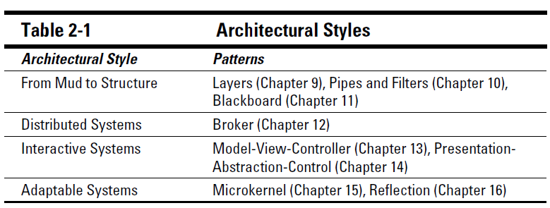
Patterns and architectural styles

Slide 31
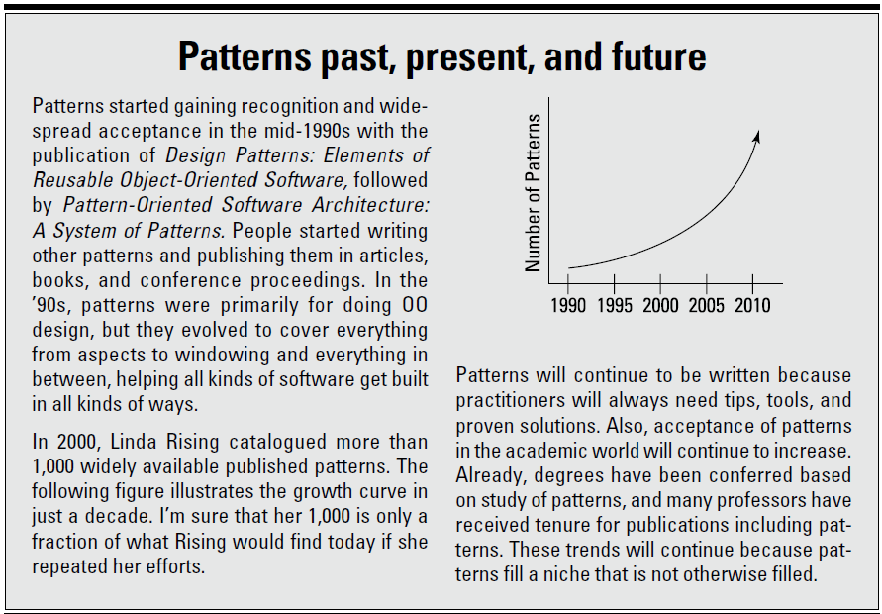

Slide 32
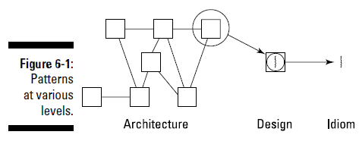
Different Depths of Patterns
Not all patterns have the same depth — meaning that they don’t address the same scopes or scales of problems

Slide 33
Different Depths of Patterns
Architectural patterns define the structure of the solution at the highest level. These patterns influence the entire system and require all the parts of the system that are touched by the pattern to participate in its design.
Design patterns solve individual design problems within a particular context. In the pattern scope hierarchy, design patterns are the medium-scale patterns.
  For example, MVC may introduce a tight coupling, creating problem if there are many views and controllers. The design pattern Command Processor, addresses this problem.

Slide 34
Different Depths of Patterns
Idioms: The lowest-level patterns are idioms. Idioms have the narrowest scope and are specific to a programming language or platform, but they help you get past their limitations.
  For example: Use a left or right bit shift operation to multiply or divide by a power of 2 if the computer doesn’t have a multiplication function, is one example of an idiom.

Slide 35
Employing enabling techniques
There are a number of fundamental principles for constructing software called enabling techniques.
These techniques are independent of the particular methods that you use to create software, such as waterfall, agile, or Unified Process
Balancing the trade-offs involves in using the enabling techniques helping to create an architecture that balances the functional and nonfunctional requirements of the system

Slide 36
Enabling techniques
Abstraction
Encapsulation
Information hiding
Modularization
Separation of concerns
Coupling and cohesion
Sufficiency and completeness
Separation of policy and implementation
Separation of interface and implementation
Single point of reference
Divide and conquer
Notes:
✓ Information hiding: Information hiding keeps information that clients
don’t need to know hidden from them so that it’s protected and the
clients don’t misuse it. Encapsulation is frequently used to implement
information hiding.
✓ Modularization: Modularization handles system complexity by breaking
the system into parts with well-defined boundaries. This technique is
especially useful as you design software architectures because they
frequently are too big to be implemented efficiently as single entities.
Modules can contain one or more components, as I talk about elsewhere.
✓ Separation of concerns: Within the system, unrelated responsibilities
should be separated. You use separation of concerns to define elements
that perform specific functions rather than elements that perform a variety
of functions.
✓ Coupling and cohesion: Coupling is how different modules in the system
relate to one another. Cohesion is a measure of how related the objects
and functions within a module are to each other. High cohesion and low
coupling lead to systems that are easy to modularize and build.
✓ Sufficiency and completeness: Every component should be sufficient
to include all the characteristics that are needed for useful and efficient
interaction with other components. Every component should also capture
all the important characteristics making it complete.
✓ Separation of policy and implementation: Keeping the implementation
of algorithms free of system-context-related information simplifies reuse.
You use this technique to design parts of the system to deal with context related,
or policy, information and other parts to implement abstract
algorithms.
✓ Separation of interface and implementation: This technique separates
the interface that clients use from the implementation of the functionality
that the clients expect. It makes reusing the implementation easier
and promotes information hiding (discussed earlier in this list).
✓ Single point of reference: Avoid inconsistency by defining the items
within the software architecture only once. Achieving a single point of
reference depends on your programming environment, because some
languages, like C++, make achieving this principle difficult. Although C++
also requires a single point of definition, it needs declarations to appear
in several places.
✓ Divide and conquer: Divide a problem or solution into smaller parts
that are easier to solve or implement. You use this technique often as
you work with large problems.

Slide 37
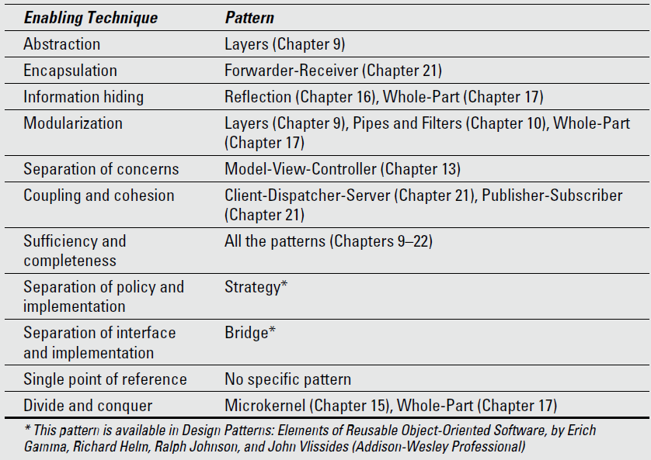
Patterns for enabling techniques
Dr Farooque Azam, CEME, NUST

Slide 38
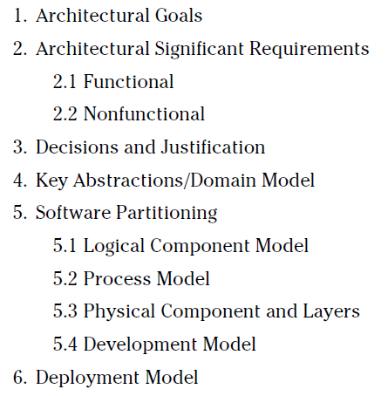
Organizing the architecture document
The actual organization of your document may vary, but a typical table of contents looks like this: -
Dr Farooque Azam, CEME, NUST

Slide 39
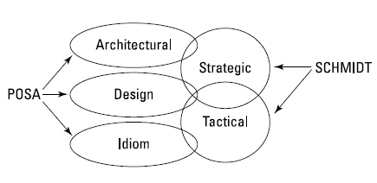
Different Classifications of Patterns
POSA: Pattern-Oriented Software Architecture: A System of Patterns, by Frank Buschmann, Regine Meunier, Hans Rohnert, Peter Sommerlad, and Michael Stal (Wiley)
Pattern-Oriented Software Architecture, Volume 2: Patterns for Concurrent and Networked Objects, by Douglas C. Schmidt, Michael Stal, Hans Rohnert, and Frank Buschmann (Wiley).

Slide 40
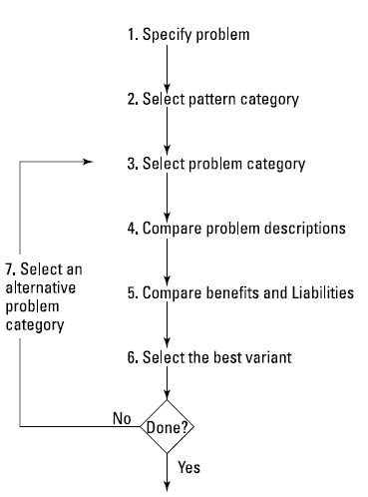
Selecting a Particular Pattern
Dr Farooque Azam, CEME, NUST

Slide 41
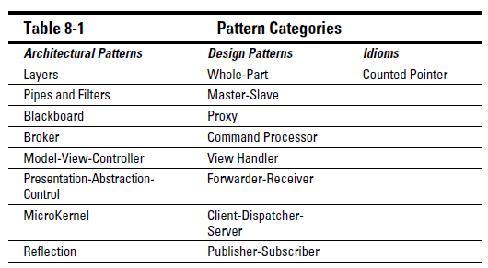
Select the pattern category

Slide 42
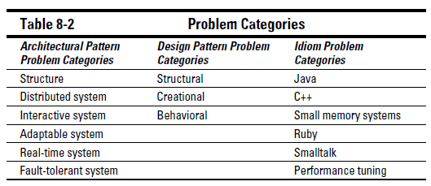
Select the problem category

Slide 43
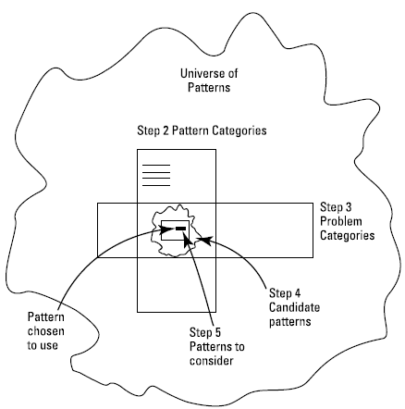
Narrowing the search to find the right pattern
Dr Farooque Azam, CEME, NUST

Slide 44
Designing Solution Architecture with Patterns
Pick a software development method
Use your pattern catalog (refer to Chapter 7) to support your design
If the pattern system doesn’t include a pattern for your design problem, try to find a different pattern
If you can’t find a pattern, design a solution from scratch

Slide 45
END

