Slide 1
Islamabad GeoIntel
AI-Assisted Geographic Intelligence & POI Discovery
Hackathon Final Submission • Deployed & Validated • September 2026
800
14
52/52
HTTPS
POIs
Categories
Tests
Live
islamabad-geointel.streamlit.app

Slide 2
The challenge — and our design choice
Turn open geographic data into an owned, auditable city-intelligence layer.
• Core discovery should not depend on a paid commercial places API.
• Sector labels must come from evidence, not nearest-point guesswork.
• Natural language should improve usability without inventing POIs or coordinates.
• The result should be deployable, mobile-friendly, testable and low-cost.
DESIGN PRINCIPLE
Local database = source of truth
Open data → normalization → safe query layer → interactive map
No paid Google Places/Geocoding API.
No external generative-AI API.

Slide 3
Architecture
A modular pipeline with explicit boundaries between data, logic and presentation.
OSM /
Overpass
→
Acquire
→
Normalize
→
SQLite
→
Search + Geo
+ NL
→
Streamlit
+ Folium
Governance rails: provenance • unique OSM identity • evidence-based sectors • safe failure • no secrets

Slide 4
Pilot data engineering
F-5 / F-6 / F-7 discovery; reference points were never treated as sector boundaries.
1,244
1,049
800
249
raw occurrences
unique OSM identities
searchable POIs
excluded by rules
• Six raw GeoJSON acquisitions using address/tag and 1,200 m radius discovery.
• 195 duplicate occurrences identified before final normalization.
• Raw tags/source retained for auditability.
• Sector assignment uses explicit tag/address evidence; uncertain records stay uncertain.

Slide 5
Validated database snapshot
Final read-oriented SQLite database deployed with the application.
800
14
92
708
Searchable
Categories
Sector-attributed
Not definitive
Sector attribution
F-5
F-6
F-7
Ambiguous
Unassigned
32
43
17
27
681
Integrity: ok • Unique key: (osm_type, osm_id)

Slide 6
What is in the pilot?
14 normalized categories; counts are pilot-database measurements, not citywide completeness claims.
food_drink
133
retail
130
accommodation
87
financial
83
professional_services
76
transport
68
government
52
recreation
43
other_amenity
36
education
31
religion
31
healthcare
24
public_service
5
emergency
1

Slide 7
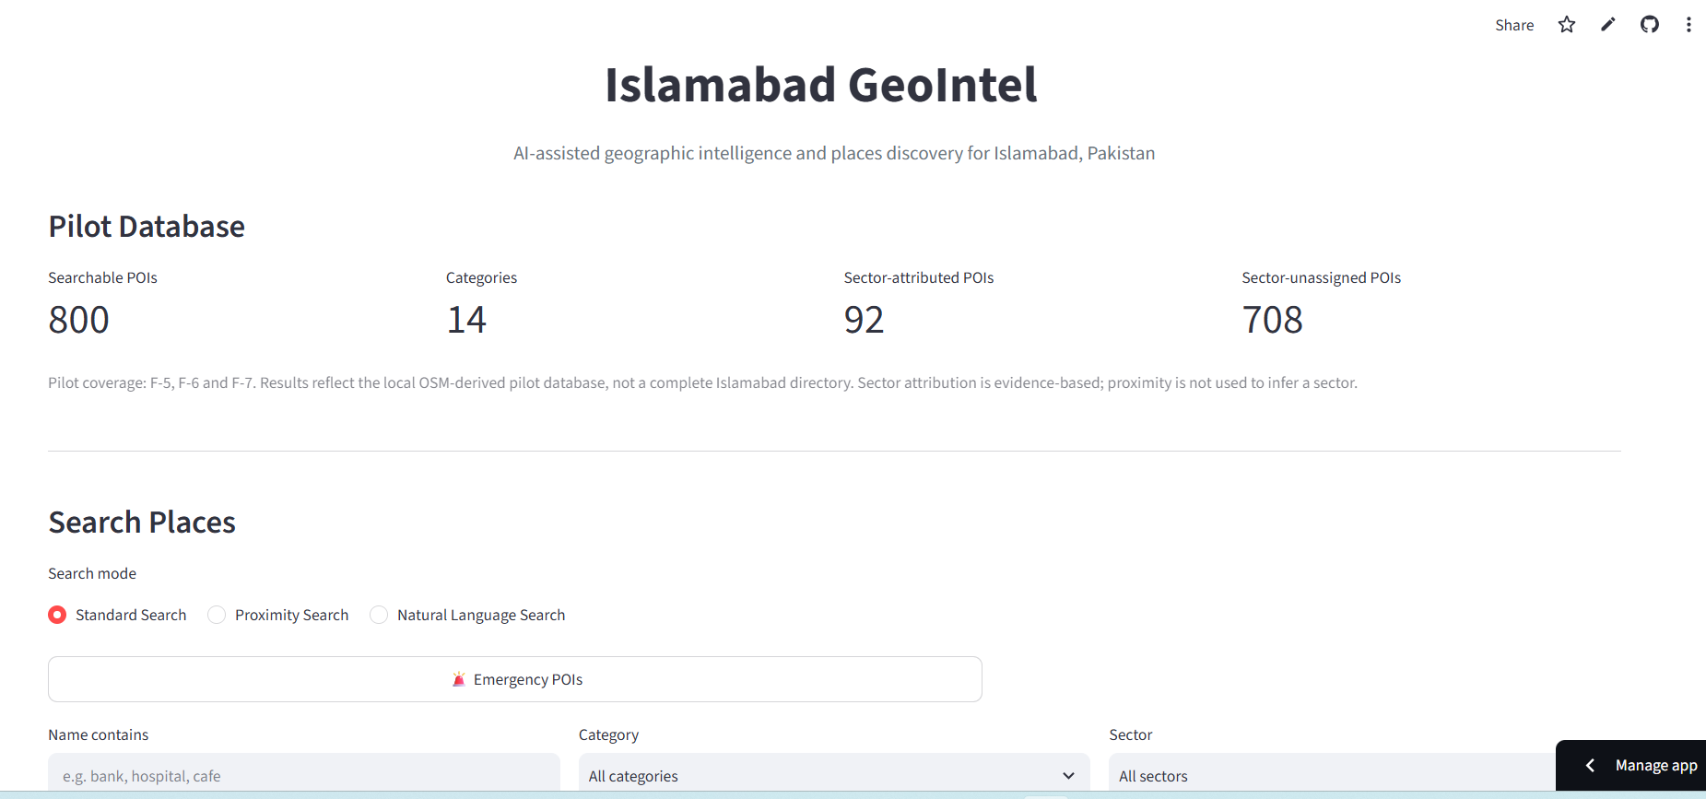
The deployed product
Three search modes + emergency quick action, backed by the same local database.
• Standard: name/category/sector filters.
• Proximity: browser location, manual coordinates or map click.
• Natural Language: constrained parser → structured QueryPlan.
• Emergency: first-class category with explicit pilot warning.
• Outbound Google Maps navigation links only.

Slide 8
AI-assisted — without hallucination
Deterministic natural-language parsing keeps the database as the source of truth.
“hospitals in F-6”
→
1 • Kulsum International Hospital
“food in F-6”
→
10 POIs
“nearest hospital”
→
Nearest result + distance
“emergency within 2 km”
→
1 • تھانہ کوہسار
“best beautiful places”
→
Safe unsupported-query message
No arbitrary SQL • No external LLM • No invented coordinates

Slide 9
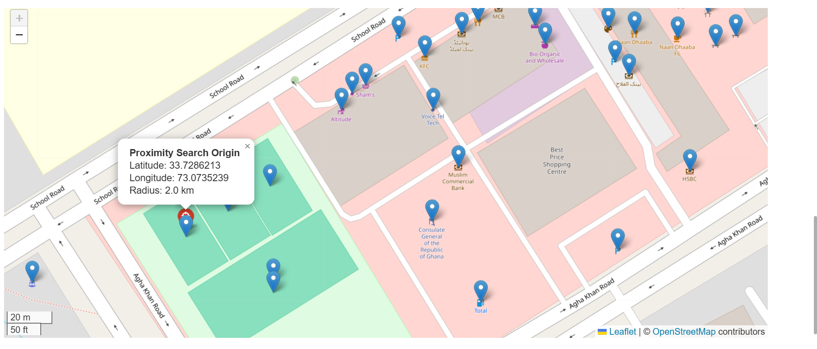
Geographic intelligence that stays synchronized
Map clicks update the exact SQLite origin used for radius and distance calculations.
• Haversine distance locally.
• Red origin + radius circle.
• POI click or empty-map click moves origin.
• Results and distances recalculate.
• OSM attribution visible on map.
Correctness was prioritized over eliminating Streamlit rerun dimming.

Slide 10
Deployment & mobile validation
The local HTTP limitation disappeared where it should: on the final HTTPS deployment.
LOCAL LAN / HTTP
PRODUCTION / HTTPS
Browser geolocation could be blocked.
Safe fallback + manual/map origin remained available.
iPhone automatic browser geolocation validated successfully.
Live URL
GitHub → Streamlit Community Cloud
main • app.py • Python 3.14 • no secrets
islamabad-geointel.streamlit.app

Slide 11
Verification evidence
Automated tests plus live functional checks — not just a successful build.
52/52
46
1
YES
automated tests
“bank” results
hospital in F-6
mobile geolocation
• SQLite integrity check: ok.
• Live Proximity: red origin, circle, active origin and distances all update.
• Live Emergency: warning + 1 pilot record + map/proximity validated.
• Deployment commit 77eff03 pushed to origin/main.
• Working tree clean after archiving obsolete draft artifacts.

Slide 12
Responsible data & cost posture
The prototype is intentionally conservative about provenance, uncertainty and external services.
• OSM-derived data remains under ODbL; attribution retained.
• Software code licensed under MIT.
• No Google scraping; no billing-backed Places/Geocoding API.
• No external generative-AI API for natural-language search.
• Emergency result is explicitly labelled as incomplete pilot coverage.
• OSM contact/address/opening-hours values are source-derived, not independently verified.

Slide 13
Limitations → production roadmap
A hackathon pilot with a clear path to city-scale operation.
CURRENT LIMITS
NEXT
• F-5/F-6/F-7 only.
• No consistent sector polygons.
• OSM completeness/freshness varies.
• Radius search uses large candidate scan.
• Bounded NL vocabulary.
• Islamabad-wide scheduled acquisition.
• Authoritative polygons + point-in-polygon.
• PostgreSQL/PostGIS at scale.
• Broader safe NL grammar.
• Freshness, audit, export & governance tooling.

Slide 14
Why this is hackathon-ready
A complete vertical slice: data engineering → geospatial logic → AI-assisted UX → deployment.
OWN DATA LAYER
SAFE AI UX
GEO ENGINE
800 normalized POIs
Auditable provenance
Deterministic NL
No hallucinated places
Radius / nearest
Interactive origin sync
ENGINEERING
MOBILE
LOW COST
52 passing tests
Git milestones
Responsive UI
HTTPS geolocation
Open data
No paid Google/LLM API

Slide 15
Islamabad GeoIntel
Open data. Owned intelligence. Auditable AI-assisted search.
LIVE DEMO
islamabad-geointel.streamlit.app
Source: github.com/ahmadsajjad-logix/islamabad-geointel
Thank you

