Slide 1



Deriving Functional Properties of Components from the Analysis of Digital Mock-Ups
Ahmad Shahwan Jean-Claude Léon Gilles Foucault Lionel Fine
G-SCOP Laboratory Université de Grenoble, Grenoble-INP INRIA Rhone-Alpes
EADS
May 2012

Slide 2
Outlines
Motivation
Related Works
Overview of our Approach
Conventional Interfaces
Detecting Geometric Interactions
Qualitative Reasoning Process
Application of Construction Rules
Conclusions and Future Works

Slide 3
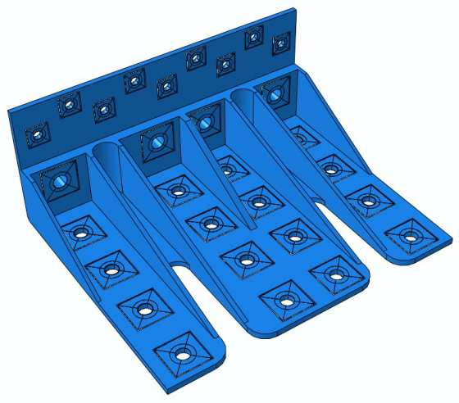
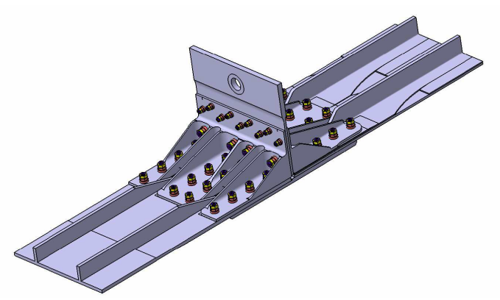
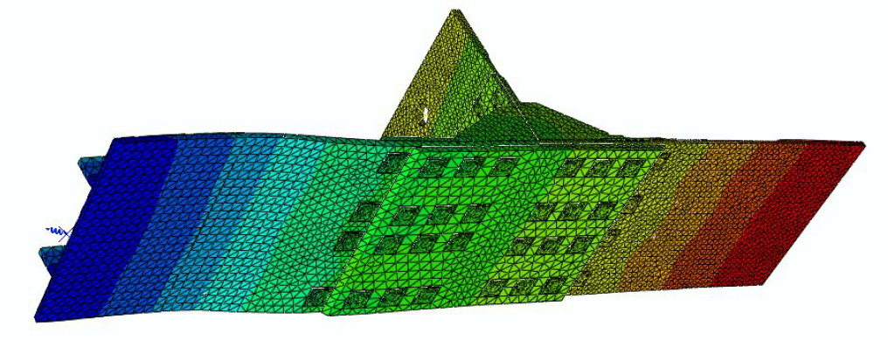
Motivation
Importance of Simplification for Finite Element Analysis.
Manual Simplification needs manpower.
Automated Simplification needs Semantic Information linked to a structured geometric model of components.
Our work comes to fill this gap.
Semantic Annotation
Design Model
Simulation Model
#CapScrew
Simplification
#Nut

Slide 4
Related Works
Use of textual information to deduce semantics [Hang et al. 2006, Iyer et al. 2005, Min et al. 2008]
No standards or norms ➔ unreliable results.
Analyzing form features [Joshi et al. 1988, Zhu et al. 2002, Thakur et al. 2009]
Adresses standalone components;
Limited geometric complexity;
Require user intervention.
Using assembly constraints to deduce geometric interactions [Schenk et al. 2005]
Constraints are not always explicitly available (e.g. STEP files);
One configuration can be expressed in different ways;
Constraints are omitted for large DMUs.
Relation between shape, function and behavior is well-established [Albers et al. 2009, Gero 1990]

Slide 5
Overview of our Approach
Input: A DMU represented as a STEP file.
Output: Semantic information, including mechanical and kinematic properties.
Contextual analysis of components: Conventional Interfaces (CIs) in an assembly model.
Functional interpretation of an interface: Functional Interface (FI)
Qualitative reasoning process to analyze components’ behaviors.
Taxonomy of Functional Designation (FD): deriving functional features of components from their FIs.
Structural geometric model of components that links to functional annotations.

Slide 6
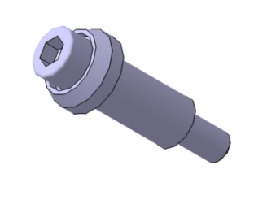
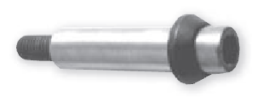
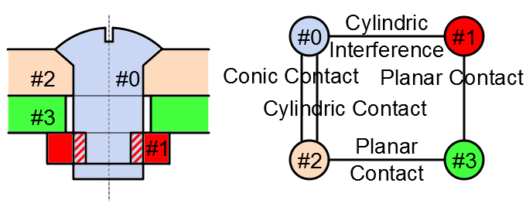
Conventional Interfaces
Real Shape: Shape of the physical body of a component.
Digital Shape: Possible volume, surface, or line model representing a component in a DMU.
Real Shape
Idealization
Digital Shape
Detailed Threaded Link
Simple Cylinder
Digital shapes are conventional representations of a component.
Digital shapes influence the interfaces between components in a DMU, leading to Conventional Interfaces (CIs).
Three categories of CIs
Contact
Interference
Clearance

Slide 7
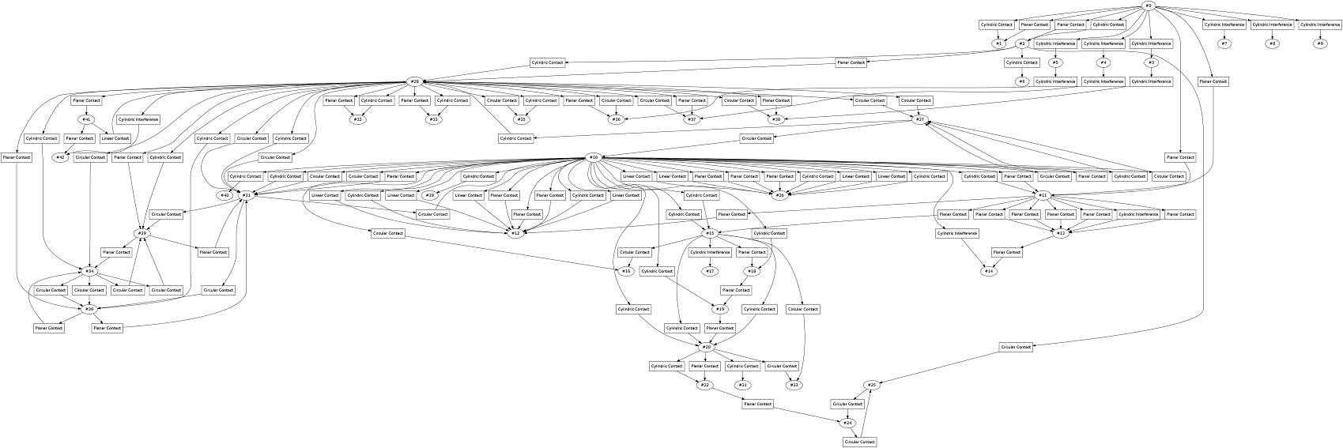
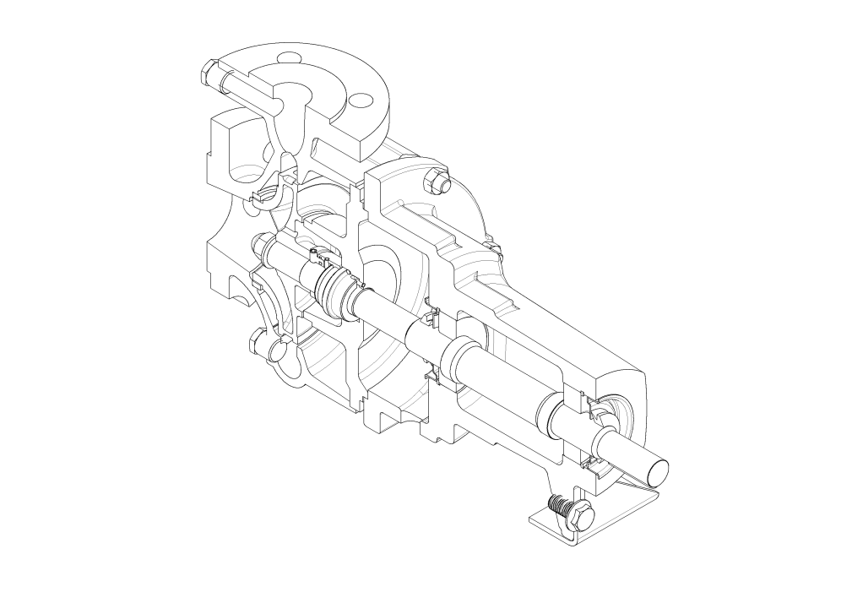
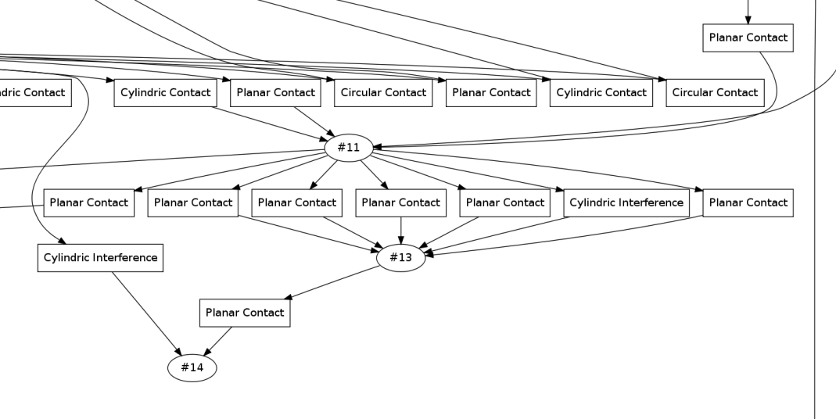
Detecting Geometric Interactions
CI are structured to build the Conventional Interface Graph (CIG).
CIG(C, CI): C set of components in a DMU, CI set of conventional interfaces.

Slide 8
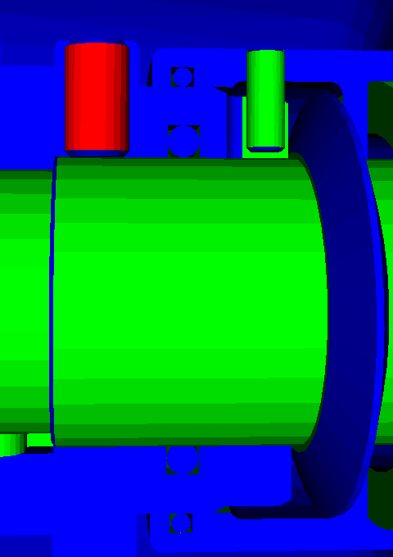

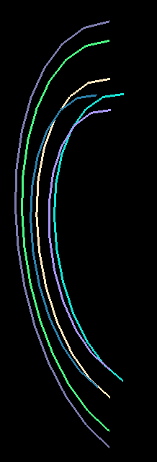
Detecting Geometric Interactions
Detection of CIs
Geometric processing of the DMU.
Geometric modelers lack performance and are not robust enough.
The need for specific algorithms.
?
CAD Model
Results using OCCT
Our Results
Detection of Linear Contacts

Slide 9
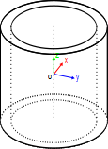
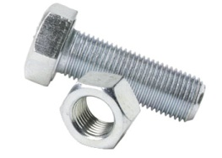
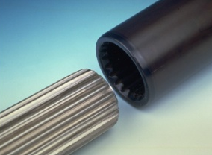
Qualitative Reasoning Process
Due to idealization, one CI can be associated to more than one Functional Interface (FI), considering only its geometry.
Reduce the number of FIs to ideally one per CI.
To this end, use a qualitative reasoning process based on the concept of Reference State.
Conventional Interface
Cylindrical Interference
?
Functional Interface
Threaded Coupling
Spline Coupling

Slide 10
Qualitative Reasoning Process
General hypothesis
Interfaces between components are time-invariant.
Components are rigid bodies
Reference State: Description of physical and qualitative behavior of a DMU. In our analysis reference states materialize as hypothesis.
Mechanical Reference State
Hypothesis: Assembly is at rest; thus, all components of a DMU are in static equilibrium.
Reasoning upon this reference state is based on the real shape/force duality.
Kinematic Reference State
Hypothesis: Unless justified by a functional kinematic chain, all internal motion in a DMU are rotational.
Reasoning upon this reference state is based on the real shape/kinematics duality.

Slide 11
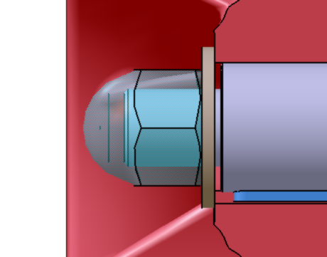
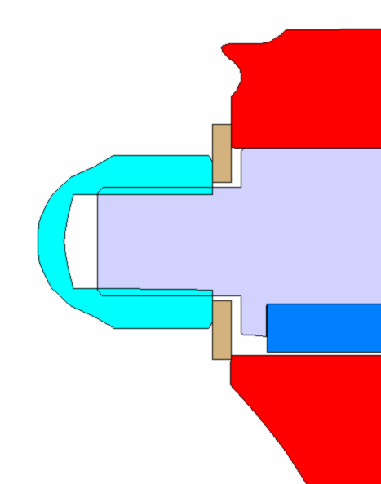
Mechanical Analysis
All components are at static equilibrium;
For each component
External forces sum up to zero, and
Moment of external forces sum up to zero around all axes.
FI that violate this hypothesis are eliminated.
Planar Contact
Cylindrical Interference
Planar Support
Spline Link
interpretations
Unbalanced
Planar Support
Threaded Link
Balanced

Slide 12
Mechanical Analysis
Use of mechanical screws to represent forces and moments.
Qualitative reasoning ➔ Qualitative values.
Value | Null | Not null | Strictly Positive | Strictly Negative | Arbitrary
Symbol | 0 | ± | + | - | *
Constraint | x = 0 | x ≠ 0 | x > 0 | x < 0 | Non
Three structure: levels are CIs, nodes are FIs.
All Solutions algorithm V.S. Best Solution algorithm.

Nullable Screw
1
Threaded Coupling
1

Initial (null) screw
Planar Support
Non-nullable Screw
2
Spline Coupling

Slide 13
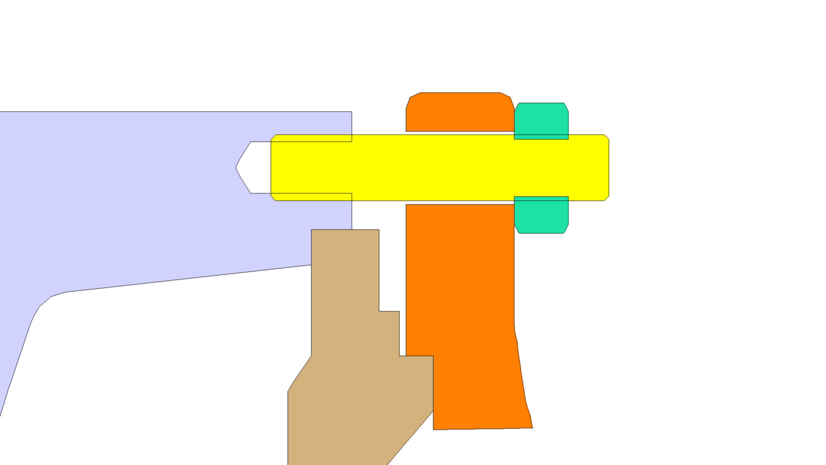
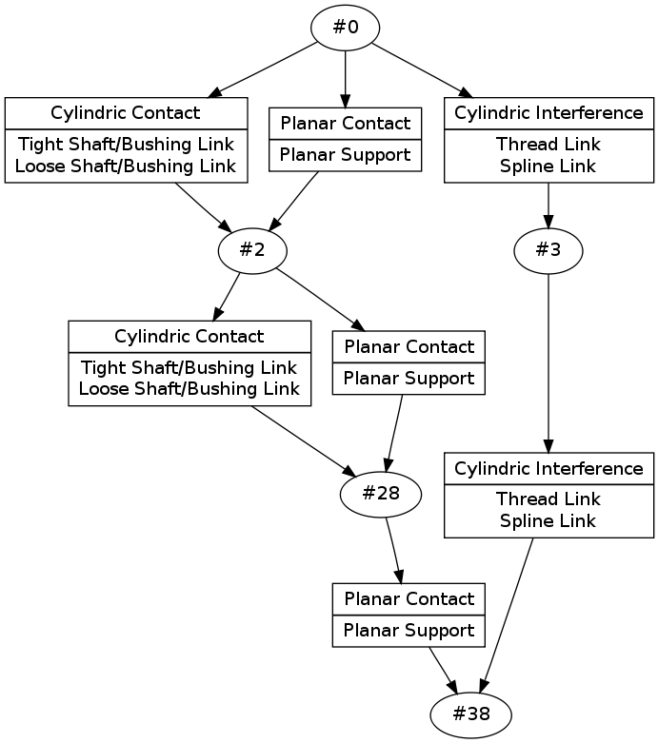
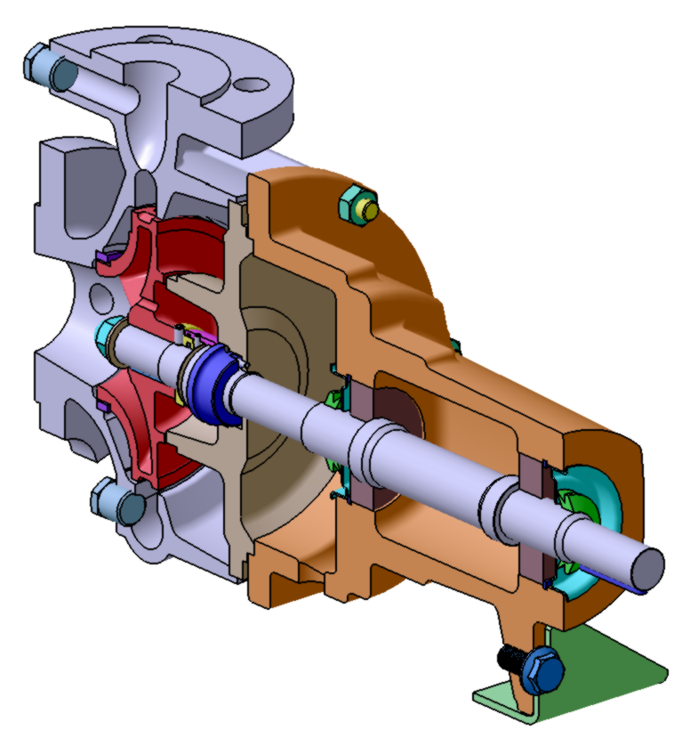
Examples
#38
#0
#3
#28
#2
All-solutions method
Best-solution method
Initialization

Slide 14
Application of Construction Rules
Domain specific rules enable:
The elimination of inconsistent solutions,
The assignment of component FD.
To enable dynamic domain rules, rules and taxonomies are represented using an ontology.
The ontology is then instantiated with information coming from reference state analysis, producing the DMU’s knowledge base.
Reasoning upon this KB, applying domain (construction) rules, leads to the classification of components into FD classes.

Slide 15
Using a Knowledge Base
Knowledge Base (Ontology)
Initialization
Concepts
Rules
x
y
Domain Expertise
Component
Conventional Interface
…
…
a
b
Instantiation
Individuals
Relations
Screw
Nut
Threaded Link
Planar Support
Ref. Sate Analysis
inner-forms
outer-forms
x
a
y
a
forms
forms
Reasoning
Classification
x
b
y
b
Screw ⬄
----
Nut⬄
----

Slide 16
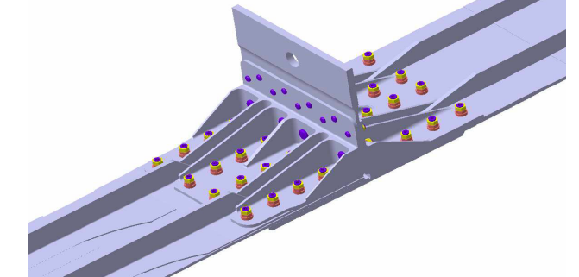
Example of FD
Screw
Nut
Counter-nut

Slide 17
Conclusions and Future Work
Our results confirm the utility of exploiting interactions between components in a DMU to deduce functional information.
Qualitative reasoning based on pure geometry:
Algorithmic analysis of geometric configuration under a given reference state.
Rule-based reasoning inspired by domain knowledge.
Further work:
Identification of other reference states to enrich the knowledge base with new facts about the DMU.
Recognition of components functional designations
Acknowledgment: work conducted in the scope of the ROMMA project funded by ANR.

Slide 18
References
Hong T., Lee K., Kim S., Similarity comparison of mechanical parts to reuse existing designs. CAD 38 (2006), 973–984.
Iyer N., Jayanti S., Lou K., Kalyanaraman Y., Ramani K., Shape-based searching for product lifecycle applications. CAD 37 (2005), 1435–1446.
Min P., Halderman J., Kazhdan M., Funkhouser T., Early experiences with a 3d model search engine. 8th Int. Conf. 3D Web Tech. (2003), 7–19.
Joshi S., Chang T. C., Graph-based heuristics for recognition of machined features from a 3D solid model. Comput. Aided Des. (1988), 20(2), 58—66.
Zhu H., Menq C. H., B-Rep model simplification by automatic fillet/round suppressing for efficient automatic feature recognition, Comput. Aided Des. (2002), 34(2), 109—123.
Thakur A., Banerjee A. G., Gupta S. K., A survey of CAD model simplification techniques for physics-based simulation applications, Comput. Aided Des. (2009), 41(2), 65—80.
Schenk M., Straßburger S., Kissner H., Combining Virtual Reality and Assembly Simulation for Production Planning and Worker Qualification. Int. Conf. Changeable, Agile, Reconfigurable and Virtual Production (2005),11—414.
Albers A., Braun A., Clarkson P. J., Enkler H.-G., Wynn D., Contact and channel modelling to support early design of technical systems, ICED (2009), 61—72.
Gero J. S., Design prototypes: a knowledge representation schema for design. AI Magazine (1990), 11 (4) 26–36.

