Slide 1



ROMMA Task 1 Model Functional Analysis Status Briefing
Ahmad Shahwan Moreno Trlin Gilles Foucault Jean-Claude Léon
G-SCOP Laboratory Université de Grenoble, Grenoble-INP INRIA Rhone-Alpes
September 2012

Slide 2
Overview
Using local coordinate system for quantative reasoning.
Results.
Limitation of DL.
Exploring FOL.

Slide 3
Local coordinate system

Slide 4
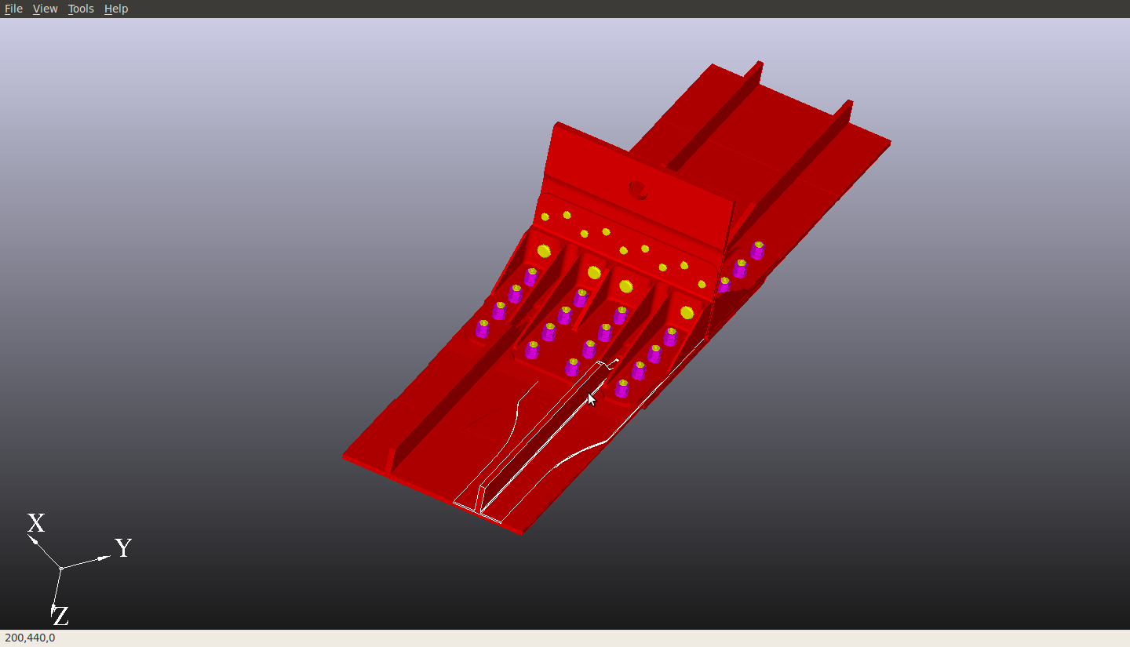
Results

Slide 5
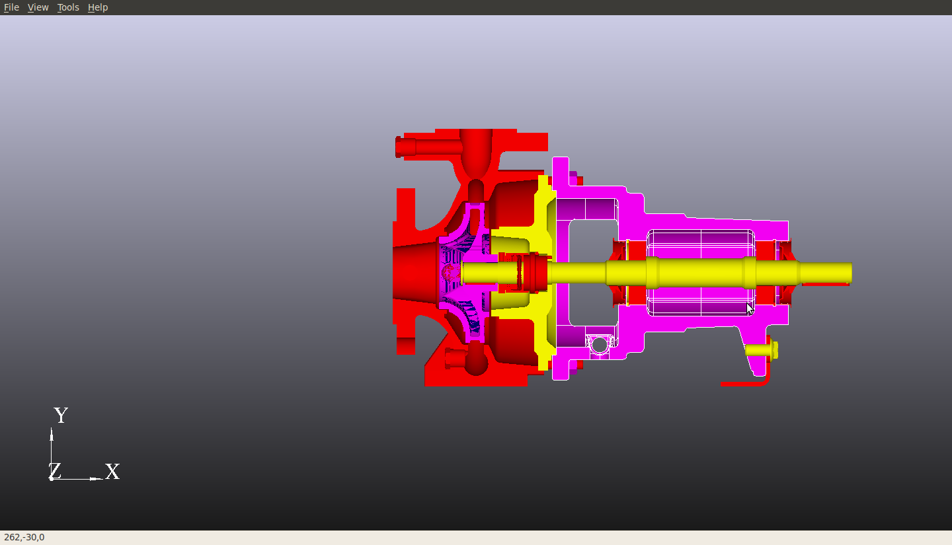
Results

Slide 6
Limitation of Description Logic
Screw ⬅
Component and
(innerForms some ThreadedLink) and
(forms some PlannarSupport)
Component
forms
innerForms
Planar Support
Threaded Link
?

Slide 7
First Order Logic
Screw(x) :=
Component(x) ∧
∃ y, z;
ThreadedLink(y) ∧ innerForms(x, y) ∧
PlanarSupport(z) ∧ forms(x, z) ∧
orthogonal(y, z)
Component
forms
innerForms
Planar Support
Threaded Link

