Slide 1
From CAD to FEA through functional annotations
Ahmad Shahwan
Jean-Claude Léon
Gilles Foucault
ROMMA status briefing December 2012

Slide 2
Overview
Workflow Reminder
From Global Coordinate Systems to Local Coordinate Systems
Limitations of Global CS
Adopting Local CS
Screw Addition/Subtraction
Local CS and Internal Forces Cycles
Indeterminate Static Equilibrium
New Results

Slide 3
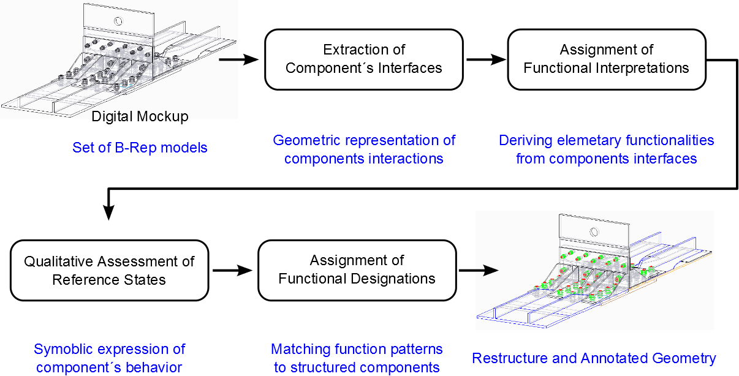
Workflow Reminder

Slide 4
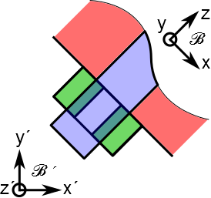
Limitation of Global CS
Interface CS
Global CS
(3.5 DoF)
(2 DoF)
+
+
(1 DoF)
(0 DoF)
Studying the nut equilibrium:
Using Global CS → Spline connection is valid!
Using Interface CS → Spline connection is invalid.
=
=

Slide 5
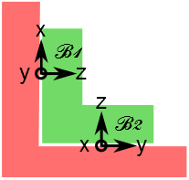
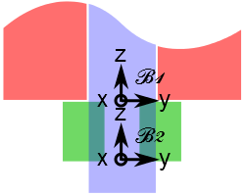
Choosing Local CS
Two interfaces with different CS’s
Two interfaces with the same CS
To enable summation of screws:
CS should be unified over components interfaces.
CS for each component;
Chosen amongst those of its interfaces.

Slide 6

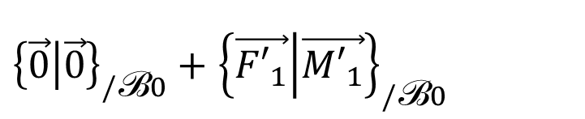

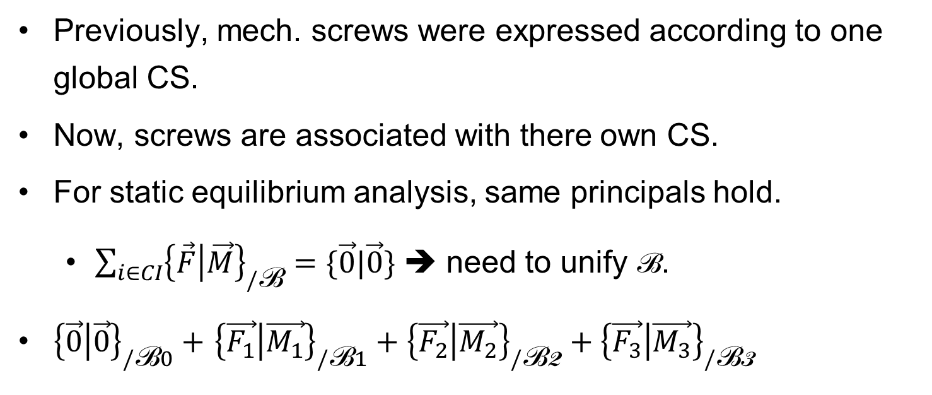


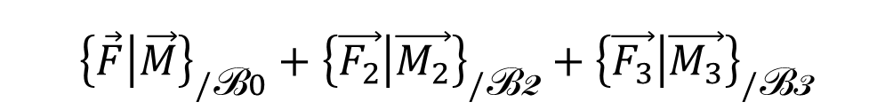
Adopting Local CS
Previously, mech. screws were expressed according to one global CS.
Now, screws are associated with there own CS.
For static equilibrium analysis, same principals hold.
$\sum_{i∈CI}{{\left\{\vec{F} | \vec{M}\right\}}_{/\text{B}}=\{\vec{0}|\vec{0}}\}$ ➔ need to unify B.
${\left\{\vec{0} | \vec{0}\right\}}_{/\text{B}0}+$ ${\left\{\vec{F_{1}} | \vec{M_{1}}\right\}}_{/\text{B}1}+{\left\{\vec{F_{2}} | \vec{M_{2}}\right\}}_{/\text{B}\text{2}}+{\left\{\vec{F_{3}} | \vec{M_{3}}\right\}}_{/\text{B}\text{3}}$
$${\left\{\vec{F} | \vec{M}\right\}}_{/\text{B}0}+{\left\{\vec{{F′}_{2}} | \vec{{M′}_{2}}\right\}}_{/\text{B}\text{0}}$$
${\left\{\vec{0} | \vec{0}\right\}}_{/\text{B}0}+$ ${\left\{\vec{{F′}_{1}} | \vec{{M′}_{1}}\right\}}_{/\text{B}0}$
$${\left\{\vec{F} | \vec{M}\right\}}_{/\text{B}0}+{\left\{\vec{{F′}_{3}} | \vec{{M′}_{3}}\right\}}_{/\text{B}0}$$
$${\left\{\vec{F} | \vec{M}\right\}}_{/\text{B}0}+{\left\{\vec{F_{2}} | \vec{M_{2}}\right\}}_{/\text{B}\text{2}}+{\left\{\vec{F_{3}} | \vec{M_{3}}\right\}}_{/\text{B}\text{3}}$$
$${\left\{\vec{F} | \vec{M}\right\}}_{/\text{B}0}+{\left\{\vec{F_{3}} | \vec{M_{3}}\right\}}_{/\text{B}\text{3}}$$
$${\left\{\vec{F} | \vec{M}\right\}}_{/\text{B}0}$$

Slide 7
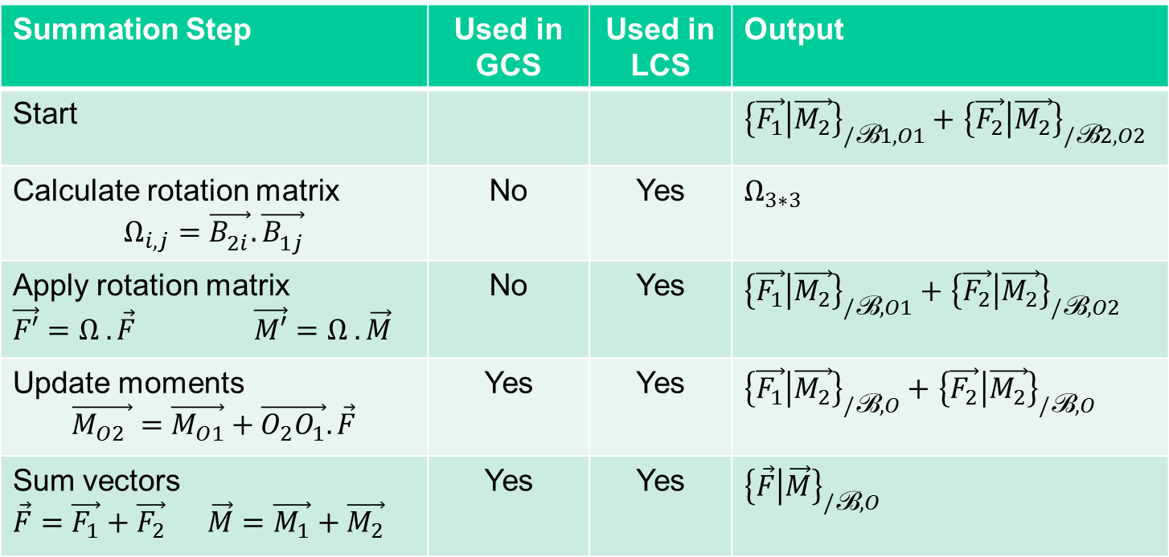
Screw Addition/Subtraction
Summation Step | Used in GCS | Used in LCS | Output
Start |  |  | ${\left\{\vec{F_{1}} | \vec{M_{2}}\right\}}_{/\text{B}1, O1}+$ ${\left\{\vec{F_{2}} | \vec{M_{2}}\right\}}_{/\text{B}2, O2}$
Calculate rotation matrix $$Ω_{i,j}=\vec{B_{2i}^{}}. \vec{B_{1j}^{}}$$ | No | Yes | $$Ω_{3∗3}$$
Apply rotation matrix $\vec{F′}=Ω . \vec{F}$ $\vec{M′}=Ω . \vec{M}$ | No | Yes | ${\left\{\vec{F_{1}} | \vec{M_{2}}\right\}}_{/\text{B}, O1}+$ ${\left\{\vec{F_{2}} | \vec{M_{2}}\right\}}_{/\text{B}, O2}$
Update moments $$\vec{M_{O2} }=\vec{M_{O1}}+\vec{O_{2}O_{1}}. \vec{F}$$ | Yes | Yes | ${\left\{\vec{F_{1}} | \vec{M_{2}}\right\}}_{/\text{B}, O}+$ ${\left\{\vec{F_{2}} | \vec{M_{2}}\right\}}_{/\text{B}, O}$
Sum vectors $\vec{F}=\vec{F_{1}}+\vec{F_{2}}$ $\vec{M}=\vec{M_{1}}+\vec{M_{2}}$ | Yes | Yes | $${\left\{\vec{F} | \vec{M}\right\}}_{/\text{B}, O}$$

Slide 8
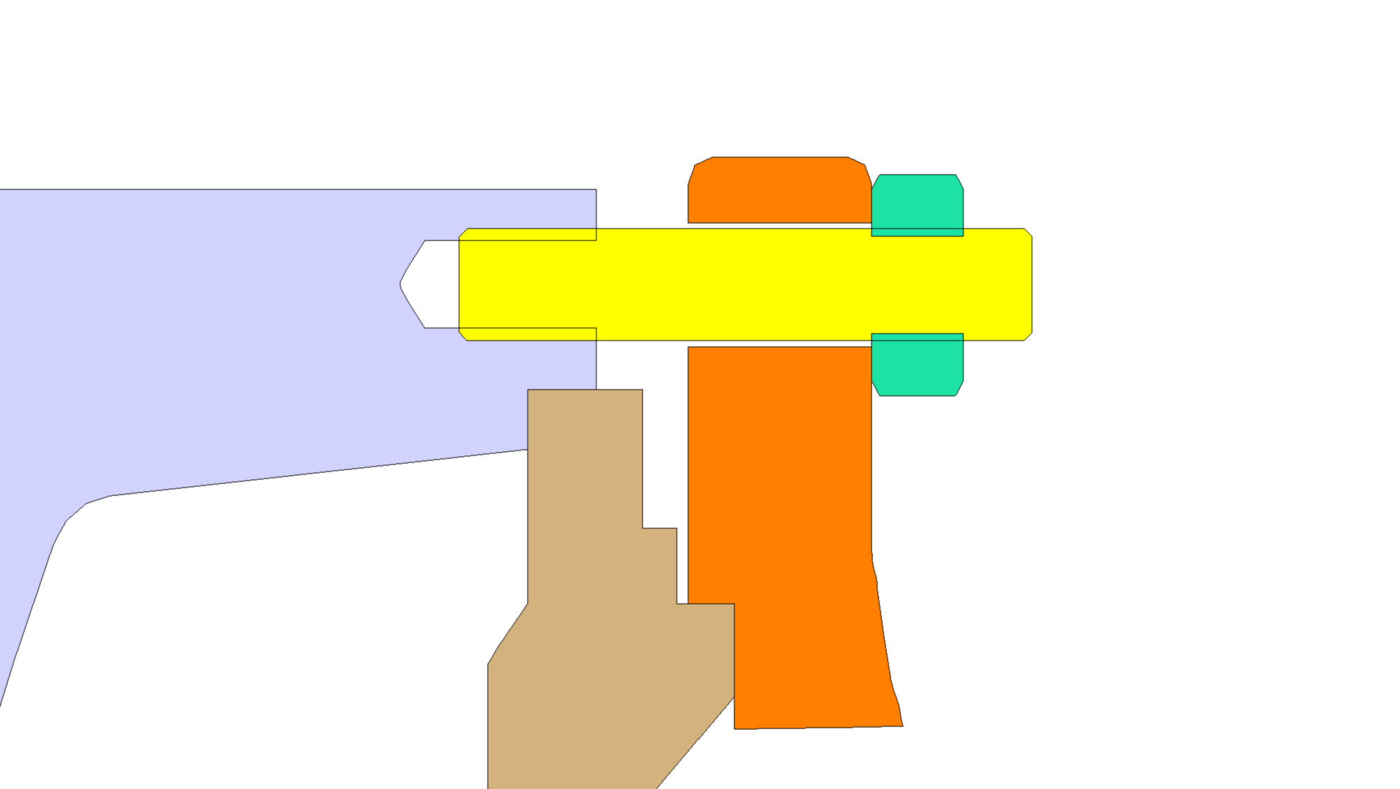
LCS & Internal Force Cycles
1
5
2
z
y
4
3
x
z
Originally internal forces where projected on each axis of the GCS ➔ Graph of force propagation.
This is not possible any more!

Slide 9
LCS & Internal Force Cycles
1
5
2
4
3
Generate force propagation graph independently from CS.
Currently, we only propagate forces between contacts and threads;
Advantage: force propagates in one direction through theses interfaces.
Disadvantages: not general enough!
Detecting propagation direction at threaded links.

Slide 10
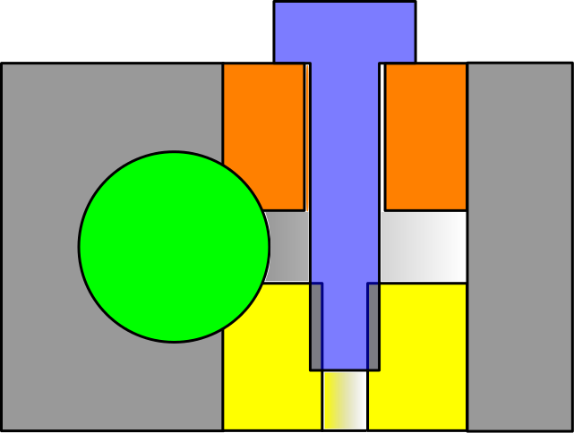
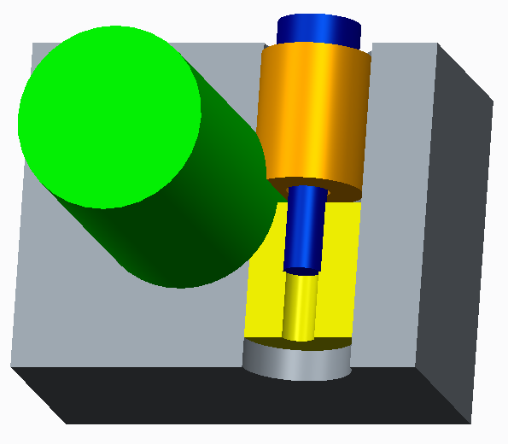
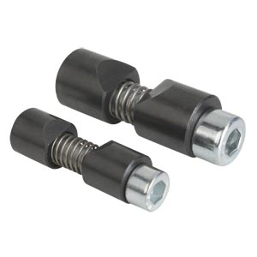
LCS & Internal Force Cycles
Example of cylindrical washer elements.
Here internal forces propagate through shaft/bushing link.
Problem with this kind of interfaces is that they defuse internal forces in more than one direction!

Slide 11
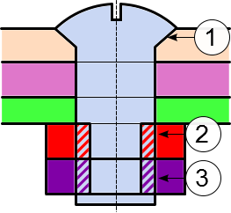
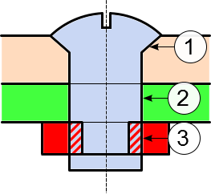
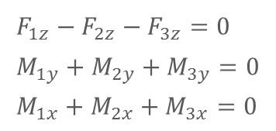
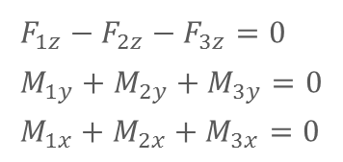
Indeterminate static equilibrium
Indeterminate static (hyperstatic) equilibrium may be functional, or may indicate anomaly.
Nut/counter-nut tightening is an example of functional hypestatic configurations.
Indeterminism is used here to increase internal system energy.
$$F_{1z}−F_{2z}−F_{3z}=0 \\ M_{1y}+M_{2y}+M_{3y}=0 \\ M_{1x}+M_{2x}+M_{3x}=0$$
Incorrect interpretation of tight fit produces an erroneous hyperstatic equilibrium.
This may helps the elimination of irrelevant interpretations.
$$F_{1z}−F_{2z}−F_{3z}=0 \\ M_{1y}+M_{2y}+M_{3y}=0 \\ M_{1x}+M_{2x}+M_{3x}=0$$

Slide 12
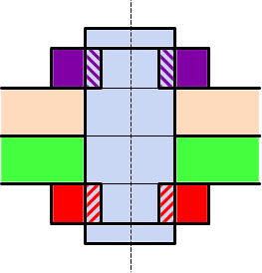
Indeterminate static equilibrium
Isostatic
Hyperstatic as a result of detection error
Hyperstatic functional
3
1
2
2
3
1

Slide 13
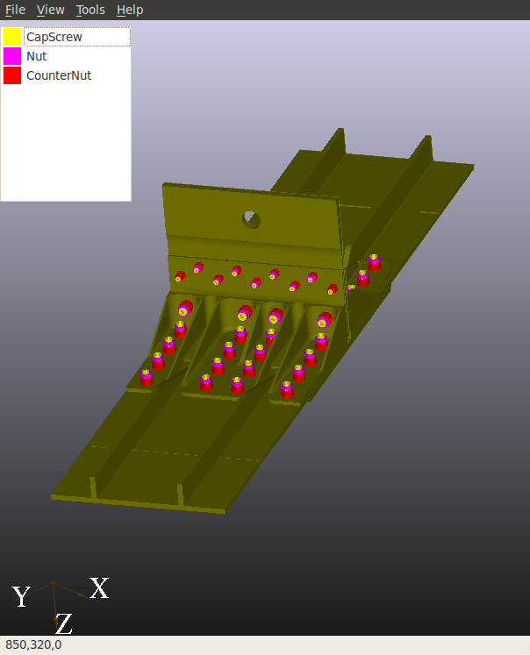
New Results
Manipulating the way facts are submitted.
Adding new rules.
Recognition of new components
Distinction between nuts and counter-nuts in the root

Slide 14
Thanks

