Slide 1
ROMMA Task 1
Geometric Model Processing
Status Briefing
Ahmad Shahwan - Gilles Foucault - Jean-Claude Léon
G-SCOP Laboratory
Université de Grenoble, Grenoble-INP
March 2011

Slide 2
Introduction
A PhD thesis in participation to ROMMA Project.
The ultimate goal is to identify components’ funtional designation given the solid model of a product.
Subtasks
  Geometric analysis of the model.
  Reasoning and inference.

Slide 3
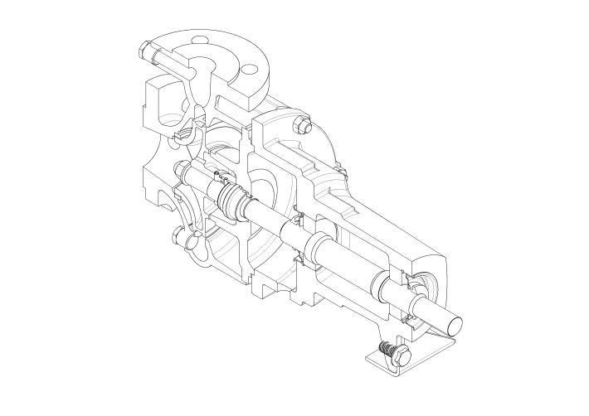
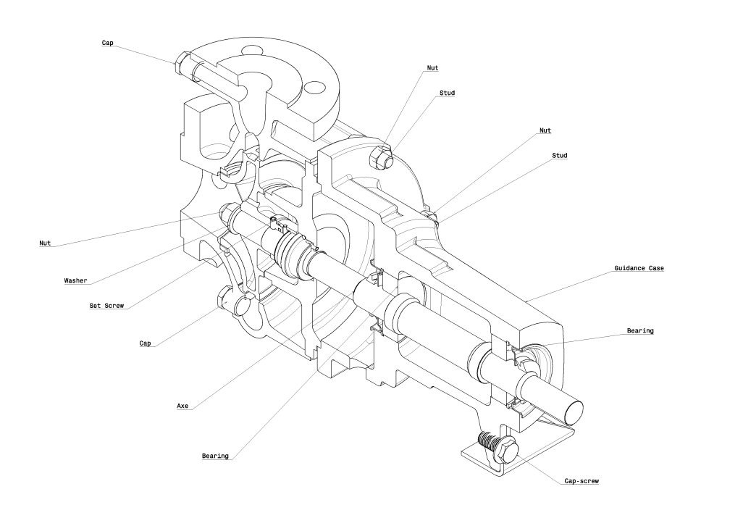
Introduction
Input: the solid model of a product (its DMU).
Output: the same model, now annotated with components functional designations.
Task 1

Slide 4
Conventional Interfaces
A Conventional Interface between two neighboring solids describe the geometrical interaction between them.
They can be either of the following:
  Interference,
  Contact, or
  Clearance.

Slide 5
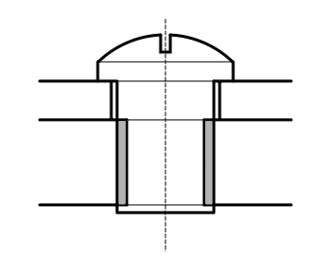
Conventional Interfaces
Example: A cap-screw
Contact
Clearance
Interference

Slide 6
The Identification Process
Models are analysed geometrically to obtain Conventional Interfaces between solids.
Conventional Interface Graph (CIG) is built as the data structure upon which the reasoning will be done.
The inference of functional designation and kinematic classes is accomplished based on hypotheses and reference states.

Slide 7
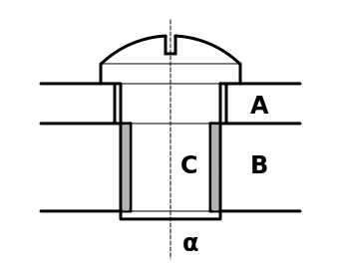
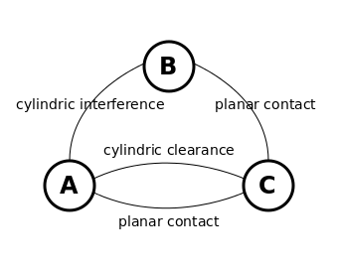
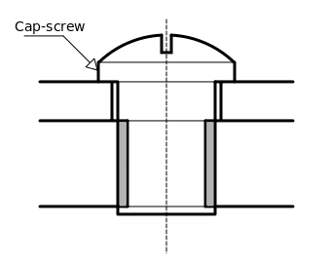
The Identification Process
Example: Cap-screw.
Solid Model
CIG
Annotated Model

Slide 8
Geometric Analysis
Detection of conventional interfaces between components.
We consider DMUs to be presented as B-Reps in a STEP format file.
Tools: OpenCASCADE development platform.
Basic algorithms have been sketched so far based on bounding boxes and Boolean operations to detect interaction zones.
Efficient and robust algorithms are to be developed:
  Exploiting the canonical nature of functional surfaces,
  Using octrees…
The output of this phase is the CIG.

Slide 9
Reasoning and Inference
Reference States
  The product is mechanically isolated; no external forces.
  No internal mobility in the general case.
Dualities
  Geometry/Force
  Geometry/Mobility
Mobility classes are inferred
  Structures; One mobility class.
  Mechanisms; Two or more mobility classes.
User Interaction may be required to guide the reasoning.
Iterative process.

Slide 10
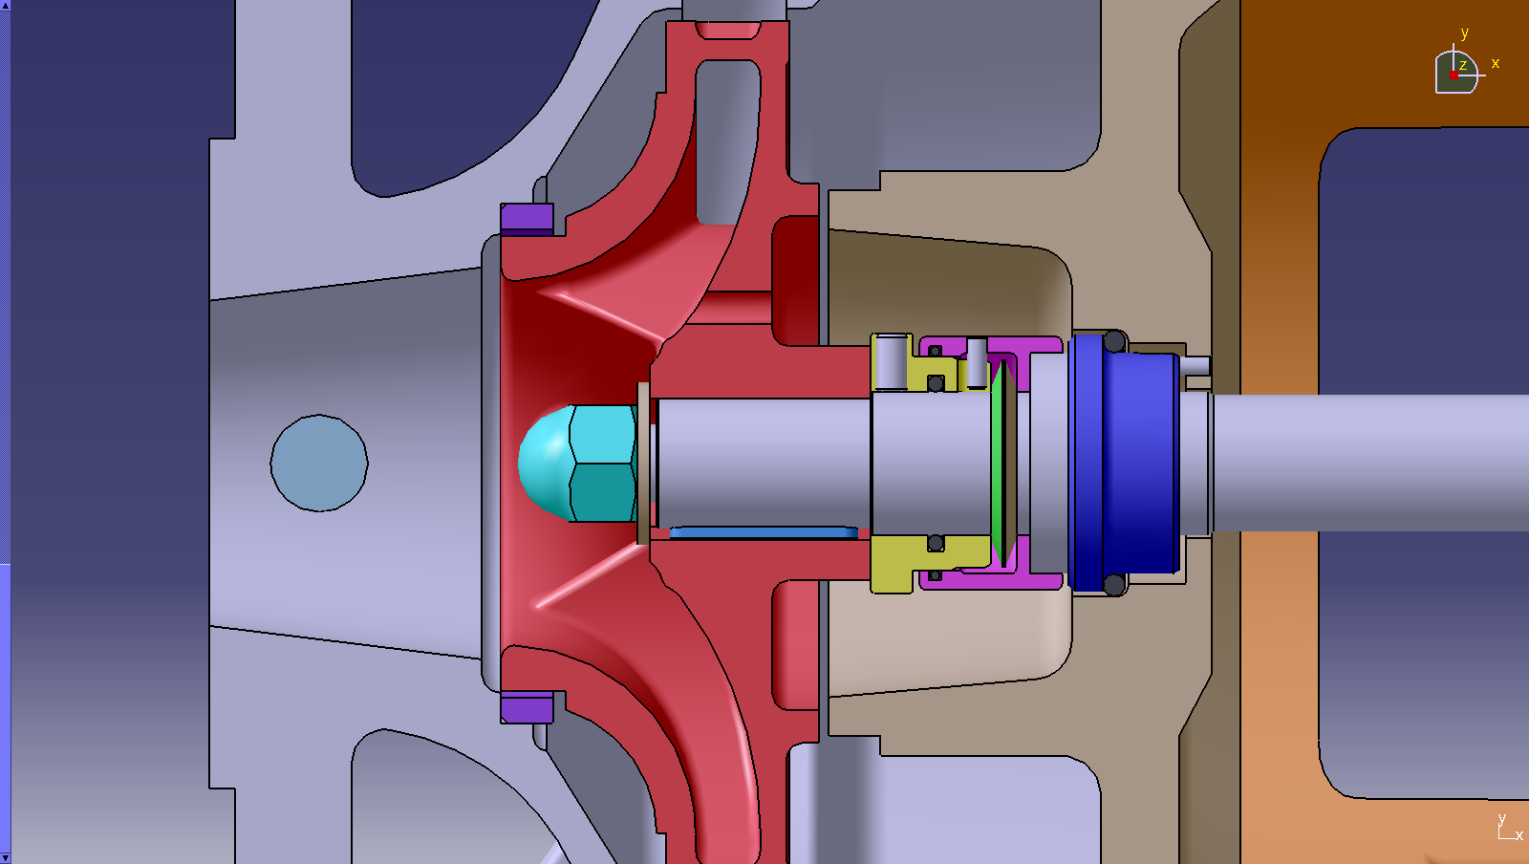
Reasoning and Inference
Example: Threaded connection.

Slide 11
Semantic Annotations
Based on the result of our analysis and reasoning, components are classified according to their functional designation into a comprehensive taxonomy.
Preliminary ontology is sketched using OWL to this end.
Methods of augmenting the models with such semantic annotation are suggested in [1].

Slide 12
Conclusions
Current work motivates the reasoning upon component geometric interaction to infer functional and kinematic properties.
Future work
  More efficient and robust algorithms is to be developed exploiting the prevailing features of product models.
  Data structures.
  Continue formalizing inference rules.

Slide 13
Bibliography
G. Foucault, A. Shahwan, J-C. Léon, & L. Fine. What is the Content of a DMU? Analysis and Proposal of Improvements. In Proc. AIP-PRIMECA, La Plagne France, March 2011.
A. Shahwan, G. Foucault, J-C. Léon, & L. Fine. Towards Automated Identification of Functional Designations of Components Based on Geometric Analysis of a DMU. In Proc. GTMG, Grenoble France, March 2011.

Slide 14
Thanks

