Slide 1

Toward Automated Identification of Functional Designations of Components Based on Geometric Analysis of a DMU
Ahmad SHAHWAN, Gilles FOUCAULT, Jean-Claude LEON
G-SCOP Laboratory & INRIA
Grenoble University, France

Slide 2
Overview
Introduction
  Motivation and Problematic
  Literature Overview
Theoretical Framework
  Concepts
  Reference States and Axioms
From DMU to Functional Designations
  Overview
  Geometric Analysis
  Reasoning and Inference
Conclusions

Slide 3
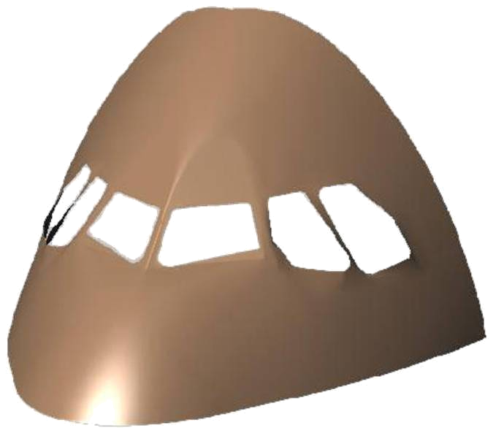
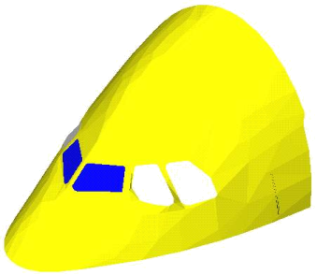
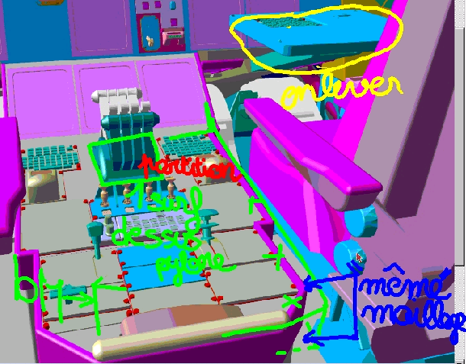
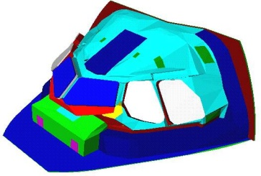
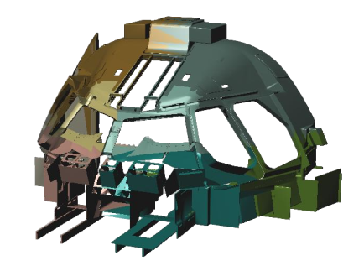
Motivation
Importance of DMUs in the product lifecycle.
Different level of details are needed for different engineering needs.
Courtesy Airbus EEI
Courtesy Airbus EEI / Laboratoire 3S
A380 cockpit DMU
A380 cockpit DMU for
thermal simulation

Slide 4
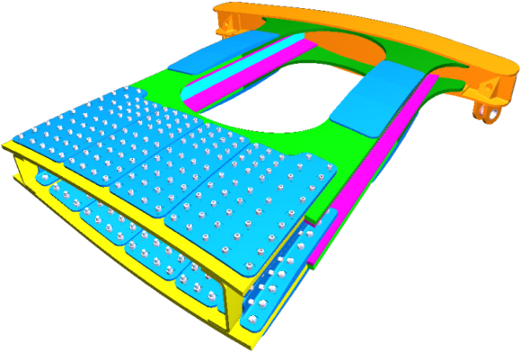
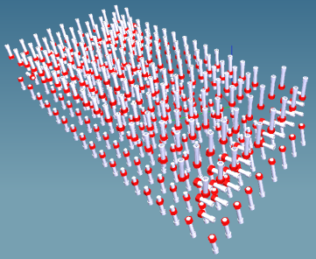
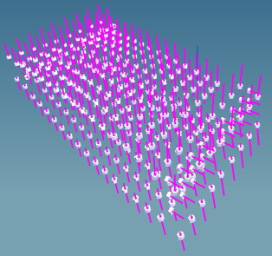
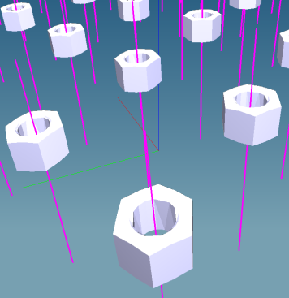
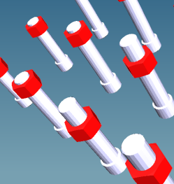
Motivation
Little or no semantic is present in a DMU!
The knowledge about components designations permits the automation of the simplification process.
Idealization Operation
3D ➔ 1D
Structural behavior Model

Slide 5
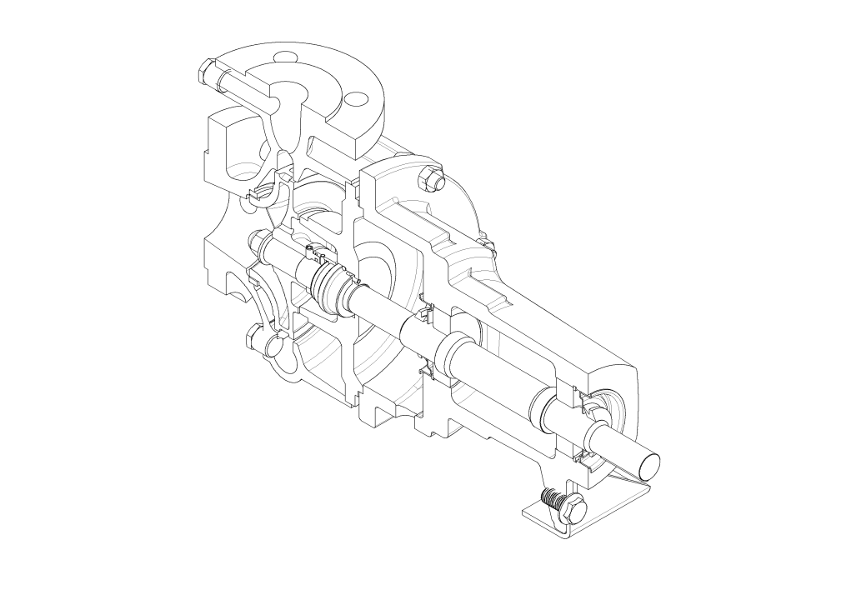
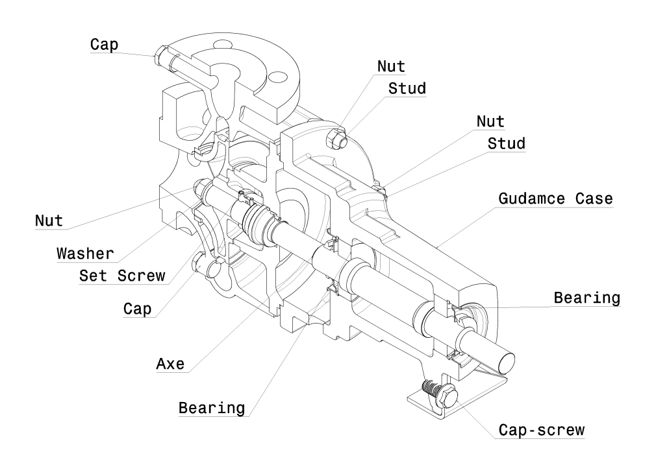
Problematic
Extracting functional denominations of components given the solid model of the product.

Slide 6
Literature Overview
Literature tackled the problem of form feature identification; CAD ➔ CAM, CAPP.
We address the problem of functional designations identification; CAD ➔ FEA, …
In both cases, geometric analysis of the CAD model is needed.
Existing approaches focus on component’s individual geometries.
We advocate the inference based on interaction between neighboring components.

Slide 7
Literature Overview
Intermediate graph representation (Joshi & Chang 1988, Gavankar & Henderson 1994, C.F. Yuen, Wong & Venuvinod 2003, Di Stefano el al. 2004).
Hierarchical structures of details (Falcidieno & Giannini 1989).
Expert Systems (Henderson & Anderson, 1984, Ames 1991, Bouzakis & Andreadis 2000, Sharma & Gao 2002, Sadaiah & Yadav 2002).
Syntactic Pattern Recognition (Jain & Kumar 1998, Bhandarkar & Nagi 2000).

Slide 8
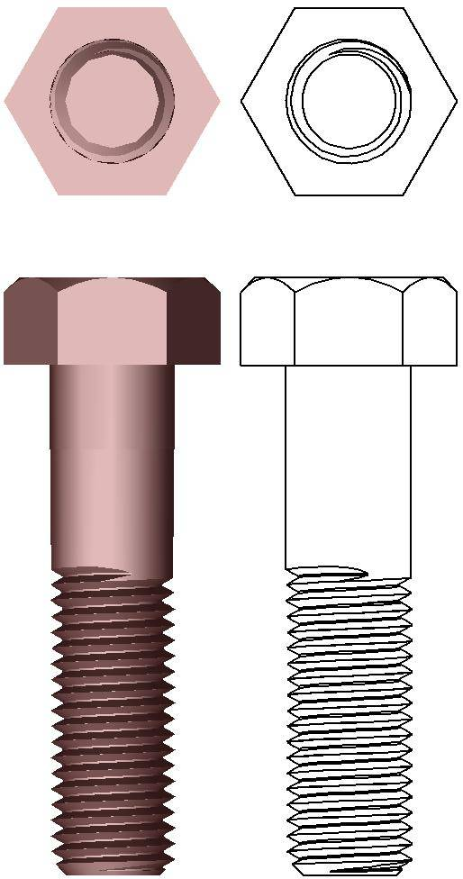
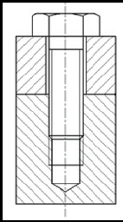
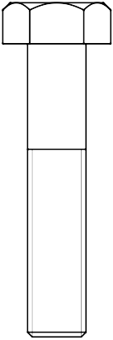
Concepts
Solid model of a product.
Functional surfaces.
Conventional Interfaces:
  Interference;
  Contact; and
  Clearance.
Contact
Clearance
Interference

Slide 9
Reference States and Dualities
Two reference states:
  The product is mechanically isolated: no external forces. Model interactions between components to characterize internal forces.
  The product is kinematically operational: user’s input of few kinematic constraints.
Relate to two dualities, respectively:
  Geometry/Force duality.
  Geometry/Mobility duality.

Slide 10
From DMU to Functional Designations
DMU Input
Locate Reference Surfaces
Geometric Analysis
Identify Conventional Interfaces
Generate Intrinsic Representation
Taxonomy of CI
Generate Conventional Interface Graph
Inference of Functional Designation
Reasoning & Inference
Inference of Functional Designation
Components FD
Taxonomy of FD
DMU Functional Designations

Slide 11
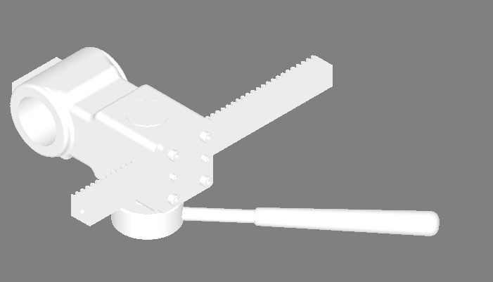
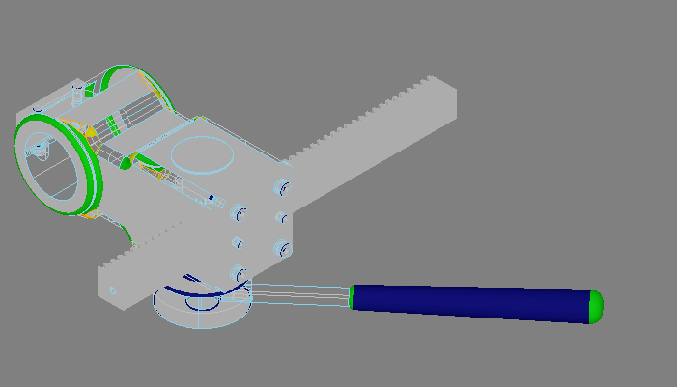
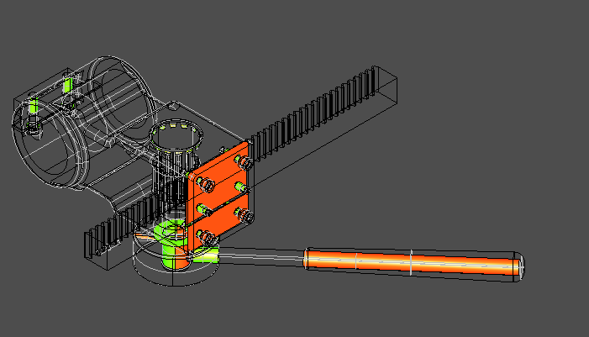
Geometric Analysis
Input: the product’s DMU as B-Rep.
Reference surfaces: locate functional surfaces (canonical shapes).
Identify CI: detect interference, contact, or clearance zones.

Slide 12
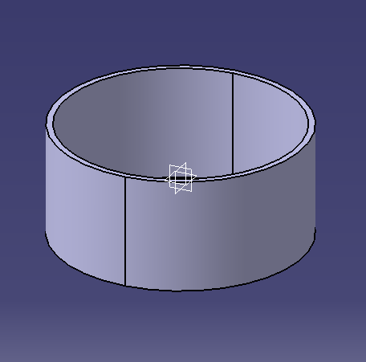
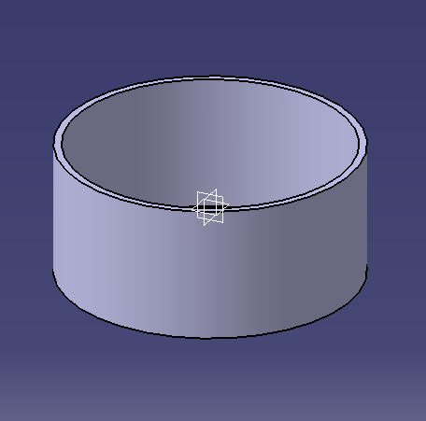
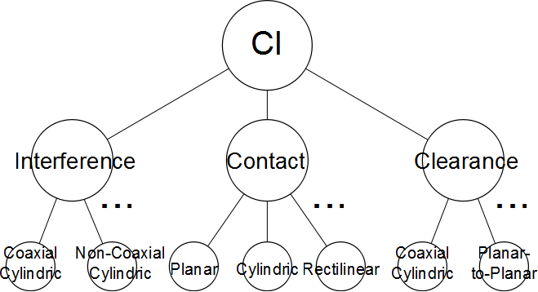
Geometric Analysis
Generate Maximal Surfaces
  Represent our surfaces intrinsically
Taxonomy of CI
Hyper-graph

Slide 13
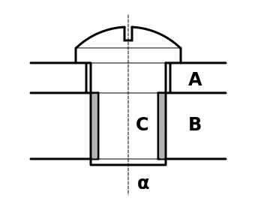
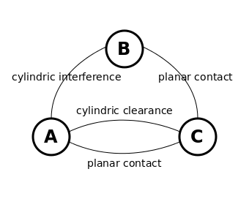
Geometric Analysis
Generate Conventional Interface Graph (CIG)
Ref. State 1 + G/F duality ➔ Inference of components functional properties.
Ref. State 2 + G/M duality ➔ Inference of components mobilities.
Iterative process.
Solid Model
CIG

Slide 14
From DMU to Functional Designations
DMU Input
Locate Reference Surfaces
Geometric Analysis
Identify Conventional Interfaces
Generate Intrinsic Representation
Taxonomy of CI
Generate Conventional Interface Graph
Inference of Functional Designation
Reasoning & Inference
Inference of Functional Designation
Components FD
Taxonomy of FD
DMU Functional Designations

Slide 15
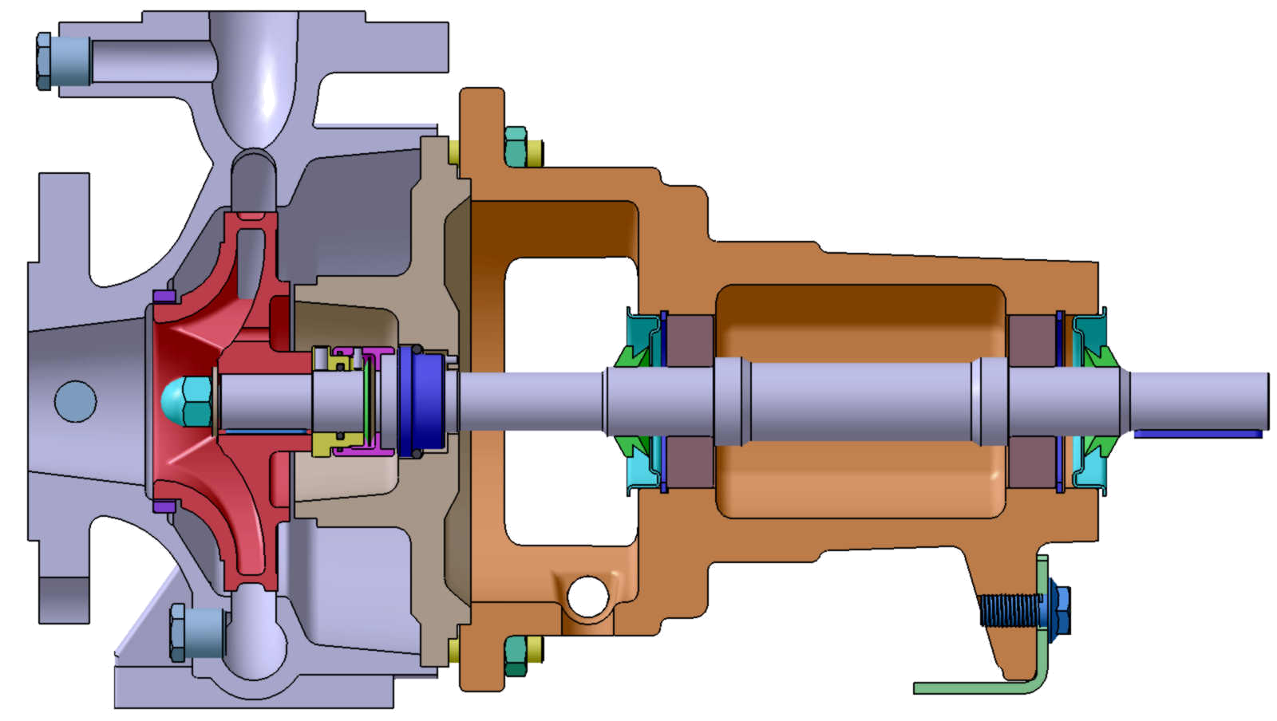
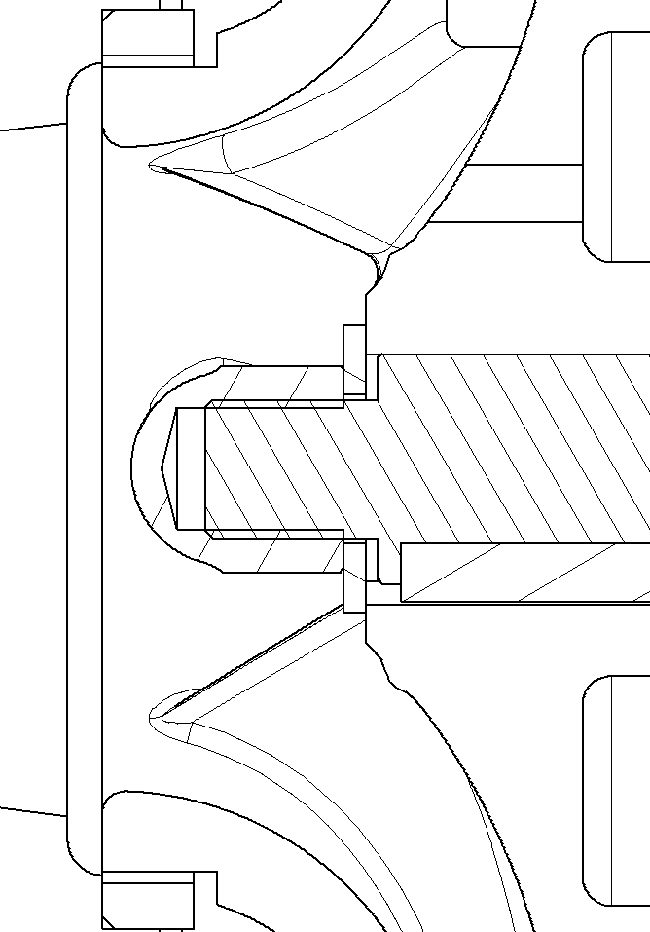

Inference Step 1
Water Pressure
Engine Torque

Slide 16
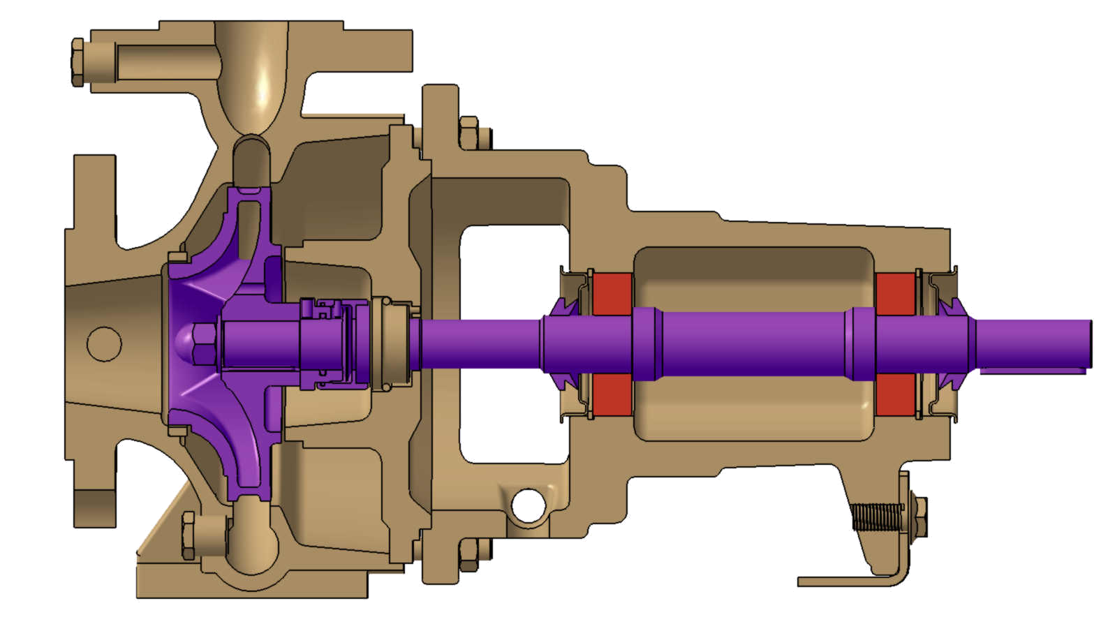
Inference Step 2
Rotation
Fixed
Kinematic class 1: Motionless.
Kinematic class 2: Rotational motion around the axes.
Kinematic class 1: Idealized part.

Slide 17
Reasoning and Inference
Interfaces may lead to more than one possible solution.
Criteria are needed to select the most meaningful option:
  Mechanical state: minimize the amount of functions per component.
  Kinematic state: No internal mobility in the general case.

Slide 18
Conclusions
Preliminary work towards automatic identification of functional designations.
Emphasis is put on the geometric interaction between objects (representing components) rather than the geometric properties of objects themselves.
Analysis of DMUs shows the merit of this approach.

Slide 19
Thanks

