Slide 1
ROMMA Task 1
Geometric Model Processing
Status Briefing
Ahmad Shahwan - Gilles Foucault - Jean-Claude Léon
G-SCOP Laboratory
Université de Grenoble, Grenoble-INP
April 2011

Slide 2
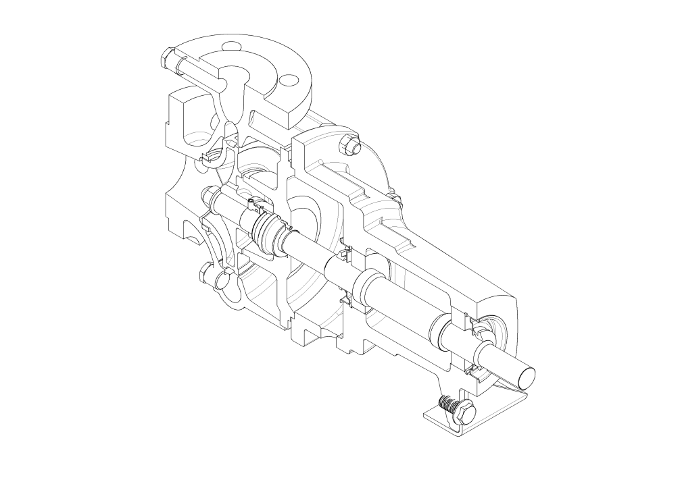
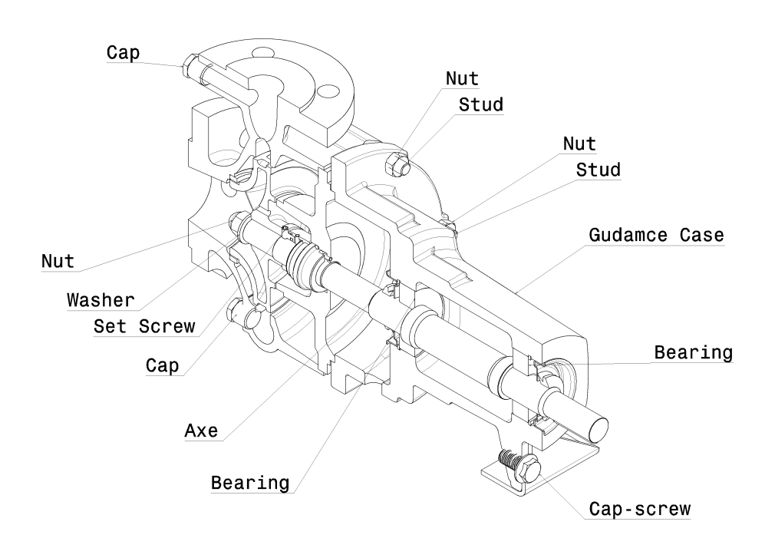
Motivation
Extracting functional denominations of components given the solid model of the product.

Slide 3
Data Flow Diagram
Maximal Surface/Edges Detection
Unique B-Rep Model
Geometric Interaction Detection
Geometric CI Graph
Generation of Homographs 3D
Function CI Graph
(all possible homographs)
Interpretations
STEP File
Functional Designations Taxonomy
Elimination of Homographs Using Ref State 1
Internal Efforts Screws
Conventional Interfaces Taxonomy
Annotated Model
Function CI Graph
(less homographs)
Functional Designations
Kinematic Screws
Eliminating Multiple Candidates
Functional Designations (multiple suggestions)
Matching with Functional Designations
Functional CI Graph (least homographs)
Elimination of Homographs Using Ref State 2
Kinematic Constraints
User

Slide 4
Data Flow Diagram
Maximal Surface/Edges Detection
Unique B-Rep Model
Geometric Interaction Detection
Geometric CI Graph
Generation of Homographs 3D
Function CI Graph
(all possible homographs)
Interpretations
STEP File
Functional Designations Taxonomy
Elimination of Homographs Using Ref State 1
Internal Efforts Screws
Conventional Interfaces Taxonomy
Annotated Model
Function CI Graph
(less homographs)
Functional Designations
Kinematic Screws
Eliminating Multiple Candidates
Functional Designations (multiple suggestions)
Matching with Functional Designations
Functional CI Graph (least homographs)
Elimination of Homographs Using Ref State 2
Kinematic Constraints
User

Slide 5
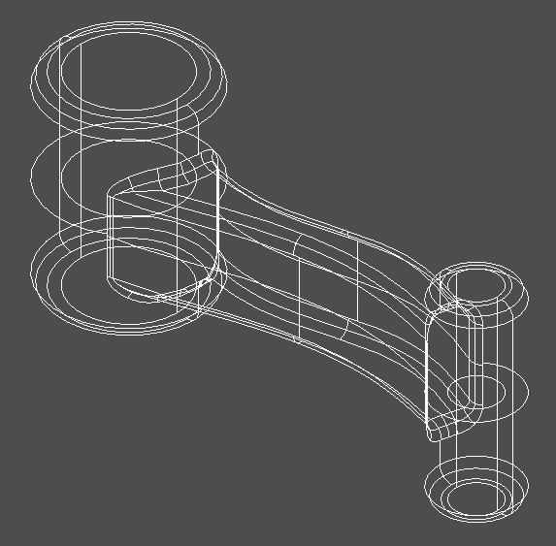
STEP File
ISO 10303 Standard.
AP203 allows the representation of the geometry of the product in a standard textual format using Boundary Representation (B-Rep).
ISO-10303-21;
HEADER;
FILE_DESCRIPTION(('a Product shape'),'1');
FILE_NAME('Euclid Shape Model','1998-09-10T11:31:03',('Author Name'),(
'MATRA-DATAVISION'),'OL-2.0B','EUCLID','Authorisation status');
FILE_SCHEMA(('AUTOMOTIVE_DESIGN_CC1 { 1 2 10303 214 -1 1 3 2}'));
ENDSEC;
DATA;
#1 = PRODUCT_RELATED_PRODUCT_CATEGORY('Undefined Category','Undefined De
scription',(#2));
#2 = PRODUCT('the product name','the product name','void',(#3));
#3 = MECHANICAL_CONTEXT('Mechanical',#4,'Assembly');
#4 = APPLICATION_CONTEXT('EUCLID');
#5 = APPLICATION_PROTOCOL_DEFINITION('CommitteeDraft','automotive_design
',1997,#4);
#6 = SHAPE_DEFINITION_REPRESENTATION(#7,#11);
#7 = PRODUCT_DEFINITION_SHAPE('void','void',#8);
#8 = PRODUCT_DEFINITION('void','void',#9,#10);
#9 = PRODUCT_DEFINITION_FORMATION('ID','void',#2);
#10 = PRODUCT_DEFINITION_CONTEXT('as proposed',#4,'First_Design');
#11 = ADVANCED_BREP_SHAPE_REPRESENTATION('',(#12),#18620);
#12 = MANIFOLD_SOLID_BREP('',#13);
#13 = CLOSED_SHELL('',(#14,#291,#3567,#3629,#3762,#3869,#4146,#7477,
#7539,#7672,#7779,#7807,#7835,#7998,#10155,#12312,#12461,#12610,
#14726,#16765,#16844,#17057,#17221,#17365,#17502,#17591,#17752,
#17847,#18042,#18071,#18165,#18278,#18327,#18393,#18540,#18606,
#18613));
#14 = ADVANCED_FACE('',(#15),#30,.T.);
#15 = FACE_BOUND('',#16,.T.);

Slide 6
Data Flow Diagram
Maximal Surface/Edges Detection
Unique B-Rep Model
Geometric Interaction Detection
Geometric CI Graph
Generation of Homographs 3D
Function CI Graph
(all possible homographs)
Interpretations
STEP File
Functional Designations Taxonomy
Elimination of Homographs Using Ref State 1
Internal Efforts Screws
Conventional Interfaces Taxonomy
Annotated Model
Function CI Graph
(less homographs)
Functional Designations
Kinematic Screws
Eliminating Multiple Candidates
Functional Designations (multiple suggestions)
Matching with Functional Designations
Functional CI Graph (least homographs)
Elimination of Homographs Using Ref State 2
Kinematic Constraints
User

Slide 7
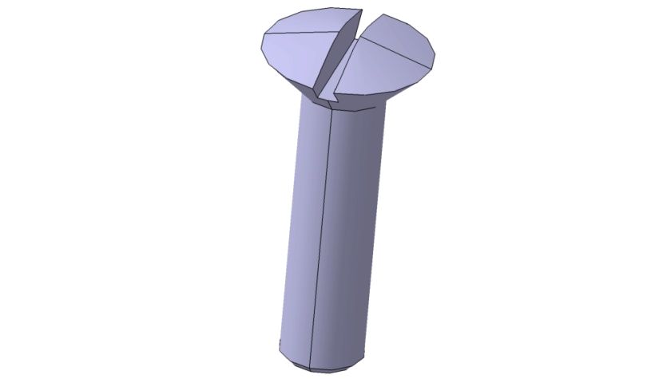
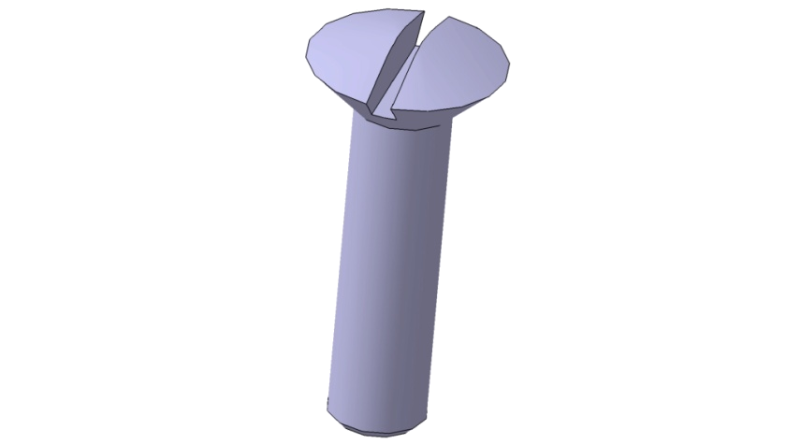
Geometric Analysis
Using B-Rep the same object might be represented differently, as the same face might be divided into more than one without changing the geometry. Same for the edges.
To guarantee a unique representation and the independence of the modeling process, we first convert the B-Rep model into maximal surfaces and edges, which represent the product intrinsically.
Hyper-graph

Slide 8
Data Flow Diagram
Maximal Surface/Edges Detection
Unique B-Rep Model
Geometric Interaction Detection
Geometric CI Graph
Generation of Homographs 3D
Function CI Graph
(all possible homographs)
Interpretations
STEP File
Functional Designations Taxonomy
Elimination of Homographs Using Ref State 1
Internal Efforts Screws
Conventional Interfaces Taxonomy
Annotated Model
Function CI Graph
(less homographs)
Functional Designations
Kinematic Screws
Eliminating Multiple Candidates
Functional Designations (multiple suggestions)
Matching with Functional Designations
Functional CI Graph (least homographs)
Elimination of Homographs Using Ref State 2
Kinematic Constraints
User

Slide 9
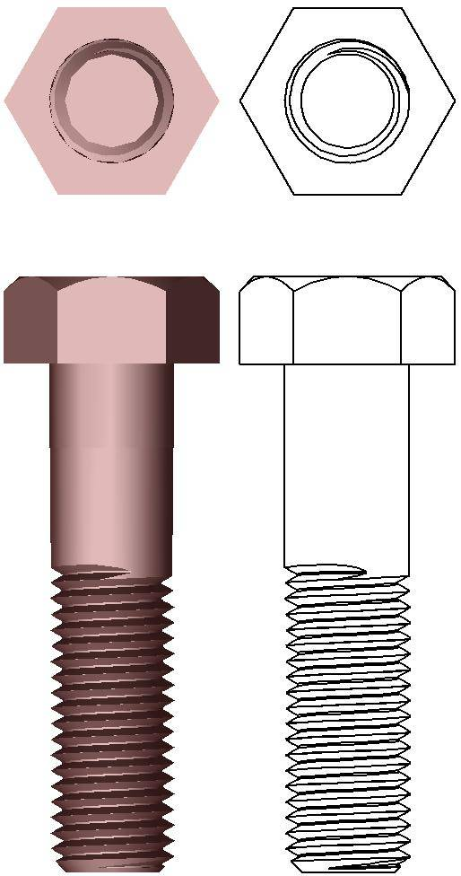
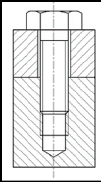
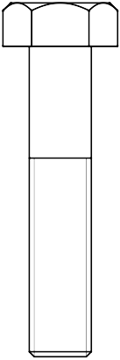
Conventional Interfaces
The result of the geometric interaction between neibouring components.
Can be one of the following:
  Interference;
  Contact; and
  Clearance.
Reflect the conventions of idealization.
Contact
Clearance
Interference

Slide 10
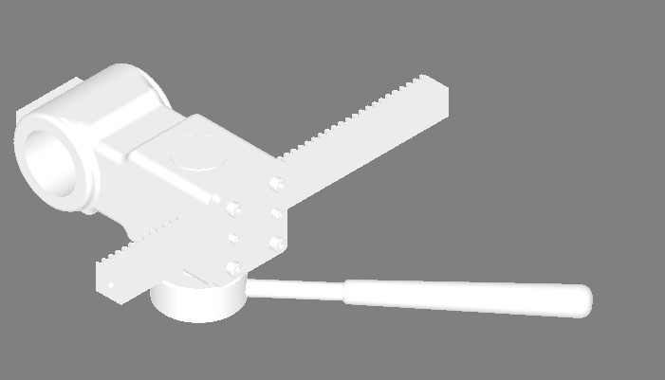
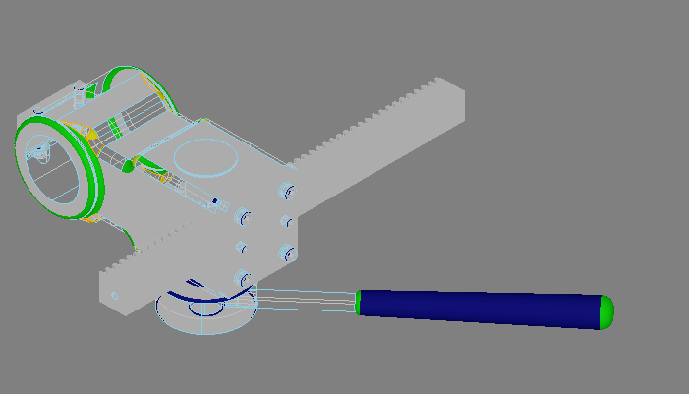
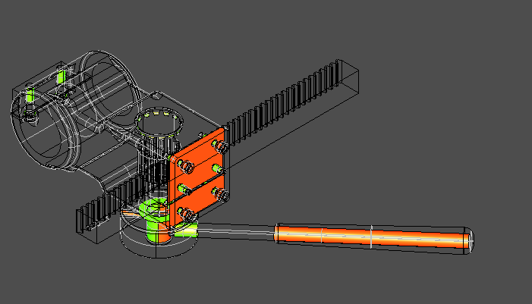
Geometric Analysis
Input: the product’s DMU as Maximal Surfaces and Edges B-Rep.
Reference surfaces: locate functional surfaces (canonical shapes).
Identify CI: detect interference, contact, or clearance zones.

Slide 11
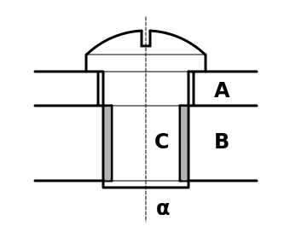
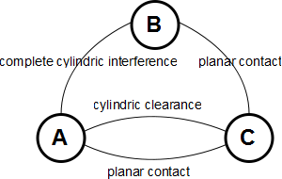
Geometric Analysis
The model is then represented as Geometric Conventional Interface Graph, where:
  Nodes are components;
  Edges are geometric interaction.
Solid Model
Geometric CI Graph

Slide 12
Data Flow Diagram
Maximal Surface/Edges Detection
Unique B-Rep Model
Geometric Interaction Detection
Geometric CI Graph
Generation of Homographs 3D
Function CI Graph
(all possible homographs)
Interpretations
STEP File
Functional Designations Taxonomy
Elimination of Homographs Using Ref State 1
Internal Efforts Screws
Conventional Interfaces Taxonomy
Annotated Model
Function CI Graph
(less homographs)
Functional Designations
Kinematic Screws
Eliminating Multiple Candidates
Functional Designations (multiple suggestions)
Matching with Functional Designations
Functional CI Graph (least homographs)
Elimination of Homographs Using Ref State 2
Kinematic Constraints
User

Slide 13
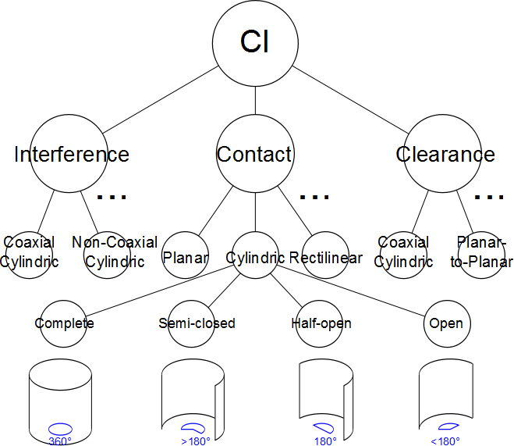
The CI Taxonomy
A hierarchy of all possible geometric configurations.
  Each leaf in the hierarchy defines unambiguously a particular geometrical configuration called lexeme.

Slide 14
The IC Taxonomy
Lexeme: is the smallest meaningful geometric configuration. Those are the leaves of the hierarchy.
One lexeme can be interpreted in more than one functional meaning, we call interpretations that map to the same geometric configuration homographs.
More than one lexeme may have the same functional interpretation, we call those lexemes synographs.
Homographs and synographs are the result of non-standard idealization of geometric congiguration.

Slide 15
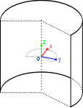
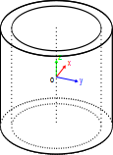
The CI Taxonomy
For each lexeme the taxonomy defines:
  A coordinate system w.r.t. the geometry.
  A set of all possible interpretations (homographs).
Semi-closed Cylindrical Contact
Homographs
Loose Shaft Linkage
Complete Coaxial Cylindrical Contact
Homographs
Spline Likage
Threaded Linkage
Example of two lexemes and their associated interpretations

Slide 16
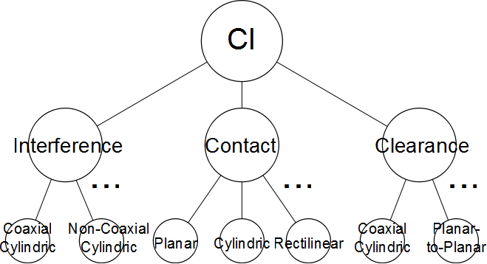
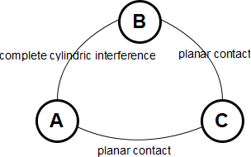
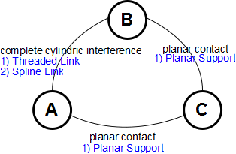
Generation of 3D Homographs
In the Geometric Conventional Interface Graph we map each edge to its lexeme in the taxonomy and replace it with all related homographs, generating the Functional Conventional Interface Graph.
Taxonomy of Conventional Interfaces
Geometric Conventional Interface Graph
Functional Conventional Interface Graph

Slide 17
Data Flow Diagram
Maximal Surface/Edges Detection
Unique B-Rep Model
Geometric Interaction Detection
Geometric CI Graph
Generation of Homographs 3D
Function CI Graph
(all possible homographs)
Interpretations
STEP File
Functional Designations Taxonomy
Elimination of Homographs Using Ref State 1
Internal Efforts Screws
Conventional Interfaces Taxonomy
Annotated Model
Function CI Graph
(less homographs)
Functional Designations
Kinematic Screws
Eliminating Multiple Candidates
Functional Designations (multiple suggestions)
Matching with Functional Designations
Functional CI Graph (least homographs)
Elimination of Homographs Using Ref State 2
Kinematic Constraints
User

Slide 18
Reference States and Dualities
Two reference states:
  The product is mechanically isolated; no external forces. Model interactions between components characterizing internal forces.
  The product is kinematically operational; user’s input of a kinematic constraints.
Relate to two dualities, respectively:
  Geometry/Force duality.
  Geometry/Mobility duality.

Slide 19
Mechanical & Functional Analysis
At this stage we are interested in Mechanical & Function Analysis process.
The objective of this process is to interpret the geometrically described conventional interface, into a function interface with precise physical and kinematic properties.
Ideally this process maps each geometrical interaction with one functional interface, however, the algorithm may converge with one interactions still be mapped to more than one interface, because of the lack of standards.
If no valid functional configuration can be inferred, model inconsistency is assumed.

Slide 20
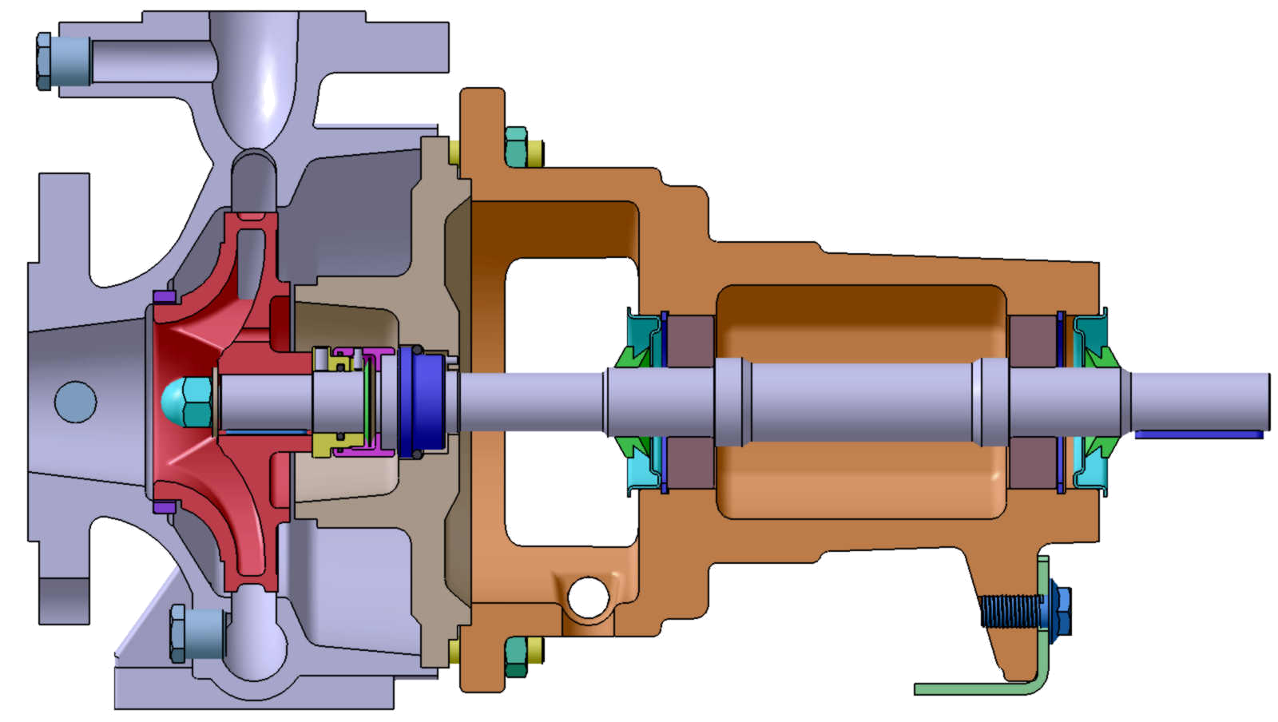
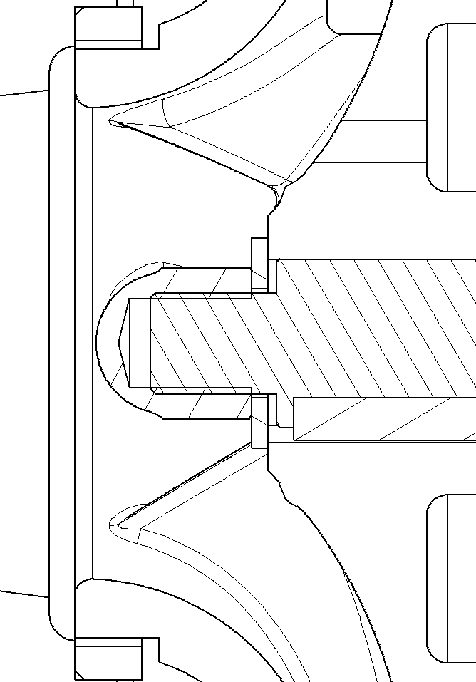

Inference Step 1
Water Pressure
Engine Torque

Slide 21
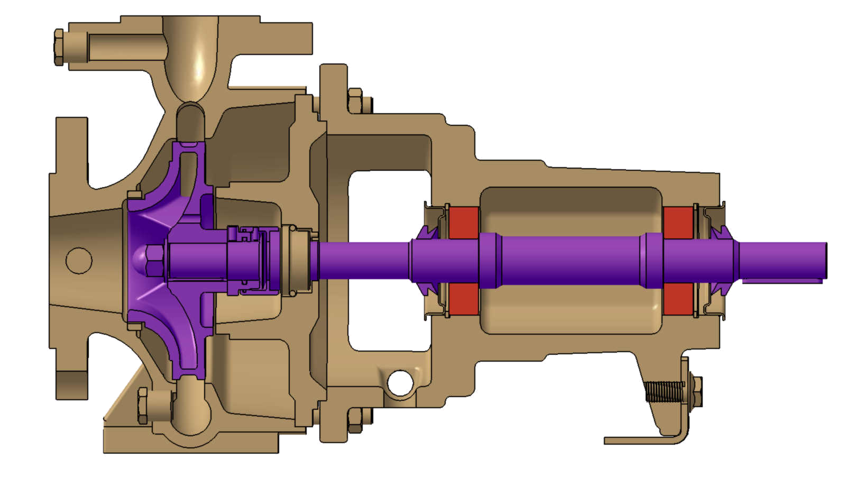
Inference Step 2
Rotation
Fixed
Kinematic class 1: Motionless.
Kinematic class 2: Rotational motion around the axes.
Kinematic class 1: Idealized part.

Slide 22
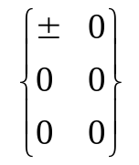
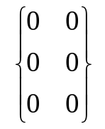
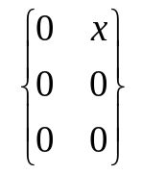
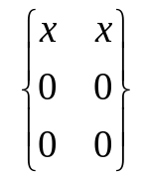
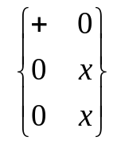
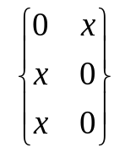
The CI Taxonomy
Each interpretation is characterized by two structures defining constraints on each of internal efforts screw and kinematic screw.
Constraints are: null (0), strictly positive (+), strictly negative (-), non-null (±), or arbitrary (x).
Internal Efforts
Kinematic
Threaded Linkage
Spline Linkage
Planar Support

Slide 23

Mechanical & Functional Analysis
Mechanical analysis is used to eliminate homographs who invalidate one of the two reference states.
Physical and kinematic properties of each interpretation is described using screws.
For each combination of (not yet eliminated) interpretation, that we can an assumption, we check its validity as follows
  Transform all the screw to the same coordinate system (rotations).
  Translate all screws to the same origin.
  Nullify the sum of all screws.
  The assumption is valid iff the nullification along with the constraints on the screws does not imply inconsistency.

Slide 24
Mechanical & Functional Analysis
The algorithm:
  Apply CI Taxonomy suggestion to the Geometric CI graph, replacing each edge (lexeme) by all its possible interpretations (homographs).
  Initially, all nodes are open.
  Until (all nodes are closed)
    Among open nodes, choose a node with smallest number of valid assumptions.
    Using Ref. State (1 or 2), eliminate interpretations that lead to inconsistency.
    Recalculate number of valid assumptions.
    If (number of valid assumptions is one, or no interpretation was eliminated)
      Mark node as closed (not open).
    If (no more valid interpretation)
      Report inconsistent model.
Where
  Our Graph is a pseudo-graph, i.e. parallel edges are allowed.
  Number of valid assumptions is the product of number of remaining interpretations over all the interfaces involving a node.

Slide 25
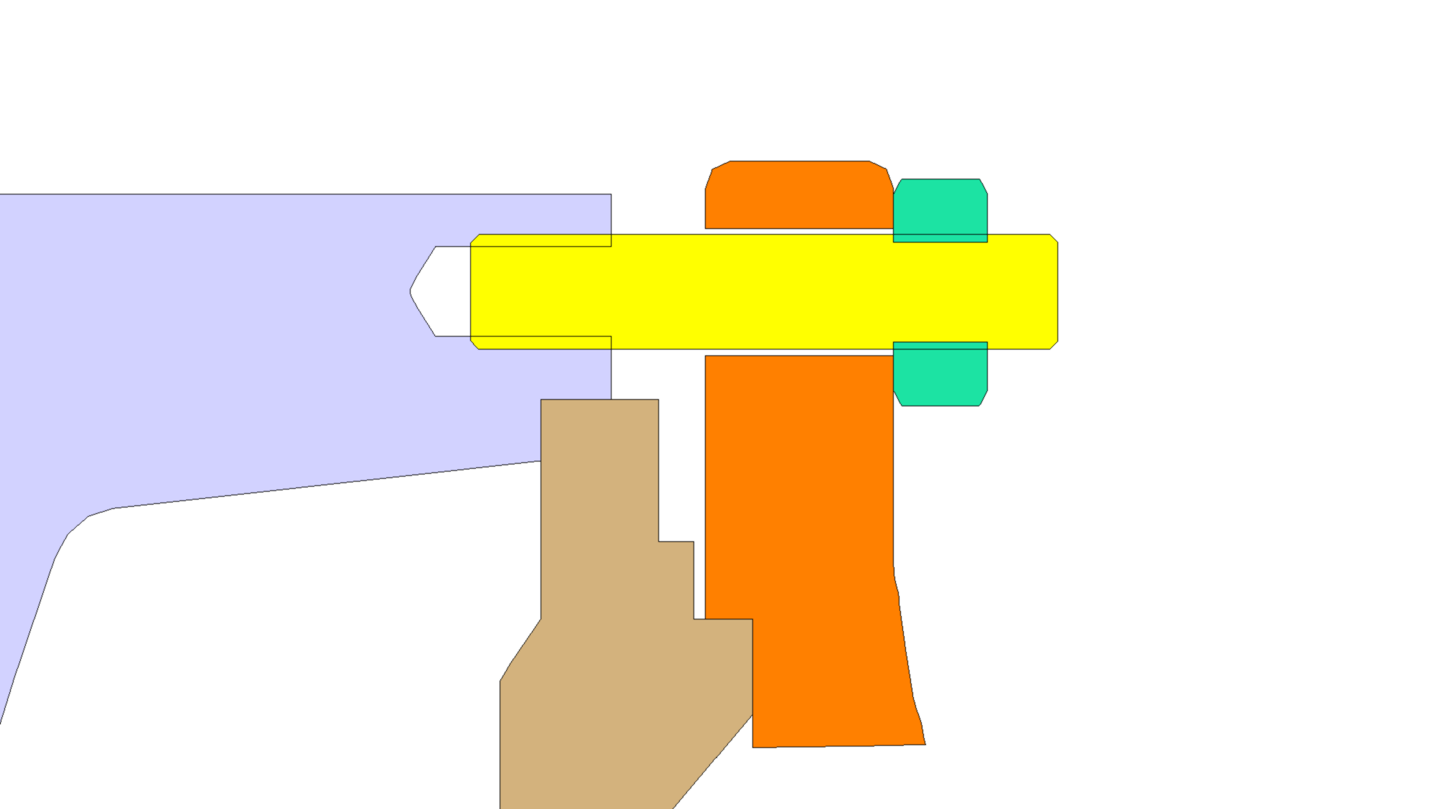
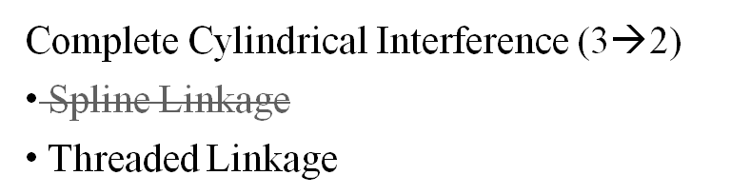
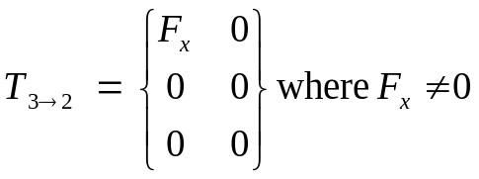
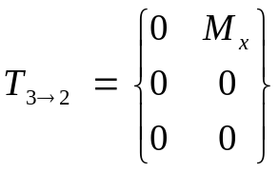
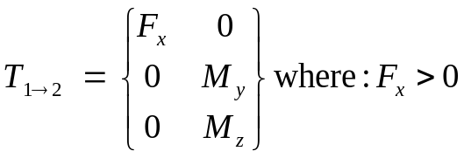
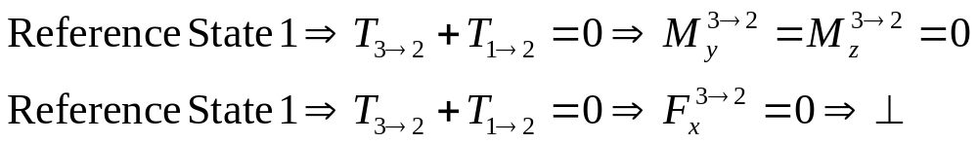
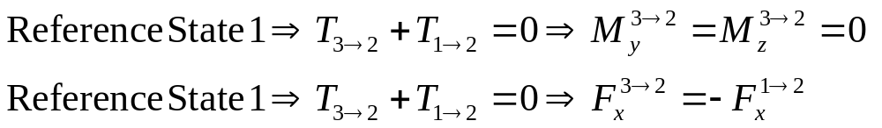
Reasoning Using Screws
1
Planar Contact
Planar Contact
Complete Cylindrical Contact
Planar Support
5
2
Planar Contact
Complete Cylindrical Interference
Threaded Linkage
Complete Cylindrical Contact
Spline Linkage
4
3
Complete Cylindrical Interference (3→2)
Spline Linkage
Threaded Linkage
Complete Cylindrical Interference
Complete Cylindrical Interference (3→2)
Spline Linkage
Threaded Linkage
Planar Contatc (1→2)
Planar Support
Planar Contatc (1→2)
Planar Support

Slide 26
Reasoning Using Screws
Planar Contact
1
Planar Support
Complete Cylindrical Contact
Planar Contact
Loose Shaft Link
Tight Shaft Link
Planar Support
5
2
Planar Contact
Planar Support
Complete Cylindrical Interference
Complete Cylindrical Contact
Threaded Linkage
Loose Shaft Link
Tight Shaft Link
4
3
Complete Cylindrical Interference
Threaded Linkage
Spline Linkage
Physical Analysis leads to multible interpretations.
This may be eliminated by the kinematic analysis.

Slide 27
Data Flow Diagram
Maximal Surface/Edges Detection
Unique B-Rep Model
Geometric Interaction Detection
Geometric CI Graph
Generation of Homographs 3D
Function CI Graph
(all possible homographs)
Interpretations
STEP File
Functional Designations Taxonomy
Elimination of Homographs Using Ref State 1
Internal Efforts Screws
Conventional Interfaces Taxonomy
Annotated Model
Function CI Graph
(less homographs)
Functional Designations
Kinematic Screws
Eliminating Multiple Candidates
Functional Designations (multiple suggestions)
Matching with Functional Designations
Functional CI Graph (least homographs)
Elimination of Homographs Using Ref State 2
Kinematic Constraints
User

Slide 28
Matching with Functional Designations
At this phase, each component will be given be given a functional designation, based on the functional interfaces it has. The Functional Designation Taxonomy is used to this end.
More than one designation may be assigned to one component.

Slide 29
Data Flow Diagram
Maximal Surface/Edges Detection
Unique B-Rep Model
Geometric Interaction Detection
Geometric CI Graph
Generation of Homographs 3D
Function CI Graph
(all possible homographs)
Interpretations
STEP File
Functional Designations Taxonomy
Elimination of Homographs Using Ref State 1
Internal Efforts Screws
Conventional Interfaces Taxonomy
Annotated Model
Function CI Graph
(less homographs)
Functional Designations
Kinematic Screws
Eliminating Multiple Candidates
Functional Designations (multiple suggestions)
Matching with Functional Designations
Functional CI Graph (least homographs)
Elimination of Homographs Using Ref State 2
Kinematic Constraints
User

Slide 30
Eliminating Multiple Candidates
Interfaces may lead more than one possible solution.
Criteria are needed to select the most meaningful option:
  Mechanical state: minimize the amount of functions per component.
  Kinematic state: No internal mobility in the general case.

Slide 31
Conclusions
Emphasis is put on the geometric interaction between objects (representing components) rather than the geometric properties of objects themselves.
Analysis of DMUs shows the merit of this approach.

