Slide 1
ROMMA Task 1 Model Functional Analysis Status Briefing
Ahmad Shahwan Moreno Trlin Gilles Foucault Jean-Claude Léon
G-SCOP Laboratory Université de Grenoble, Grenoble-INP INRIA Rhone-Alpes
February 2012

Slide 2
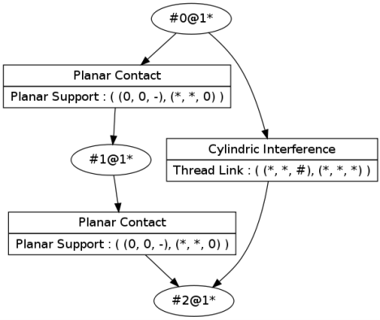
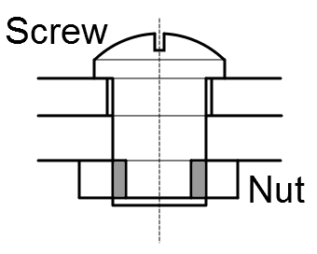
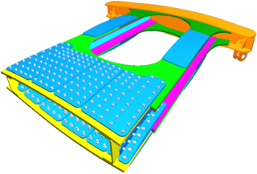
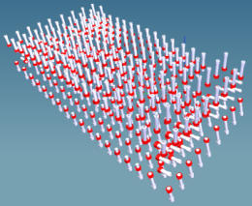
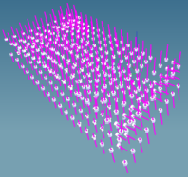
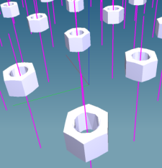
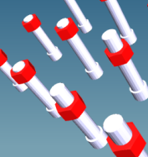
Motivation
Semantic Annotation
Engineers / Manual Work
Design Model
Simulation Model
Functional Properties
Idealization

Slide 3
Data and Process Flow Diagram
Maximal Surface/Edges Detection
Unique B-Rep Model
Geometric Interaction Detection
Geometric CI Graph
Initialization of the Instances Knowledge Base
Entity Knowledge Base
Interpretations
Functional CI Graph
(all possible interpretation)
STEP File
Functional Designations Taxonomy
Conventional Interfaces Taxonomy
Internal Forces Screws
Domain Specific Knowledge
Reducing Uncertainty Using Ref State 1
Annotated Model
Functional CI Graph
(less interpretations)
Functional Patterns
Supplementary Rules
Kinematic Screws
Matching Components with Functional Designations
Functional Designations (multiple suggestions)
Reducing Uncertainty Using Rules
Functional CI Graph (least interpretations)
Reducing Uncertainty Using Ref State 2
Kinematic Constraints

Slide 4
Currently Implemented Modules
Maximal Surface/Edges Detection
Unique B-Rep Model
Geometric Interaction Detection
Geometric CI Graph
Initialization of the Instances Knowledge Base
Entity Knowledge Base
Interpretations
Functional CI Graph
(all possible interpretation)
STEP File
Functional Designations Taxonomy
Conventional Interfaces Taxonomy
Internal Forces Screws
Domain Specific Knowledge
Reducing Uncertainty Using Ref State 1
Annotated Model
Functional CI Graph
(less interpretations)
Functional Patterns
Supplementary Rules
Kinematic Screws
Matching Components with Functional Designations
Functional Designations (multiple suggestions)
Reducing Uncertainty Using Rules
Functional CI Graph (least interpretations)
Reducing Uncertainty Using Ref State 2
Kinematic Constraints
Implemented
Partially implemented

Slide 5
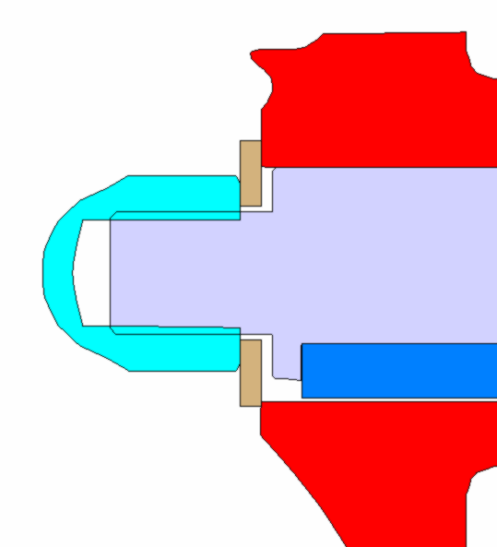
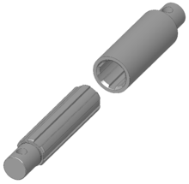
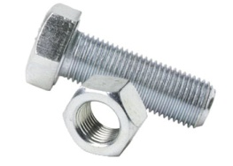
Mechanical Analysis
Two solutions (or more) are evenly correct from a geometrical point of view
➔ Need for other criteria to eliminate irrelevant one(s).
Planar Contact
Cylindrical Interference
Planar Support
Spline Link
interpretations
Unbalanced
Planar Support
Threaded Link
Balanced

Slide 6
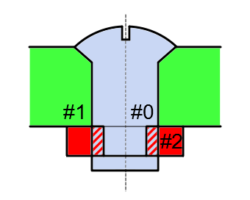
The Algorithm
Geometric Analysis
#1
Initialization of instances
Conical Contact
CI Taxonomy
Planar Contact
Conical Support
Planar Support
Cylindrical Interference
#0
Threaded Link
#2
Spline Link
Conventional Interface Graph

Slide 7
The Algorithm
Mechanical Analysis
#1
#1
CI#1
@1
1
@1
2
CI#2
Conical Contact
Planar Contact
Conical Support
Planar Support
1
Cylindrical Interference
1
#0
#0
#2
2
Threaded Link
2
#2
@2
@2
@1
Spline Link
@1
Spline Link
CI#1
CI#1
CI#1
CI#2
CI#2
CI#2

Slide 8
The Algorithm
Detection of Functional Designations
#1
Coaxial/Concentric
Orthogonal
Conical Support
Planar Support
#0
#2
Threaded Link
Capscrew
FD Taxonomy

Slide 9
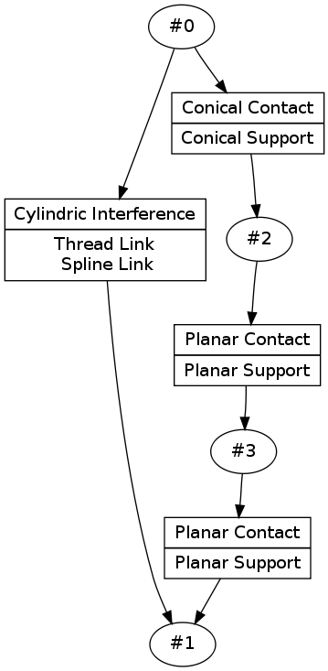
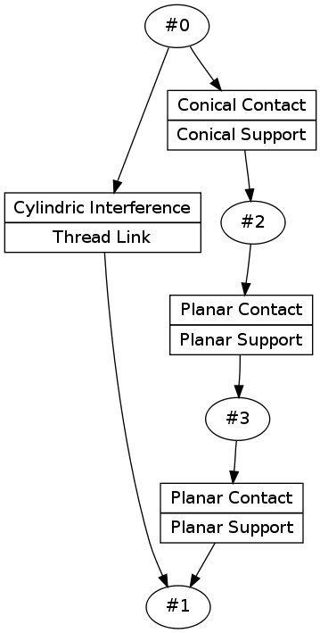
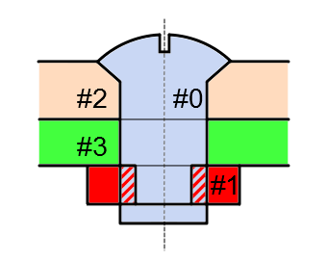
Examples

Slide 10
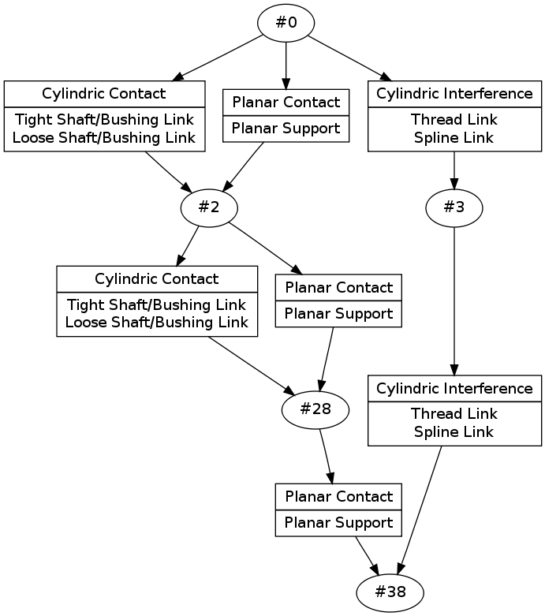
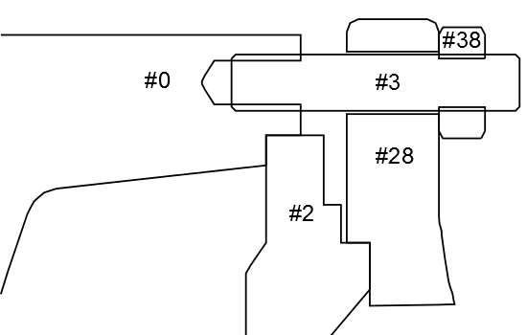
Examples
Cylindrical interferences could be resolved.
No decision could be taken about cylindrical contacts

Slide 11
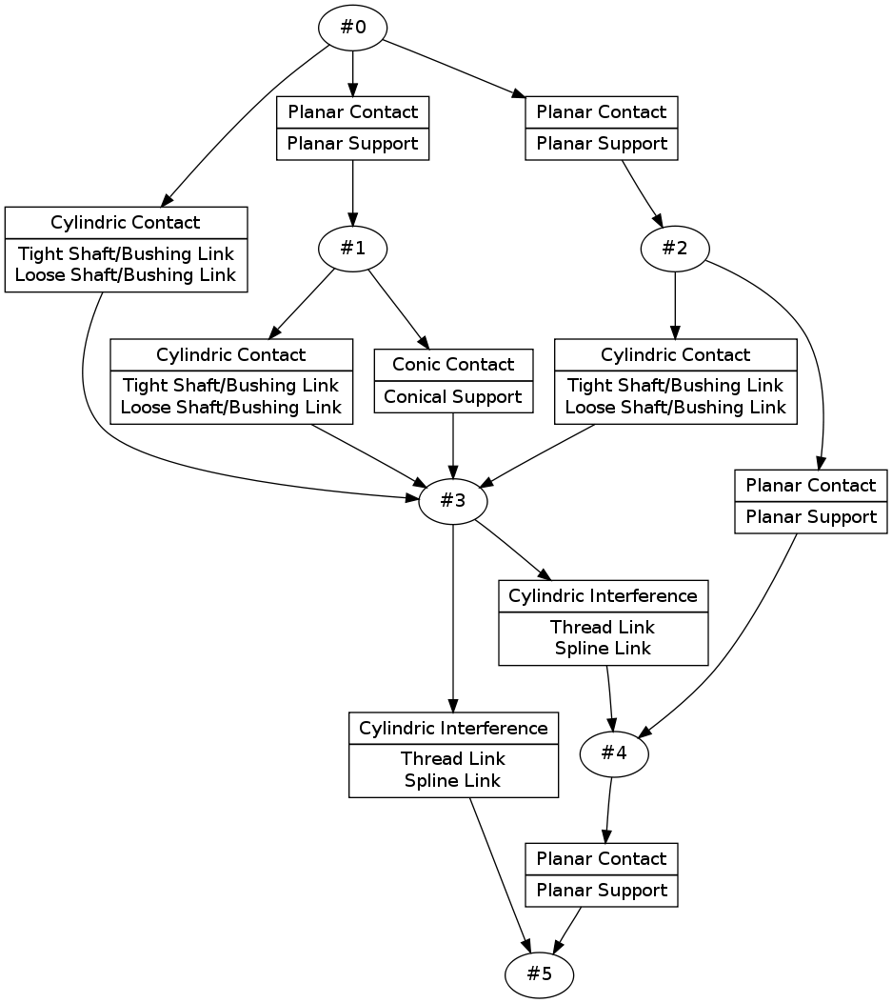
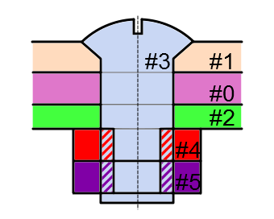
Examples
?
Threaded Link
We where able to decide about the threaded link for the counter-nut, but not for the nut.
Again, application of rules.

Slide 12
Thanks

