Slide 1



ROMMA Task 1 Model Functional Analysis Status Briefing
Ahmad Shahwan Moreno Trlin Gilles Foucault Jean-Claude Léon
G-SCOP Laboratory Université de Grenoble, Grenoble-INP INRIA Rhone-Alpes
May 2012

Slide 2
Overview
Review of mechanical analysis.
Enhanced “determinant” algorithm for mechanical analysis.
Using a ontologies.
Internal forces’ cycle detection.
Interface with DL reasoners.

Slide 3
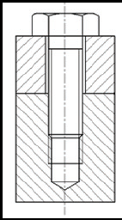
Review of mechanical analysis
Geometric Configurations
Conventional Interface
Functional Interpretation
Functional Designations
CI: Planar Contact
FI: Planar Support
Geometric Analysis
Component
Mech. Analysis
Component
Domain Rules App,
Cap Screw
CI: Cylindric Interference
FI: Threaded Link
CI: Threaded Link
CI: Threaded Link

Slide 4
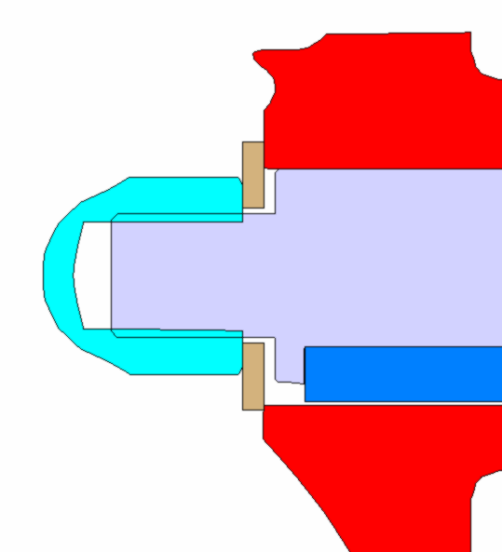
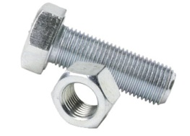
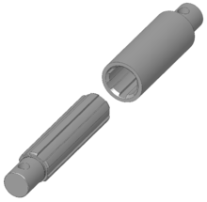
Enhanced Deterministic Algorithm
For each geometric configuration, sort possible functional interpretation according to their simplicity.
Cylindric Interference
1
2
Threaded Link
(simpler)
Spline Link
(more complicated)

Slide 5
Enhanced Deterministic Algorithm
Explore the simplest interpretation first, if a solution is possible, stop searching, and return this solution, otherwise, explore the next simplest interpretation.
3
1
2

Slide 6
Enhanced Deterministic Algorithm
Returns one, best, solution.
Conventional Interface
1
1
Functional Interpretation

Slide 7
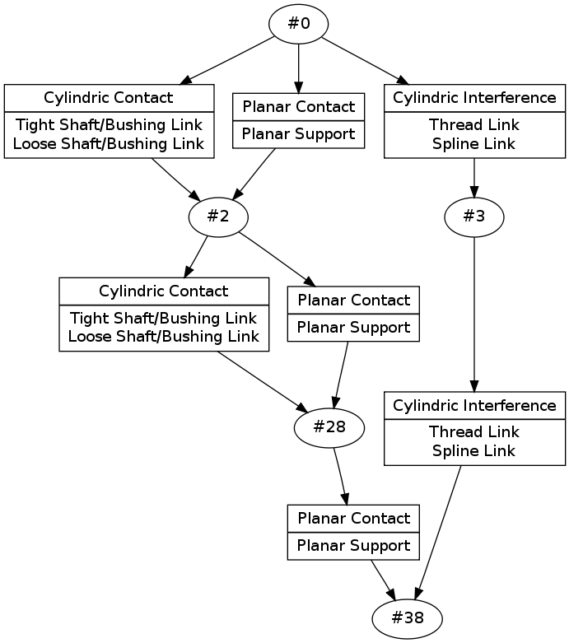
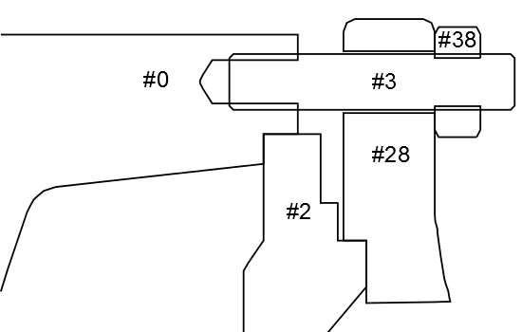
Examples
All-solutions method
Best-solution method
Initialization

Slide 8
Using a Knowledge Base
KB
Concepts
(classes)
Axioms
(rules)
General Domain Knowledge
T-Box
Individuals
(instances)
Roles
(relations)
Specific Case Study
A-Box

Slide 9
Using a Knowledge Base
Knowledge Base (Ontology)
Initialization
Concepts
Rules
x
y
Domain Experties
Component
Conventional Interface
…
…
a
b
Instantiation
Individuals
Relations
Screw
Nut
Threaded Link
Planar Support
Ref. Sate Analysis
inner-forms
outer-forms
x
a
y
a
forms
forms
Reasoning
Classification
x
b
y
b
Screw ⬄
----
Nut⬄
----

Slide 10
Detecting Internal Forces Cycles
DL reasoners cannot do!
Based on mechanical analysis, for each axis, create a directed graph, where forces can propagate in the positive direction.
Whether or not internal force can propagate in a certain direction is determined by the interface screw.
When more than one interface exist between two components, screws are ORed.

Slide 11
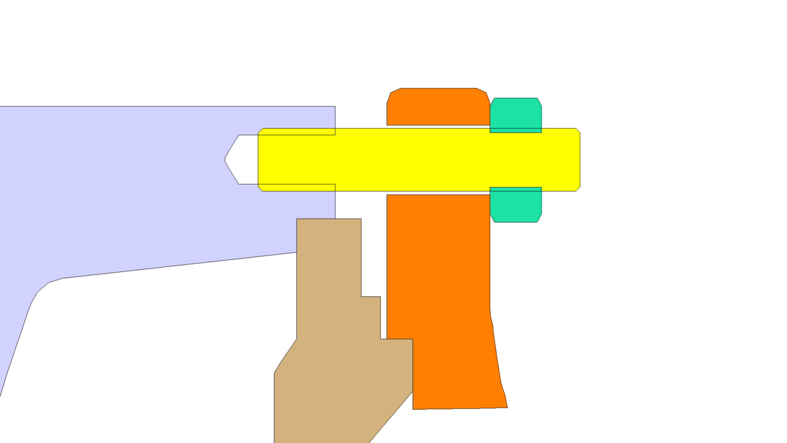
Detecting Internal Forces Cycles
1
5
2
y
4
3
z
x

Slide 12
Interface with DL Reasoners
Ontology / OWL
Semantic Annotator
Ontology / DIG
DIG Client
HTTP
Fact++ DIG Server
DL Reasoner Fact++

