Slide 1
From CAD to FEA through functional restructuring of the geometry
Ahmad Shahwan
Jean-Claude Léon
Gilles Foucault
ROMMA status briefing Mars 2013

Slide 2
Overview
Workflow Reminder
Detecting loads cycles in local coordinates system
From oriented graphs to non-oriented graphs
Indeterminate Static Equilibrium
How to detect
Examples
Reasoning Problems
Unique Name Assumption
Open World Assumption

Slide 3
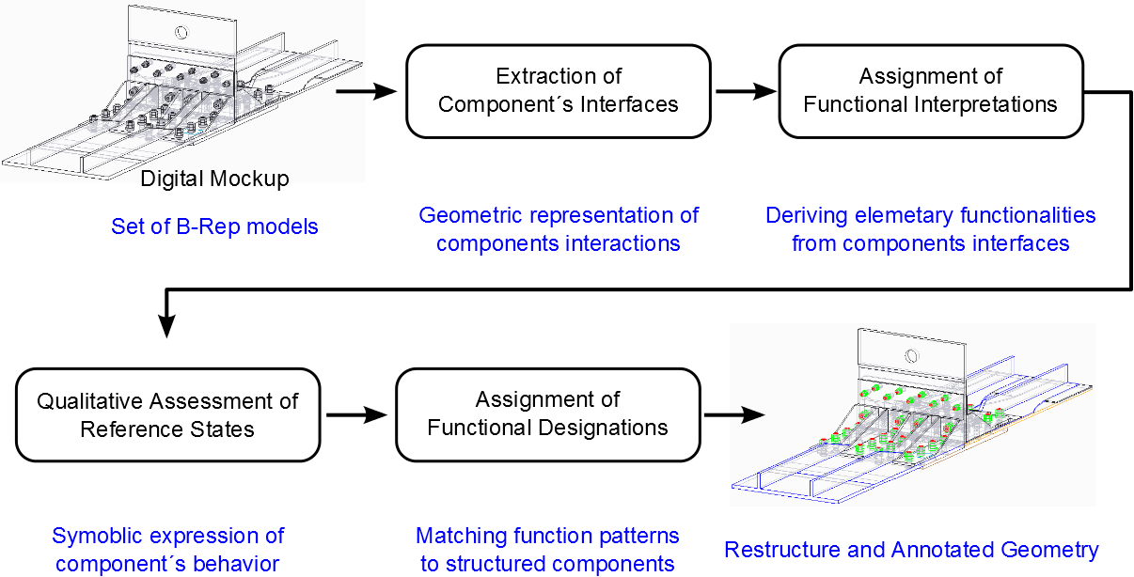
Workflow Reminder

Slide 4
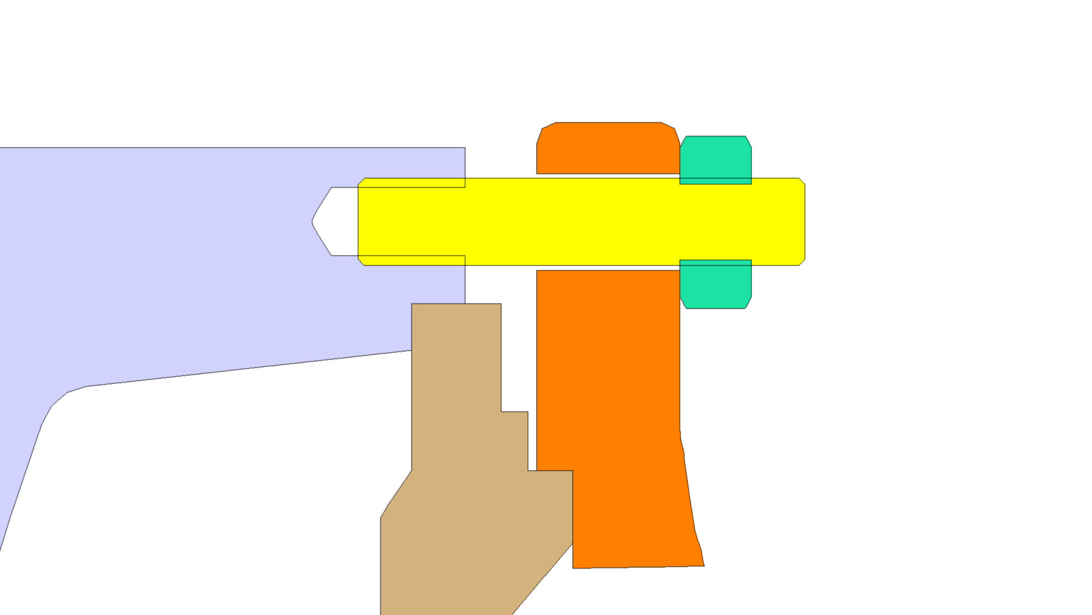
Internal Force Cycles
Global CS: Global axes
notion of direction
Loads propagation graph:
Directed graph
Nodes are components
1
3
4
2
5
2
1
y
x
5
z
5
4
3
Local CS: No global axes
notion of direction is missing
Loads propagation graph:
Undirected graph
Nodes are CI
Edges are labeled with components’ IDs
3
5
1
4
2
1
4
2
5
3

Slide 5
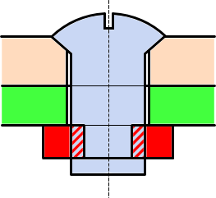
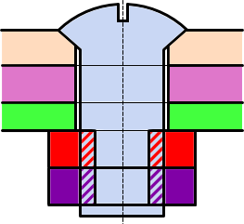
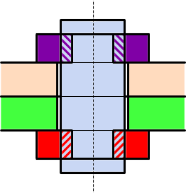
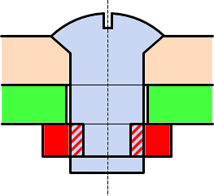
Indeterminate static equilibrium
Is-static equilibrium
Functional hyper-static equilibrium
Functional hyper-static equilibrium
Non-functional hyper-static equilibrium
Once Loads cycles are detected, multiple load generators (threaded link, tight shaft link) denote indeterminate static equilibrium.
Are those configuration functional or not?

Slide 6
Unique name assumption
DL reasoners (such as FaCT++, Pellet) don not consider the UNA:
Example 1
Adam father of Abel
Adam father of Cain
Father of at least 2 = {}
Example 2
Adam father of Abel
Adam father of Cain
Abel is different from Cain
Father of at least 2 = {Adam}

Slide 7
Open World Assumption
DL reasoners don not consider the OWA, thus, our knowledge base should be closed locally.
Example 1
Adam father of Abel and Adam father of Cain
Abel is different from Cain
Not father of Eve = {}
Example 2
Adam father of Abel and Adam father of Cain
Abel, Cain and Eve are mutually different.
Adam has at most 2 children.
Not father of Eve = {Adam}

Slide 8
Impact on our reasoning
Query | UNA | OWA
Cap-Screw ⬅ at least one Threaded Link and one Planar Support | No | No
Stud ⬅ at least 2 Threaded Links | Yes | No
Stud ⬅ at least 2 Threaded Links and no Planar Support | Yes | Yes
Nut ⬅ Only 2 Interfaces: one Planar Support and one Threaded link | Yes | Yes
Meaningful rules always require those assumption.
In our work, supplementary fact are provided to the reasoner to distinguish instances (solving the UNA) and to locally close the word by cardinality constraints (solving the OWA).

Slide 9
Latest communications
Article “Deriving Functional Properties of Components from the Analysis of Digital Mock-ups” submitted to a special issue “Morphological, structural and functional modelling and CAD-centric information exchange for complex collaborative design efforts in industry” of Engineering Computations – Computer Aided Design Software, in the frame of ROMMA project.

Slide 10
Thanks

Slide 11
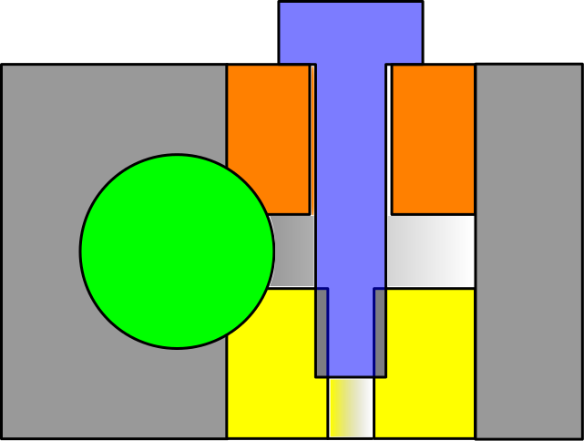
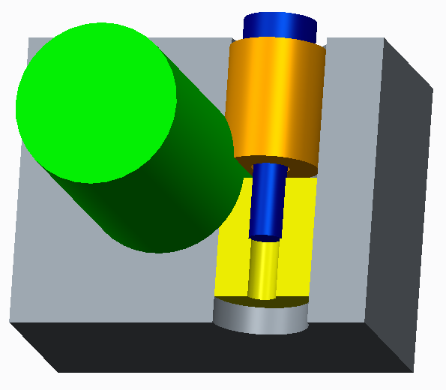
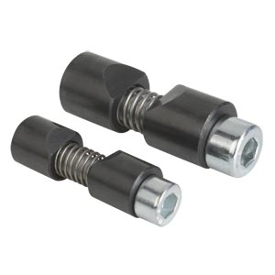
LCS & Internal Force Cycles
Example of cylindrical washer elements.
Here internal forces propagate through shaft/bushing link.
Problem with this kind of interfaces is that they defuse internal forces in more than one direction!

Slide 12
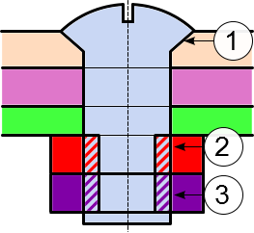
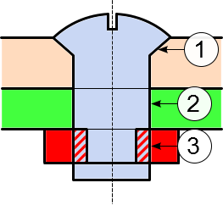
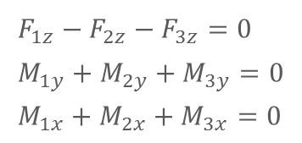
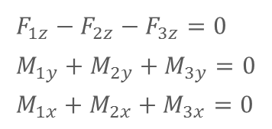
Indeterminate static equilibrium
Indeterminate static (hyperstatic) equilibrium may be functional, or may indicate anomaly.
Nut/counter-nut tightening is an example of functional hypestatic configurations.
Indeterminism is used here to increase internal system energy.
$$F_{1z}−F_{2z}−F_{3z}=0 \\ M_{1y}+M_{2y}+M_{3y}=0 \\ M_{1x}+M_{2x}+M_{3x}=0$$
Incorrect interpretation of tight fit produces an erroneous hyperstatic equilibrium.
This may helps the elimination of irrelevant interpretations.
$$F_{1z}−F_{2z}−F_{3z}=0 \\ M_{1y}+M_{2y}+M_{3y}=0 \\ M_{1x}+M_{2x}+M_{3x}=0$$

