Slide 1
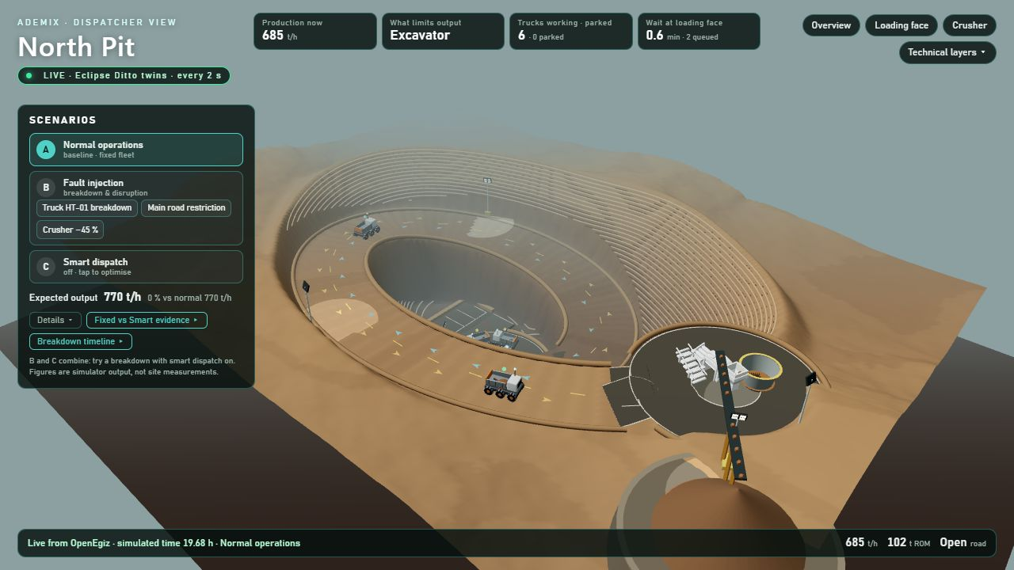
DIGITAL MINE ON OPENEGIZ 2026
North Pit Digital Twin
A live 3D digital twin of an open pit’s loading, haulage and crusher chain on the OpenEgiz platform, built to show the dispatcher what limits output and what to do next.
TEAM
Live capture of the running stand (Eclipse Ditto)
Ademix
Built with Eclipse Ditto, MQTT, React Three Fiber and Python
AUTHORS
Ahmad Shah Yawar
Gulzat Turken
Notes:
Title page. Project: North Pit Digital Twin, team Ademix, authors Ahmad Shah Yawar and Gulzat Turken. The picture is a real capture of the running stand, not a render: everything on it is twin state returned through Eclipse Ditto every two seconds.

Slide 2
OPERATIONAL CONTEXT AND DECISION PROBLEM
INTRODUCTION
WHO
DECISION
WHY HAULAGE
The mine dispatcher and shift supervisor
Response to disruptions
Haulage links every facility
The people who decide, minute by minute, where every haul truck goes.
A truck breaks down, the haul road is restricted, or crusher capacity falls: compare throughput, queues, cycle time and utilization before choosing.
Face, road and crusher share one flow, so a problem and its consequence are both visible in a live 3D view.
The mine is a fictional, reduced layout calibrated from the anonymized North Pit configuration of the MIT-licensed OpenMines project. Synthetic live telemetry is kept separate from sourced parameters.
Notes:
This is the Team’s own concept from SUBMISSION.md. The user is the dispatcher; the decision is the response to a disruption. Everything else in the deck follows from this one decision.

Slide 3
COMPETITION TASK AND PROJECT RESPONSE
INTRODUCTION
Requirement of “Digital Mine on OpenEgiz” | How the project meets it
Digital twin of a mine facility on OpenEgiz | Open-pit loading, haulage and crusher chain as 11 Eclipse Ditto twins
Simulate equipment operations | Excavator, six 77 t trucks, dump bay and crusher with FIFO queues and cycle timing
Model transportation processes | 3.2 km two-lane haul road, speed limits and direction-aware breakdowns
Analyze production data | Live KPIs, matched fixed-versus-smart evidence, recovery history and fleet curves
Predict facility performance | Analytical capacity and bottleneck for every condition, within 0.3 % of the simulation
“What-if” scenarios | Breakdown, road restriction, crusher slowdown and Smart Dispatch, each with a clean reset
Submission | GitHub repository, English, one Docker Compose command, no paid service
Notes:
The left column follows the competition announcement: a digital model of a mine or its facilities on OpenEgiz, simulation of equipment and transportation, data analysis, performance prediction and what-if scenarios. Each entry points to a later slide and to something visible on the running stand.

Slide 4
PRODUCTION CHAIN: LOADING FACE TO PRIMARY CRUSHER
INTRODUCTION
LOADING FACE
HAUL ROAD
ROM BIN
CRUSHER
770 t/h
3.2 km
600 t
900 t/h
One excavator; four 20.32 t passes load a 77 t truck in 6 min
Two separated lanes, 25 km/h, six 77 t haul trucks
One dump bay; a truck tips only when a full load fits
Primary crusher, planning capacity
Sourced: 77 t payload, 20.32 t shovel pass (OpenMines) Derived: 6 min loading
Team assumption: 3.2 km route, 600 t bin, 900 t/h crusher
Notes:
Every parameter carries its provenance. The truck payload and shovel pass come from OpenMines; the loading time is derived from them; the route length, ROM bin and crusher capacity are team planning assumptions, not site or manufacturer figures. A free round trip takes about 22.4 minutes.

Slide 5
RESEARCH AIM AND OBJECTIVES
PURPOSE
Give the mine dispatcher a live digital twin that shows what limits ore flow, and which fleet decision restores it, with evidence that can be checked.
RESEARCH OBJECTIVES
01
02
03
Identify the binding constraint, loader, road or crusher, under each operating condition.
Determine the smallest fleet that sustains maximum output in each condition.
Quantify the production loss and the recovery after an equipment breakdown.
Notes:
Where each objective is met: O1 on the scenario and prediction slides; O2 on the Smart Dispatch slide; O3 on the breakdown slide and the results summary.

Slide 6
RESEARCH TASKS AND IMPLEMENTATION STATUS
TASKS
# | Task | Done, and where to see it
1 | Represent the chain as 11 connected Eclipse Ditto twins | Mine model view
2 | Simulate it: FIFO queues, cycle times, mass balance | Python engine, 92 tests
3 | Stream live state through MQTT and Ditto every 2 s | LIVE badge, smoke check
4 | Visualize it as a 3D mine driven by twin state | Command center
5 | Run three disruptions with a clean reset | Scenario controls B, reset A
6 | Turn analysis into a decision the dispatcher can apply | Smart Dispatch, Decision
7 | Prove it with tests, matched evidence and stated limits | Model credibility panel
Notes:
Each task maps to a part of the running stand. The next three slides show how tasks 1 to 4 were built; the Results section shows what tasks 5 to 7 produced.

Slide 7
SYSTEM ARCHITECTURE ON OPENEGIZ
METHOD
1. Simulator
2. MQTT
3. Eclipse Ditto
4. Ademix API
5. 3D view
Deterministic Python engine: FIFO queues, exclusive loader and dump bay, mass balance
Ditto Protocol updates, a full snapshot every two seconds
11 digital twins, the single source of state
One bulk Ditto read per poll; scenario and dispatch controls
React Three Fiber command center labels LIVE, DEMO or REPLAY
11
143
2 s
20×
twins in Ditto
required fields with units, checked by smoke test
between twin updates on screen
simulated seconds per real second
Notes:
The 3D scene is not a separate animation: it draws only what the API returns from Ditto. Controls go the other way: a scenario or dispatch request changes the engine, and the UI waits for the returned twin state to confirm it. The read-only smoke check verifies the Ditto source, all 11 twins and all 143 fields with units.

Slide 8
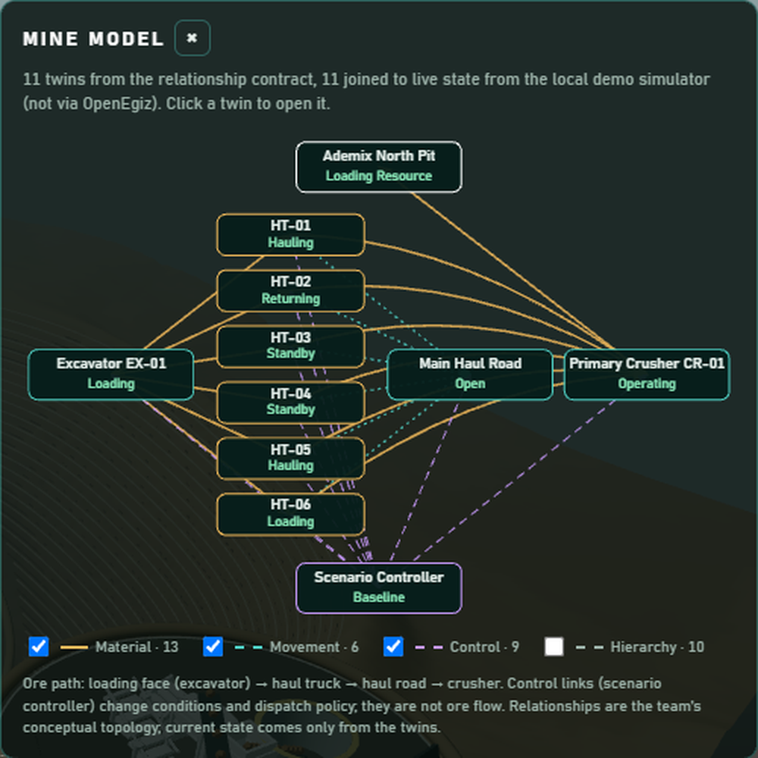
DIGITAL TWIN MODEL AND RELATIONSHIPS
METHOD
Twins | Kind
6 | haul trucks, 77 t
1 | excavator and loading face
1 | haul road, two lanes
1 | crusher with dump bay and ROM bin
1 | scenario controller
1 | mine aggregate, the parent
Links: 13 material, 6 movement, 9 control, 10 hierarchy. Control links never pretend to be ore flow; clicking a node opens that live twin.
Mine model view (local demo mode, same engine)
Notes:
The relationship contract has exactly 11 nodes and 38 directed edges, and every endpoint resolves to a seeded twin. Each node shows that twin’s returned state, or “State unavailable” if the field is missing; nothing is invented.

Slide 9
FUNCTIONAL MODULES OF THE TWIN
METHOD
Fleet supervision
Production monitor
What-if engine
Each truck’s state, payload, speed, trips and cycle time
Throughput, live constraint, queues and ROM bin level
Three disruptions started and reset from the stand
Smart Dispatch
Decision workspace
Show effect
Sizes the fleet to the bottleneck and parks surplus trucks
Recommendation, evidence and a confirmed Apply control
Focuses the affected assets and explains the causal chain
Mine model explorer
Fuel and CO₂ estimate
Guided demonstration
The 11 twins and 38 typed links, each node clickable
Shift diesel and tank-to-wheel CO₂, labelled estimates
Six steps on real controls, each confirmed by the twins
Also available as technical layers: equipment specifications, IoT sensors, topology, data flow, weather and safety.
Notes:
Every module reads its values from the returned Eclipse Ditto twins or from versioned evidence; none runs its own animation of the outcome. Fuel and CO₂ are comparable-equipment estimates, not measurements.

Slide 10
WHAT-IF SCENARIO ANALYSIS
RESULTS
Condition | Output t/h | Cycle | Face wait | Crusher wait | What the dispatcher should do
Normal | 770.0 | 36.0 | 13.6 | 0.0 | Loader limits output: park surplus trucks
HT-01 breakdown | 770.0 | 30.1 | 7.6 | 0.0 | Tow the blocked lane; five trucks still feed the loader
Road at 10.72 km/h | 645.3 | 42.8 | 0.0 | 0.0 | Restore road speed; keep all six trucks cycling
Crusher −45 % | 495.0 | 51.6 | 3.4 | 25.4 | Restore the crusher; park trucks to limit dump queueing
Hours 2–9 after a common four-hour warm-up, from compare_scenarios.py. Cycle and waits in minutes. Every scenario starts and resets from the stand without code changes.
Notes:
Synthetic model results, not mine measurements. The breakdown’s steady row hides its transient cost: in the common returning-lane case the first hour falls from 770 to 691 t/h. The road restriction removes the loading queue because trucks spend their time travelling; the crusher slowdown moves the queue to the dump bay.

Slide 11
PREDICTED CAPACITY MATCHES THE SIMULATION
RESULTS
capacity = min(fleet supply, loading 770, dump 4,620, crusher 900 or 495) t/h
Condition | Predicted constraint | Predicted t/h | Simulated t/h | Gap
Normal | Loading | 770 | 770.0 | 0.0 %
HT-01 breakdown | Loading | 770 | 770.0 | 0.0 %
Road at 10.72 km/h | Haul-road travel | 647.4 | 645.3 | −0.3 %
Crusher −45 % | Crusher | 495 | 495.0 | 0.0 %
The predicted constraint equals the live, measured constraint in all four conditions. Simulated values: hours 2–9 after a four-hour warm-up.
Notes:
Fleet supply = active trucks × 77 t × 3,600 ÷ (6 min loading + 1 min dumping + two-way travel time). Under the road restriction: 6 × 77 × 3,600 ÷ 2,569 s = 647.4 t/h, against 645.3 t/h simulated. The test suite checks that the simulation converges to the prediction within ±2 % over 16 h in every scenario. This agreement verifies the implementation; it is not a validation against a real mine.

Slide 12
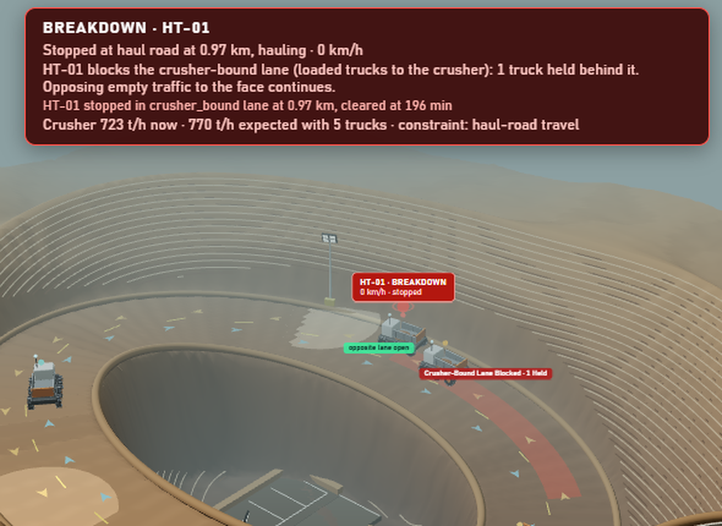
TRUCK BREAKDOWN: LANE-SPECIFIC CAUSE AND EFFECT
RESULTS
HT-01 stops at 0 km/h on the haul road.
Only its own lane is blocked; opposing traffic keeps moving.
Towed clear after 20 simulated minutes.
First hour: 770 → 691 t/h, −10.3 %.
Capture: local demo mode, same engine
Notes:
“Show effect” focuses the affected place and builds the causal chain from returned twin fields: the blocked lane comes from road-main.blockage_lane, never from screen position. A failure in a queue or bay blocks nothing, and the alert says so. HT-01 stays out of service until Normal operations is selected.

Slide 13
SMART DISPATCH: EQUAL OUTPUT, FEWER TRUCK-HOURS
RESULTS
6 → 4
770
−33 %
1.6
trucks cycling; two park as ready reserves
t/h with either policy
truck-hours per 1,000 t (7.79 → 5.19)
min wait at the face, down from 13.6
Truck-hours per 1,000 t, Smart versus fixed, by condition:
Normal −33 %
Breakdown −20 %
Road restricted 0 %
Crusher slow −50 %
Matched 8-hour windows from one identical start. Estimated diesel per 1,000 t falls 26 % in Normal. Model estimates, not measured savings.
Notes:
Smart Dispatch computes how many trucks the active bottleneck needs and parks surplus empty trucks on a ready line; it releases them when a truck is lost, the road slows or the policy is switched off. Under the road restriction the model would need eight trucks, so all six keep cycling and there is nothing to save.

Slide 14
SUMMARY OF VERIFIED RESULTS
RESULTS
143
8 of 8
0 t
required fields with units across 11 Eclipse Ditto twins, all returned live
fixed and Smart runs across all four conditions pass live, then reset cleanly
ore mass-balance error in every scenario: no tonne created or lost
−33 %
−79 t
140
truck-hours per 1,000 t at the same 770 t/h; −50 % under crusher slowdown
total cost of a breakdown over 3 h, then output returns to 770 t/h
automated tests: 92 simulator and API, 48 data and evidence
Live checks from integration runs of the combined build; savings and losses are model results, not mine measurements.
Notes:
Sources: smoke_check.py (Ditto source, 11 twins, 143 fields and units); verify_scenarios.py (fixed and Smart Dispatch with baseline, breakdown, road restriction and crusher slowdown, then reset with no stale breakdown, blockage or standby state); the engine’s four-part mass balance, which stays at zero in every scenario; fixed_vs_smart.json and production_recovery.json for the savings and the breakdown cost.

Slide 15
SCIENTIFIC AND TECHNICAL NOVELTY
OUTCOME
1. Decision-oriented twin
2. Bottleneck-aware fleet sizing
The recommendation comes from versioned evidence, is applied through the real control, and shows “in force” only when the twins confirm it.
Trucks needed = capacity × free cycle ÷ payload, rounded up; surplus trucks park and return when a disruption needs them.
3. Direction-aware breakdown model
4. Matched-start comparative evidence
A failed truck blocks only its own lane; opposing traffic keeps moving, and the 3D view marks the exact lane from twin fields.
Every comparison starts from one identical simulated state with identical windows, plus fleet curves and one-at-a-time sensitivity.
5. Explicit credibility layer
6. Typed relationship graph
Every number is tagged live or saved model evidence; mass balance passes only within 0.000001 t; the limits are stated inside the app.
38 links typed as material, movement, control or hierarchy; each node opens its live twin in the 3D mine.
Notes:
Where to see each point on the stand: 1 the Decision button and its Apply control; 2 Scenario C, Smart dispatch, with the required, cycling and parked counts; 3 Truck HT-01 breakdown, then Show effect; 4 Fixed vs Smart evidence and the Breakdown timeline; 5 the model credibility section inside the Decision workspace; 6 the Mine model button. The fleet-size rule is required trucks = ceil(bottleneck capacity × free cycle time ÷ (77 t × 3,600 s)).

Slide 16
COMPLIANCE CONTEXT: KAZAKHSTAN SAFETY RULES
OUTCOME
Regulatory requirement
Implementation in the twin
The mine’s project documentation sets safe bench heights, berm and working-platform dimensions and slope angles for the specific site.
The working-face passport states the permitted dimensions at each face.
Illustrative value in the 3D pit | Value
Bench height | 10 m
Bench face angle | 70°
Working platform | 20 m
Overall slope | 45°
The app labels them “Illustrative assumptions for a conceptual project, not approved Kazakhstan design values.” On a real site they are replaced by the approved project documentation and face passports, and checked by a qualified mining engineer.
Source: Kazakhstan industrial safety rules for open-pit mining
Notes:
The pit wall in the 3D scene is generated from these illustrative values (PIT_DESIGN in TerrainStage.tsx). A 45° overall slope with 10 m benches at 70° implies a catch berm of about 6.4 m, derived only to keep the slope consistent; the actual berm width is left to the site’s project design. The Specifications layer in the app shows the same disclaimer.

Slide 17
CONTRIBUTIONS AND NOVELTY OF THE PROJECT
CONCLUSION
Contributions
Novelty
11 live Eclipse Ditto twins of a full face-to-crusher chain
A deterministic simulation with FIFO queues and 0 t mass-balance error
A 3D command center drawn only from returned twin state
Three disruptions, Smart Dispatch and a Decision workspace
Decisions applied through the real control, confirmed by the twins
Fleet sized to the bottleneck: same 770 t/h, 33 % fewer truck-hours
Direction-aware breakdowns and matched-start evidence
A truth layer: every number tagged live or saved evidence
Scope: a deterministic conceptual model on synthetic telemetry, verified against its formulas and not validated against an operating mine.
Notes:
The closing message: a complete, live, decision-first twin whose every number can be traced and checked. The scope line repeats the model-truth contract so no slide overstates what the model is. Repository: github.com/openegiz-contest/team-111

